Slide 1
Taking the Pulse of Yellowstone’s “Breathing” Caldera
Hydrothermal
Notes:
This presentation has links to extra content embedded in the slides – best viewed in Presentation Mode!
This presentation focuses on hydrothermal activity and volcanic gases in Yellowstone. First, you will view a seven minute video about volcanoes and hydrothermal explosions. To watch it, click anywhere on this slide. Then, you’ll examine a few maps to see where Yellowstone National Park is and its significant features—geological as well as practical ones like roads and villages. Finally, you’ll learn about hydrothermal systems in Yellowstone while your teammates learn more about earthquakes and the area’s eruption history.
The link to the video takes you to the American Museum of Natural History’s Science Bulletin: “Monitoring the Fire Below.” https://www.youtube.com/watch?v=rFe-VSf-TQ8 Retrieved 5 November 2014. (Search for “monitoring fire below youtube.”)

Slide 2
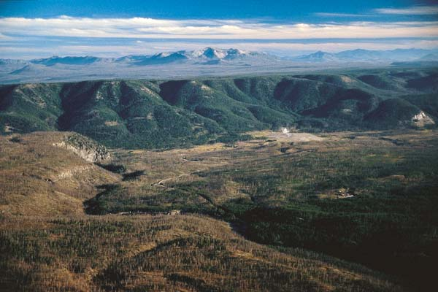
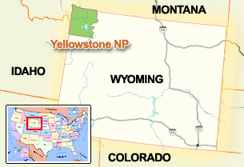
Where is Yellowstone?
Notes:
Yellowstone lies partially in three states -- Montana, Idaho and Wyoming.
Much of Yellowstone is a large crater (a “caldera”) that is surrounded by cliffs. The cliffs are topped by lava flows. This picture was taken from the top of a lava flow. The green bluffs below the mountains are the rim of the caldera. In the foreground are two lava flows.
Photo by Bob Smith, University of Utah. Accessed from National Science Foundation: Discovery. “Yellowstone Rising.” http://www.nsf.gov/discoveries/disc_images.jsp?cntn_id=110651&org=NSF Retrieved 27 December 2011.
Map from National Park Service: “Yellowstone Location Map.” http://www.nps.gov/features/yell/interactivemap/yelllocationmap.htm Retrieved 27 December 2011.

Slide 3
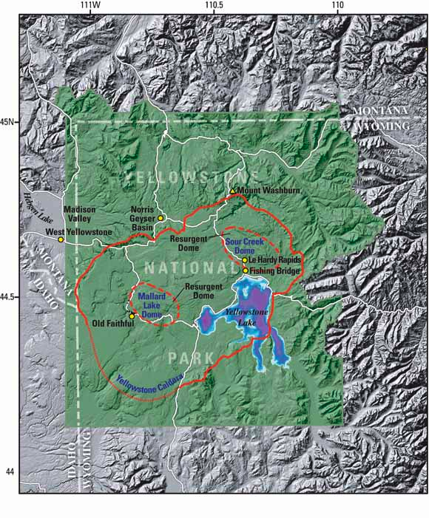
What is Yellowstone?
Exploring the landscape
Notes:
This image shows that the region is mountainous, but there is more subdued topography within most of the national park. The Yellowstone caldera, 640,000 years old, appears as a red-orange line. Where the line is thinner, geologists can only infer the caldera boundary. Volcanic material has filled the caldera and smoothed out the topography. Two later episodes of volcanism pushed up domes within the caldera: the Mallard Lake Dome and Sour Creek Dome.
The squiggly white lines are paved roads.
If you are doing this assignment with a paper map and transparent overlays instead of Google Earth, this map or the one on the next slide could serve as your base map. Your team of three experts will need to decide which map you will use. If you are using paper maps, you have a copy of the two maps in your instructions.
Image from USGS Fact Sheet 100-03. 2004. “Tracking Changes in Yellowstone‘s Restless Volcanic System.” http://pubs.usgs.gov/fs/fs100-03/index.html#yellowstone_fig2 Retrieved 27 December 2011.

Slide 4
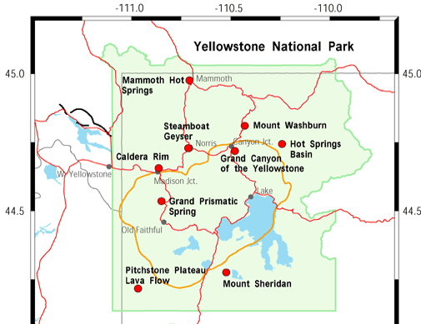
What is Yellowstone?
Exploring the landscape
Notes:
This map of Yellowstone shows roads as red lines and the location of the most recent caldera as a gold line. The park is the green area.
Red dots are links to photos and information about the park from the Yellowstone – Teton Epicenter’s “Location Map.”
By clicking anywhere on the slide, you will open the webpage with live links on the red dots. http://www.yellowstonegis.utah.edu/maps/index.html. (Search for “yellowstone gis epicenter” and choose the maps link.
Image from Yellowstone – Teton Epicenter: “Location Map.” http://www.yellowstonegis.utah.edu/maps/index.html Retrieved 28 December 2011.

Slide 5
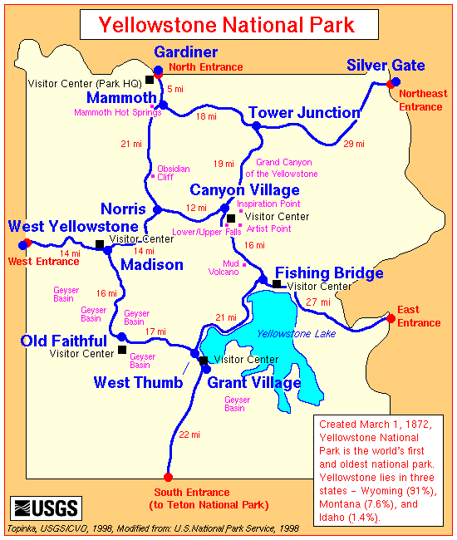
What is Yellowstone?
Cultural and geological features
Notes:
This general map shows where some of the geological and cultural or tourist attractions are. These are where many visitors stop to look at sights, buy supplies, or stay the night. The next map shows more detail.
Map from USGS Cascade Volcano Observatory. http://vulcan.wr.usgs.gov/Imgs/Gif/Yellowstone/Maps/map_yellowstone.gif Retrieved 28 December 2011.

Slide 6
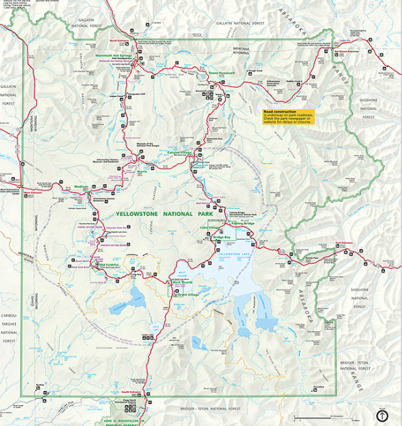
What is Yellowstone?
Cultural and geological features
Notes:
This map shows details that you might want to refer to when learning your part of the geology. It is part of the map/brochure that the National Park Service gives visitors as they enter the park. You can view this map better by clicking anywhere on the map and then being patient….there’s a lot of data to open. http://www.nps.gov/hfc/carto/PDF/YELLmap1.pdf (Search for “Yellowstone detail yellmap1.”)
The base map that you will draw on is a simplified version of this map.
Image from National Park Service: Park Map Viewer. http://www.nps.gov/pwr/customcf/apps/maps/showmap.cfm?alphacode=yell&parkname=yellowstone%20national%20park Retrieved 28 December 2011.

Slide 7
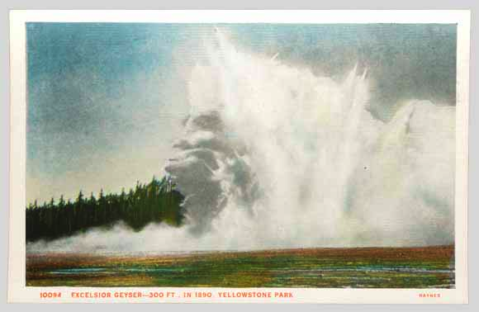
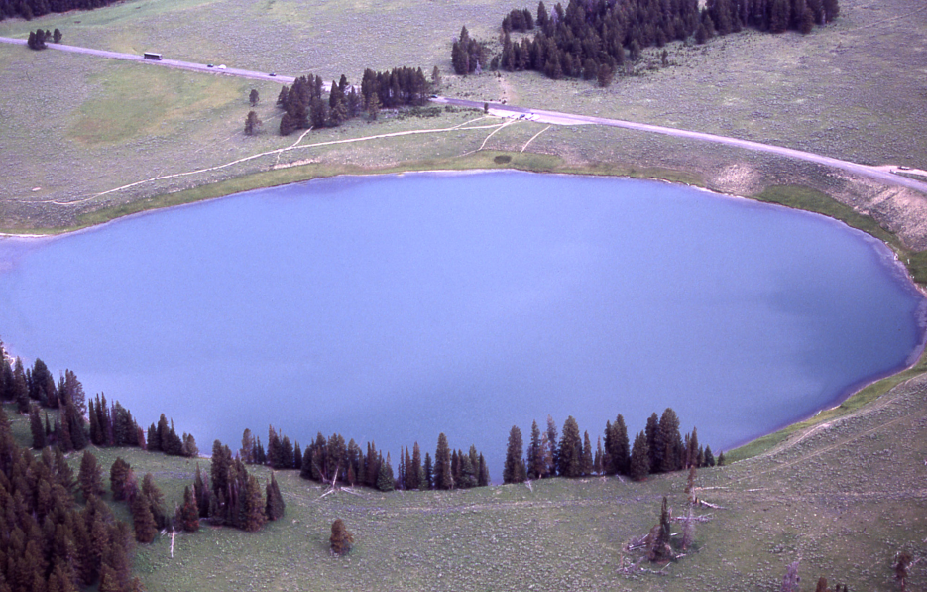
Taking Yellowstone’s Pulse Hydrothermal explosions
Notes:
The left-hand image is an old postcard of a hydrothermal explosion at Excelsior geyser in 1888. In the 1880’s to 1890’s Excelsior Geyser, in Midway Geyser Basin, had a series of explosions. (Note that the date on the postcard is wrong.) Unlike volcanic eruptions, hydrothermal explosions are from pressurized water exploding out of the ground—not lava.
The right-hand picture is of Indian Pond, which is a crater made by a hydrothermal explosion in Yellowstone. The crater has since filled with water.
The largest hydrothermal-explosion crater in the world is located on the northern edge of Yellowstone Lake. There are more than a dozen large hydrothermal-explosion craters between Norris Geyser Basin and Mammoth Hot Springs. And, as recently as 1989, Porkchop Geyser exploded. You can learn much more by clicking on the postcard. http://yellowstone.net/geology/steam-explosion/ Retrieved 17 November 2014. (Search for “porkchop steam explosion.”)
Postcard from Haynes, KF.J. 1888. Accessed from U.S. Geological Survey Fact Sheet 2005-3024. 2005. “Steam Explosions, Earthquakes, and Volcanic Eruptions—What’s in Yellowstone’s Future?” http://pubs.usgs.gov/fs/2005/3024/ Retrieved 31 December 2011.
Photo from Peaco, J. 2001. National Park Service: Yellowstone Digital Slide File: Thermal Explosions: 17244. http://www.nps.gov/features/yell/slidefile/thermalfeatures/thermalexplosions/Page.htm Retrieved 30 December 2011.

Slide 8
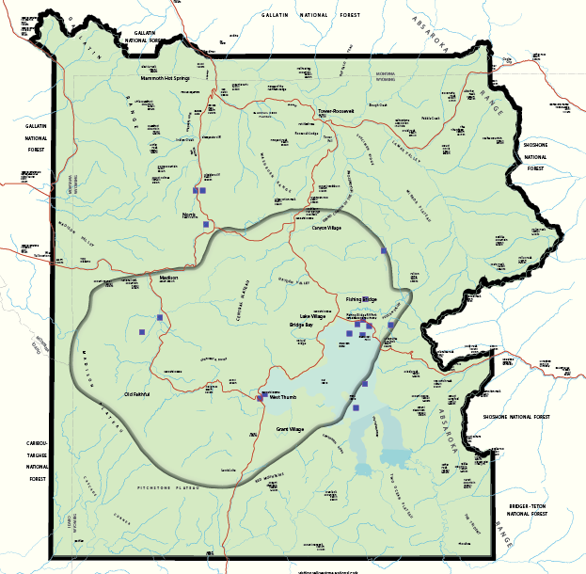
Taking Yellowstone’s Pulse Hydrothermal explosions
Hydrothermal explosions
Notes:
Look for the dark blue squares that mark where scientists find evidence for hydrothermal explosions. (Red lines are roads; the grey oval is the caldera.)
Data from USGS Fact Sheet 2005-3024. 2005. “Steam Explosions, Earthquakes, and Volcanic Eruptions—What’s in Yellowstone’s Future?” http://pubs.usgs.gov/fs/2005/3024/ Retrieved 30 December 2011.

Slide 9
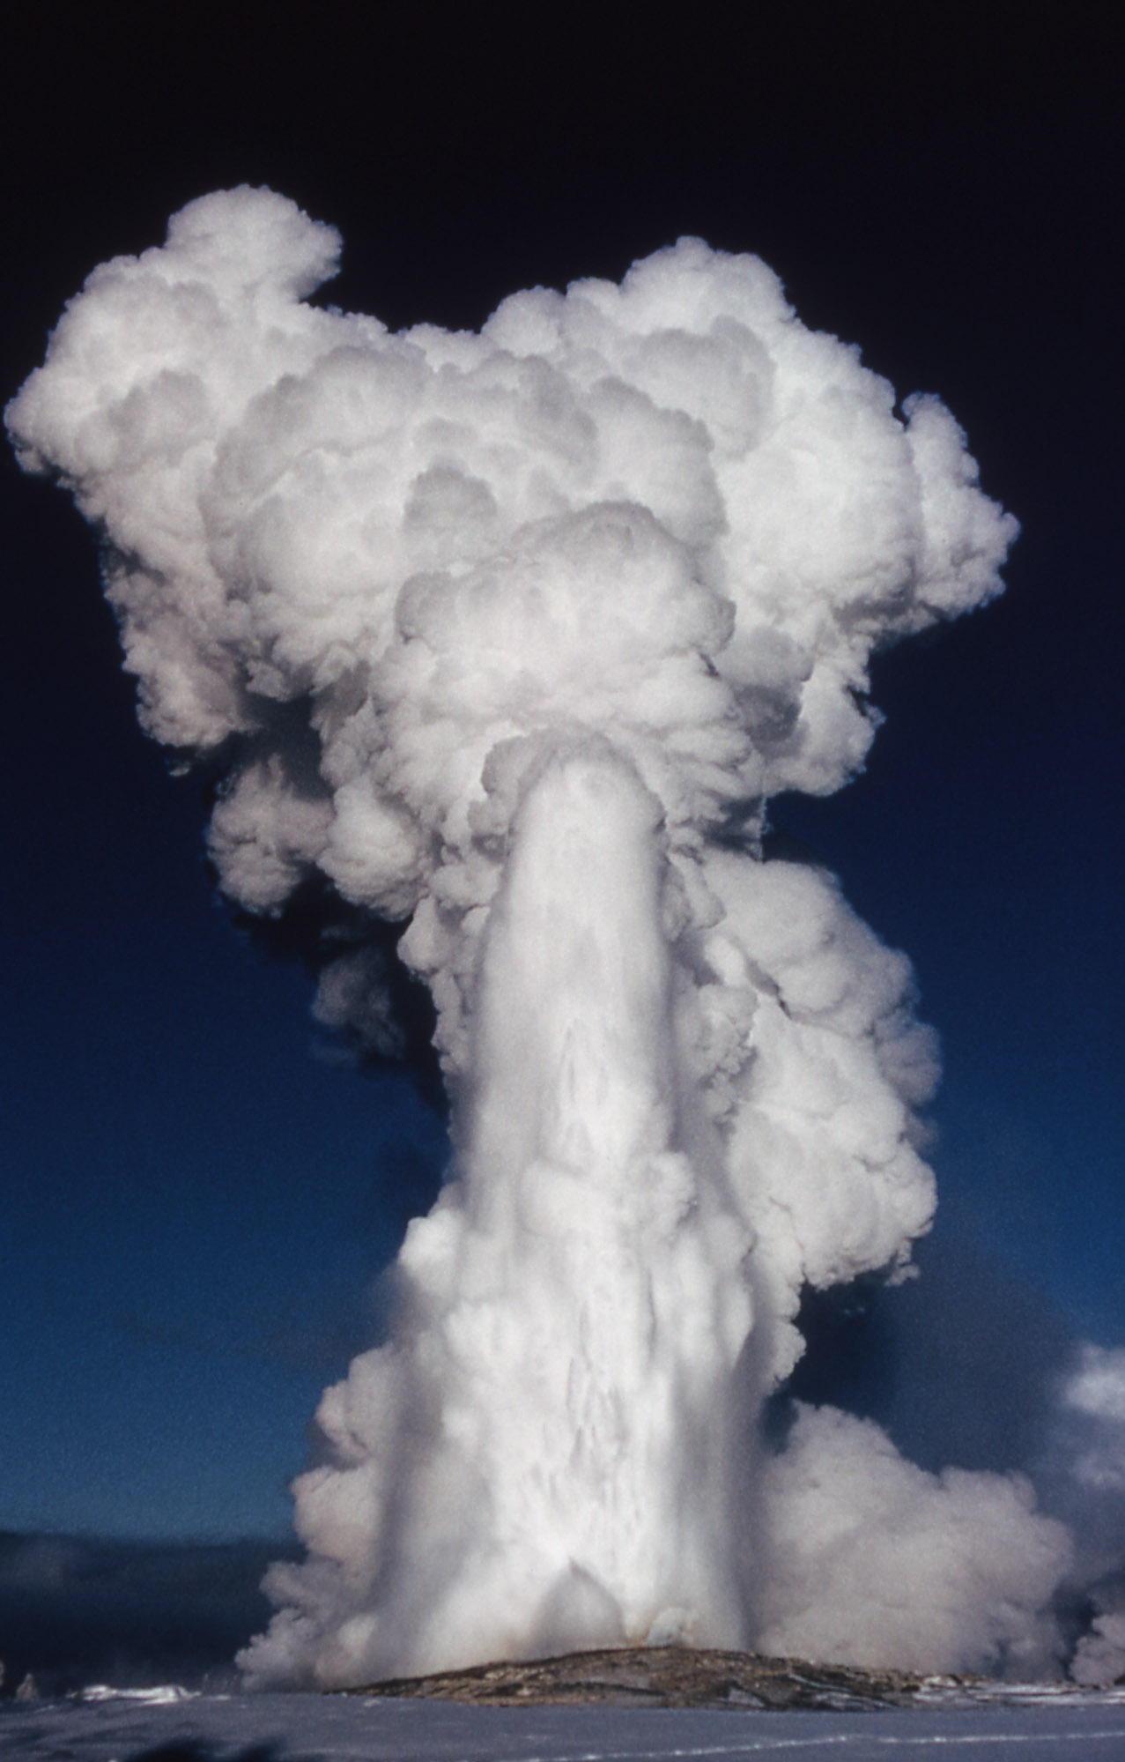
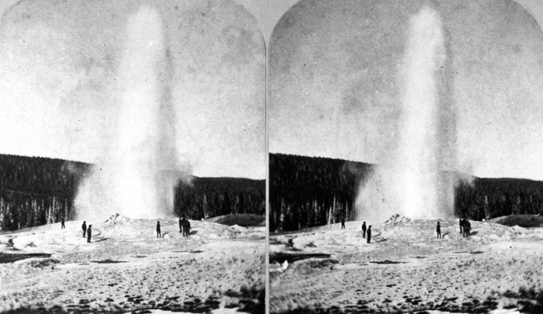
Taking Yellowstone’s Pulse Geysers
Old Faithful
Notes:
Old Faithful is probably the most famous geyser in the world, gathering an international audience even in winter to watch it erupt next to the Old Faithful Inn.
The photos on the left were taken in 1872 by the famous photographer William Henry Jackson. He worked for the “Hayden Survey,” the first official survey of Yellowstone, led by Ferdinand V. Hayden. Jackson and the painter Thomas Moran produced images that were essential for bringing the marvels of Yellowstone into the public eye—and into Congress’s eye. The pair of images are slightly offset from each other so that viewers could see Old Faithful in 3D using a stereopticon.
When you click on the 1872 photos, you will be taken to a streaming webcam of Old Faithful. This can take a minute or more to load. http://www.nps.gov/features/yell/webcam/oldFaithfulStreaming.html Retrieved 16 November 2014. (Search for “old faithful geyser webcam.”)
When you click on the modern color photograph, you will be taken to a webcam at Old Faithful and several other sites in Yellowstone. (Be patient.) http://volcanoes.usgs.gov/volcanoes/yellowstone/yellowstone_multimedia_10.html Retrieved 7 November 2014. (Search for “YVO webcam.”)
Left-hand image from Jackson, W.H. 1872. US Geological Society Photographic Library. ID. Jackson, W.H. 1572. http://libraryphoto.cr.usgs.gov/cgi-bin/show_picture.cgi?ID=ID.%20Jackson,%20W.H.%201572 Retrieved 31 December 2011
Right-hand image from National Park Service: Yellowstone Digital Slide File. Upper Geyser Basin: 05205. 1964. http://www.nps.gov/features/yell/slidefile/thermalfeatures/geysers/upper/Page-6.htm Retrieved 31 December 2011.

Slide 10
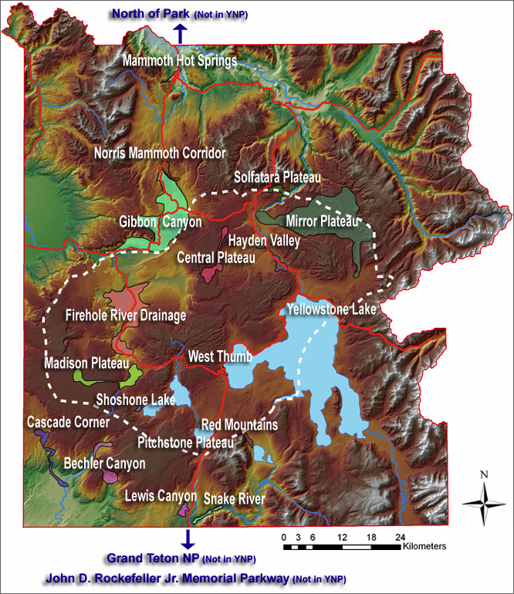
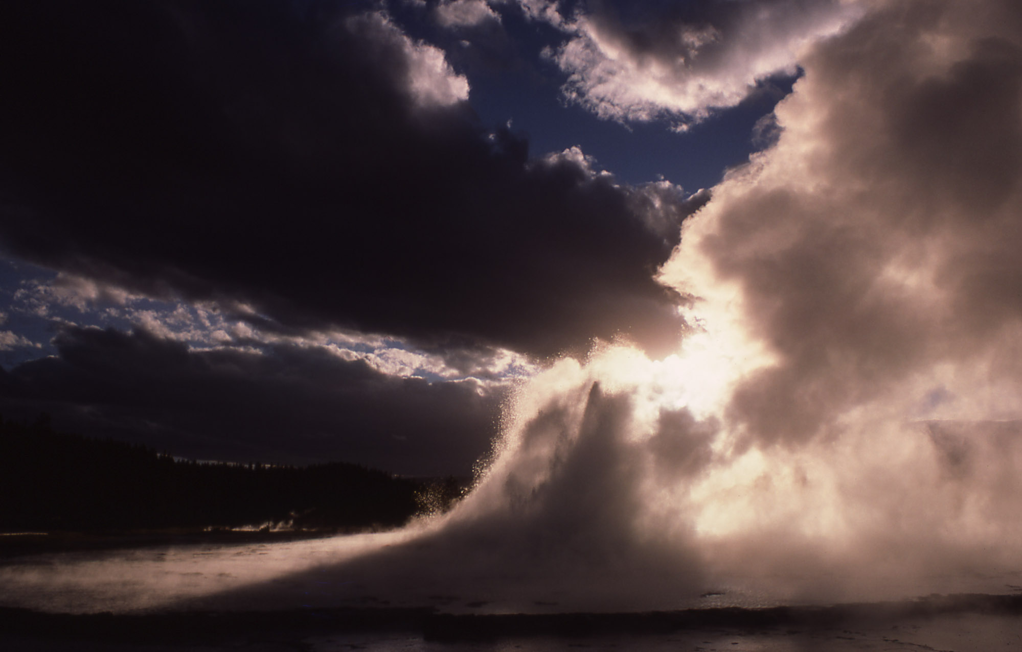
Taking Yellowstone’s Pulse Hydrothermal activity
Regions of geysers, volcanic vents, and mudpots
Notes:
Yellowstone has over 10,000 water and hydrothermal features. Hydrothermal regions are labeled on this map in white letters. Clicking on the map links to a website that details the geysers and fumaroles and mudpots known to researchers at Montana State University and the National Park Service. Click on a balloon to zoom into a thermal region. By continuing to zoom, you can learn about individual features. http://www.rcn.montana.edu/Default.aspx Retrieved 7 November 2014. (Search for “rcn montana yellowstone.”)
The photo is of Great Fountain Geyser, in the Lower Geyser Basin.
Left-hand image from the Research Coordination Network: YNP Thermal Features. http://www.rcn.montana.edu/resources/features/features.aspx?nav=11&map=81 Retrieved 31 December 2011.
Right-hand image from Schmidt, H. 1977. Yellowstone Digital Slide file: Midway & Lower Geyser Basins: 06675. http://www.nps.gov/features/yell/slidefile/thermalfeatures/geysers/midwaylower/Page-3.htm Retrieved 31 December 2011.

Slide 11
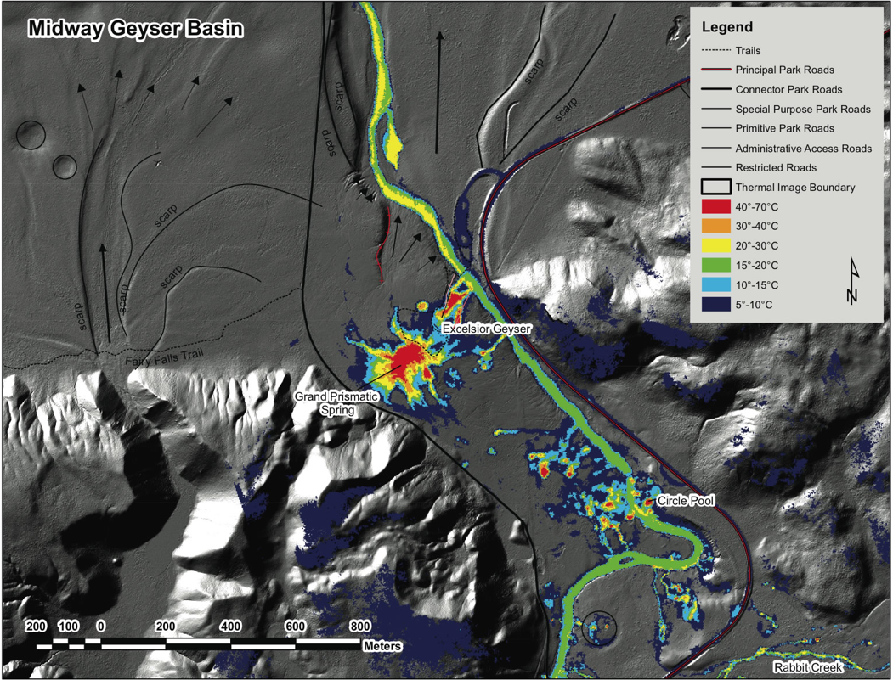
Taking Yellowstone’s Pulse Hydrothermal activity
Notes:
We can also now view hydrothermal features with infrared cameras on airplanes. The technology is called Forward Looking InfraRed (FLIR) and is suited perfectly for Yellowstone and other volcanic areas.
Image from Jaworowski, C.; Heasler, H.P.; Neale, C.M.U.; and Sivarajan, S. 2010. “Using Thermal Infrared Imagery and LiDAR in Yellowstone Geyser Basins”, Yellowstone Science, v. 18, no. 1, pp. 8-19. Accessed from from Yellowstone Volcano Observatory: “New technologies help characterize hydrothermal activity at Yellowstone”. http://volcanoes.usgs.gov/yvo/publications/2010/jaworowski.php Retrieved 31 December 2011.

Slide 12
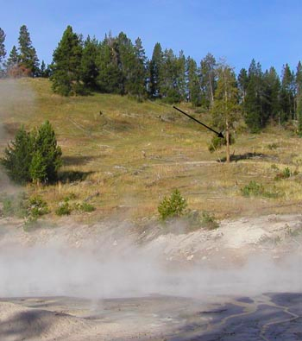
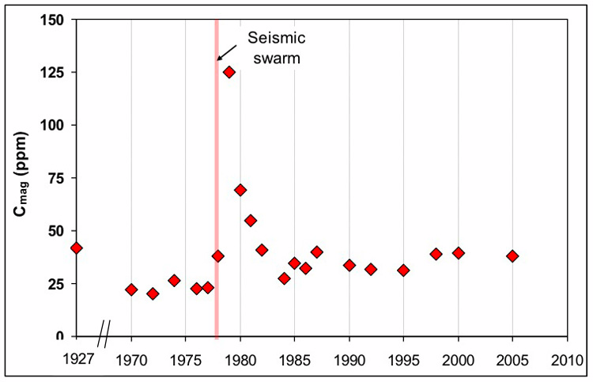
Taking Yellowstone’s Pulse Volcanic gas emissions
Live tree—and dead trees nearby
Notes:
Volcanic gases can be difficult or unsafe to sample and monitor. However scientists can use other indicators that the ground has emitted volcanic gas. The arrow in the photo points to a tree at Cooking Hillside, just north of Yellowstone Lake. Scientists sampled a core of its wood to measure its carbon content. The graph shows the results of the measurements. There is a spike in 1978 that is associated with a swarm of earthquakes. To learn details, click on the graph. http://volcanoes.usgs.gov/volcanoes/yellowstone/yellowstone_monitoring_85.html (Search for “yvo gassy link.”)
The dead trees around the live one were killed by heat. Other tidbits are that:
1897. Eight bears were found dead near “Death Gulch” (southeast of the park boundary) from carbon dioxide (CO2) or hydrogen sulfide (H2S) poisoning. These gases are heavier than air and tend to stay near the ground especially on windless cold nights.
2003. Several new vents that release volcanic gases were found in Norris Geyser Basin. These are called “fumaroles”.
2004. Five bison were found dead in the Norris Geyser Basin, probably from CO2 or H2S poisoning.
Only one human has died due to gases in Yellowstone.
CO2 is released in small amounts from virtually all of Yellowstone’s hydrothermal features.
Images from Evans, W.C.; Bergfeld, D; McGeehin, J.P.; King, J.C.; and Heasler, H. 2010. “Tree-ring 14C links seismic swarm to CO2 spike at Yellowstone, USA”, Geology v.38, p.1075-1078. Accessed from Yellowstone Volcano Observatory: “New Study Reveals Gassy Link to Past Earthquake Swarm”. http://volcanoes.usgs.gov/yvo/publications/2011/11cookinghillside.php Retrieved 31 December 2011.

Slide 13
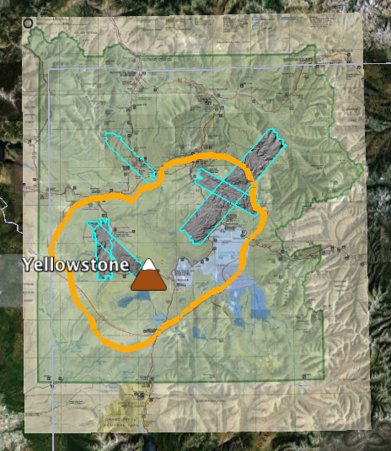
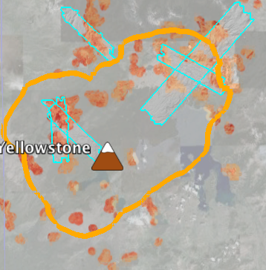
Taking Yellowstone’s Pulse Hydrothermal features
Hydrothermal features in Google Earth
Notes:
If your team will be using Google Earth (GE) to compare where the interesting features in the park are, you might want to become familiar with your data on GE now. These two images were made with GE. The left-hand one shows all of the park, with an overlay of the National Park Service map, the caldera in gold, and turquoise outlined areas of high-tech satellite-based topography (LiDAR).
The right-hand image is zoomed in closer. You can see where it’s from by the northwest-southeast trending LiDAR region. This image does not have the official park map showing. Just the base map, the caldera, LiDAR, and hot areas in orange shades are shown. The heat was measured from NASA’s Landsat satellites from 1985 to 2007. With GE, you can see the changes over time. You’ll be able to add layers and remove them easily in GE.
There is a separate set of instructions which guide you through using Google Earth. Also, we have prepared some files that are ready for you to open in GE. (You can also make your own files from a spreadsheet by following our instructions.) The next slide has links to these files.

Slide 14
Taking Yellowstone’s Pulse Data
Links to data files:
The National Park Service map as an overlay
Satellite images of the ground (LiDAR)
Yellowstone’s caldera
Yellowstone’s hot areas
Links to instructions:
Instructions for using Google Earth
Instructions for converting an Excel spreadsheet into a file for Google Earth
Notes:
Both images were clipped from the a GE map with earthquakes as dots. One of your teammates will be able to supply this data.

Slide 15
Taking Yellowstone’s Pulse Student resources
Other Resources
Data
Map linking to data for individual hydrothermal features.
http://www.rcn.montana.edu/Default.aspx (Search for “rcn montana yellowstone.”)
Information
Learn about hydrothermal systems and how they work.
http://www.nps.gov/yell/naturescience/geothermal.htm (Search for “nps how hydrothermal systems work.”)
Learn about geysers and other hydrothermal features of Yellowstone.
http://yellowstone.net/geysers/ (Search for “yellowstone net geysers.”)
Learn more about geysers from the Geyser Observation and Study Assoc.
http://www.geyserstudy.org/ (Search for “geyser observation.”)
Learn more measuring volcanic gas emissions.
http://volcanoes.usgs.gov/activity/methods/gas/index.php (Search for “usgs monitoring volcanic gases.”)
Notes:
You can use these links to update your maps with the most recent information about hydrothermal systems and volcanic gas emissions.

Slide 16
Taking Yellowstone’s Pulse Sources
American Museum of Natural History (n.d.) Science Bulletins: “Yellowstone: Monitoring the Fire Below, “Signs of Restlessness.” http://www.amnh.org/explore/science-bulletins/earth/documentaries/yellowstone-monitoring-the-fire-below/article-signs-of-restlessness (Search for “amnh signs restlessness.”)
Christensen, R. et. al.2007. USGS: Open-file Report 2007-1071. “Preliminary Assessment of Volcanic and Hydrothermal Hazards in Yellowstone National Park and Vicinity.“ http://pubs.usgs.gov/of/2007/1071/ (Search for “preliminary volcanic hydrothermal hazards yellowstone.”)
Dzurisin, D.; Savage, J.C.; and Fournier, R.O. 1990. “Recent crustal subsidence at Yellowstone Caldera, Wyoming.” Bulletin of Volcanology, v. 52, p. 247-270. accessed from Yellowstone Volcano Observatory,“ Leveling Data Across Yellowstone Caldera.” http://pubs.er.usgs.gov/publication/70016303 (Search for “recent subsidence at yellowstone.”)
Puckas, C.; Smith, R; Meertens, C.; and Chang, W-L. 2007. “Crustal deformation of the Yellowstone-Snake River Plain volcano-tectonic system: Campaign and continuous GPS observations, 1987-2004.” Journal of Geophysical Research, v. 112. http://volcanoes.usgs.gov/yvo/2007/PuskasJGR.pdf (Search for “Puskas deformation yellowstone-snake river.”)
USGS. 2010. Yellowstone Volcano Observatory. “Volcano Monitoring at Yellowstone National Park” http://volcanoes.usgs.gov/yvo/activity/monitoring/index.php (Search for “YVO monitoring.”)
USGS. 2008. Yellowstone Volcano Observatory. “Recent ups and downs of Yellowstone Caldera.” http://volcanoes.usgs.gov/yvo/publications/2007/upsanddowns.php (Search for “ups downs yellowstone.”)
USGS. 2005. U.S. Geological Survey Fact Sheet 2005-3024: “Steam Explosions, Earthquakes, and Volcanic Eruptions--What’s in Yellowstone’s Future?” http://pubs.usgs.gov/fs/2005/3024/ (Search for “usgs steam explosions yellowstone.”)
USGS. 2004. U.S. Geological Survey Fact Sheet 100-03: “Tracking Changes in Yellowstone’s Restless Volcanic System.” http://pubs.usgs.gov/fs/fs100-03/ (Search for “tracking changes yellowstone.”)
Notes:
All retrieved 6 November 2014.

