Slide 1
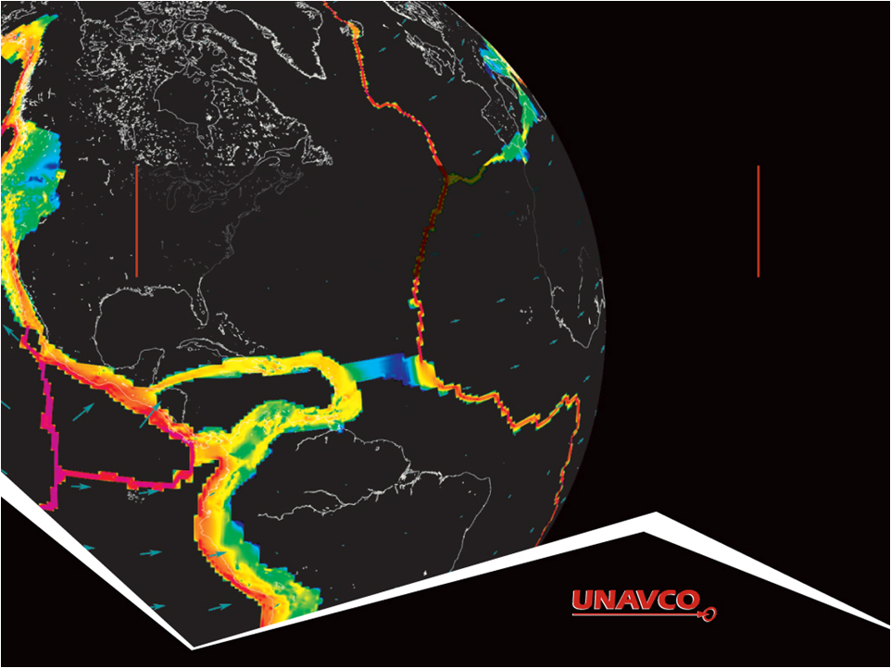
GPS Data and Earthquake Hazard
Original activity design by Roger Groom and Robert Butler. Modifications by Beth Pratt-Sitaula. Some slides contributed by Vince Cronin.
Version May 26, 2013

Slide 2
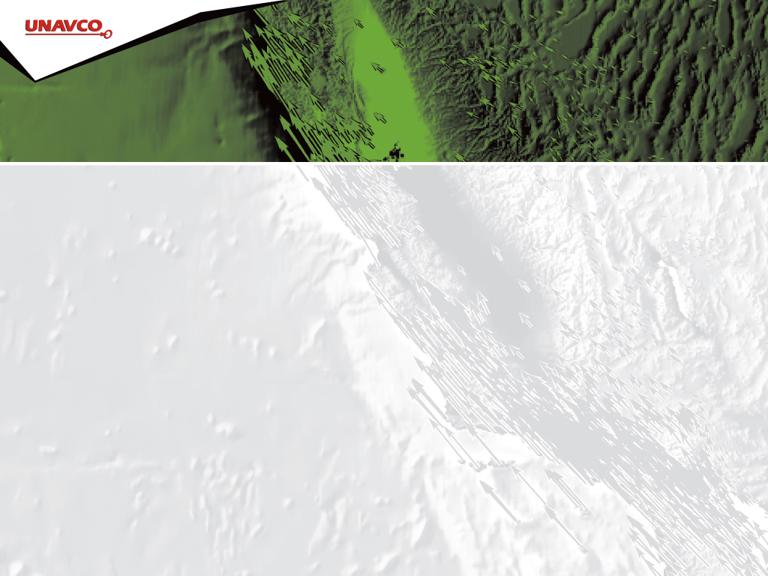
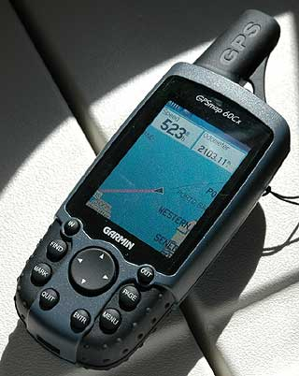
GPS receiver
Notes:
This is a handheld GPS unit that has been available to the public for more than a decade now and is often used for hiking or other outdoor activities.

Slide 3

GPS receiver
Notes:
Whether they know it or not, students use GPS receivers daily in their cars, phones, cameras, and more. Most have heard the term “GPS” but few know much about how the system actually works or high precision GPS for science and industrial use.

Slide 4
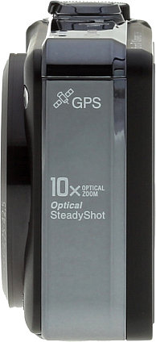

GPS receiver
Notes:
Whether they know it or not, students use GPS receivers daily in their cars, phones, cameras, and more. Most have heard the term “GPS” but few know much about how the system actually works or high precision GPS for science and industrial use.

Slide 5
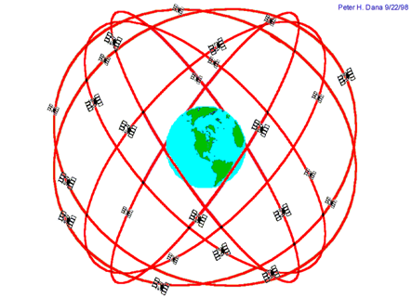
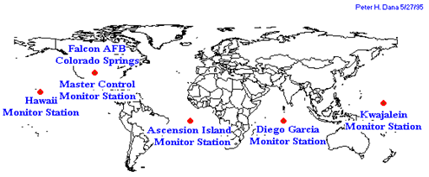
The Global Positioning System
24-32 satellites
20,200 km altitude
55 degrees inclination
12 hour orbital period
5 ground control stations
Need 4 satellites to be accurate
Each satellite passes over a ground monitoring station every 12 hours
Notes:
From the users point of view, GPS is a passive system: you need only a low-powered receiver to obtain the signals, which contain all the information you need to determine your position. This requires that the satellites carry atomic clocks to keep accurate time and transmit to the user the position of the satellite in the sky. The orbits are computed by Department of Defense (DoD) by tracking the satellites at five ground Master Control Monitoring stations with known positions and then uploaded to the satellites which then transmit the information continuously along with the time. With hand-held receivers, it is possible to find your position to a few meters, limited primarily by the accuracy of the broadcast orbits. As we shall see, the civilian scientific community uses over 200 stations to determine the orbits with an accuracy of a few centimeters, allowing millimeter positioning with after several hours of tracking.

Slide 6
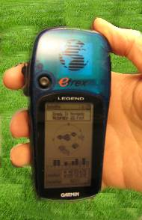
Consumer-grade GPS accuracy
Horizontal: +/- 10 m (30 ft) error
Vertical: +/- 15 m (45 ft) error
Your location is:
37º 23.323’ N
122º 02.162’ W
Notes:
Since each satellite maintains time very accurately (~1 nanosecond = 30 cm), it can tag its signal with the time of transmission. This information, together with the location of the satellite, also transmitted to the receiver, is sufficient to allow the receiver to calculate the range to each satellite provided that the receiver also knows also knows the time. Equipping receivers with atomic clocks would be very expensive, so the receiver tags the signal with the time of its internal clock to create a “pseudorange” (range plus an unknown clock correction). The software in the receiver than uses the pseudoranges from four satellites to solve for the four unknowns: three coordinates and the receiver clock correction.

Slide 7
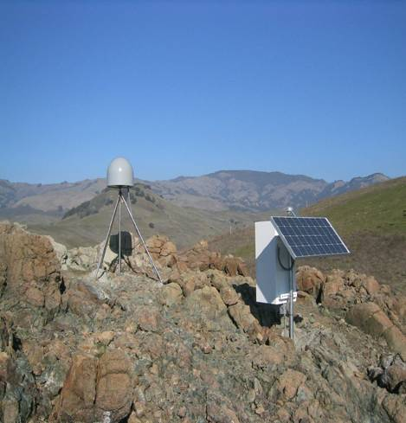
Anatomy of a High-precision Permanent GPS Station
GPS antenna inside of dome
Monument solidly attached into the ground with braces.
If the ground moves, the station moves.
Solar panel for power
Equipment enclosure
GPS receiver
Power/batteries
Communications/ radio/ modem
Data storage/ memory
Notes:
Example of a typical remote GPS station. In urban areas, some are also fixed to the roof of large reinforced buildings and hooked into grid power supply with battery backup. Many stations are now being equipped with “real time” communication to allow immediate transfer of data to researchers. In other places logistics or country-specific regulations require that data not be transmitted but is instead downloaded manually on a given schedule (monthly, quarterly, annually depending on the site)

Slide 8
High-precision GPS
Current accuracies of few millimeters per year
Stable monuments
Sophisticated processing software
Ability to use additional satellite information
Long measurement times
Notes:
High precision GPS operate in essentially the same way as regular consumer GPS but due to a variety of factors including stable monuments, use the satellite signal carrier phase, dual-frequency receivers, high-precision orbital information, stable monuments, multiple stations, sophisticated processing, and long measurements times, these station are able to achieve accuracies of 1-2 mm/yr in many situations.

Slide 9
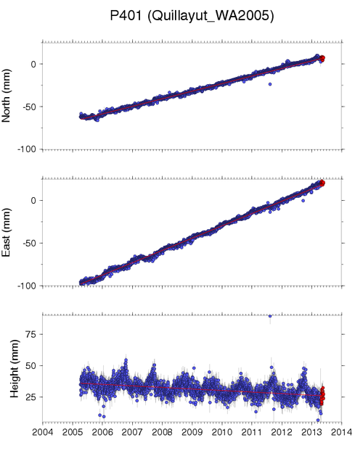
Reading GPS data
Station position over time
  North-South
  East-West
  Up-Down
Notes:
P401-Quillayut station is located in the town of Forks on the Olympic Peninsula of Washington State.
ALL DATA IN THIS ACTIVITY WERE ACQUIRED FROM http://pbo.unavco.org/data/gps
The data are “raw” position files in the Stable North American Reference Frame (SNARF) (for more on reference frames see http://facility.unavco.org/data/maps/GPSVelocityViewer/GPSVelocityViewer-frames.html_

Slide 10
Reading GPS data
6 – (-63) = 69 mm
2013.4 – 2005.25 = 8.15 years
2004
2005
2006
2007
2008
2009
2010
2011
2012
2013
2014
From the changing position velocity can be calculated using SLOPE (rise-over-run)
69 mm / 8.15 years = 8.5 mm/yr
Notes:
Using just the North-south data, you can run through how to estimate station velocity in this direction by using the simple, graphical method of rise-over-run to determine slope.
Students will have to be comfortable with estimating as best they can from the axes scales – Y axis more so due to fewer tick marks
Zero point is arbitrary. Relative location is important. (In older PBO time series the zero was often set to the average position over the data interval
PLEASE NOTE: the velocity estimates presented in this activity are NOT the official ones published by PBO but those likely to be determined graphically using data through May 2013. However, the graphically-measured velocities are quite representative of the published ones and completely sufficient for class discussions regarding accumulating strain and earthquake hazard.

Slide 11
Reading GPS data
69 mm / 8.15 years = 8.5 mm/yr
120 mm / 8.15 years = 14.7 mm/yr
2004
2005
2006
2007
2008
2009
2010
2011
2012
2013
2014
Repeat process for east-west movement
Notes:
Using just the North-south data, you can run through how to estimate station velocity in this direction by using the simple, graphical method of rise-over-run to determine slope.
Students will have to be comfortable with estimating as best they can from the axes scales – Y axis more so due to fewer tick marks

Slide 12
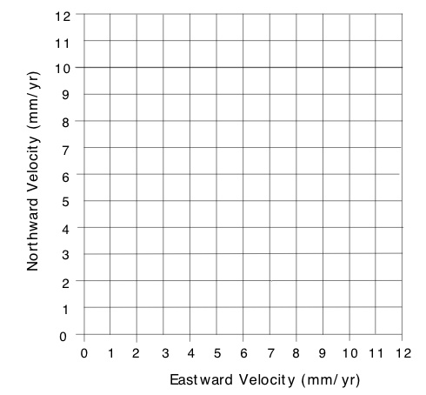
Quillayut, WA GPS Velocity
17.0 mm / yr
13
14
Notes:
At this point you can have your students simply use a graphical measurement (using paper with tick marks to measure) to determine the hypotenuse measurement of the total horizontal velocity OR you can remind of the Pythagorean method: sqrt(a^2 + b^2) = hypotenuse

Slide 13
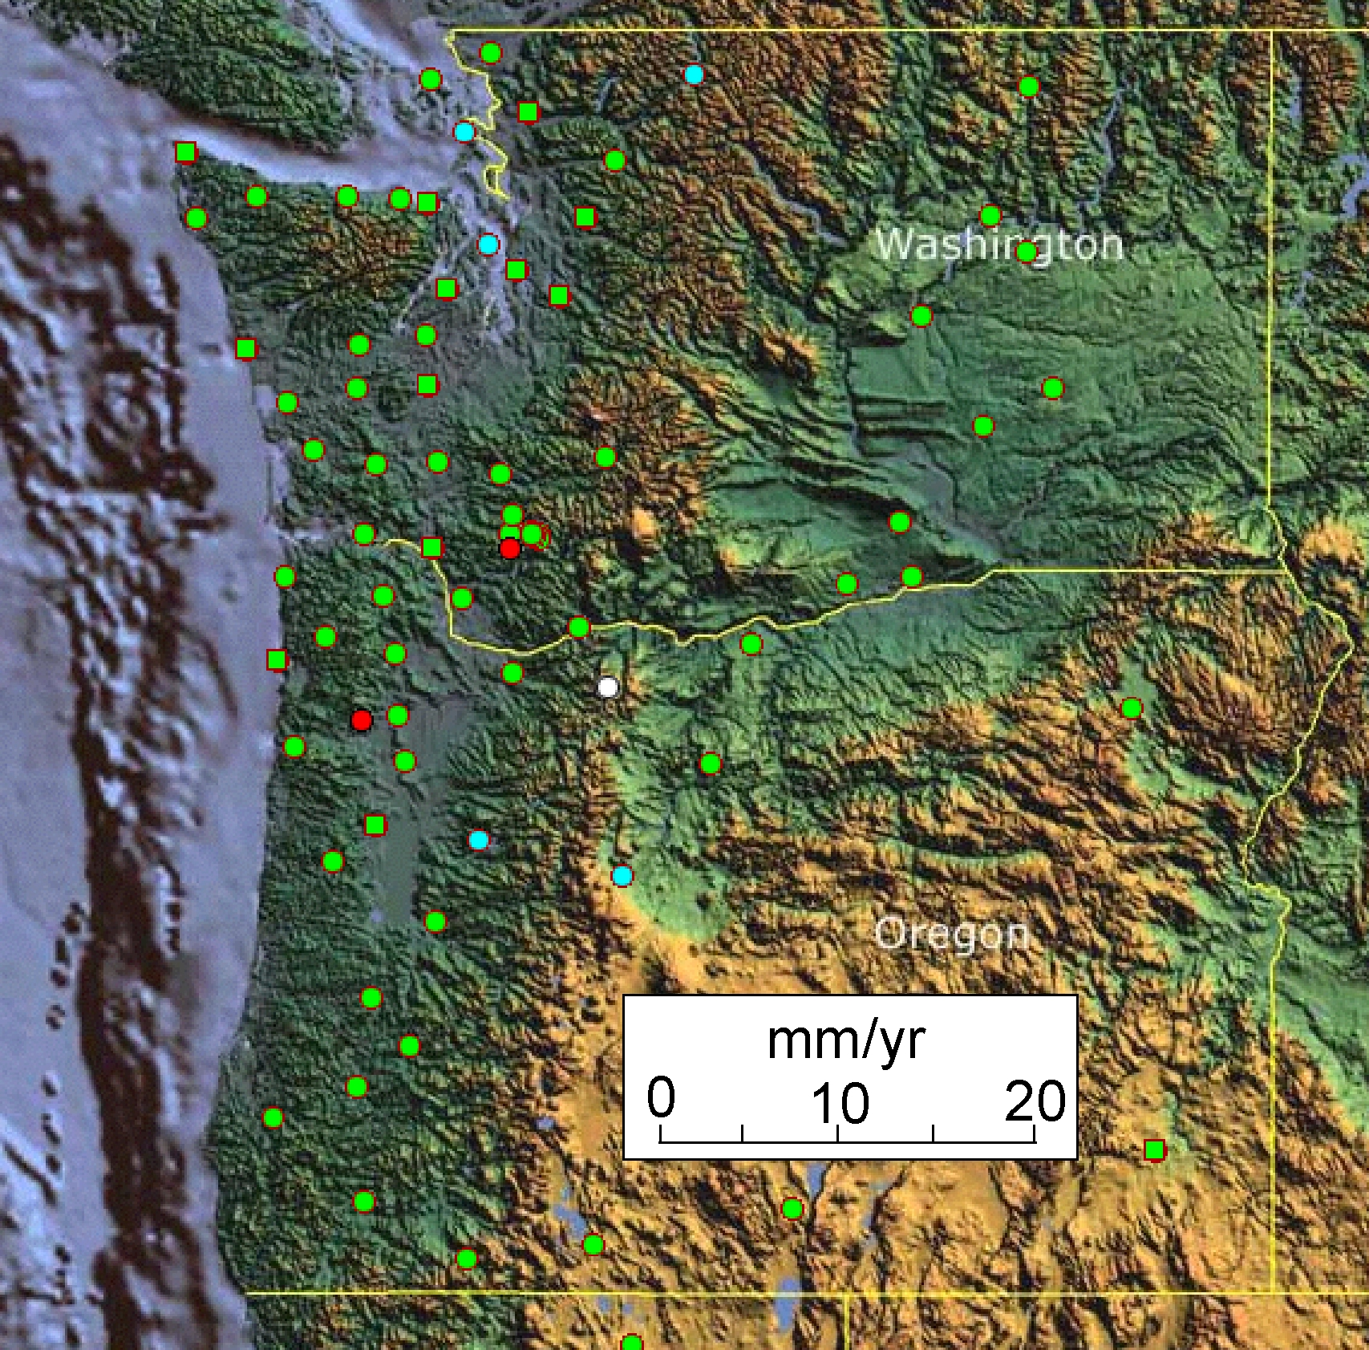
GPS Stations in Cascadia
Neah
Bay
Pacific
Beach
Tumwater
Othello
Kelso
Tillamook
Wasco
La Grande
Newport
Corvallis

Slide 14
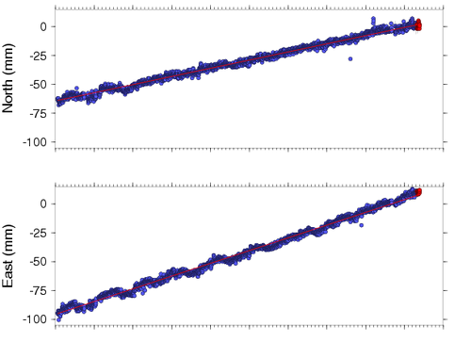
Neah Bay, WA GPS Data
2004
2005
2006
2007
2008
2009
2010
2011
2012
2013
2014
Notes:
Station NEAH

Slide 15
Neah Bay, WA GPS Data
68 mm / 9.4 yr = 7.2 mm/yr
105 mm / 9.4 yr = 11.2 mm/yr
2004
2005
2006
2007
2008
2009
2010
2011
2012
2013
2014
Notes:
Station NEAH

Slide 16
Neah Bay, WA GPS Velocity
13.3 mm / yr
Notes:
At this point you can have your students simply use a graphical measurement (using paper with tick marks to measure) to determine the hypotenuse measurement of the total horizontal velocity OR you can remind of the Pythagorean method: sqrt(a^2 + b^2) = hypotenuse

Slide 17
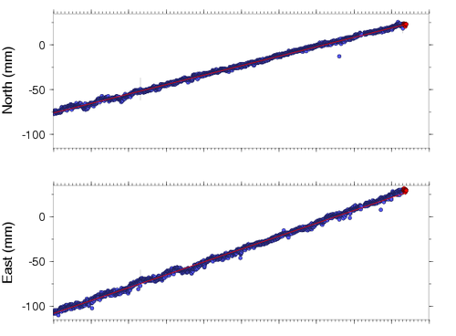
Pacific Beach, WA GPS Data
2004
2005
2006
2007
2008
2009
2010
2011
2012
2013
2014
Notes:
Station PABH

Slide 18
Pacific Beach, WA GPS Data
100 mm / 59.4 yr = 10.6 mm/yr
125 mm / 9.4 yr = 13.5 mm/yr
2004
2005
2006
2007
2008
2009
2010
2011
2012
2013
2014
Notes:
Station PABH

Slide 19
Pacific Beach, WA GPS Velocity
17.2 mm / yr
13
14

Slide 20
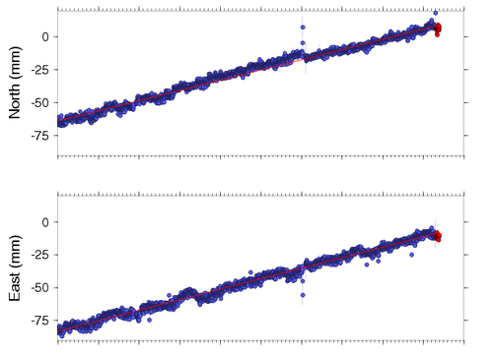
Tillamook, Oregon GPS Data
2004
2005
2006
2007
2008
2009
2010
2011
2012
2013
2014
Notes:
Station CHZZ
Note: station antenna was shot by vandals in 2010 and had to be replaced leading to a slight offset in the data

Slide 21
Tillamook, Oregon GPS Data
73 mm / 9.4 yr = 7.8 mm/yr
75 mm / 9.4 yr = 8.0 mm/yr
2004
2005
2006
2007
2008
2009
2010
2011
2012
2013
2014
Notes:
Station CHZZ
Note: station antenna was shot by vandals in 2010 and had to be replaced leading to a slight offset in the data

Slide 22
Tillamook, Oregon GPS Velocity
11.1 mm / yr

Slide 23
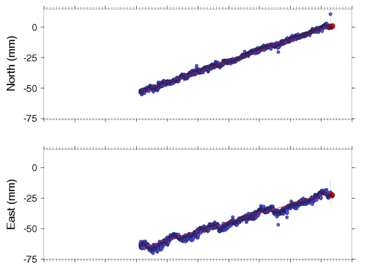
Newport, OR GPS Data
2004
2005
2006
2007
2008
2009
2010
2011
2012
2013
2014
Notes:
Station P367
Note: this station has a different start date than most in this exercise!

Slide 24
Newport, OR GPS Data
54 mm / 6.3 yr = 8.6 mm/yr
44 mm / 6.3 yr = 7.0 mm/yr
2004
2005
2006
2007
2008
2009
2010
2011
2012
2013
2014
Notes:
Station P367
Note: this station has a different start date than most in this exercise!

Slide 25
Newport, OR GPS Velocity
11.1 mm / yr

Slide 26
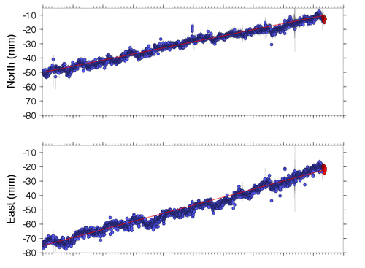
Tumwater, WA GPS Data
2004
2005
2006
2007
2008
2009
2010
2011
2012
2013
2014
Notes:
Station TWHL

Slide 27
Tumwater, WA GPS Data
40mm / 9.4 yr = 4.3 mm/yr
54 mm / 9.4 yr = 5.7 mm/yr
2004
2005
2006
2007
2008
2009
2010
2011
2012
2013
2014
Notes:
Station TWHL

Slide 28
Tumwater, WA GPS Velocity
7.1 mm / yr

Slide 29
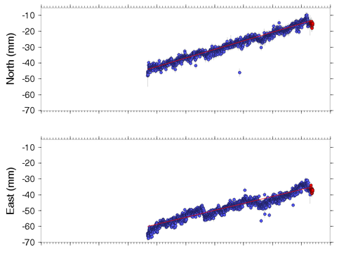
Kelso, WA GPS Data
2004
2005
2006
2007
2008
2009
2010
2011
2012
2013
2014
Notes:
Station P446

Slide 30
Kelso, WA GPS Data
30 mm / 5.1 yr = 5.3 mm/yr
31 mm / 5.1 yr = 5.4 mm/yr
2004
2005
2006
2007
2008
2009
2010
2011
2012
2013
2014
Notes:
Station P446

Slide 31
Kelso, WA GPS Velocity
7.6 mm / yr

Slide 32
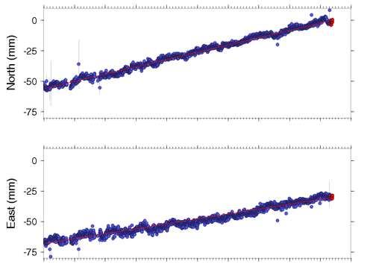
Corvallis, Oregon GPS Data
2004
2005
2006
2007
2008
2009
2010
2011
2012
2013
2014
Notes:
Station CORV

Slide 33
Corvallis, Oregon GPS Data
57 mm / 9.4 yr = 6.1 mm/yr
43 mm / 9.4 yr = 4.6 mm/yr
2004
2005
2006
2007
2008
2009
2010
2011
2012
2013
2014
Notes:
Station CORV

Slide 34
Corvallis, OR GPS Velocity
7.6 mm / yr

Slide 35
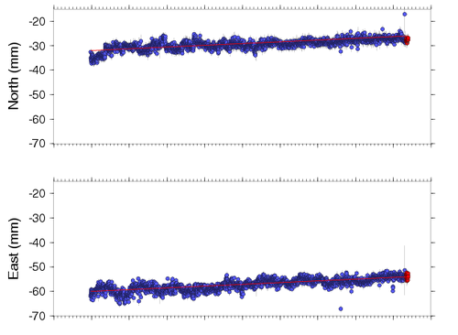
Othello, WA GPS Data
2004
2005
2006
2007
2008
2009
2010
2011
2012
2013
2014
Notes:
Station P451

Slide 36
Othello, WA GPS Data
6 mm / 8.4 yr = 0.7 mm/yr
7 mm / 8.4 yr = 0.8 mm/yr
2004
2005
2006
2007
2008
2009
2010
2011
2012
2013
2014
Notes:
Station P451

Slide 37
Othello, WA GPS Velocity
1.1 mm / yr

Slide 38
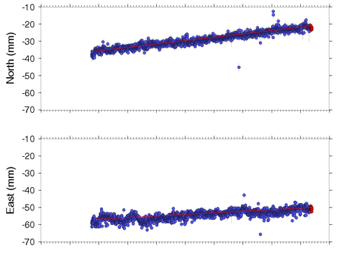
Wasco, OR GPS Data
2004
2005
2006
2007
2008
2009
2010
2011
2012
2013
2014
Notes:
Station P445

Slide 39
Wasco, OR GPS Data
16 mm / 7.6 yr = 1.8 mm/yr
7 mm / 7.6 yr = 0.9 mm/yr
2004
2005
2006
2007
2008
2009
2010
2011
2012
2013
2014
Notes:
Station P445

Slide 40
Wasco, OR GPS Velocity
1.8 mm / yr

Slide 41
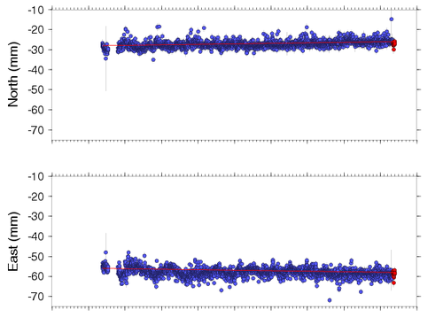
La Grande, OR GPS Data
2004
2005
2006
2007
2008
2009
2010
2011
2012
2013
2014
Notes:
Station P022

Slide 42
La Grande, OR GPS Data
3 mm / 8 yr = 0.4 mm/yr
-2 mm / 8 yr = -0.3 mm/yr
2004
2005
2006
2007
2008
2009
2010
2011
2012
2013
2014
Notes:
Station P022

Slide 43
La Grande, OR GPS Velocity
-0.5 mm / yr
-1
1
2
3
4
5
6
7
8
9
10
11

Slide 44
GPS velocities
Neah
Bay
Pacific
Beach
Tumwater
Othello
Kelso
Tillamook
Wasco
La Grande
Newport
Corvallis

Slide 45
Notes:
Extra in case you wish to make any more graphs for specific other stations.

Slide 46
13
14

