Slide 1
Getting to know EarthScope Plate Boundary Observatory & UNAVCO
Shelley Olds, UNAVCO

Slide 2
About UNAVCO
NSF and NASA funded
Non-profit
Consortium
Membership-governed
Facilitates geoscience research and education using geodesy
Operates the Nation’s geodesy facility, including the Plate boundary Observatory on behalf of NSF
Broaden the use of UNAVCO data and products by a wide audience of educational and research users

Slide 3
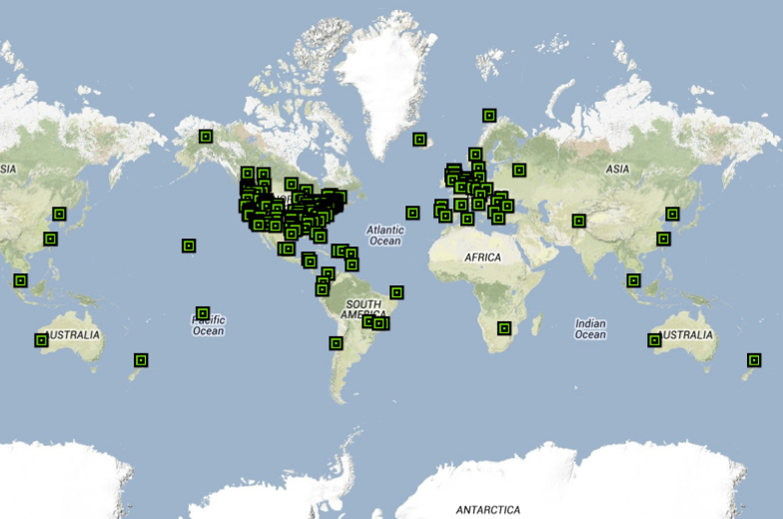
UNAVCO Consortium Members

Slide 4
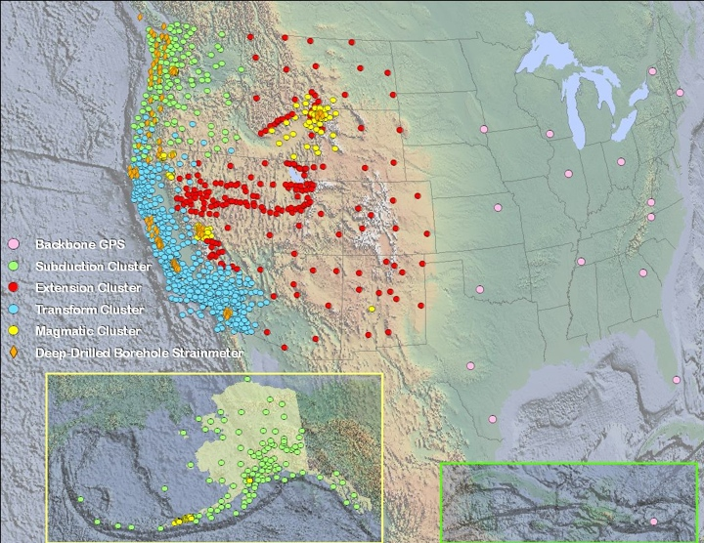
Meet the Plate Boundary Observatory
Geodesy Advancing Geosciences & EarthScope (GAGE)
Continent-scale network
GPS
Borehole strainmeters
Laser strainmeters
LiDAR
Focus:
Extended plate boundary
Operated by UNAVCO

Slide 5
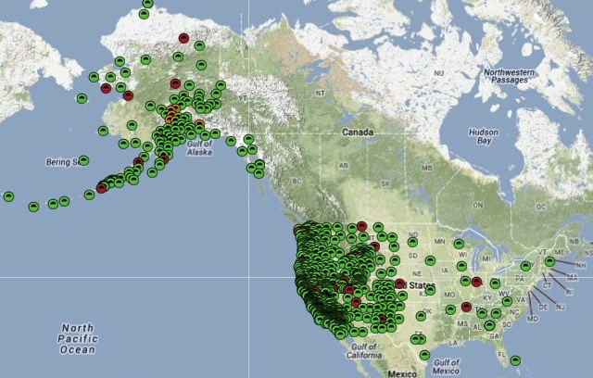
EarthScope PBO GPS Network

Slide 6
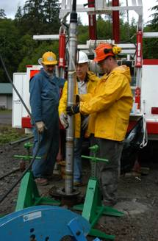
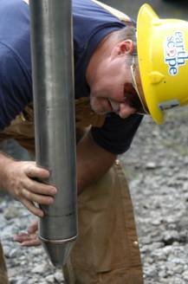
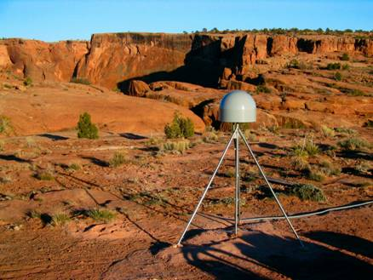
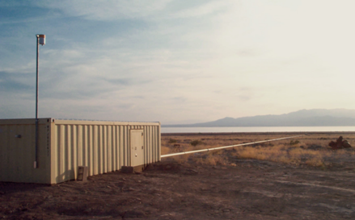
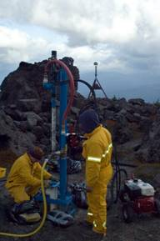
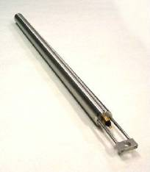
Plate Boundary Observatory Instruments
GPS: 1100 Continuous
74 Borehole Strainmeters
and 78 Borehole Seismometers
5 Laser Strainmeters
26 Shallow Borehole
Tiltmeters
6
Notes:
PBO uses other equipment besides GPS
Tiltmeters common in volcanic settings

Slide 7
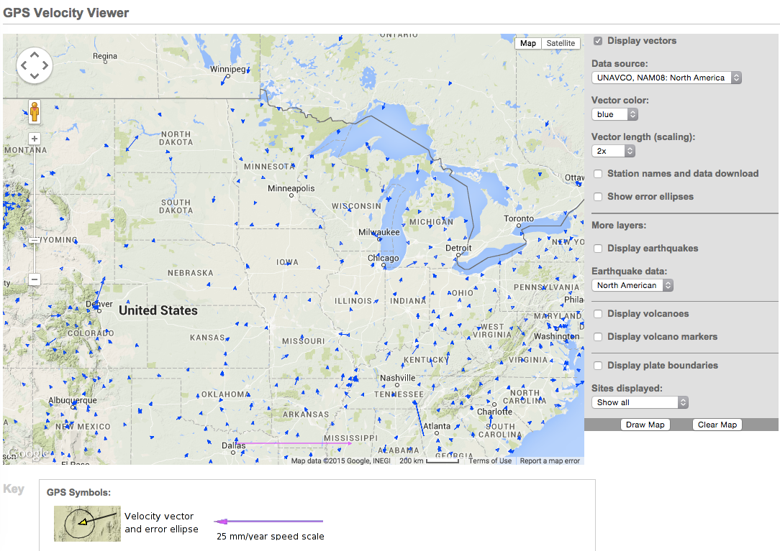
Tectonic motions of Midwestern United States from GPS using a stable North America reference frame (NAM08)
http://www.unavco.org/software/visualization/GPS-Velocity-Viewer/GPS-Velocity-Viewer.html
At the tail of each blue vector, a GPS station is permanently mounted to the ground, measuring plate motion at that point.
Notes:
A GPS station is permanently mounted to the ground at the tail of each blue vector.
Length and direction of the arrow shows the velocity of the ground.

Slide 8
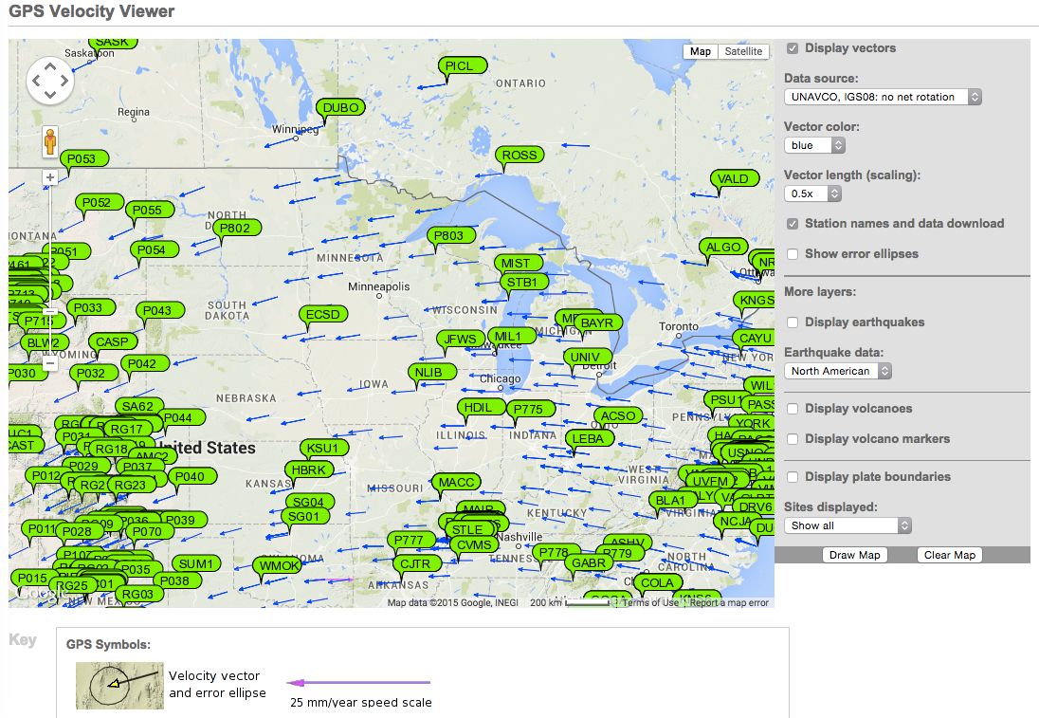
Tectonic motions of Midwestern United States from another perspective: World reference frame (IGS08)
Each green tag is part of the EarthScope Plate Boundary Observatory. The length and direction of the arrow shows the velocity of the ground at that point.

Slide 9
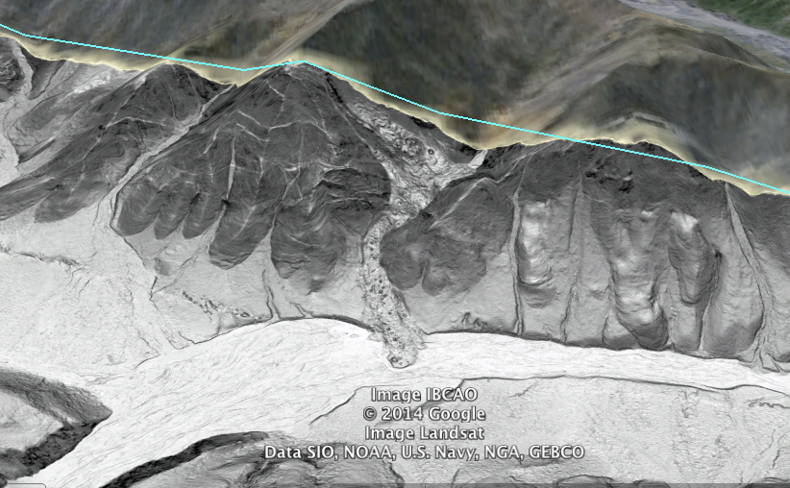
LiDAR – looking below the trees
Open Topography: http://www.opentopography.org/

Slide 10
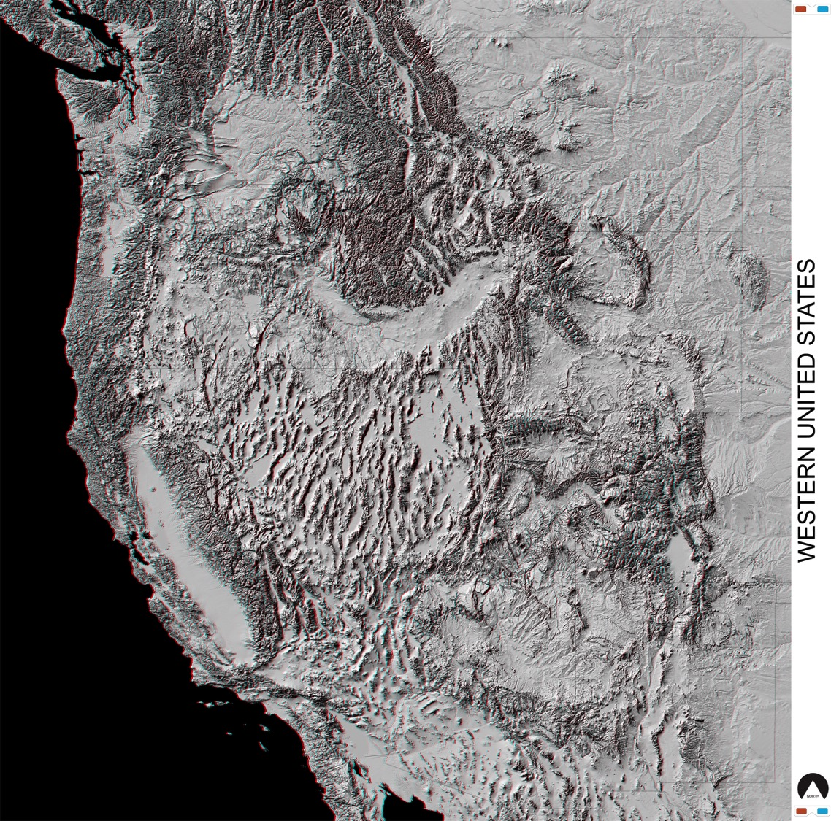
Western US in 3D
Courtesy: Parul Morin, National Center for Earth-surface Dynamics
Data Repository
http://www.nced.umn.edu/Data_Repository.html
[retrieved on 08 March 2015]

Slide 11
Education & Community Engagement
^{Training} Technical short courses, educational workshops, evaluation, new delivery methods
Education Materials Curriculum development (Strain module, GETSI project [NSF-TUES], existing learning materials
Communications Website, outreach materials, social media, conferences
Workforce Development RESESS, RESESS Alumni network, Science Workshop mentoring

Slide 12
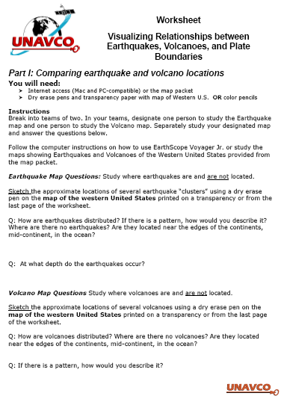
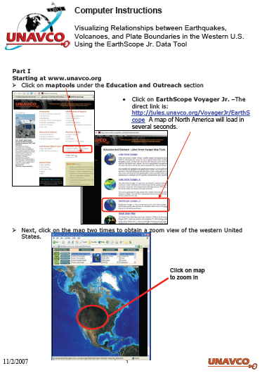
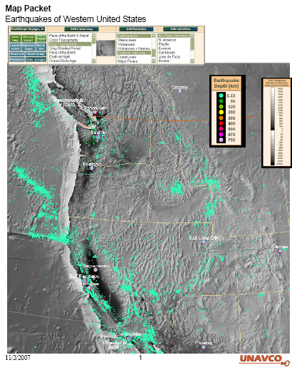
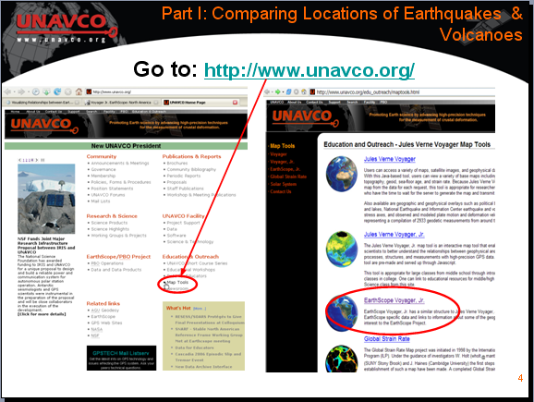
Learning Materials, Exhibits, Social Media
Tutorials & How to’s
Lessons
Animations
How to’s for data
Facebook, Twitter, etc
Based on time series inversion algorithms of Lundgren et al. (J. Geophys. Res., 2001) and Berardino et al. (IEEE, 2002).
Notes:
UNAVCO is developing free, place-based, data-rich learning modules for educators and students in introductory Earth science courses at secondary and undergraduate levels.
These modules integrate new scientific discoveries related to crustal deformation and explore applications of GPS, LiDAR, and InSAR techniques to research.
They also provide students with case studies highlighting the process of scientific discovery. This presentation will provide an overview of our current and in-development visualization tools and how they are used in our learning modules.

Slide 13
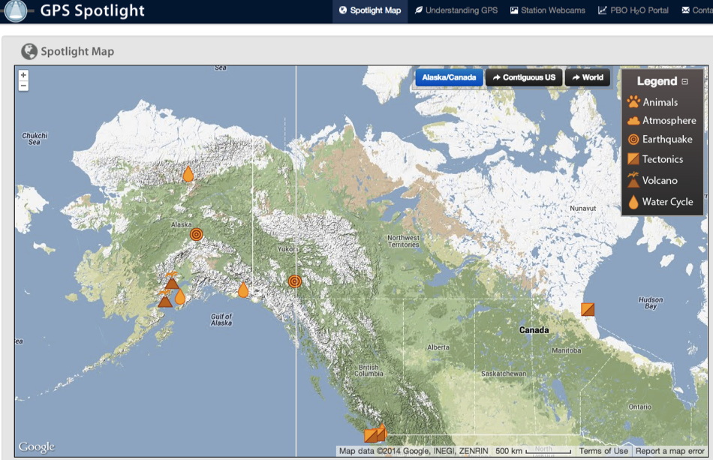
Reading literacy with science highlights, snapshots , and GPS Spotlights
http://unavco.org/
http://xenon.colorado.edu/spotlight/index.php?action=map

Slide 14
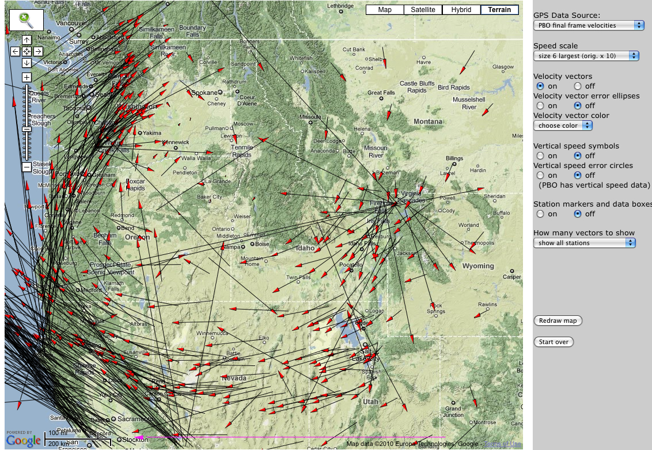
Use Data Tools: GPS Velocity Viewer
25 mm/yr
Data Source: UNAVCO Plate Boundary Observatory: North American Reference Frame
UNAVCO GPS Velocity Viewer
Notes:
Explain again what the vector arrows mean and walk through the map to point out interesting areas.
Explain reference frame …
It is the visual display of GPS, LiDAR, InSAR data, however, that helps make plate tectonics come alive for learners as a process that is happening in the present.

Slide 15
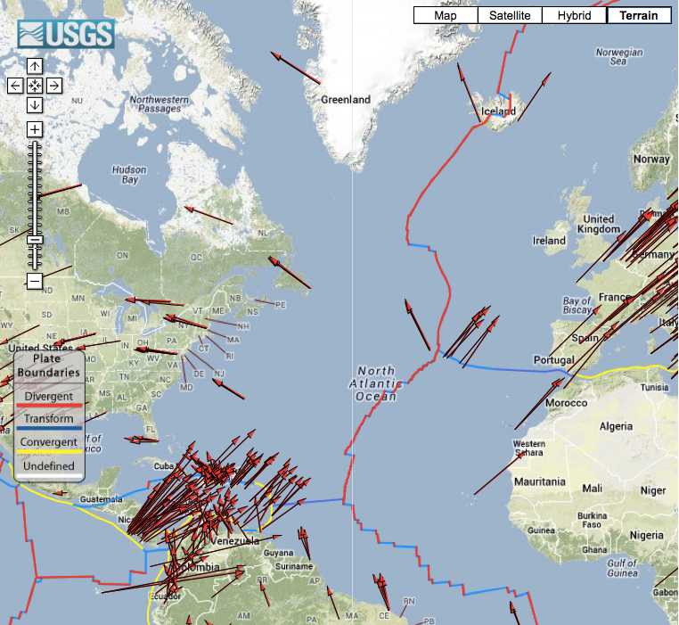
Comparing Plate Movement
GSRM Project GPS Data

Slide 16
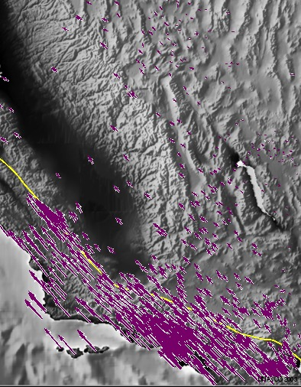
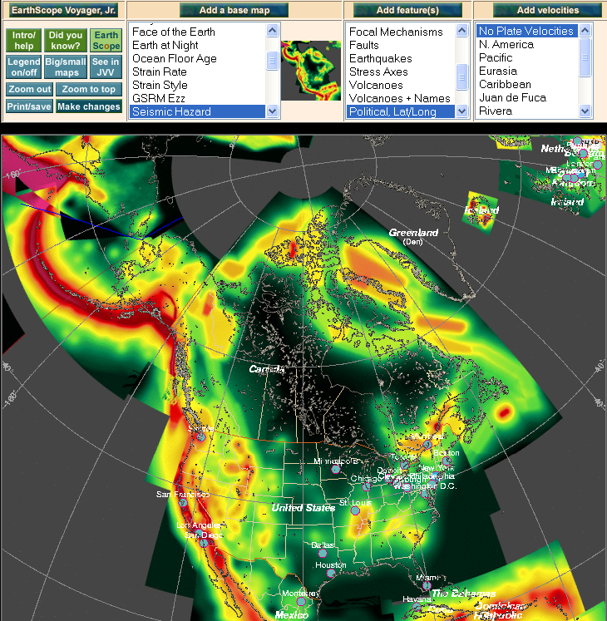
Jules Verne & EarthScope Voyager Jr.
Seismic Hazard Map
Velocity Vectors
http://www.unavco.org/edu_outreach/maptools.html

Slide 17
UNAVCO & PBO supported science
Plate movement
Earthquakes
Volcanoes
Glacial movements and isostatic adjustment
Hydrologic changes
Atmospheric – water vapor

Slide 18
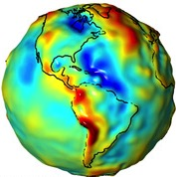
Study & Apply Geodesy & Measuring Gravity
Geodesy is the science of …
measuring Earth’s
size,
orientation,
And
shape
Gravitational
Field
NASA GRACE
variations of these with time
Map showing variations in the strength of the gravitational force over the surface of the Earth
Blue = less gravity
Red = more gravity
18
Notes:
18
18
Traditional geodetic application is the precise positioning of points on the surface of the Earth.

Slide 19
Anatomy of a High-precision Permanent GPS Station
GPS antenna inside of dome
Monument solidly attached into the ground with braces.
If the ground moves, the station moves.
Solar panel for power
Equipment enclosure
GPS receiver
Power/batteries
Communications/ radio/ modem
Data storage/ memory

Slide 20
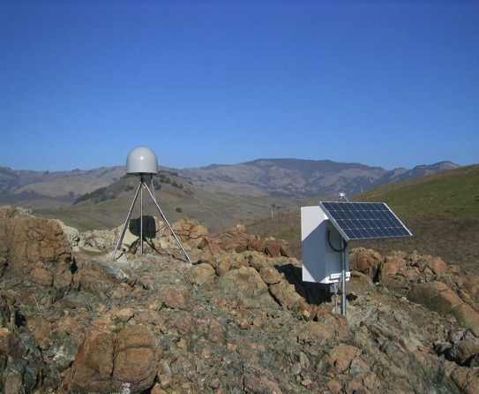
Introduction: GPS Basics
Four satellite signals are needed to locate the receiver in 3D space.
The fourth satellite is also used for time accuracy.
Position can be calculated within to a millimeter.
Needs ground control and time quality
Notes:
Also note that the GPS stations used for scientific work are more precise for many reasons: the unit uses both of the signals coming from the satellites, two the clocks are atomic rather than crystal, (see slide). These stations can measure the change in position of a location with millimeter accuracy.

Slide 21
Demonstration Pinpoint Location With GPS
How to demonstrate this:
http://www.youtube.com/watch?feature=player_embedded&v=s_CeiMjO5Pc#!

Slide 22
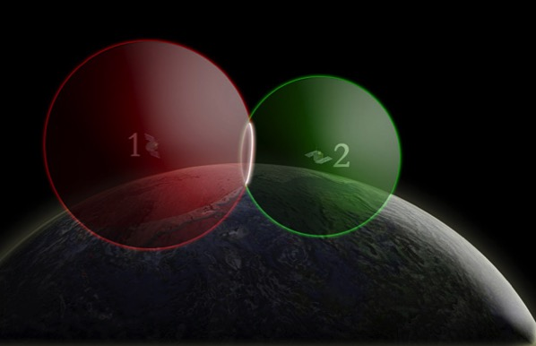
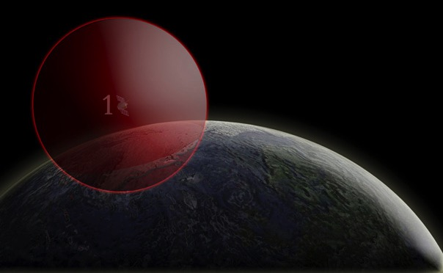
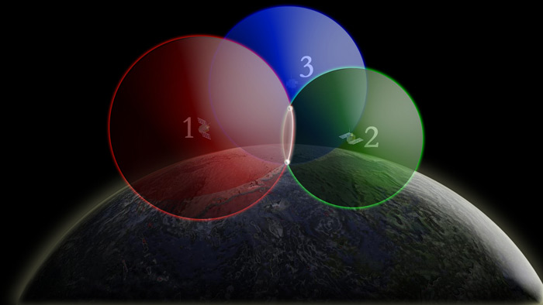
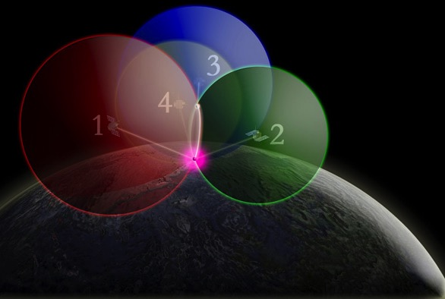
Find your location using GPS – 4 intersecting spheres
One satellite,
the GPS could be anywhere on the edge of the sphere.
Two satellites, GPS could be on the circle where spheres intersect.
3 satellites:
spheres intersect in 2 places.
4 satellites, spheres intersect in one place.

Slide 23
Thank You!
Contact: Shelley Olds
Education –at- unavco.org
http://www.unavco.org/
Follow UNAVCO on _________
Facebook Twitter

Slide 24
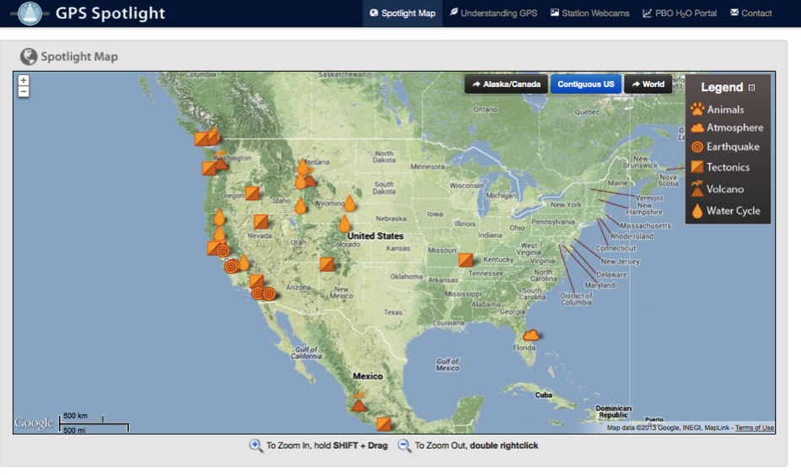
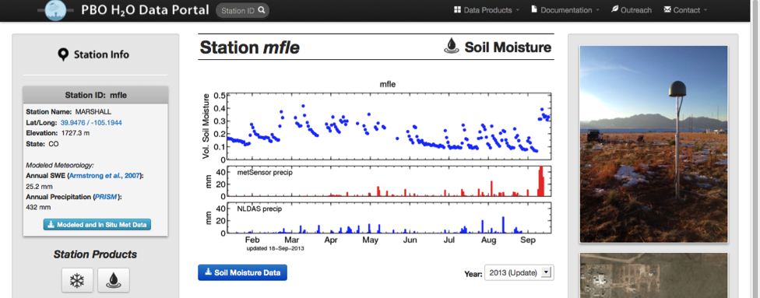
More websites of interest
Learn more about how GPS works and the science learned through research
GPS Spotlight: http://xenon.colorado.edu/spotlight/index.php
PBO H2O: http://xenon.colorado.edu/portal/index.php

Slide 25
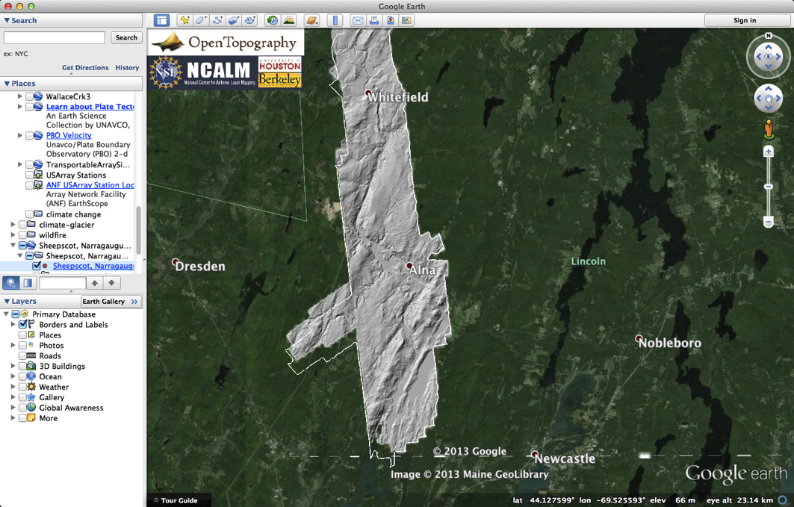
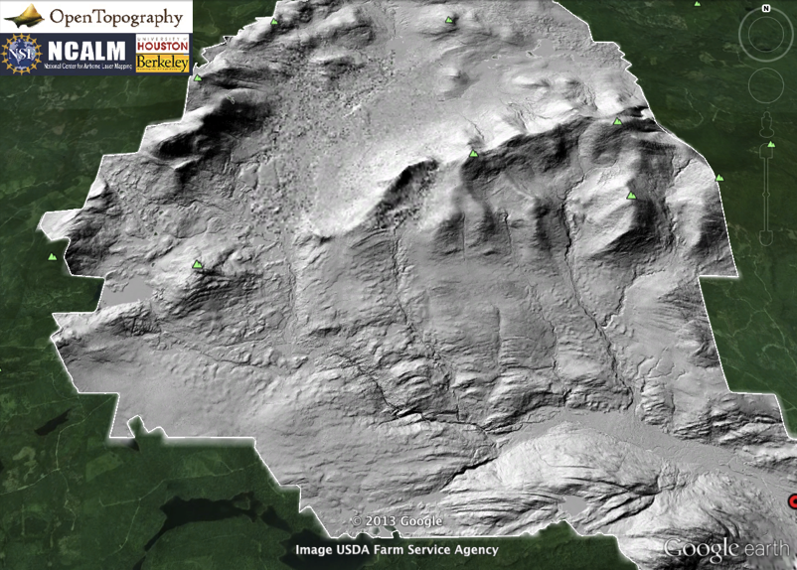
More websites of interest
See the ground and forests with LiDAR
Many places to get LiDAR!
Open Topography: http://www.opentopography.org/
New York: http://gis.ny.gov/elevation/lidar-coverage.htm
Maine: http://www.maine.gov/megis/projects/lidar.shtml
Vermont: http://vcgi.vermont.gov/warehouse/products/ALL-LDR_MIX_LIDAR_STATE_ALL
New Hampshire: http://www.granit.unh.edu/resourcelibrary/specialtopics/lidar/

Slide 26
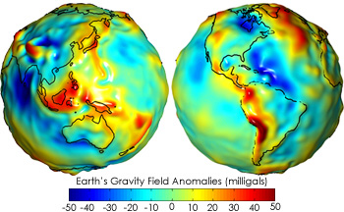
About GRACE
http://earthobservatory.nasa.gov/Features/GRACE/page3.php

