Slide 1
Kathryn Materna
María Araya
InSAR Processing and Theory with GMTSAR: Sentinel-1A Time Series

Slide 5
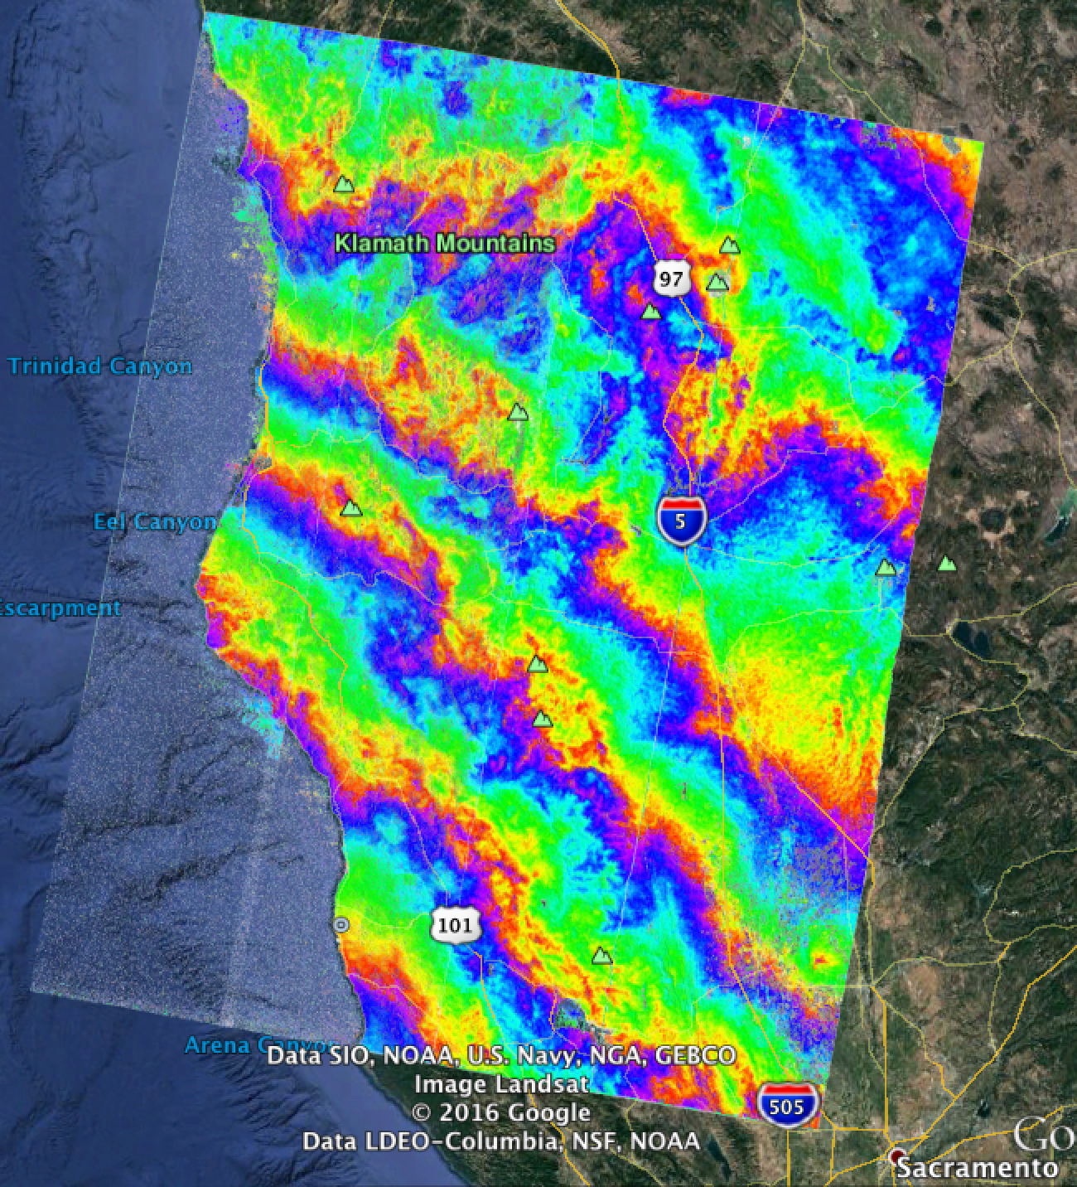

Slide 6
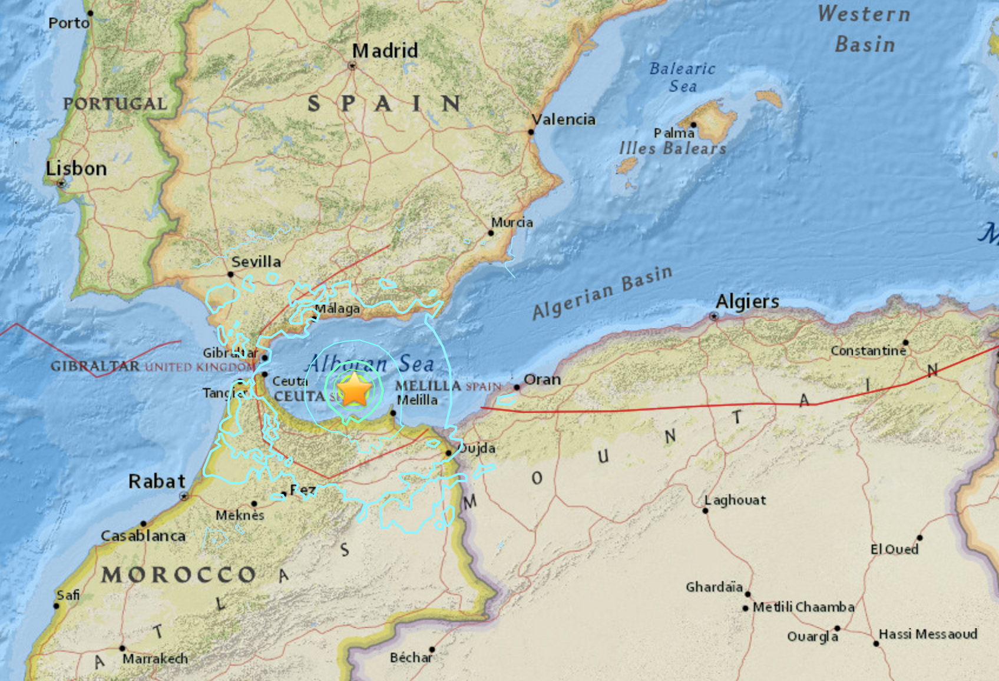
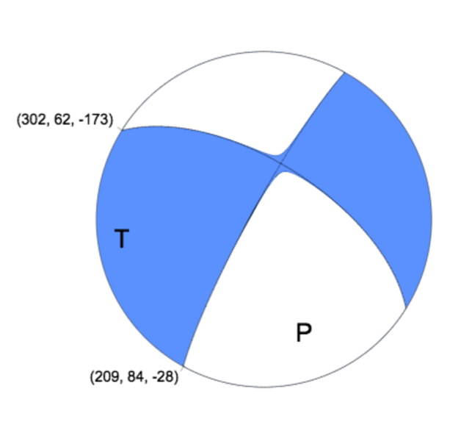
Earthquake: M6.3, Jan. 2016
12 km depth
50 km offshore

Slide 7
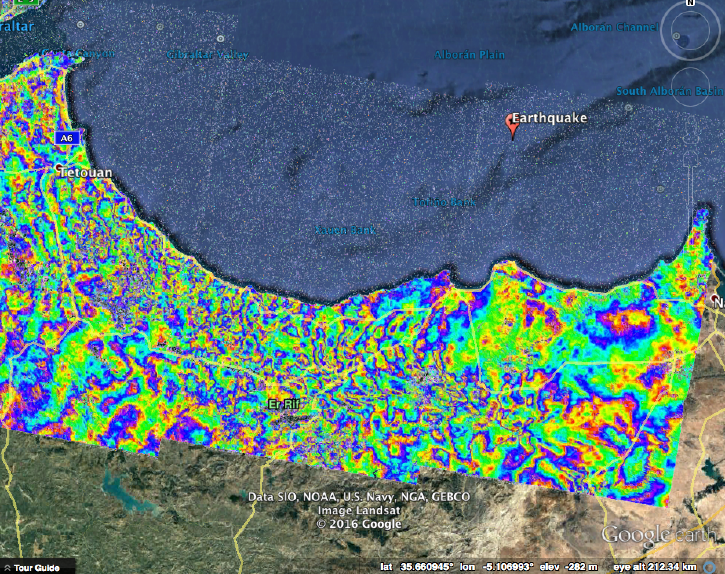
Intf: Jan 10, 2016 – Feb 15, 2016
Sentinel-1A
Earthquake: M6.3 on Jan 25, 2016

