Slide 1
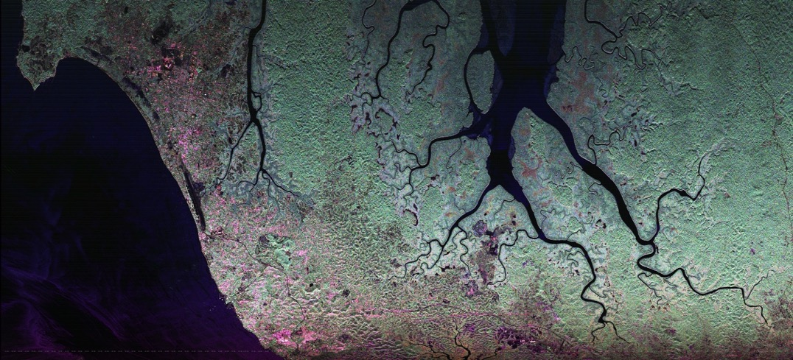
Teaching SAR with UAVSAR
Naiara Pinto, NASA/JPL 334F

Slide 2
UAVSAR Workshops

Slide 3
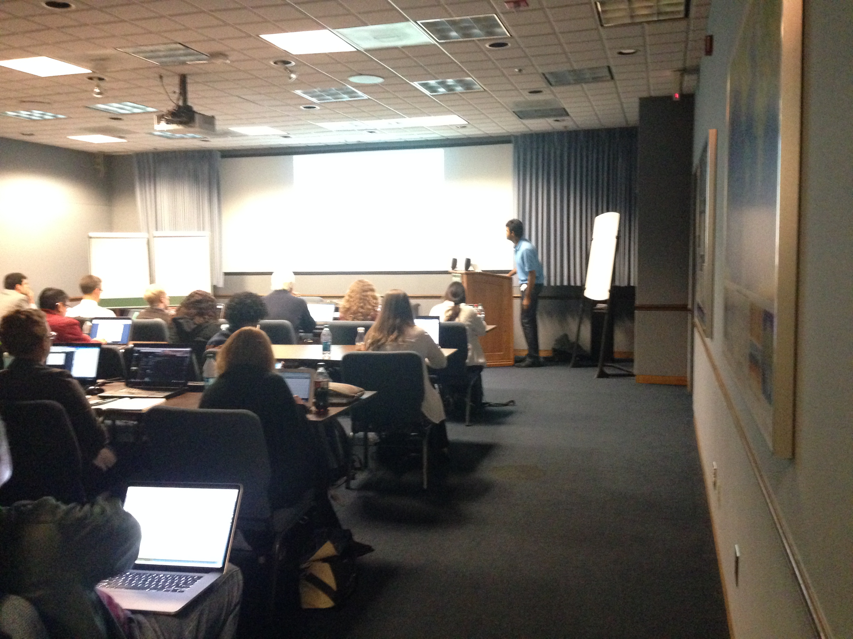
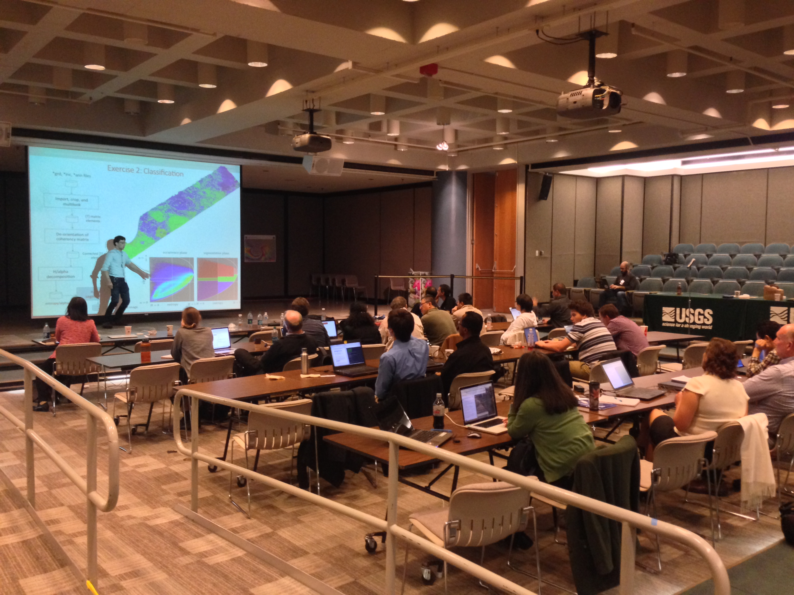
2014 UAVSAR Workshop
Piyush Agram
Marco Lavalle
Exercises using Earthkit:
-Fire scar mapping
-Generic InSAR Analysis Tool (GIAnT)

Slide 4
2015 UAVSAR Workshop
Posted presentations and tutorials on:
Inundation mapping (B. Chapman)
Landslides (E. Fielding)

Slide 5
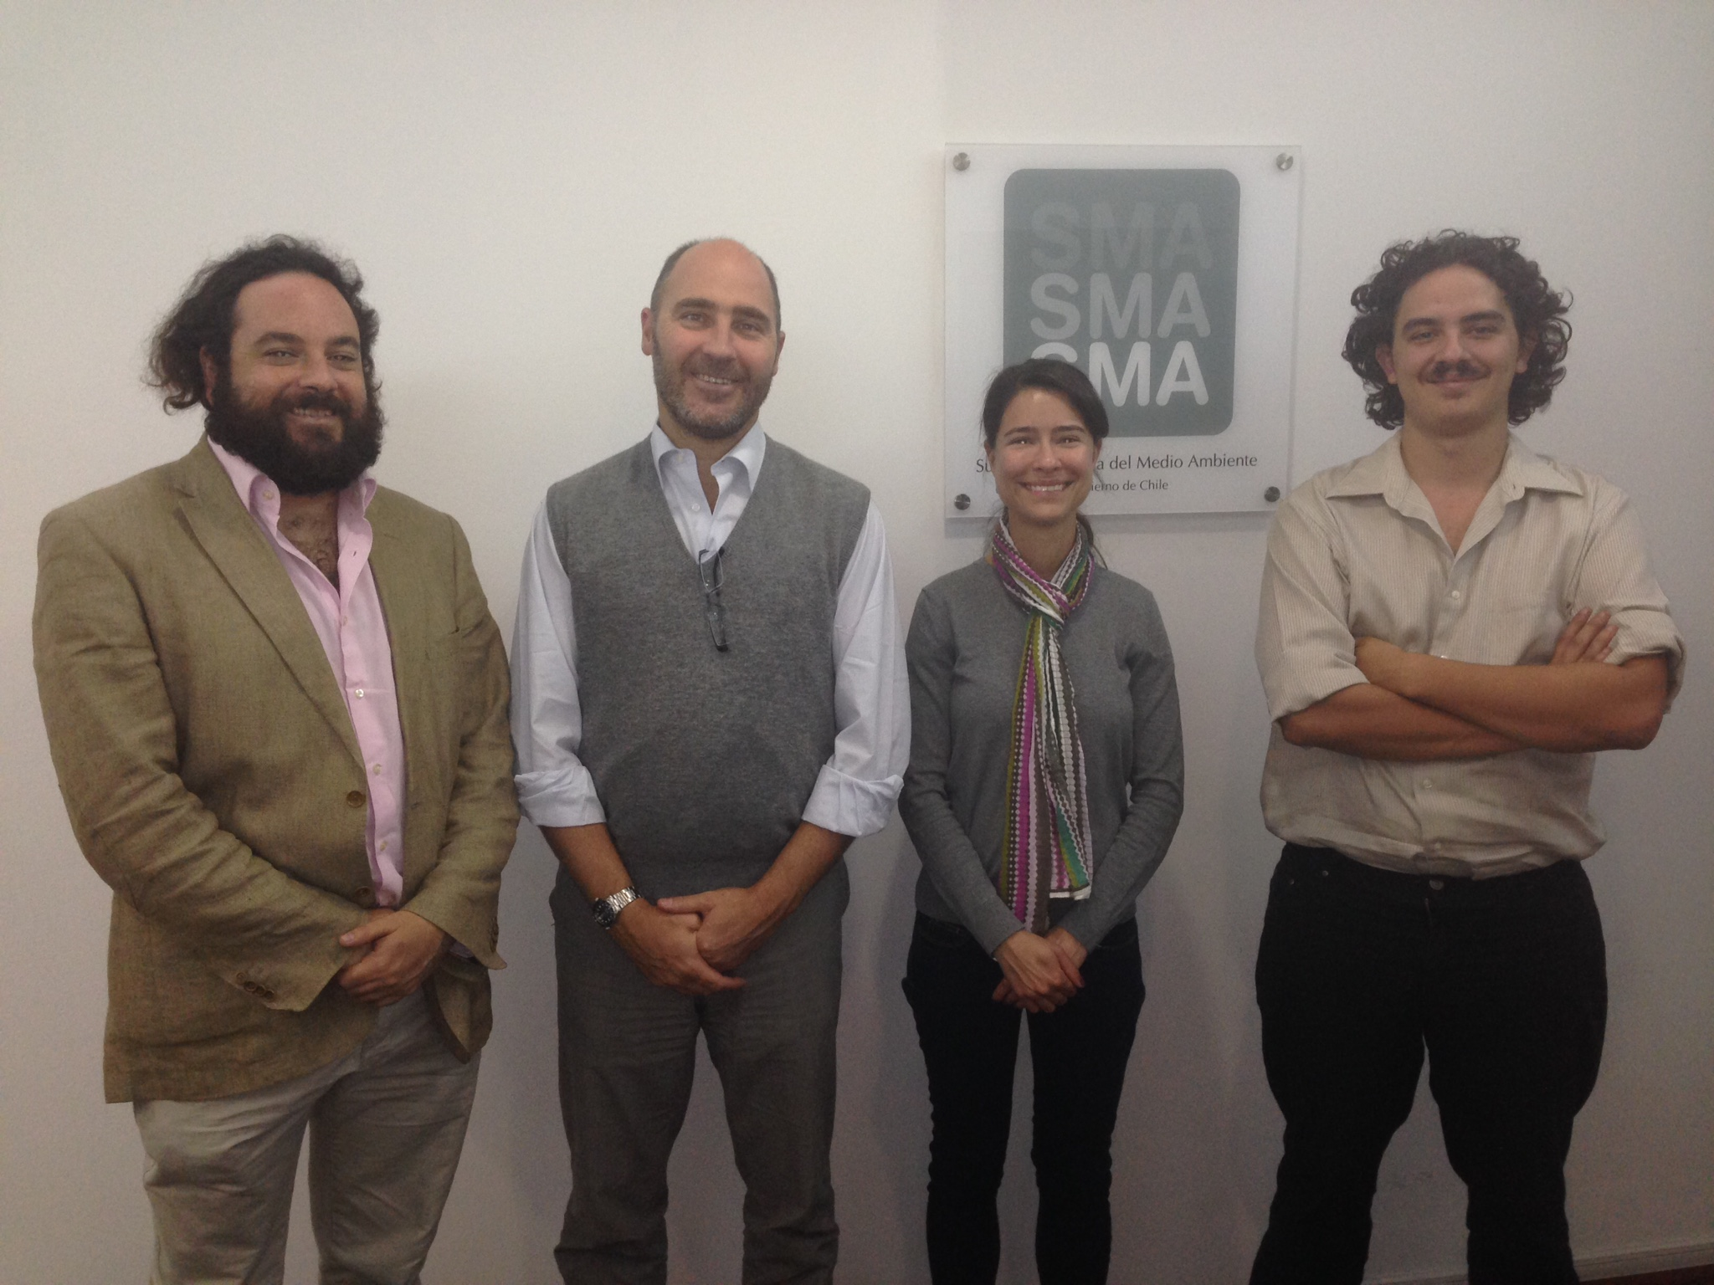
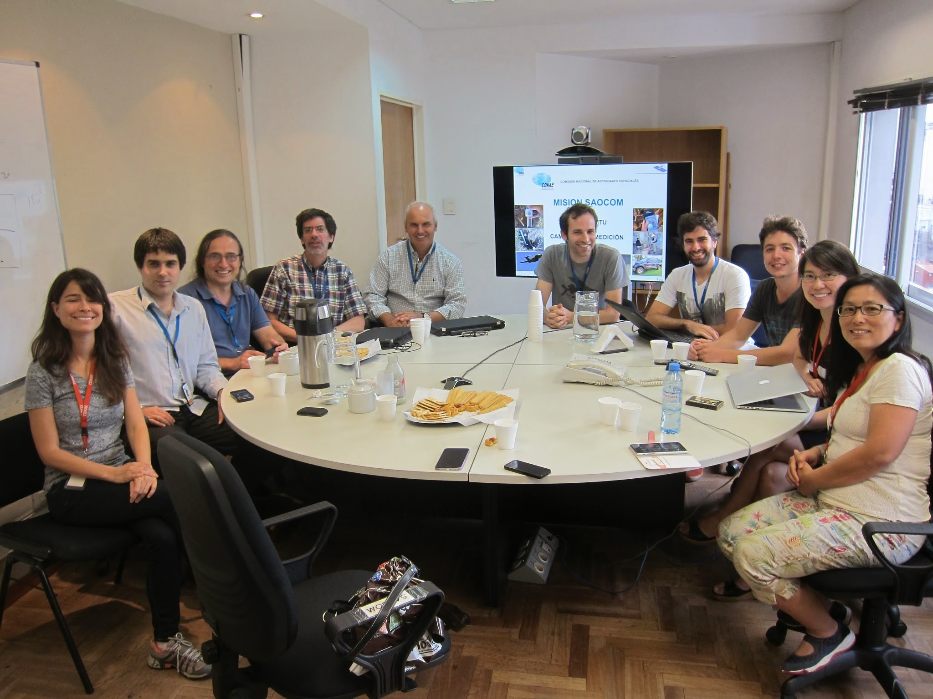
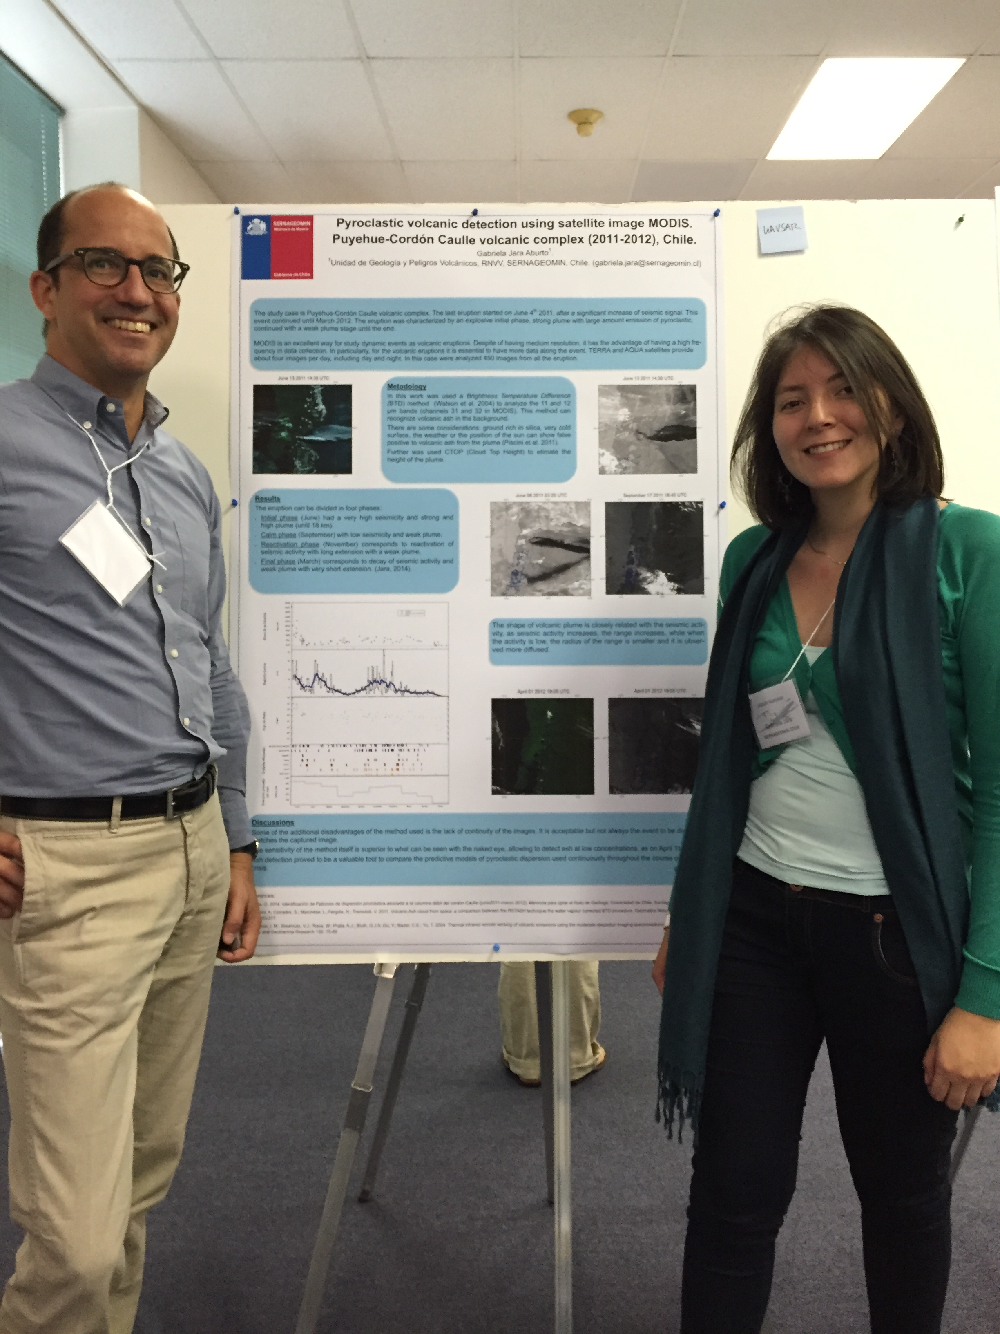
2015 UAVSAR Workshop
GRSS provided travel support for 4 students (Chile, Colombia) and 1 senior researcher (Argentina)
Environmental Ministry, Santiago
CONAE, Buenos Aires
NASA/Ames
We asked graduate students to present posters on UAVSAR data collected in their countries

Slide 6
ForestSAT
Santiago, 2015

Slide 7
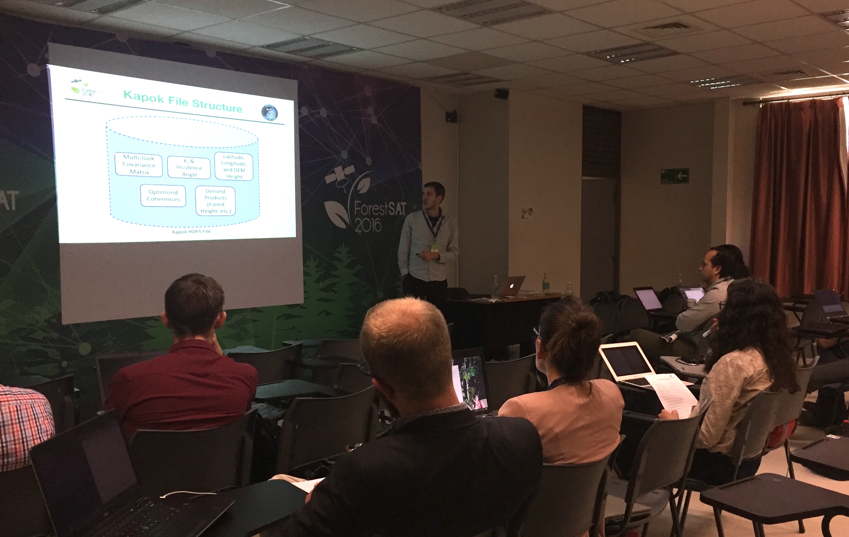
PolInSAR using Kapok
Python environment
Line-by-line command instructions
Small datasets
Top-down approach
Michael Denbina
Slumgullion landslide

Slide 8
AfriSAR follow-up
Gabon, 2017

Slide 9
Attendees
Location | # Students | Target Audience | Attending Institutions
AGEOS HQ Nkok | 15 | Advanced RS | AGEOS ANPN (Park Service) World Resources Institute The Nature Conservancy Omar Bongo University
Gabon Oregon Center Libreville | 16 | Applied RS | Tropical Ecology Institute (IRET) Plurmea NGO National Cartography Institute Red Cross Omar Bongo University
Gabonese Applications community.
Workshop attendees were selected by AGEOS.
Two sessions to tailor to students’ previous experience with remote sensing and programming.

Slide 10



AFRISAR
Workshop
Feb 2017
Program
Location | Friday, Feb 10, 2017 | Monday | Tuesday | Wednesday | Thurs | Friday
Session I: AGEOS | GEODAY AGEOS Rep Fatoyinbo DLR Rep ESA Rep | Lidar Cornejo Duncanson | SAR Basics Papathanassiou Pardini Villard | Polarimetry Papathanassiou Pardini Villard | PolInSAR Papathanassiou Pardini Villard | Advanced Topics and Software Simard Villard Papathanassiou
Session II: Gabon Oregon Center |  | Radar Overview and Data Download Hensley Pinto | Lidar Cornejo Duncanson | SAR Hensley Simard Obiang Pinto | InSAR and Polarimetry Hensley Simard Obiang Pinto
    http://j-geo.org
    10-17 February, 2017
    Instructors from NASA, DLR, and Cesbio
    Event organized by AGEOS and ESA
French speaker
JOINT TALKS
THEORY + HANDS-ON

Slide 11
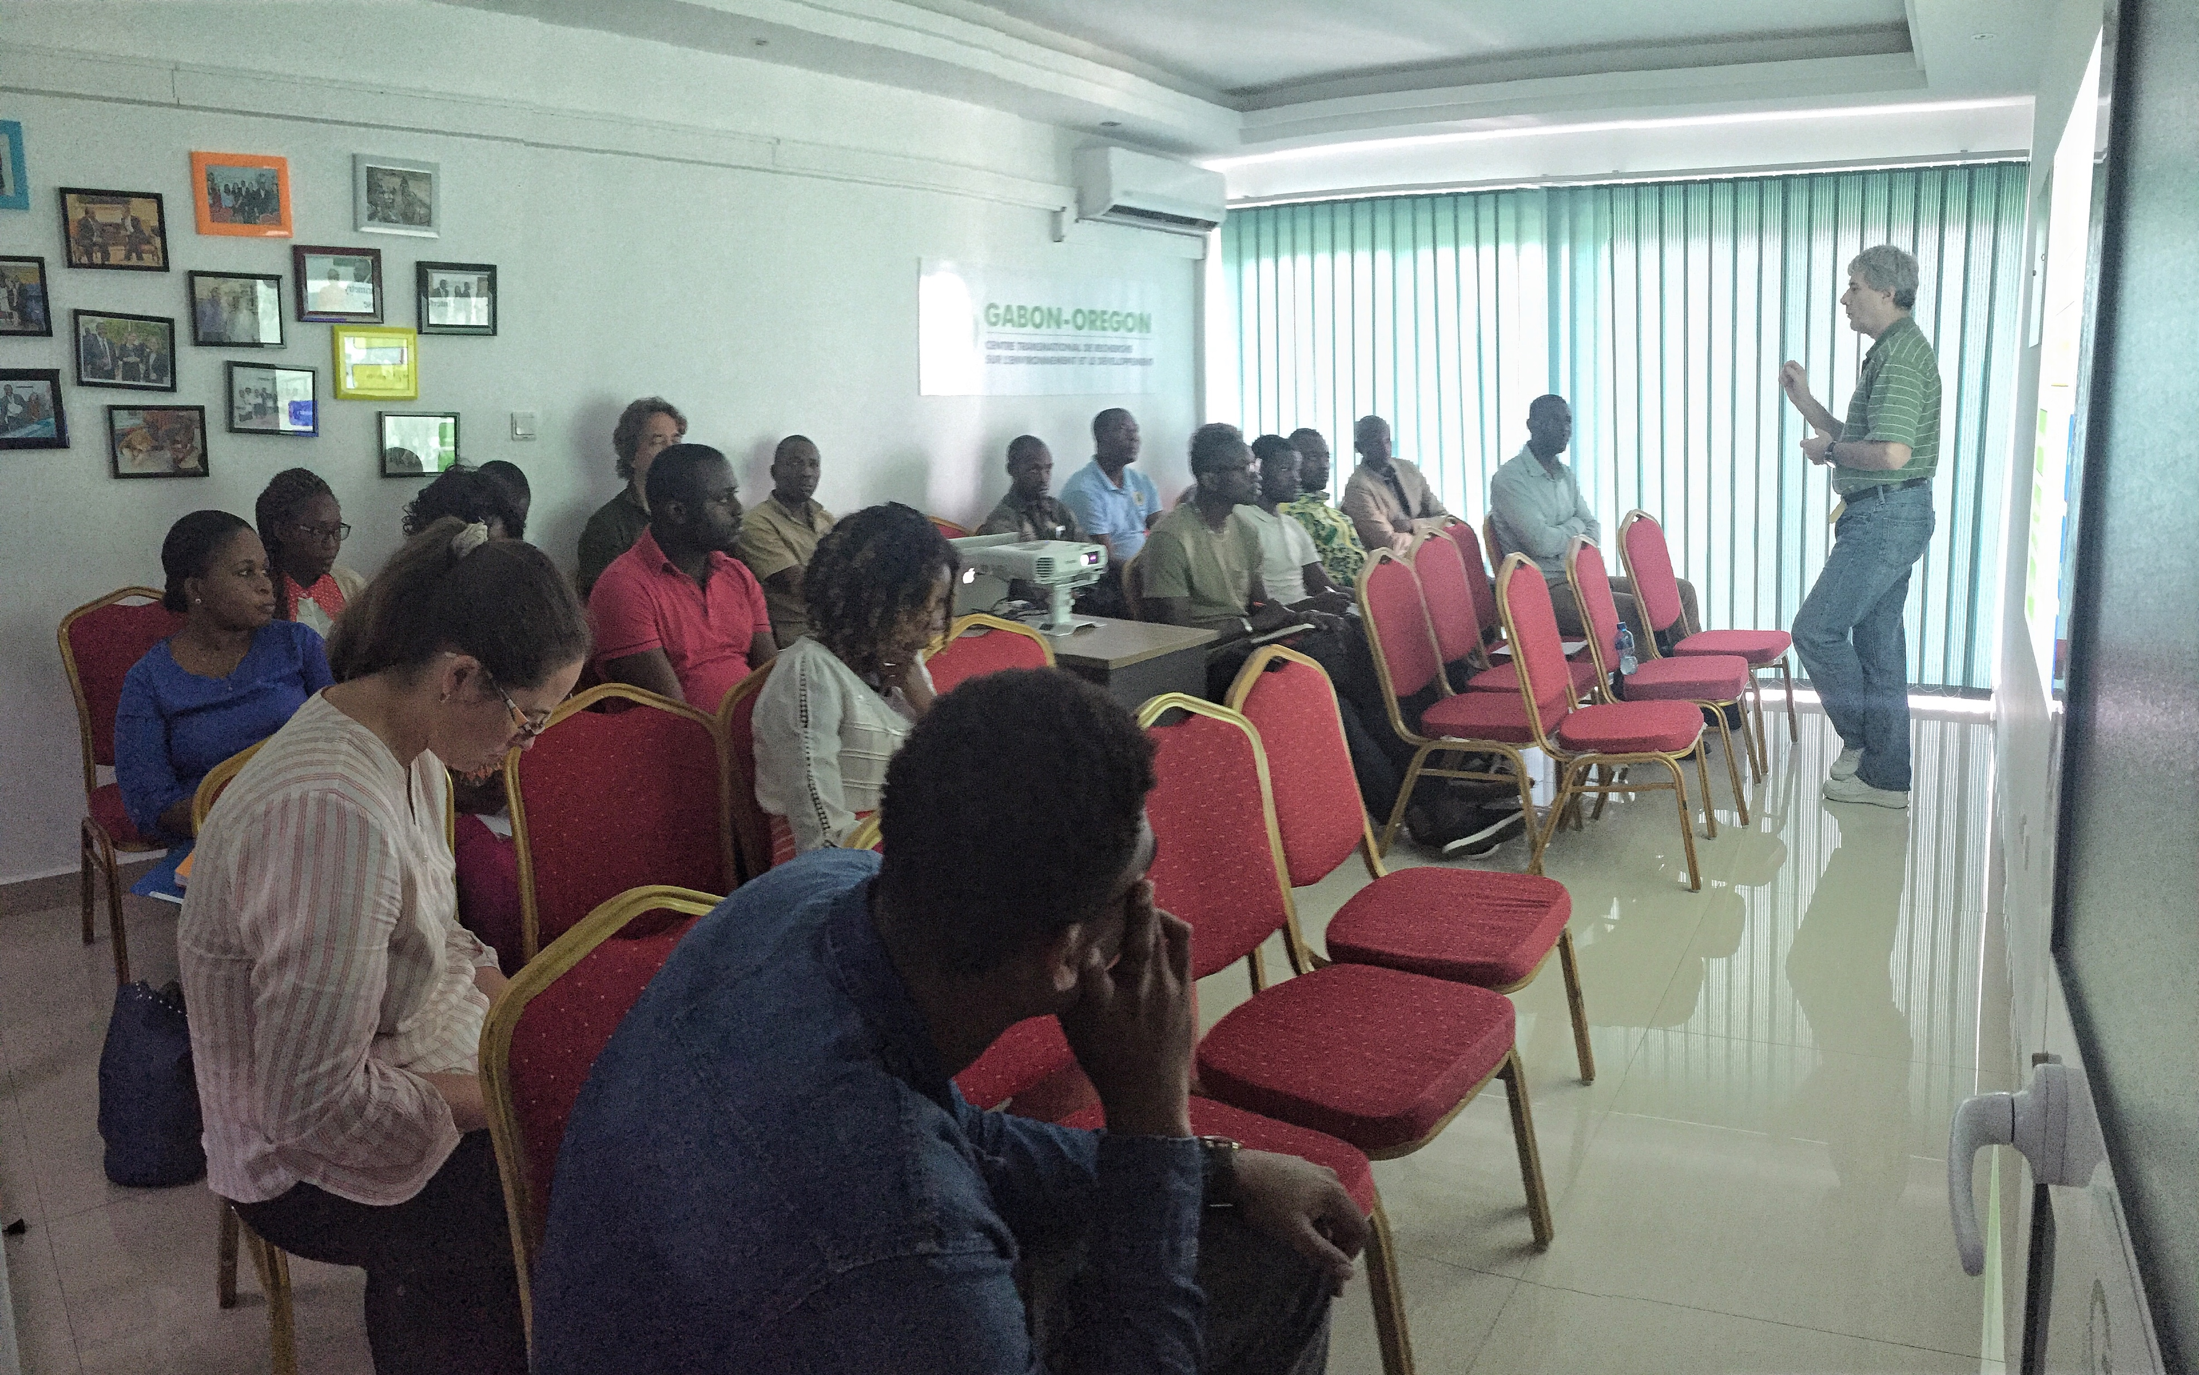
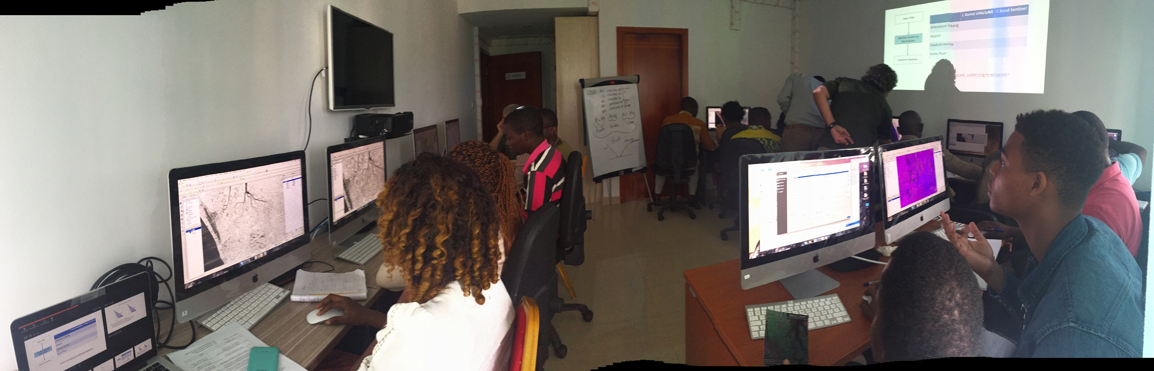
Gabon Oregon Center SAR Training
Morning theory session led by Scott Hensley
Intro to radar and JPL
How to download UAVSAR and other free SAR imagery
SAR
InSAR, polarimetry, and PolInSAR
Morning theory class
Afternoon lab class
Afternoon session taught by Hensley, Obiang, Pinto, and Simard
Sentinel and UAVSAR images showing Libreville
SAR filtering and geocoding
Data visualization
Polarimetric decompositions

Slide 12
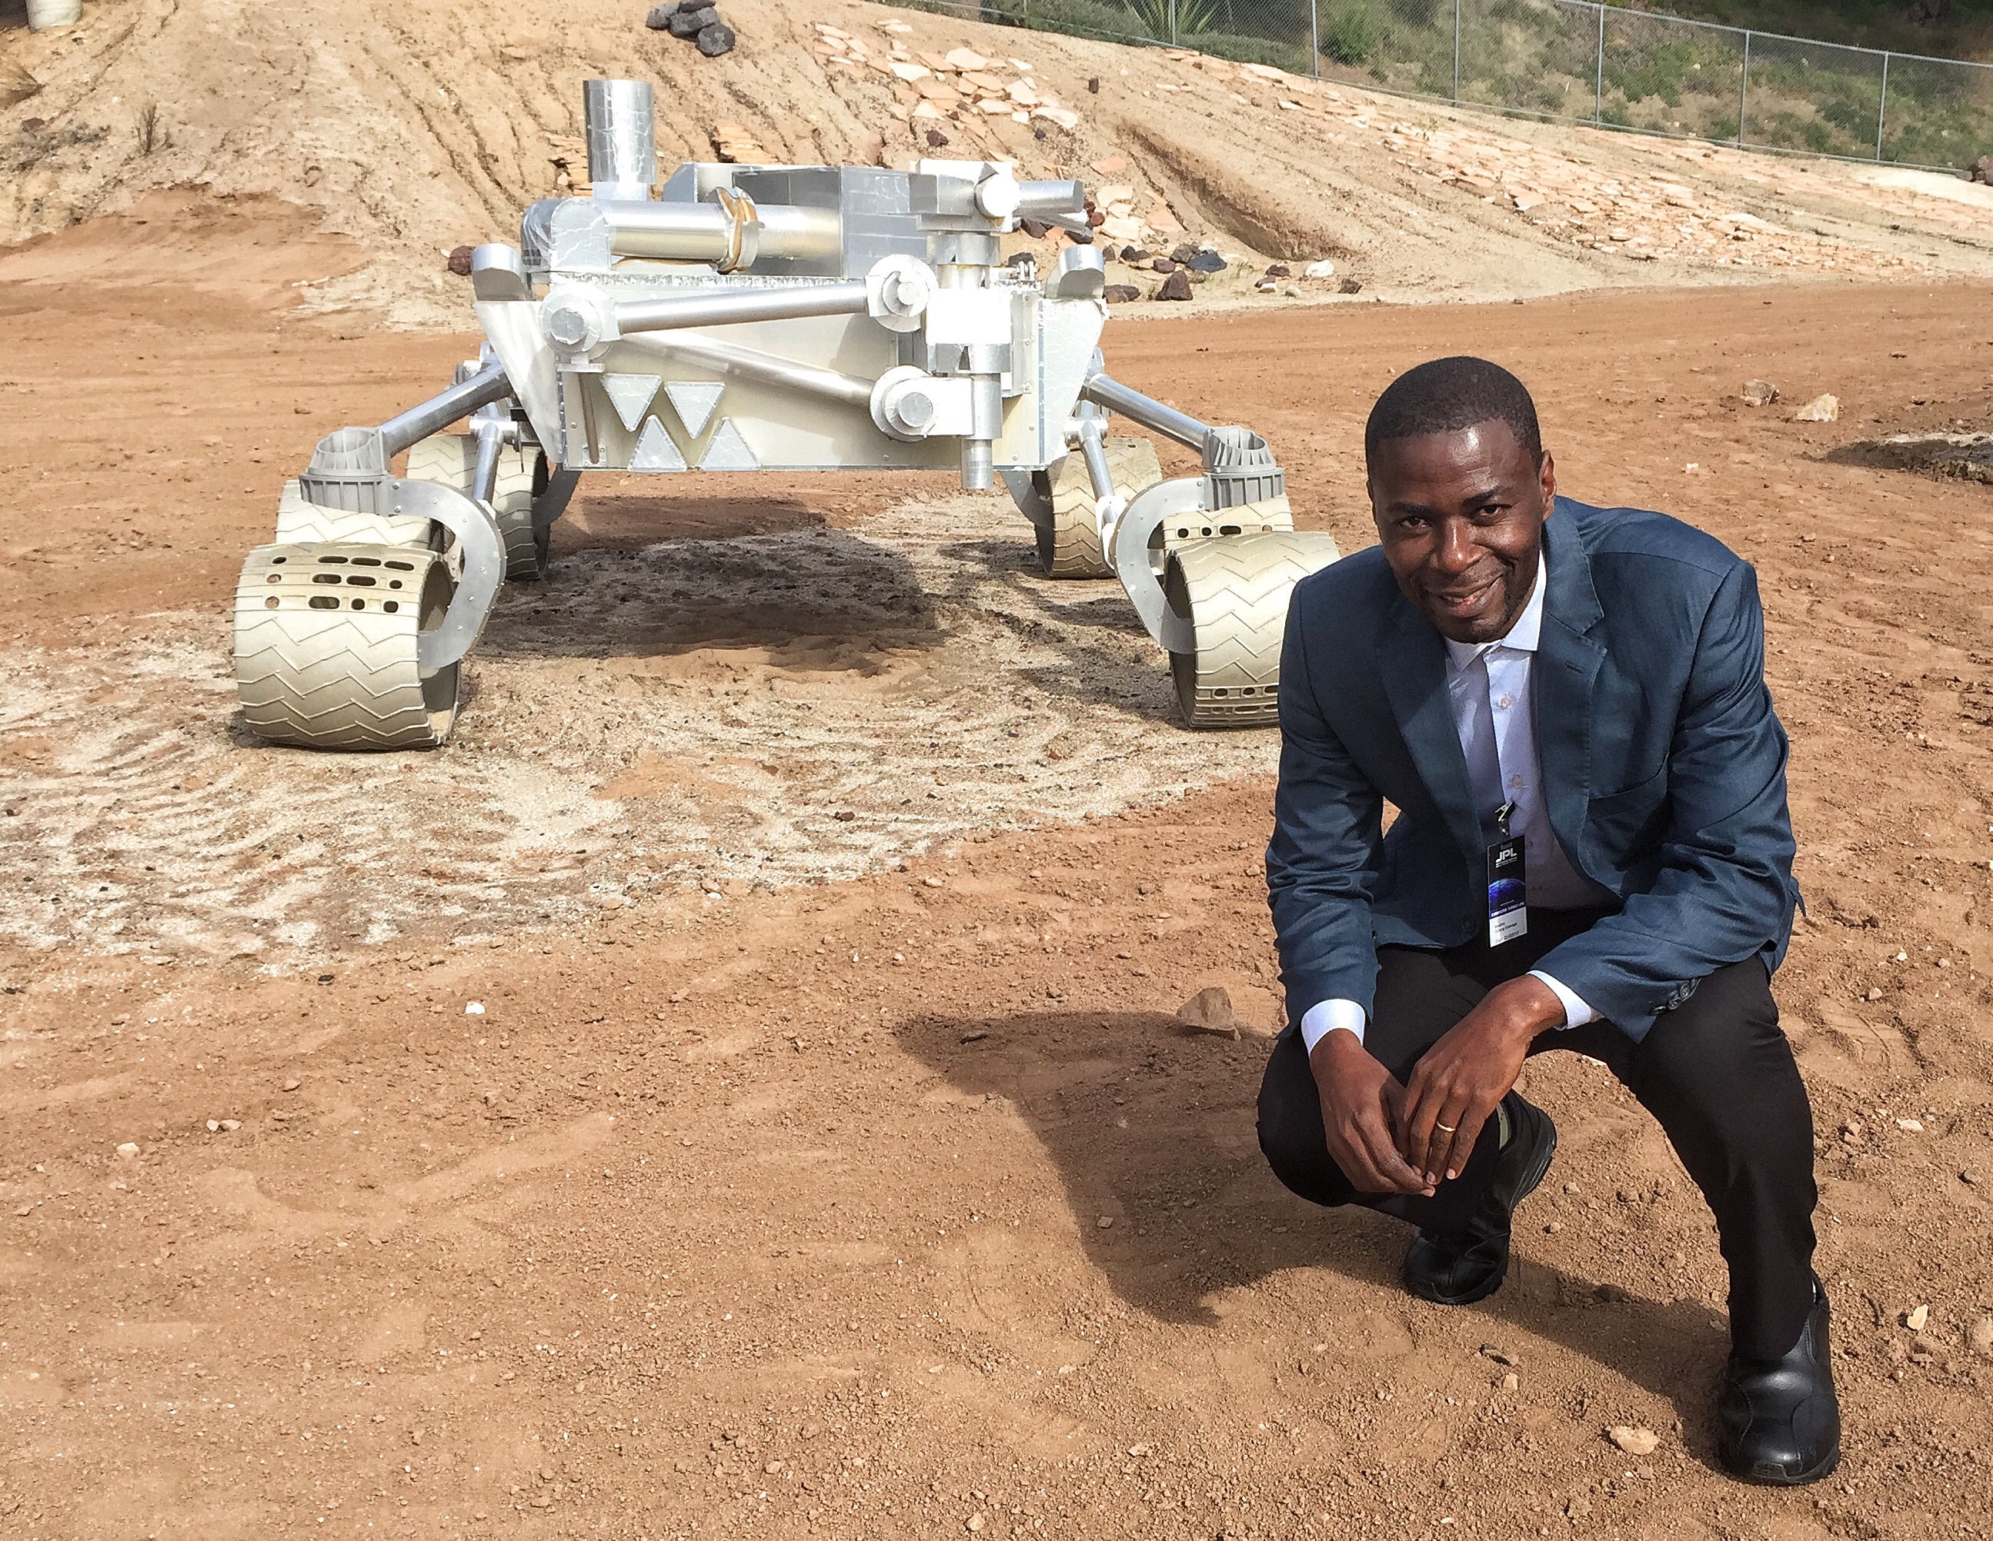
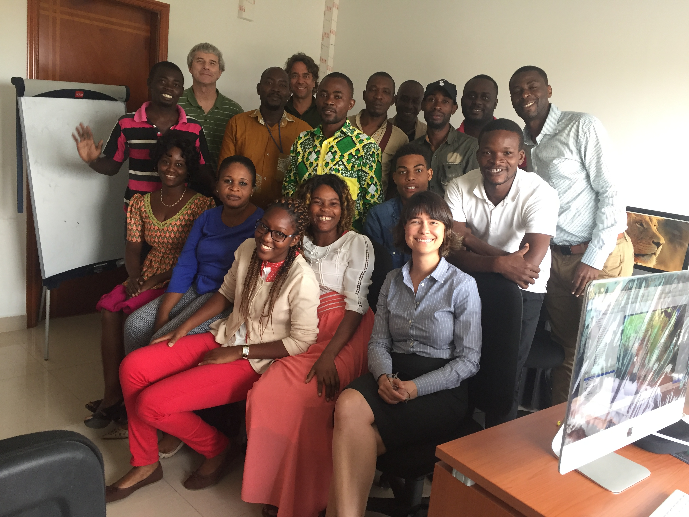
Teaching the teachers
Senior Gabonese researchers are critical facilitators:
  Received $ for visit from Omar Bongo Univ. professor through JPL Visitor Colloquium Series and Gabon Oregon Center
  Libreville Gabon Oregon Center reps provided computer lab
  Gabonese teachers use UAVSAR datasets in graduate courses to provide continuity
  They speak French!
Medard Obiang in Pasadena
Lab class in Libreville
Local datasets
Local datasets contribute to student engagement. Students were excited to explore the Libreville images.

Slide 13
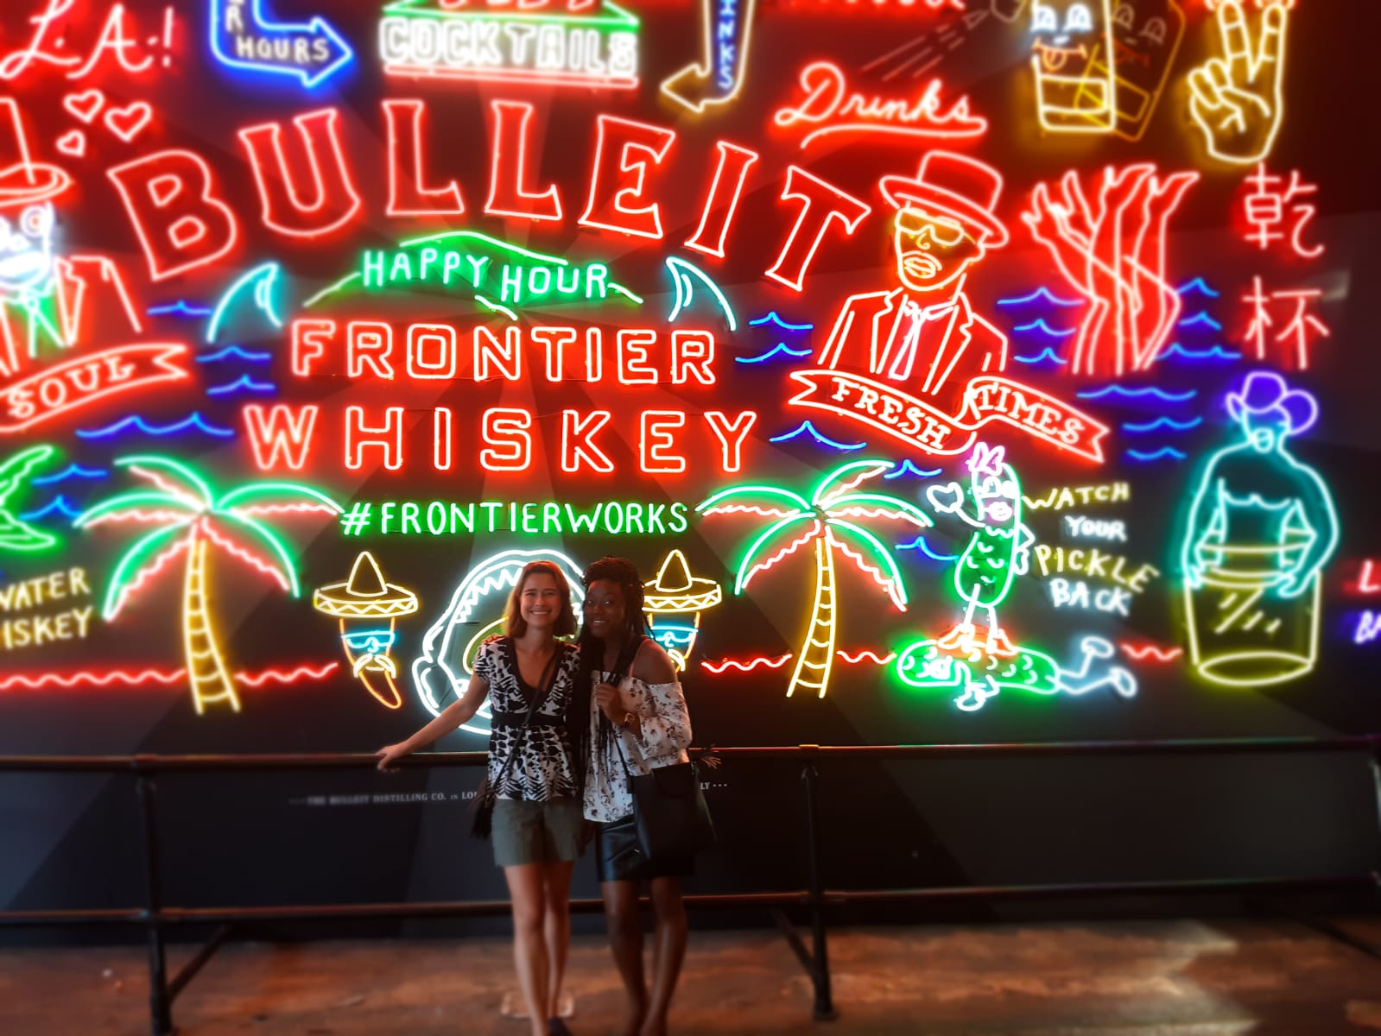
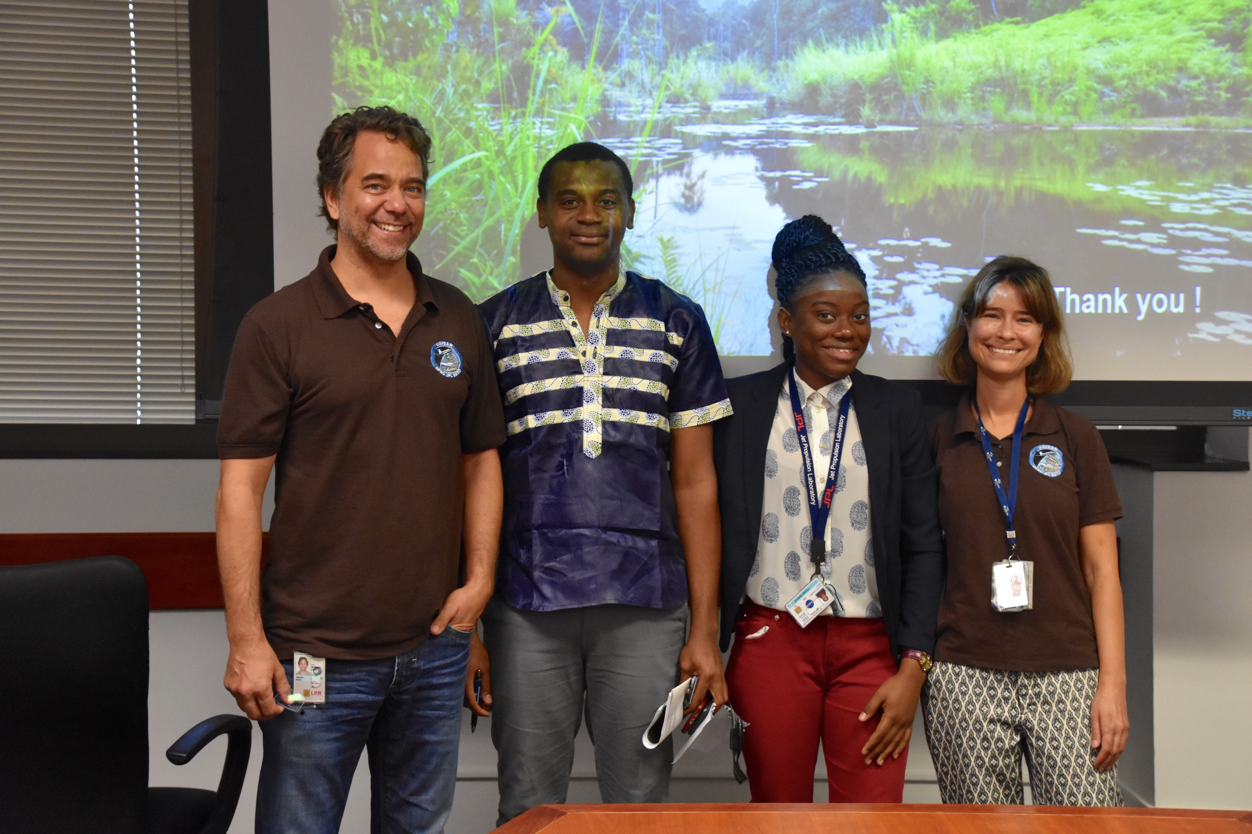
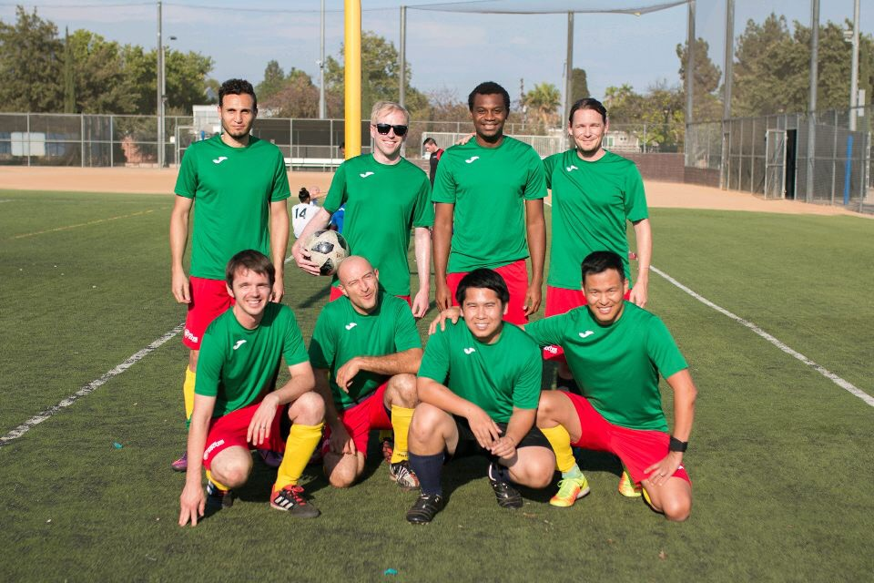
Graduate student involvement
6-month internship at JPL funded by ROSES grant (M. Simard)
Students asked to produce a tutorial on deforestation and biomass mapping
Marc
Creck
Anaick
Naiara

Slide 14
Lessons Learned

Slide 15
Need continuous involvement with graduate programs. We can ask students and faculty to:
  Improve product documentation and white papers for specific applications and languages
  Co-produce tutorials
  Present posters at meetings
Evaluate student GIS / programming skills ahead of time
  If a single group is unavoidable, pair experienced students with non-programmers
Need to understand unique challenges of government / university ArcGIS users. Many image manipulation operations are hidden from the user:
  Image resampling
  Image stretching
  Masking nodata values
  Co-registration with shapefiles
End-to-end study cases with small datasets that bypass software installation and GIS hurdles
Command line interface is OK
  However library dependencies are not
  Difficulties with paths and moving between directories
Medard Obiang in Pasadena

