Slide 1
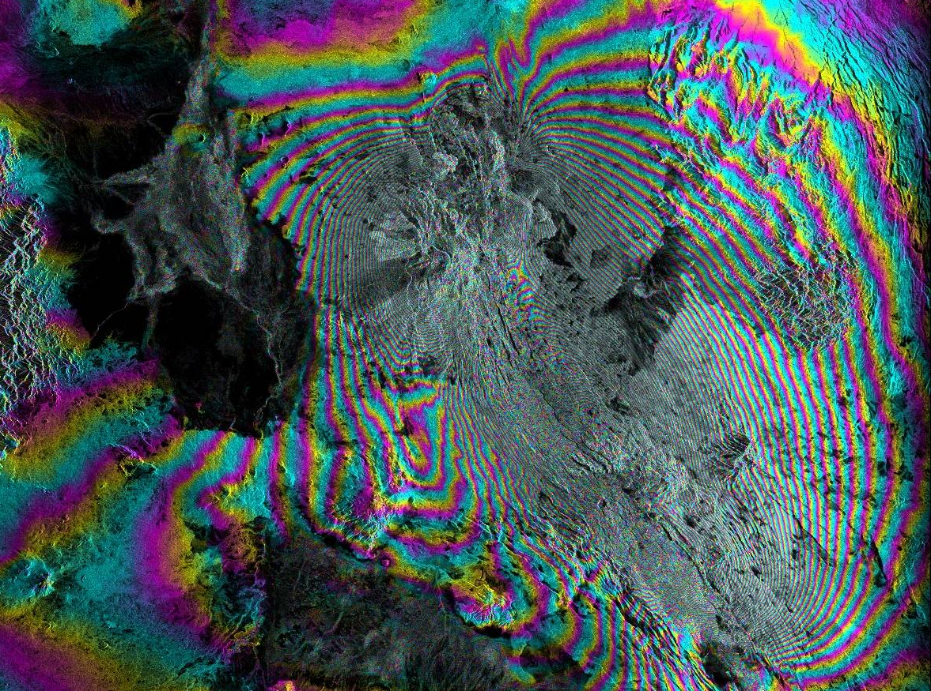



Recent SAR-Related Outreach & Training Activities AT UAF and ASF
Synthetic Aperture Radar Literacy and Training Workshop
Franz J Meyer
Associate Processor, Geophysical Institute
Chief Scientist, Alaska Satellite Facility
University of Alaska Fairbanks (UAF)
2018 SAR Literacy & Training Workshop

Slide 2
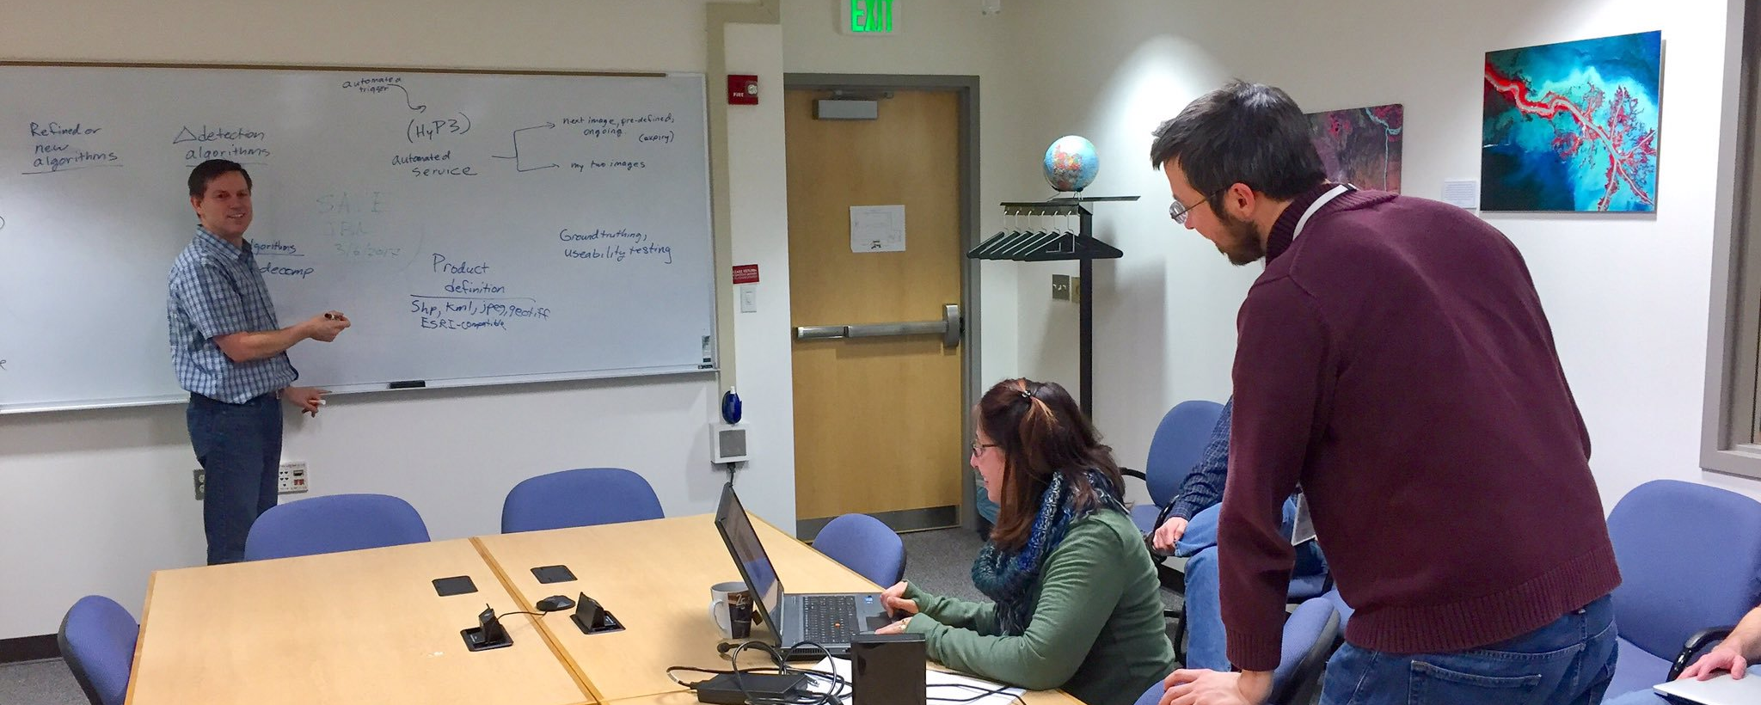
Summary of Outreach Activities

Slide 3
Recent UAF & ASF Outreach Activities
Hosting Visiting Scientists and Students
Hosting Guest Researchers
  July 2017: Bernhard Rabus, SFU, Canada [funded by SFU]
  Sep – Oct 2017: Jun Su Kim, German Aerospace Center [funded by DLR]
  April 2019: Xiaoxiang Zhu, German Aerospace Center [funded by DLR]
Visiting Undergraduate & Graduate Students
  Apr – Sep 2017: Stephan Zeitvogel, KIT, “SAR Data Quality Analysis with Application to SIR-C”
  Apr – Sep 2018: Hannes Kistner, KIT, “Automatic QA/QC tools with Application to Operational SIR-C Data Processing”
  Sep – Dec 2018: Steffen Becker, KIT, “Integrating Error Models and Source Model
  Inversions into the InSAR Processing System SARVIEWS”
  Summer 2016 & `17: Computer Science Undergraduate Students developing cloud-
  based SAR and InSAR processing tools

Slide 4
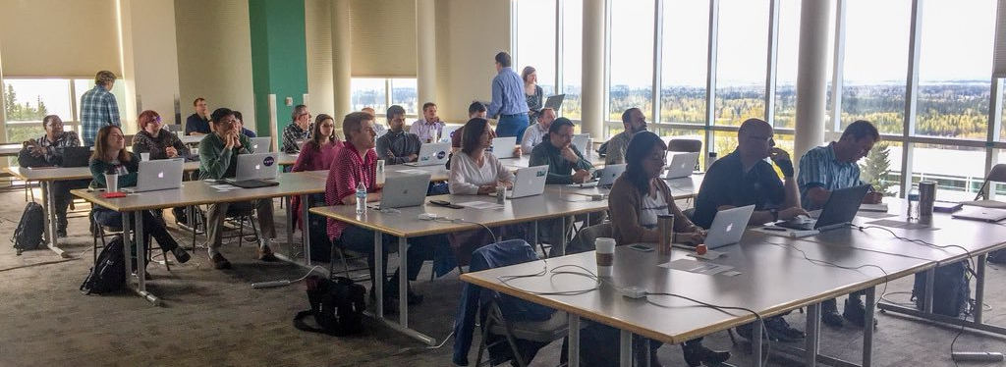
Recent UAF & ASF Outreach Activities
Science User Support: Cloud Computing Support
Helping science users to take efficient advantage of ASF AWS-based Sentinel-1 archive (bring algorithm to the data)
  Working with partners in Italy and across the US to build processing workflows in AWS next to ASF archive (AWS East 1)
Hosting AWS Cloud Processing workshop in May 2017 with two AWS instructors

Slide 5
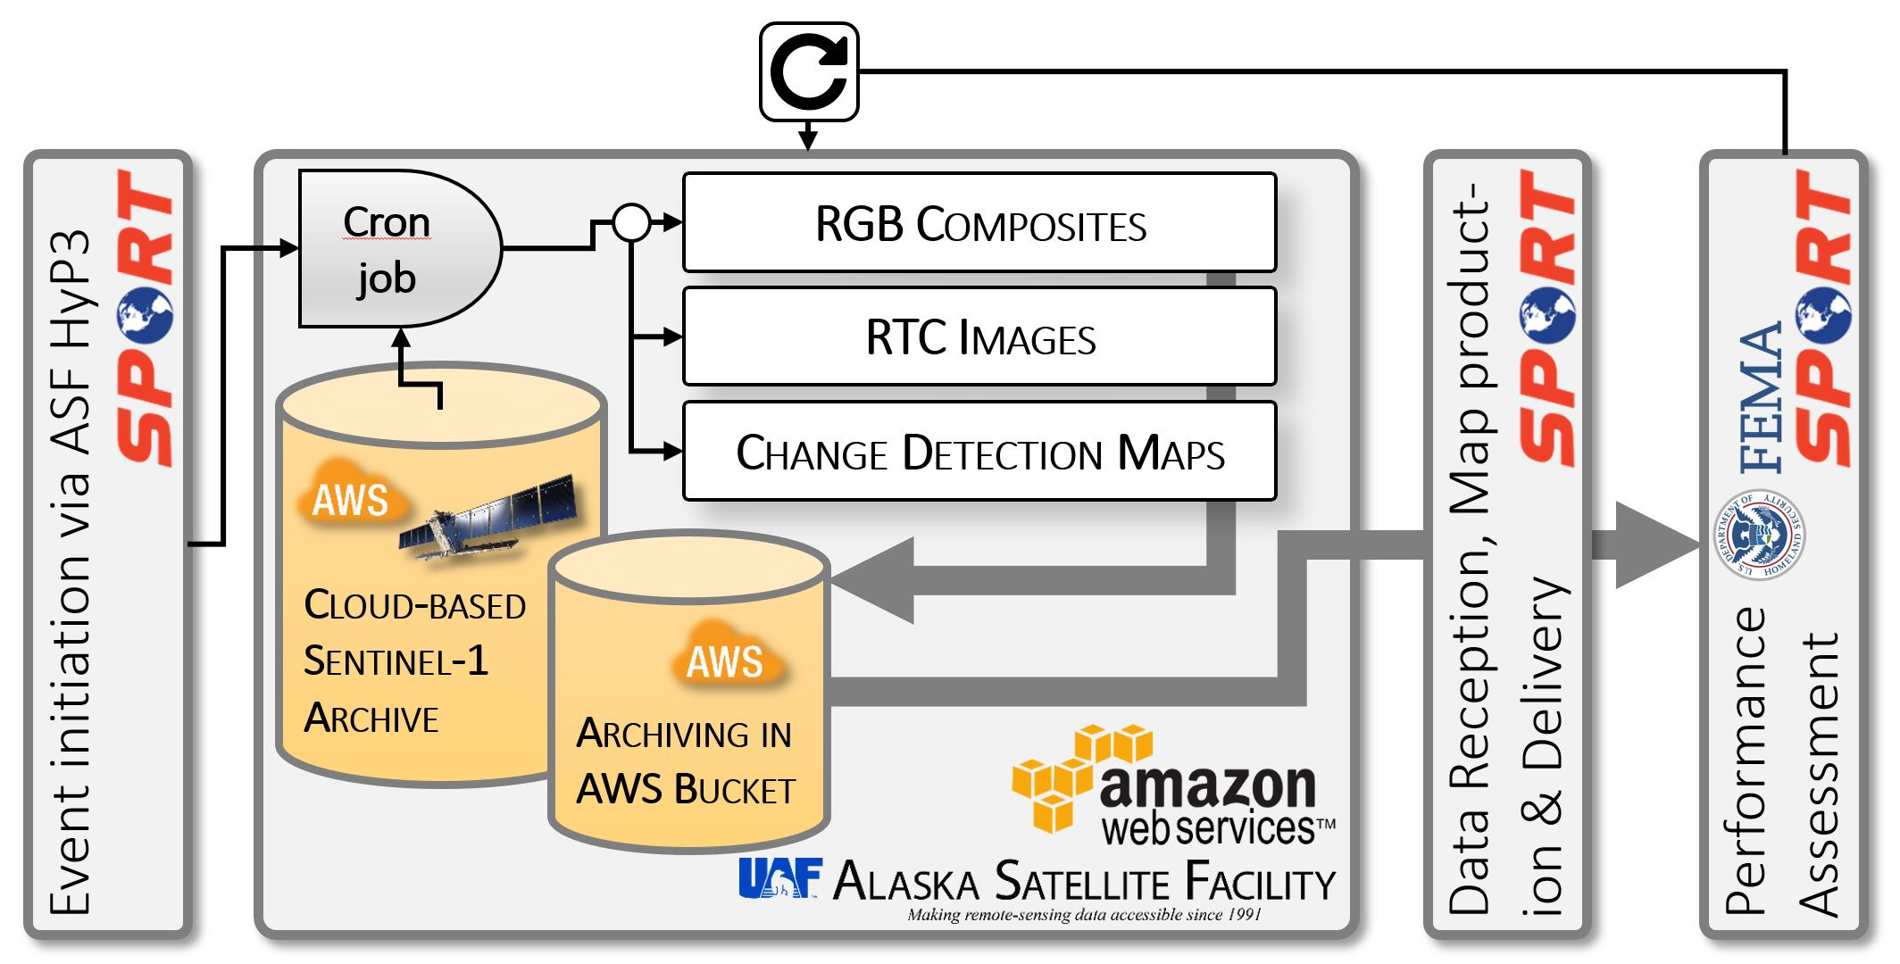
Recent UAF & ASF Outreach Activities
Science User Support: Disaster Response Support Using SAR
Since 2016: regular support of disaster response for several weather-related natural hazards in collaboration with NASA SPoRT and FEMA
For efficient and automated value-added product generation, utilizing ASF’s Sentinel-1 prototyping platform HyP3
Algorithms for SAR-based hazard mapping were developed in Meyer’s UAF team and then transitioned to ASF for integration into HyP3
Workflow for automatic creation of flood hazard products and delivery to stakeholders
(end-user: FEMA)

Slide 6

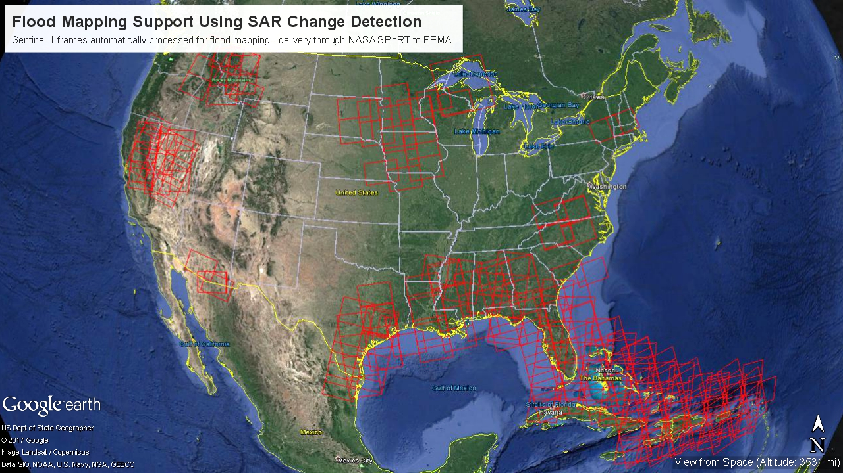
Recent UAF & ASF Outreach Activities
Science User Support: Response to Hurricanes Harvey, Irma, & Maria
Response to Harvey, Irma, & Maria
Fall 2017: Contributed to response to the Hurricane events Harvey (Texas), Irma and Maria (Caribbean and Florida)
  Processing of ~1,000 RTC, Change Detection, and RGB Products & Delivery to FEMA

Slide 7
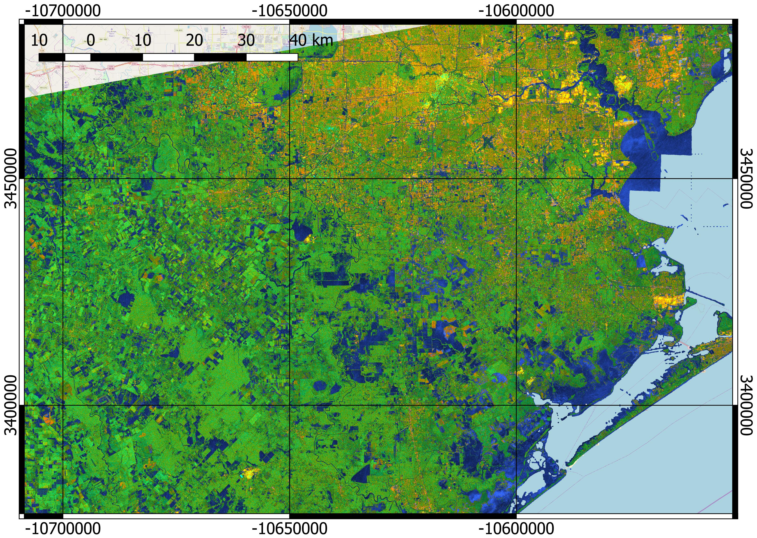
Recent ASF Outreach Activities
Science User Support: Response to Hurricanes Harvey, Irma, & Maria
Success Story: ASF SAR Data Products Integrated into FEMA
Example of colorized Sentinel-1-based Flood Map for Hurricane Harvey Response
Flooded areas are shown in blue
Example of ASF SAR Products integrated into FEMA’s Flood Delineation Maps
Flooded areas are shown in blue

Slide 8

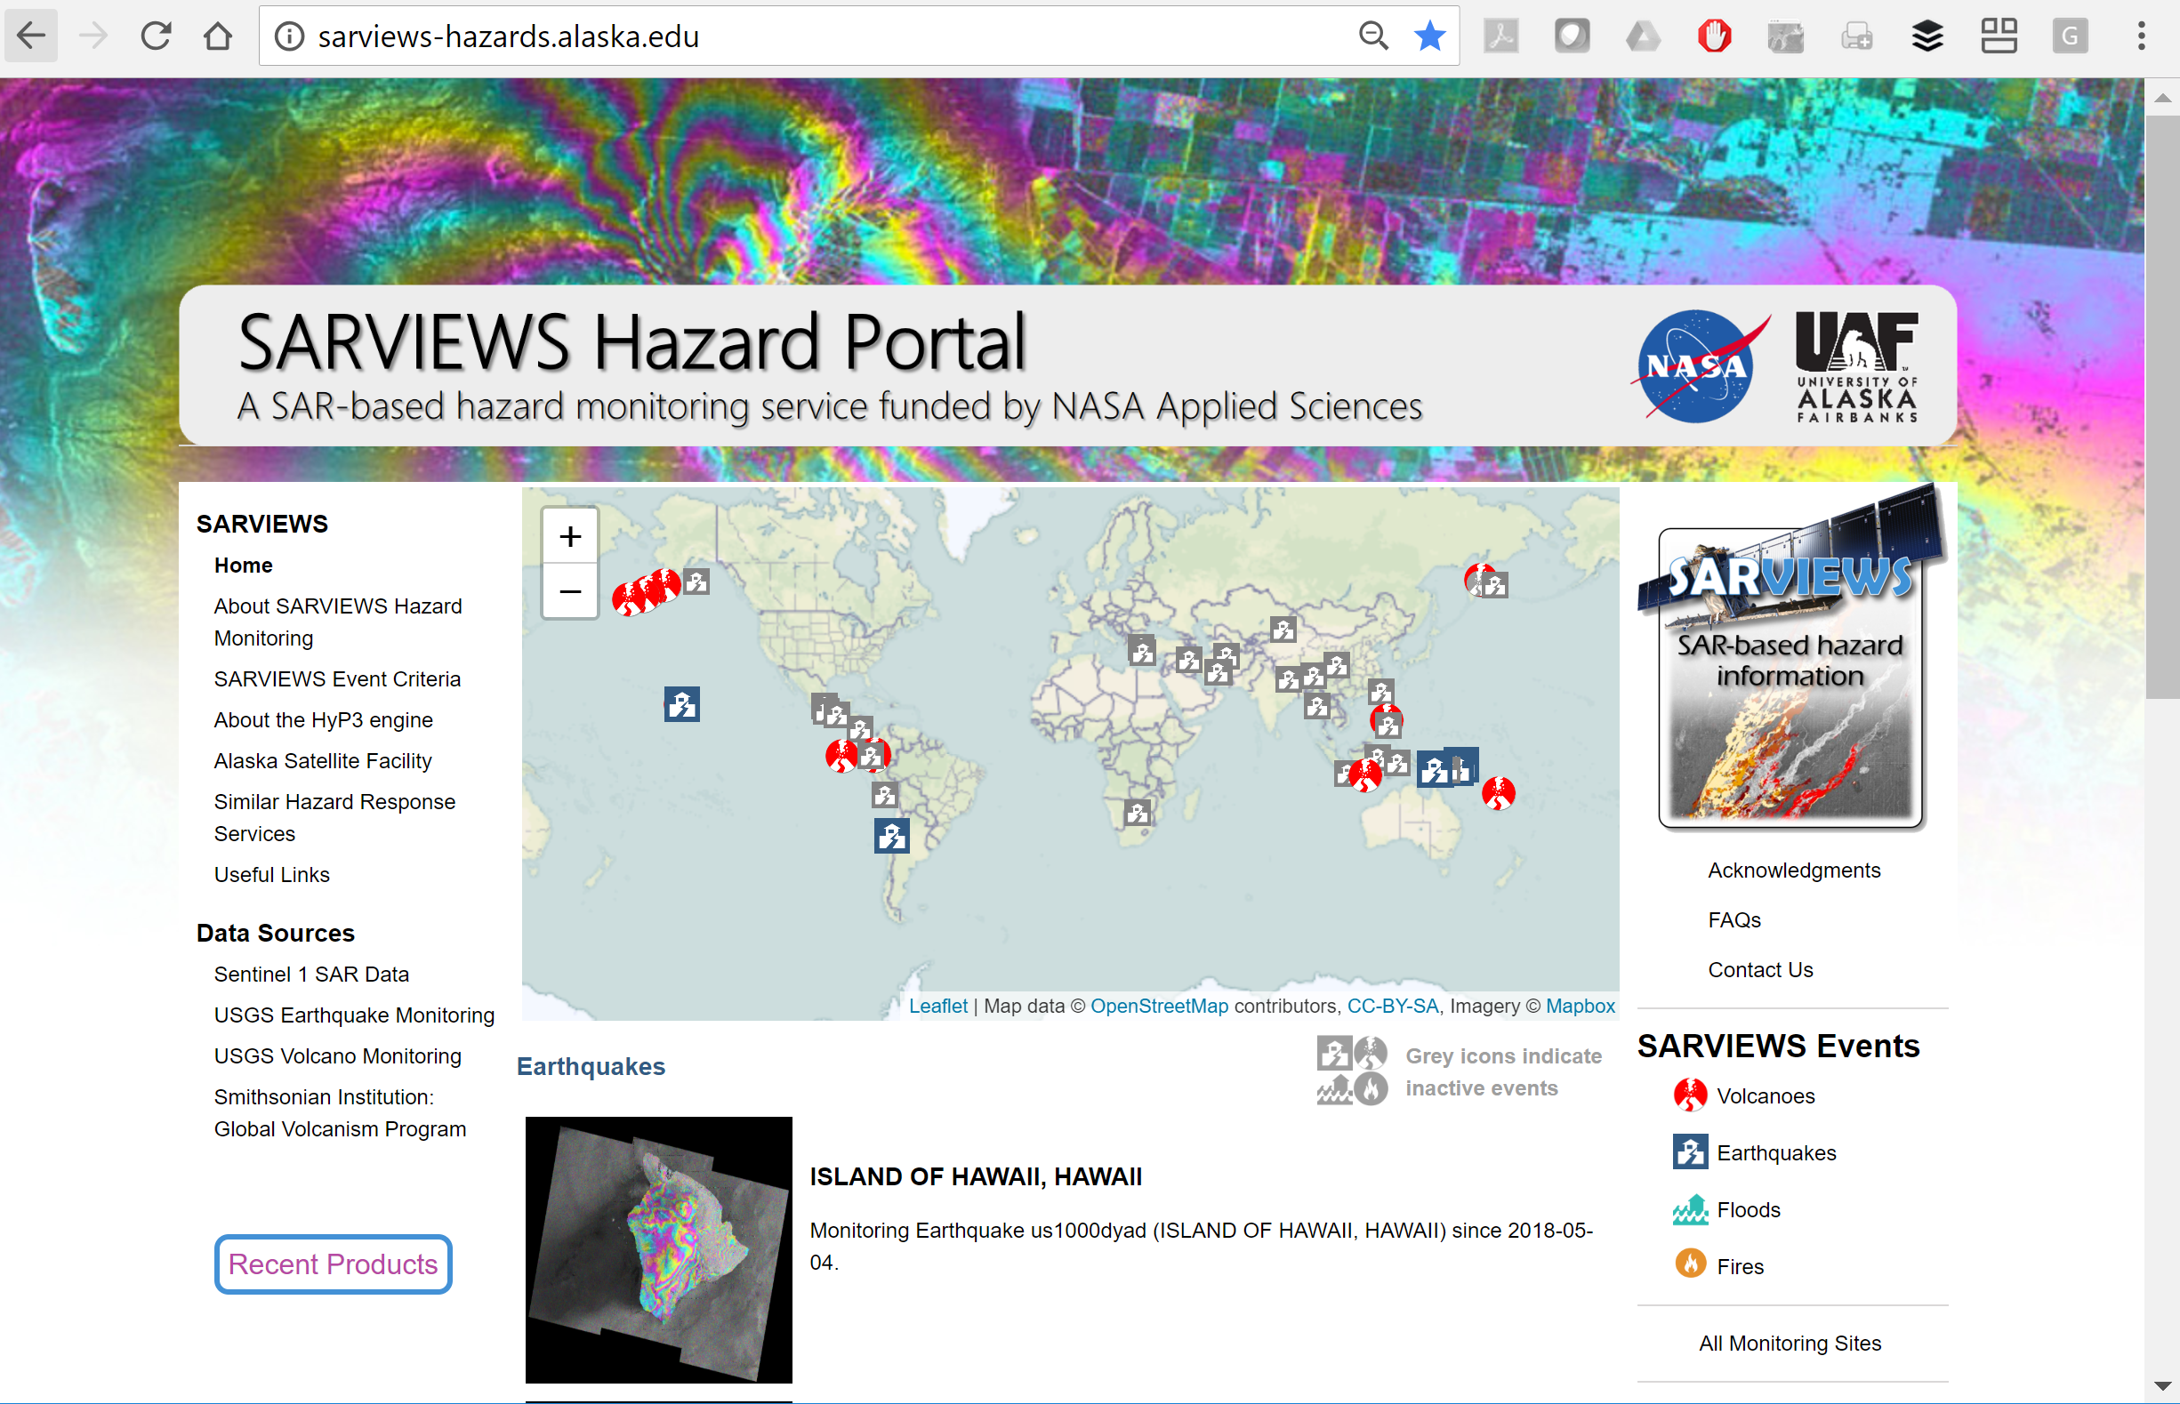
Recent ASF Outreach Activities
Science User Support: SARVIEWS
Funded by: Applied Sciences Program
SARVIEWS: Automatic production of value-added products (InSAR; RTC data) from SAR for Geophysical Events (earthquakes; volcanoes; flooding)
  Algorithms developed by UAF and transferred to ASF for use in Sentinel-1 prototyping pipeline HyP3 (Hybrid Pluggable Processing Pipeline)
  SARVIEWS uses HyP3 functionality (on premises) for production of hazard products
  Sharing of Data with sciences & applications users through SARVIEWS Hazard Portal
Visit Us @ http://sarviews-hazards.alaska.edu/

Slide 9

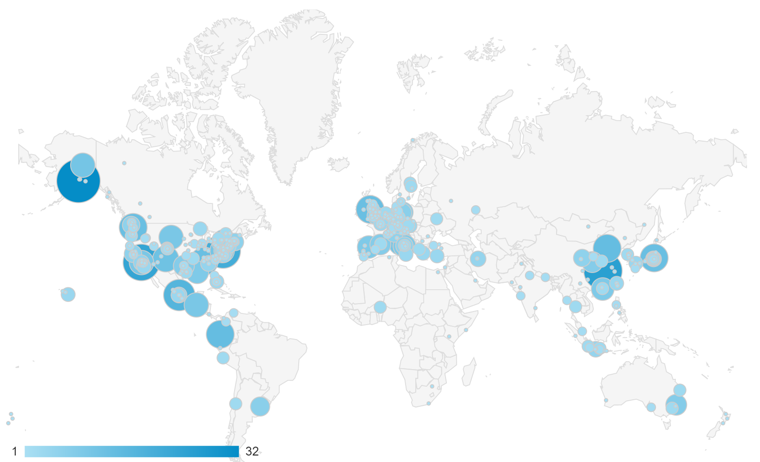
Recent ASF Outreach Activities
SARVIEWS Success Stories
Funded by: Applied Sciences Program
SARVIEWS Data Portal has robust traffic, indicating interest in value added products
Webpage Access Metrics:
  1,073 unique users (22/week) from 64 nations running 3,452 sessions (72/week)

Slide 10
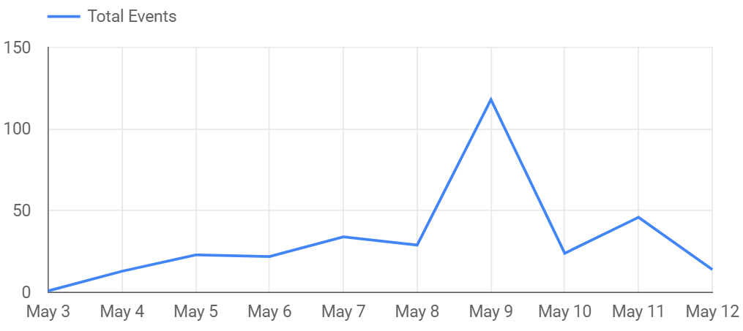
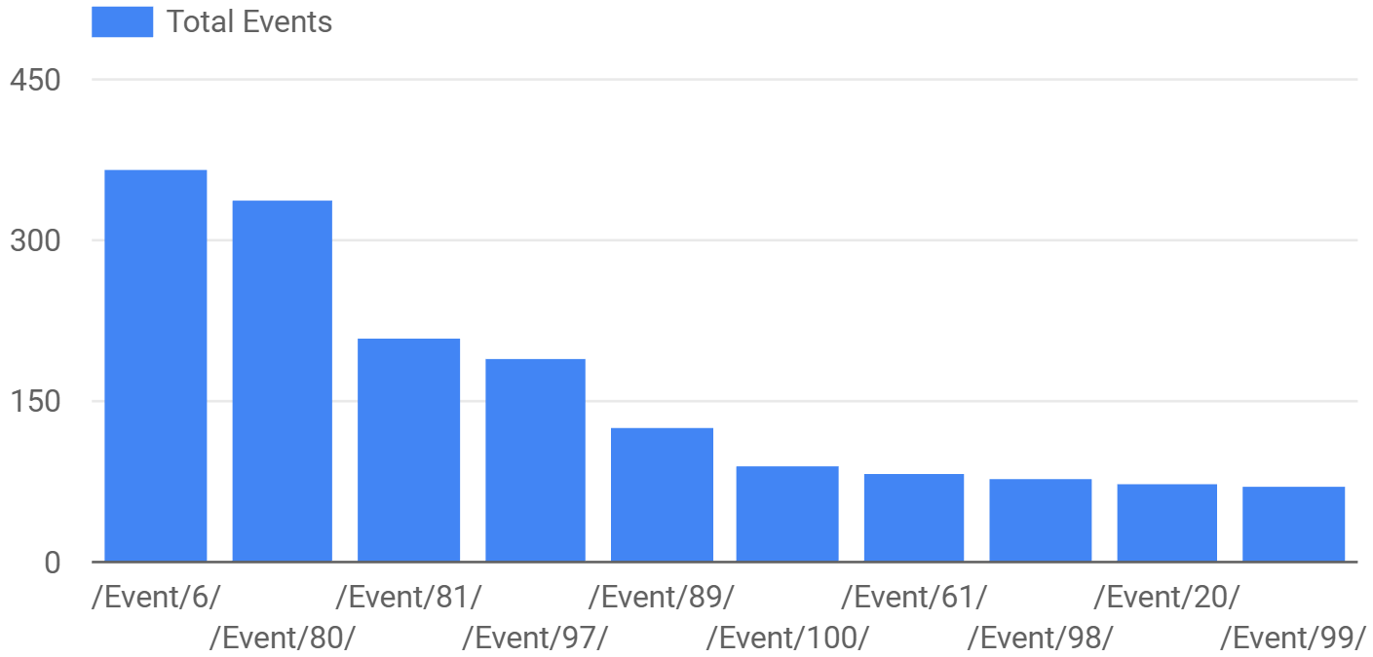
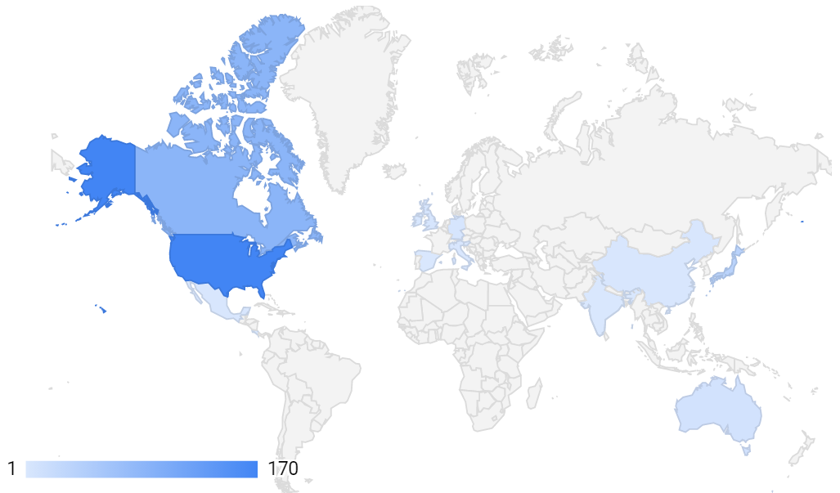
Recent ASF Outreach Activities
SARVIEWS Success Stories
Funded by: Applied Sciences Program
Event InSAR Data in High Demand by Geoscience Users of SAR
Data Download Metrics:
  Since March 2018, 2,214 InSAR and RTC products downloaded
  Per event, most downloads from country affected by event → data meet in-region hazard analysis needs
Example: Kilauea Events
Most Downloaded Event Data
Timeline of Data Downloads
Sep 19, 2017 – Puebla Earthquake, Mexico
Mar 2018 – Hawaii Earthquake and Kilauea eruption
Aug 2018 – North Slope Earthquakes
Location of User

Slide 11
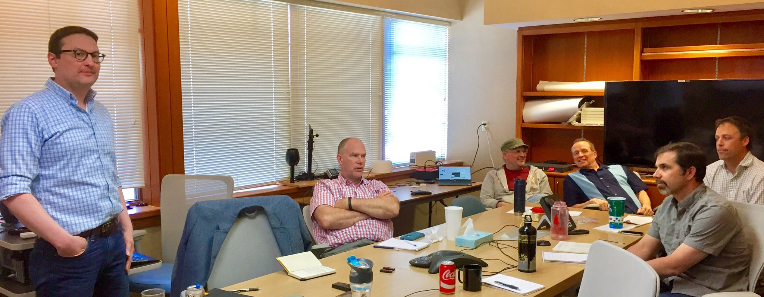
Summary of Training Activities

Slide 12
Recent ASF Training
FY 17 SAR Capacity Building Activities
Oct 12 – 13, 2016: SAR Training to NASA SPoRT and SERVIR, Huntsville, AL
  “Radar Remote Sensing and Its Applications in Land Monitoring”
Apr 19, 2017: Half-day Training to AK Pacific River Forecast Center
  Training on retrieving and geocoding of SAR data; use of SAR in flood mapping; generation of change detection products
Apr 26, 2017: Half-day Training to Alaska Fire Serivce
  Retrieving and geocoding of SAR data; change detection; fire mapping
Apr 27, 2017: Half-day Training to Alaska Department of Transportation
  Retrieving and geocoding of SAR data; change detection
Aug 23 – 25, 2017: SAR Training to NASA SPoRT, Huntsville, AL
  Continuation of previous training with focus on polarimetry (in particular dual-pol)
  Collaboration with Bruce Chapman, Paul Siqueira, NASA SPoRT, and NASA SERVIR

Slide 13

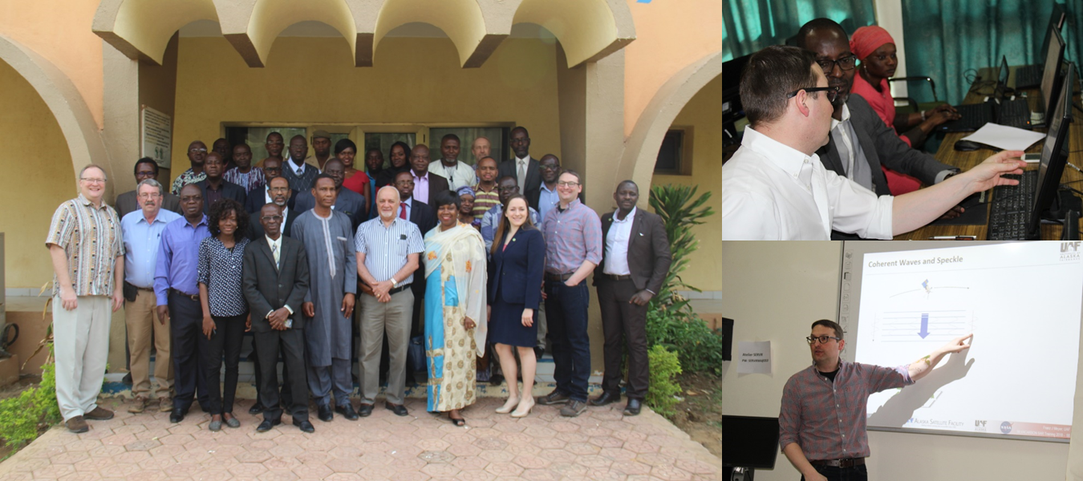
Recent ASF Training Activities
Recent FY18 In-Person Training Activities
Jan 29–Feb 4: Training to 35 attendees from 7 West-African Nations [Niger, Nigeria, Senegal, Burkina Faso, Benin, Ghana, Kenya] on SAR for Forest Monitoring
  Approx. 35 attendees from seven nations
  Technical Focus: SAR concepts and SAR for Forest and Agriculture Monitoring
  Sensor Focus: Sentinel-1 and NISAR

Slide 14
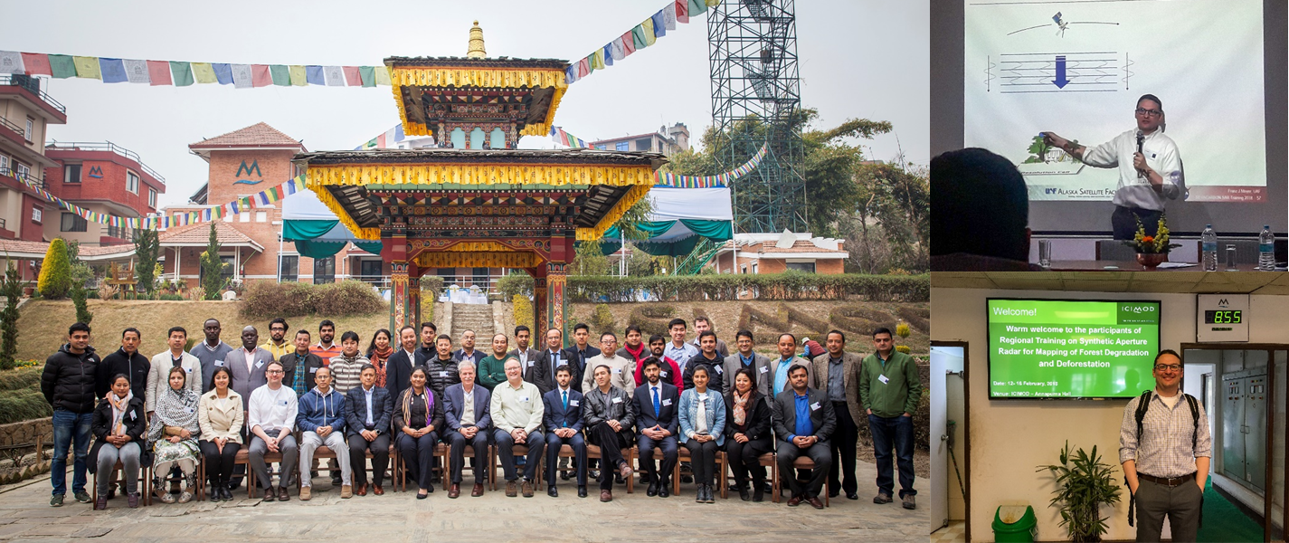
Recent ASF Training Activities
Recent FY18 In-Person Training Activities
Feb 12–16: Training to 40 attendees from 8 Nations [Afghanistan, Pakistan, India, Nepal, Myanmar, Bangladesh, Thailand, Bhutan] on SAR for Forest Monitoring
  Approx. 40 attendees from seven nations
  Technical Focus: SAR concepts and SAR for Forest and Agriculture Monitoring
  Sensor Focus: Sentinel-1 and NISAR

Slide 15
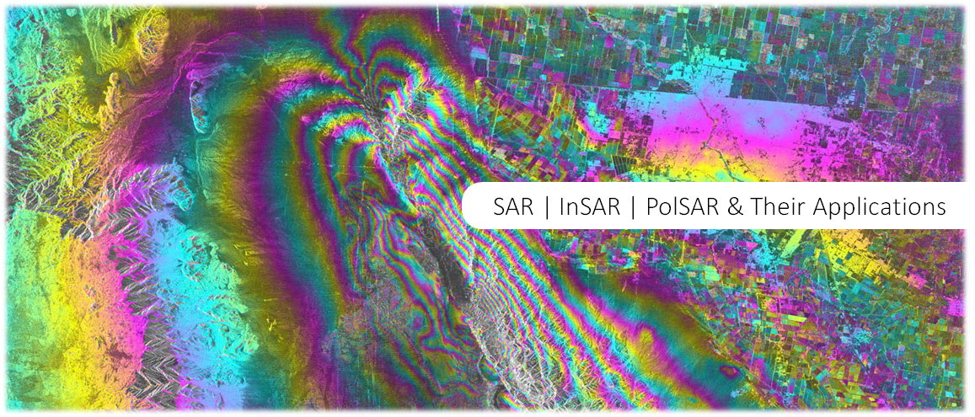
Recent Training Activities
Graduate-level Class on Microwave Remote Sensing Available Online
Moved UAF class GEOS657 “Microwave Remote Sensing” into an online environment enabling remote participation via Google Hangout
  For information about the class, please visit radar.community.uaf.edu
  Remote participation for individual classes possible via Google Hangout (more information here – please send me an email should you plan on attending a lecture)
  AWS-based Virtual SAR Lab AMI is used to enable remote participation in labs
  Feel free to peruse through the class syllabus and the other content of the class webpage and provide feedback / suggestions / comments to fjmeyer@alaska.edu

Slide 16
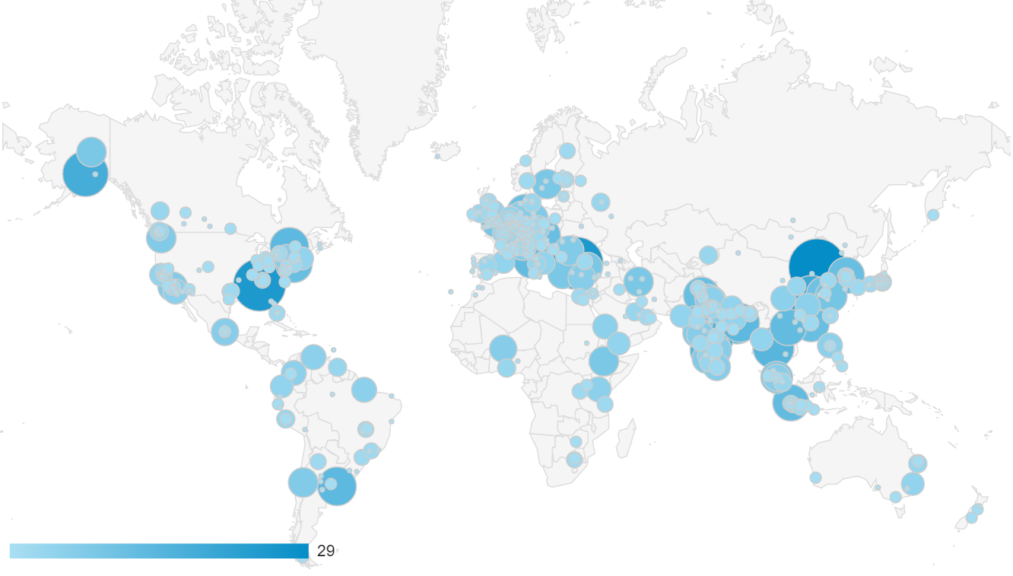
Recent Training Activities
Graduate-level Class on Microwave Remote Sensing – Users Statistics
Since August 2017:
  More than 1650 users (~38 unique users/week) and 3068 sessions (~70/week)
  Users from 102 countries (ranking: USA [20%], India [13%], China [6%], Germany [5%], Italy [3%], …)

Slide 17
“SAR Capacity Building Center” Proposal Funded
NASA ROSES Group on Earth Observations Work Programme Proposal “SAR-CBC: A Capacity Building Center for the Use of SAR in Decision Making” was selected for funding
  Goals:
    Developing SAR resources (material; SAR-CBC portal; webinars; on-site trainings) for decision-making community
    All material in English and Spanish
  Participating organizations:
    University of Alaska Fairbanks (Meyer; Arko; web design)
    Jet Propulsion Laboratory (Rosen; Owen)
    Marshall Space Flight Center SERVIR Project (Anderson; Flores; Cherrington)
  Start Date and Duration:
    March 2018; 3 years

Slide 18




Core SAR-CBC Team
University of Alaska Fairbanks & Alaska Satellite Facility
  UAF: Experience in SAR research, applications & training
  ASF: Access to global SAR archives & expertise in
  cloud solutions to SAR
Jet Propulsion Laboratory
  Years of experience in SAR theory, applications, & training
  Integration with upcoming NASA SAR Mission NISAR
  Access to expertise in a range of SAR-related applications fields
University of Alabama Huntsville / NASA SERVIR
  Years of experience in remote sensing capacity building
  Integration with end user community in the target region
  Expertise in providing training materials in English and Spanish
  Expertise in success and outcome metrics

Slide 19
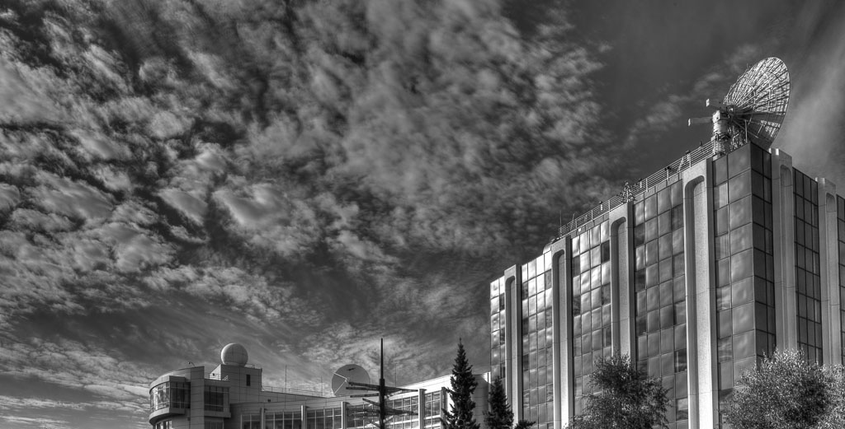
Questions?

