Slide 1
Working with
Planetary-Scale Data
Joe Flasher, Open Geospatial Data Lead

Slide 2
What is cloud computing?
The on-demand delivery of IT resources over public or private networks with zero up-front costs, no long-term contracts, and pay-as-you-go pricing.

Slide 3
Advantages of sharing data in the cloud
Once data is in the cloud, can be accessed from around the world regardless of local infrastructure
Allows access to any amount of compute or storage
Only pay for what you use, do not need to over purchase capacity at the start of a project
New services continually added to allow new applications
Costs go down as AWS achieves economies of scale

Slide 4


Why does AWS care about Open Data?
Sharing data on AWS makes it accessible to a large and growing community of researchers, entrepreneurs, and enterprises who use the AWS cloud.
Many of our public sector customers use AWS to make their data available to a global community of researchers, entrepreneurs, students, and fellow government agencies.
Many of our commercial sector customers rely on quality open data as much as they rely on our cloud infrastructure services.

Slide 5
What does data want?
Notes:
Obviously, data doesn’t *want* anything, but why is someone bothering to make the data open in the first place?

Slide 6
What does data want?
Data wants to be used.
Notes:
…I do think it’s safe to say that if someone is producing data, they expect the data to be useful in some way and they want the data to be used, they want the data to be put to work.

Slide 7
What does data want?
Data wants to be used.
Why is this important?
Notes:
So, let’s assume this is true. That data wants to be used. Why should we care what data wants? What are we getting at here? It’s a fundamental question that’s worth thinking about.

Slide 8
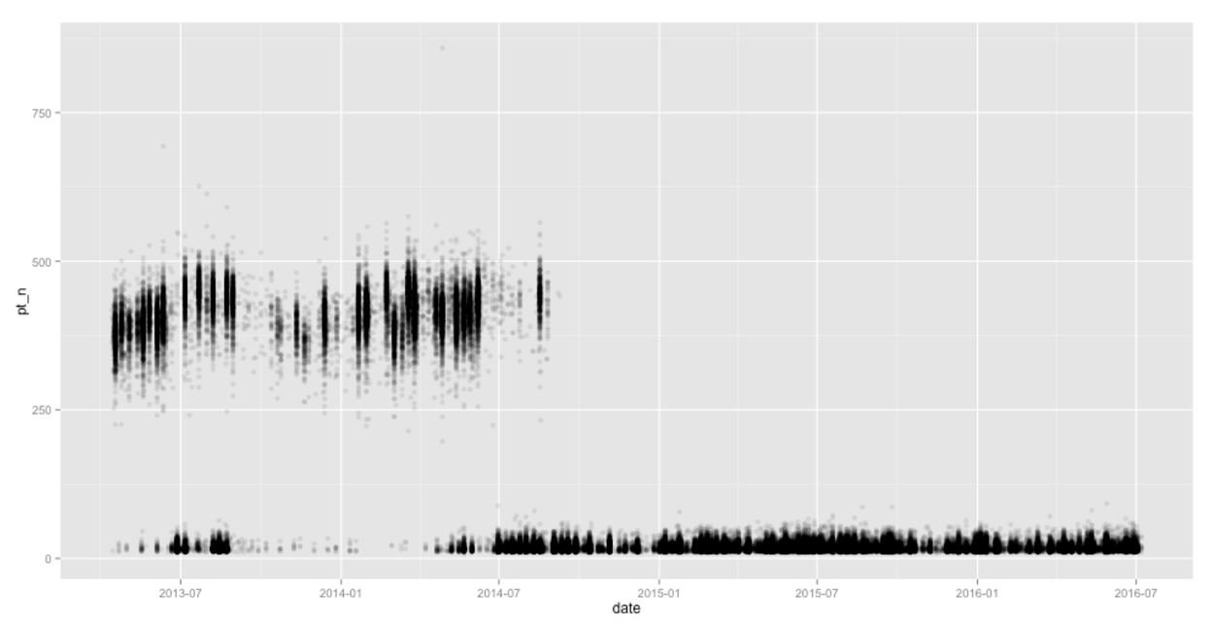
Landsat on AWS
Graph by Drew Bollinger (@drewbo19) at Development Seed
Notes:
If we’re going through the process of making data available, we should make it available in a way that is useful. Data is often made availale in formats good for archiving, not for processing.

Slide 9
What does data want?
Data wants to be used.
Why is this important?
Lower cost of knowledge.
Notes:
Access to good data and computing resources lowers the cost of human knowledge. This is why I work in computing, and particularly why I work for AWS. The cloud democratizes access to vast amounts of data and computing power. This enables humans to access and collaborate on massive scale datasets, no matter where they are in the world. The fact that you can make an API call and securely provision massive computing clusters, is still astonishing to me. The idea that this system that was largely set up to share documents is the same thing that allows

Slide 10
What does data want?
Data wants to be used.
Why is this important?
Lower cost of knowledge.
How?
Notes:
OK. So, I think we all agree that there’s value in this. How do we do it?

Slide 11
What does data want?
Data wants to be used.
Why is this important?
Lower cost of knowledge.
How? ¯\_(ツ)_/¯
Notes:
OK. So, I think we all agree that there’s value in this. How do we do it?

Slide 12
“No matter who you are, most of the smartest people work for someone else.”
— Bill Joy, co-founder of Sun Microsystems
Notes:
This is often called Joy’s Law. It sounds funny, but it’s almost certainly true, and if it’s true, you should figure out how to take advantage of this fact. You need to make data available to as many people as possible.

Slide 13
The AWS Open Data program makes more data more available to more people.
Notes:
This is our mission. We want to make sure all of the smartest people can get access to useful data, no matter where they are.

Slide 14

https://registry.opendata.aws

Slide 15
“…data must be organized, well-documented, consistently formatted, and error free. Cleaning the data is often the most taxing part of data science, and is frequently 80% of the work.”
— Data Driven by DJ Patil and Hilary Mason
Notes:
We largely focus on solving the data acquisition and cleanup process. We focus on STAGING DATA FOR ANALYSIS on the cloud.

Slide 16
Undifferentiated Heavy Lifting

Slide 17
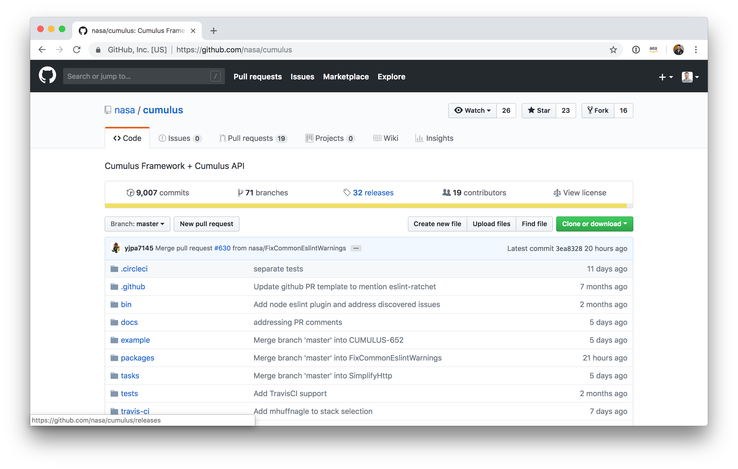
Cumulus + NISAR

Slide 18
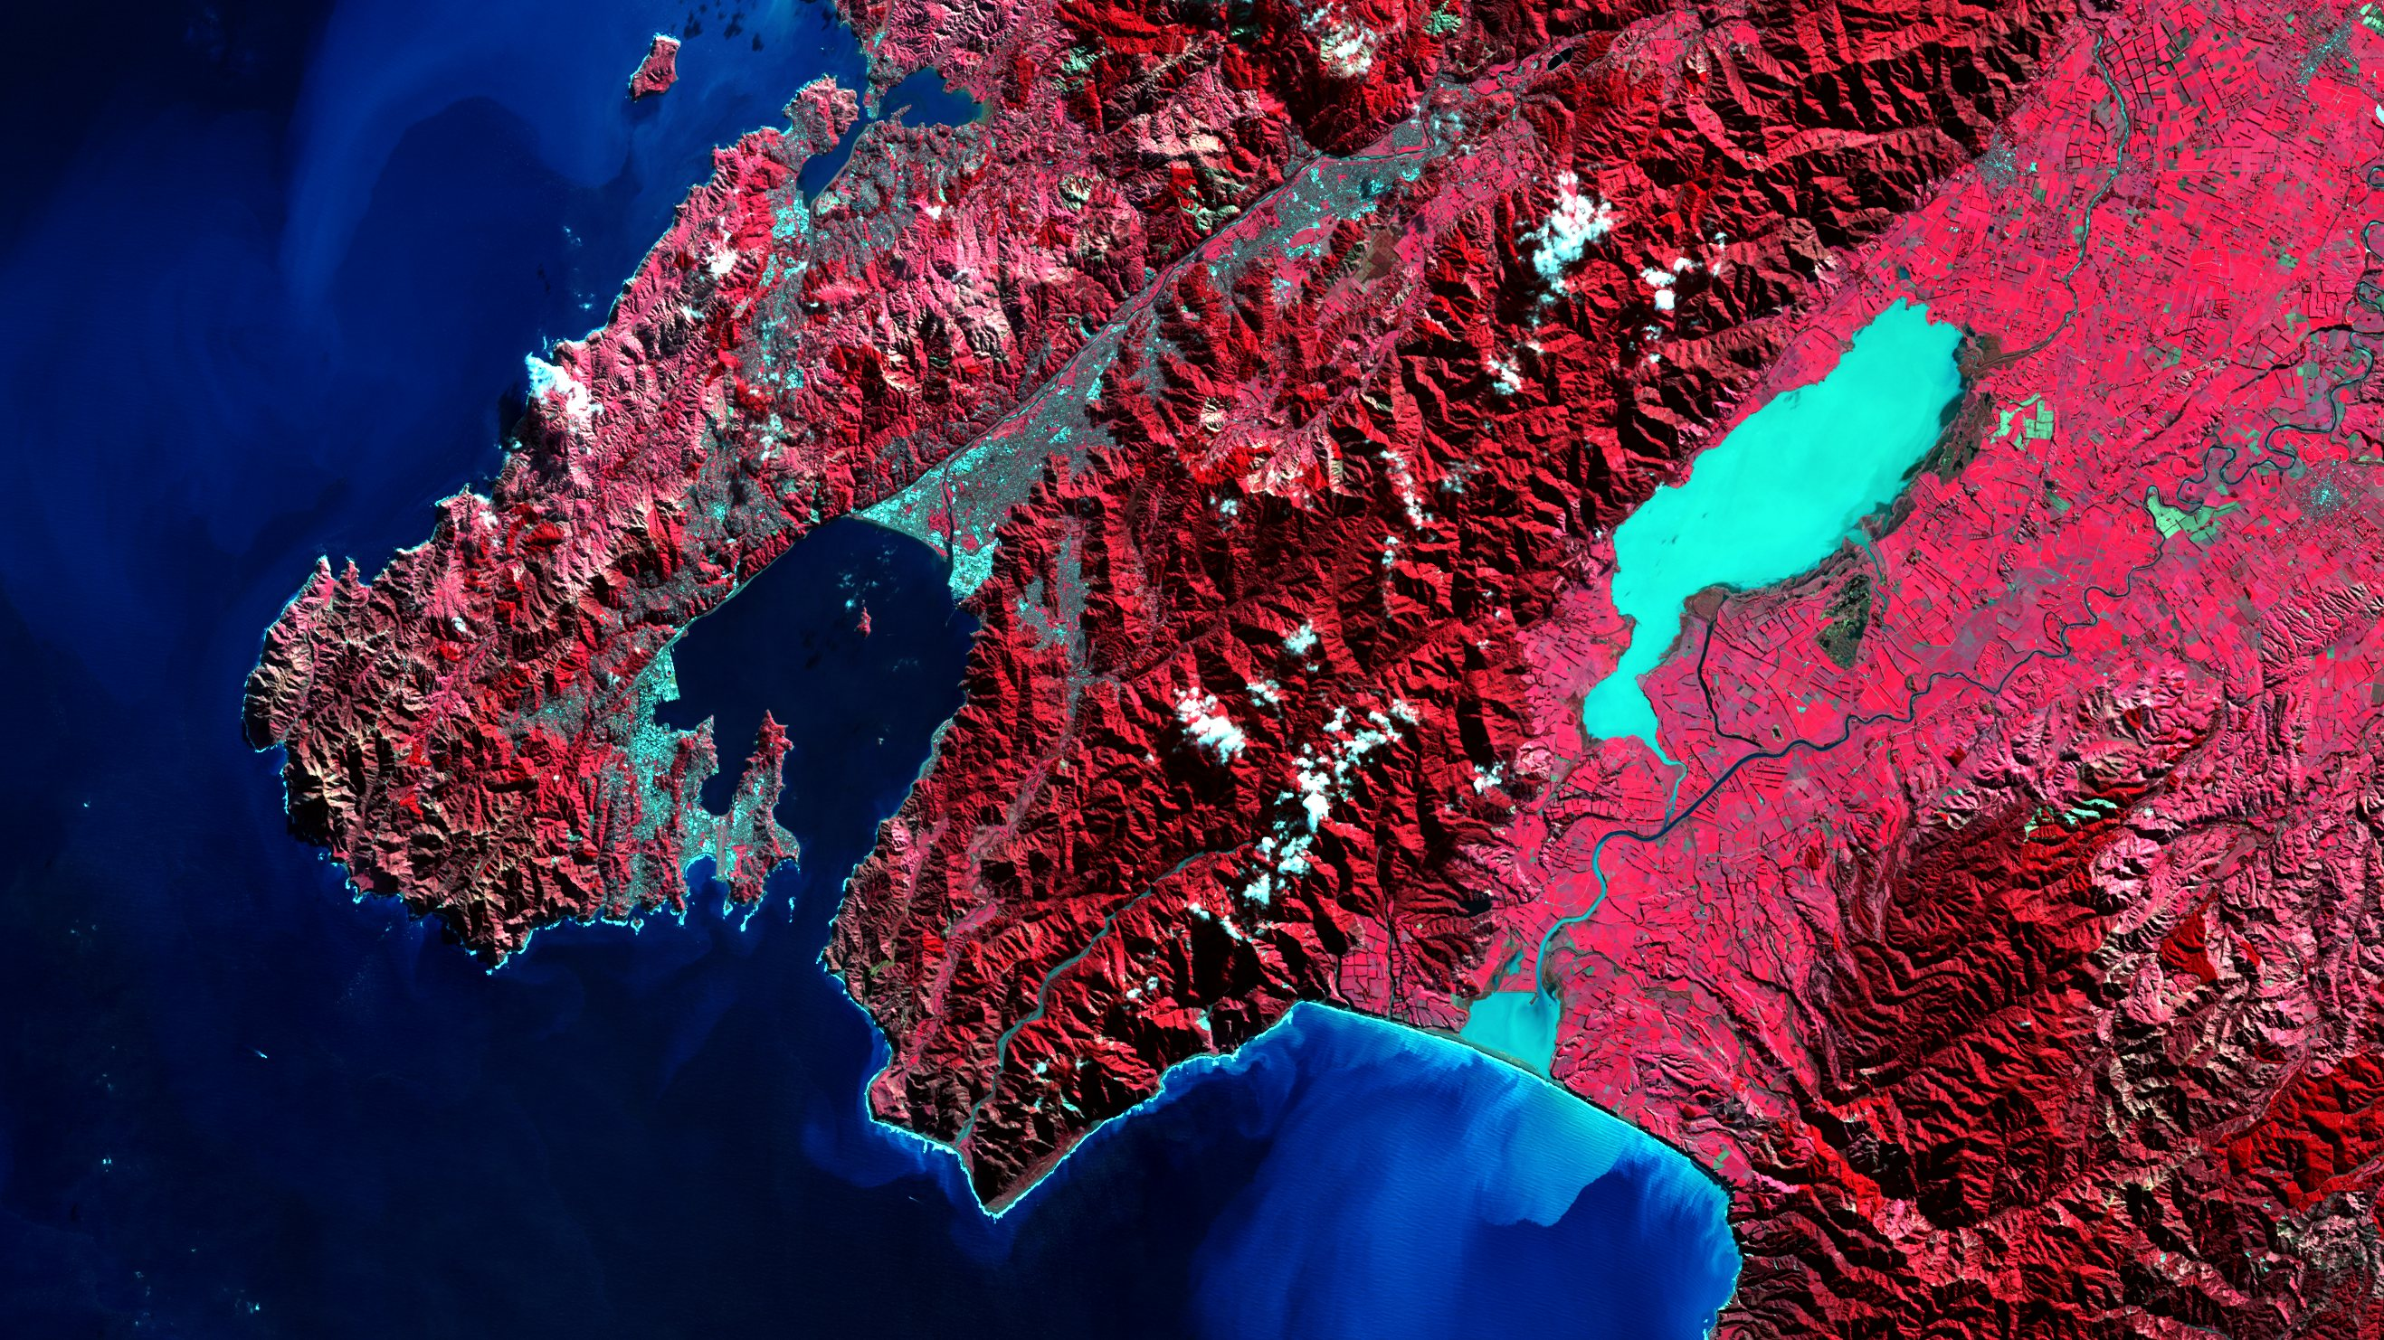
Earth on AWS
aws.amazon.com/earth
aws.amazon.com/earth/research-credits
aws.amazon.com/education/awseducate/
Notes:
We want anyone to be build their own planetary-scale applications.
In September, we launched Earth on AWS, which is a new landing page for large geospatial and environmental datasets.
These are just a few examples of the kind of data that are available today, and we’re continually looking to bring on more.
This data is available for you to do whatever you want with. You own your applications. You own your IP. Go forth.
Having this data in the cloud allows people to close the gap between data and action. People can ask questions that they simply wouldn’t ask before.

Slide 19

Landsat on AWS

Slide 20




Staging data for analysis
USGS
.tar
Amazon
EC2
Scenes are unarchived and bands made available individually.
GDAL is used to add “internal tiling” on each GeoTIFF, which allows developers to use HTTP range gets to access specific portions of each band.
This allows people to only access the data they need when they need it.
.tiff

Slide 21
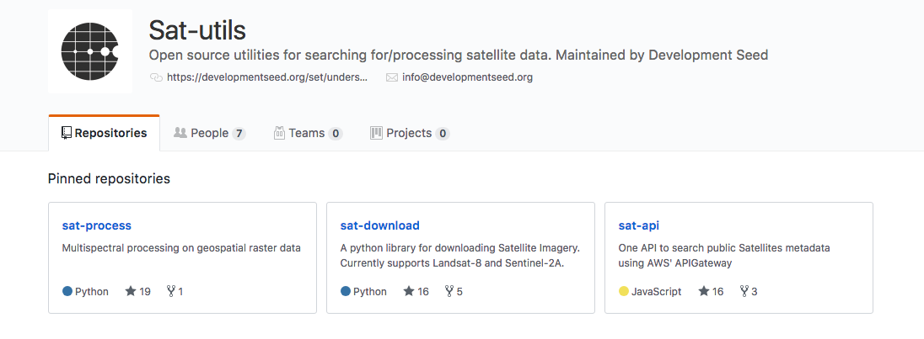
sat-utils
Open source utilities for searching and processing multiple satellite sources, maintained by Development Seed.
https://github.com/sat-utils

Slide 22
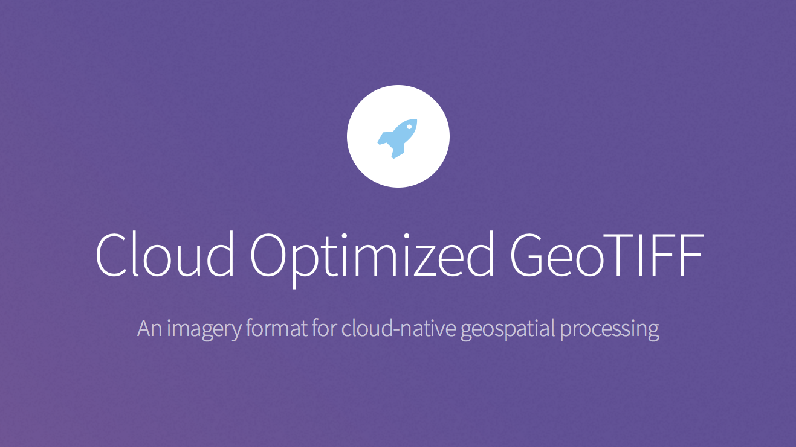
cogeo.org

Slide 23
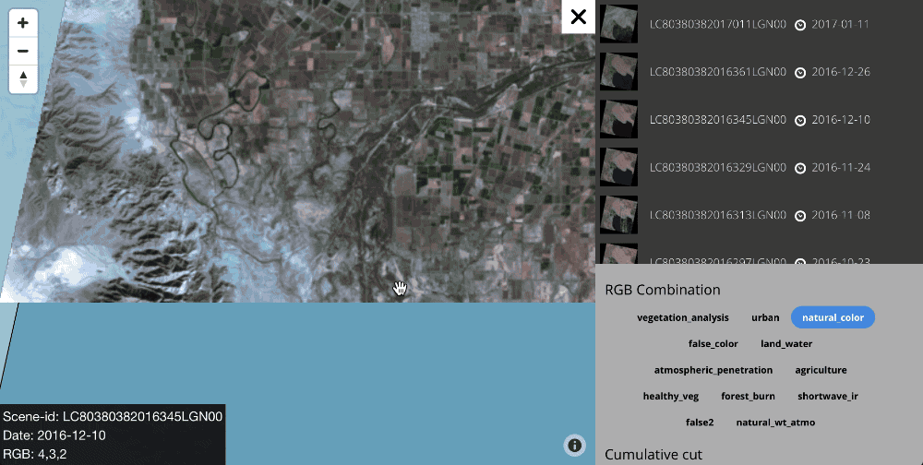
landsat-tiler from Mapbox
https://github.com/mapbox/landsat-tiler
Notes:
Uses GDAL enabled Lambda functions on AWS running on top of Landsat on AWS Public Dataset to dynamically generate tiles
Access to petabytes of data without running a server
Only made possible because data is made availalbe as indiviudal bands in a cloud-optimized GeoTIFF format

Slide 24
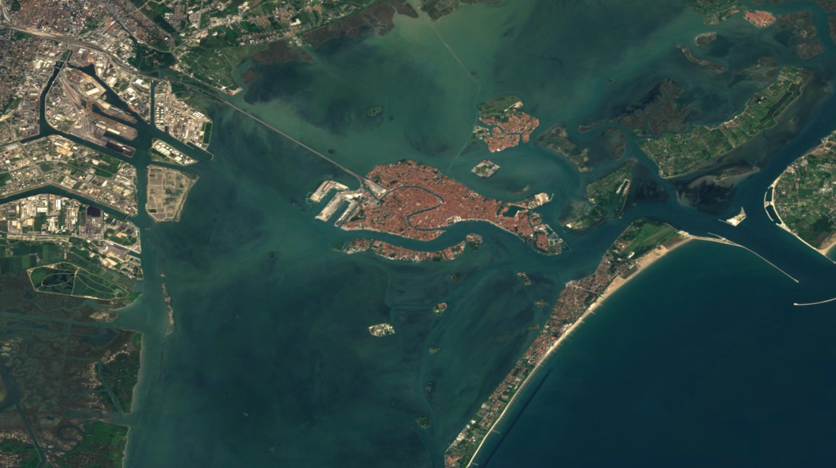
Sentinel 1 & 2 on AWS
Notes:
- We have provided a grant to a Slovenian company called Sinergise to explore ways to share Sentinel-2 data via Amazon S3.
- It is being used by Zooniverse to support crowdsourcing efforts for earthquake disaster relief in Ecuador, Building Radar to provide a global view of construction to customers, EOX to create a cloudless atlas over Europe and many others.
- Image is of Venice from EOX, an Austrian company, usingSentinel on AWS and catalog services from Sinergise to combine over 8 trillion pixels and create a cloudless atlas over Europe. Tiles are publicly available in S3 at s3://eox-s2maps.
The data gets accessed at a tremendous rate. Last year, we logged roughly 14 billion hits on the data and served 4.7PB of data to over 1,000 AWS users.

Slide 25
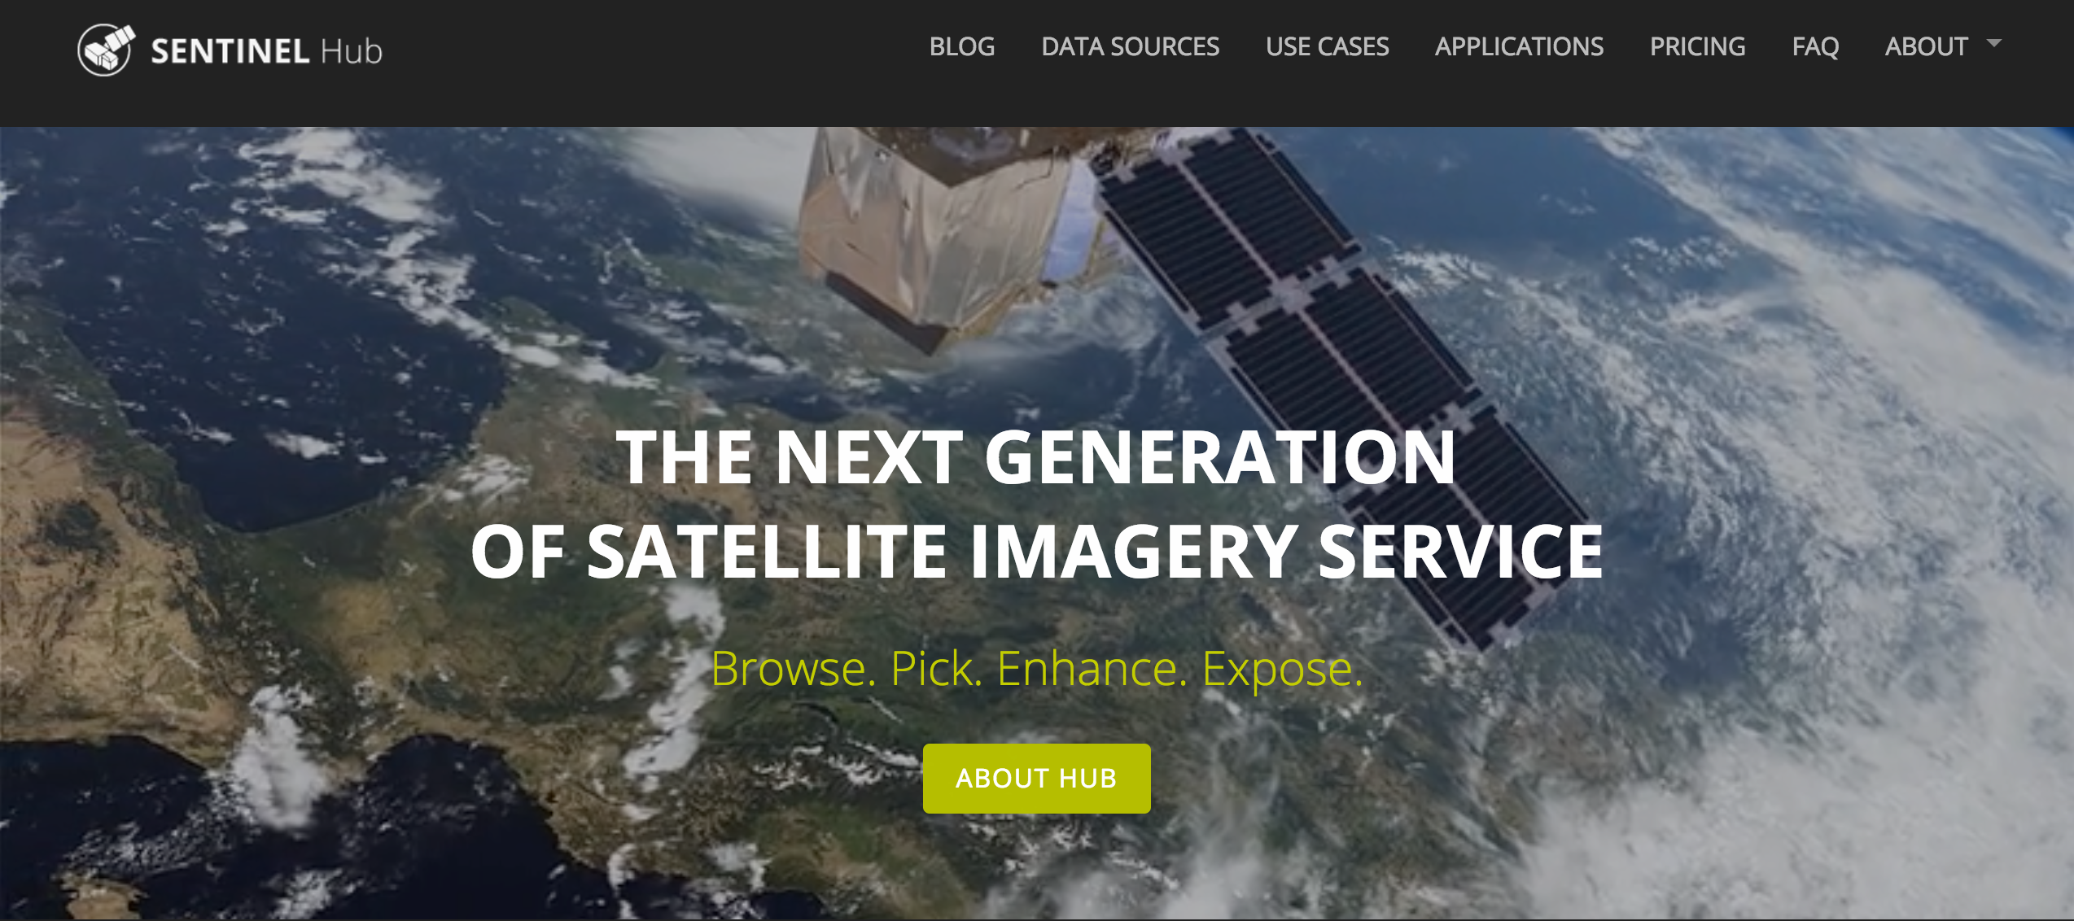
Sentinel Hub
http://www.sentinel-hub.com/

Slide 26
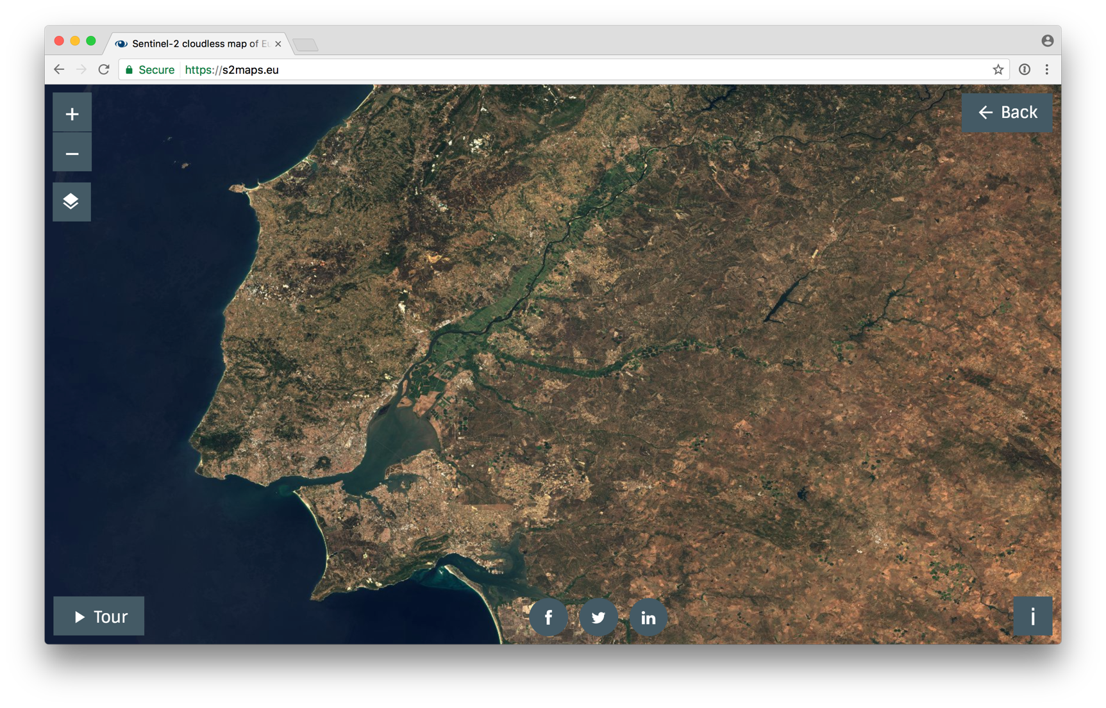
EOX
EOX, an Austrian company, used Sentinel on AWS and catalog services from Sinergise to combine over 80 trillion pixels and create a global cloudless atlas. Tiles are publicly available in S3 at:
s3://eox-s2maps
https://s2maps.eu/
Notes:
Almost 300 Terabyte of Sentinel-2 data were crunched fully automated pixel by pixel using EOX homebrewn software combined by Joachim Ungar and Stephan Meißl with further Open Source tools. Supported by the processing power of Amazon Web Services and catalog services by Sinergise, our small team was able to craft this wide-area cloudless map of Europe in a fast and inexpensive manner.
The GeoTIFFs used to provide this service are also opened up. EOX has made them available in their own S3 bucket. It is a requester pays bucket, which means that they can share the data without incurring any data transfer costs.

Slide 27
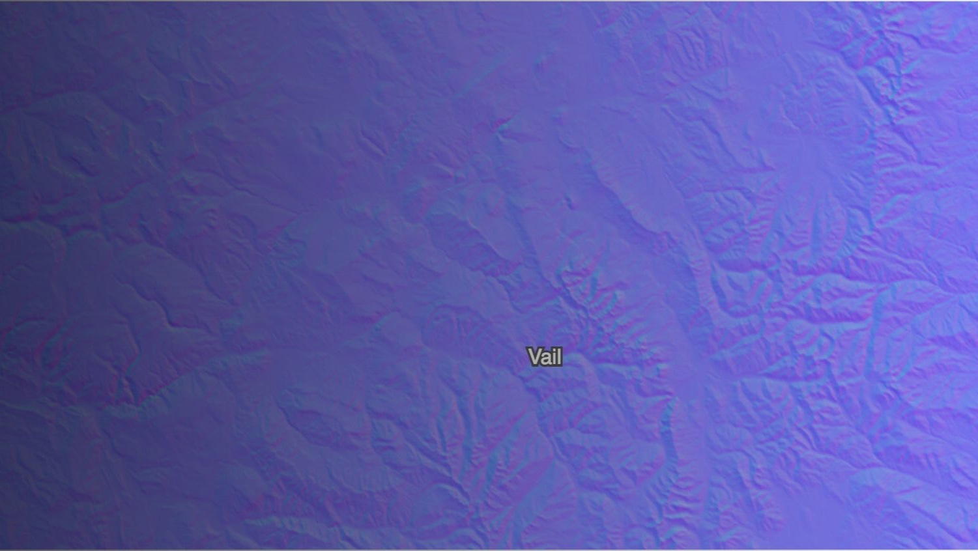
Terrain Tiles
Notes:
This is a global dataset providing basemap elevation coverage, tiled for easy usage. Tiles are available in multiple output formats, optimized for different use cases. Data is aggregated from several open data providers including 3 meter and 10 meter 3D Elevation Program (3DEP) in the United States, 30 meter Shuttle Radar Topography Mission (SRTM) globally, and coarser Global Multi-resolution Terrain Elevation Data (GMTED) and ETOPO1. Data updates are provided by Mapzen.

Slide 28
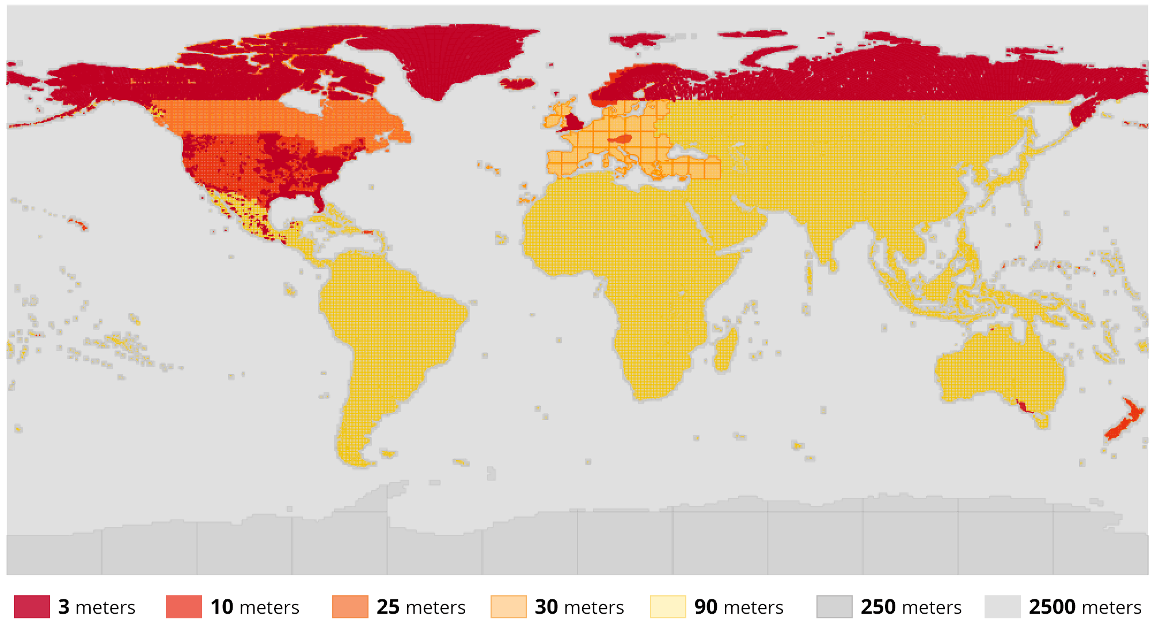
Tilezen open source terrain tiles
Mapzen recently released version 2 of their terrain tiles dataset
Large scale usage of AWS Batch and AWS Lambda
~3 billion tiles generated, 3.75 million per minute
Total rendering of the world took less than 1 week, ~10x time improvement
AWS Lambda was used as a dynamic testing mechanism before rendering
https://aws.amazon.com/public-datasets/terrain/
Notes:
- This is a global dataset providing basemap elevation coverage, tiled for easy usage. Tiles are available in multiple output formats, optimized for different use cases.
- Focus on usage of AWS Batch

Slide 29
What have we learned?
Notes:
Wrapping it up, what have we learned working with a number of customers and large datasets?

Slide 30
What have we learned?
Time is precious.
Notes:
You can’t get your time back, if you don’t need to waste your time waiting on something to finish running/downloading, why would you?

Slide 31
What have we learned?
Time is precious.
Copying data is bad.

Slide 32
Copying data is bad because it:
obscures provenance
creates latency (time is precious!)
duplicates storage

Slide 33
What have we learned?
Time is precious.
Copying data is bad.
Building software is hard.

Slide 34

Notes:
This curve makes sense not only for data products but for data access mechanisms themselves

Slide 35
What have we learned?
Time is precious.
Copying data is bad.
Building software is hard.
Nothing is free.
Notes:
Policies need to be mindful of the fact that these things carry real costs that *someone* needs to pay. The nice thing about competition in the cloud industry is that there’s a lot of pressure to lower infrastructure costs.

Slide 36
Links that were shared
https://aws.amazon.com/opendata/public-datasets/
https://aws.amazon.com/education/awseducate/
https://registry.opendata.aws/sentinel-1/
https://apps.sentinel-hub.com/eo-browser/
http://pangeo.io/
https://aws.amazon.com/blogs/publicsector/brain-workshop-meets-cloud/
http://www.data4sdgs.org/initiatives/africa-regional-data-cube
https://docs.rastervision.io/en/0.8/
https://www.opendronemap.org/
https://openaerialmap.org/
Notes:
Policies need to be mindful of the fact that these things carry real costs that *someone* needs to pay. The nice thing about competition in the cloud industry is that there’s a lot of pressure to lower infrastructure costs.

Slide 37

Thank you!
Joe Flasher, Open Geospatial Data Lead
jflasher@amazon.com

