Slide 1
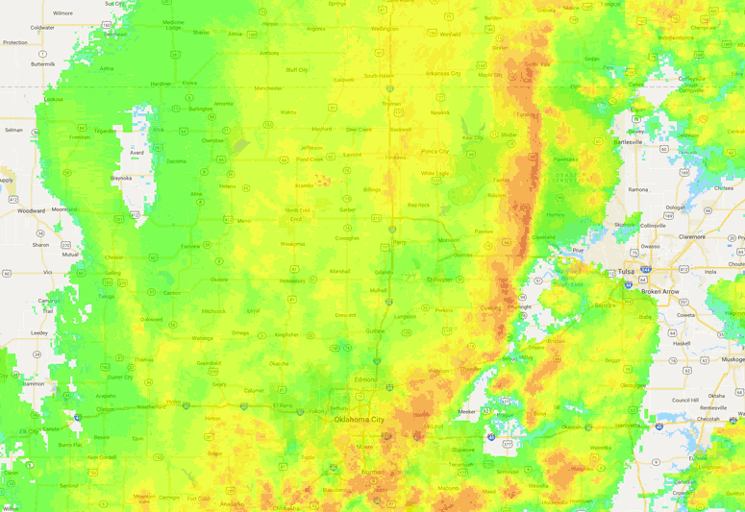
Google Earth Engine for training/research
Ground-based radar + Sentinel backscatter, Oklahoma
Outline:
Course for nonmajors (mostly undergraduate)
What are they looking for? How GEE helps
Graduate training
Data discovery (within SAR and beyond)
~300 km

Slide 2
Learning outcomes
By the end of this talk, you will be able to:
Describe the range of backgrounds of the students in my remote sensing class for nonmajors
Understand some of the strengths and weaknesses of Google Earth Engine when used in teaching
Assess whether my graduate students should really be spending their time in GEE
Form an opinion about my ability to write learning outcomes

Slide 3
“Observing the Earth – Remote sensing and GIS”
Currently in third year, first year using GEE
Constituents:
Mostly non-majors
Between 20 and 50 students
20% with strong programming skills
20% very intimidated by programming/computers
Spectrum in between
Notes:
Point out that majors looking for exposure to less specialized, current research on a broad range of issues

Slide 4
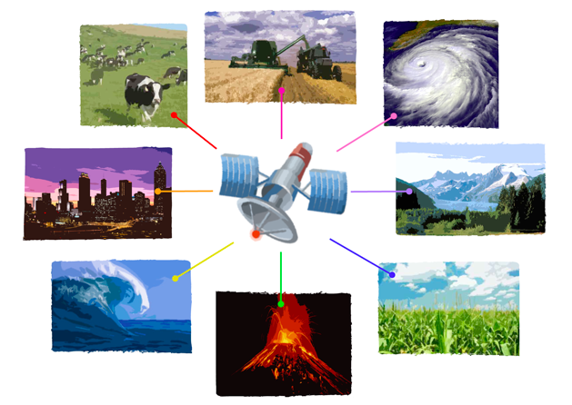
What we cover
Data types
raster vs. vector, image formats
Key concepts in geodesy, projections
Electromagnetic spectrum
Imaging basics
Orbit, antenna resolution equations
History of space observation
Where are satellites, how much $, risks
Science applications from surface to ionosphere

Slide 5
Course surveys – interests?
Buzzwords – GIS - remote sensing - cloud
CV-building
Drones? Can we do drones too?
Tools – crops/soils, regional and urban planning
Generally interested in “real” GIS tools
Very interested in use of drones
Genuine concern/interest about the Earth
Climate change, anthropogenic signals, hazards

Slide 6
MY goals
Get the students to look at and manipulate real data
Contend with math and computer phobia
Algorithms, doing something once, then doing many times
Highlight tools that they can potentially use in the future
Develop appreciation (and support) for free and open data (and tools)

Slide 7
Development over time
First years
Introduced students to Matlab and Google Earth
Strengths
Can do nearly any type of analysis
Slope maps/NDVI/pixel-tracking on glaciers
Many NASA data products kml/kmz
Weaknesses
Installation
Downloading data (particularly for students on library desktops)
Some students bored silly, others completely lost

Slide 8
This year – Google Earth Engine
Benefits
NONE of the students have used it (even playing field)
Links to scripts (for help from instructor)
Data is right there – no downloading
Lots of time series tools
Students love that they can just zoom around and repeat analyses all over the world
Weaknesses
Language is still awkward for new users
Challenging to debug
Profiles? Why is it so hard to make a profile????
Not easy to make a nice figure of what is on the screen

Slide 9
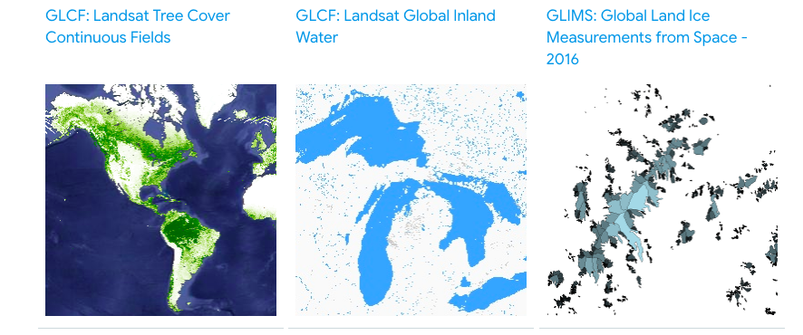
Available datasets
So many-
Sentinel 1-3, DEMs, Landsat, MODIS, population grids
Homework – 20 students given free rein, worked with 16 different data types

Slide 10
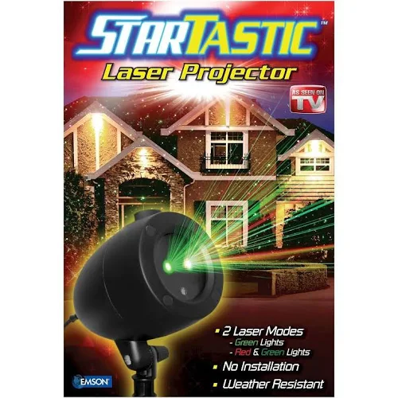
Visualization
Non-majors (and majors) are challenged by thinking beyond rgb
GEE allows for quick cycling through of colormaps, band ratios, etc.
Lawn laser example

Slide 11
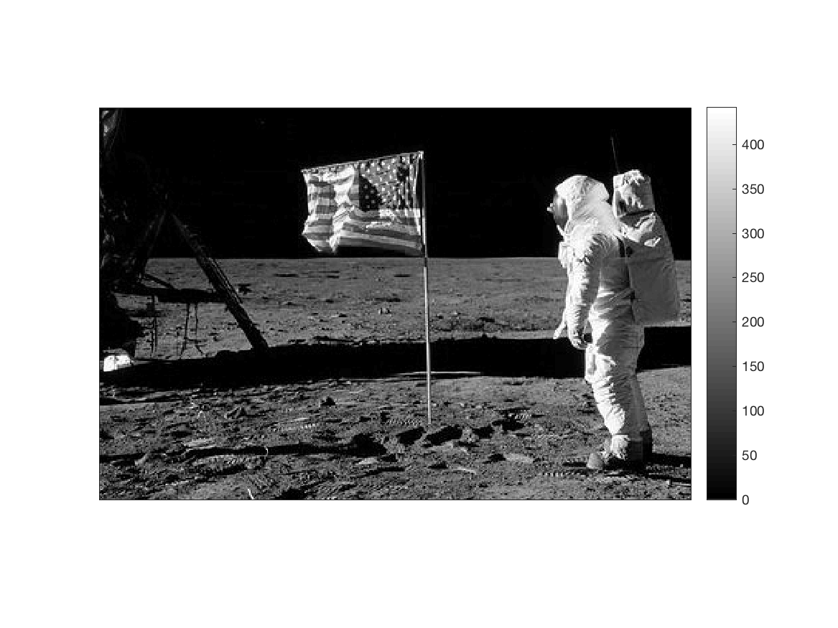
Amplitude of all band: Square root(red²+blue²+green²)

Slide 12
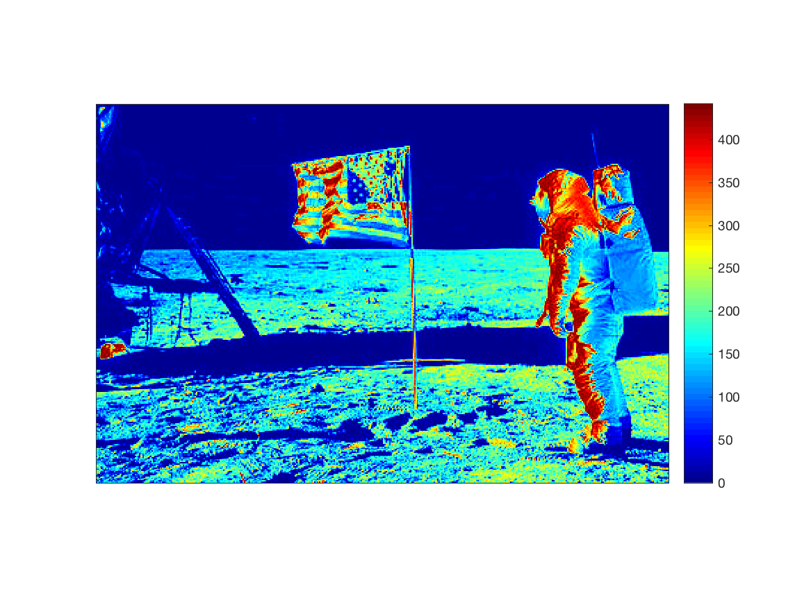
Brightness -> just a number (0-1, 0-255, 0-N)
Color = interpretation

Slide 13
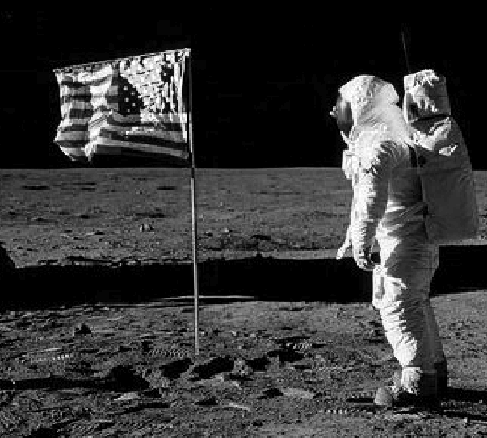
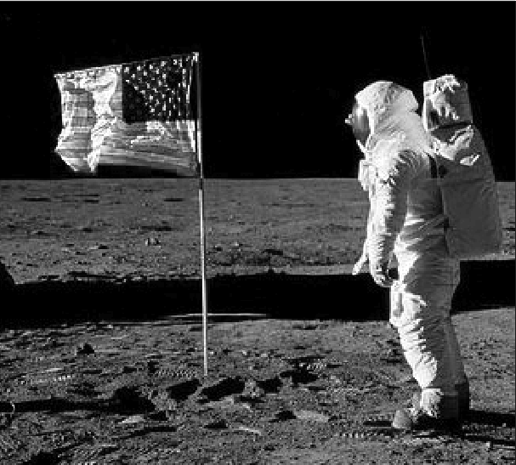
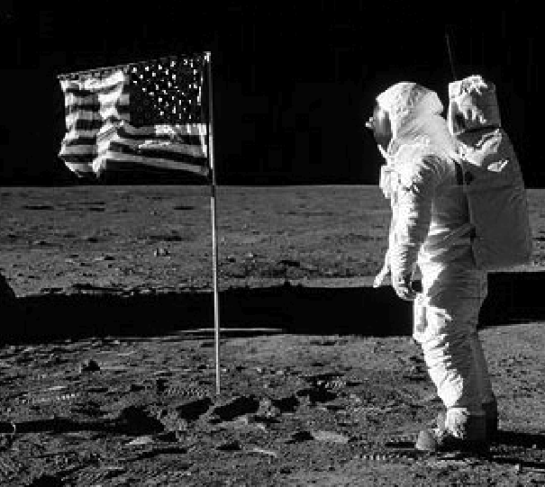
Classroom exercise – which is which?
blue
red
green

Slide 14
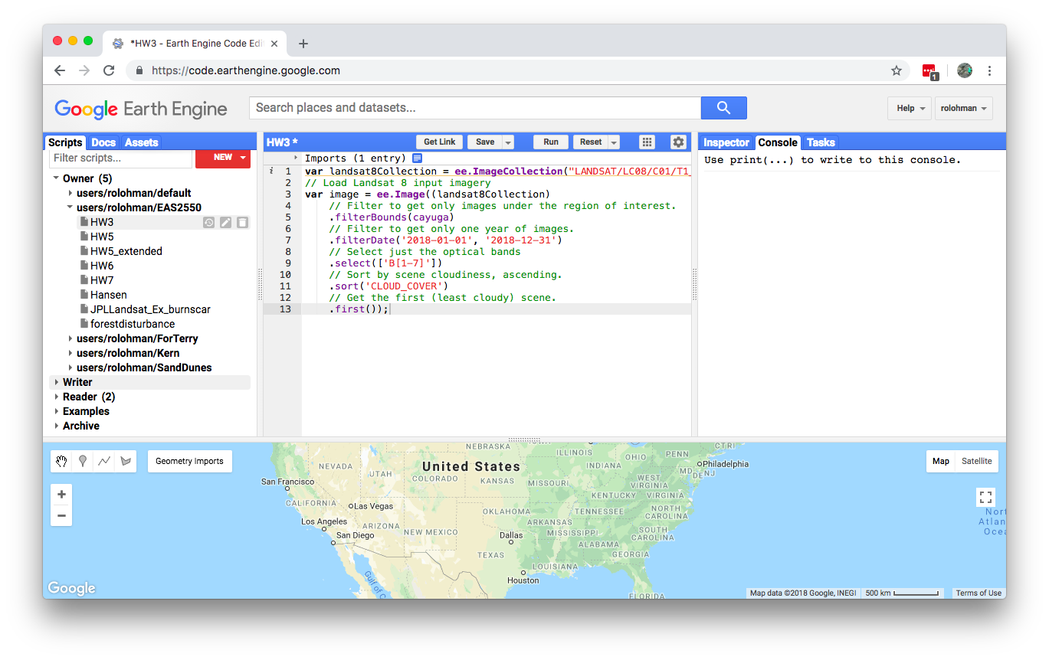
Get link – Makes it easy for students to send me code

Slide 15
Exercises so far
Sorting data (cloud cover, season, location)
Band math (NDVI, other combos)
Time series (NDVI, night lights, population)
Averages over regions
Counting (population within a contour of shaking intensity for recent earthquakes)
Fun – comparing SAR dual-pol with NDVI, letting students find band combos that emphasize contrast in agricultural areas.

Slide 16
Undergrad take-homes
My main challenge – making exercises that are interesting but not too difficult
SAR – we talk about resolution, but they don’t focus anything themselves
Goal – understand capability, potential pitfalls
Example – RF interference (potential political issue)

Slide 17
Graduate research
Solid Earth deformation
In past, mostly focused on phase only
Take-home points
Data discovery, evaluation of time series depth, amplitude effects
Combination with other data types
Weather models, ground-based radar, land use change, Landsat, etc.
Bringing in own data (geotiffs)

Slide 18
Soil moisture in arid/hyperarid regions
Before
After
Example: Unusual storm in Saudi Arabia in May, 2018 – lakes in between sand dunes

Slide 19
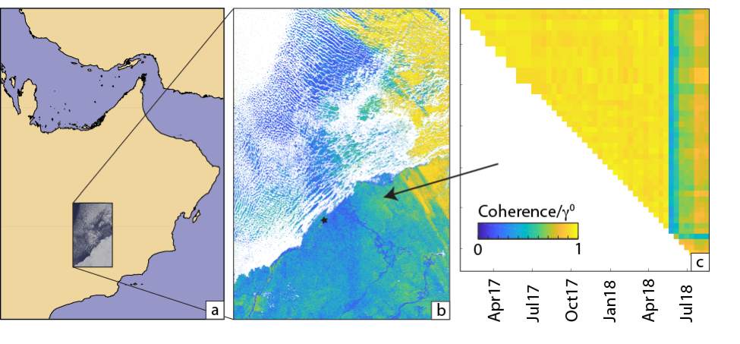
Soil moisture in arid/hyperarid regions
Coherence time series at a point
Blue = rain, Yellow = dry
Drying out
Rain
Coherence – more stable than amplitude, but has sign ambiguity

Slide 20
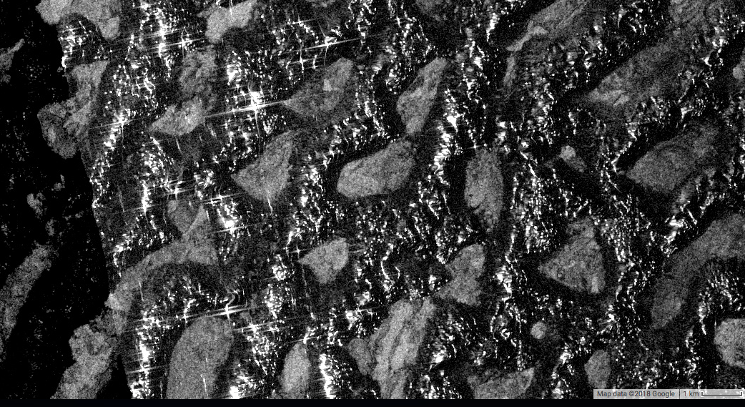
Sand Dunes in Saudi Arabia

Slide 21
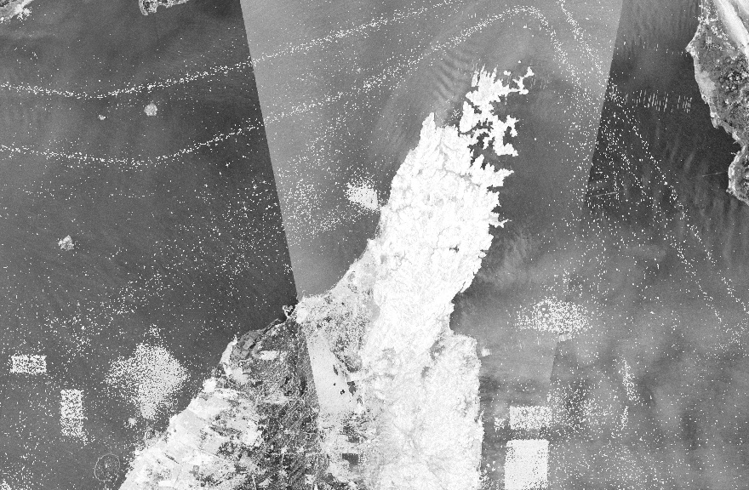
Why do they make the boats stay in boxes????

Slide 22
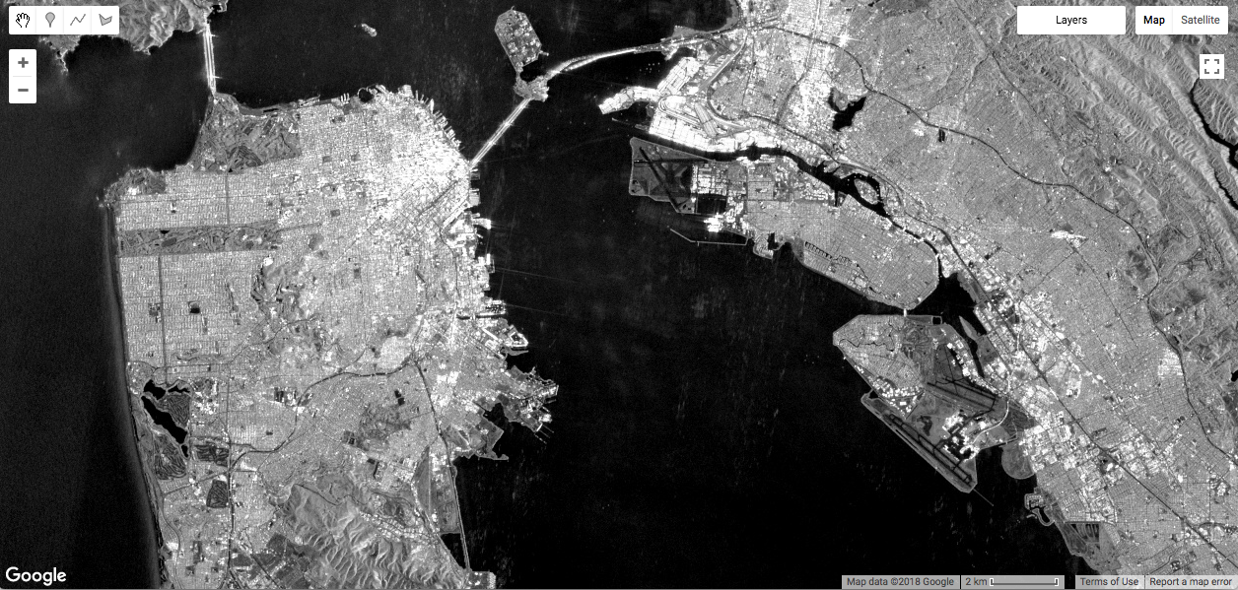
Median

Slide 23
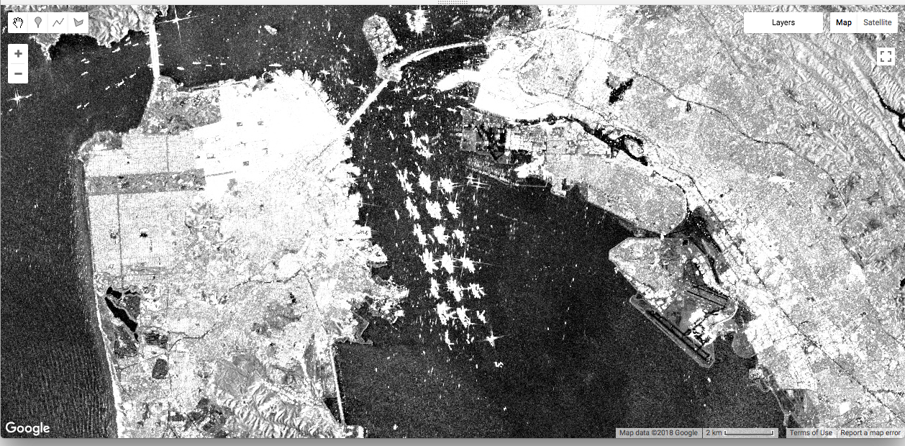
Max – 2015-2016

Slide 24
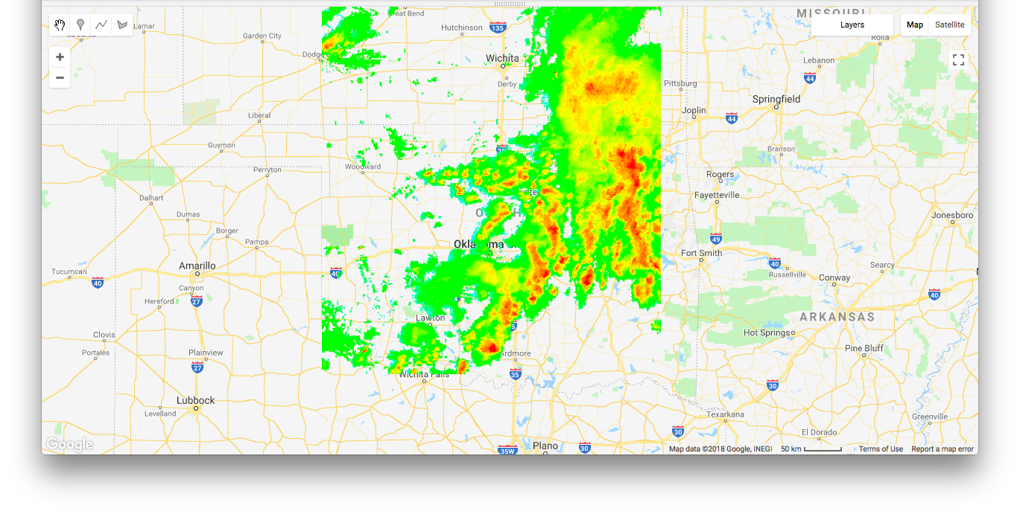
Oklahoma example: Ground-based radar – brought in as geotiff to personal assets area
Storm direction

Slide 25
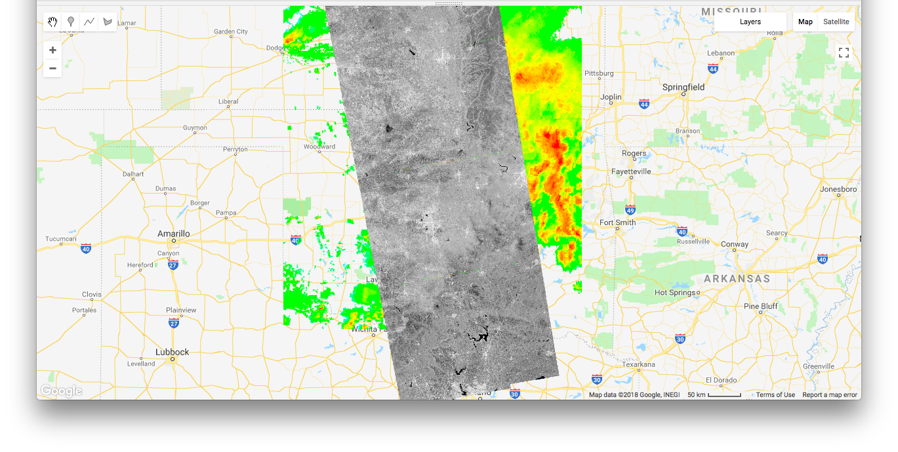
2015/09/09 SAR amplitude

Slide 26
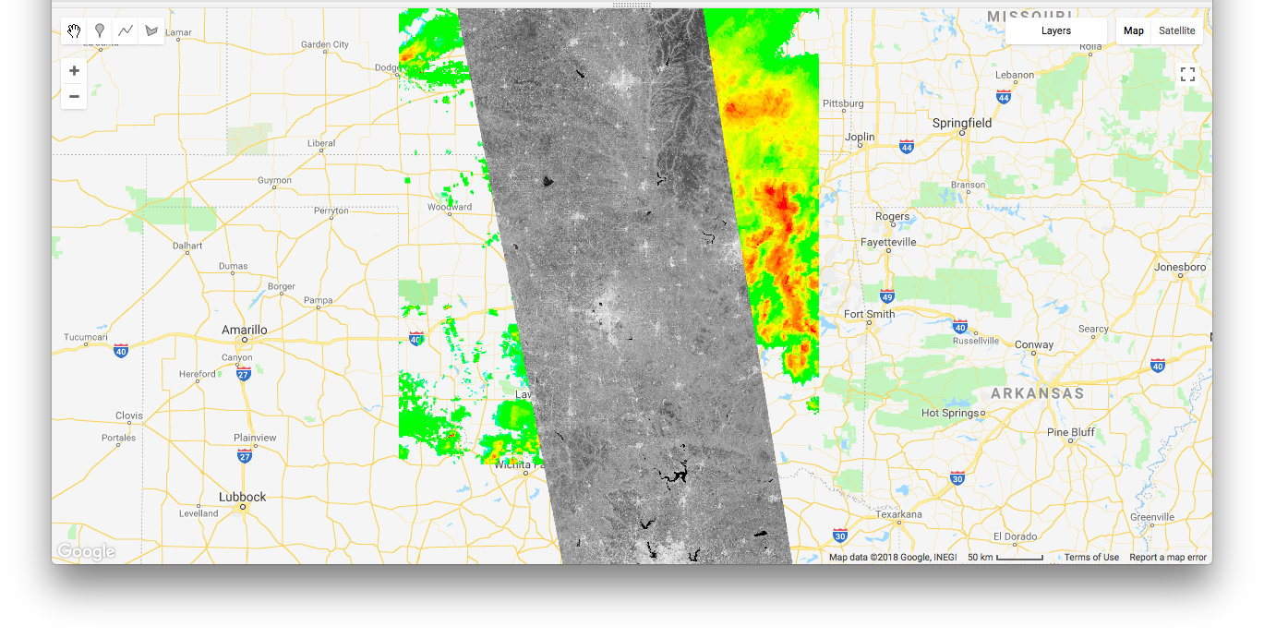
Median of 5 dates

Slide 27
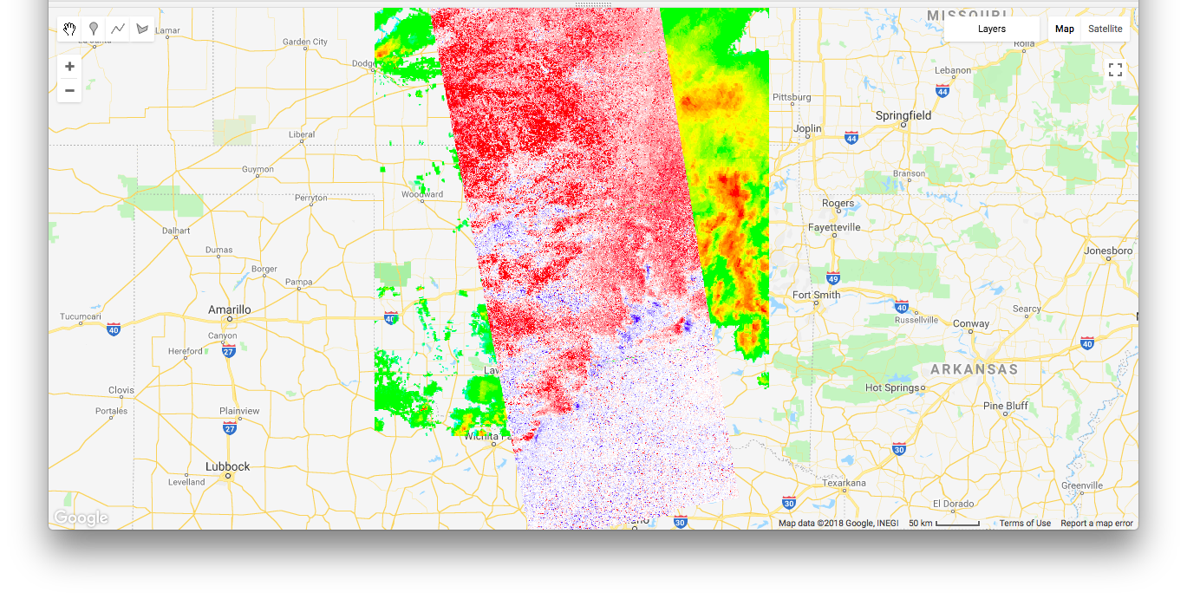
Red = lighter than average, blue = darkening
No change here

Slide 28
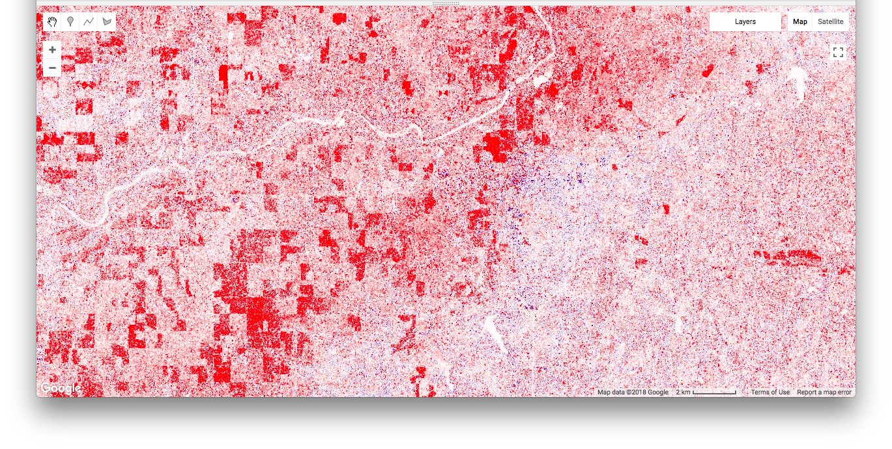
Brightening mostly in fields that are “bare” according to NDVI (Landsat)

Slide 29
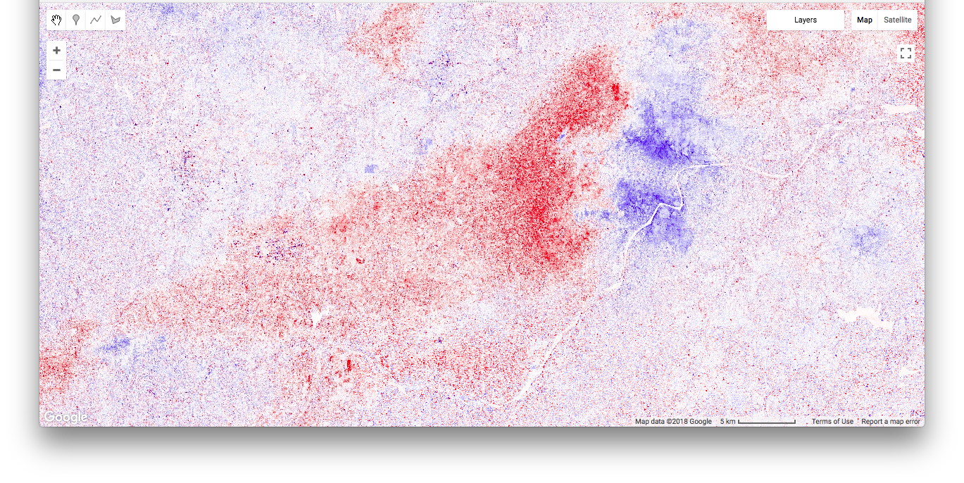
At storm front – brightening and darkening, not correlated with surface

Slide 30
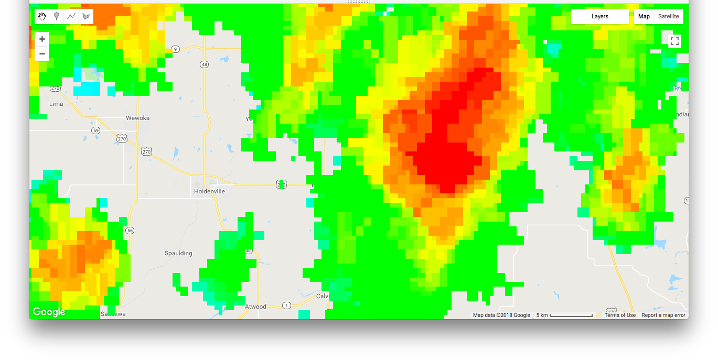

Slide 31
Other applications
Examining contribution to inferred displacement time series in areas with logging (Cascadia)
Challenges in separating vegetation term from soil moisture term
Combine Landsat-based LC datasets with precipitation/weather models
GEE internal spatial filters work well for actual analysis

Slide 32
Take home points
GEE very effective tool for some sorts of teaching, intercomparison of datasets
Fast, with access to incomprehensible amounts of data
Not very useful for making effective final figures, but can output products to geotiff

