Slide 1
Technical Overview of InSAR Short Courses
Scott Baker
Synthetic Aperture Radar Literacy and Training Workshop
Oct 22-24, 2018

Slide 2
Outline
UNAVCO SAR short courses timeline
Technical details of JupyterHub on XSEDE
InSAR friendly data products (GeoSLC)
Overview of GeoSCIFramework

Slide 3
UNAVCO SAR Short Courses
2008
2013
2018
ROIPAC: Paul Rosen, Yuri Fialko, Eric Fielding, Matthew Pritchard, Walter Szeliga, Piyush Shanker Agram, Scott Baker
COMET InSAR: Leeds
ISCE (no class 2017): Paul Rosen, Eric Fielding, Walter Szeliga, Piyush Shanker Agram, Scott Baker, Matt Pritchard, Zhong Lu, Andy Hooper, David Bekaert, Heresh Fattahi, Gareth Funning
GMTSAR: David Sandwell, Rob Mellors, Xiaopeng Tong, Scott Baker, Paul Wessel, Kurt Feigl,Xiaohua Xu, Katia Tymofyeyeva, Matt Wei, Leonardo Uieda, Anders Hogrelius
Nonspecialist workshops
EarthKit
JupyterHub
Courses cover SAR/InSAR theory and principles, processing, data access, have in-person and online participants,
ROIPAC/ISCE have used various methods for software/data including pre configured laptops, custom cloud framework (EarthKit), and JupyterHub
GMTSAR gives series of homework problems 2-3 weeks before, students provide own computers. Some sample datasets for processing, but focus on student/group projects, a little more freeform
Common Issues: Difficulties with software installation, bandwidth in the classroom, insufficient computing resources

Slide 4
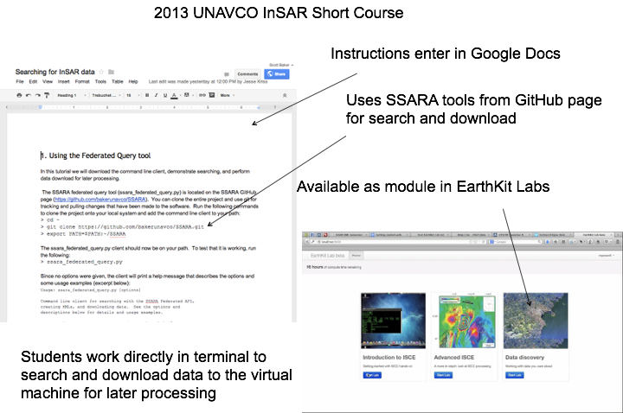
2013 InSAR Course: EarthKit
EarthKit Stack
Amazon Elastic Block Storage
Amazon EC2
Cloud resource server:
node.js
Ruby sinatra (http://www.sinatrarb.com/)
REST framework
Web application stack:
Bootstrap
Flightjs (http://flightjs.github.io/)
miso.js (http://misoproject.com/)
talks with google drive for instructions
require.js (http://requirejs.org/)
javascript module loader
ttyjs (https://github.com/chjj/tty.js/)
javascript terminal
Guacamole (http://guac-dev.org/)
HTML5 remote desktop client

Slide 5
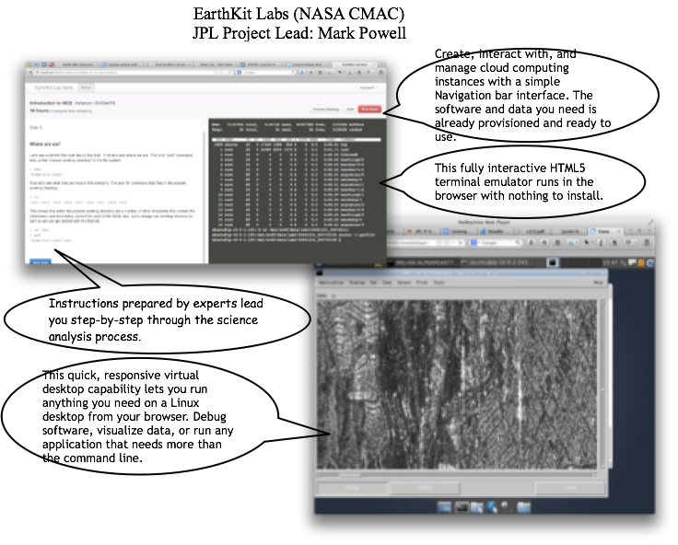
2013 InSAR Course: EarthKit

Slide 6
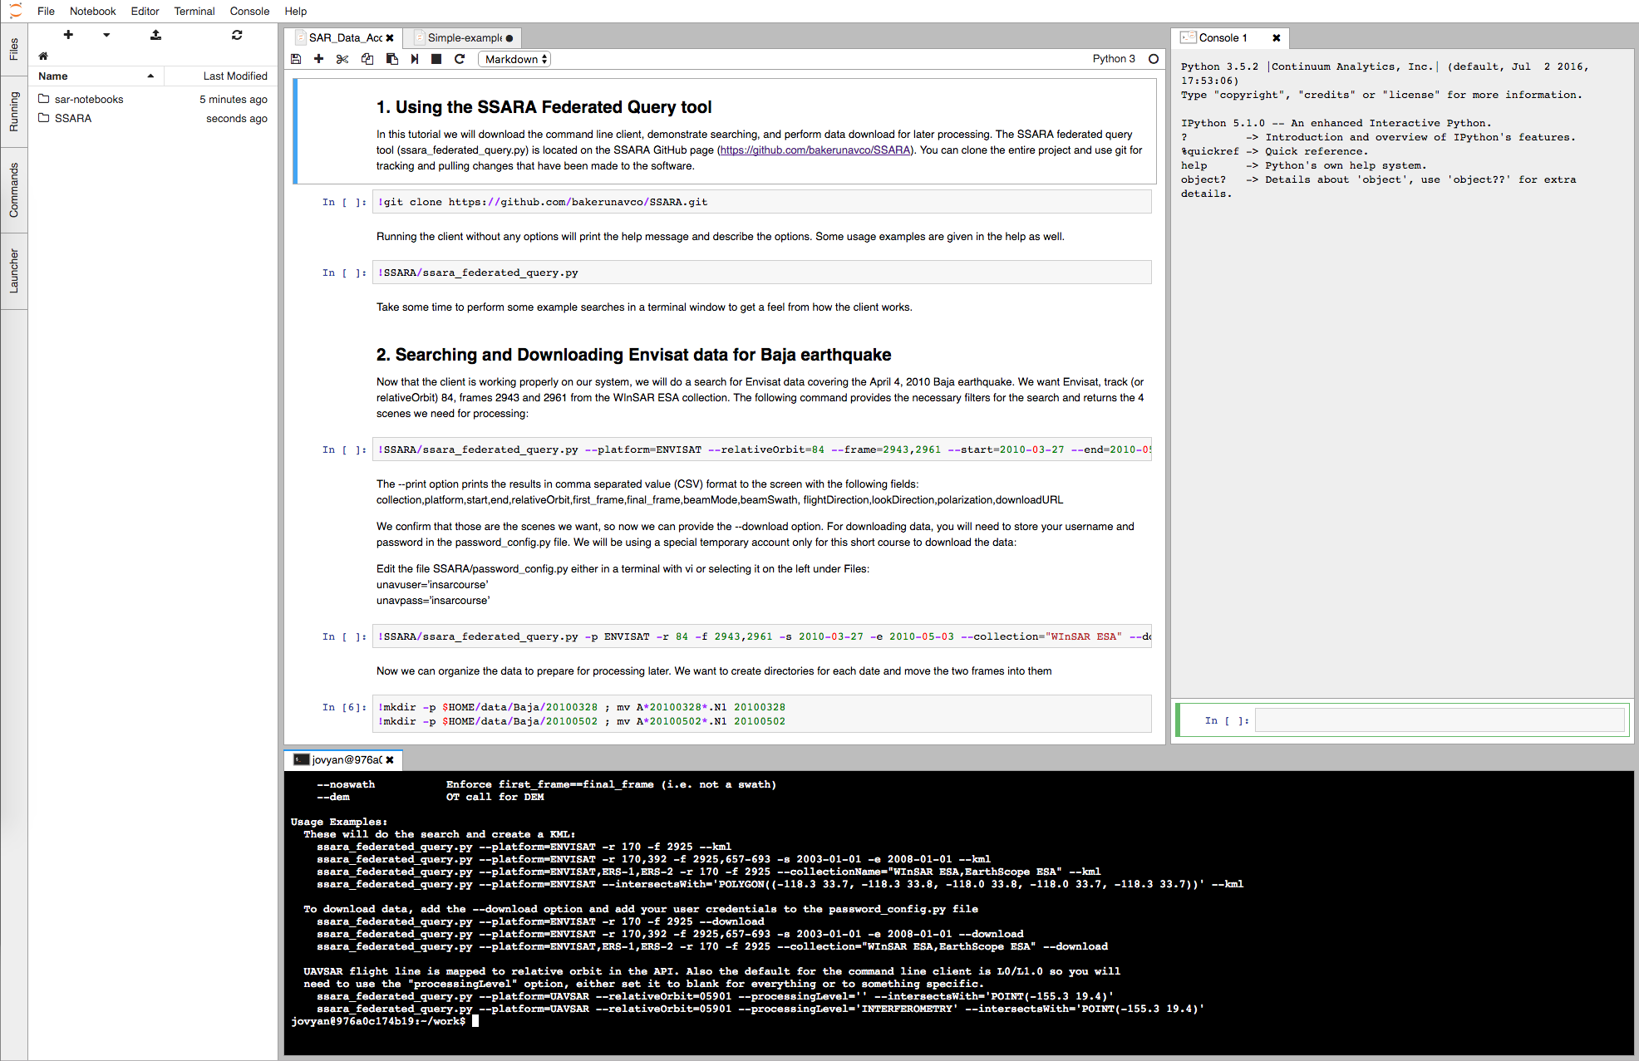
JupyterHub
JupyterHub, a multi-user Hub, spawns, manages, and proxies multiple instances of the single-user Jupyter notebook server. JupyterHub can be used to serve notebooks to a class of students, a corporate data science group, or a scientific research group.
Three subsystems make up JupyterHub:
a multi-user Hub (tornado process)
a configurable http proxy (node-http-proxy)
multiple single-user Jupyter notebook servers (Python/IPython/tornado)
JupyterHub performs the following functions:
The Hub launches a proxy
The proxy forwards all requests to the Hub by default
The Hub handles user login and spawns single-user servers on demand
The Hub configures the proxy to forward URL prefixes to the single-user notebook servers
File Browser
Python Notebooks
Python Console
Terminal Window

Slide 7
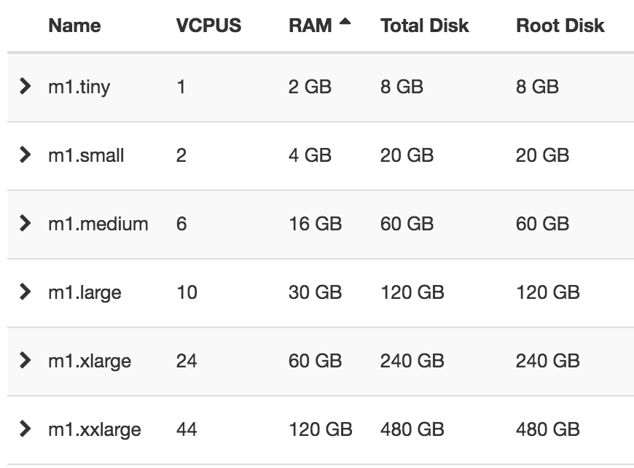
XSEDE/Jetstream Overview
Cloud storage and computing on XSEDE resources with startup allocation
Copy of SAR data on Wrangler HPC (10PB Storage System)
Co-located data and computing resources
Improved bandwidth for SAR archive downloads (UNAVCO data center limited with 1Gbps connection)
Jetstream: A national science and engineering cloud [Stewart, 2015]
built on Openstack and provides scalable computing with on-demand instances in varying sizes. Users with an allocation can launch a virtual machine (VM) and attach storage volumes to create an InSAR processing and analysis environment.
Build shared SAR data processing and analysis system (JupyterHub and machine images)
US-based researchers can apply for XSEDE allocations separately if more computing resources are needed
JupyterHub
Leverage existing open source software to create a multi-user computation environment using docker containers
Persistent docker volumes connected to user’s container
Containers configured with JupyterLab for user interface: https://github.com/jupyterlab/jupyterlab
Learning resources: Notebooks
Computing resources: docker images with InSAR software

Slide 8
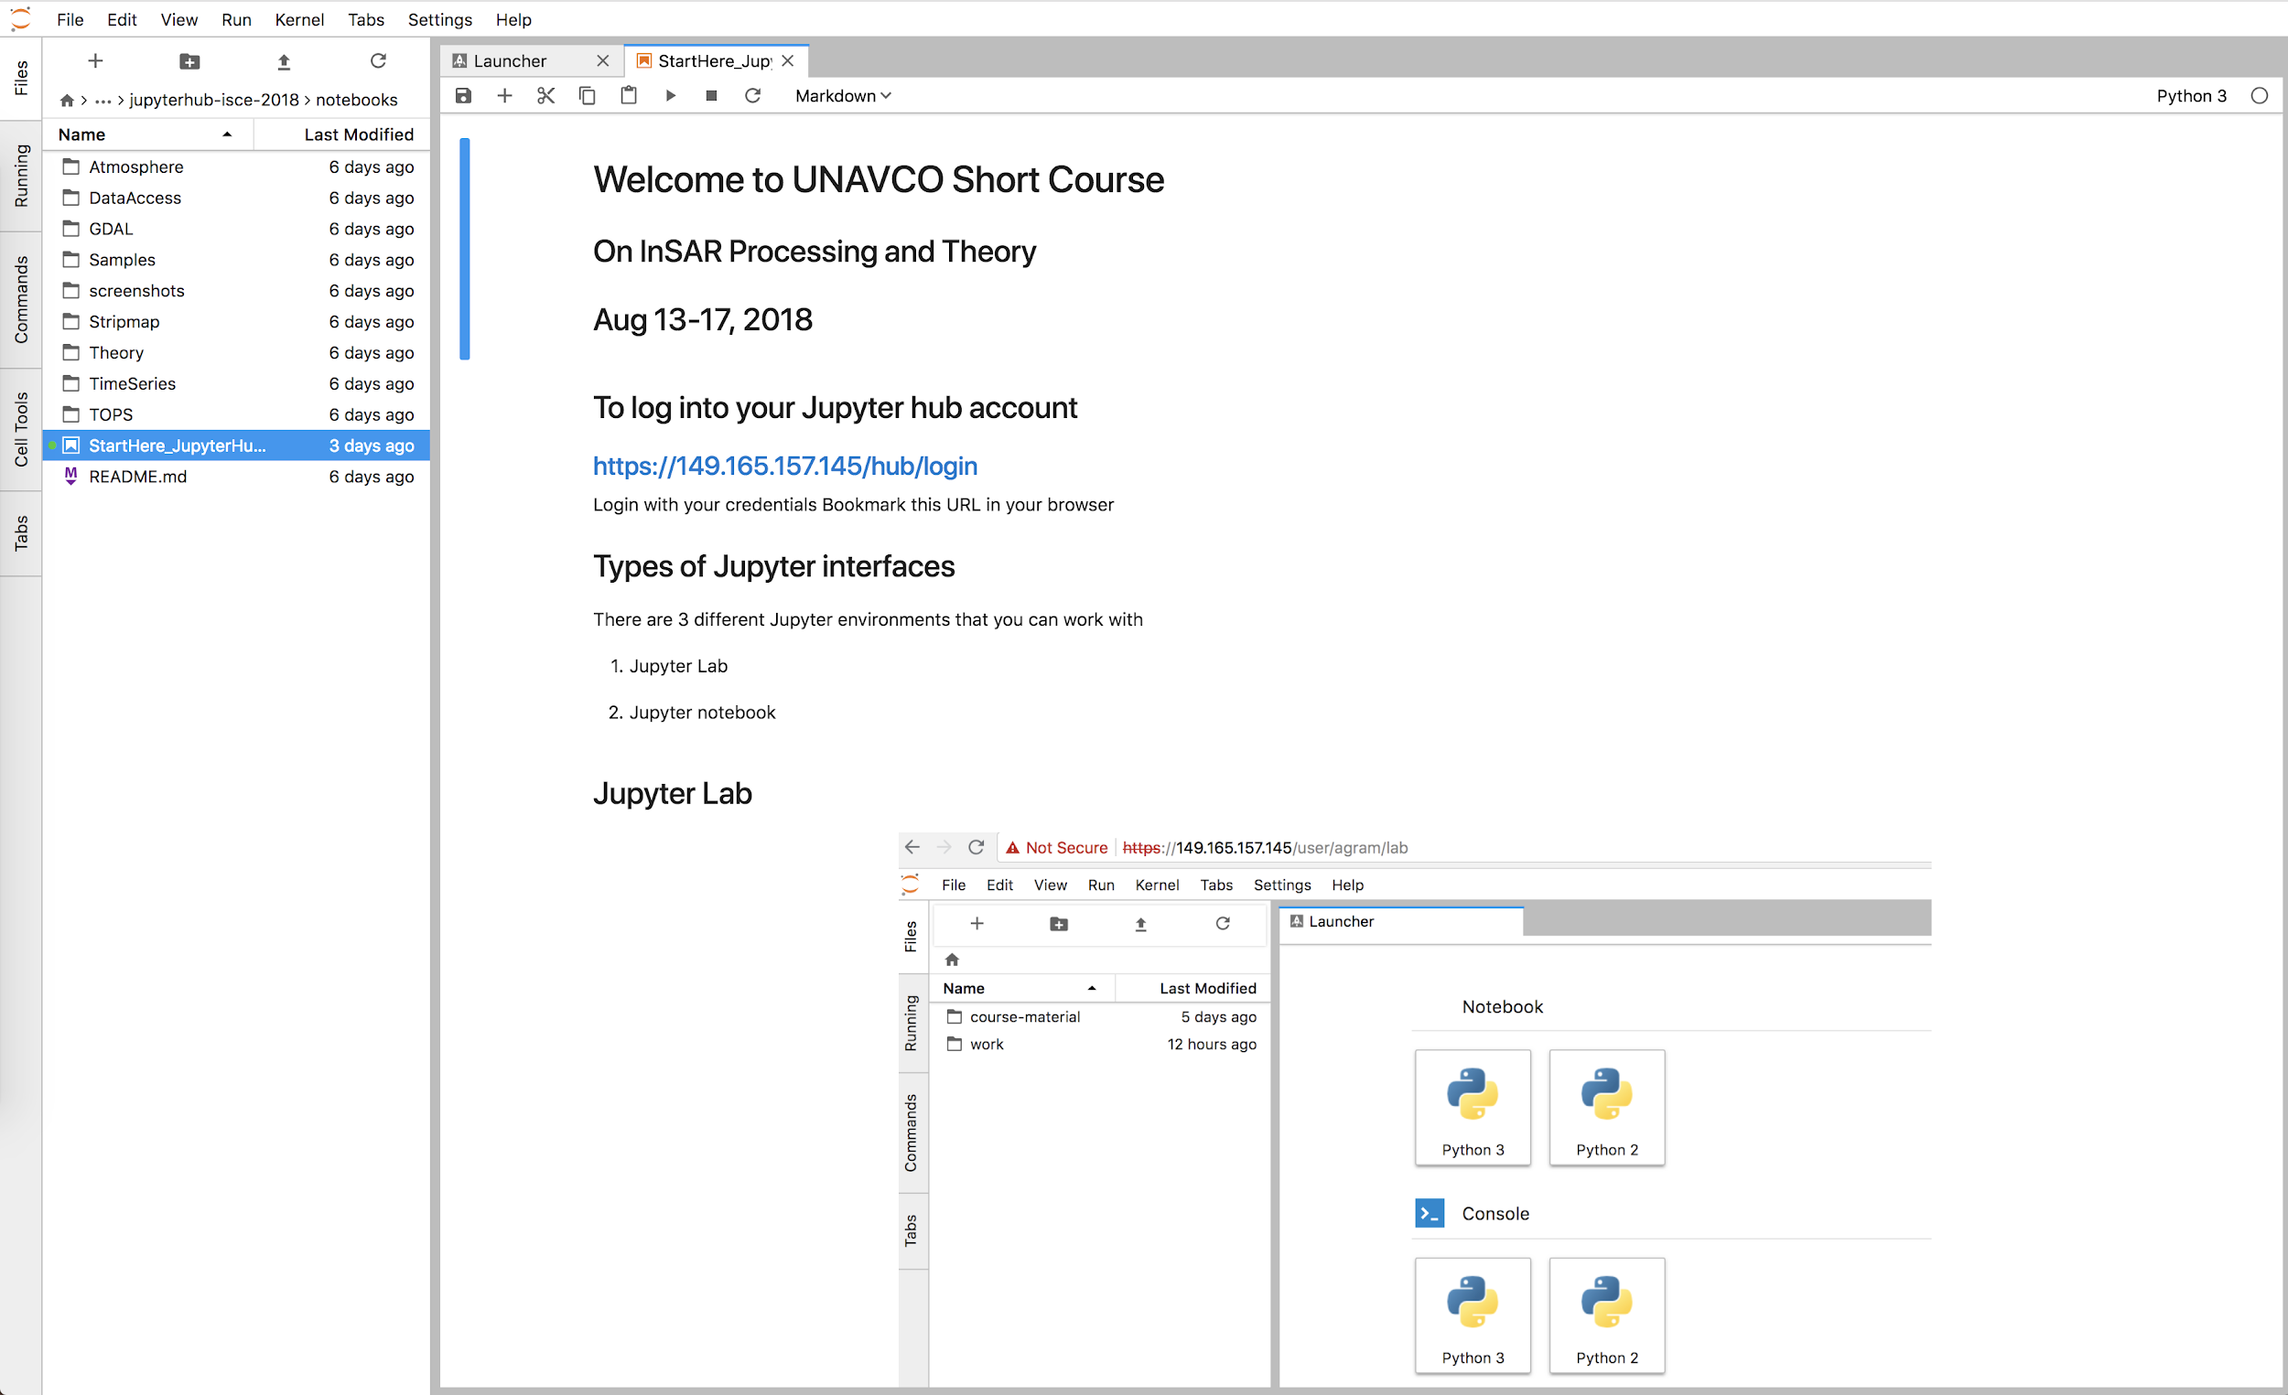
2018 ISCE Short Course w/ JupyterHub
36 participants
Single m1.xxlarge VM (44C, 120GB RAM) running on XSEDE/Jetstream
5TB volume for persistent data
Custom image with ISCE/GIAnT based on the jupyter/scipy-notebook image
Content developed by instructors: notebooks, sample data…
only ~10% used the hub after the course
XSEDE allocation used was part of a UNAVCO SAR startup allocation, but XSEDE has a specific educational allocation for academic courses and training activities:
https://portal.xsede.org/allocations/education

Slide 9
Past Course Material
UNAVCO supported short course material can be found online:
Course Materials - InSAR
2017 InSAR Processing and Theory with GMTSAR
2016 InSAR Processing with ISCE, GIAnT, and StaMPS
2016 InSAR Processing and Theory with GMTSAR
2015 Advanced InSAR Processing with ISCE, GIAnT, and StaMPS
2015 InSAR Processing and Theory with GMTSAR
2014 InSAR Processing and Theory with GMTSAR
2014 InSAR: An introduction to Processing and Applications using ISCE and GIAnT
2013 InSAR Processing and Theory with GMTSAR
2013 InSAR: An introduction to Processing and Applications using ROI_pac and GIAnT
2011 InSAR: An introduction to Processing and Applications for Geoscientists
2010 InSAR: An introduction to Processing and Applications for Geoscientists
2009 InSAR: An introduction to Processing and Applications for Geoscientists
2008 InSAR: An introduction to Processing and Applications for Geoscientists

Slide 10
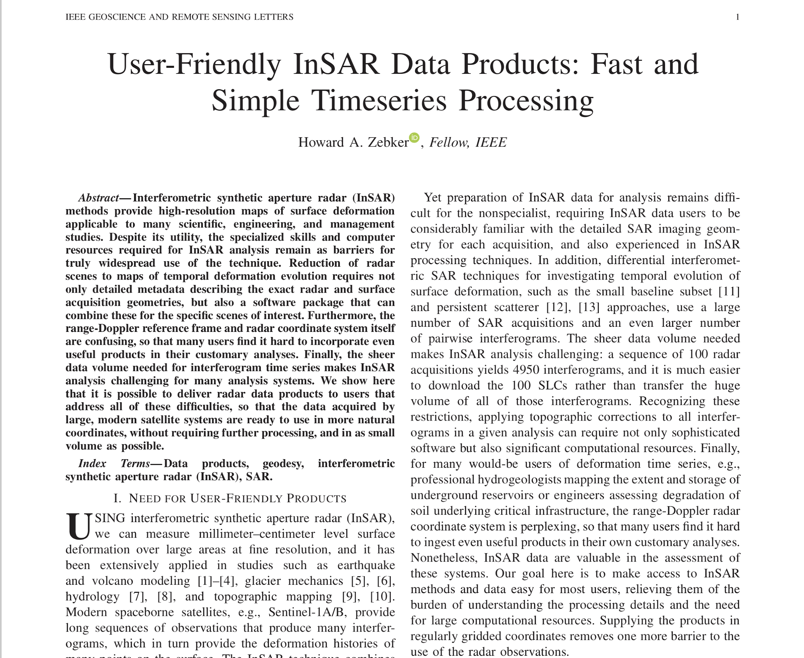
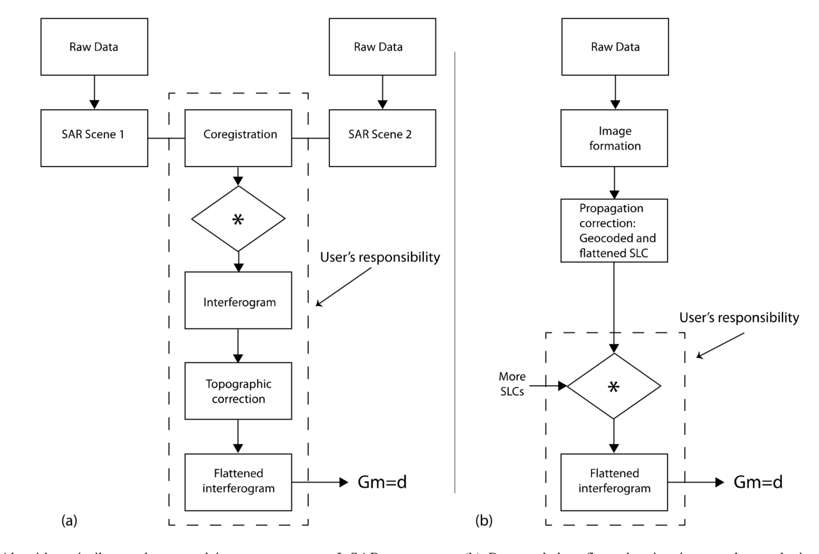
GeoSLCs
User-Friendly InSAR Data Products: Fast and Simple Timeseries Processing
Example data products and script available (some delivered to GEE):
https://imaging.unavco.org/data/geoslc/
The SLCs are geocoded to the 30m SRTMGL1 data and are ~200MB each, so the data volume you need to download and the time it takes to make an interferogram is greatly reduced
Example command to make an interferogram once the script and data are downloaded
geoslc2intf.py S1B_IW_SLC__1SDV_20180517T161525_20180517T161552_010963_01411F_59D5.SAFE.geoslc.tif S1B_IW_SLC__1SDV_20180505T161525_20180505T161552_010788_013B7D_25D2.SAFE.geoslc.tif
You can bypass the data download by using the VSICURL functionality of GDAL with:
geoslc2intf.py /vsicurl/https://imaging.unavco.org/data/geoslc/T087/S1B_IW_SLC__1SDV_20180517T161525_20180517T161552_010963_01411F_59D5.SAFE.geoslc.tif /vsicurl/https://imaging.unavco.org/data/geoslc/T087/S1B_IW_SLC__1SDV_20180505T161525_20180505T161552_010788_013B7D_25D2.SAFE.geoslc.tif

Slide 11
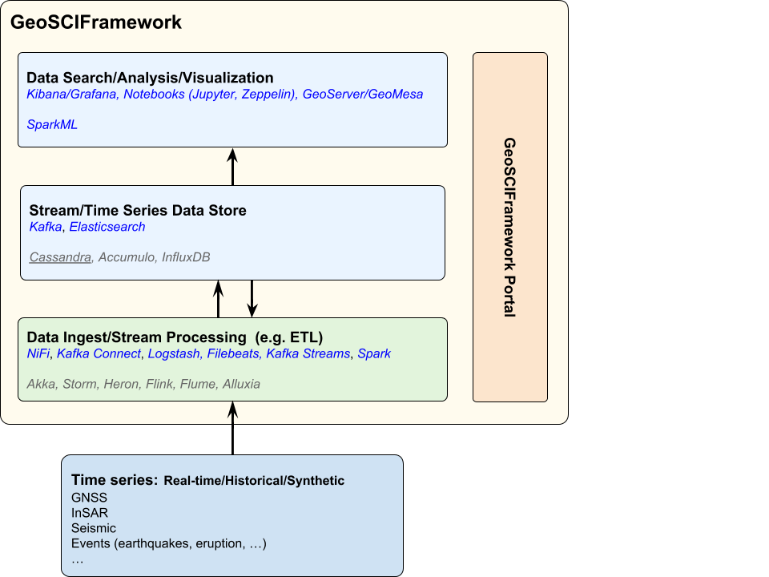
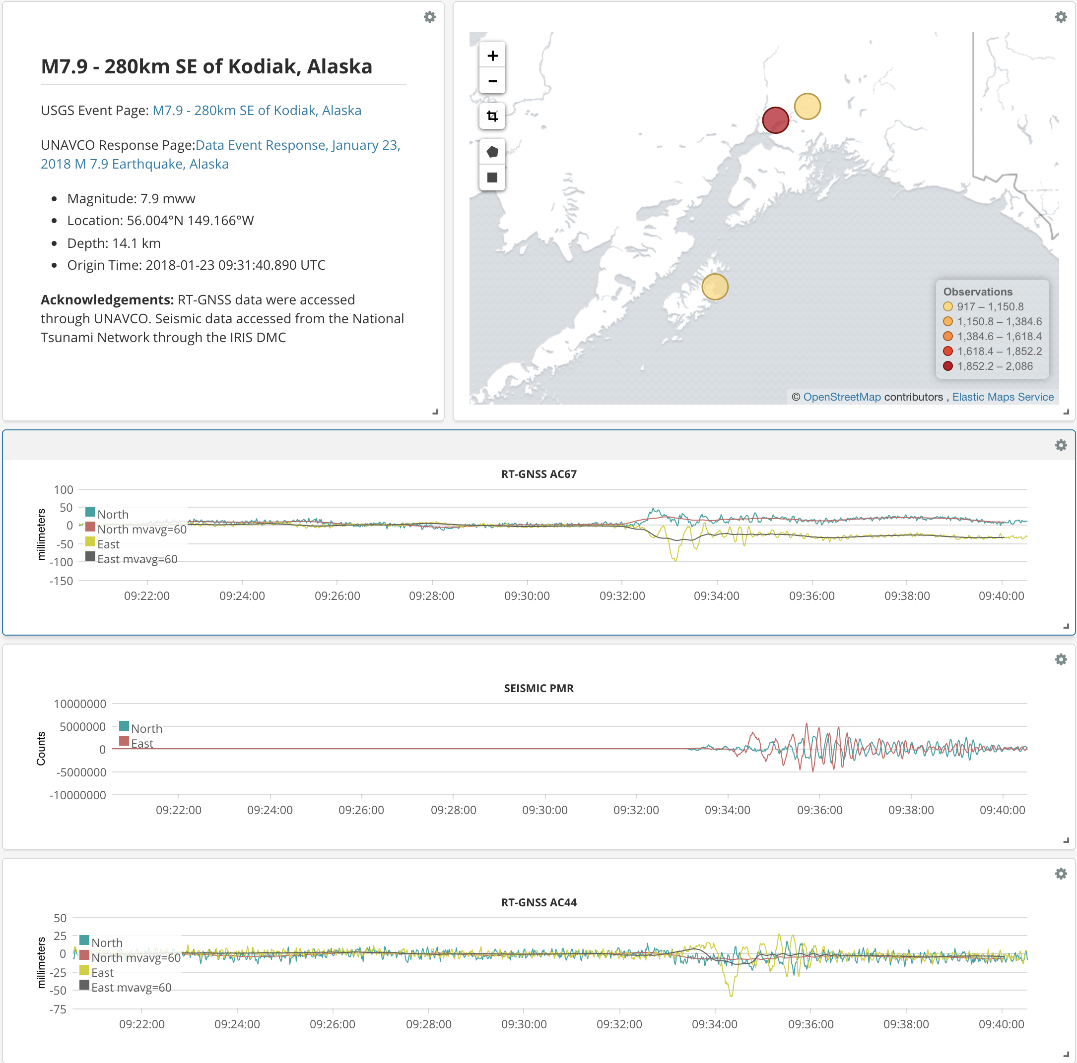
GeoSCIFramework Overview
NSF funded, multi-year (2019-2022), four-organization (UNAVCO, University of Colorado, University of Oregon, and Rutgers University) collaboration to develop a data framework for generalized real-time streaming analytics and machine learning for geoscience and hazards research.
Develop a real-time processing system capable of handling a large mix of sensor observations.
Focus of this system is automation of the detection of natural hazard events using machine learning, as the events are occurring.
Support rapid analysis and understanding of data associated with hazardous events (earthquakes, volcanic eruptions, tsunamis).

