Slide 1
Activities
EO College
Audience
Key experiences
Network
SAR education resources

Slide 2
ACTIVITIES
On-site training

Slide 3
Participants of the Summer School 2013 @ Dornburg Castle, Jena.
Established in 2013
Yearly events
Focus on Applications
Interdiciplinary exchange
Summer Schools
Workshops
Collaborations

Slide 4
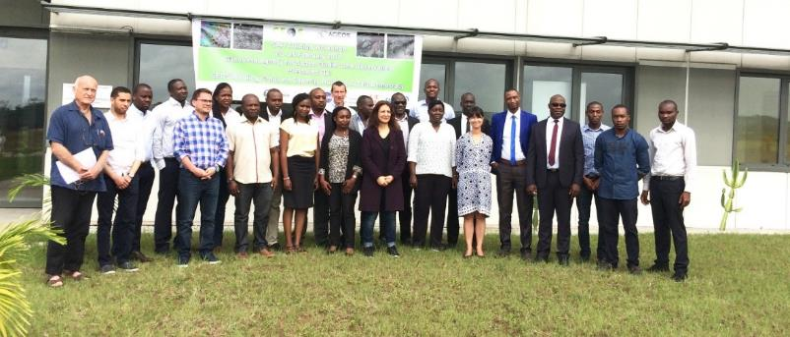
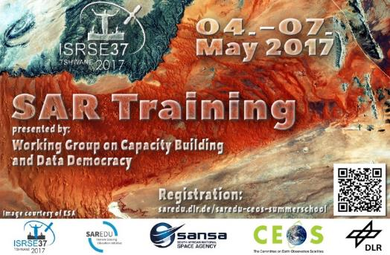
Summer Schools
Workshops
Collaborations

Slide 5
Workshops
Date | Location | Event
2013 | Jena, Germany | I. SAR-EDU Summer School
2014 | Berlin, Germany | National Copernicus Forum
2014 | Jena, Germany | II. SAR-EDU Summer School
2014 | Toluca, Mexico | AEXA Workshop
2015 | Jena, Germany | III. SAR-EDU Summer School
2016 | Lusaka, Sambia | CEOS Workshop
2016 | Jena, Germany | IV. SAR-EDU Summer School
2017 | Libreville, Gabon | CEOS Workshop
2017 | Tshwane, South Africa | SAR Workshop @ISRSE
2017 | San Jose, Costa Rica | SAR Workshop
2017 | Jena, Germany | V. SAR-EDU Summer School
2017 | Stellenbosch, South Africa | SAR-EDU Workshop
2018 | Jena, Germany | VI. SAR-EDU Summer School

Slide 6
EO COLLEGE
eo-college.org

Slide 7
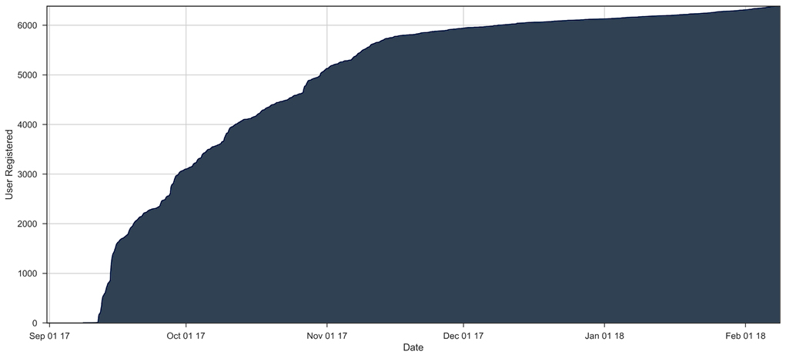
EO COLLEGE WEBSITE
September 2017
> 8.400 registered users
> 25.000 h spent on page
> 750.000 pageviews

Slide 8
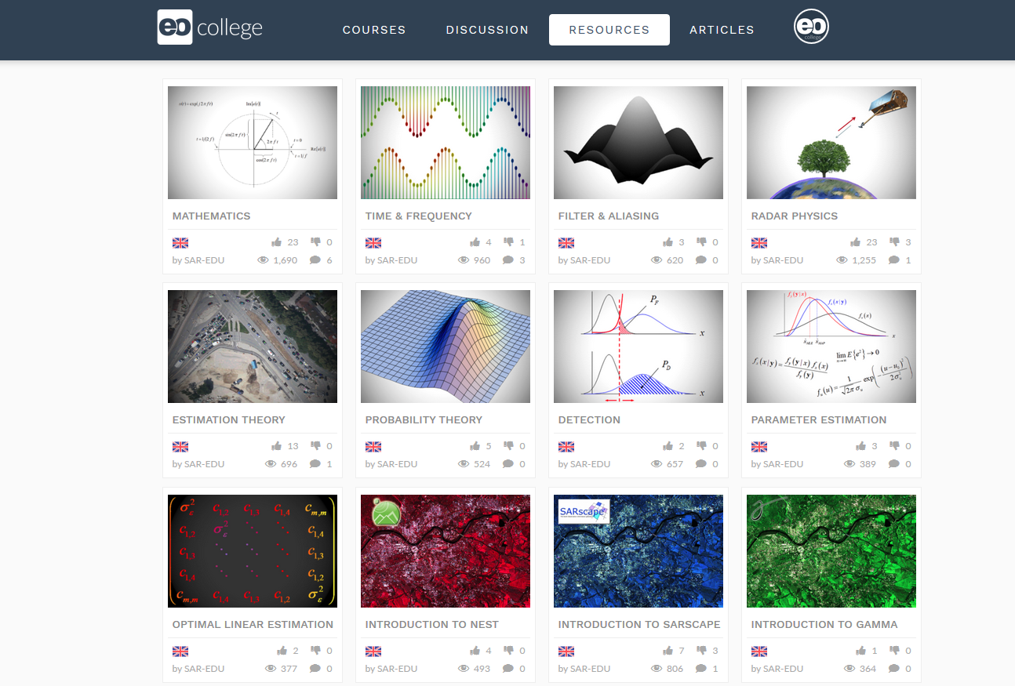

Slide 9
FREE OF CHARGE
START: 09-OCT-2017
OPEN TO ANYBODY
5 LESSONS
SELF-PACED LEARNING
CERTIFICATE FOR COMPLETION

Slide 10
ACTIVITIES
SAR-EDU network

Slide 11
Collaborations include the following institutions/activities
CEOS WGCapD → Participition in Telecons, Provision of trainers + funding for international workshops
Copernicus Academy → European network of EO education initiatives
EO4GEO → European consortium targeting the creation of standardized knowledge base + curricula in EO
FIS/ESERO Germany → Education initiative to bring remote sensing into schools

Slide 12
EO4GEO OBJECTIVES & CONSORTIUM
EO4GEO aims to help bridging the skills gap between supply and demand of education and training in the space/geospatial sector by reinforcing the existing ecosystem and fostering the uptake and integration of space/geospatial data and services in end-user applications.
EO4GEO will work in an multi- and interdisciplinary way and apply innovative solutions for its education and training actions including: case based and collaborative learning scenarios; learning-while-doing in a living lab environment; on-the-job training; the co-creation of knowledge, skills and competencies; etc.
EO4GEO will define a long-term and sustainable strategy to fill the gap between supply of and demand for space/geospatial education and training taking into account the current and expected technological and non-technological developments in the space/geospatial and related sectors (e.g. ICT).

Slide 13
AUDIENCE

Slide 14
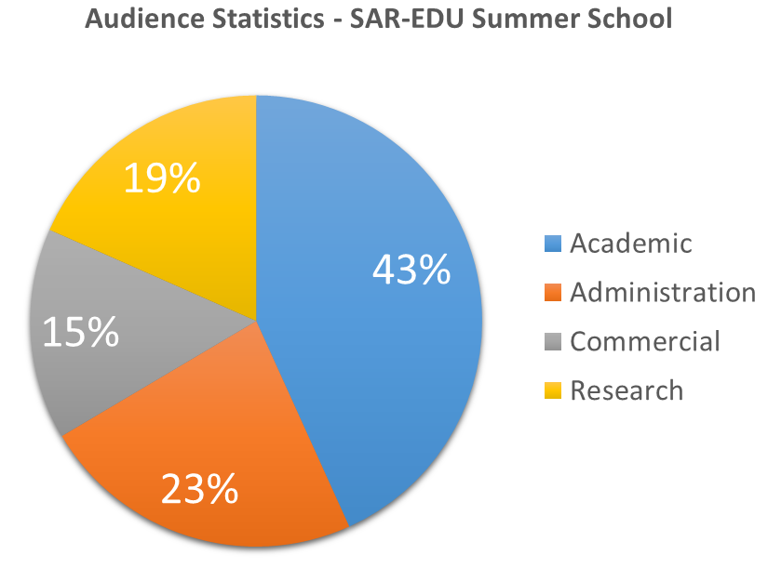
Audience Statistics – SAR-EDU Summer School
n = 185
(based on 6 years of Summer School)

Slide 15
Audience Needs – SAR-EDU Summer School
More practicals
Less theory, more application context
Course in their mother tongue
Software: Free, windows, Graphical user interface
Workflow: Automated
Data: Free, preprocessed

Slide 16
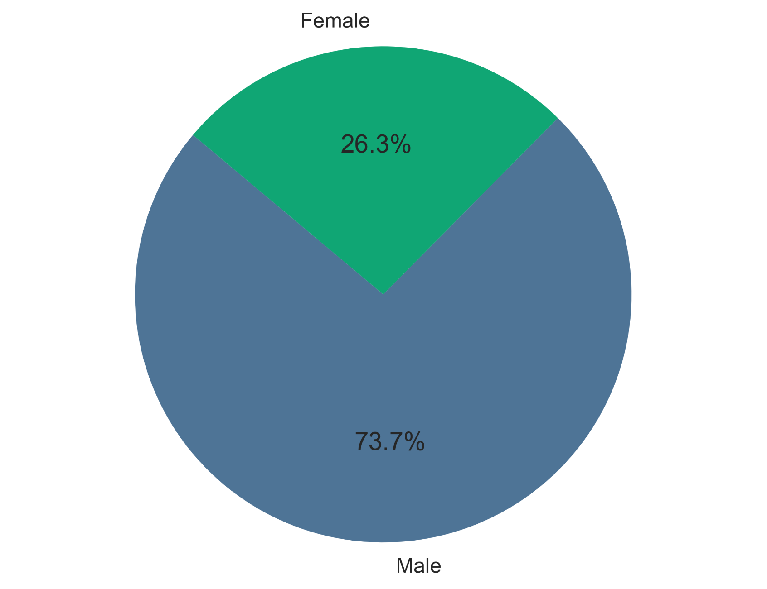
n=365
Echoes in Space - Gender

Slide 17
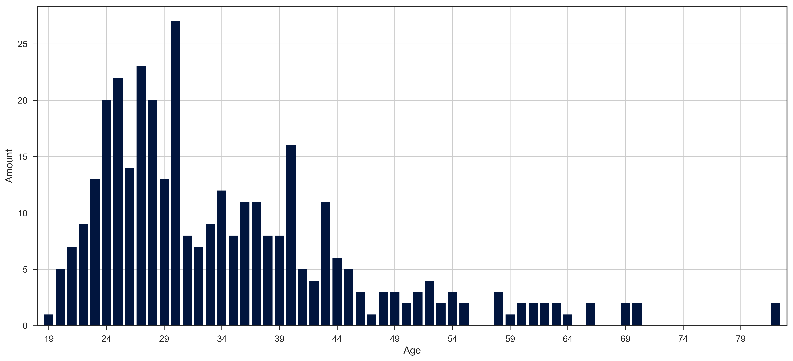
Echoes in Space - Age
n=365

Slide 18
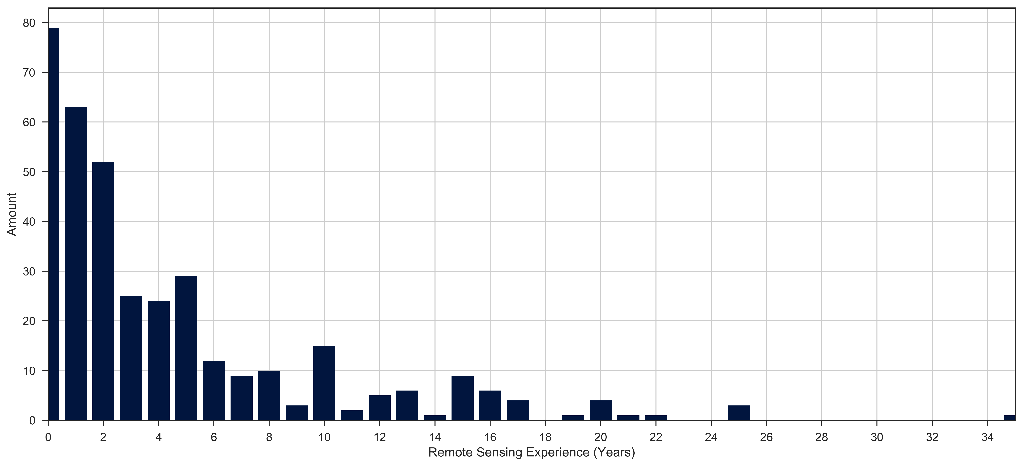
Echoes in Space - Remote Sensing experience
n=365

Slide 19
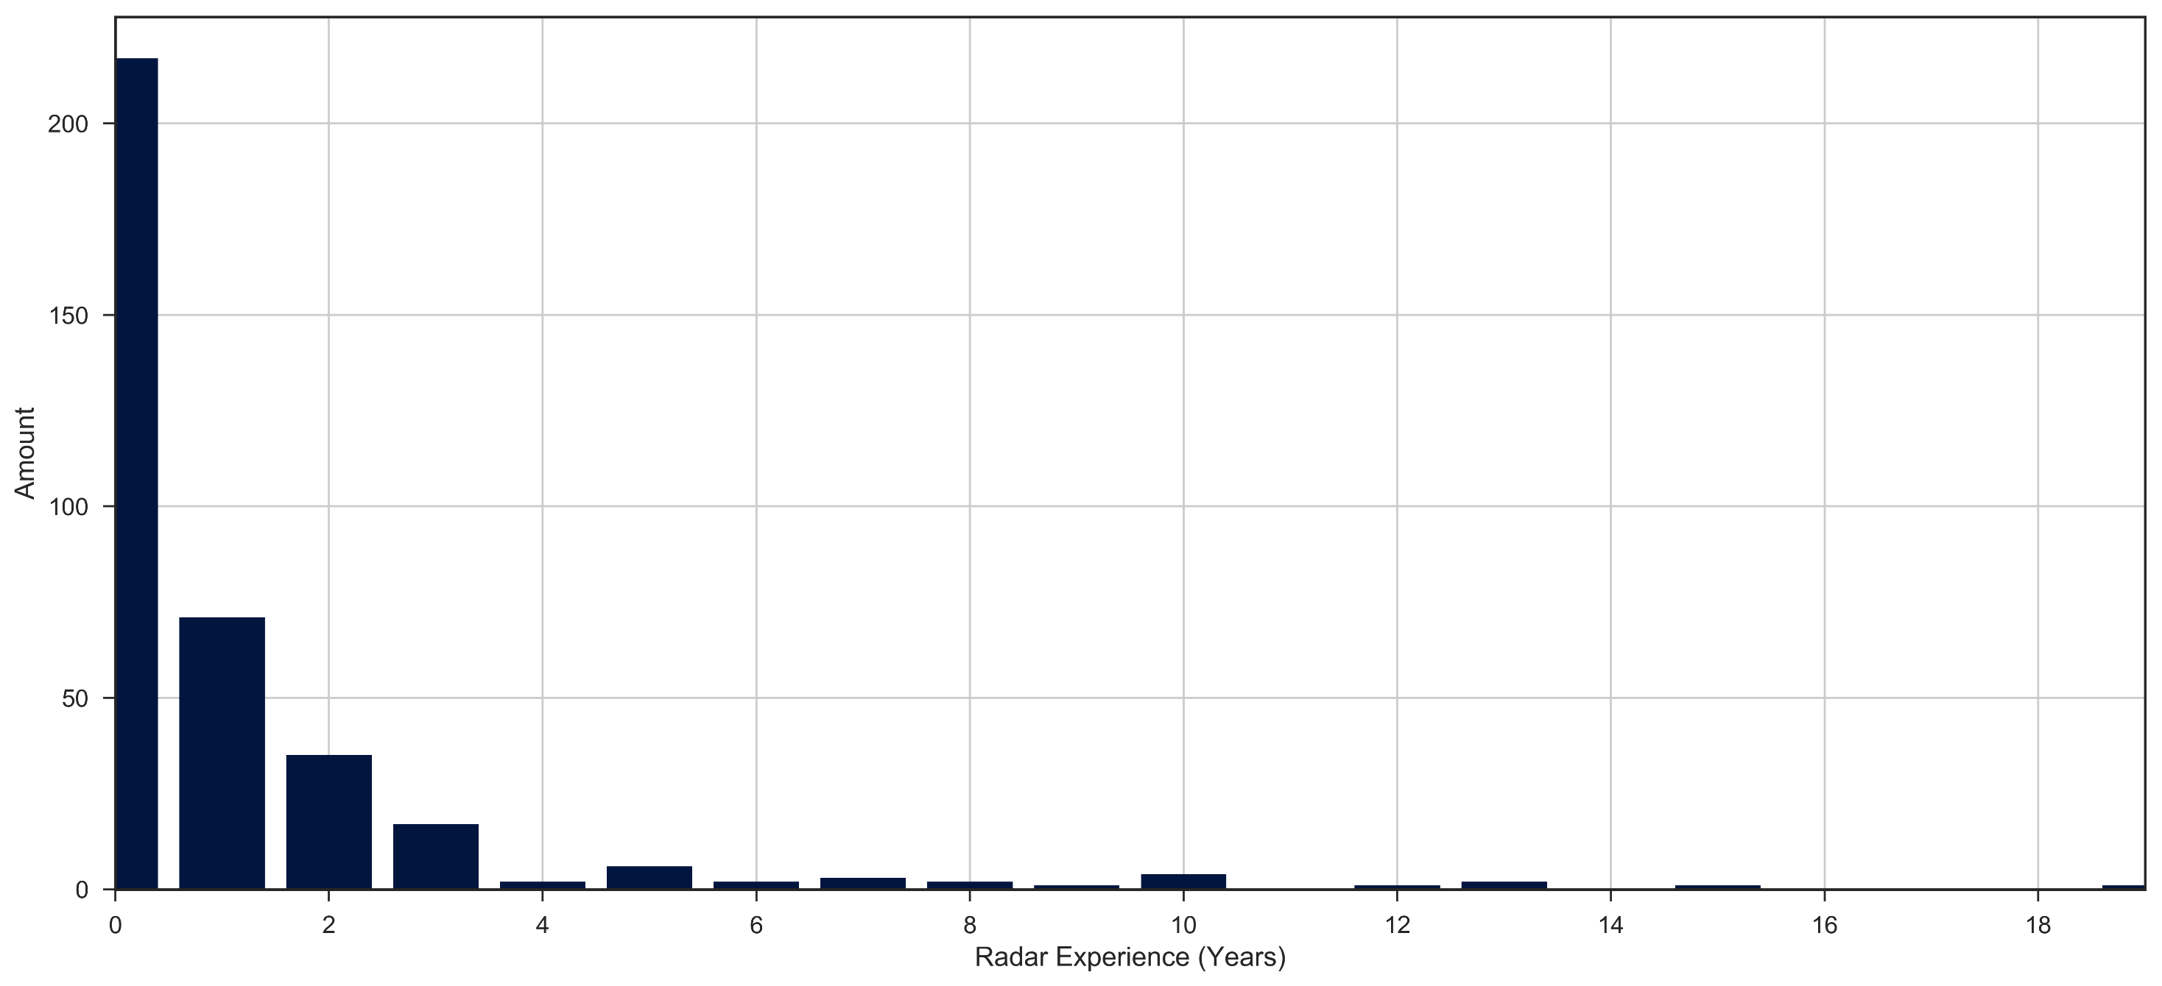
Echoes in Space - Radar experience
n=365

Slide 20
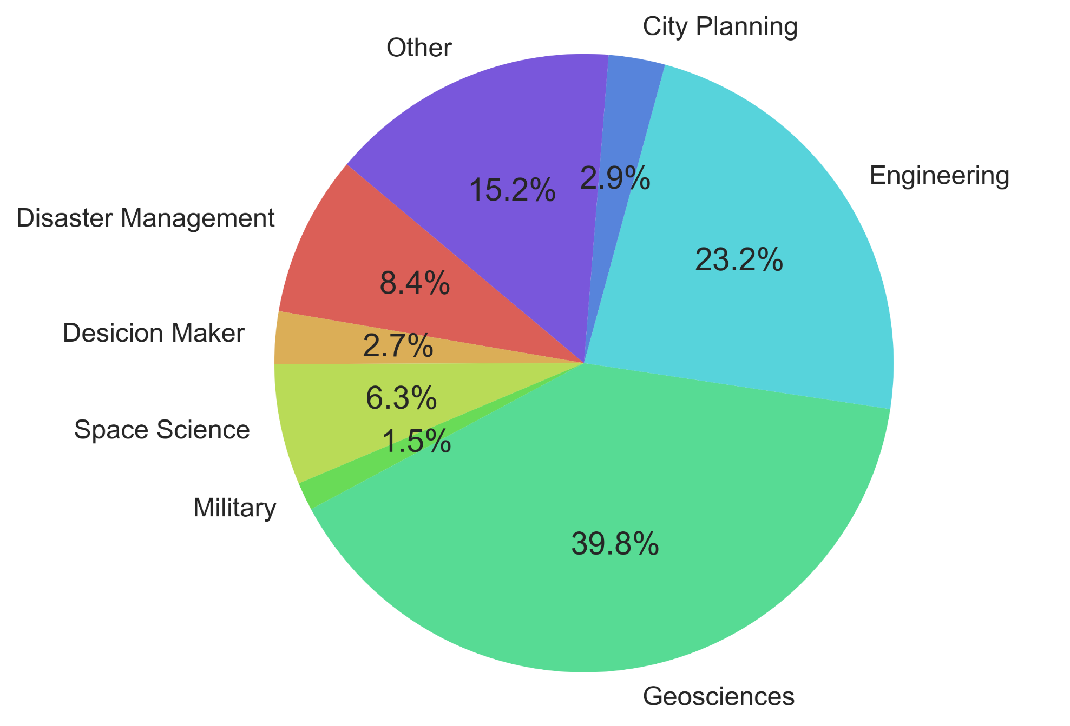
Echoes in Space - Profession field
n=365

Slide 21
Echoes in Space - Profession field -OTHER
Archaeology
Surveying and Geoinfomatics
Energy, Crime data
Life long learner
Research and Development
Scientist
Government Auditor, Data Scientist
Plant Ecophysiology
Territorial and environmental management
Information Technology
Territorial and environmental managment
Agriculture
Architect
Astrophysics, Science Communication
Education - Teacher
Environmental Sciences
Water management
Data analyst
GIS Software Developer
Builder
Retired
Education
Environmental Professional
Project Associate
Maritime Watch keeper
Security
Chief operating officer in a financial institution
Agronomical Engineering
Health Care
Software development
Project Manager
Agrohydrology
Regulator
Natural Sciences
Climate risk assessment, climate adaptation, SDGs, DRR
Forensics
LULC monitoring
Catastrophe model developer
IT consultant
Information Technology
Responsible for an exhibition about satellite images in a museum
Start upper
Ecology
Aviation
Weather Forecasting
Cartography
Biology

Slide 22
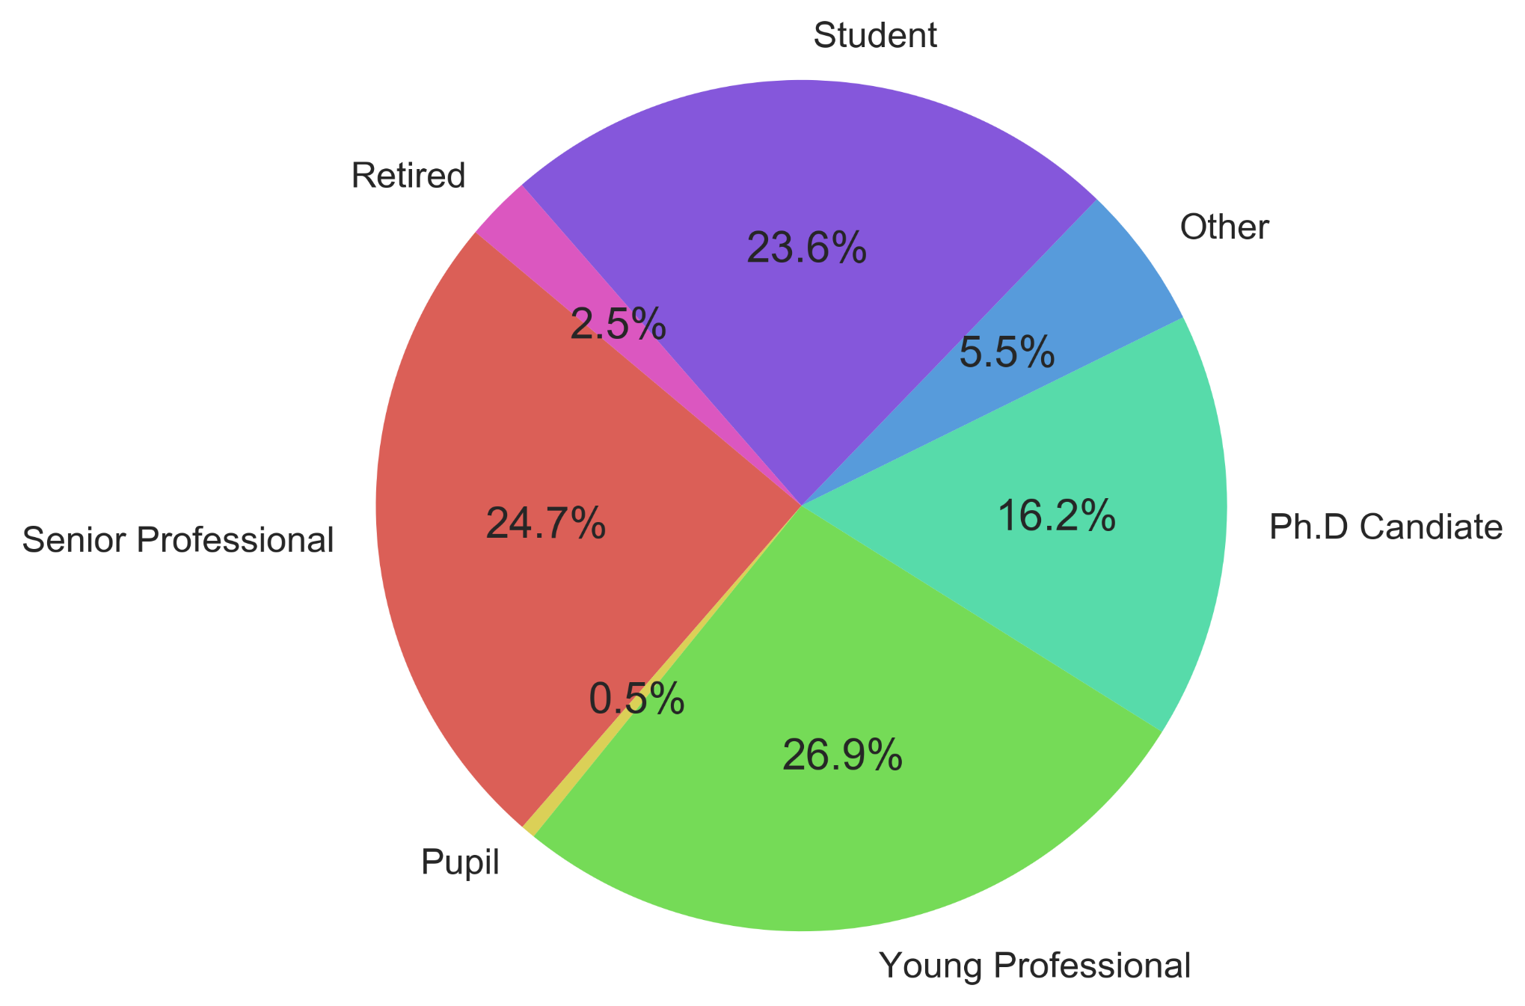
Echoes in Space - Profession Level
n=365

Slide 23
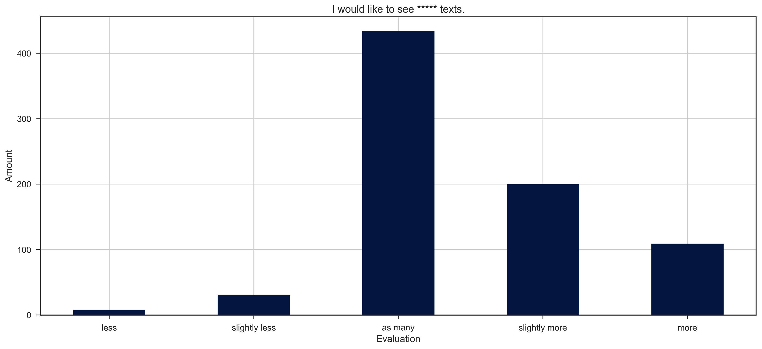
n=777
Echoes in Space - I would like to see ***** texts

Slide 24
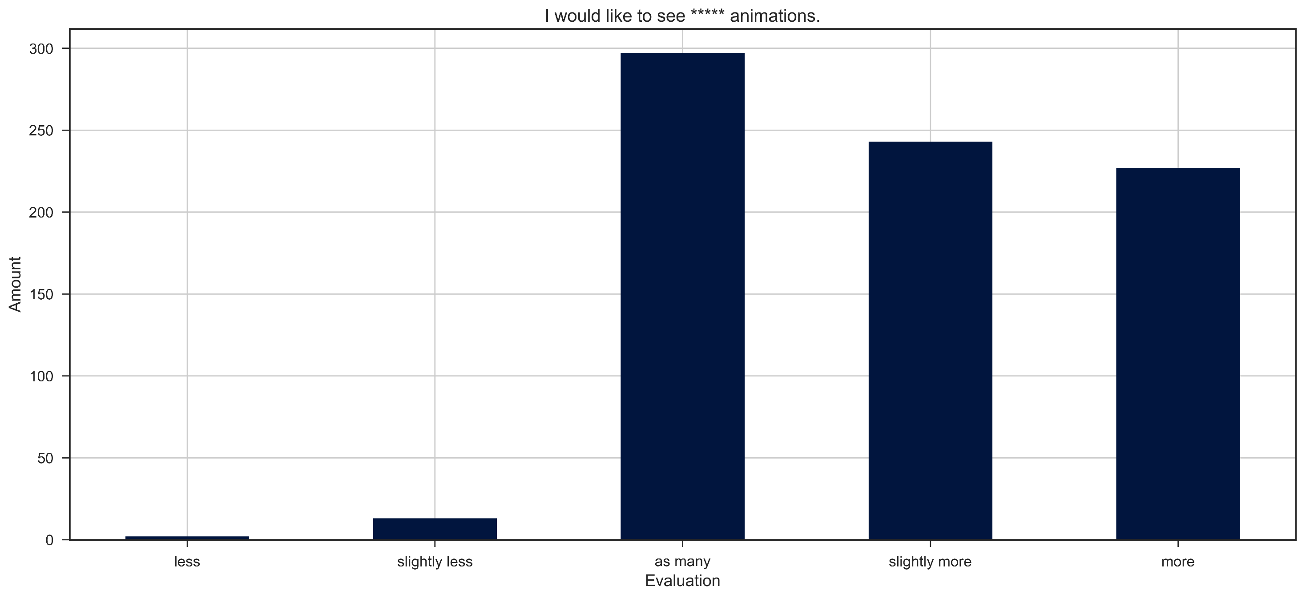
n=777
Echoes in Space - I would like to see ***** animations

Slide 25
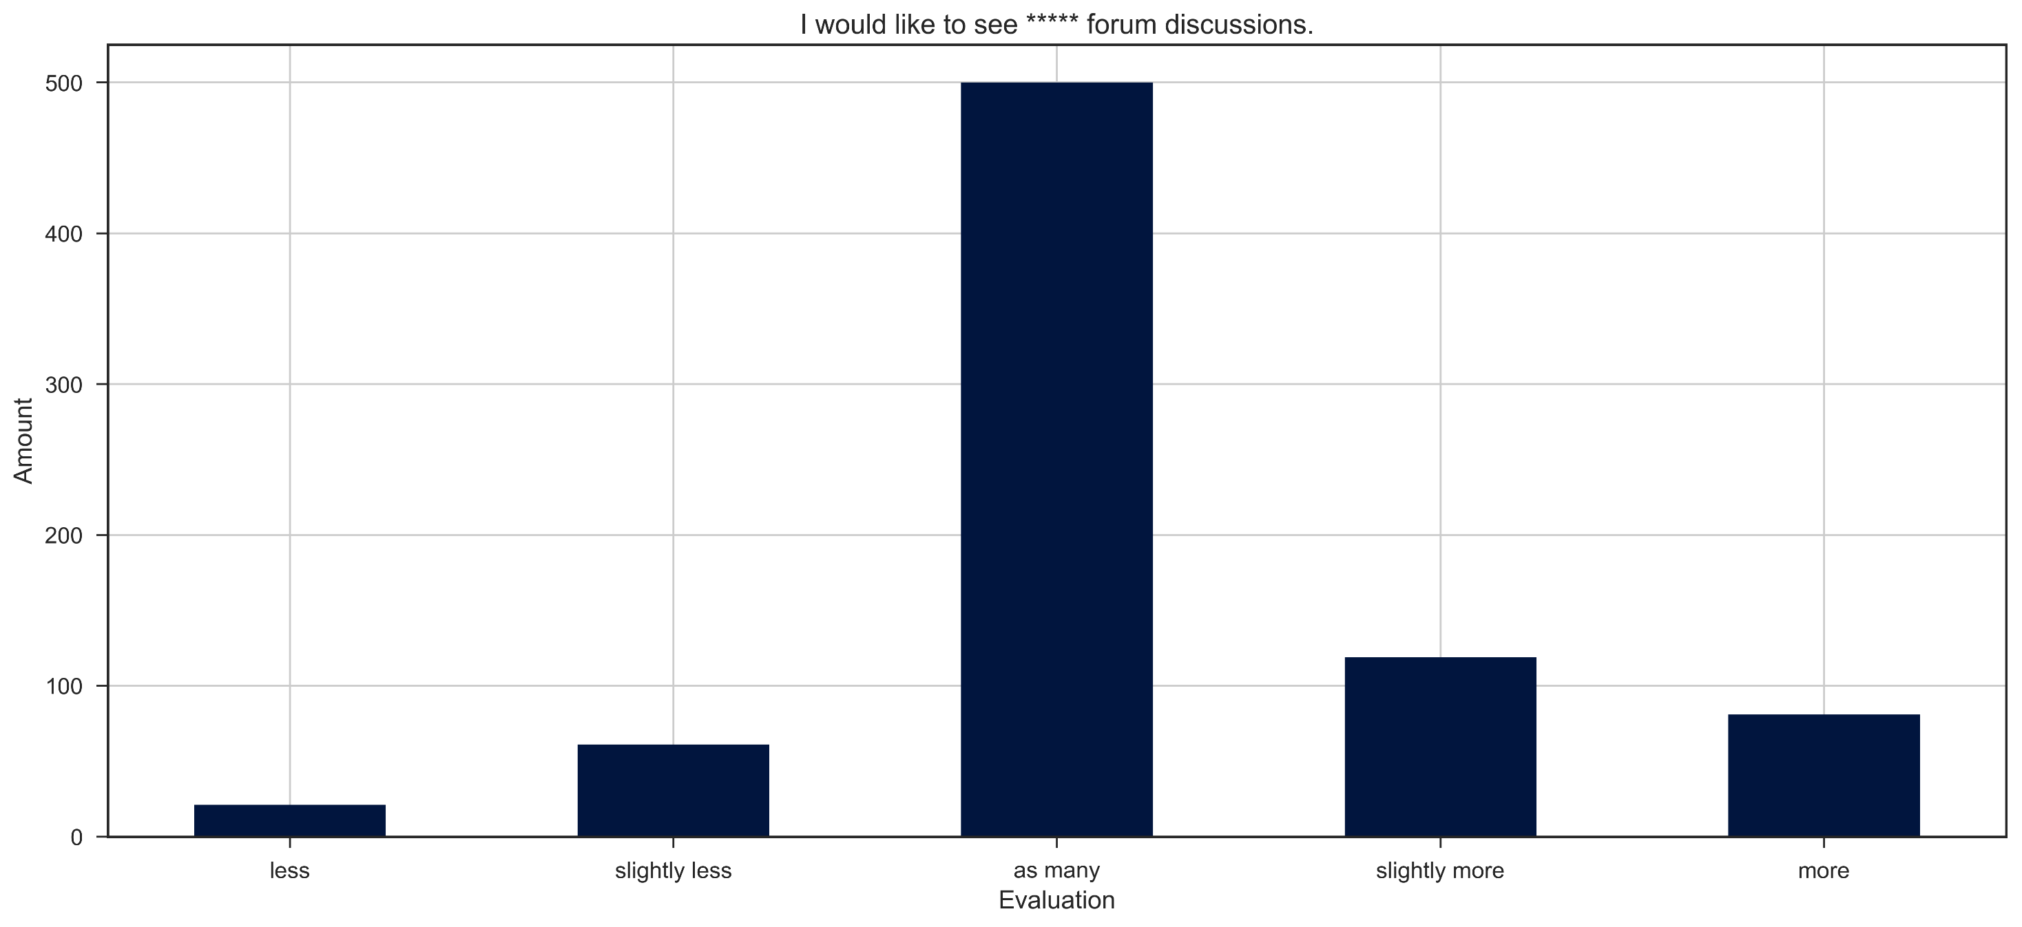
n=777
Echoes in Space - I would like to see ***** forum discussions

Slide 26
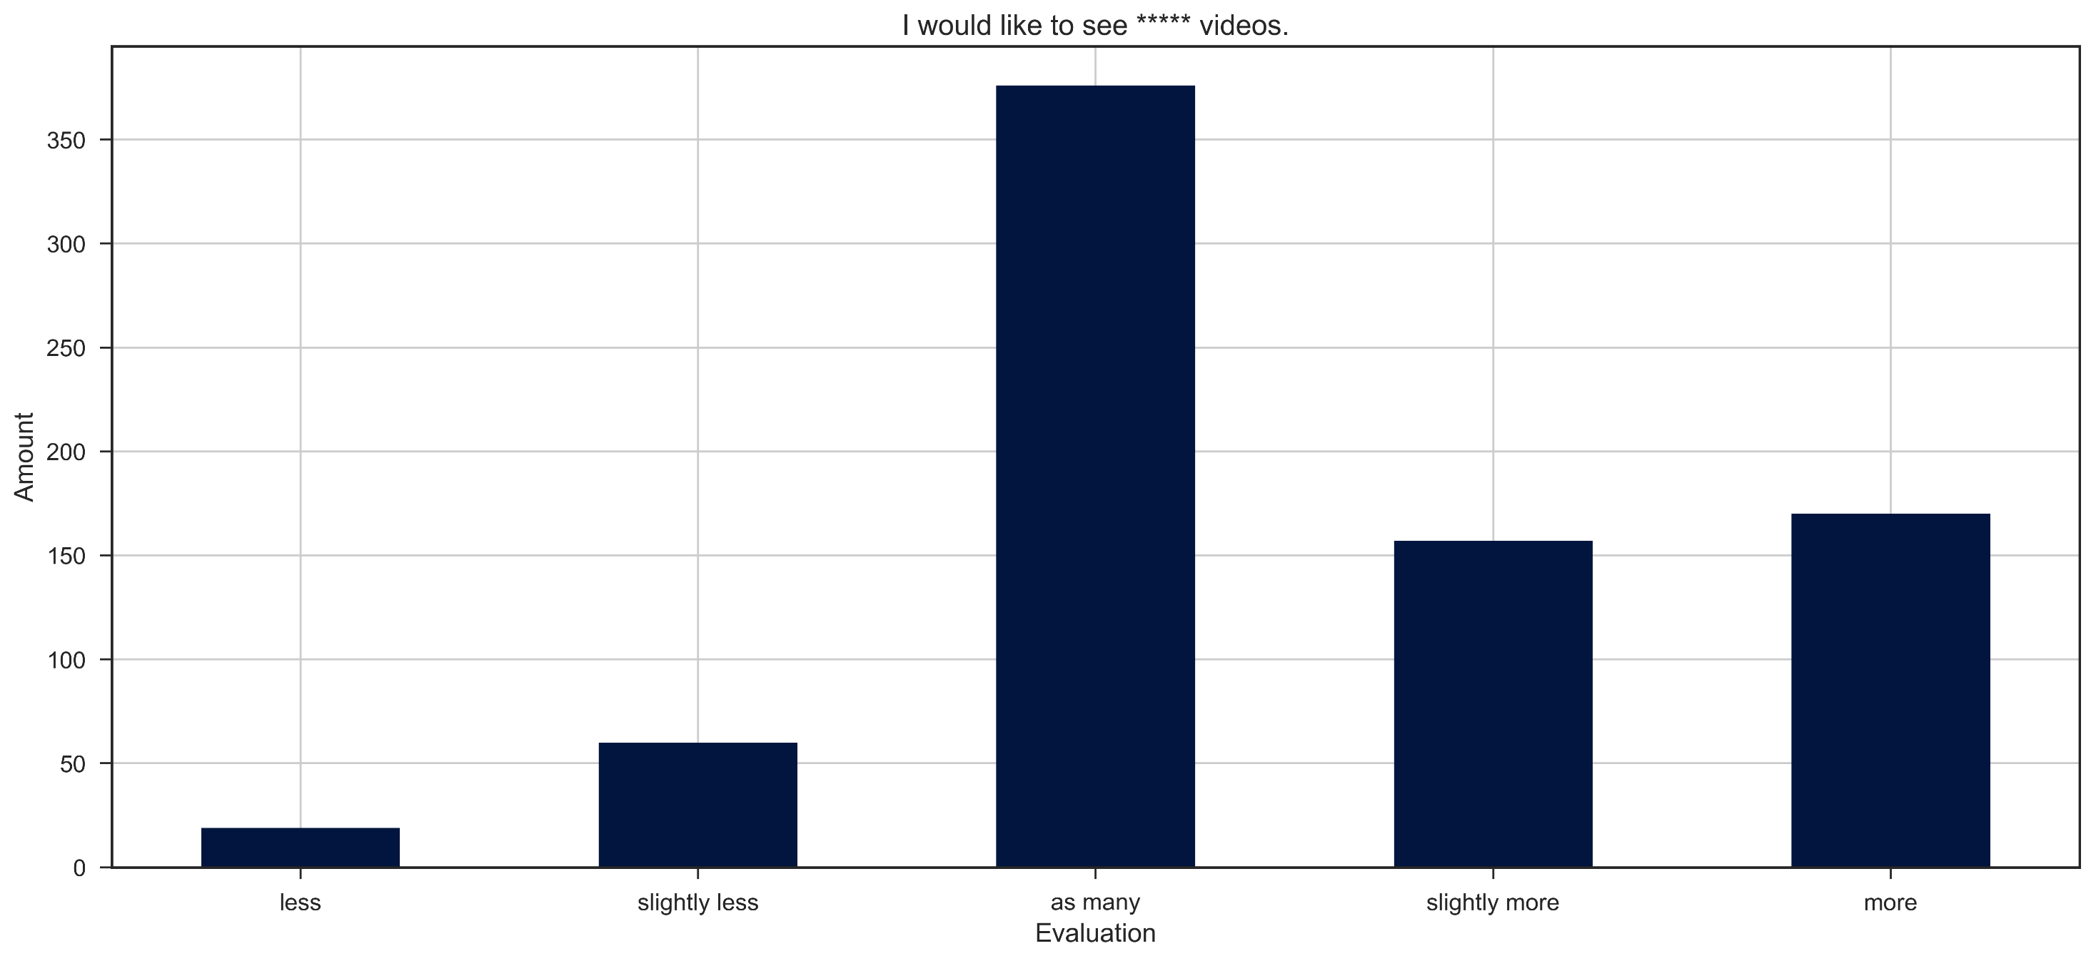
n=777
Echoes in Space - I would like to see ***** videos

Slide 27
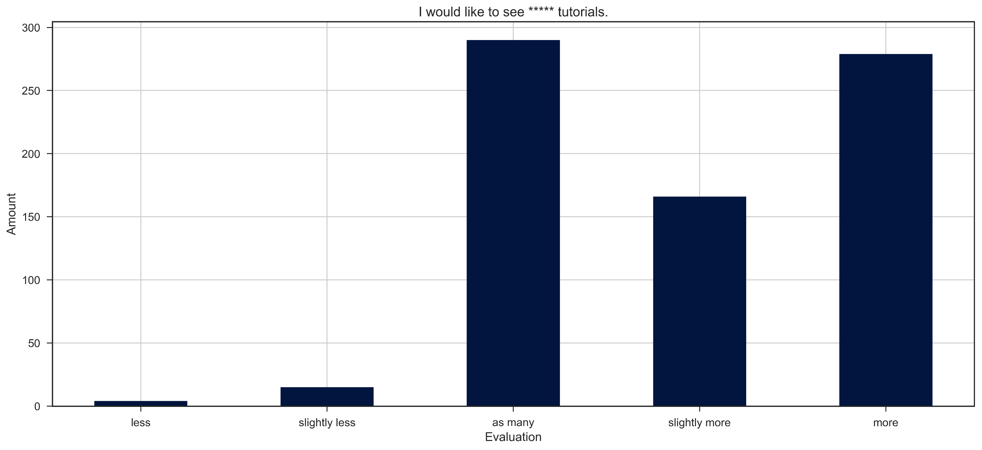
n=777
Echoes in Space - I would like to see ***** tutorials

Slide 28
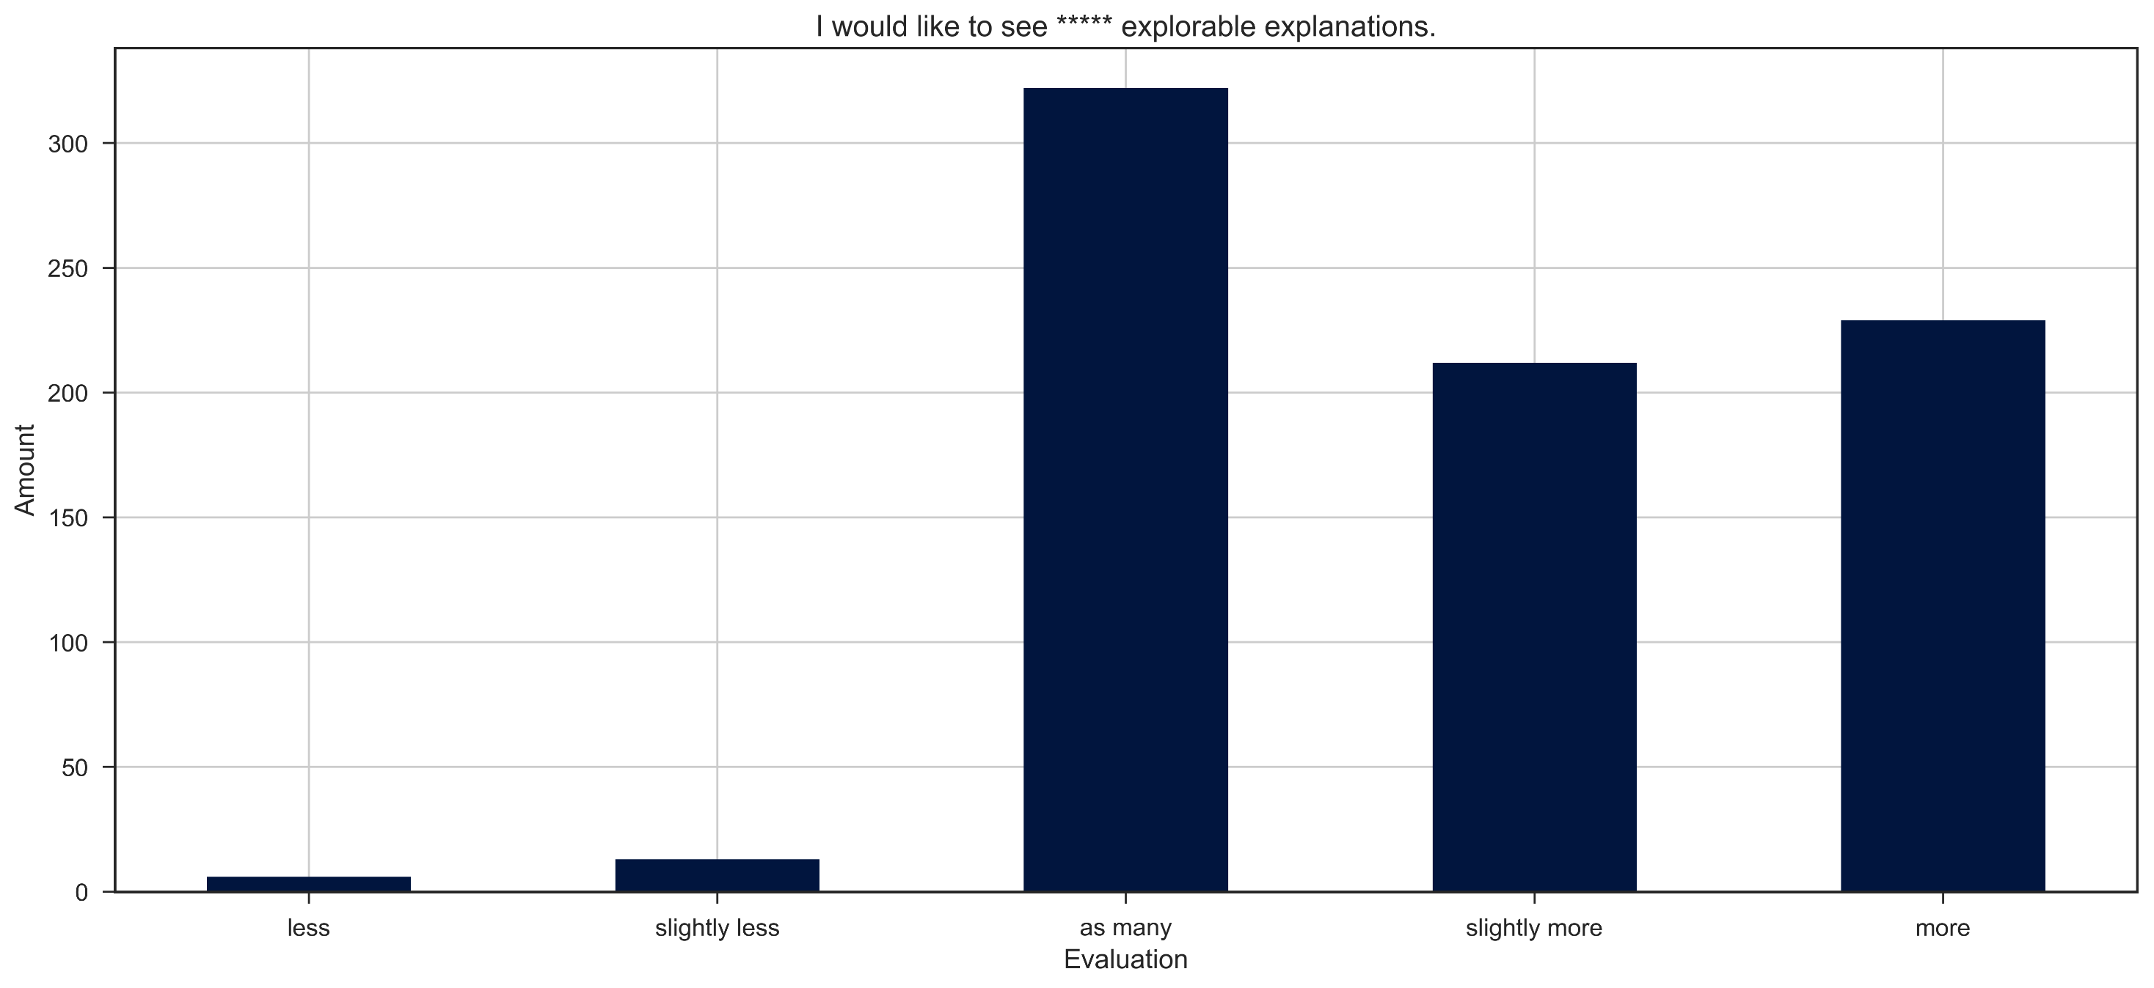
n=777
Echoes in Space - I would like to see ***** explorable explanations

Slide 29
Echoes in Space - User needs
Users asking for more advanced courses
More animations, less ‚talking heads‘
(Spanish) Subtitles
Video transcripts
Offline Version (Downloadable Book/PDF)
Courses on SAR time series
Issue: large data sets → many users with limited bandwidth
Provide interactive python notebooks
Difficulties in finding/using SAR software →(next slide)

Slide 30
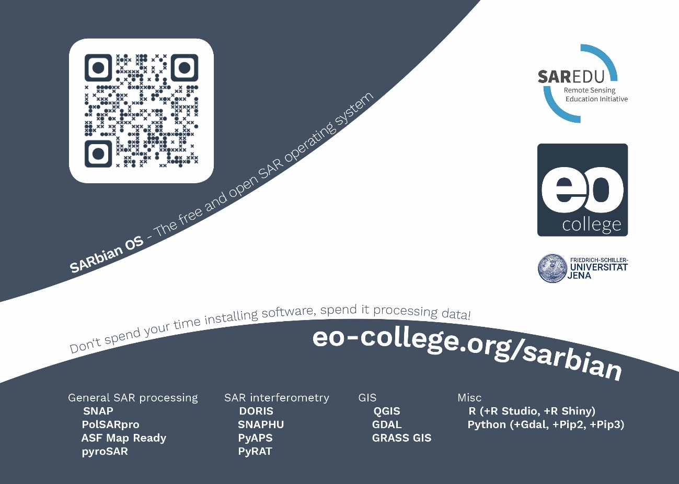

Slide 31
WEB PORTAL
SAR education resources

Slide 32
Requirements
(Link to other resources)
Educational Objective
Content
Further Reading

Slide 33
MATHE-MATICS
DATA
PROCESSING
SAR
IMAGING
BASICS
IMAGE
PROCESSING
INSAR
POLSAR
PASSIVE MICROWAVE
RADAR- GRAMMETRY
TOMOGRAPHY
METHODS
ANTHROPO-SPHERE
BIOSPHERE
CRYOSPHERE
HYDRO-SPHERE
LITHO-SPHERE
OCEANO-GRAPHY
APPLICATIONS

Slide 34
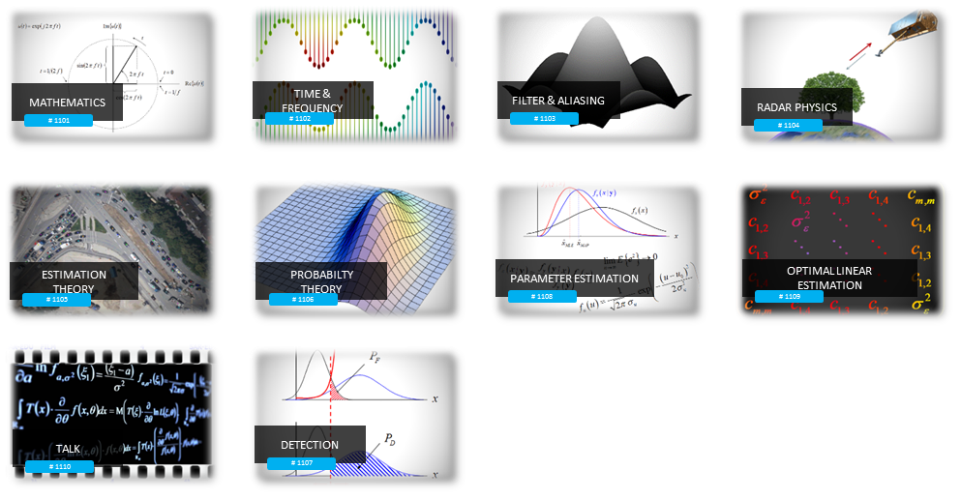
MATHE-MATICS

Slide 35
DATA
PROCESSING

Slide 36
SAR
IMAGING

Slide 37
MATHE-MATICS
DATA
PROCESSING
SAR
IMAGING
BASICS
IMAGE
PROCESSING
INSAR
POLSAR
PASSIVE MICROWAVE
RADAR- GRAMMETRY
TOMOGRAPHY
METHODS
ANTHROPO-SPHERE
BIOSPHERE
CRYOSPHERE
HYDRO-SPHERE
LITHO-SPHERE
OCEANO-GRAPHY
APPLICATIONS

Slide 38
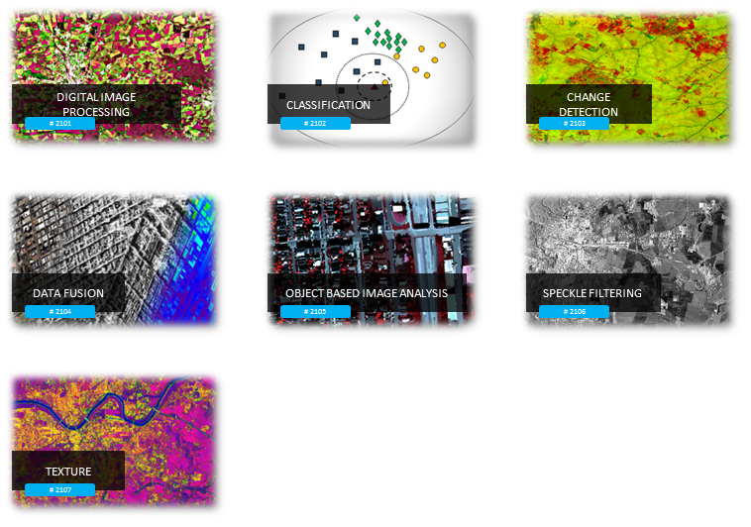
IMAGE
PROCESSING

Slide 39
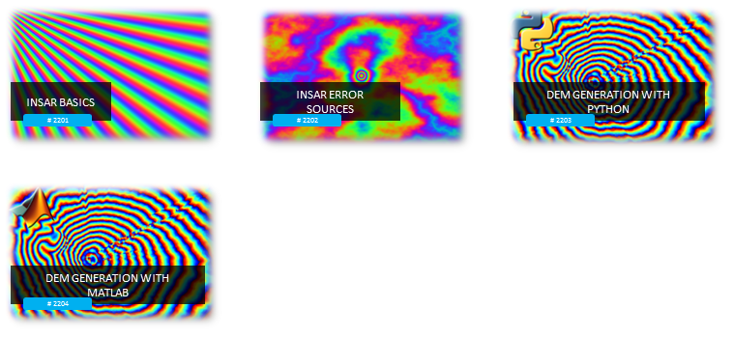
INSAR

Slide 40
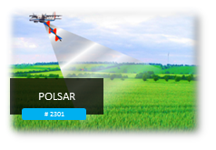
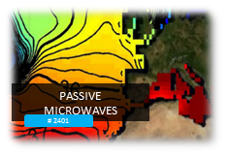
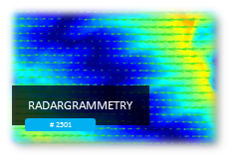
ADVANCED
SAR METHODS

Slide 41
MATHE-MATICS
DATA
PROCESSING
SAR
IMAGING
BASICS
IMAGE
PROCESSING
INSAR
POLSAR
PASSIVE MICROWAVE
RADAR- GRAMMETRY
TOMOGRAPHY
METHODS
ANTHROPO-SPHERE
BIOSPHERE
CRYOSPHERE
HYDRO-SPHERE
LITHO-SPHERE
OCEANO-GRAPHY
APPLICATIONS

Slide 42
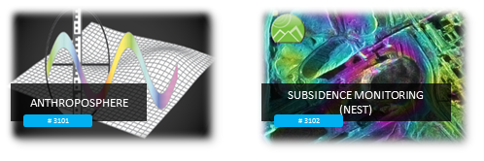
ANTHROPO-SPHERE

Slide 43
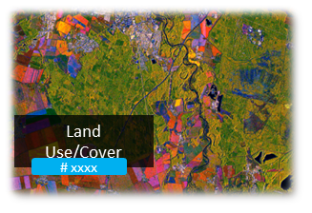
BIOSPHERE

Slide 44
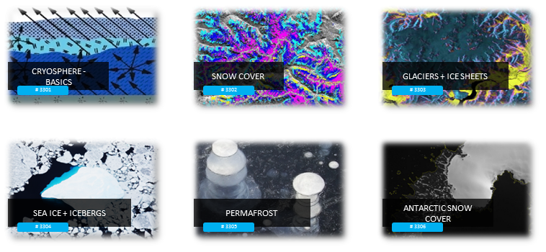
CRYOS-SPHERE

Slide 45
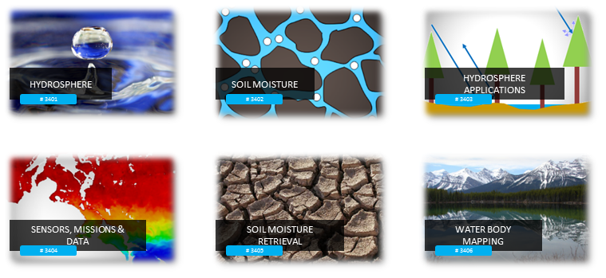
HYDROS-SPHERE

Slide 46
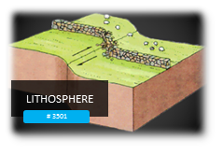
LITHOS-SPHERE

Slide 47
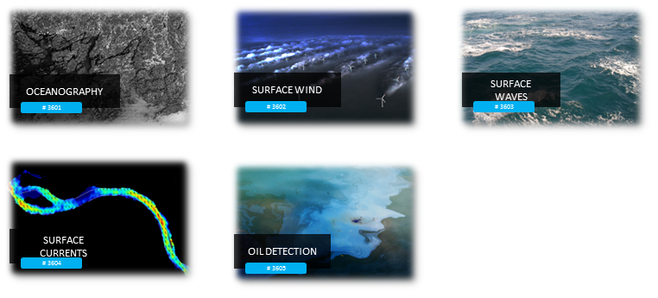
OCEANO-GRAPHY

Slide 48
Friedrich-Schiller University Jena
Department for Earth Observation
robert.eckardt@uni-jena.de

