Slide 1
The Applied Remote Sensing Training (ARSET) Program
Erika Podest, Jet Propulsion Laboratory, California Institute of Technology
Education and Capacity Building in the Use of SAR/InSAR Data
Denver, Colorado
Oct. 22, 2018
Notes:
Today I will provide an overview on NASA’s Applied Remote Sensing Training Program, which provides capacity building in different areas including SAR. For those that do not know me, I am a scientist at JPL focusing on the use of radar for terrestrial studies (wetlands and freeze/thaw specifically) and since two years ago I have been partly supporting the ARSET program as an instructor specifically its SAR and SMAP trainings.

Slide 2

NASA’s Applied Remote Sensing Training Program (ARSET)
http://arset.gsfc.nasa.gov/
Empowering the global community through remote sensing training
Part of NASA’s Applied Sciences Capacity Building Program
Seeks to increase the use of Earth science in decision-making through training for:
  policy makers
  environmental managers
  other professionals in the public and private sector
Topics for Trainings Include:
Water Resources
Air Quality
Disasters
Eco
Notes:
ARSET started in 2009 and is part of NASA’s Applied Sciences Program falling within its capacity building focus area. The objective of ARSET is to do capacity building on a global scale of NASA and other remote sensing products specifically to the applications community seeking to engage policy makers, environmental managers, and other professionals in the public and public sector. ARSET is global in scope.
The four topic areas of its trainings are water resources, air quality, land, and disasters. Some examples of recent trainings in these thematic areas are:
- Under Land: Change detection for land cover mapping
- Under Water: Processing Satellite Imagery for Water Quality
-Under Air Quality: High Temporal Resolution Air Quality Observations from Space
-Under Disasters: Monitoring Urban Floods Using Remote Sensing or Monitoring Tropical Storms for Emergency Preparedness

Slide 3
ARSET Team Members
Program Support
Ana Prados, Program Manager (GSFC)
David Barbado, Spanish Translator (GSFC)
Brock Blevins, Training Coordinator (GSFC)
Annelise Carleton-Hug, Program Evaluator (Consultant)
Elizabeth Hook, Technical Writer/Editor (GSFC)
Selwyn Hudson-Odoi, Training Coordinator (GSFC)
Marines Martins, Project Support (GSFC)
Stephanie Uz, Program Support (GSFC)
Disasters & Water Resources
Sean McCartney, Lead (GSFC)
Amita Mehta, Instructor (GSFC)
Sherry Palacios, Instructor (ARC)
Erika Podest, Instructor (JPL)
Land & Wildfires
Cynthia Schmidt, Lead (ARC)
Amber Jean McCullum, Instructor (ARC)
Health & Air Quality
Pawan Gupta, Lead (GSFC)
Melanie Cook, Instructor (GSFC)
Notes:
subject matter experts funded at some level. Guest speakers.

Slide 4
ARSET Program Assessment
training registration forms
informal conversations with training participants
two formal surveys
  Survey 1: given immediately after training
  Survey 2: .5-1 yr after training
ad hoc interviews with past participants
Notes:
ARSET has an independent consultant to do the assessments

Slide 5
ARSET Training Formats
Online
-Offered through the internet
-2-5 weeks long
-1-2 hours a week
-Available at all levels
-Live & recorded
-Free
-Materials available in English & Spanish
In-Person
-Hosted with a partner
-Typically in a computer lab
-2-7 days long
-Focus on locally-relevant case studies
-Certain topics can be presented in Spanish
Train the Trainer
-Online or in-person
-Designed for individuals and organizations looking to develop their own applied remote sensing trainings
Notes:
ARSET has three different training formats.
-Online trainings or the webinars usually consist in 3-5 webinars in the series extending from 2-5 weeks between the first and last webinar. Each webinar is 1-2 hours long including a period of questions and answers with the instructor at the end. Webinars are available at all levels, meaning beginner through advanced but most of them are beginner. Most webinars are in English though some are in Spanish too. All webinars are free. The only request is for participants to register. All of the presentation material and recordings are freely available.
-In person trainings are usually hosted with a partner, typically in a computer lab. These trainings can vary from 2-7 days in length and are focused on locally relevant case studies. Again, these are in English but sometimes in person trainings are also in Spanish.
-train the trainer is either online or in person and is designed for individuals and organizations looking to develop their own applied remote sensing trainings.

Slide 6


ARSET Training Levels
Advanced (Level 2)
Requires level 1 training or equivalent knowledge
In-depth and highly focused topics
Advanced Webinar: SAR Image and Data Processing
Basic (Level 1)
Requires level 0 training or equivalent knowledge
Covers specific applications
Introduction to Synthetic Aperture Radar
Fundamentals (Level 0)
Assumes no prior knowledge of remote sensing
Fundamentals of Remote Sensing
Notes:
ARSET has different training levels from level 0, which covers fundamentals and assumes no prior knowledge. The basic level 1 requires a basic level of knowledge and covers specific applications. For example Introduction to Synthetic Aperture Radar.
Then there is the Advanced Level 2, which requires a level 1 level of knowledge and is more focused such as for example the Advanced SAR training.

Slide 7




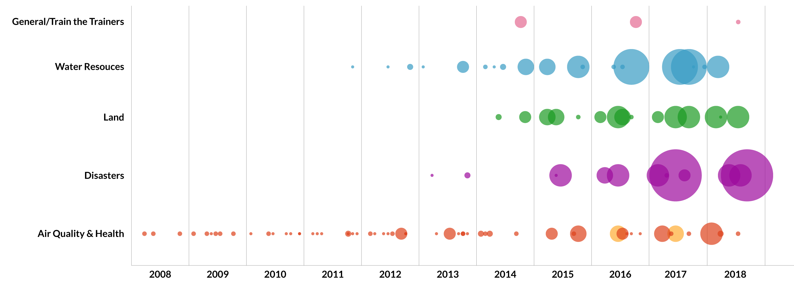
ARSET Trainings
110+ trainings
18,000+ participants
160 countries
4,000+ organizations
SAR Trainings
* size of bubble corresponds to number of attendees
Notes:
Reach: ARSET has a mailing list of interested people around the world and the reach and interest has been growing with time. Overall since 2009 ARSET has done over 110 trainings with a total of around 18000 participants in 160 countries and more than 4000 organizations. Here each bubble represents a specific training in the topic area within a given year and the size of the bubble corresponds to the number of attendees and you can see that there has been a significant increase in the last four years. Note the two large purple bubbles in disasters training in 2017 and 2018, those correspond to the SAR trainings. The level of participation in those trainings was beyond any other training that ARSET had ever done.

Slide 8
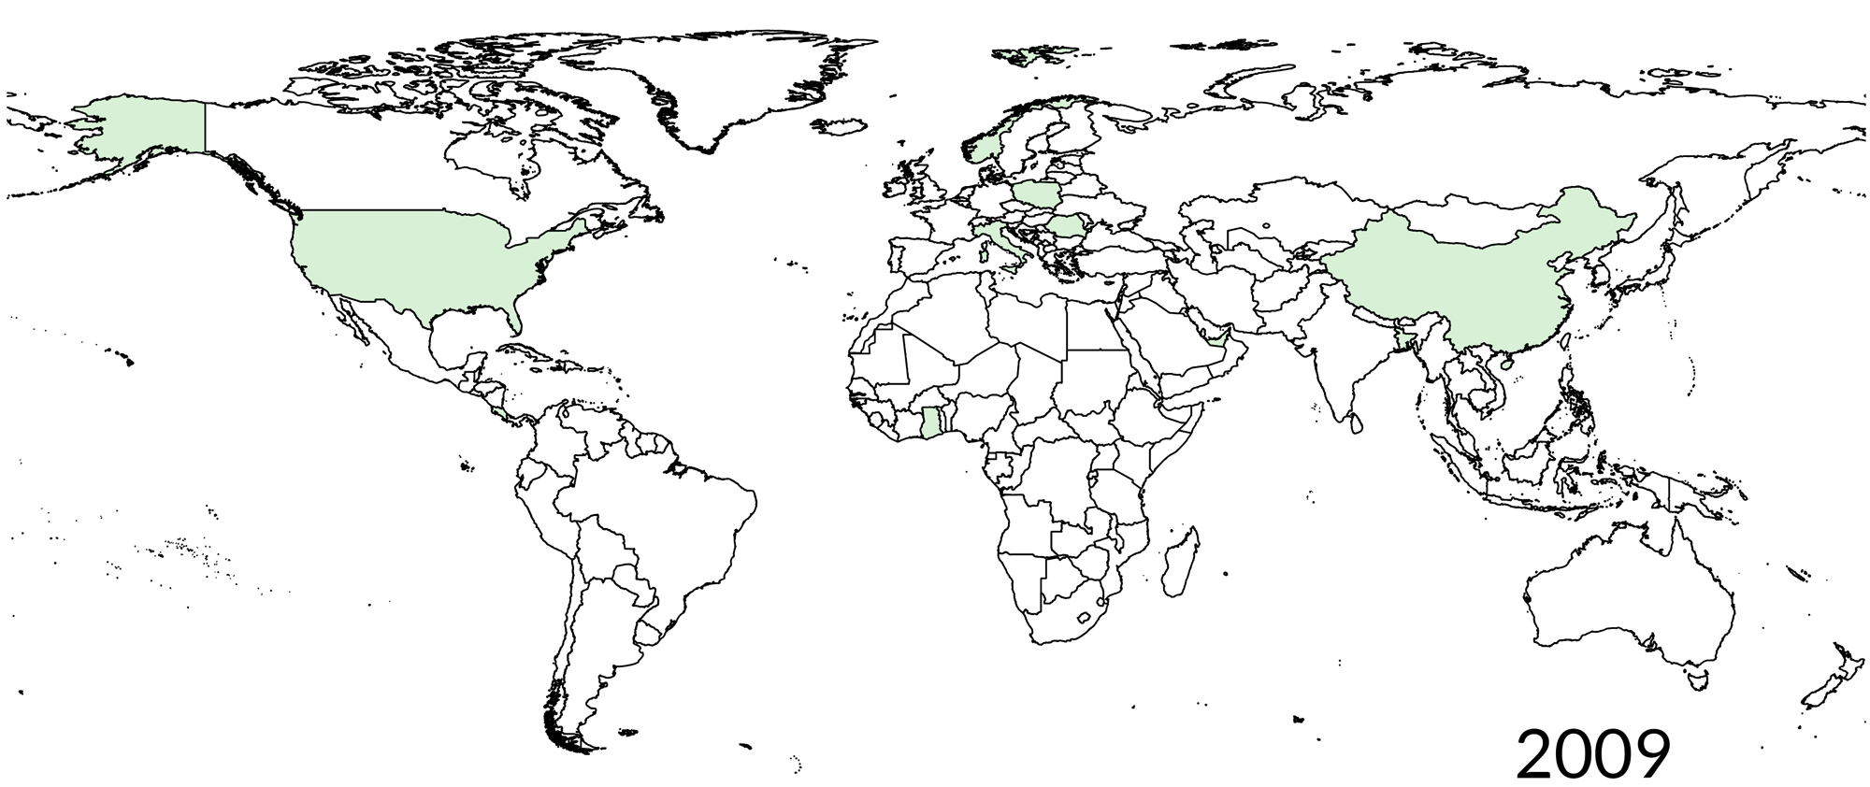
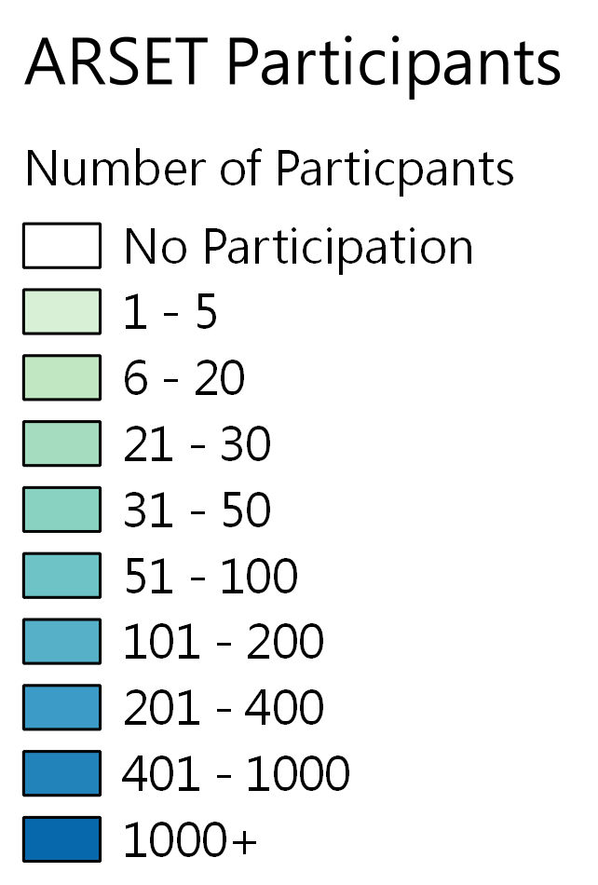
ARSET Trainings
ARSET Global Participants (2009, 2012-2017)
110+ trainings
18,000+ participants
160 countries
4,000+ organizations
Notes:
and this video shows the global distribution of the average number of ARSET participants per year with green being a lower level of participation and blue a higher level.

Slide 9
ARSET Participants
Attendee Sectors
Since 2013 ARSET has seen a…
1,300% increase in the number of attendees from private businesses
800% increase in the number of attendees from Non-Profits & NGOs
600% increase in the number of attendees from Federal/Central Governments
increase in share of attendees from academia as online trainings broaden international access
* percent increases are estimates
Notes:
Attendee Sectors updated 5/23/18
and this graph shows the breakdown of ARSET participants according to different sectors, with the largest one being academia followed by the government, private business and non-profits.

Slide 10


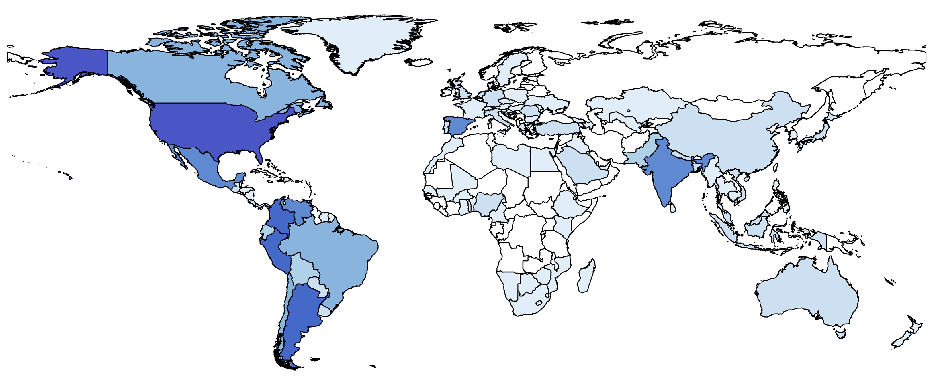
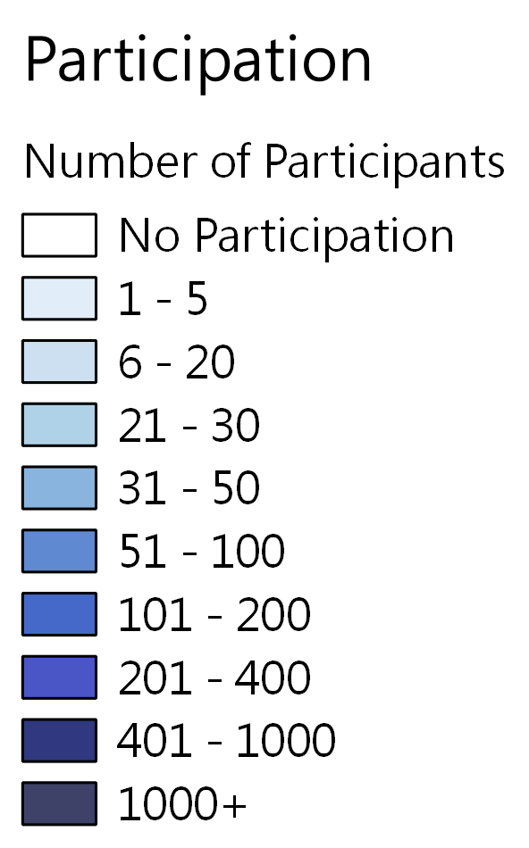
ARSET Training Impacts: Disasters Management (2013 – 2018)
13 trainings
4,990+ participants
130+ countries
1,435+ organizations
Training Topics Include…
Global Disaster Training Attendees (2017)
Earthquakes
Tropical Storms
Extreme Precipitation
Flooding

Slide 11
Online SAR Training: Introduction to SAR
Introduction to Synthetic Aperture Radar; Introducción al Radar de Apertura Sintética
Four, one-hour sessions in English and Spanish
Jun.-Jul. 2017
The objective was to provide an introduction to SAR to a non-technical audience focusing on:
-explaining concepts and understanding the information content in SAR images.
-providing demos on how to interpret SAR images, process SAR data, and perform basic analysis.
Intro to SAR Statistics:
984 participants
599 organizations
75 countries
26 U.S. States
Session 1: Basics of SAR (Podest)
Session 2: SAR Processing and Data Analysis (Podest)
Session 3: Introduction to Polarimetric SAR (Pinto)
Session 4: Introduction to SAR Interferometry (Fielding)
Notes:
The first SAR course was an Introduction to SAR online webinar in Jun-Jul 2017. It consisted of four sessions, covering the basics of SAR, SAR processing and data analysis, Introduction to Polarimetric SAR by Naiara Pinto and Introduction to INSAR by Eric Fielding. Each session was done in English and Spanish. The objective was to provide an introduction to SAR to a non-technical audience, focusing on explaining just concepts to that they could understand what sort of information SAR images provide and providing demo’s showing the necessary steps to process SAR images and how to perform basic analysis. The demo was done with Sentinel-1 data and with open source software SNAP.
There were a total of 984 participants from 599 organizations, 75 countries and 26 U.S.states. 54% stated that this was the first time they were taking an ARSET training.

Slide 12
Online SAR Training: Advanced SAR
Radar Remote Sensing for Land, Water, & Disaster Applications
Four, one-hour sessions in English and Spanish
Jul.-Aug. 2018
-Prerequisite: Introduction to SAR
The objective was to provide an advanced SAR training focused on specific topics:
-half of each session covered theory. Understanding image characteristics specific to the session’s application.
-the other half covered a demo using SNAP and either Sentinel-1 or PALSAR data.
Advanced SAR Statistics:
1024 participants
*largest ARSET training to date
Session 1: SAR for Land Cover Mapping (Podest)
Session 2: SAR for Flood Mapping (Podest)
Session 3: SAR for Mapping Crop Growth (McNairn)
Session 4: INSAR for Earthquake Deformation (Fielding)

Slide 13
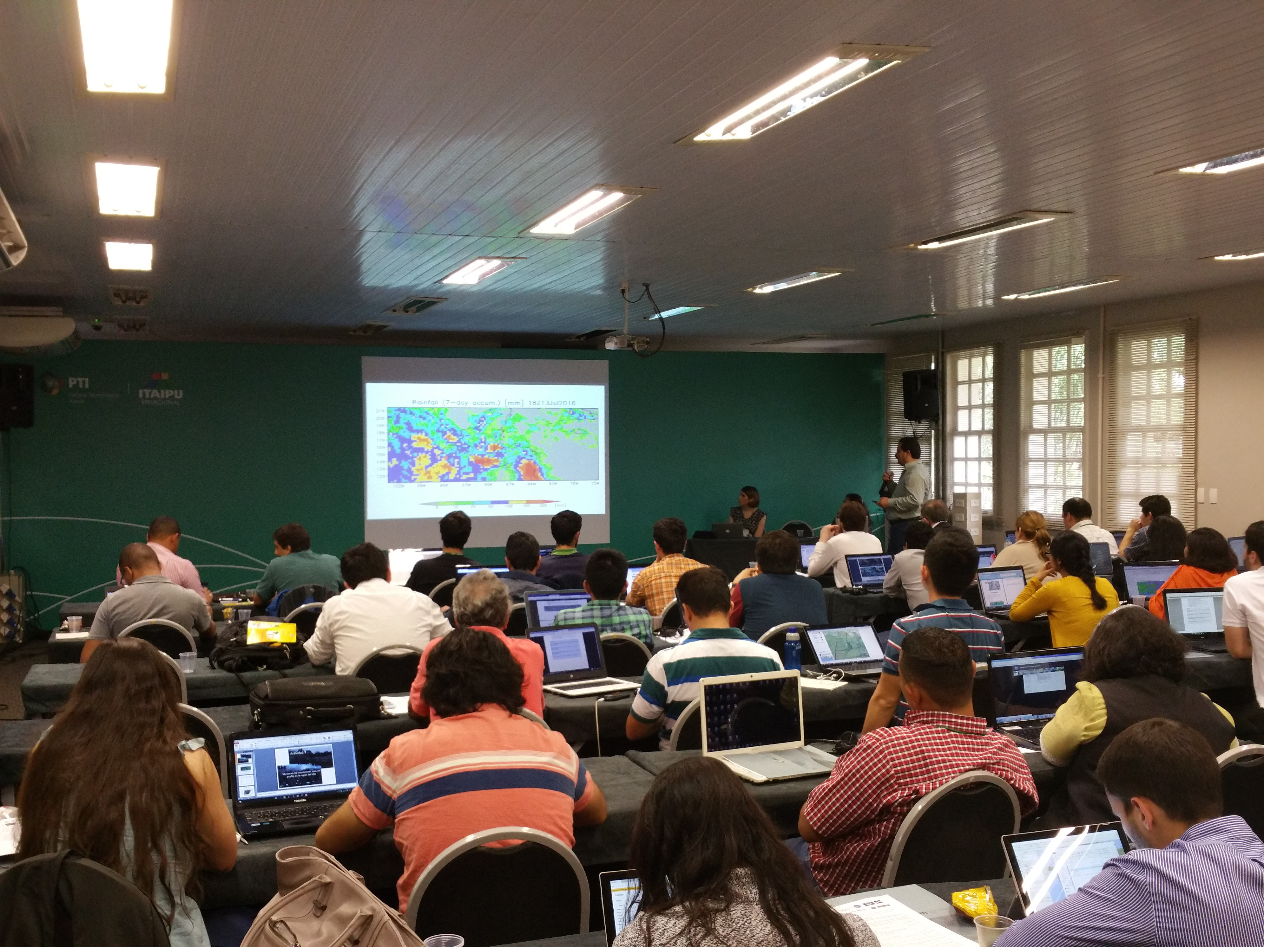
In Person Trainings
Application of Remote Sensing to Support the Management of Hydrographic Watersheds in Latin American and the Caribbean
organized by UNESCO and the ARSET Program
Foz du Iguacu, Brazil
Nov. 29-Dec. 6, 2017
Statistics:
~30-40 participants
NASA Remote Sensing for Flood Monitoring and Management Training
organized by ARSET and Dewberry
Fairfax, Virginia
Apr. 18-20. 2017
Remote Satellite Sensors for Water Resource Management in Latin America and the Caribbean
organized by UNESCO and ARSET
Foz du Iguacu, Brazil
Jul. 13-20, 2016

Slide 14
Lessons Learned from Online Trainings
Positives:
-Certificate of completion
-Define learning objectives
-Summary slide in the middle and at the end along with questions
-Course evaluation
-Open source data and software
-Accessibility to recordings and presentations
-youtube channel
-Spanish and English-greater outreach
Lessons Learned:
-Participants with slow connections had audio problems. State minimum connection speed.
-Demos are very helpful
-Homework is encouraged
-Subset demo images
-Post instructional demo guide and images
-Pre-record sessions especially the demo’s
-Stand alone power point presentations
-Use Google Earth Engine
-Show how to ingest final product into QGIS
-Q/A session and showing how to do things on the fly
Notes:
learning capsules and how to generate products

Slide 15
Lessons Learned from In-Person Trainings
Positives:
-Certificate of completion
-Define learning objectives
-Summary slide in the middle and at the end along with questions
-Course evaluation
-Open source data and software
-Accessibility to recordings and presentations
-youtube channel
-Spanish and English-greater outreach
Lessons Learned:
-Practical exercises in groups of 2-3
-Group presentations
-Subset SAR images
-Save images in pen drives
-Fast internet speed that can support the needs of the participants
-Teaching props to explain concepts
-Session no longer than 1 hour 15 minutes.

Slide 16
Specific Areas of Interest
-Large interest in INSAR (landslides, volcanoes, earthquakes)
-Landcover mapping (deforestation, biomass estimation)
-Flooding
-Data fusion (SAR and Optical)
-SAR derived products available
-Processing on the cloud

Slide 17

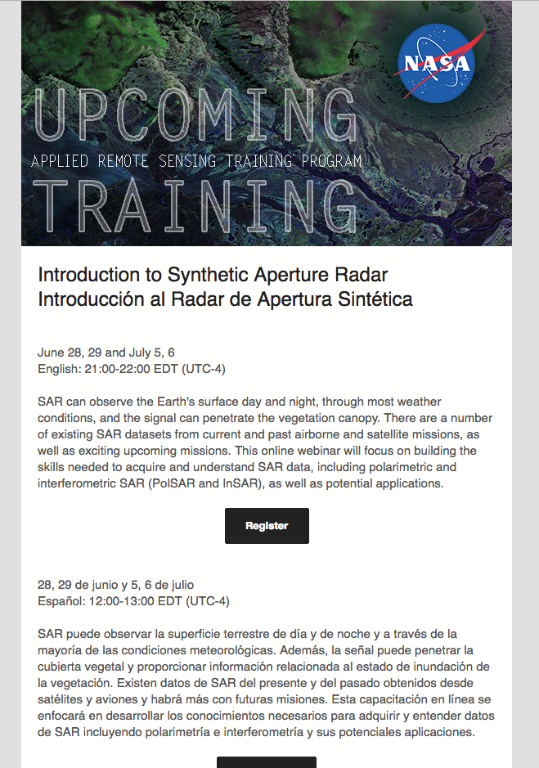
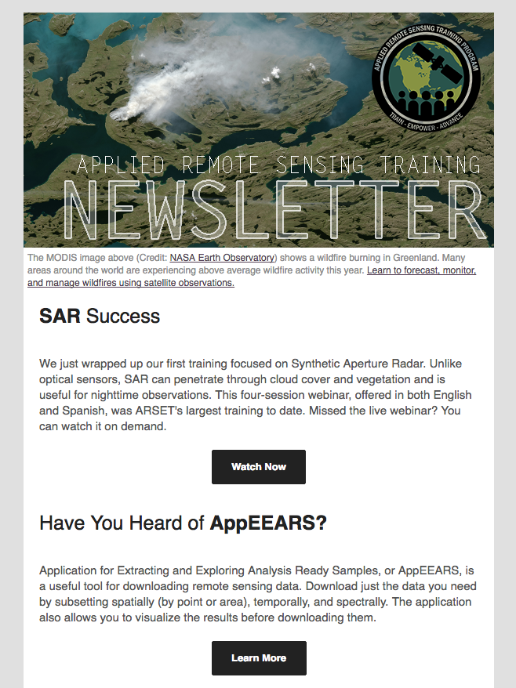
Sign up for the ARSET Listserv
https://lists.nasa.gov/mailman/listinfo/arset
Notes:
big on social media

Slide 18
http://arset.gsfc.nasa.gov/

