Slide 1
SERVIR
SPoRT
Africa Flores^{1,3}, Andrew Molthan^{2,4}, Eric Anderson^{1,3}
¹Earth System Science Center, University of Alabama in Huntsville
²NASA Short-term Prediction Research and Transition (SPoRT) Center
³NASA/SERVIR Science Coordination Office
⁴NASA / Marshall Space Flight Center
October 22, 2018

Slide 2











SERVIR connects space to village by helping developing countries use satellite data to address critical challenges in food security, water resources, weather and climate, land use, and natural disasters. A partnership of NASA, USAID, and leading technical organizations, SERVIR develops innovative solutions to improve livelihoods and foster self-reliance in Asia, Africa, and the Americas.
TBD
Agriculture & Food Security
Water & Water-Related
Disasters
Land Cover & Ecosystems
Weather & Climate

Slide 3

















What and Who is SERVIR?
“Connecting space to village”
A joint initiative of USAID and NASA that partners with regional technical institutions around the world to get Earth observation information into the hands of decision-makers to improve development outcomes.
Societal benefit from space
20+ satellites, data free and open
Major research portfolio
Limited internationally
Poverty reduction and resilience
Working on data-dependent issues in data-scarce places
International field presence
Regional hubs Hub partners
Private sector partners:
Research collaborators:
19 universities and research centers located in 14 states (in the U.S.)
Notes:
Nancy
We wanted to remind you what and who is SERVIR.
SERVIR is a jointly funded program between NASA and USAID that brings together our complementary strengths –
NASA’s unique vantage point of more than 20 satellites with free and open data and applied research for societal benefit
USAID’s unique vantage point from the ground – the village – with focus on international development, poverty reduction, and resilience
SERVIR works with regional technical institutions around the world - ADPC, RCMRD, ICIMOD, and CILSS and hub partners - to get information into the hands of decision-makers to improve development outcomes on important issues like food security and disaster resilience.
Private sector partners enable the computational power and high resolution imagery needed for some applications.
NASA brings the science. With 19 research collaborator teams located in 14 states across the US, NASA is focused on ways to leverage US science to replicate successes and innovate around the world, hand in hand with developing country organizations and scientists to leave behind increased technical capacity.
USAID brings the users. USAID’s development expertise and field presence in 100 countries provides the connections and local partnerships with stakeholders.

Slide 4
Building SAR Capacity through the SERVIR Network
Where are we now?
Internal needs and initial baseline capacity assessed
Priority applications identified
Involvement with NISAR applications user group
Awareness and involvement with CEOS trainings and pilots
Where do we want to be?
SAR-capable scientists, technicians, and practitioners throughout the broad SERVIR network. Aligns with SERVIR Strategic Goals (2015-2020) and Results Framework
Service areas of focus, prioritized:
1. Land cover, land use, ecosystems
1. Food security and agriculture
1. Water and disasters
2. Weather and climate
Applications/phenomena of focus
Surface water and floods
Forest biomass
Land cover, LCC, vegetation phenology
Agriculture, especially rice
Water height / altimetry
Soil moisture
Landslides / surface deformation
Urban planning / urbanization
Fire hazards
Coastal veg, hazards, processes
SERVIR Hubs
Science Coordination Office
Co-developers, Partners, Stakeholders
Notes:
SERVIR Hubs have good understanding of capacities, gaps, and needs. They co-design geospatial services to address those needs.
Science Coordination Office provides direct science support to Hubs. Also leads Applied Sciences Team (3 yr) and connects Subject Matter Experts (short term) to bring most innovative and appropriate science to bear for development challenges.
In the early days of SERVIR (2005 to ~2014), SAR was almost completely inaccessible, and a dead-end for designing sustainable geospatial solutions.
In the past few years, though, SAR has been great area for growth.

Slide 5
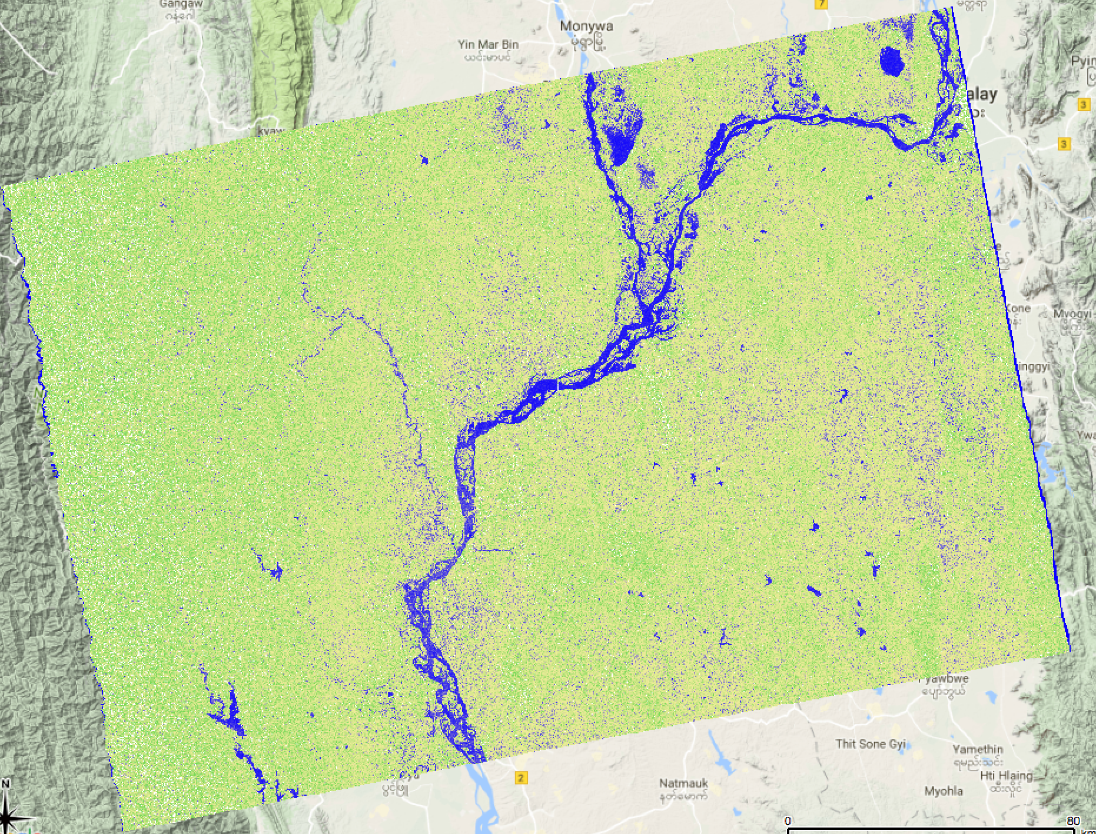
State of applying SAR in SERVIR services
Supporting Near-Real-Time Flood Monitoring in Myanmar (Sentinel-1)
  Related professional workshop in the Lower Mekong region
Internal training in Hindu Kush-Himalaya
  ALOS-2 PI at ICIMOD
Interest in Harmonized LULC mapping in West Africa
Interest in Biomass estimation in Eastern & Southern Africa
  Co-training and participation in CEOS SAR workshops
Series of workshops and creation of a SAR Handbook in all SERVIR regions
2015-08-11
Mandalay
80 km
Contains modified Copernicus Sentinel-1A data (2015), processed by ESA.

Slide 6


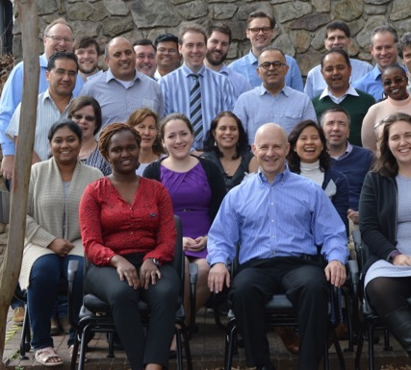
SERVIR-SilvaCarbon
SERVIR and SilvaCarbon Strengthen Global Capacity on Synthetic Aperture Radar (SAR) Applications for Forest Management
  Needs assessment: Land Cover Land Use Change (LCLUC) community in Africa and Asia – SERVIR international network
  Goal: Strengthen the capacity of SERVIR international network in the use of SAR for forest mapping/monitoring and biomass estimation
  Focus: create capacity for operational use of SAR data for LCLUC applications

Slide 7
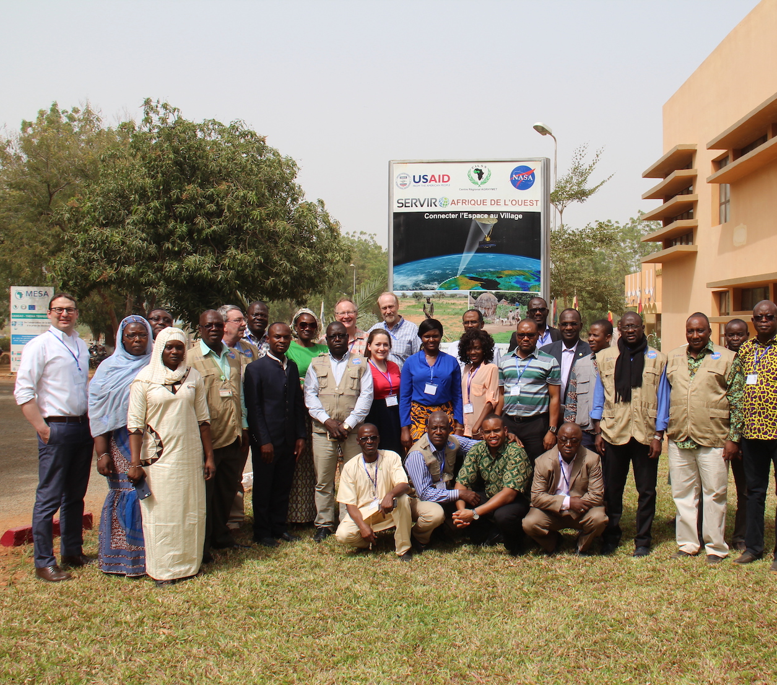
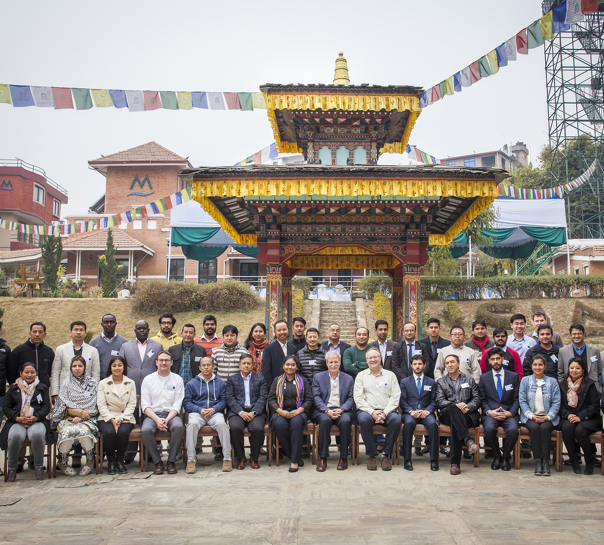
Global Round of SAR Capacity Building workshops for international partners in Africa an Asia (Spring-summer 2018)
Subject Matter Expert (SME) | Training/Book Chapter | Location
Franz Meyer (Univ. of Alaska Fairbanks) Josef Kellndorfer (Earth BigData) | SAR Basics and Forest Degradation and Deforestation | Niamey Kathmandu
Paul Siqueira (Univ. of Massachusetts) | Forest height | Bangkok
Marc Simard (JPL) Hans Andersen (USFS) | Mangrove and Sampling design | Nairobi
Sassan Saatchi (JPL) | Forest structure and biomass | Kathmandu
Total of 5 trainings:
  Training tutorials and scripts
  Open source

Slide 8
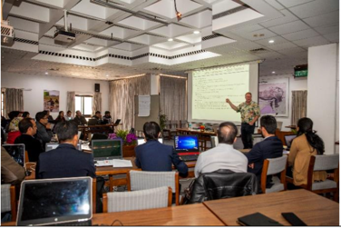
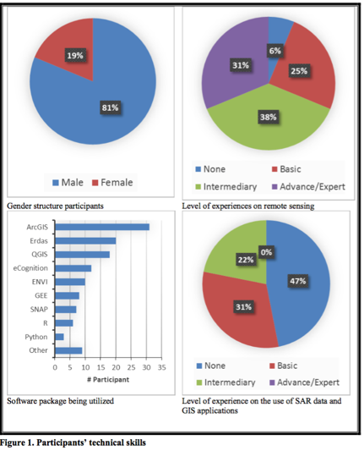
SAR Capacity Building Feedback
~132 participants in total/ 4 workshops
CB gaps:
-Time series data creation method
-cloud processing for bulk data analysis
-more tutorials and coding to access and process voluminous data
-procedures for data fusion of optical and radar
Applications:
-Automated system for forest degradation identification
-Forest health monitoring
-Deforestation early warning system
-Charcoal monitoring (West Africa)
-Illegal mining
Challenges:
Lack of consistent programing knowledge
100%
Capacity increased because of the training
Source: ICIMOD SAR training in Nepal, Feb 2018.

Slide 9
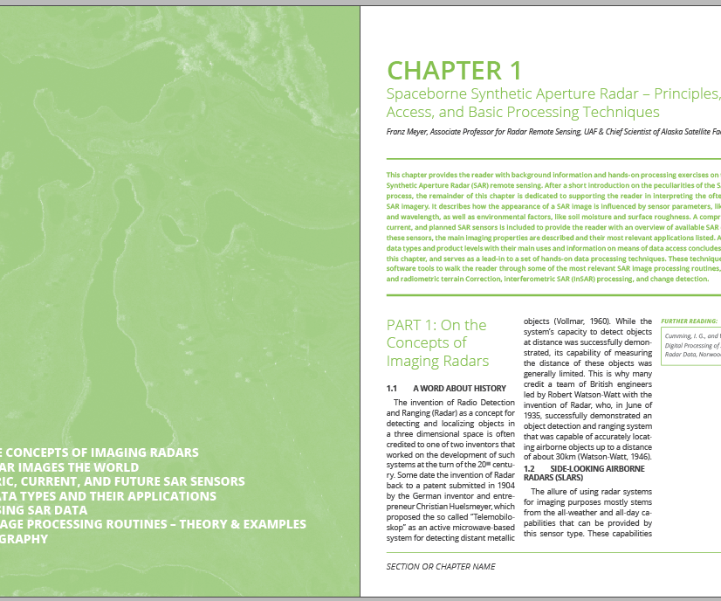
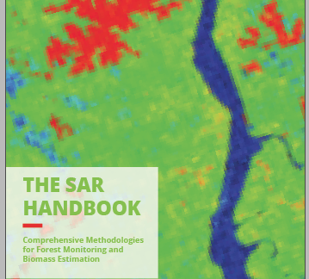
SAR-Handbook: Comprehensive Methodologies for Forest Monitoring and Biomass Estimation
Explaining how to use and from where to obtain SAR data for forest applications
Oriented to scientific LCLUC community used to optical remote sensing data
NASA- E-Book
Will include training tutorials
Additional materials:
  3 technical videos w/ animations (2 min or less)
    Goal: animate key concepts that need further explanation
  Video interviews: Introduction of SAR Handbook chapters and to the people who created it
  One Pagers: describing key pre-processing and analyses –data recipes

Slide 10




Short-term Prediction
Research and Transition (SPoRT) Center
SPoRT is focused on transitioning unique NASA and NOAA observations and research capabilities to the operational weather community to improve short-term weather forecasts on a regional and local scale.
  close collaboration with numerous WFOs and National Centers across the country
  SPoRT activities began in 2002, first products to AWIPS in 2003
  co-funded by NOAA since 2009 through satellite “proving ground” activities
Proven paradigm for transition of research and
experimental data to “operations”
Benefit
  demonstrate capability of NASA and NOAA
  experimental products to weather applications and societal benefit
  prepares forecasters for use of data from next generation of operational satellites (JPSS, GOES-R)

Slide 11
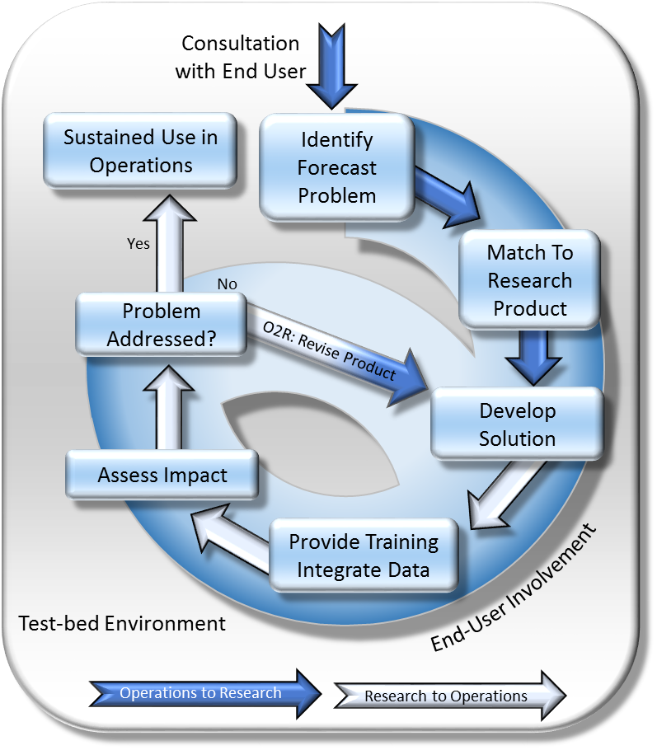
SPoRT Paradigm for R2O & O2R Success
  Keys to success
  Involve end user in entire process
  Develop end-user appropriate training
  Assess impact of solution on operations
  Incorporate feedback as part of the O2R process
  A successful transition occurs when a new capability has a predominately positive impact on the forecast problem and is used “operationally” in the end users decision support system.
  “Operational” use means regular or sustained use of data / products to make decisions

Slide 12
NASA’s Earth Science Disasters Program
NASA’s Earth Science: Disasters Program has established a ”SAR Tiger Team” of experts affiliated with various Centers, projects, and within academia to help with product development and end-user support
Activities have included use of ASF-generated and routine SAR products, along with other developments via JPL/ARIA, GSFC, and others, focused on standardization and routine visualizations
Training through event response, user engagement, ARSET, and others have been crucial for incorporating the use of these products in the “operations” for response entities, similar to MSFC/SPoRT experiences with NOAA’s NWS
Regarding SAR education, end users have a range of interests including:
  Local efforts to build their own capacity around software tools, product generation, and interpretation – the ability to be self-directed and manage generation of products
  Collaborative efforts to routinely receive SAR-based products and value-added analysis from partners, but with enough underlying background to have confidence and understanding in their capabilities and limitations

Slide 13
Collaborations with ASF
MSFC Earth Science Disasters Team and MSFC/SPoRT have been working with ASF (and through them, others) to gain knowledge about synthetic aperture radar and its uses in their program
Collaborative experiences and knowledge-sharing have facilitated outreach to more end users and a broader community engaged around SAR analysis
Training sessions led by ASF, similar to those hosted by SERVIR and others, have proven beneficial for engaging a broader community around the use of SAR in decision-making and other applications.
  Continued collaborations in the SAR community on training workshops around current missions, future missions (NISAR, commercial/international, future Designated Observables missions) presumably would be of continued benefit
SPoRT sent two team members to Fairbanks for two weeks in March for a 2-week sprint to help develop 3 products that would be beneficial to SPoRT end users
  These close collaborations between actual/potential end users and developers can be helpful in fine-tuning the needs for products and also help improve communications around training

Slide 14
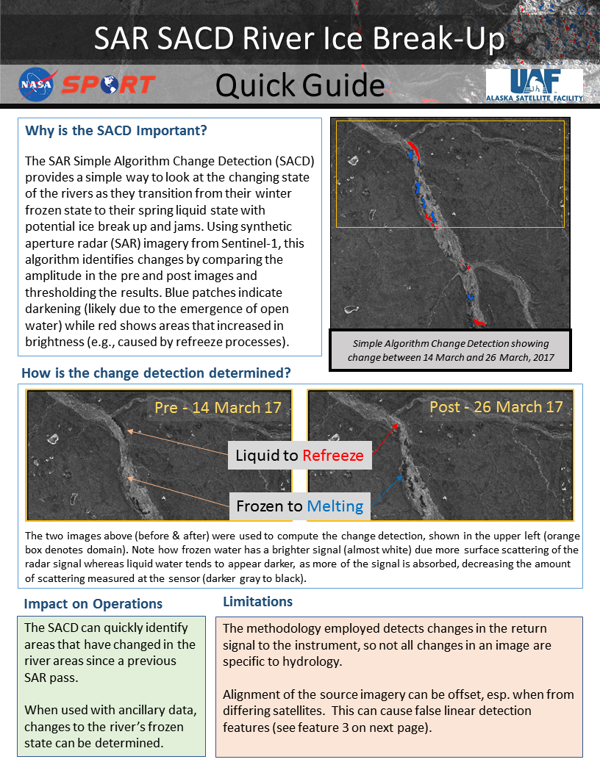
End User Training – Product Example
End-user training is an integral part of the transitioning a research product into an operational environment.
Modification of format, application, and product description help to tailor training to the decision maker’s requirements.
Training modules (Articulate and Slide format) serve to describe the science and application of the produce.
1-2 page Quick Guides offer an annotated case example with quick reference reminders of how to use the product along with caveats and limitations.
These modes of training have proven helpful for end users and could be expanded or replicated to SAR-specific topics:
  Wavelengths
  Platforms
  Polarizations
  Decompositions
  Software

