Slide 1
Short courses and workshops for new InSAR users and non-specialists
Gareth Funning, University of California, Riverside
1) The GETSI project: teaching materials
Module: 'Imaging active tectonics using InSAR and LiDAR' (includes lecture and two lab exercises for undergraduate classes)
2) WInSAR/UNAVCO 1-day short courses
InSAR for non-specialists (end-users of processed data, professional level)

Slide 2
GETSI module: 'Imaging Active Tectonics with InSAR and LiDAR'
Developed following 1 day UNAVCO 'Teaching Geodesy' workshop at GSA
Evolved out of teaching materials I used in my own undergrad/grad classes, including some based on UNAVCO's own education materials
Constructed based on thorough set of learning outcomes; evaluated by learning consultants
Publicised by workshops at UNAVCO Science Workshop and AGU, and an InTeGrate webinar

Slide 3
Imaging Active Tectonics with LiDAR and InSAR
serc.carleton.edu/getsi/teaching_materials/imaging_active_tectonics/index.html
Notes:
Image source: NOAA/NGDC, open domain

Slide 4
The Concept
Earthquakes can damage the infrastructure lifelines that society depends upon – motivating our use of LiDAR and InSAR to study faulting and earthquakes

Slide 5
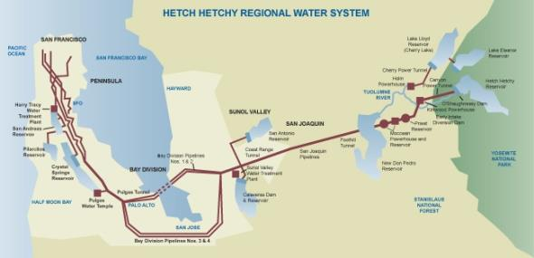
Hayward
Calaveras
Greenville
San Andreas
Fault-crossing infrastructure!

Slide 6
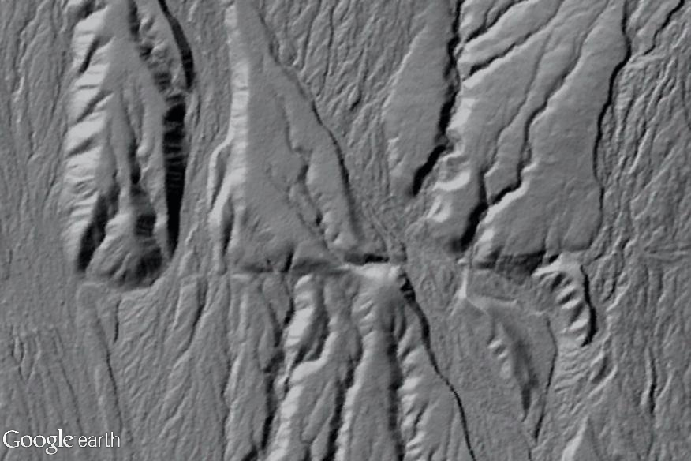
LiDAR can give you the locations of active faults and their long-term slip behavior…
…and InSAR can give you a detailed picture of the short-term slip behavior of faults (earthquakes!)

Slide 7
The Units
Identifying vulnerable infrastructure in the vicinity of, or crossing, active faults
Using LiDAR data to estimate fault slip rates and recurrence rates
An introduction to InSAR, and basic interferogram interpretation
Simple modeling of interferogram data of earthquakes
Relating societal impacts from a recent earthquake to insights gained from LiDAR and InSAR data for that fault/event

Slide 8
The Units
Identifying vulnerable infrastructure in the vicinity of, or crossing, active faults
Using LiDAR data to estimate fault slip rates and recurrence rates
An introduction to InSAR, and basic interferogram interpretation
Simple modeling of interferogram data of earthquakes
Relating societal impacts from a recent earthquake to insights gained from LiDAR and InSAR data for that fault/event

Slide 9
Unit 3 Elements
An annotated PowerPoint presentation introducing InSAR, how it works, how to interpret data and what its capabilities and limitations are
A practical exercise in interpreting a SAR interferogram of an earthquake (can be paper- or Google Earth-based)

Slide 10
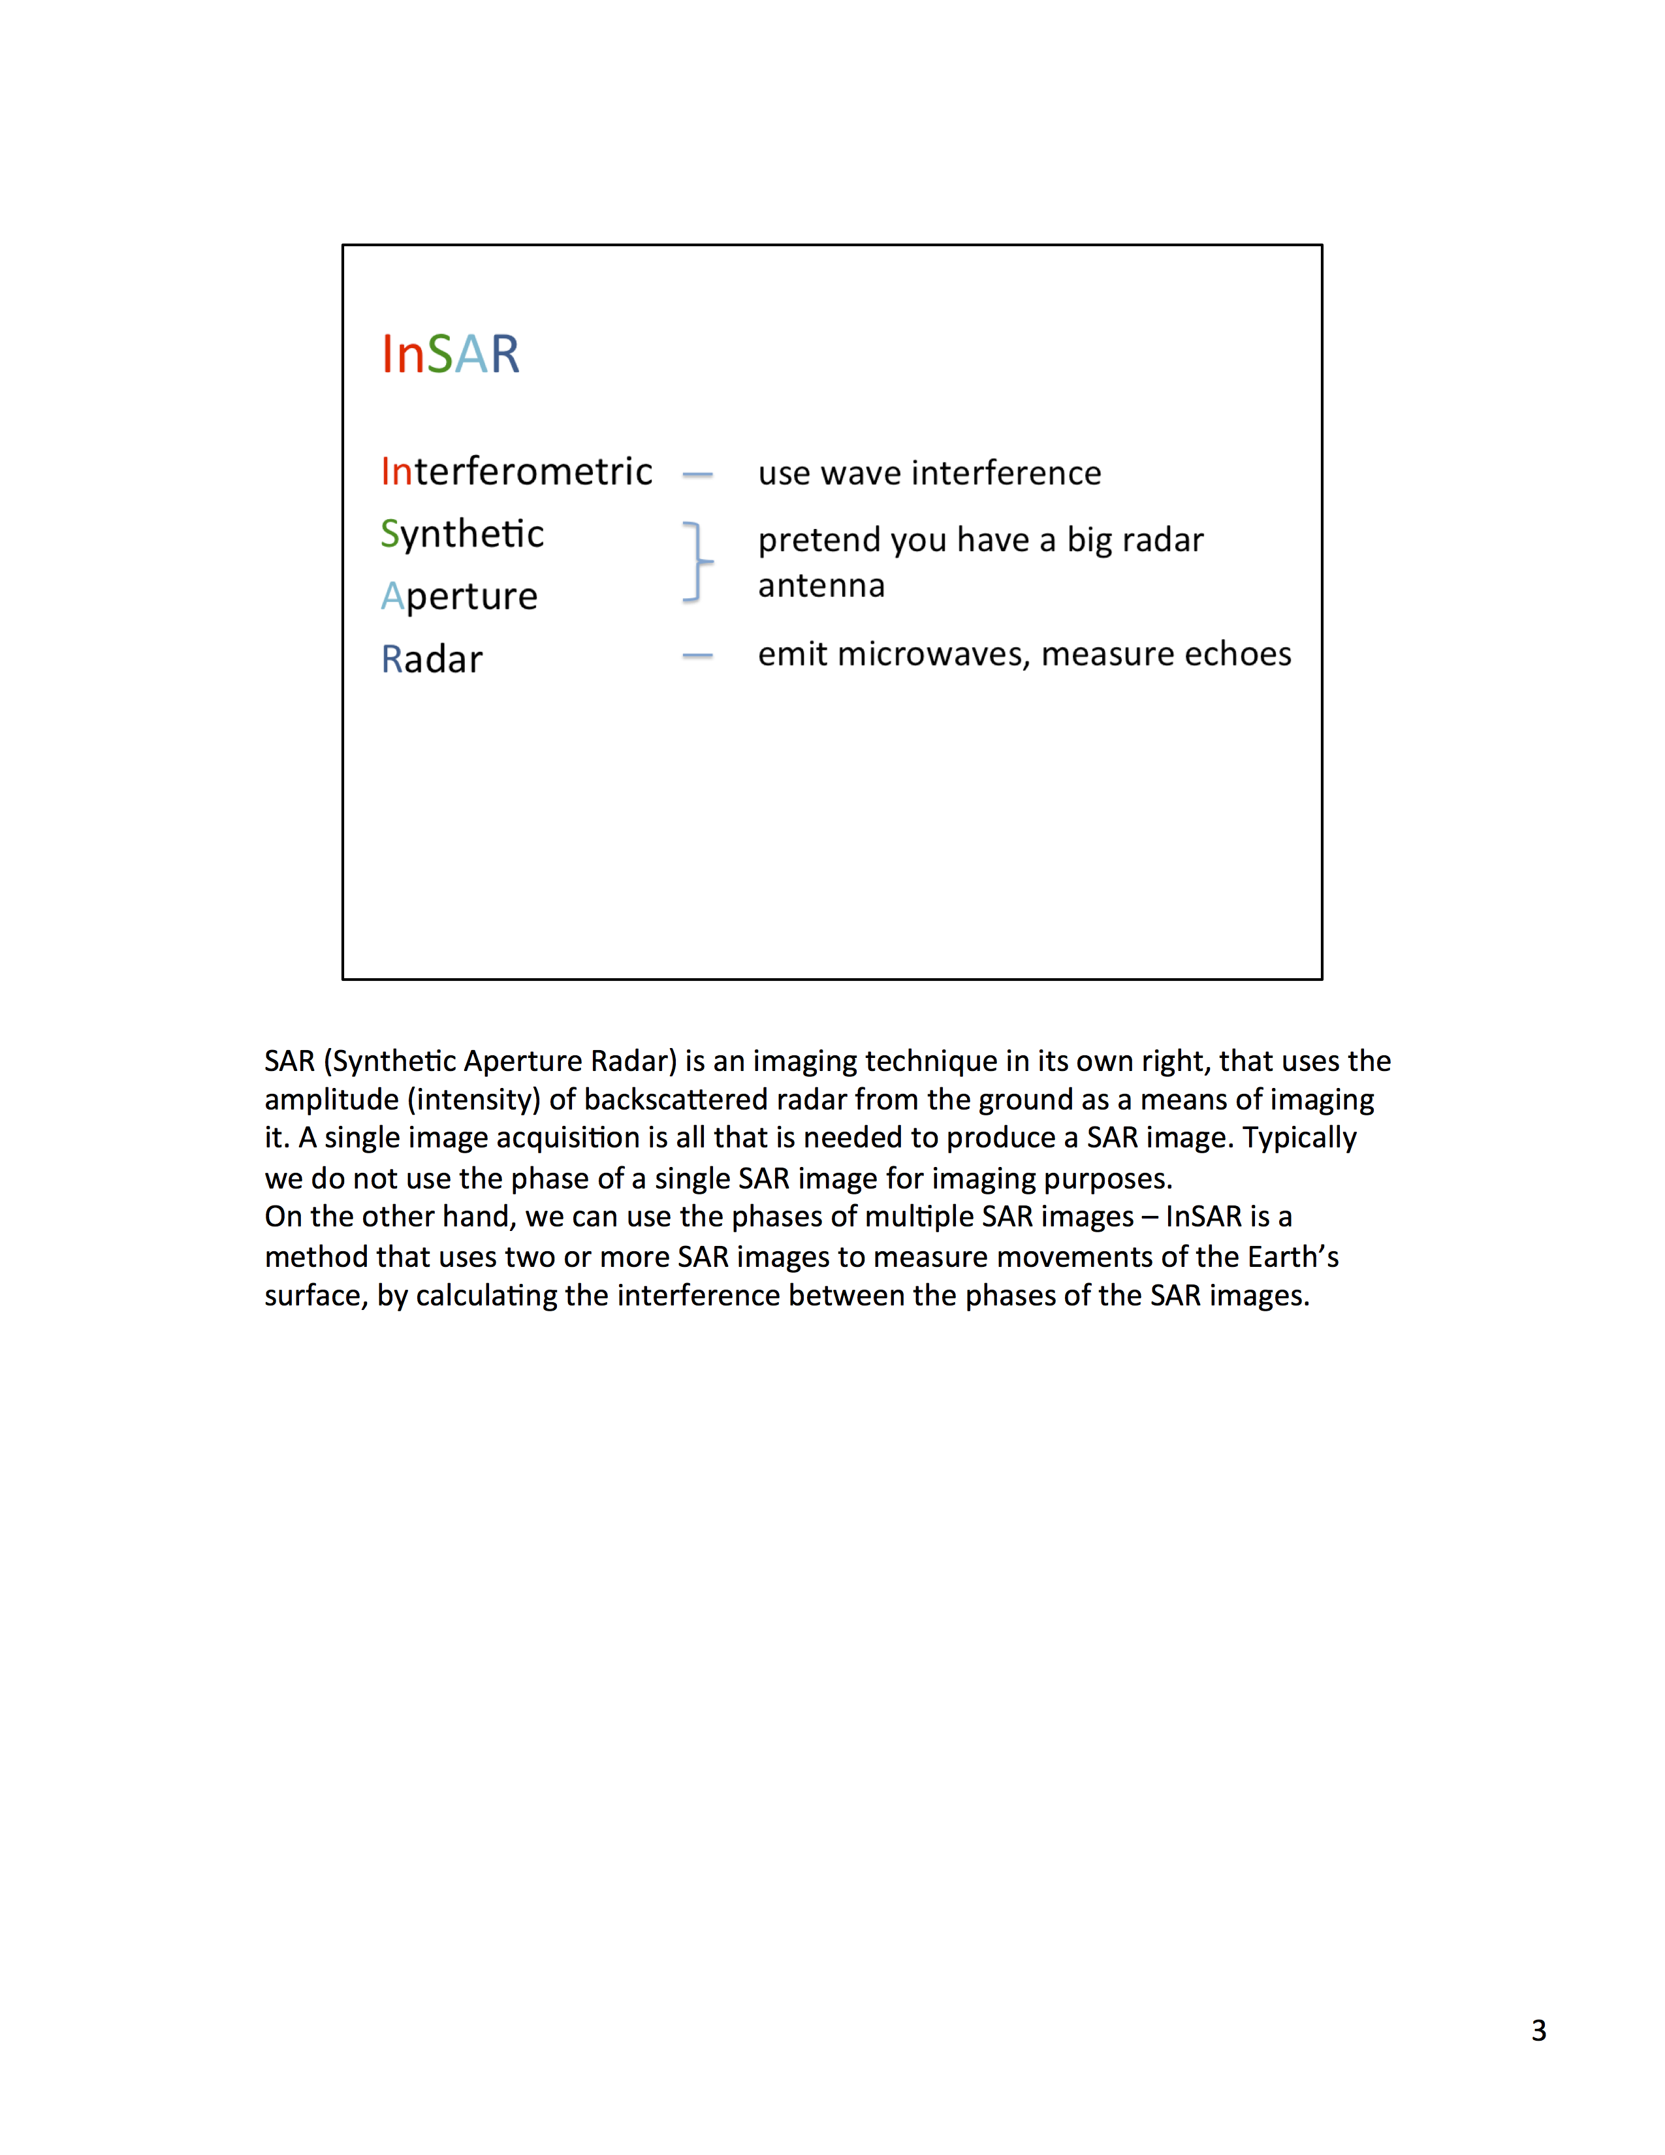
The lecture slides are fully annotated, and also can be printed as notes…

Slide 11
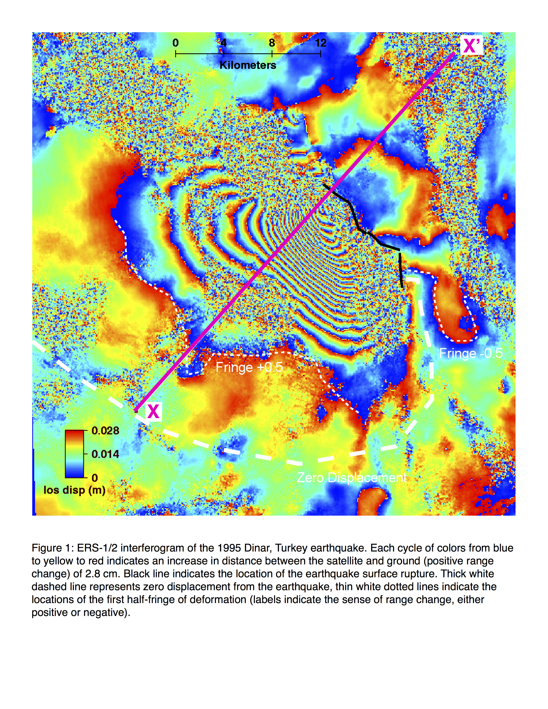

Slide 12
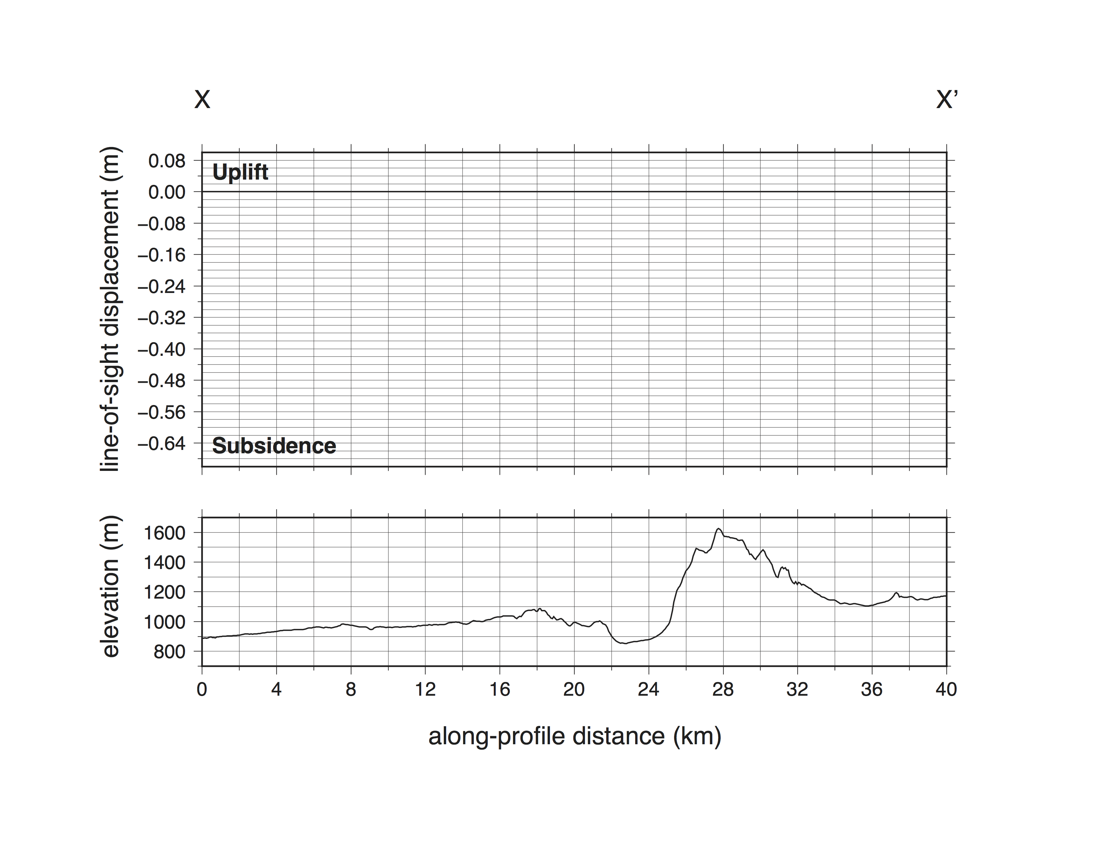

Slide 14
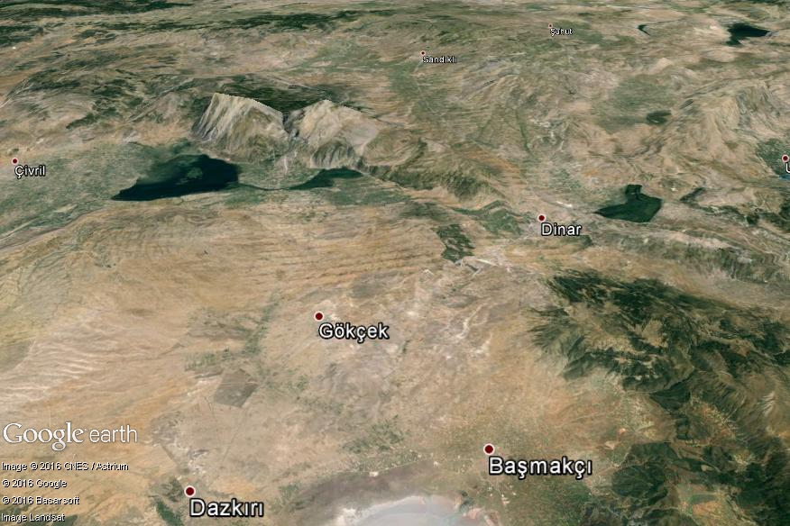
You can also view the data in Google Earth to put them in a topographic context

Slide 15
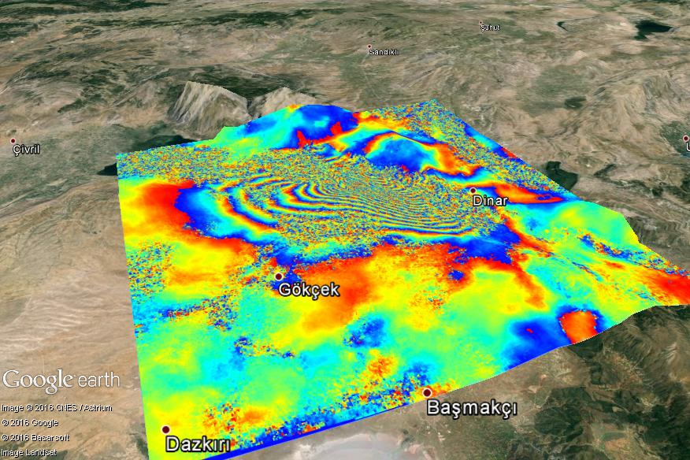
You can also view the data in Google Earth to put them in a topographic context

Slide 16
not very similar!

Slide 17
a whole earthquake cycle would look like this…

Slide 18
Unit 4 Elements
An interactive web tool that allows the manual forward modeling of InSAR data for a selection of earthquakes (Okada dislocation model projected into line-of-sight)
A practical exercise whereby students are encouraged to model a few different earthquakes, compile and compare their answers (concepts: fault geometry, uncertainties, nonuniqueness)

Slide 19
Knoxville, TN,
July 2012
serc.carleton.edu/NAGTWorkshops

Slide 20
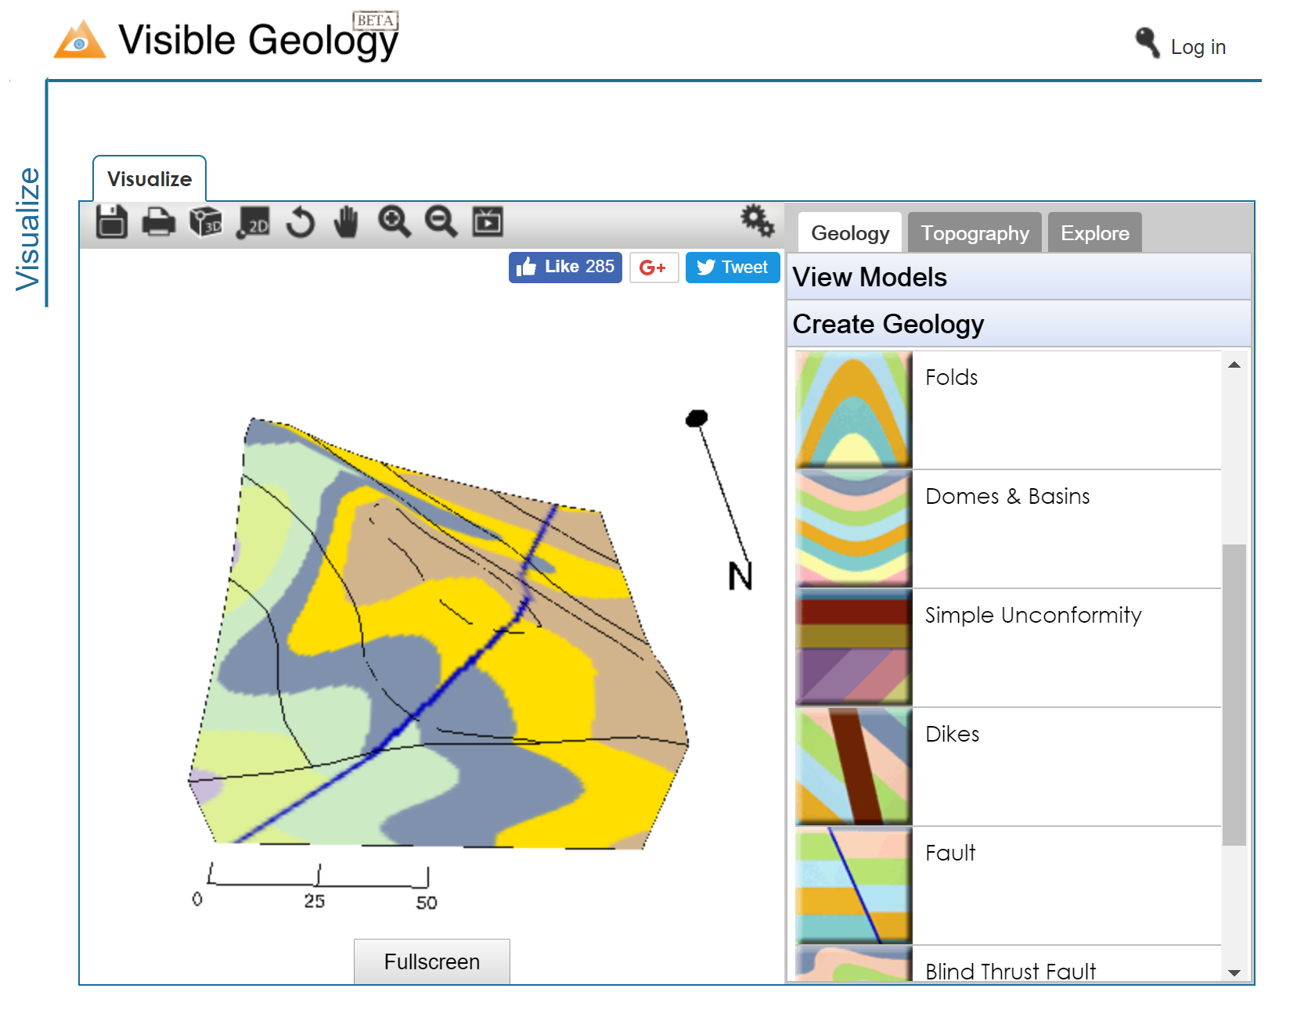
Rowan Cockett

Slide 21
Visible Earthquakes webapp at:
http://earthquakes.aranzgeo.com

Slide 22
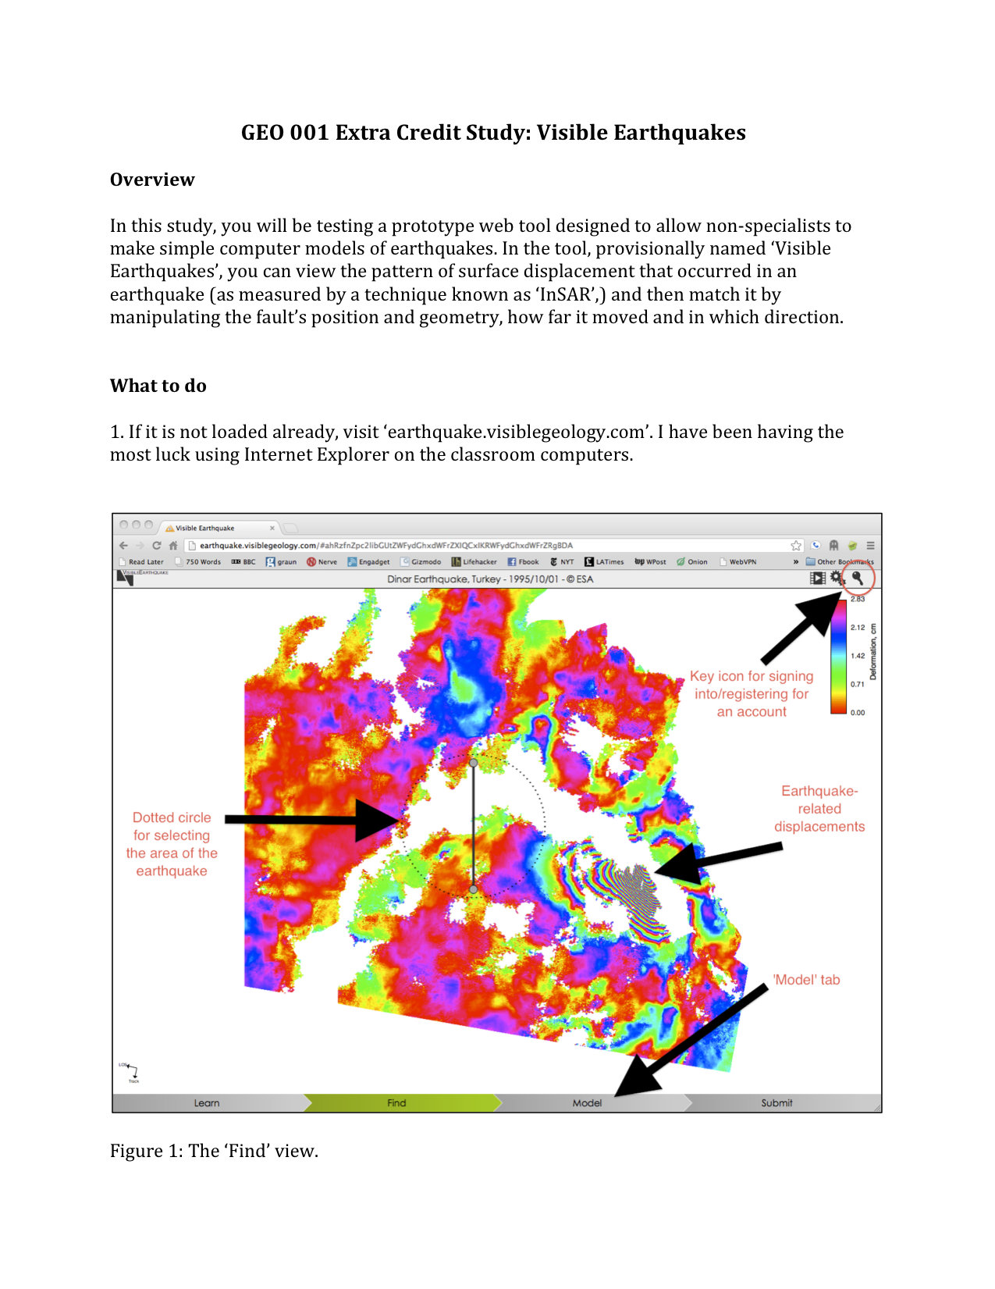
Trial activity
Students asked to reproduce Dinar earthquake pattern
31 students from an intro geology class
Minimal background information given (some details in a handout)
Models submitted, plus post-activity questionnaire

Slide 23
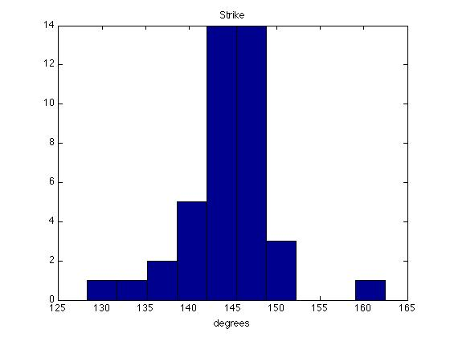
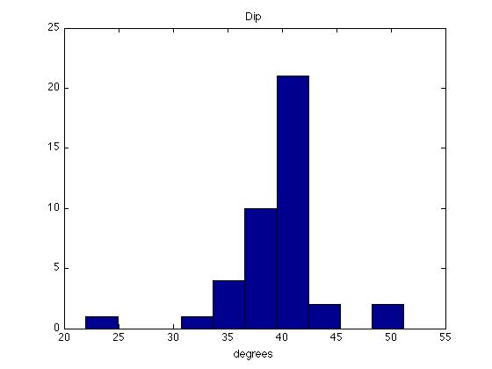
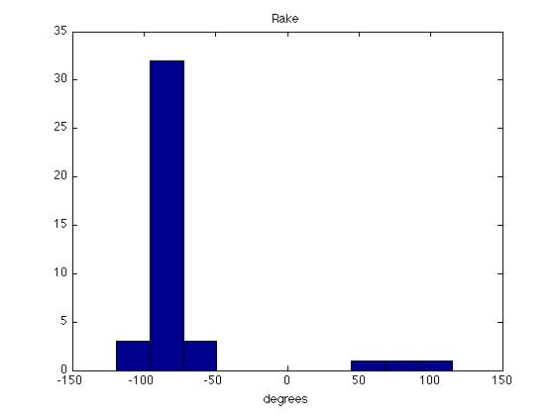
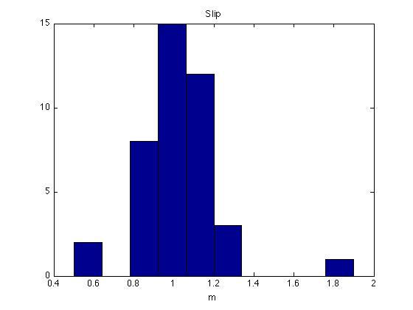
strike
dip
rake
slip

Slide 24
If the kinks were worked out of the activity, is it the sort of activity that you would like to try again, as part of a class?
35%
39%
13%
13%
[0%]

Slide 25
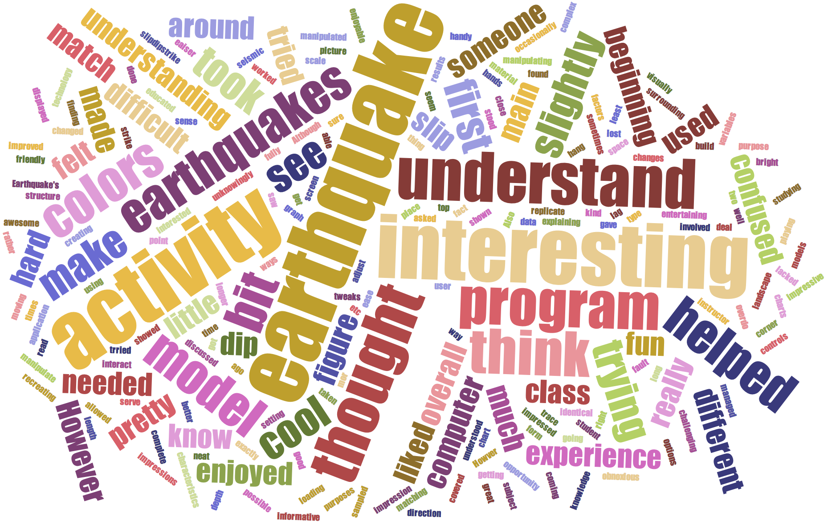
“It was challenging to figure out which variables needed to be manipulated to make an identical earthquake.”
“I was impressed with the colors!”
“I liked how it allowed the student to interact more hands on with the material covered during class.”
“I think all the geology students should try this activity because it is fun and educational. ”
“I overall very much liked this activity and, if provided a link to the website, would happily model other earthquakes on the database...”

Slide 26
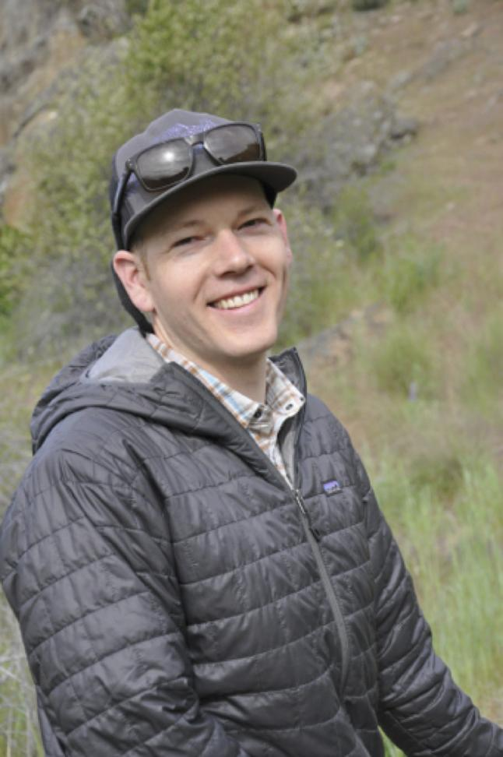
Instructor feedback
Colin Amos, Western Washington University
"…the interactive, online InSAR modeling tool really gave the students a good feel for how models complement geodetic observations... This hands-on component was an extremely valuable exercise for demystifying this process for the students."
"the InSAR modules were fantastic"

Slide 27
WInSAR: who we are and what we do
WInSAR is a group of InSAR users and researchers that coordinate InSAR activities in North America. We
advocate for opening access to SAR data
plan and sponsor training courses for the community
advise on policies and best practices
distribute and maintain software, search tools and data products
maintain an archive of SAR data for North America
The Executive Committee:
Gareth Funning (Chair), Franz Meyer (Vice-Chair), Eric Hetland (Secretary), Kristy Tiampo, Piyush Agram, Zhong Lu
winsar.unavco.org

Slide 28
Training courses, 2018
InSAR data interpretation and analysis for nonspecialists
1 day short course at UNAVCO Science Workshop (March 26th)
How to use processed InSAR data for your research, targeted at 'end users'
GMTSAR processing, August 8-10
Multi-day short course at Scripps
InSAR processing and analysis with ISCE and GIANT, August 13-17
Multi-day short course at UNAVCO

Slide 29
WInSAR/UNAVCO 1-day workshops
Idea emerged from WInSAR Executive Committee teleconferences
Designed to take advantage of the volumes of InSAR data being routinely processed
Develop a userbase of nonspecialist 'end-users'
Cover basic theory, missions, time series, data reduction/preparation and interpretation
Trialed at UNAVCO Science Workshop, March 2018, will be repeated at GSA in November

Slide 31
Draft schedule
SAR/InSAR theory and processing (45 mins)
SAR satellite missions, data repositories (45 mins)
InSAR deformation, noise, errors (1 hour)
Interferogram interpretation exercise (45 mins)
Time series methods: theory (45 mins)
Time series methods: demonstration (45 mins)
Getting data ready for modeling (45 mins)
From LOS phase to displacement exercise (30 mins)

Slide 32
Draft schedule
SAR/InSAR theory and processing (45 mins)*
SAR satellite missions, data repositories (45 mins)
InSAR deformation, noise, errors (1 hour)
Interferogram interpretation exercise (45 mins)*
Time series methods: theory (45 mins)
Time series methods: demonstration (45 mins)
Getting data ready for modeling (45 mins)
From LOS phase to displacement exercise (30 mins)
*from GETSI unit 3 materials Remote session (P. Agram)

Slide 33
Given LOS velocities, plus information on azimuth and incidence angles, can you solve for the horizontal and vertical movement rates of the landslides?
[Data from Berkeley Hills, CA]

Slide 34
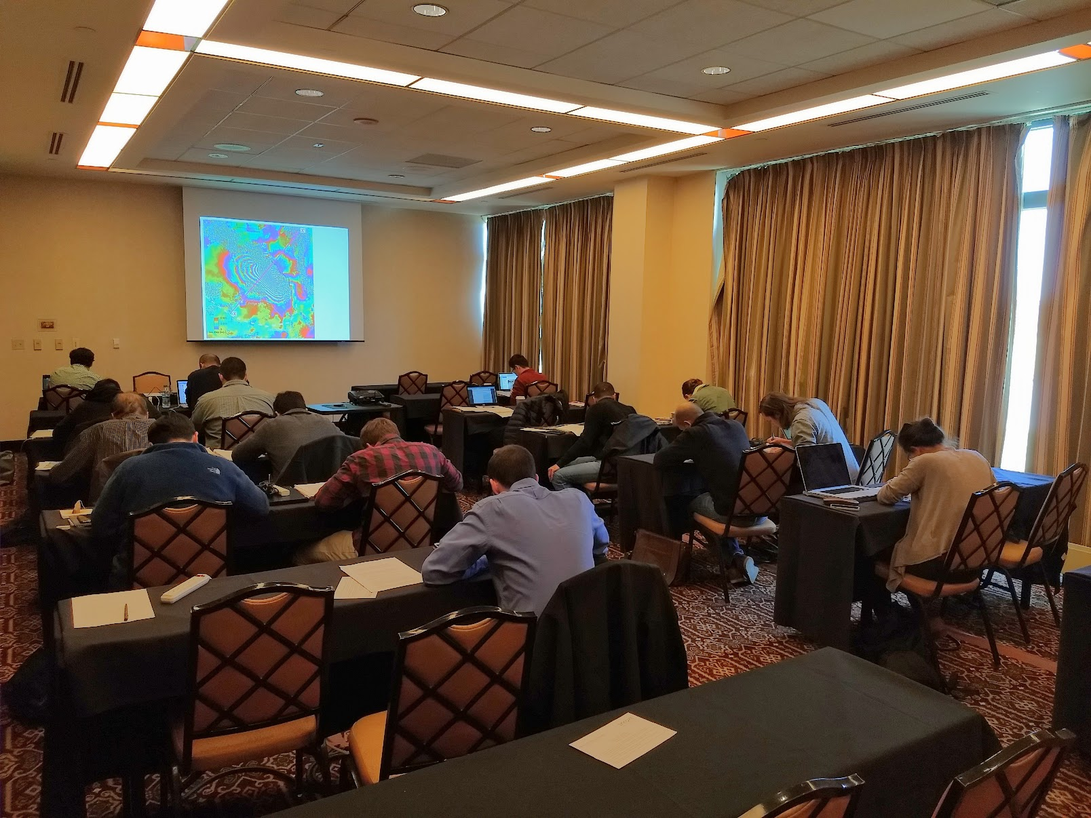

Slide 35
Actual schedule
SAR/InSAR theory and processing (45 75 mins)
SAR satellite missions, data repositories (45 15 mins)
InSAR deformation, noise, errors (1 hour)
Interferogram interpretation exercise (45 mins)
Time series methods: theory (45 90 mins)
Time series methods: demonstration (45 15 mins)
Getting data ready for modeling (30 45 mins)
From LOS phase to displacement exercise (30 mins)

Slide 36
What participants liked
Responses were overall very positive. In particular, participants noted:
The level of background information was pitched at a good level (~graduate class)
Practical exercises were valuable for reinforcing understanding
Lectures and exercises were integrated well

Slide 37
Improvements participants suggested
Make course materials available ahead of time
Simplify the material on time series methods (although some participants liked it as-is)
Make the time series demonstration an activity
Reduce jargon if possible!
We will try to implement these changes for the forthcoming workshop…

