Slide 1
NISAR Project Status
October 2018
Paul A. Rosen
NISAR Project Scientist
Jet Propulsion Laboratory
California Institute of Technology

Slide 2
NISAR Mission Objectives Responsive to US National Academy
Key Research Objectives:
Understand the response of ice sheets to climate change and the interaction of sea ice and climate
Understand the dynamics of carbon storage and uptake in wooded, agricultural, wetland, and permafrost systems
Determine the likelihood of earthquakes, volcanic eruptions, and landslides
Key Applications Objectives:
Understand societal impacts of dynamics of groundwater, hydrocarbon, and sequestered CO₂ reservoirs
Provide agricultural monitoring capability in support of food security objectives
Apply NISAR’s unique data set to explore the potentials for urgent response and hazard mitigation
Partnership with the Indian Space Research Organisation (ISRO)
Joint NASA-ISRO research objectives
Joint development and operation of space-borne observatory
Dual-frequency, polarimetric, repeat-pass interferometry SAR
Notes:
2
NISAR focuses on three key science objectives and three key applications areas, each of which has been identified as keen areas of interest for both the US and Indian science and applications communities. Reducing uncertainties in the projections of climate change is clearly a high scientific priority, and likely an area of scientific focus for some time to come. Two of three NISAR science objectives are focused squarely on reducing these uncertainties by providing quantitative measurements of ice sheet dynamics and carbon flux dynamics over the life of the mission that will constrain models to lower uncertainties, and no doubt lead to model improvements as well. The third science objective, focused on solid earth, aims to improve our understanding of how fault systems interact throughout the seismic cycle, how volcanoes behave throughout the eruptive cycle, and similarly how landslides move throughout their cycle. These hazard related science investigations will reveal processes occurring in the crust and improve our ability to forecast future events.
Using the same techniques as those used to fulfill the science objectives, a number of important applications can be addressed. In particular, availability or security of water, energy, and food for ever-growing populations is clearly of interest to governments and industries. NISAR would examine the exploitation of stressed aquifers and on-shore hydrocarbon reserves as well as provide a means for determining quantitative crop yield through biomass estimation. This objective is an operational concern for India, who consider NISAR a pathfinder for future Indian operational missions. A third key area that many on the SDT are passionate about is the exploitation of NISAR’s all-weather day/night imaging capabilities to explore the potentials for urgent response and hazard mitigation.

Slide 3

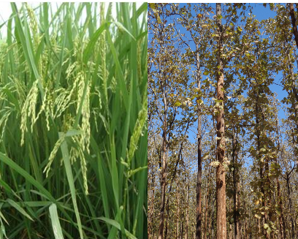
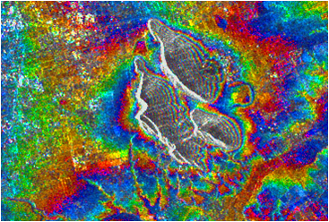
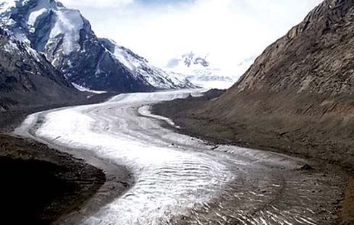

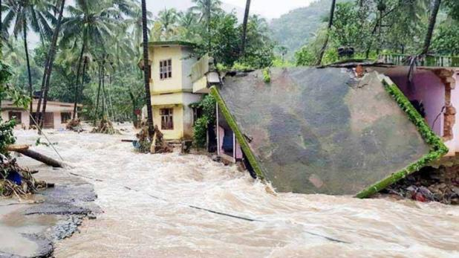
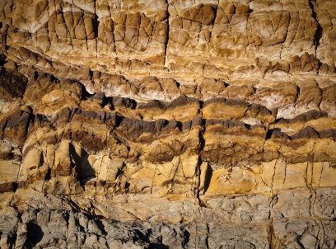
NISAR: Indian Space Research Organisation Proposed Applications
Ecosystem Structure: 1.1 Agriculture biomass & Crop monitoring; 1.2 Forest biomass; 1.3 Forest disturbance; 1.4 Mangroves / Wetlands; 1.5 Alpine vegetation; 1.6 Vegetation phenology; 1.7 Soil moisture; 1.8 Ecosystem stress assessment
Land Deformation: 2.1 Inter-seismic / Co-seismic deformations; 2.2 Landslides; 2.3 Land subsidence; 2.4 Volcanic deformations
Cryosphere: 3.1 Polar Ice Shelf / Ice sheet; 3.2 Sea Ice Dynamics; 3.3 Mountain snow/ glacier 3.4 Glacier dynamics/ hazard (Himalayan Region); 3.5 Climate response to glaciers; 3.6 Sea–Ice advisory on safer marine navigation in Antarctica region
Coasts & Ocean: 4.1 Coastal erosion / shoreline change; 4.2 Coastal subsidence and vulnerability to sea-level rise; 4.3 Coastal bathymetry; 4.4 Ocean surface wind; 4.5 Ocean wave spectra; 4.6 Ship detection; 4.7 Coastal watch services; 4.8 tropical cyclone
Disaster Response: 5.1 Floods; 5.2 Forest fire damage assessment; 5.3 Coastal oil spill; 5.4 Earthquakes / Others
Geological Applications: 6.1 Structural & Lithological mapping; 6.2 Lineament mapping; 6.3 Paleo-Channel study; 6.4 Geomorphology; 6.5 Land degradation mapping; 6.6 Geo-archaeology; 6.7 Mineral explorations

Slide 4
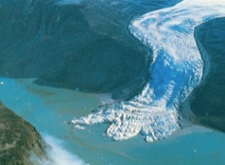
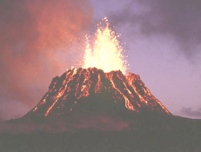
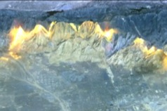
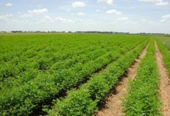
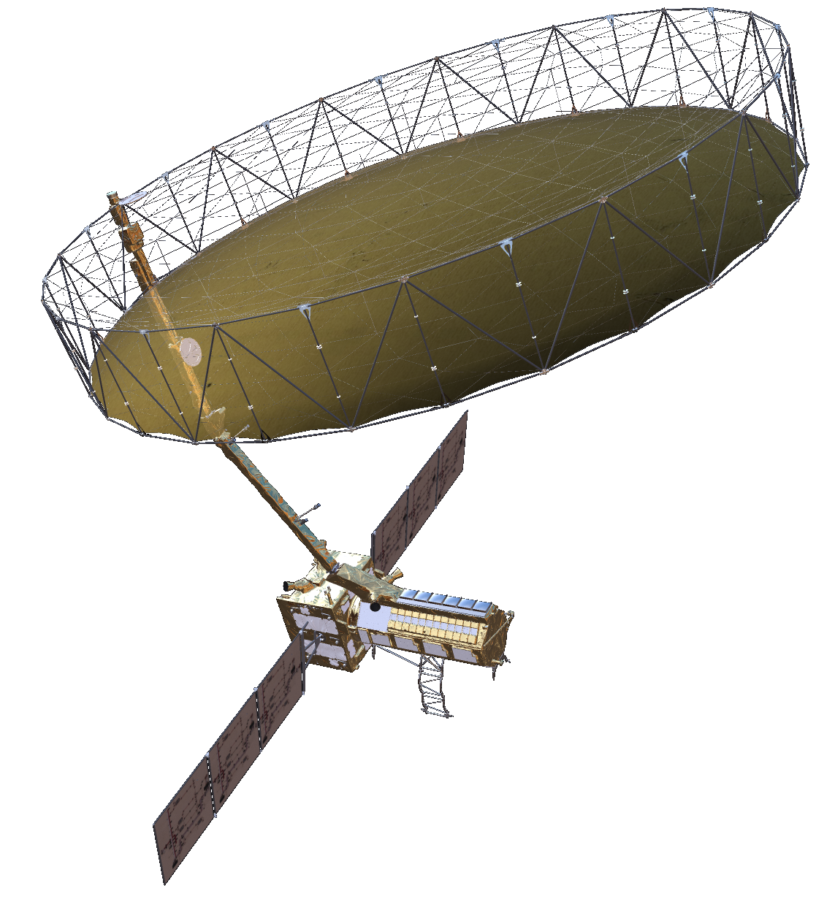
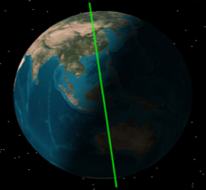
NISAR Science Observation Overview
NISAR Characteristic: | Enables:
L-band (23 cm wavelength) | Low temporal decorrelation and foliage penetration
S-band (9 cm wavelength) | Sensitivity to light vegetation
SweepSAR technique with Imaging Swath > 240 km | Global data collection
Polarimetry (Single/Dual/Quad) | Surface characterization and biomass estimation
12-day exact repeat | Rapid Sampling
3 – 10 meters mode-dependent SAR resolution | Small-scale observations
3 yrs (NASA) / 5 yrs (ISRO) science operations | Time-series analysis
Pointing control < 273 arcseconds | Deformation interferometry
Orbit control < 500 meters | Deformation interferometry
> 10% (S) / 50% (L) observation duty cycle | Complete land/ice coverage
Left-only pointing (Left/Right capability) | Uninterrupted time-series Rely on Sentinel-1 for Arctic
NISAR Will Uniquely Capture the Earth in Motion
NISAR Uniquely Captures the Earth in Motion
Observation Geometry
747 km
33º
6 AM / 6 PM
47º
Earth surface
>240 km

Slide 5
NISAR Systematic Observations
Repeated every 12 day cycle for the life of the mission
No target conflicts: overlapping targets uses union of all modes specified
Colors indicate different radar modes
Persistent updated measurements of Earth
41 Tbits / day total L+S band science data downlink
120 Tbytes / day total L+S band L0-L2 data products
J. Doubleday
P. Sharma, JPL

Slide 6
NISAR Global Product Suite
26-35 Tbits of raw L-band data per day on average
3-6 Tbits of raw S-band data per day on average
L-SAR L0a, L0b, L1, and L2 science products
S-SAR L0 science product of data downlinked through NASA Ka-band
Free and open archive in Alaska Satellite Facility DAAC
L0
L1
L2
MLD
Polarimetric products
COV
GCOV
RAW
RSD
SLC
GSLC
Geocoded SLC
IFG
Interferometric products
UNW
GUNW

Slide 7
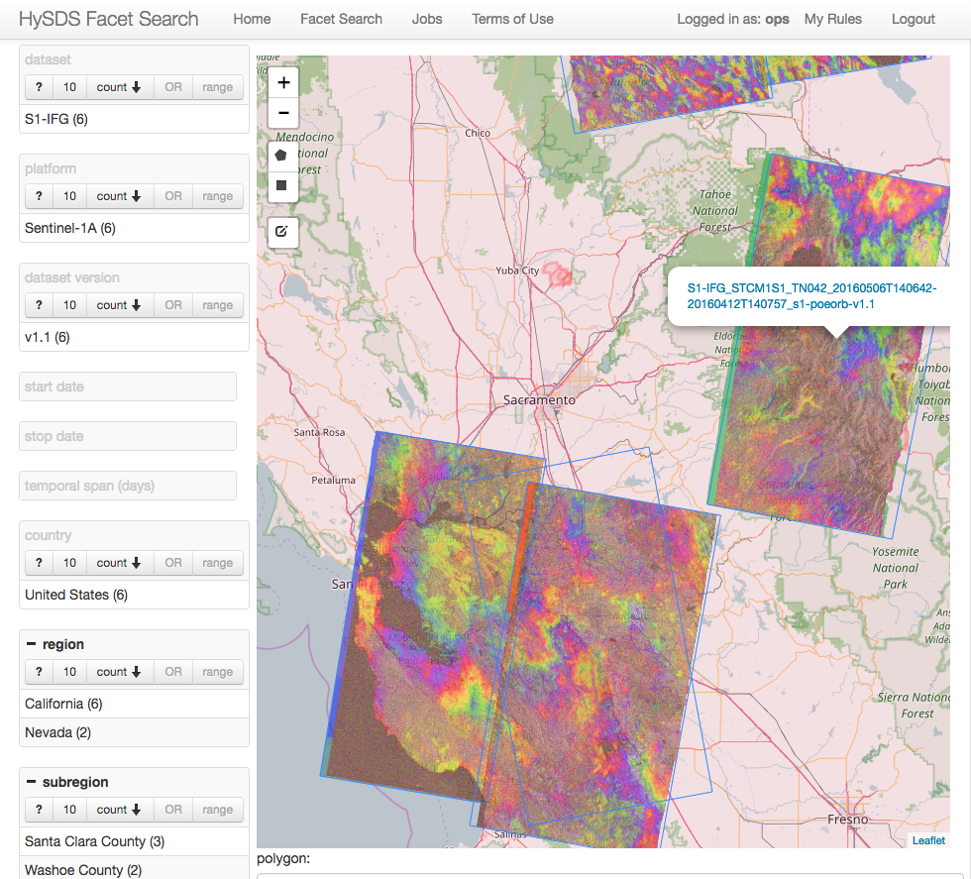
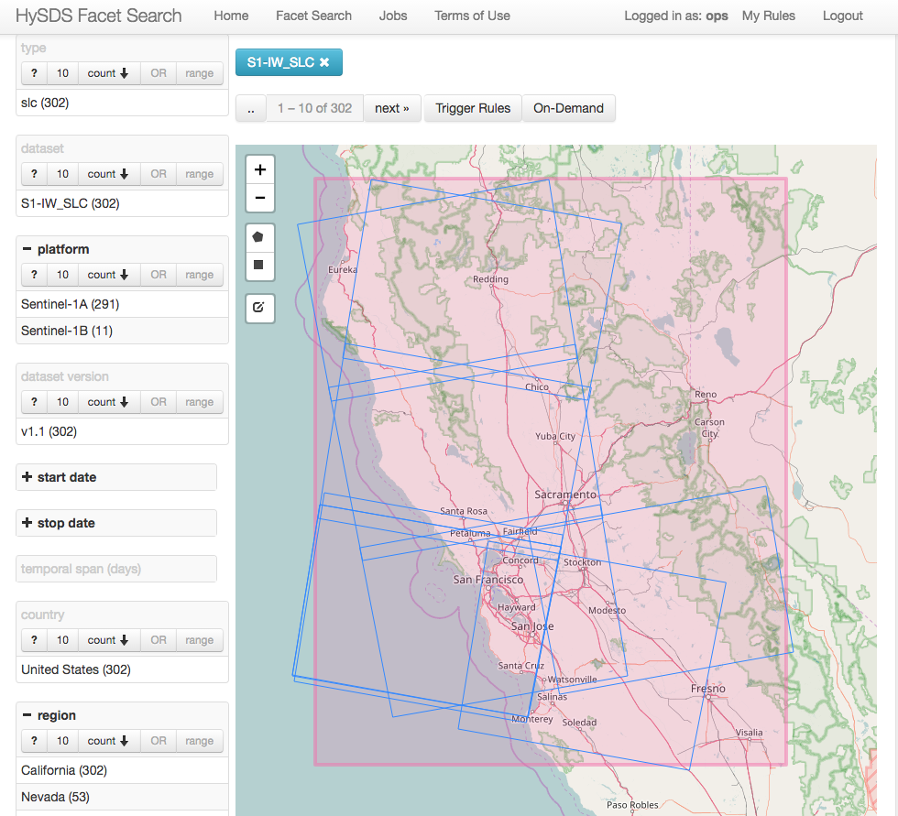
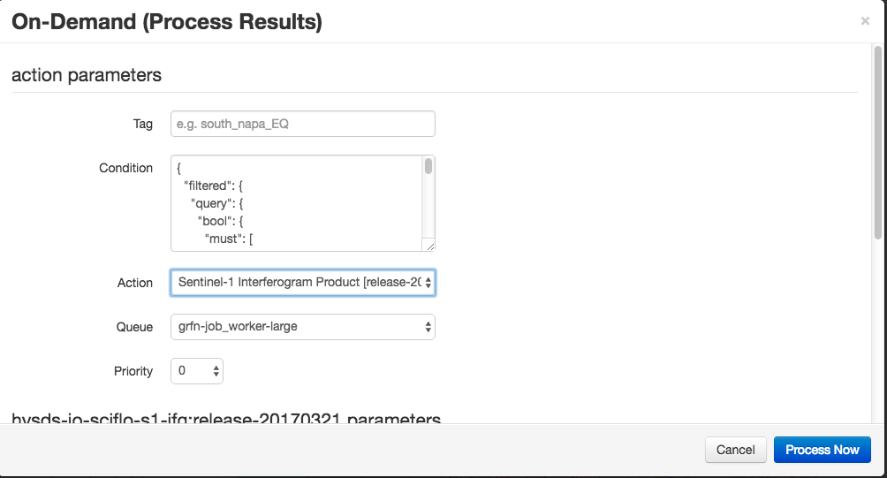
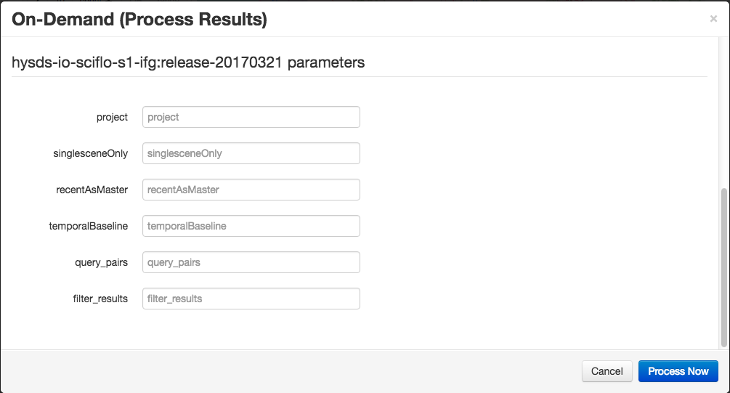
NISAR Data Processing and Access Moving to the Cloud
Cloud Processing and distribution allows scalability and localization with users
On-demand processing allows users to satisfy their needs without high-capability computing and networks.
Prototyped with ARIA/GRFN Cloud Processing System
Selection of Data
On-demand Products Generated on and Distributed from Cloud
Custom On-demand settings

Slide 8
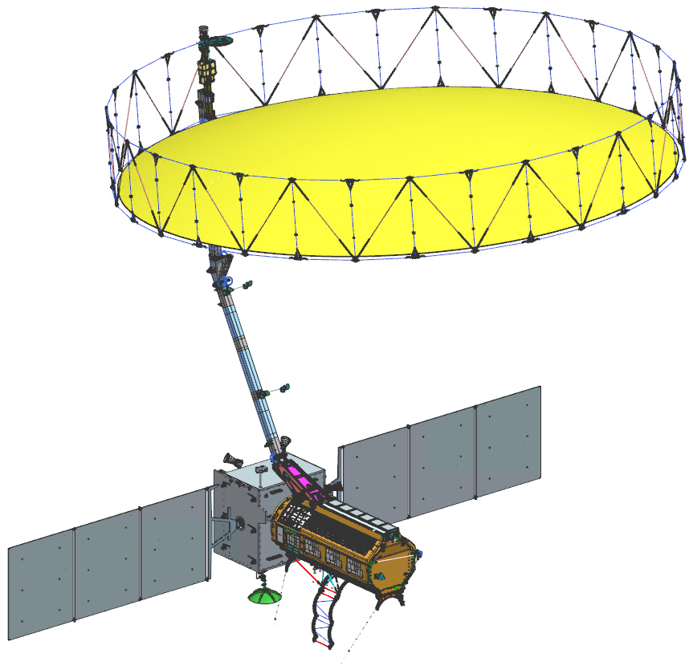
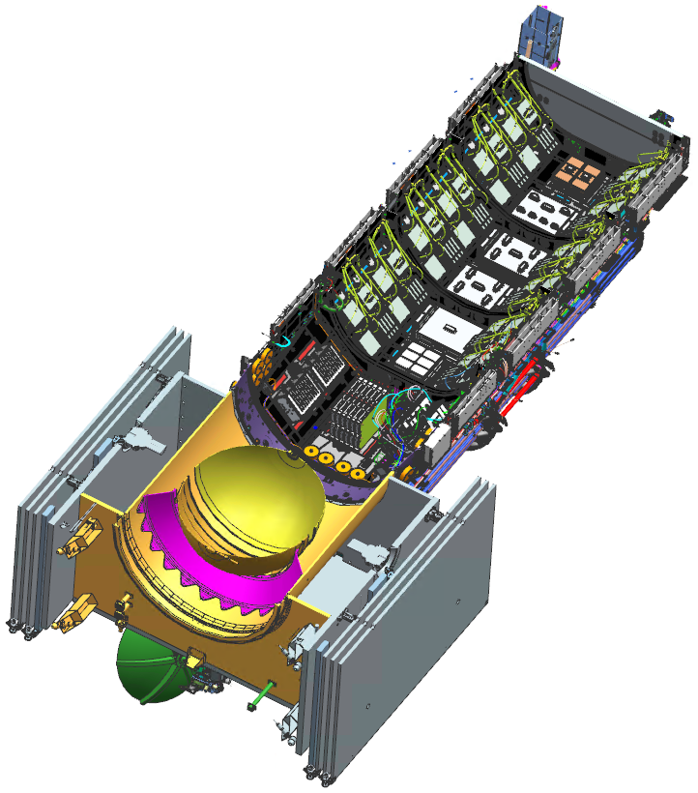
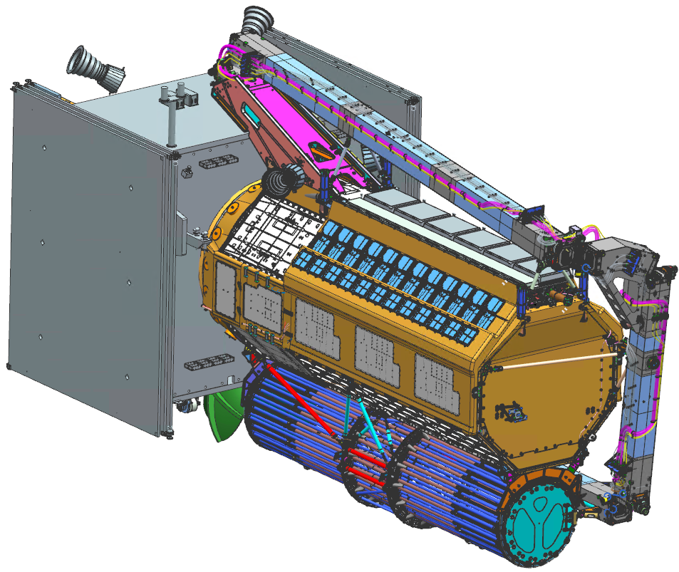
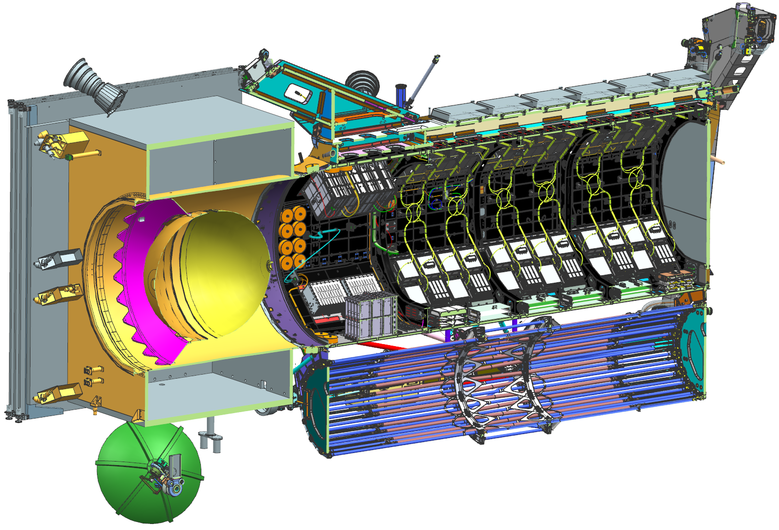
NISAR Observatory
JPL and ISRO have made significant progress toward building the NISAR observatory
Deployed Configuration
Stowed Configuration
    This document has been reviewed (LRR036044) and determined not to contain export controlled technical data.

Slide 9
High Level Schedule
CDR Season
Project Critical Design Review Successful

Slide 10
NISAR Current Status - Summary
Critical Design Review in October 2018 successful
All Engineering Models, some Flight Models built
Launch Readiness Date remains steady: December 2021
Science Team and Project will adopt a left-only observation plan
  Forgoes Arctic coverage above 77.5 deg N in favor of continuous time series, greater Antarctic coverage
  Relies on Sentinel-1 Program of Record to complete coverage
  Example of optimizing the international SAR constellation for science
  Requires 1-month launch hold to late Jan 2022 to wait out eclipse season

Slide 11
NISAR Status With Respect to Training
Mission Systems will hold its CDR in October 2019
By then:
  Simulated NISAR products L0-L2
  Project-distributed L0-L2 workflow for these products based on ISCE
  Updated UNAVCO ISCE/GIAnT Short Course materials
  Many L3 ATBD’s in Jupyter Notebooks
  Many Validation Workflows in Jupyter Notebooks
Planning a Science Workshop in similar timeframe to socialize products and software
Project is eager to harmonize with other training activities
    This document has been reviewed (LRR036044) and determined not to contain export controlled technical data.

Slide 12
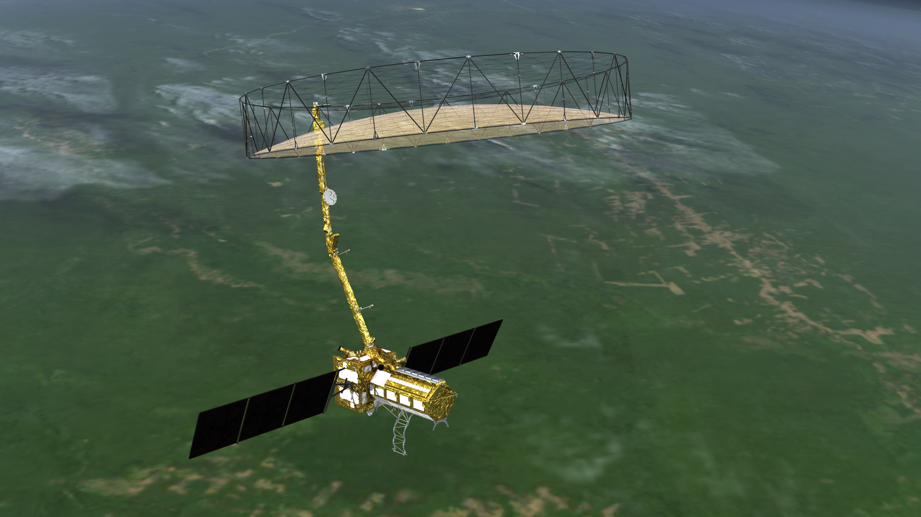
Questions?
NISAR over Amazon

