Slide 1
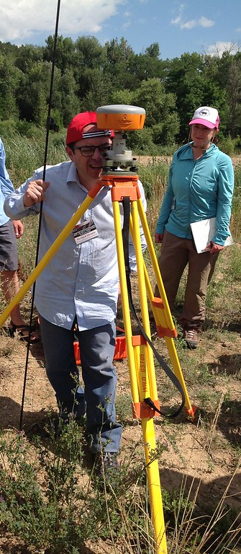
Unit 1: GNSS Fundamentals
This is the ‘gateway.’ All must do.
Students address:
How does GNSS work?
Which tools work best for what?
Accuracy and Precision?
Sources of uncertainty?
Components of a GNSS system?
How does research benefit society?
photo: UNAVCO

Slide 2
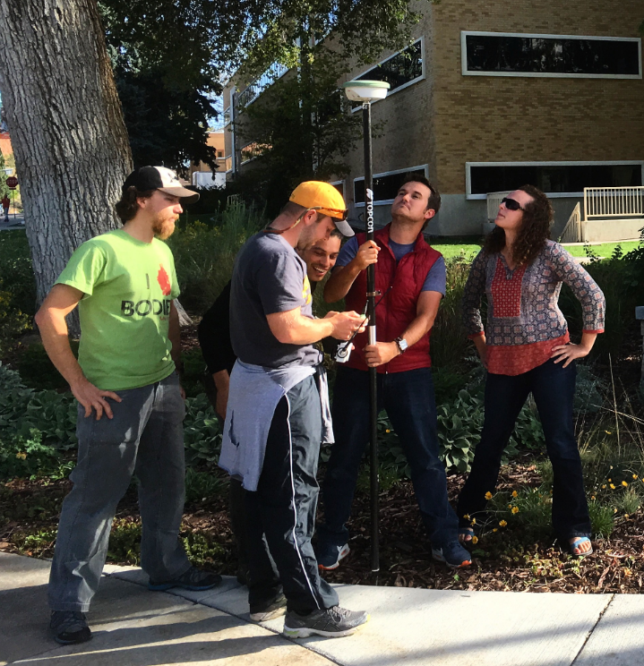
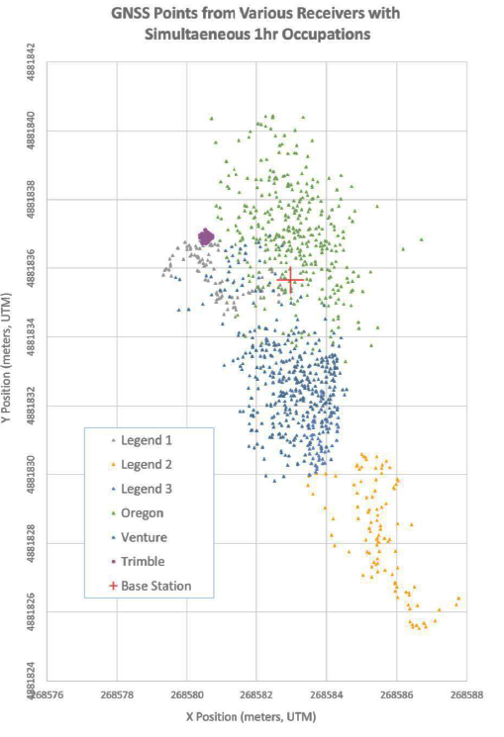
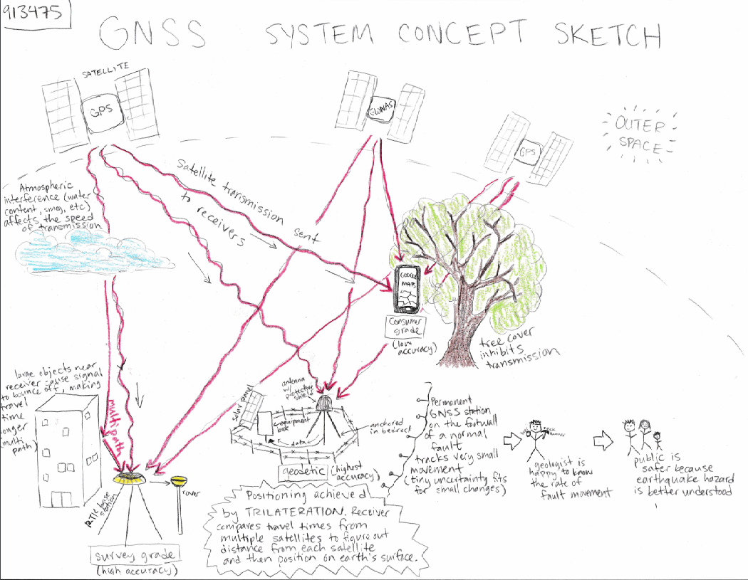
Unit 1: GNSS Fundamentals
photo: crosby
Accuracy/Precision Exercise
Hardware Demo/Concept Sketch

Slide 3
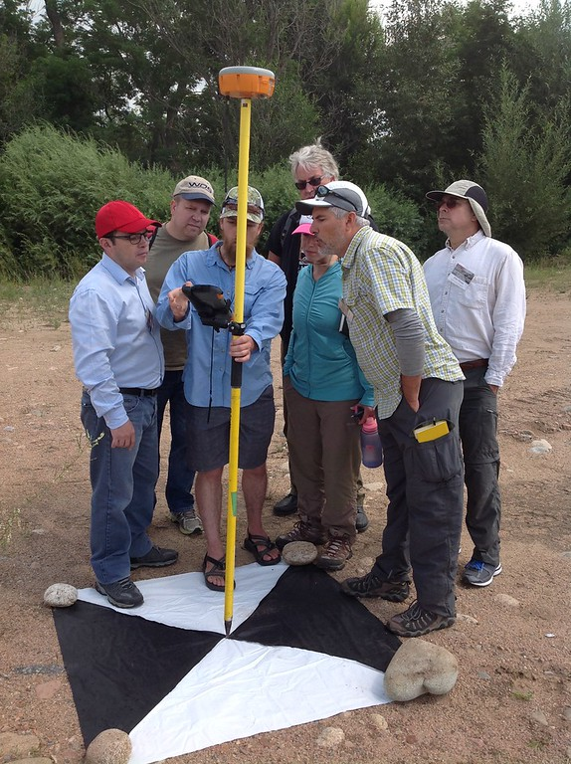
Unit 2: Kinematic GNSS Methods
rapid, high precision measurements
Kinematic GNSS:
Students address:
What is and how does RTK-GPS work?
How to design and conduct a survey?
How to post-process data?
Summative assessment:
Integrated yet simple field survey
photo: UNAVCO

Slide 4
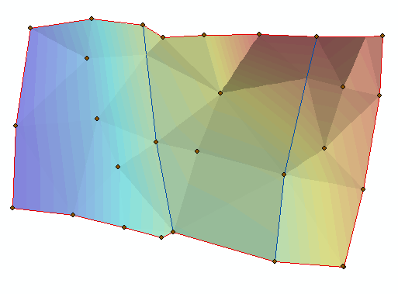
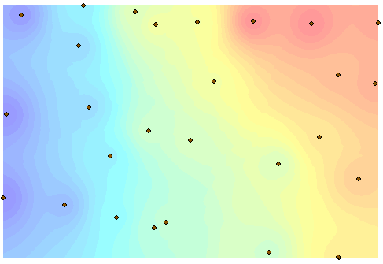
Unit 2.1: Topography and Kinematic GNSS
How collect data to create a surface?
How to best sample topography?
How to interpolate surfaces?
How can topography address societal issues?
Triangulate Irregular Network (TIN) Inverse Distance Weighted
Rover
photo: crosby

Slide 5
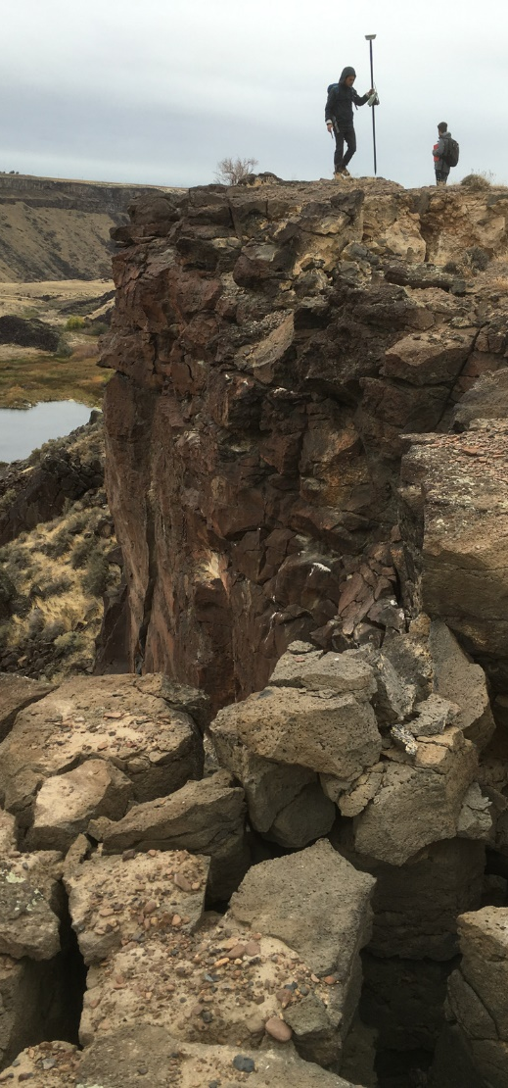
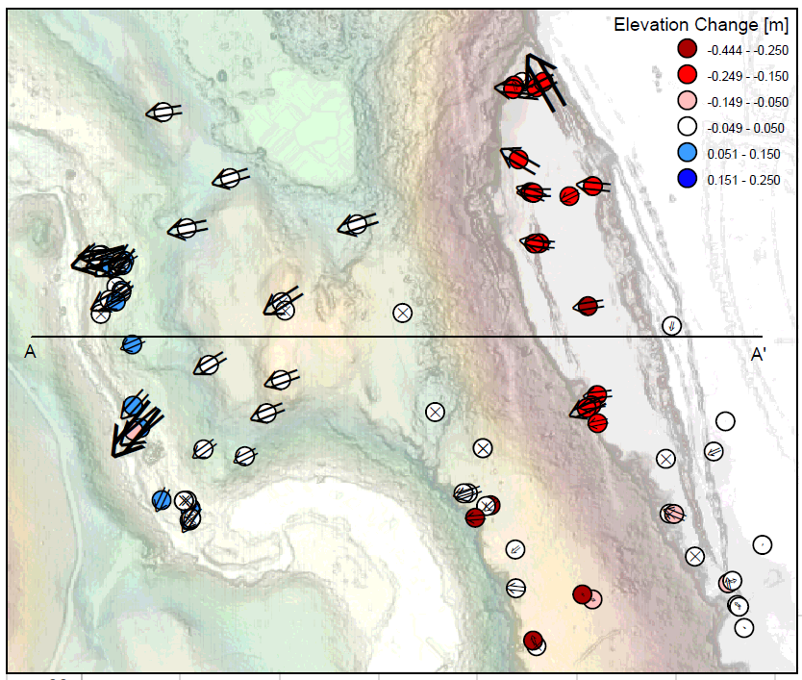
Unit 2.2: Change Detection with GNSS
How to survey change?
How to analyze and interpret change?
Which dimension is change in (2D vs 3D)?
How apply change data to societal issues?
photo: crosby
Data from Salmon Falls Landslide, ID

Slide 6
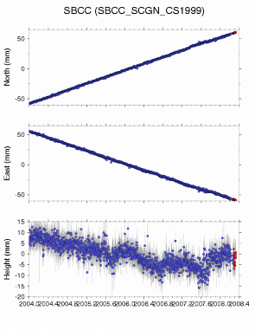
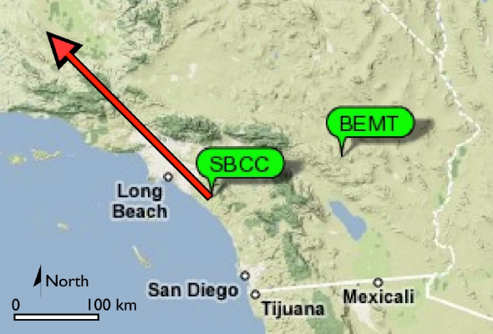
Unit 3: Static GNSS Methods
What are the components of static GNSS?
How to design, conduct, and process static GNSS?
How to analyze and interpret static GNSS?
How use static GNSS for societal issues?
photos: crosby

Slide 7
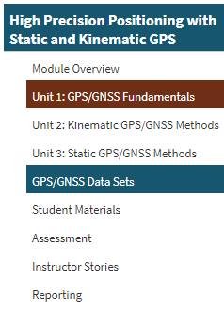
Additional Resources
Prepared Datasets
Student Examples
Instructor Stories
Borah Fault Leveling Line
Other Online Resources
Hardware Considerations
What else would you like to see?

Slide 8
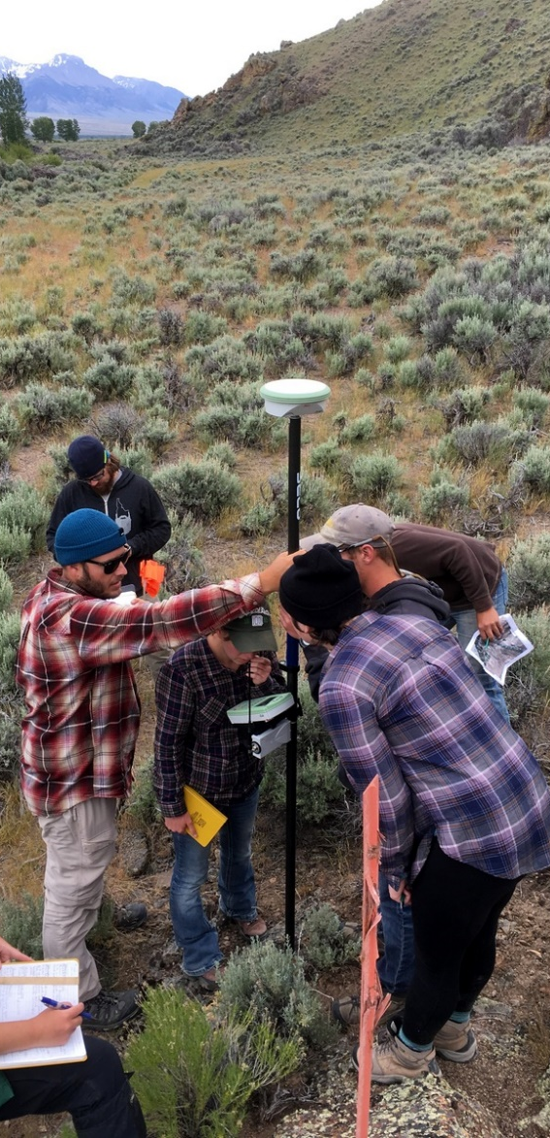
Best Practices
Test all hardware before you go in the field
Troubleshooting hardware is an essential skill
Collect the dataset ahead of the students
Try to dig up historic data
Work in groups of ~5/instrument
Modify the assignments and lectures to meet your needs
Have fun!

Slide 9
Questions?

