Slide 1
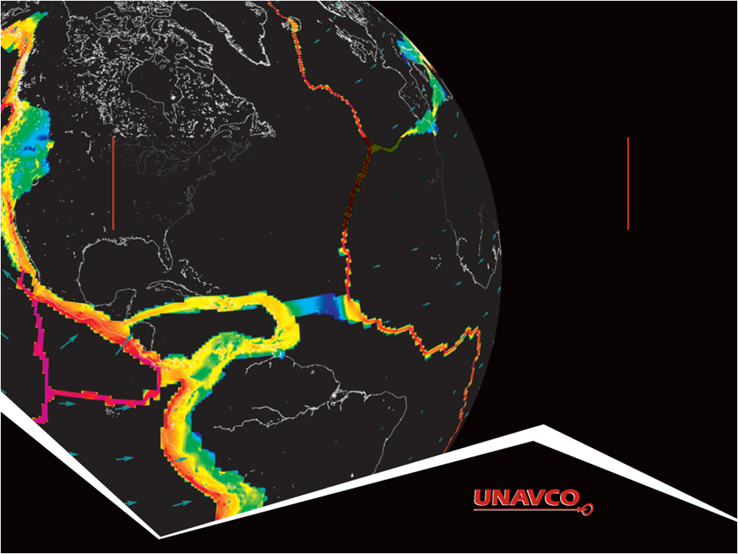
Visualizing Relationships with DATA: Earthquakes, Volcanoes, and Plate Tectonics
Ruth Powers (UNAVCO Master Teaching-in-Residence); Becca Walker and Shelley Olds (UNAVCO)
Notes:
Realized that our challenge is more general than plate tectonics
As you will see we have multiple data types and multiple science applications
And multiple educator and student needs
Which require vis tools to accommodate this

Slide 2
Activity Outcomes
Learners should be able to…
Explore & describe locations of earthquakes and volcanoes, and how they inform us about plate boundary zones
Compare plate motion between the Pacific Northwest and California based on crustal motion (from velocity vectors)
Describe the difference between a plate boundary and plate boundary zone
Determine plate boundary zones using multiple lines of evidence: GPS plate velocity vector maps, earthquake and volcano locations
Notes:
Explore locations of earthquakes and volcanoes
Compare plate motion between the Pacific Northwest and California
Determine plate boundary zones using multiple lines of evidence: GPS plate velocity vector maps, earthquake and volcano locations

Slide 3
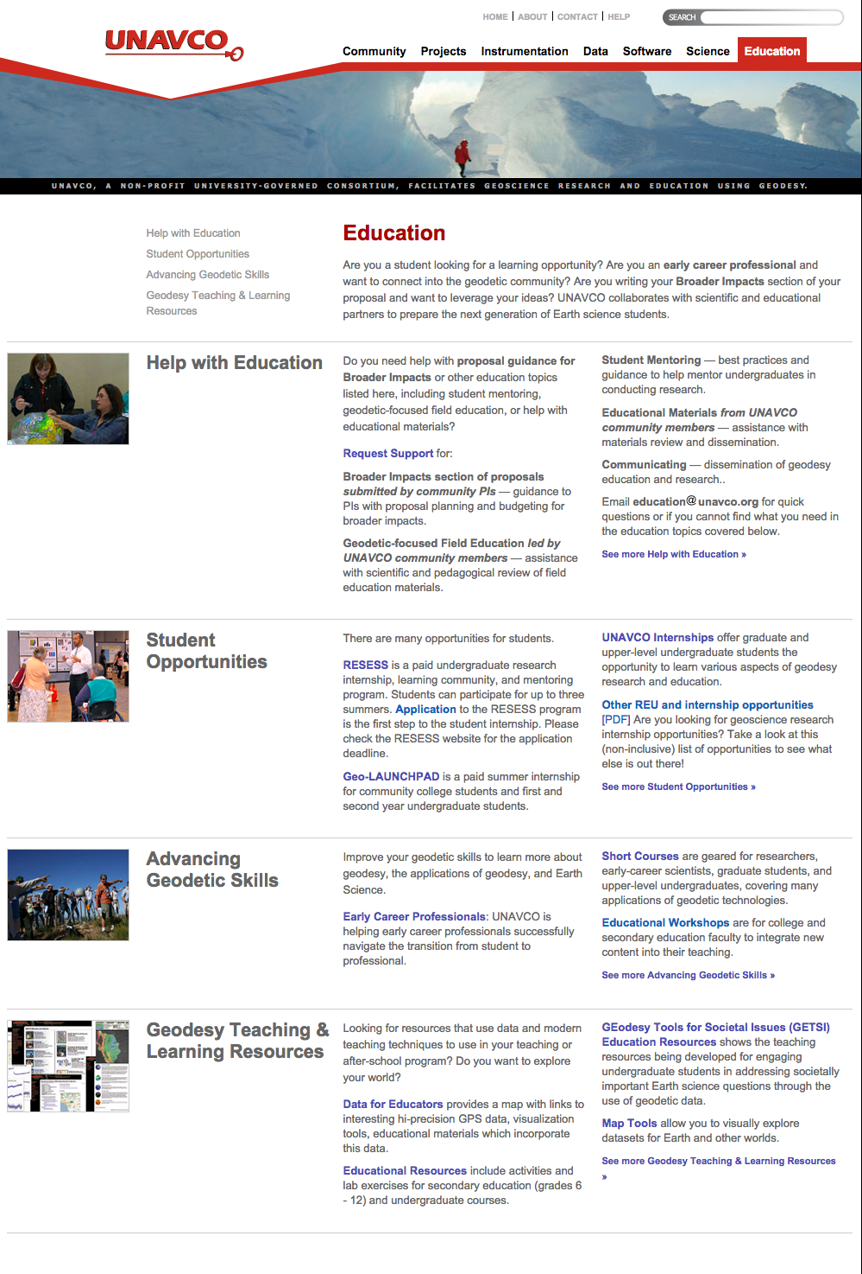
Part 1: Prepare Your Map for Study
Start at: http://www.unavco.org/
Click on Education
then
Interactive Data & Mapping Tools
Click on
EarthScope Voyager Jr.

Slide 4
Getting Oriented to the Map

Slide 5
Getting Oriented to the Map

Slide 6
Zoom Into the Western U.S.
Click on map to zoom in
Zoom into the
United States
Zoom into the Western United States

Slide 7
Add Political Lat/Long under Add Features
Add political boundaries and latitude/longitude lines

Slide 8
Part 2: Compare Earthquake and Volcano Locations
Work with a partner
Follow the instructions:
Add your feature (hold ctrl- or command-key to keep the Political, Lat/Long)
Study your map
Answer the questions
Draw the locations of your feature
Share your findings
Stop at Part 3

Slide 9
Earthquake and Volcano Distribution

Slide 10
Earthquakes and Volcanoes
Discussion:
What geographic features (mountains, plains, valleys, etc) are frequently where there are only:
Earthquakes?
Volcanoes?
In which regions do you find earthquakes and volcanoes near each other? What’s there?
Summarize the relationships you discovered.
What explanation can you provide for the observed relationships?

Slide 11
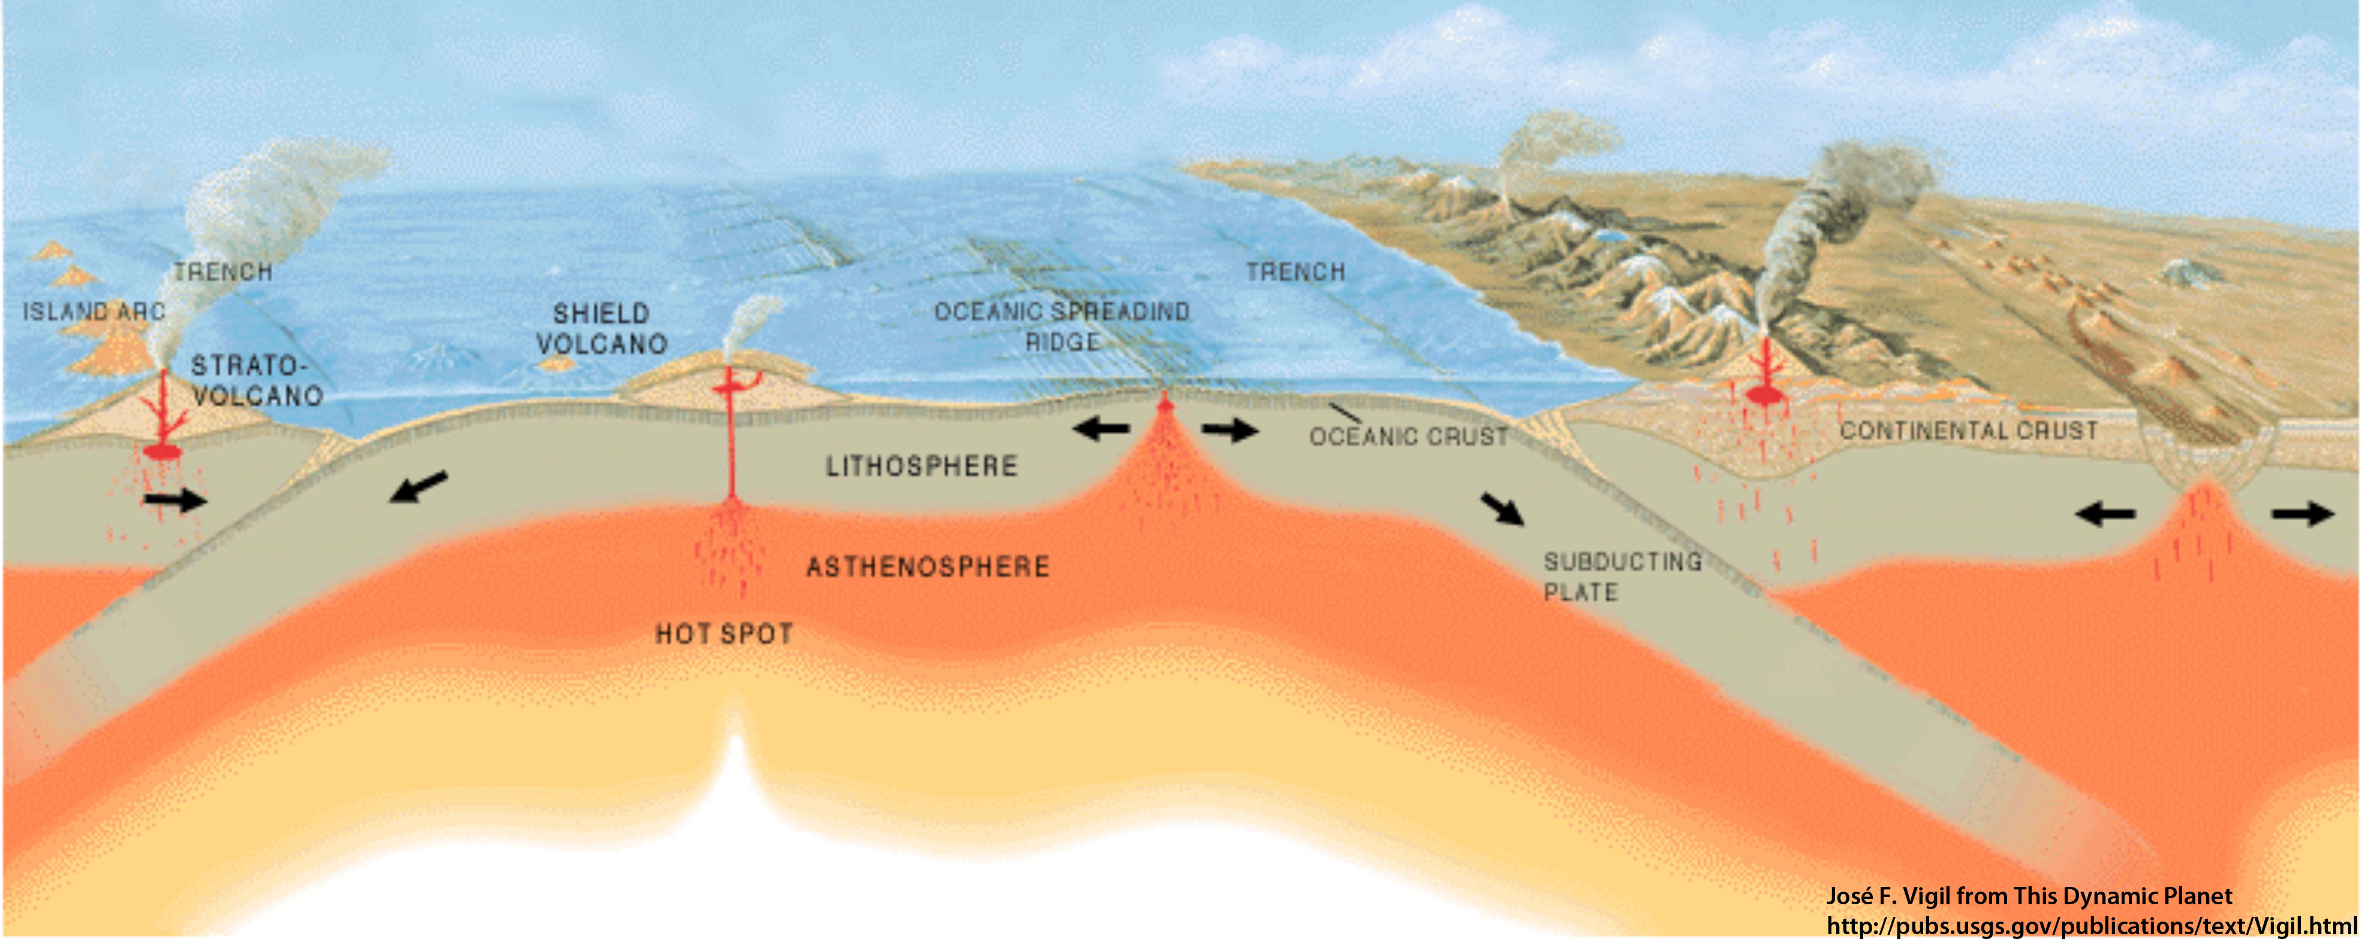
Part 3: Examine GPS Vector Data
GPS station positions change as plates move.
A
B
How will GPS Station B’s position change relative to GPS Station A?
GPS stations are not to scale

Slide 12
Part 3: Examine GPS Vector Data
GPS station positions change as plates move.
A
B
GPS Station B is moving toward A.
GPS stations are not to scale
Notes:
Note that the red arrow is really just an arrow… there is no scale to show the rate of motion.

Slide 13
About Velocity Vectors
Length of the vector arrow (magnitude) = shows how fast the ground is moving at the GPS station.
Direction of the vector arrow = the direction that the ground is moving at that GPS station
Tail of vector
= location of GPS station

Slide 14
About Velocity Vectors
Notice the length of the three sets of vectors. Where is the ground moving the quickest?

Slide 15
Reference frames: North American & Pacific Plates
North American Reference frame
The rest of the world’s plates move, The interior of the North American plate doesn’t move.
Pacific Reference Frame
The rest of the world moves;
The Pacific plate doesn’t move.
Notes:
Leet’s see how a frame of reference changes your view.
Under Add velocities is a list of the tectonic plates. Typically scientists look at the velocities using a reference frame near where they are looking. In the example above, looking at Alaska, scientists might choose either the Pacific plate or North America reference frames to investigate how the velocities change – sometimes you see surprising and subtle features by doing this! For instance, by using the North America reference frame, you can see that the very edge of Alaska is being pushed inland due to the subducting Pacific plate

Slide 16
Add Features and Velocity Vectors

Slide 17
Part 3 continued: Sketch and Study the Vectors
Sketch some of the observed velocity vectors on your map of the Western United States
Answer questions in Part 3: Examine GPS Vector Data continued
Discuss with your teammate
Bonus: How would you characterize the width of the plate boundaries on your map?
Based on your data, which plate boundaries should be shown as a thin line or a broad zone? Why?

Slide 18
Part 4: Put It All Together
Notes:
Show vectors using JVV Jr or Velocity View of convergent, divergent, transform – or have students do this- use modeled data with JVV Jr.

Slide 19
Quick Reference: What’s this boundary type?
How do the lengths of the vectors change -
Longer / shorter as they get closer to land?
Which way are they pointing?
Reference frame: Pacific Plate
Notes:
Note: these are vectors that are modeled using other scientific techniques.

Slide 20
Quick Reference
How do the lengths of the vectors change -
Longer / shorter as they get closer to land?
Reference frame:
South American Plate

Slide 21
Quick Reference: Convergent Boundary
Longer vectors running into shorter vectors towards land
Draw this in the box under Part 4: Put it all together

Slide 22
Quick Reference: What’s this boundary type?
How do the lengths of the vectors change -
Longer / shorter as they get closer and onto land?
Which way are they pointing?
Reference frame:
North American Plate

Slide 23
Quick Reference:
How do the lengths of the vectors change -
Longer / shorter as they get closer and onto land?
Which way are they pointing?
Reference frame:
Pacific Plate

Slide 24
Quick Reference: Transform Boundary
Longer vectors parallel to shorter vectors
Draw this in the box under Part 4: Put it all together

Slide 25
Quick Reference What’s this boundary type?
Which way are the vectors pointing?
How do the lengths of change?
Reference frame:
No Net Rotation

Slide 26
Quick Reference
Which way are the vectors pointing?
How do the lengths of change?
Reference frame:
European Plate

Slide 27
Quick Reference: Divergent Boundary
Example 1
Example 2
Vectors pointing away from each other
Draw this in the box under Part 4: Put it all together

Slide 28
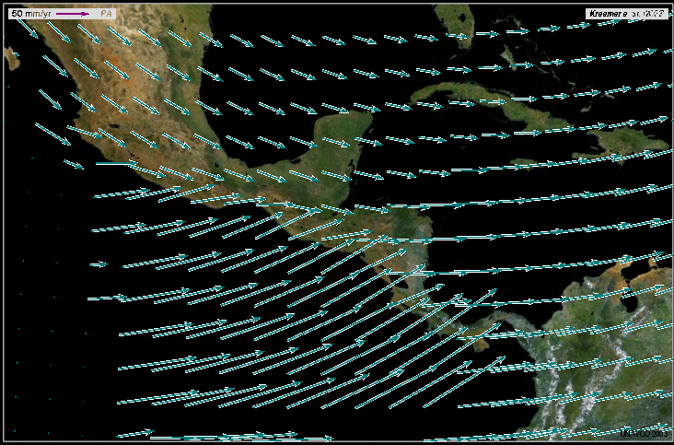
What’s this plate boundary?
Reference frame:
Pacific Plate

Slide 29
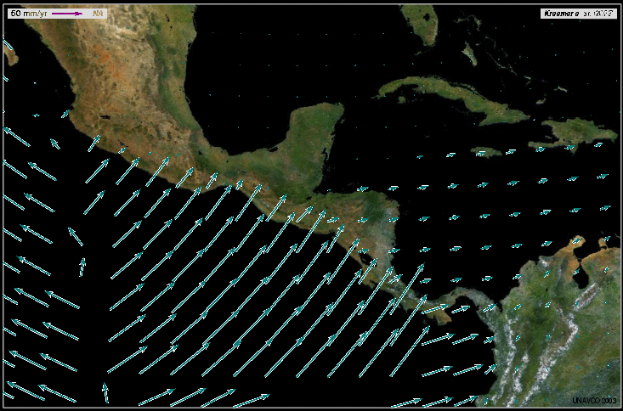
Divergent Boundary
Reference frame:
North American Plate

Slide 30
Can you name the boundary types?

Slide 31
Part 4: Sketch and Study the Modeled Vectors
Sketch vectors where they are very different from each other
Draw where you believe the plate boundaries are located
Compare with plate boundaries in EarthScope Voyager Jr.
Answer questions
Discuss with your teammate

Slide 32
Plate Boundaries Along the West Coast

Slide 33
Thinking of Boundaries as Zones

Slide 34
Global Motion

Slide 35
Wrap Up
What we did:
Explored locations of earthquakes and volcanoes
Compared plate motion between the Pacific Northwest and California
Determined plate boundary zones using multiple lines of evidence:
Ground motion using GPS vector maps
Locations of
Earthquakes
Volcanoes

Slide 36
Other Tools to Explore
UNAVCO GPS, Earthquake, Volcano Viewer
http://www.unavco.org/software/visualization/GPS-Velocity-Viewer/GPS-Velocity-Viewer.html
Google search: unavco GPS Velocity Viewer
IRIS Earthquake Browser
www.iris.edu.ieb

Slide 37
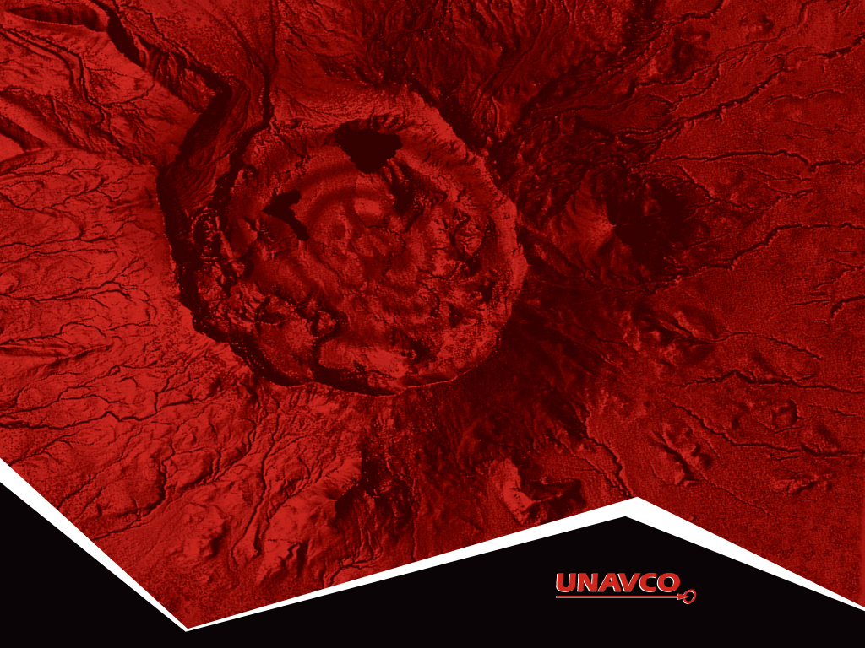
Thank You!
Contact:
education unavco.org
http://www.unavco.org/
Follow UNAVCO on _______ Facebook Twitter

