Slide 1
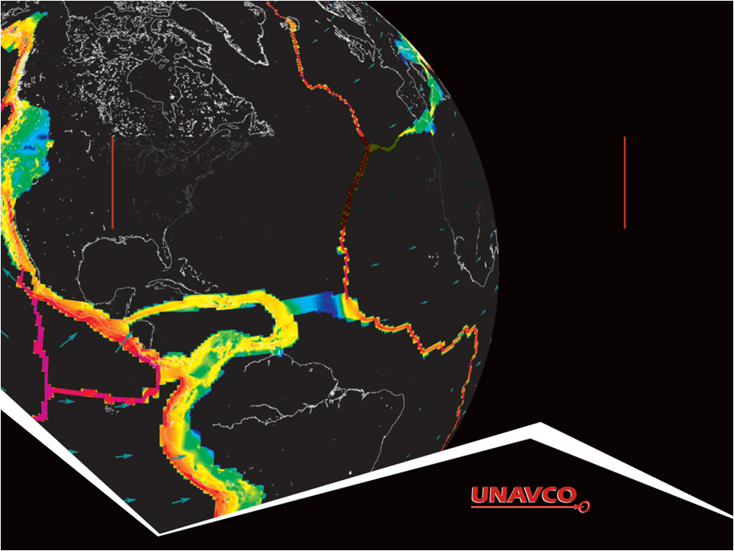
Visualizing Relationships Between Earthquakes, Volcanoes, and Plate Tectonics in Alaska
Ruth Powers (UNAVCO Master Teaching-in-Residence); Becca Walker and Shelley Olds (UNAVCO)
Notes:
Realized that our challenge is more general than plate tectonics
As you will see we have multiple data types and multiple science applications
And multiple educator and student needs
Which require vis tools to accommodate this

Slide 2
Activity Outcomes
Learners should be able to…
Describe how the locations of earthquakes, volcanoes, and velocity vectors from GPS stations in the Western United States inform us about plate boundary zones
Describe and draw a velocity vector
Analyze regional plate motion and crustal deformation based on velocity vector maps
Describe the difference between a plate boundary and plate boundary zone
Notes:
Explored locations of earthquakes and volcanoes
Compared plate motion between the Pacific Northwest and California
Determined plate boundary zones using multiple lines of evidence: GPS plate velocity vector maps, earthquake and volcano locations

Slide 3
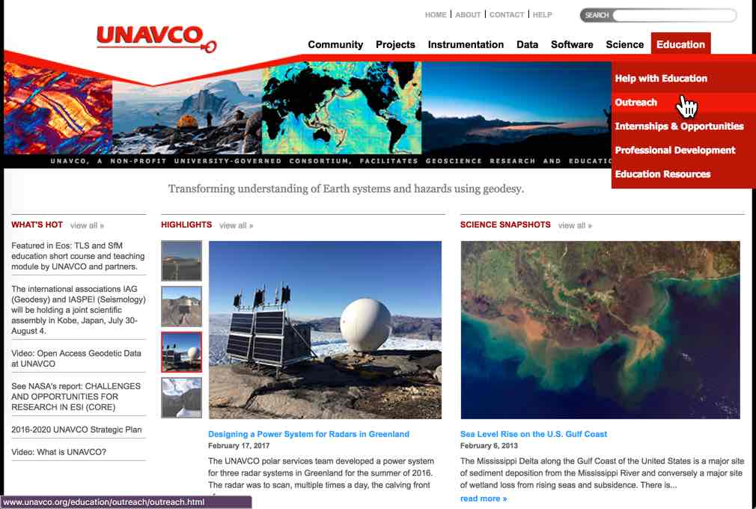
Part 1: Prepare Your Map for Study
Start at: http://www.unavco.org/
Click on Education
→ Outreach →
Interactive Data & Mapping Tools
Click on
EarthScope Voyager Jr.

Slide 4
Getting Oriented to the Map

Slide 5
Getting Oriented to the Map

Slide 6
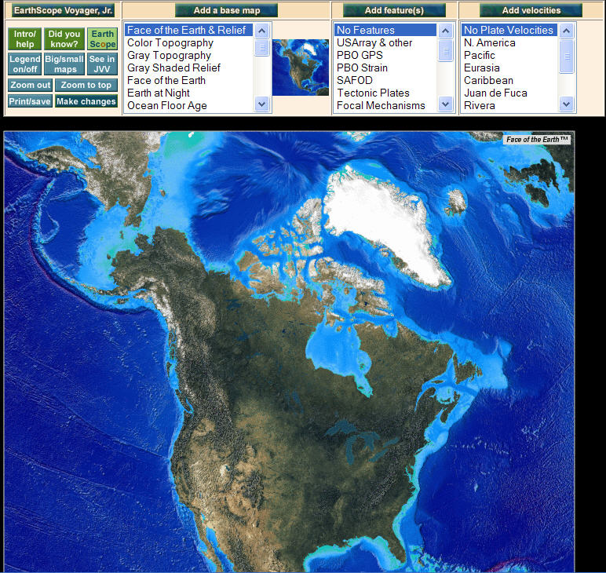
Zoom Into Alaska
Click on map to zoom in
And zoom again

Slide 7
Under Add Features → select Political Lat/Long
Add political boundaries and latitude/longitude lines
Then click on
“Make changes”

Slide 8
Part 2: Compare Earthquake and Volcano Locations
Work with a partner
Add your feature (either Earthquakes or Volcanoes)
(hold ctrl- or command-key to keep the Political, Lat/Long)
Study your map
Answer the questions
How are the data distributed?
How would describe the spatial pattern(s) of the data? Are they located near the edges of the continent, mid-continent, in the ocean?
At what depth(s) do the earthquakes occur? (hint: look at the legend)

Slide 9
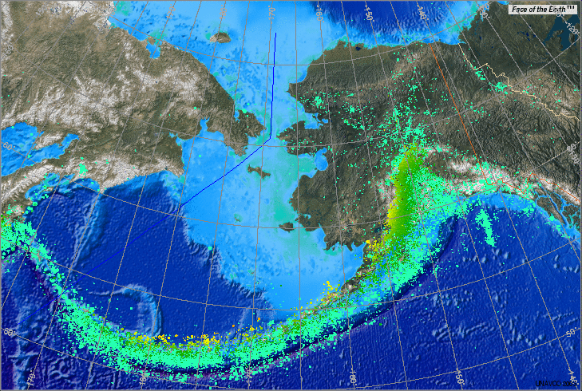
Earthquake Distribution

Slide 10
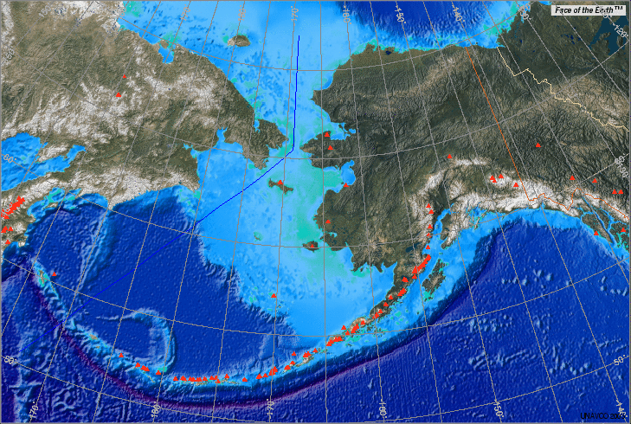
Volcano Distribution

Slide 11
Earthquake and Volcano Distribution in the Western U.S.

Slide 12
Earthquakes and Volcanoes
Discussion:
What geographic features (mountains, plains, valleys, etc) are frequently where there are only:
Earthquakes?
Volcanoes?
In which regions do you find earthquakes and volcanoes near each other? What’s there?
Summarize the relationships you discovered.
What explanation can you provide for the observed relationships?

Slide 13
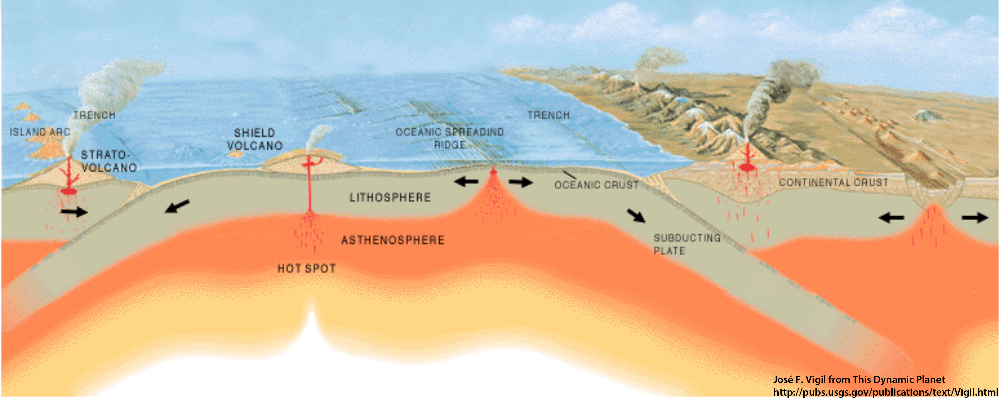
Part 3: How is Alaska moving over time?
Analyzing ground motions with GPS data.
GPS station positions change as tectonic plates move.
GPS Station B
GPS Station A
How will ground under GPS Station A move relative to GPS Station B?
GPS stations are not to scale

Slide 14
Part 3: How is Alaska moving over time?
Analyzing ground motions with GPS data.
GPS station positions change as plates move.
GPS Station A
GPS Station B
GPS Station A is moving toward B.
GPS stations are not to scale
Notes:
Note that the red arrow is really just an arrow… there is no scale to show the rate of motion.

Slide 15
Anatomy of a High-precision Permanent GPS Station
GPS antenna inside of dome
Monument solidly attached into the ground with braces.
If the ground moves, the station moves.
Solar panel for power
Equipment enclosure
GPS receiver
Power/batteries
Communications/ radio/ modem
Data storage/ memory

Slide 16
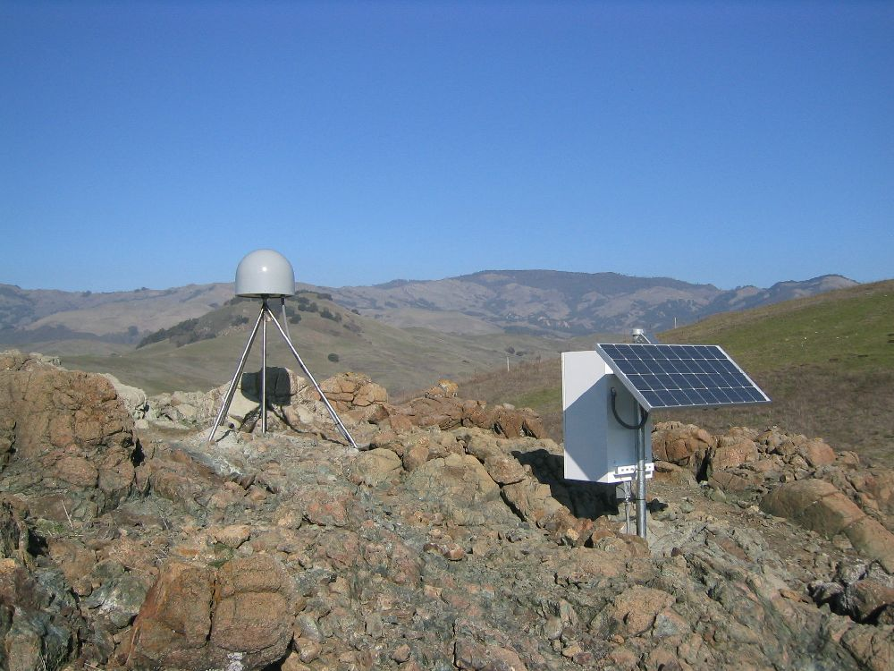
Introduction: GPS Basics
Three satellite signals are needed to locate the receiver in 3D space.
The fourth satellite is used for time accuracy.
Position can be calculated within a sub-millimeter.
Needs ground control and time quality
Notes:
Also note that the GPS stations used for scientific work are more precise for many reasons: the unit uses both of the signals coming from the satellites, two the clocks are atomic rather than crystal, (see slide). These stations can measure the change in position of a location with sub-millimeter accuracy.

Slide 17
Demonstration Pinpoint Location With GPS
How to demonstrate this:
http://www.youtube.com/watch?feature=player_embedded&v=s_CeiMjO5Pc#!

Slide 18
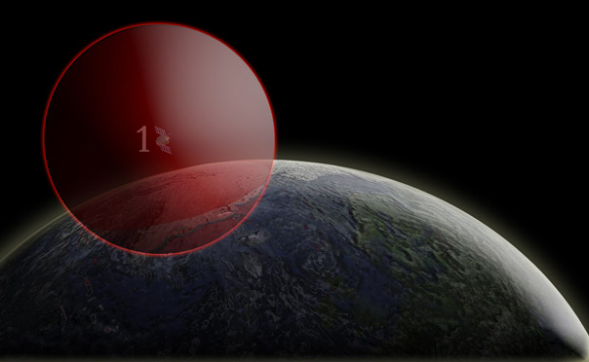
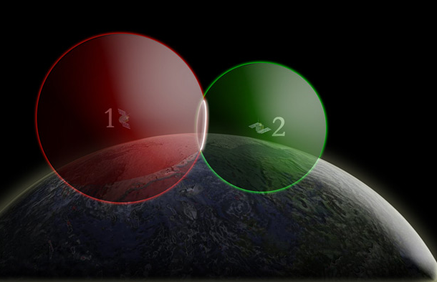
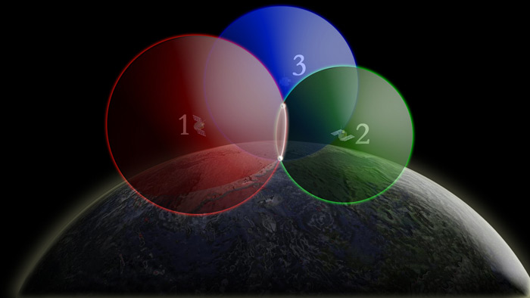
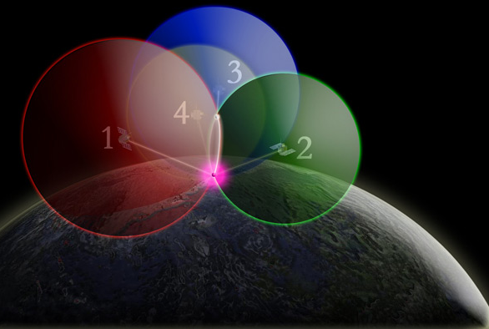
One way to find your location – 4 intersecting spheres
With one GPS satellite, the GPS receiver could be anywhere on the edge of the sphere.
With two GPS satellites, the GPS receiver could be on the circle where spheres intersect.
With four GPS satellites, the spheres intersection in one place.
With three GPS satellites, the GPS receiver could be two places where the spheres intersect.

Slide 19
About Velocity Vectors
Length of the vector arrow = how fast the plate is moving (magnitude).
Direction of the vector arrow = the direction that the plate is moving at that GPS station
Tail of vector = location of GPS station

Slide 20
Add Velocity Vectors
Under “Add velocities” click on N. America
(this reference frame keeps the North America tectonic plate fixed in place while the rest of the world’s plate move relative to North America)
Click on “Obs” for observed data.

Slide 21
Add Velocity Vectors

Slide 22
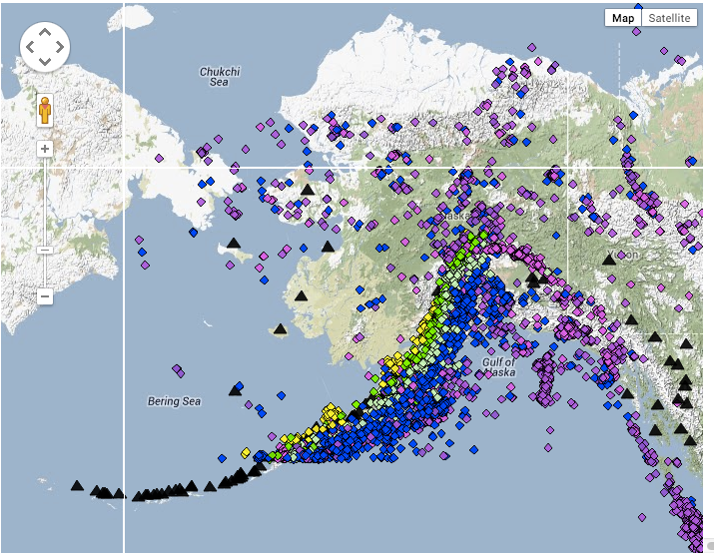
Viewing recent & near-real time data
Search for:
UNAVCO GPS
Velocity Viewer

Slide 23
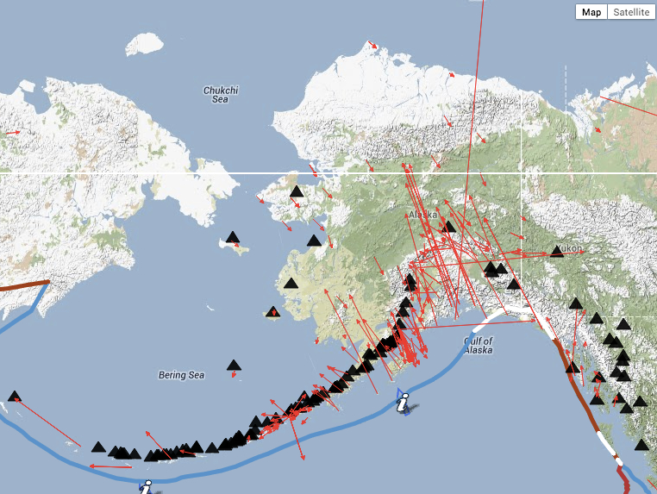
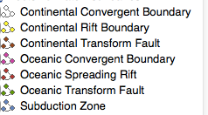
Explore Data: GPS Velocity Viewer
http://www.unavco.org/ - Click on Education → Outreach
→ Interactive Data & Mapping Tools → GPS Velocity Viewer

Slide 24
Part 3 continued: Sketch and Study the Vectors
Sketch some of the observed velocity vectors on your map - direction & lengths of the vectors.
Add different data types (earthquakes, volcanoes, plate boundaries)
What do you notice about the length of the vectors (the velocities) along the Aleutian Islands? What patterns do you see?
How does the velocity and direction of the GPS stations change from the coast to inland?
What other areas have differing velocities or velocities?
What do you think is happening in these regions to cause these differences?

Slide 25
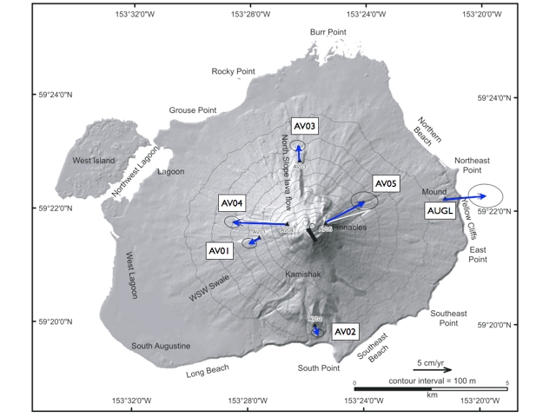
Volcano Augustine
Notes:
http://xenon.colorado.edu/spotlight/index.php?product=spotlight&station=av03

Slide 26
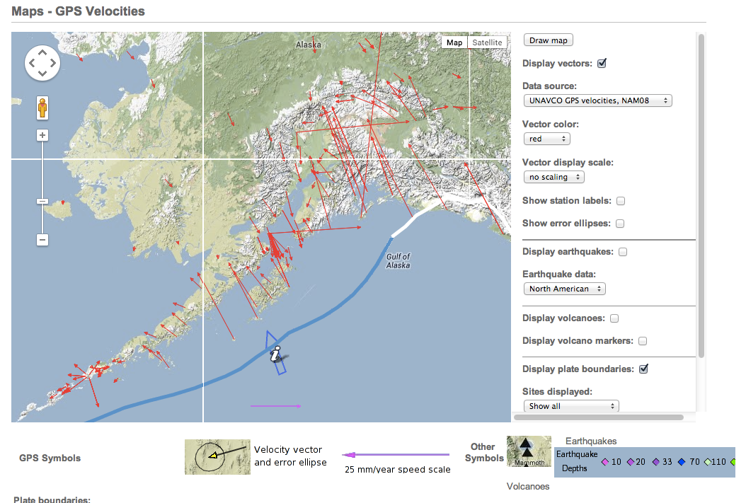
GPS Velocity Viewer- Zoomed in
http://www.unavco.org/ - click on Education then Data for Educators

Slide 27
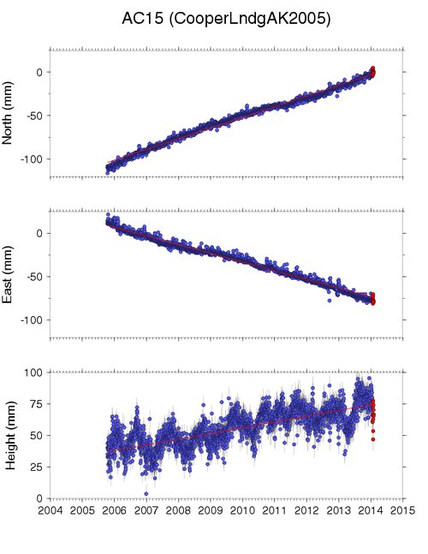
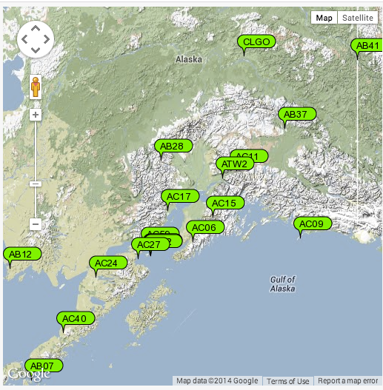
Study the GPS Data-, ex: Cooper Landing, Alaska
(optional) add Station labels and data download

Slide 28
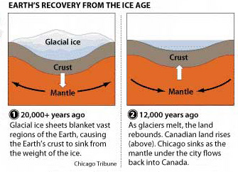
Measuring the Crust and Mantle Move
Ground motion due to:
Geophysical processes
Regional plate tectonics
Motion due to 1964 Mw 9.2 earthquake and other eqs
Volcanic inflation/ deflation/eruption
Ice processes
Post-glacial adjustments (rebound)
Present-day glacier & permafrost melting
Water
Seasonal changes
Wind-driven surges
Reservoir water-level changes
Earth/Ocean tides *
Air
Water Vapor *
Weather systems *
* GPS data in the Velocity Viewer accounts for these effects
Sella and others, 2007
Notes:
If students want to learn more about the local geology, discuss how the the ground is moving due to a number of processes.
The GPS data measures the change in position in both the horizontal and vertical. The processes with a * indicates that the GPS data in the Velocity Viewer accounts for these effects
Ground motion due to
Geophysical processes (most of the observed horizontal motion is due to these processes)
Regional plate tectonics (most evident motion is near the plate boundaries)
Motions due to 1964 Mw 9.2 earthquake (this is still measurable in the horizontal and vertical GPS data – particularly on the Kenai Peninsula)
Motions due to other recent earthquakes
Volcanic inflation/deflation/eruption (this motion is often very close to the volcano and is also visible in the vertical component of the GPS data)
Ice (this is often most visible in the vertical changes)
Post-glacial adjustments (rebound)
Present-day glacier & permafrost melting
Water (this is often most visible in the vertical changes)
Seasonal changes
Wind-driven surges
Reservoir water-level changes
Earth/Ocean tides *
Air
Water Vapor *
Weather systems *

Slide 29
Plate Boundaries

Slide 30
Plate Boundaries as Zones
Notes:
This image shows the strain rates – areas of Alaska that are changing shape. While plate boundaries are often draw as thin lines, the actual area undergoing deformation due to plate interactions can be a large zone, particularly in subduction and convergent zones.

Slide 31
Wrap Up
What we did:
Studied the patterns of earthquakes and volcanoes and made hypotheses about the relationships
Compared ground motion in different regions of Alaska
Determined plate boundary zones using multiple lines of evidence:
Ground motions measured by GPS
Locations of
Earthquakes
Volcanoes

Slide 32
Thank You!
Contact: Shelley Olds
Education -at- unavco.org
http://www.unavco.org/
Follow UNAVCO on _________
Facebook Twitter

Slide 33
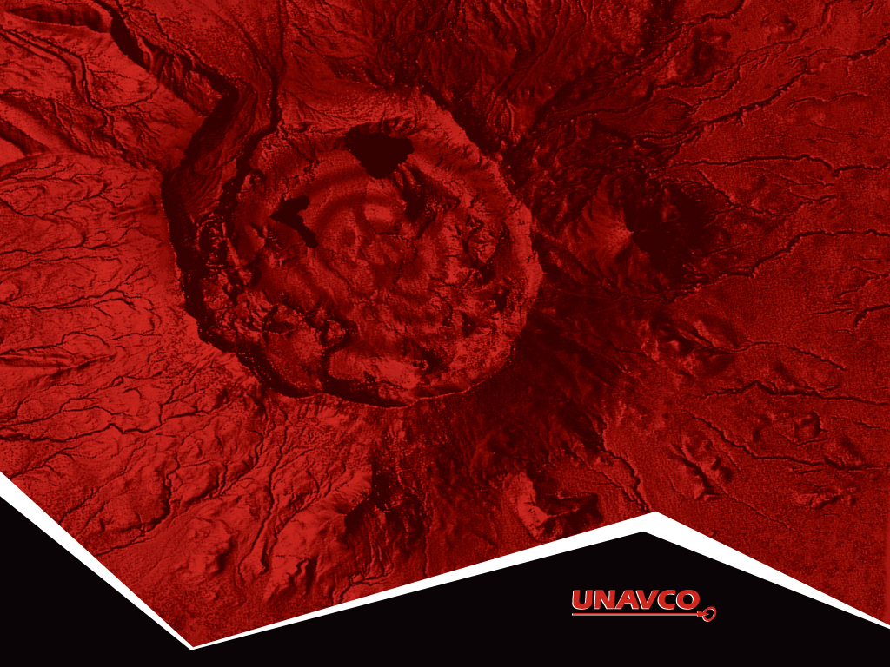
Thank You!
Contact:
education unavco.org
http://www.unavco.org/
Follow UNAVCO on _______ Facebook Twitter

Slide 34
Alaska Topography

Slide 35
Neighboring Frames of Reference: North America
Reference frame North America (SNARF) which means:
The rest of the world’s plates move, while the North America plate stays fixed.
Near Alaska, the vector arrows are pointing to the North West (NW) because the Pacific plate is moving to the NW…
and the edge of Alaska is also moving NW
Notes:
Leet’s see how a frame of reference changes your view.
Under Add velocities is a list of the tectonic plates. Typically scientists look at the velocities using a reference frame near where they are looking. In the example above, looking at Alaska, scientists might choose either the Pacific plate or North America reference frames to investigate how the velocities change – sometimes you see surprising subtle features by doing this! For instance, by using the North America reference frame, you can see that the very edge of Alaska is being pushed inland due to the subducting Pacific plate

Slide 36
Neighboring Frames of Reference: Pacific Plate
Pacific plate as reference frame:
Pacific plate doesn’t move
Near Alaska, the vector arrows point South East
Alaska is moving to the South East…

Slide 37
Thinking of Boundaries as Zones

Slide 38
Part 4: Put It All Together

Slide 39
Part 4: Sketch and Study the Modeled Vectors
Sketch vectors where they are very different from each other
Draw where you believe the plate boundaries are located
Compare with plate boundaries in EarthScope Voyager Jr.
Answer questions
Discuss with your teammate

Slide 40
Global Motion

Slide 41
Other Tools to Explore
UNAVCO GPS, Earthquake, Volcano Viewer
http://www.unavco.org/software/visualization/GPS-Velocity-Viewer/GPS-Velocity-Viewer.html
Google search: unavco GPS Velocity Viewer
IRIS Earthquake Browser
www.iris.edu.ieb

Slide 42
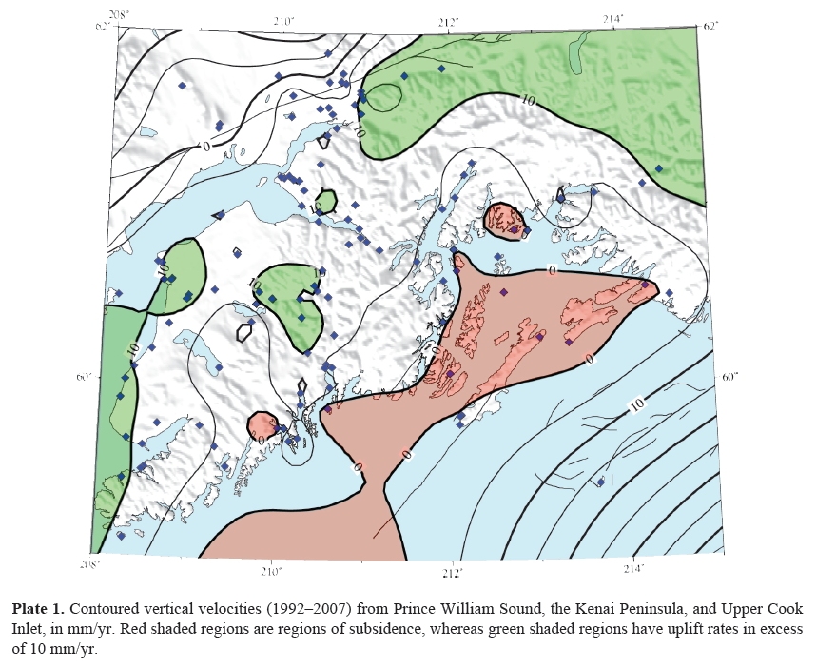
Vertical motions - Kenai
Freymueller et al. 2008
Notes:
Freymueller, J. T., Woodard, H., Cohen, S. C., Cross, R., Elliott, J., Larsen, C. F., ... & Zweck, C. (2008). Active deformation processes in Alaska, based on 15 years of GPS measurements. Active Tectonics and Seismic Potential of Alaska, 1-42.

Slide 43
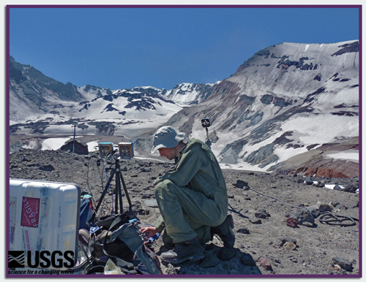
Signs of Volcanic Activity
Eruption history
Volcanic gas emission
Heat and hydrothermal activity
Earthquakes
Ground deformation
Notes:
This slide organizes the presentation, which uses Mount St. Helens as a well-monitored example of many forms of volcanic activity. You will see photos of Mount St. Helens and, in some cases, for comparison, photos from Yellowstone National Park.
The picture is of a scientist monitoring gases given off by Mount St. Helens 6 July 2011. He is taking photographs using ultraviolet light (instead of visible light) to detect sulfur dioxide (SO₂), which absorbs ultraviolet light. The presence of SO₂ is frequently a clue that magma is actively rising.
Photo by Werner, C. 2011. USGS Volcano Hazards Program: “Postcards from the Field.” http://volcanoes.usgs.gov/about/postcards/index.php#MSHgas Retrieved15 December 2011.

Slide 44
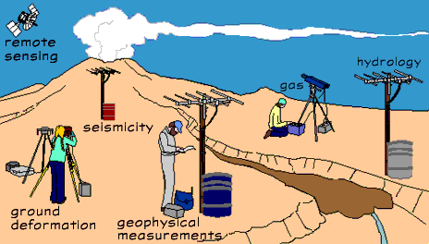
Monitoring
Scientists use tools, many of which can be set up and left, to monitor volcanoes.
Notes:
Image from USGS. 2002. Volcano Hazards Program: “How We Monitor Volcanoes”. http://volcanoes.usgs.gov/activity/methods/index.php Retrieved 1 January 2012.

Slide 45
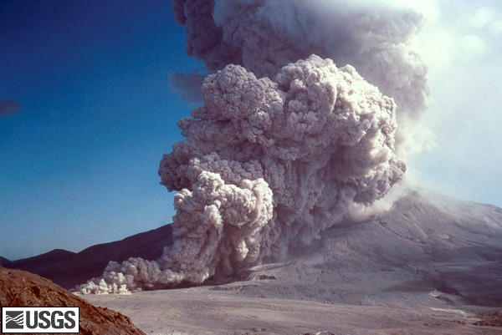
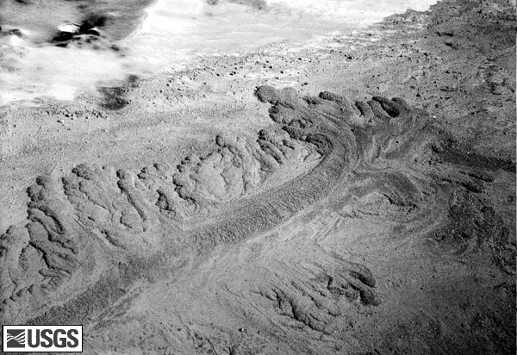
Eruption History
Pyroclastic flows
Notes:
Pyroclastic flows occur when superheated gases and solids flow down the flanks of a volcano--at rates of tens to hundreds of kilometers per hour.
Earthquakes and elevated gas levels can precede them. However, Mount St. Helens’s explosive eruption of 18 May 1980 was started by a landslide — triggered by an earthquake. The eruption produced 17 or more pyroclastic flows. The flows descended the north flank through the breach caused by the explosion, and they destroyed everything in their paths.
For more background on pyroclastic flows click on the picture.
The photo on the left is of a pyroclastic flow 7 August 1980 falling down the flank of Mount St. Helens. The photo on the right is a pyroclastic flow deposit from an eruption 12 June 1980. The tongue of debris is ½ mile long.
Lefthand photo from USGS. Lipman, P. 1980. Cascade Volcano Observatory: Digital Slide File: Mount St. Helens, Washington: Pyroclastic Flow Images: 1980-Current. http://vulcan.wr.usgs.gov/Volcanoes/MSH/Images/pyroclastic_flows.html Retrieved 13 December 2011.
Righthand photo from USGS, Rowley, P. 1980. Cascade Volcano Observatory: Digital Slide File: Mount St. Helens, Washington: Pyroclastic Flow Images: 1980-Current http://vulcan.wr.usgs.gov/Volcanoes/MSH/Images/pyroclastic_flows.html Retrieved 13 December 2011.

Slide 46
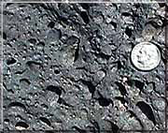
Volcanic Gases
Gas emissions
Vesicular basalt
Notes:
Gases that are dissolved in magma provide some of the energy for volcanic eruptions. Gases can be released as magma rises (easing the pressure, like opening a can of soda), as it erupts to the surface, and even as magma cools below the surface. Compare the size of the gas bubbles near the magma chamber to those near the volcano’s vent. They get bigger as the pressure on the magma lets up.
The primary gas in an eruption is water vapor!
The lefthand image is a diagram of gases exsolving (the opposite of dissolving) from magma as the magma rises. The photo, on the right, proves that magma is gassy. When magma reaches the surface—becoming “lava”--and cools quickly, holes remain from the gas bubbles it once contained.
Diagram from Driedger, C.; Doherty, A.; and Dixon, C. 2005. Living with a Volcano in your Backyard -- An Educator's Guide with Emphasis on Mount Rainier: U.S. Geological Survey and National Park Service: General Interest Publication 19. “Soda Bottle Volcano” Activity. http://vulcan.wr.usgs.gov/Outreach/Publications/GIP19/framework.html Retrieved 13 December 2011.
Photo from USGS, accessed from the National Park Service: Bryce Canyon Activity 3: Igneous Rocks. http://www.nps.gov/brca/forteachers/randmact3.htm Retrieved 13 December 2011.

Slide 47
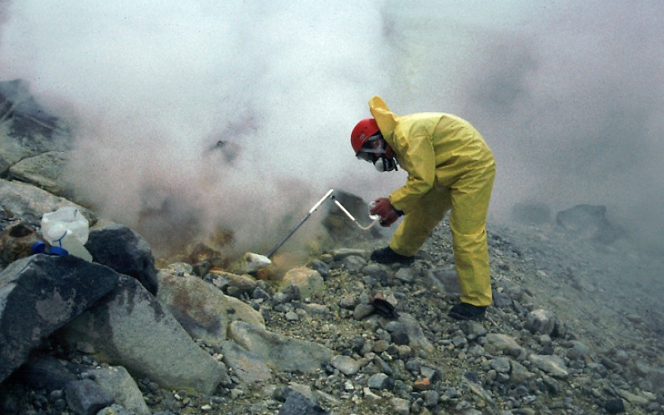
Volcanic Gases
Collecting gas samples
Notes:
A scientist collects gas samples for analysis on an Alaskan volcano. Notice his protective equipment.
Volcanic gases are hard to sample and measure because they are found in hazardous places and are toxic to living things – like this geologist. We detect the gases by using instruments on the ground or mounted on an airplane as in the previous slide. Samples can also be collected by hand, like in this photo, for analyzing in a laboratory.
Image from USGS Volcano Hazards Program: “Direct gas sampling and laboratory analysis.” http://volcanoes.usgs.gov/activity/methods/gas/sample.php Retrieved 13 December 2011.

Slide 48
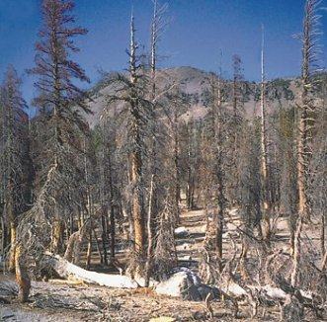
Volcanic Gases
Death by gases
Notes:
To detect and trace emissions of gases, scientists also look for changes to living things such as trees and animals
These trees at Mammoth Mountain, CA died when carbon dioxide (CO₂) suffocated their roots. Because CO₂ is denser than air, it pools at ground level. (In contrast, trees need CO₂ at branch height to photosynthesize.)
Volcanic CO₂ emissions have proven deadly to humans in Africa. In 1986, 1700 people and 3500 livestock suffocated near a lake in Cameroon. CO₂ was dissolved in the lake, like it is in a soda. A landslide disturbed the equilibrium, and, essentially, made the lake burp up the gas.
Image from USGS Fact Sheet 172-96. 2000. “Invisible CO2 Gas Killing Trees at Mammoth Mountain, California”. http://pubs.usgs.gov/fs/fs172-96/ Retrieved13 December 2011.

Slide 49
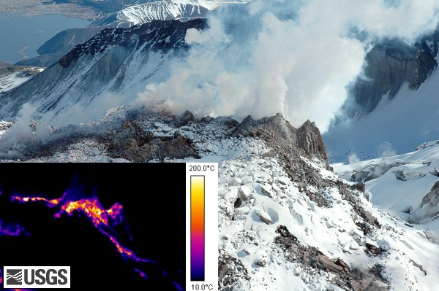
Heat and Hydrothermal Activity
FLIR image of Mt. St. Helens’ new dome June 26th 2007
Notes:
Hot magma is the ultimate source of heat in hydrothermal systems. The existence of a hydrothermal system, however, indicates only that magma lies below, not that it is pushing to the surface.
Thermal features can be monitored by aerial observations at night, photographs of geological features in infrared wavelengths of light (Forward Looking Infrared or “FLIR”), and direct temperature measurements. This pair of images shows a volcanic dome growing on Mount St. Helens in April 2007. The images are of the same features, the bigger one with visible light and the smaller one capturing the scene in infrared wavelengths.
Image from USGS Mount St. Helens, Washington Forward Looking Infrared. 2007. http://vulcan.wr.usgs.gov/Imgs/Jpg/MSH/MSH07/MSH07_top_new_growth_from_SW_04-20-07_FLIR_med.jpg Retrieved 13 December 2011.

Slide 50
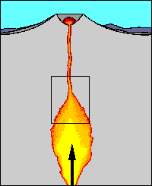
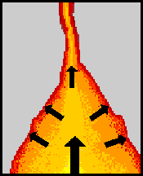
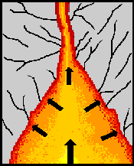
Earthquakes from magma
Formation of earthquakes by rising magma
Magma rises into reservoir
beneath volcano
Rising magma and volcanic gases exert pressure
High pressure causes breaks rocks, triggering earthquakes
Notes:
Moving magma and volcanic fluids can cause earthquakes. Earthquake activity increases before an eruption because liquid magma, hot fluids, and gases are less dense than the surrounding rocks and they force their way through the crust to reach Earth’s surface. Most volcanic earthquakes:
have a magnitude <3;
Occur shallower than 10 km; and
occur in swarms (lots of earthquakes, close together).
Image from USGS Volcano Hazards Program: “Monitoring Volcano Seismicity.” http://volcanoes.usgs.gov/activity/methods/seismic/index.php Retrieved 14 December 2011.

Slide 51
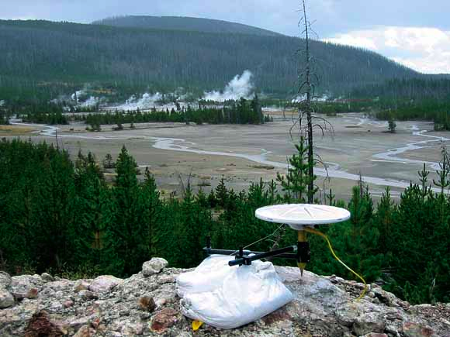
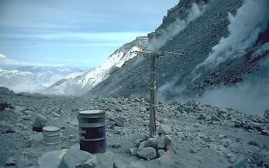
Ground Deformation
Measuring ground
deformation
Notes:
Deformation is also measured on the ground using:
Tiltmeters which work like a carpenter’s level and can be left in place;
Global Positioning Systems which use satellites to triangulate the position of a GPS receiver; and
Leveling Surveys in which scientists use survey equipment to measure position and then return periodically to make additional measurements.
The righthand photo is a permanent GPS site in Yellowstone. The lefthand one is a tiltmeter site on crater floor of Mount St. Helens.
Righthand photo from Puskas, C. USGS Fact Sheet 100-03. 2004. “Tracking Changes in Yellowstone's Restless Volcanic System”. http://pubs.usgs.gov/fs/fs100-03/ Retrieved 27 December 2011.
Lefthand photo by Brantley, S.R. 1982. USGS Volcano Hazards Program: “Tiltmeters help scientists predict eruptions at Mount St. Helens”. http://volcanoes.usgs.gov/activity/methods/deformation/tilt/msh.php Retrieved 15 December 2011.

Slide 52
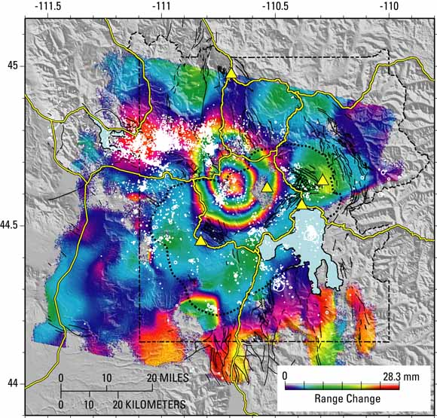
Ground Deformation
Satellite measurement of ground deformation 1996 to 2000
Notes:
Volcanoes change shape before, during, and after eruptions. They inflate (bulge) and deflate (sink) from trapped and pressurized gases or fluids.
Scientists measure changes in the ground surface as well as monitor gas emissions and the patterns of earthquakes. Deformation can be a sign that magma is rising.
This image is of Yellowstone. A satellite collected the data by using a relatively new technique called Interferometric Synthetic Aperture Radar, or InSAR. Computers compare two radar images of the area taken at different times and show changes in elevation with the colors you see. This image shows changes between 1996 and 2000.
The colored rings represent uplift—each set of colored bands from red to violet reflects 28 mm of uplift. Count how many bands of color you see and determine how much uplift occurred between 1996 and 2000.
The black dotted line marks the caldera boundary. Yellow triangles mark permanent GPS stations. White dots and circles show the epicenters of earthquakes between 1996 and 2000.
Image from USGS Fact Sheet 100-03. 2004. “Tracking Changes in Yellowstone's Restless Volcanic System.” http://pubs.usgs.gov/fs/fs100-03/ Retrieved 27 December 2011.

