Slide 1
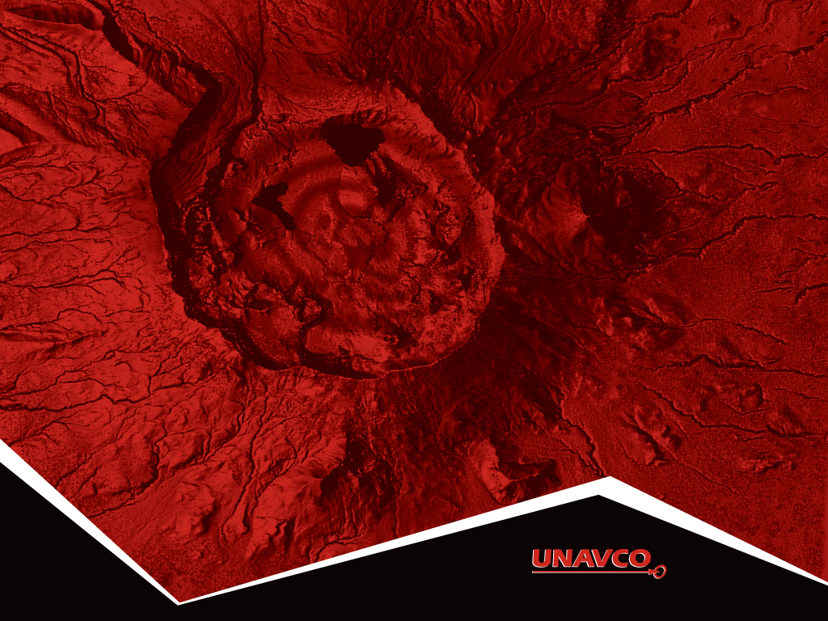
Introduction to Graphing of GPS Data
Roger Groom, Cate Fox-Lent and Shelley Olds.
Revised by Nancy W. West & Kathleen Alexander

Slide 2
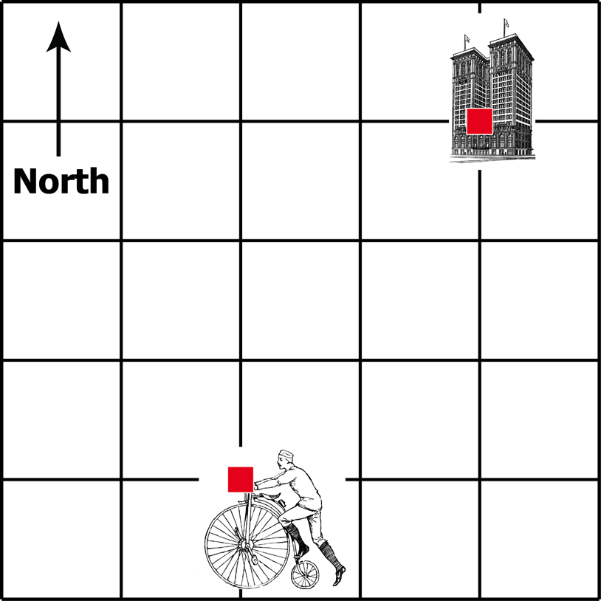
Biking through the city
Notes:
This slide is to identify students who struggle with graphing. If you already plan to do this activity with all students, skip this slide. The points pop into view when you touch the return/enter key.

Slide 3

Jose’s route through the city
Time (minutes) | North (blocks) | East (blocks)
0 | 0 | 0
1 | 0 | 0.5
2 | 1 | 1
3 | 2 | 1.5
4 | 3 | 2

Slide 4
Plot the north positions of the route
Time (minutes) | North (blocks)
0 | 0
1 | 0
2 | 1
3 | 2
4 | 3
North vs Time

Slide 5
Plot the north positions of the route
Time (minutes) | North (blocks)
0 | 0
1 | 0
2 | 1
3 | 2
4 | 3
North vs Time

Slide 6
Plot the east positions of the route
Time (minutes) | East (blocks)
0 | 0
1 | 0.5
2 | 1
3 | 1.5
4 | 2
East vs Time

Slide 7
Plot the east positions of the route
Time (minutes) | East (blocks)
0 | 0
1 | 0.5
2 | 1
3 | 1.5
4 | 2
East vs Time

Slide 8
Plot North and East position after each minute
Time (minutes) | North (blocks) | East (blocks)
0 | 0 | 0
1 | 0 | 0.5
2 | 1 | 1
3 | 2 | 1.5
4 | 3 | 2

Slide 9
Jose’s route through the city
Time (minutes) | North (blocks) | East (blocks)
0 | 0 | 0
1 | 0 | 0.5
2 | 1 | 1
3 | 2 | 1.5
4 | 3 | 2
4
3
2
1

Slide 10

Jose’s route through the city
North
4
3
2
1
0
East
-2
-1
0
1
2
3
4

Slide 11
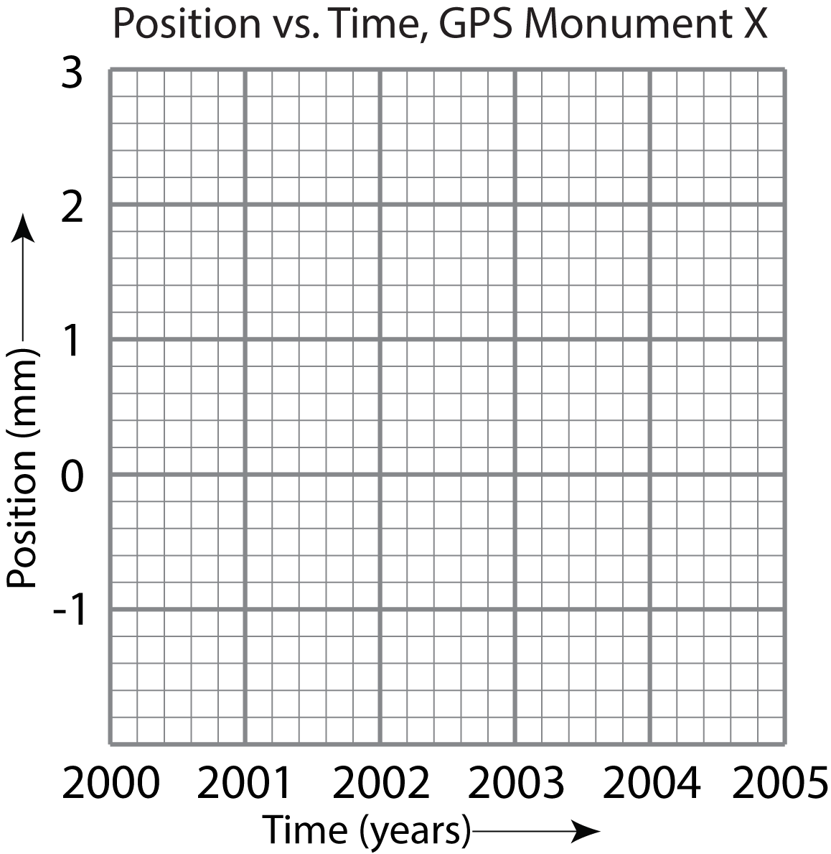
GPS Monument X
Year | Position
2000 | 0
2001 | 2
2002 | 3
2003 | -1
2004 | 2.5
… | …
Notes:
This slide is to identify students who struggle with graphing. If you already plan to do this activity with all students, skip this slide. The points pop into view when you touch the return/enter key.

Slide 12
GPS Monument A
Year | North (mm) | East (mm)
Jan 2000 | 0 | 0
2001 | 1 | 1
2002 | 2 | 2
2003 | 3 | 3
2004 | 4 | 4
2005 | 5 | 5
… | … | …
Notes:
As their first step in determining how the fictitious high-resolution GPS monument A moved over time, students use this data in their first graph. They graph the data on a grid on their worksheets.

Slide 13
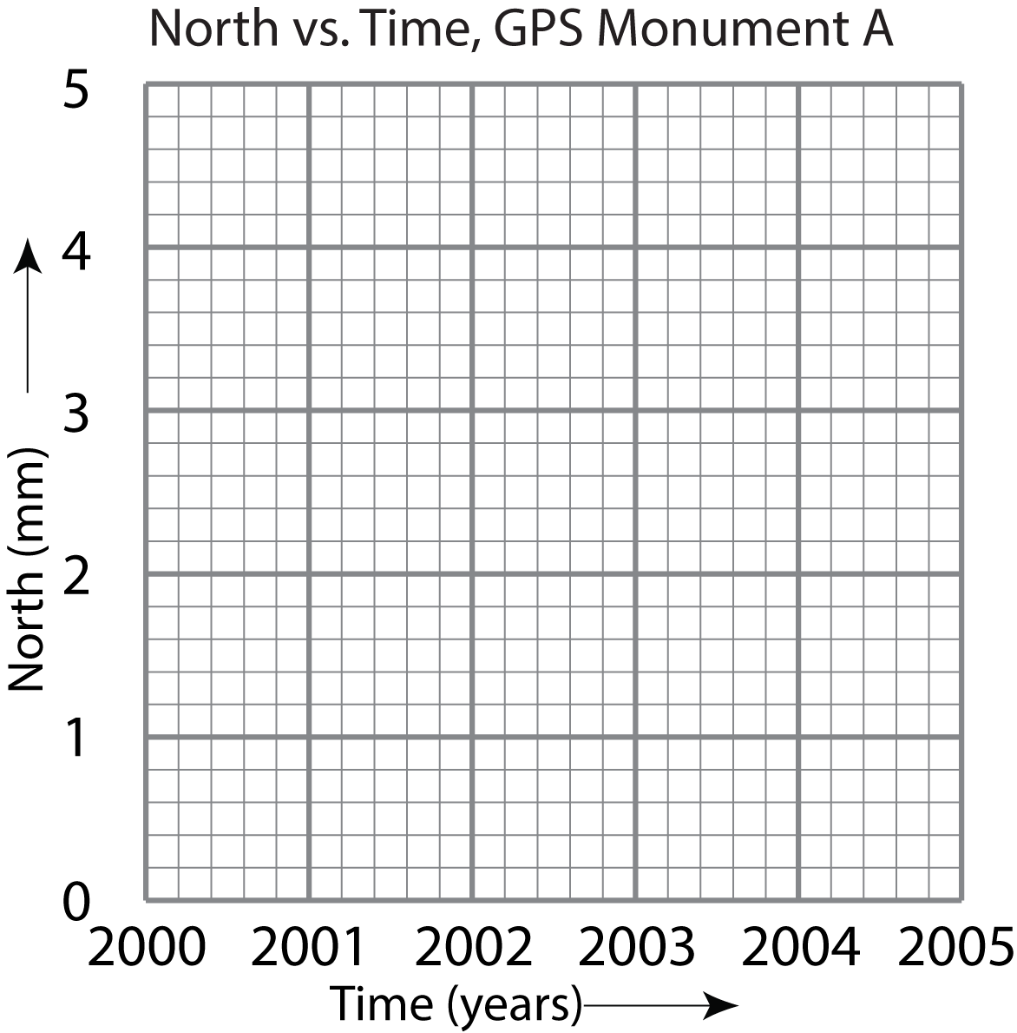
GPS Monument A
Year | North Position (mm)
2000 | 0
2001 | 1
2002 | 2
2003 | 3
2004 | 4
2005 | 5
… | …
Notes:
Students graph North vs. Time. They see the first two points already plotted on their worksheet; their task is to add the rest. Students see that the GPS moved farther north every year because the values for the positions increase. These points drop in one by one as you touch the return/enter key.

Slide 14
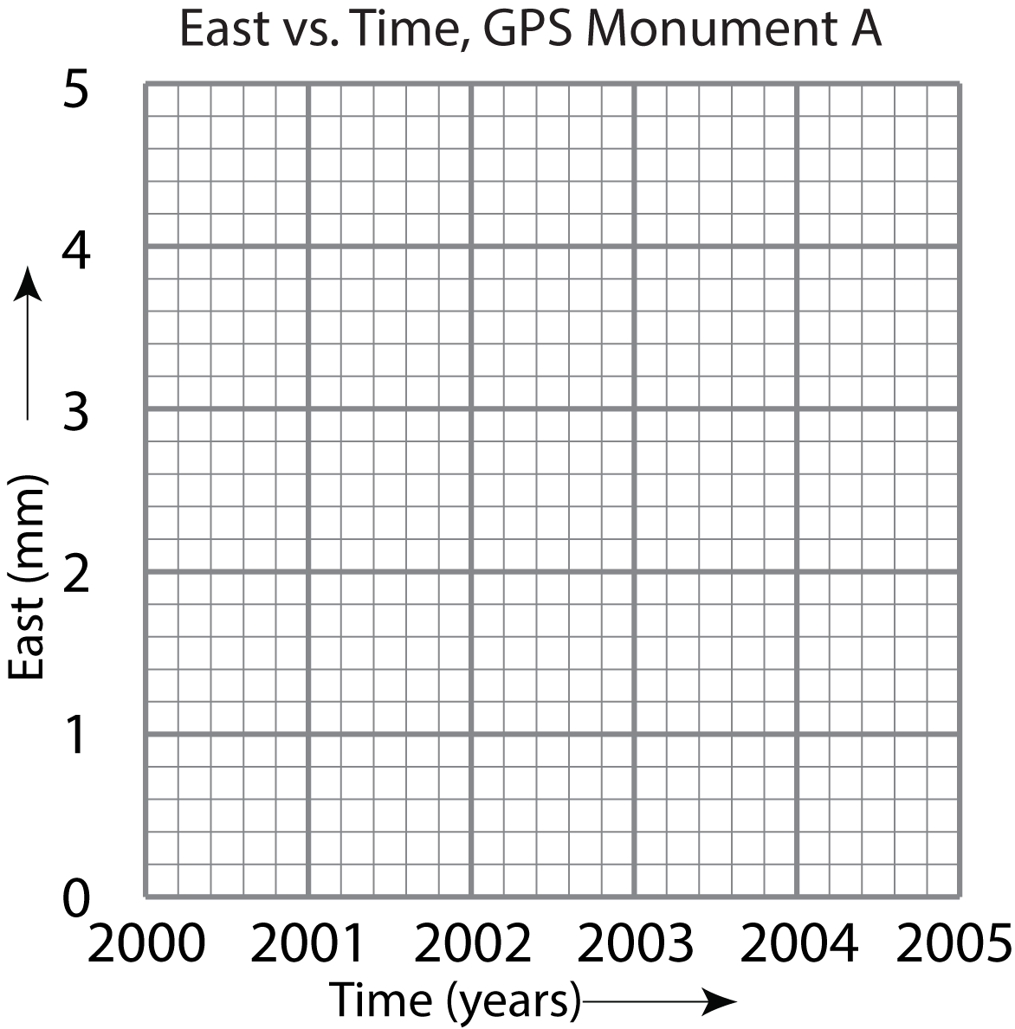
GPS Monument A
Year | East Position (mm)
2000 | 0
2001 | 1
2002 | 2
2003 | 3
2004 | 4
2005 | 5
… | …
Notes:
Students graph East vs. Time. They see the first two points on their worksheet and add the rest. This is just like the previous graph. When the numbers increase over time, the convention is that the GPS station moves east. If they were to decrease, the monument would be moving west.

Slide 15
GPS Monument B
Year | North Position (mm) | East Position (mm)
2000 | -5 | 0
2001 | -4 | -2
2002 | -3 | -4
2003 | -2 | -6
2004 | -1 | -8
2005 | 0 | -10
… |  | …
Notes:
The only substantive difference between this data and that for monument A is that monument B’s data has negative values. The important thing is that these values become more positive over time, and thus the monument moves north. The trend is what students need to pay attention to, not the values themselves.

Slide 16
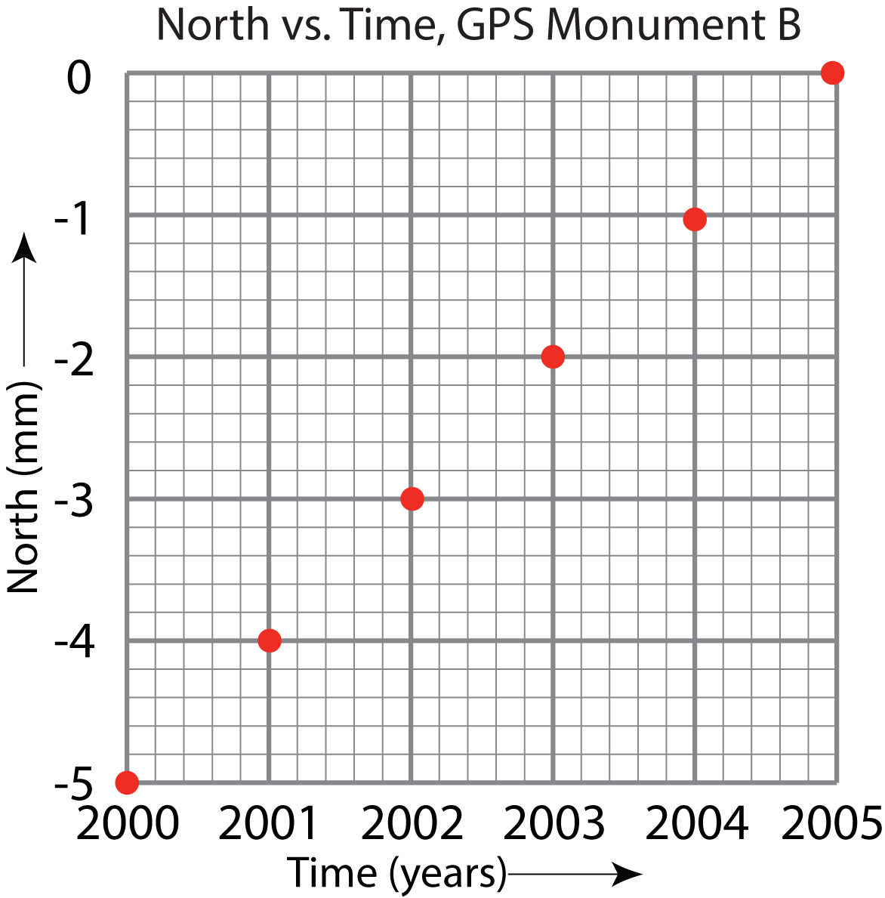
GPS Monument B
Notes:
This graph shows monument B moving north over time as the data values increase.

Slide 17
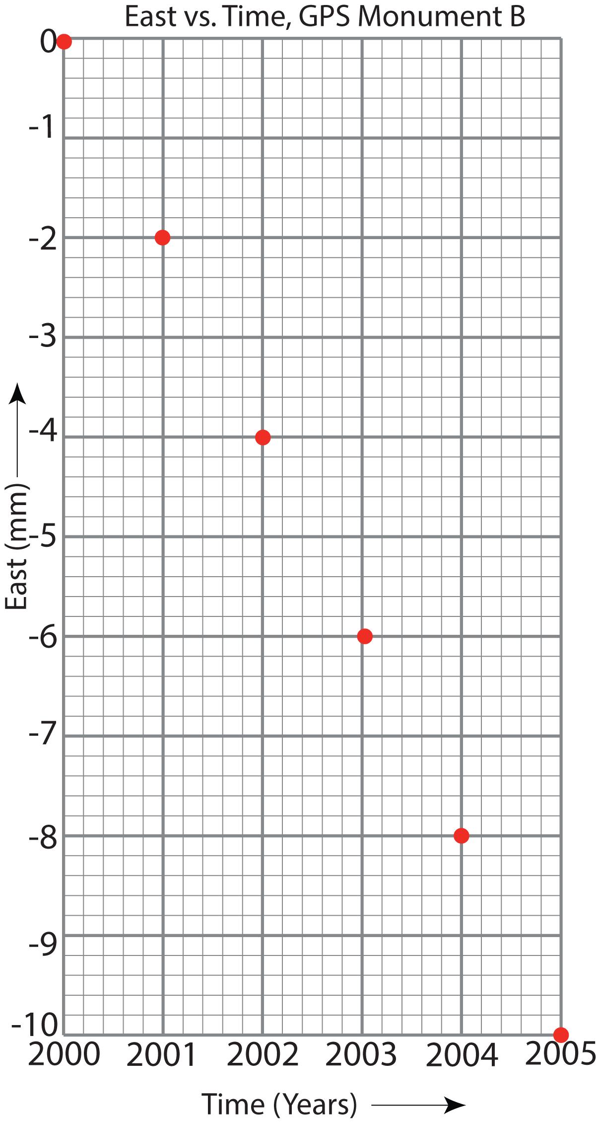
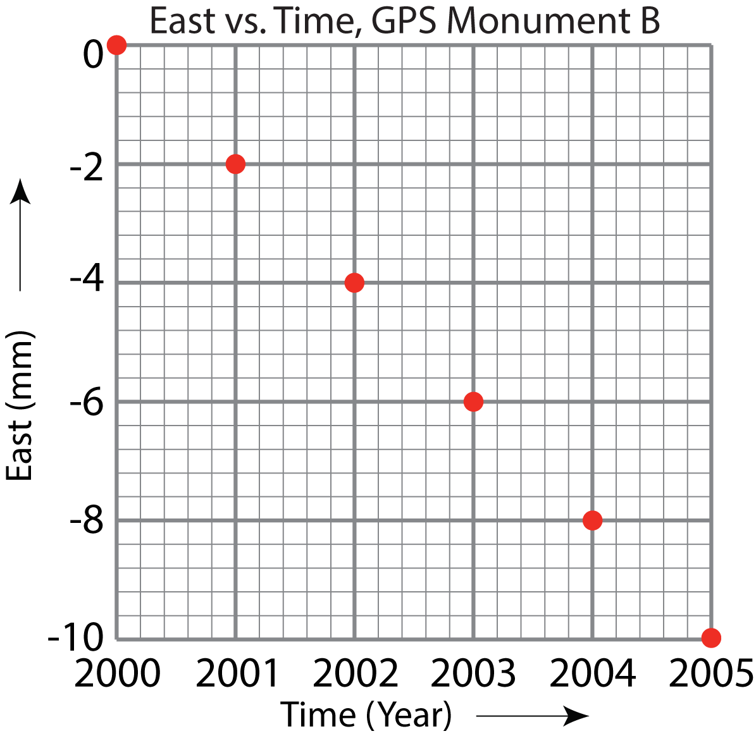
GPS Monument B
Notes:
These two graphs show the same data graphed at different scales. The left-hand graph is at the same scale as the North vs. Time graph on the previous slide: Each darker block represents 1 mm. The right-hand graph is plotted with 2 mm per dark block. If you were to draw a line through the dots (which you see when you click return/enter), the lines have different slopes—because the scaling differs.
Additionally, both lines have negative slopes because the data decreases over time. Monument B is moving west.

Slide 18
Independent vs. Dependent Variables
Graphs are usually set up so that the horizontal axis represents values independent of our control.
For example, when time is one of the things you graph, you plot it on the x-axis -- time marches along no matter what. Time is therefore the independent variable.
The y-axis is for the component that changes depending on time. This is called the dependent variable.

Slide 19
GPS Station P430
Year | North Position (mm) | East Position (mm)
2008 | -35.5 | -53.8
2009 | -29.9 | -46.3
2010 | -22.9 | -39.8
2011 | -17.8 | -35.0
2012 | -12.8 | -29.2
… |  | …
Notes:
This data comes from a research-grade, high-precision GPS monument south of the Olympic Mountains in Washington state. This is your students’ first go at mapping real data—this set has decimal points, which students have not yet seen in this activity. The grid they will plot on has 10 mm per dark block, making each light block 2 mm. Students will have to place their points as best they can by rounding the data and interpolating between lines.

Slide 20
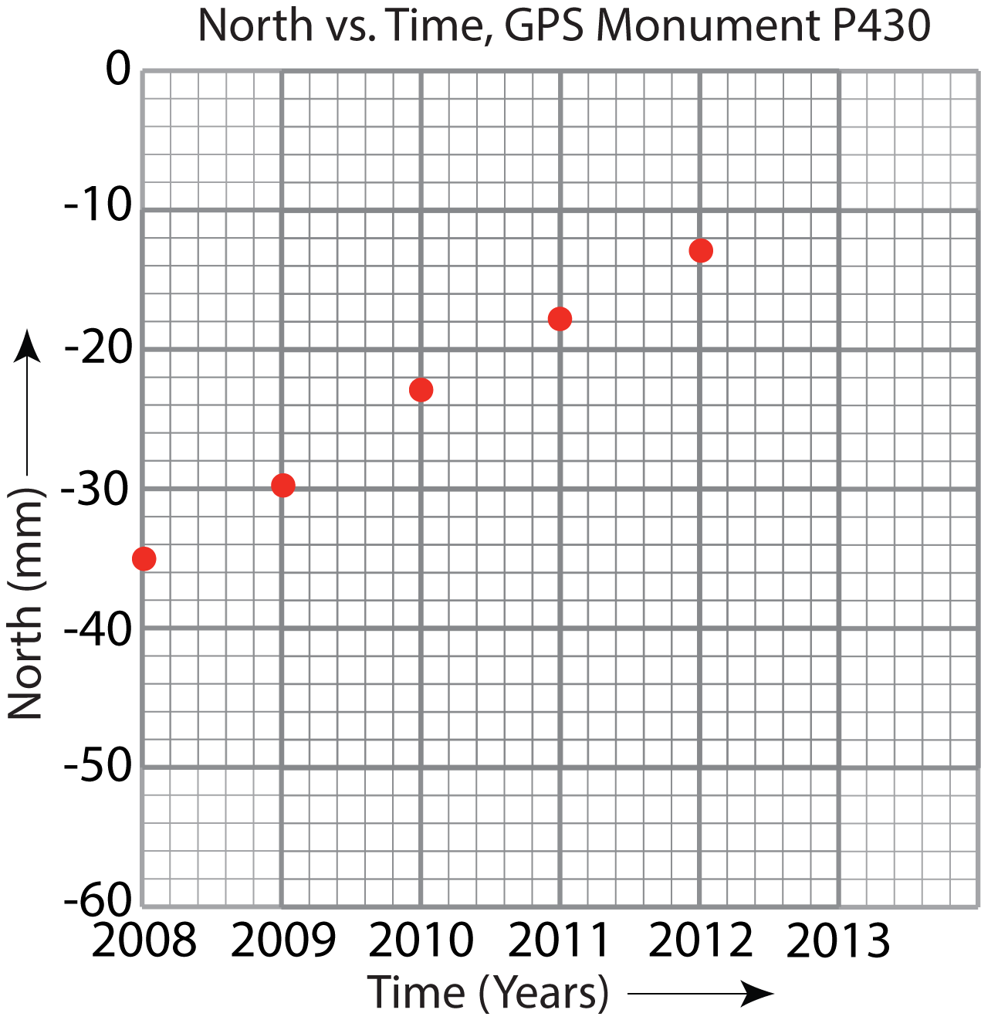
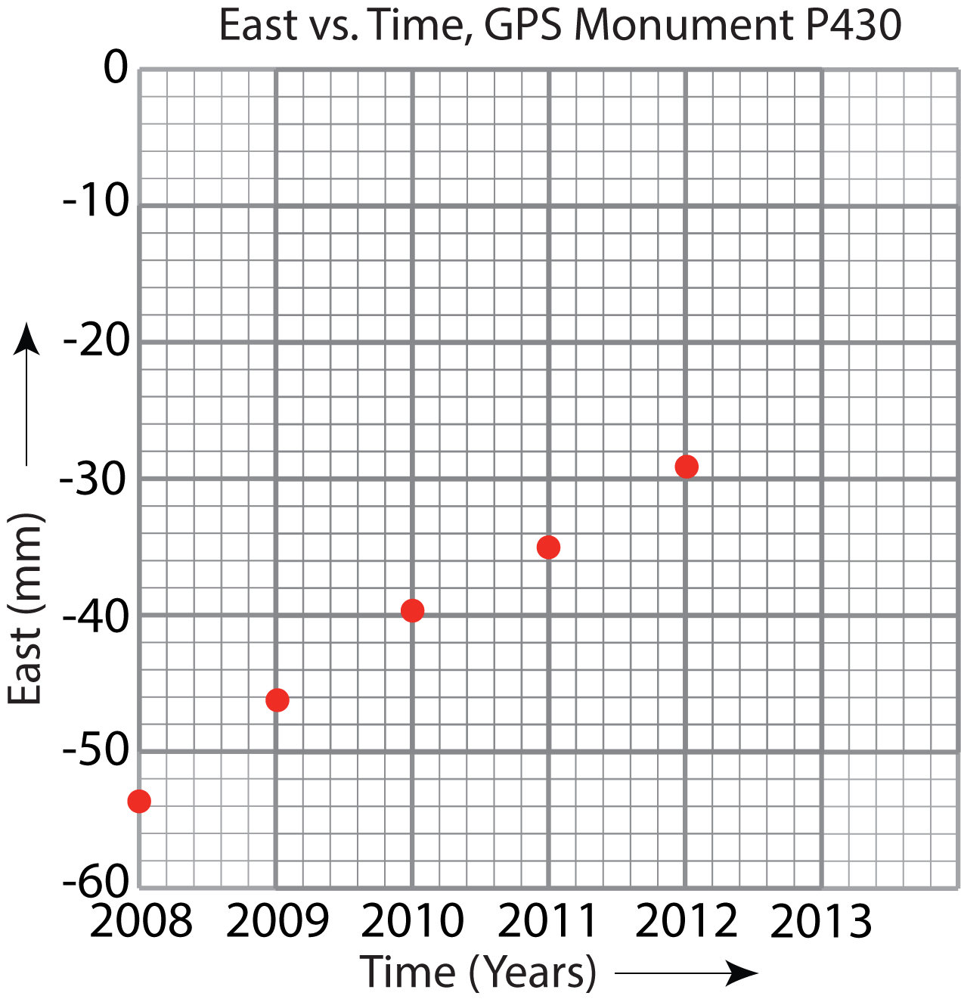
GPS Station P430
Notes:
P430 is moving north and east over time—in both cases, the trend is that numbers increase over time. And, in both cases, the data falls in a tight line.

Slide 21
GPS Station P157
Year | North Position (mm) | East Position (mm)
2008 | -52.0 | -37.4
2009 | -12.9 | -60.5
2010 | 22.1 | -76.1
2011 | 54.9 | -95.1
2012 | 86.5 | -114.5
… |  | …
Notes:
This data comes from a GPS monument in coastal northern California. Your students will graph this on graph paper that you provide. You can purchase paper or search on-line for “graph paper 10 squares per inch” or another suitable scale.
This is the first time that your students work out the scale on their own.

Slide 22
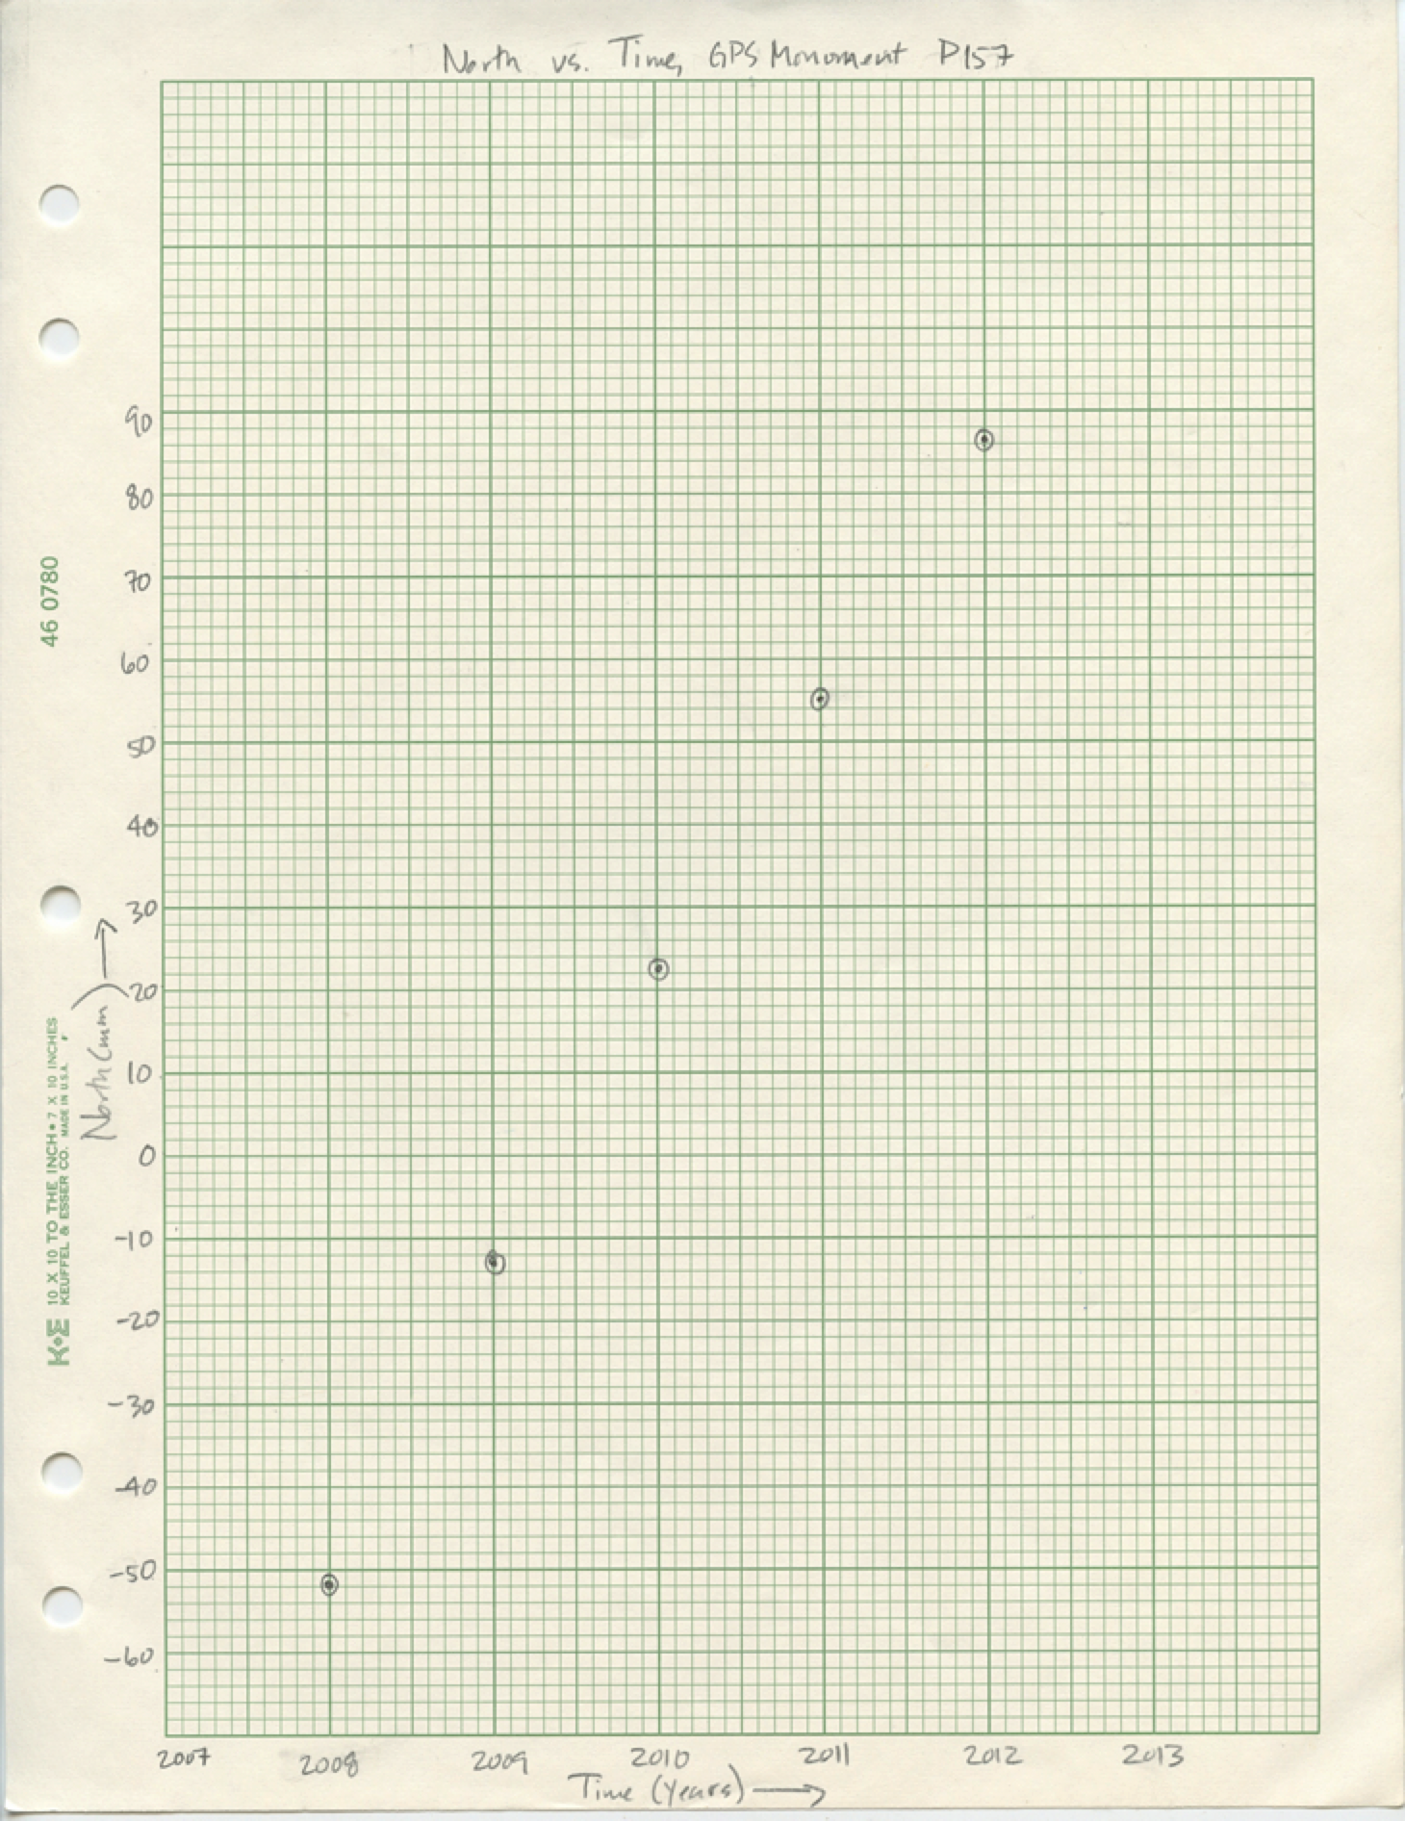
GPS Station P157
Year | North Position (mm)
2008 | -52.0
2009 | -12.9
2010 | 22.1
2011 | 54.9
2012 | 86.5
…
Notes:
Note that the vertical scale ranges from -60 to 90. Also note that the points are surrounded by circles, which make the points easier to see and protects them from being obscured by a best-fit line.

Slide 23
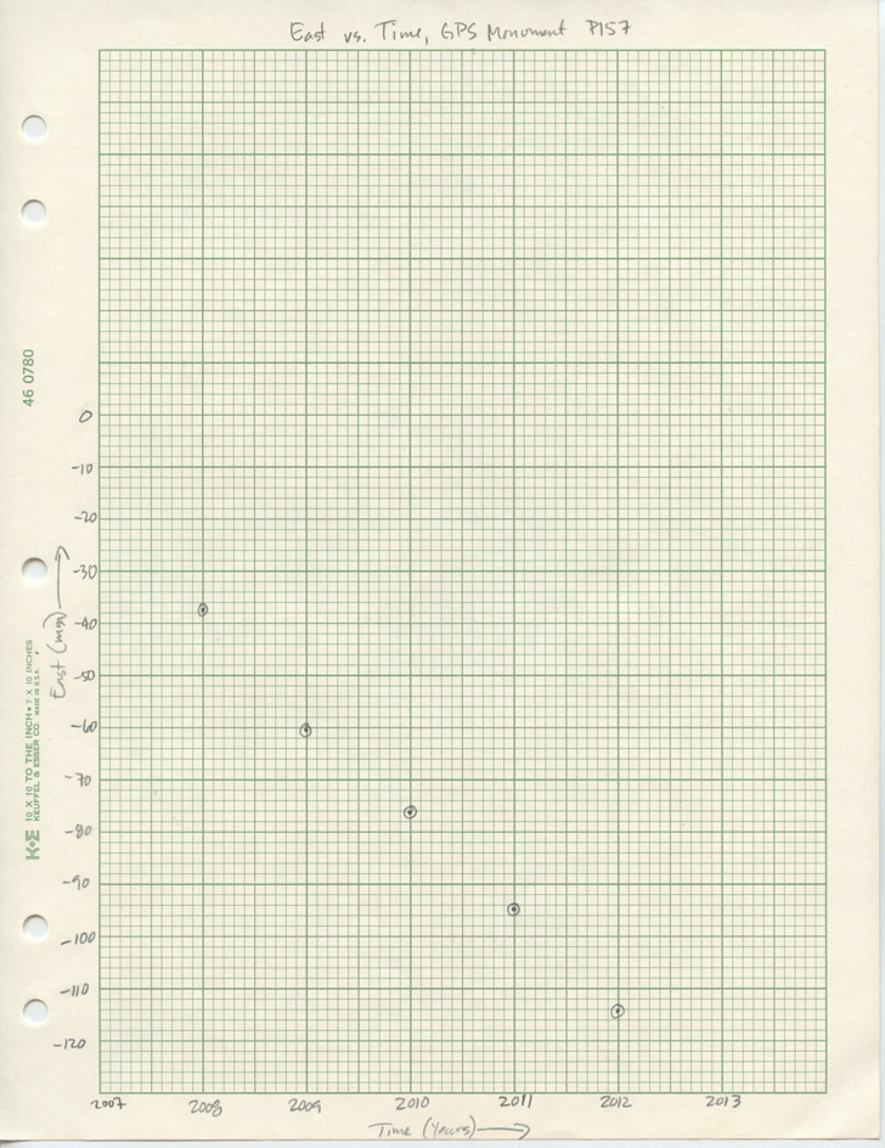
GPS Station P157
Year | East Position (mm)
2008 | -37.4
2009 | -60.5
2010 | -76.1
2011 | -95.1
2012 | -114.5
… | …
Notes:
For East vs. Time, the scale ranges from -120 to 0. Students can see that the scale does not need to be the same on every graph.

Slide 24
GPS Station P058
Year | North Position (mm) | East Position (mm) | Vertical (mm)
1/1/08 | -40.9 | -51.1 | 26.5
7/1/08 | -31.0 | -50.4 | 29.1
1/1/09 | -25.8 | -51.3 | 40.4
7/1/09 | -17.4 | -48.6 | 28.3
1/1/10 | -10.7 | -47.2 | 21.2
7/1/10 | -3.0 | -44.3 | 27.2
1/1/11 | 5.7 | -42.1 | 16.5
7/1/11 | 13.8 | -41.3 | 19.9
1/1/12 | 21.9 | -43.0 | 28.1
7/1/12 | 30.4 | -39.7 | 21.0
1/1/13 | 38.5 | -38.7 | 10.4
… |  | …
Notes:
With station P058, students graph North vs. Time, East vs. Time, and, for the first time, Vertical vs. Time. Like P157, P058 is in northern California.

Slide 25
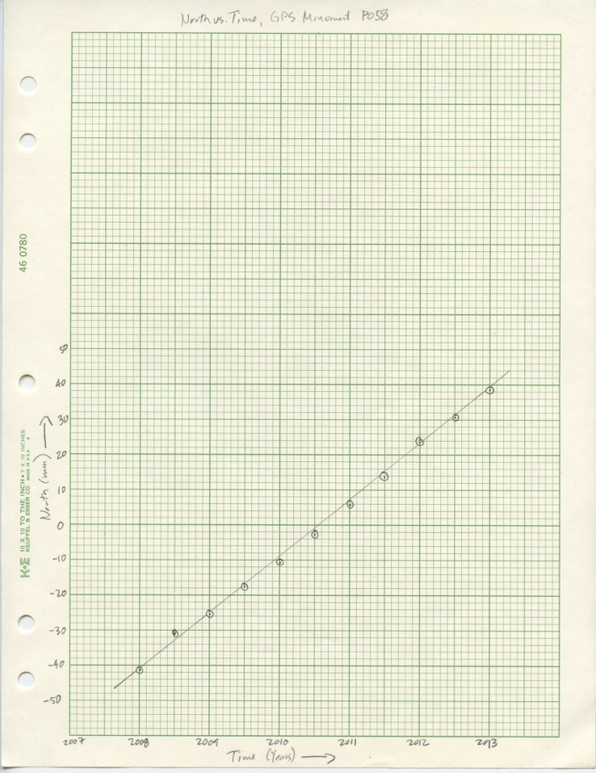
GPS Station P058
Year | North Position (mm)
1/1/08 | -40.9
7/1/08 | -31.0
1/1/09 | -25.8
7/1/09 | -17.4
1/1/10 | -10.7
7/1/10 | -3.0
1/1/11 | 5.7
7/1/11 | 13.8
1/1/12 | 21.9
7/1/12 | 30.4
1/1/13 | 38.5
…
Notes:
The best-fit line is a drawn as a single straight line—it does not go from point to point. Instead, the line averages the trend of the points. It is subjective; a linear regression done by a calculator or spreadsheet would use a statistical method of finding the best-fit line. The line is not drawn through the circles around the points—one can still see the points.

Slide 26
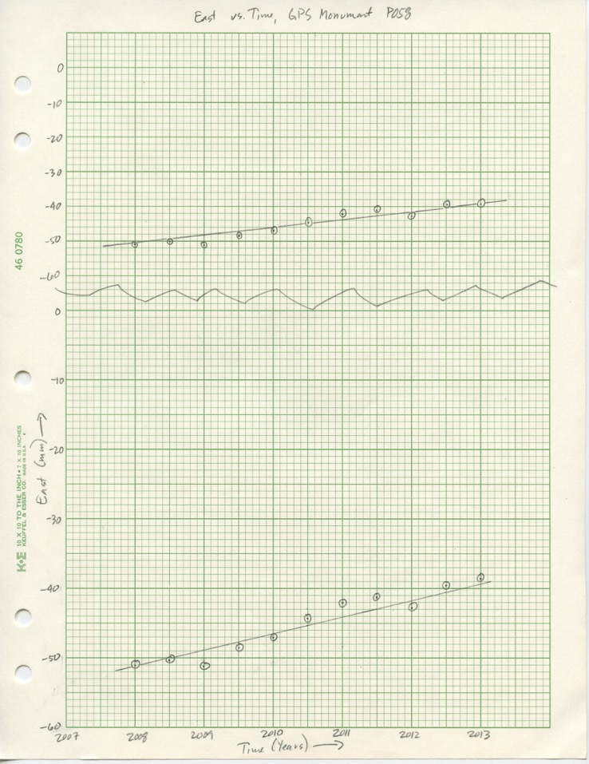
GPS Station P058
Year | East Position (mm)
1/1/08 | -51.1
7/1/08 | -50.4
1/1/09 | -51.3
7/1/09 | -48.6
1/1/10 | -47.2
7/1/10 | -44.3
1/1/11 | -42.1
7/1/11 | -41.3
1/1/12 | -43.0
7/1/12 | -39.7
1/1/13 | -38.7
… | …
Notes:
This shows the data graphed at two scales. On the top graph, each large or dark square represents 10 mm. On the bottom, each one represents 5 mm. Together they show that the slope of the line depends on the data as well as on the scaling of the graph.

Slide 27
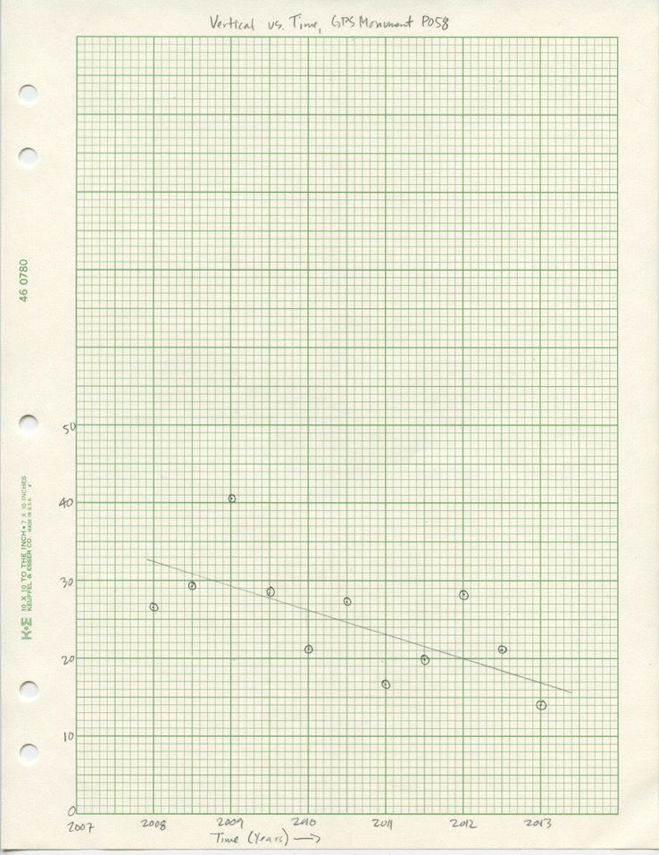
GPS Station P058
Year | Vertical (mm)
1/1/08 | 26.5
7/1/08 | 29.1
1/1/09 | 40.4
7/1/09 | 28.3
1/1/10 | 21.2
7/1/10 | 27.2
1/1/11 | 16.5
7/1/11 | 19.9
1/1/12 | 28.1
7/1/12 | 21.0
1/1/13 | 10.4
…
Notes:
This graph shows how much more scatter there is in vertical data, which is why students haven’t graphed it until now. It also shows the reason for statistics—eyeballing a single line to represent the trend of data is not incredibly accurate.

Slide 28
GPS Monument A
Year | North (mm) | East (mm)
2000 | 0 | 0
2001 | 1 | 1
2002 | 2 | 2
2003 | 3 | 3
2004 | 4 | 4
2005 | 5 | 5
Notes:
This data is to introduce the idea that graphs can also be used as maps. With north-south on the vertical axis and east-west horizontally, this is set up like many maps, with north at the top. The grid lines are analogous to lines of latitude and longitude.

Slide 29
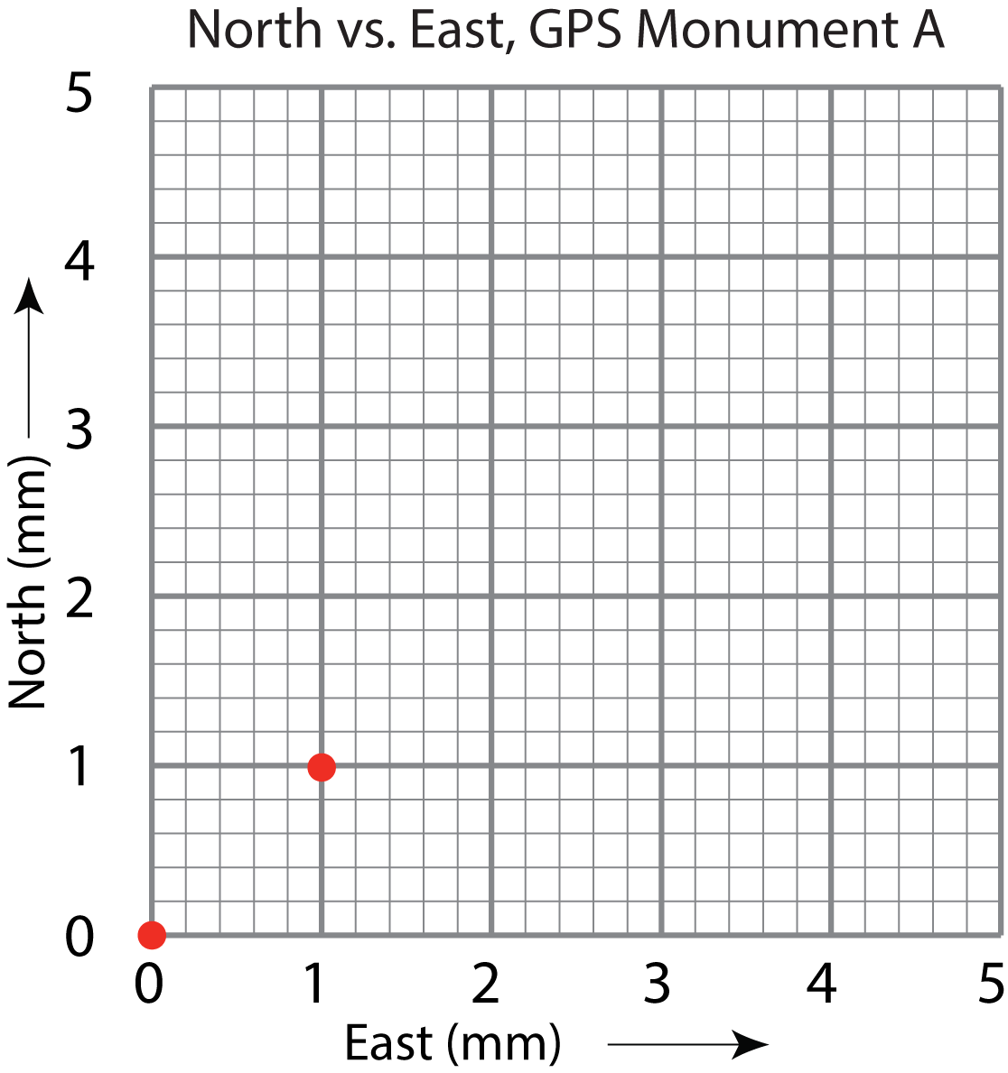
GPS Monument A
Year | North (mm) | East (mm)
2000 | 0 | 0
2001 | 1 | 1
2002 | 2 | 3
2003 | 3 | 3
2004 | 4 | 4
2005 | 5 | 5
Notes:
In this graph and the others to come, students graph North vs. East. This allows them to see the direction a monument moves and for you to introduce the concept of vectors. The first two points are plotted for them.

Slide 30
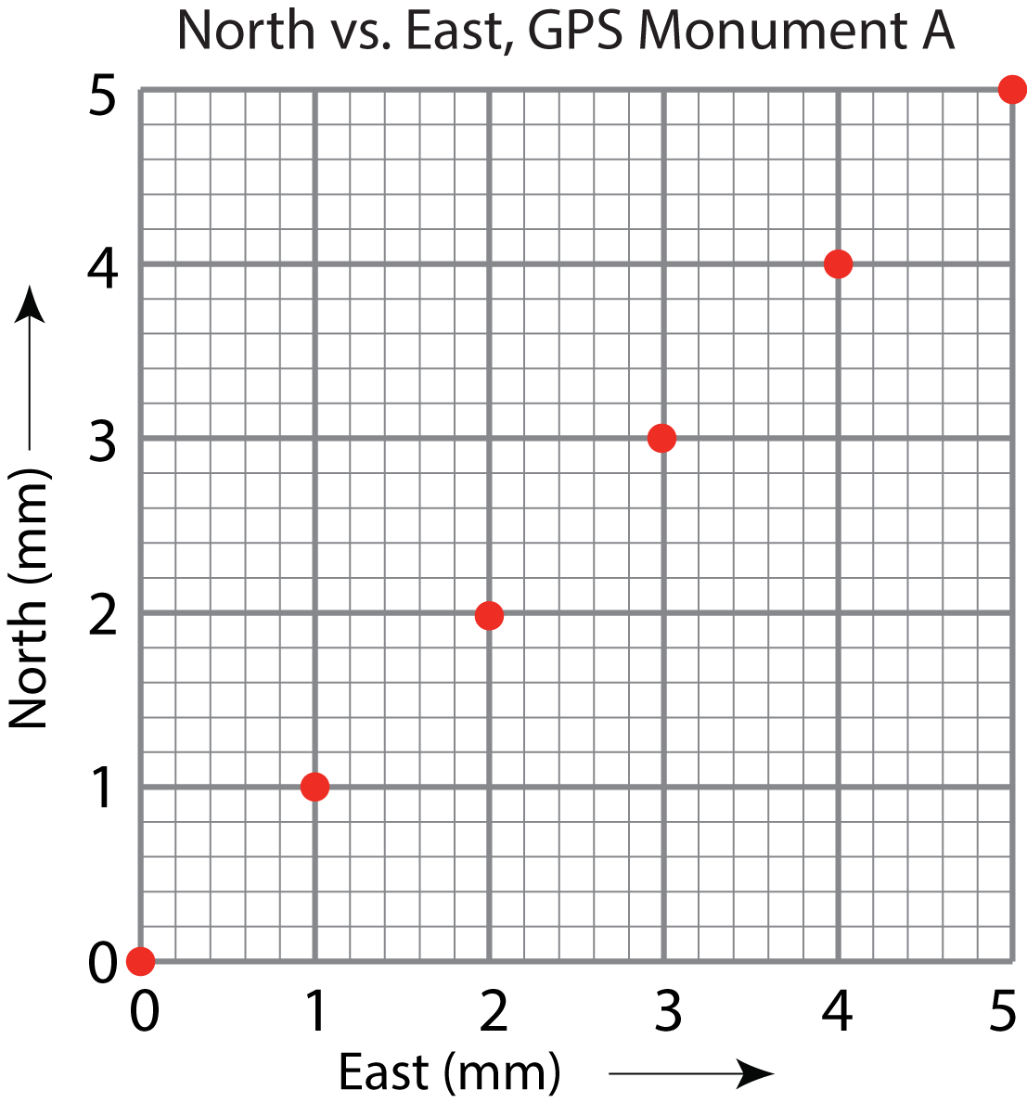
GPS Monument A
Year | North (mm) | East (mm)
2000 | 0 | 0
2001 | 1 | 1
2002 | 2 | 3
2003 | 3 | 3
2004 | 4 | 4
2005 | 5 | 5
Notes:
Your students are instructed to plot the points and then to draw a line through them, with its base at the point marking 2000 and the arrowhead at the point for 2005. This shows them the monument moves northeast from 2000 to 2005. But, it only works when both axes have the same scale. Clicking on the return/enter key drops the line in.
The blue arrow shows the direction of motion. If you were to determine its length, you would also know how fast the monument moves, its speed. (You could use the scale to measure its length with a ruler or by marking the arrow’s length on scrap paper and holding it against the scale. Or, you could use the Pythagorean theorem to calculate its length. You also know that this data is from 2000 to 2005, say from January 1, 2000 to January 1, 2005, or five years. Distance per time is speed. In this case, the speed is 7.1 mm over 5 years, or 7.1 mm/5 yrs = 1.4mm/yr.) An arrow which indicates both direction and speed is a velocity vector.

Slide 31
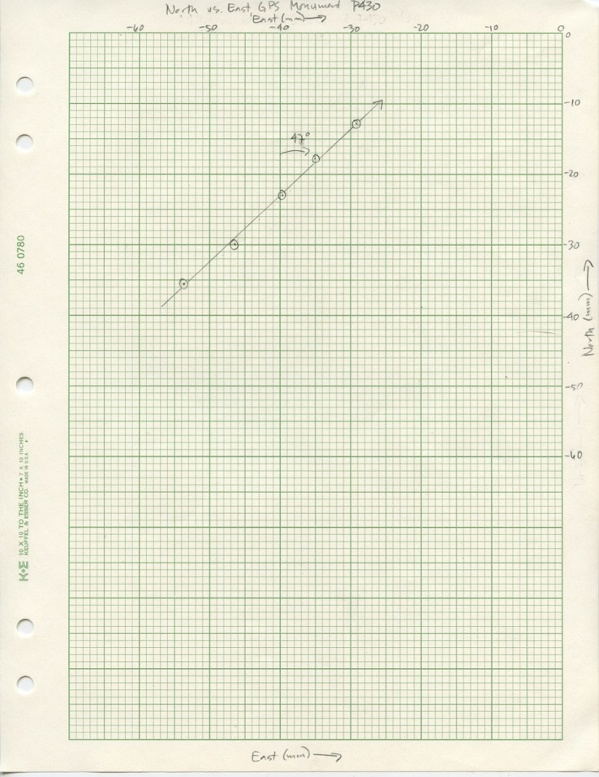
GPS Monument P430
Year | North (mm) | East (mm)
2008 | -35.5 | -53.8
2009 | -29.9 | -46.3
2010 | -22.9 | -39.8
2011 | -17.8 | -35.0
2012 | -12.8 | -29.2
Notes:
This shows North vs. East plotted for station P430, with both scales set up so that each darker or heavier block represents 10mm. Because the vertical axis is the north/south axis, your students can measure the angle the best-fit lines makes with north. That is the vector’s bearing or “azimuth.” The next slides show two ways to measure the azimuth.
The speed of this monument is 8.4 mm/yr.
The activity “Measuring plate motion with GPS” complements and expands upon this introduction to velocity vectors. Students analyze GPS data from Iceland taken from two stations on opposite sides of the Mid-Atlantic Ridge. They discover that Iceland is pulling apart.

Slide 32
GPS Monument P430
Measuring
the azimuth
Notes:
A circular protractor like this ratty old one is one tool students can use to measure the angle between the best-fit line and north. In this case the angle is 47 degrees; therefore the azimuth of the velocity vector is 47 degrees. A circular protractor is less confusing for students than a conventional half-moon protractor. Students can measure the azimuth of the vector easily, no matter which quadrant it points to.

Slide 33
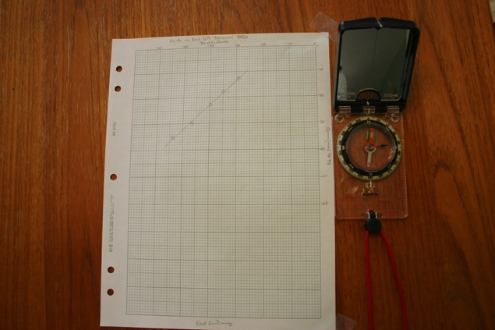
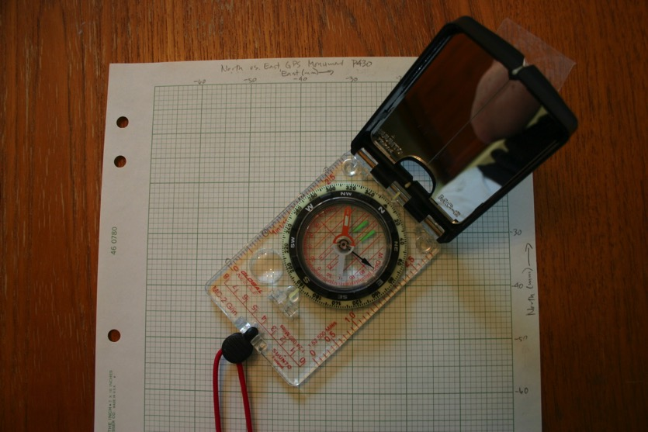
GPS Monument P430
Lining the paper up with north
Measuring the azimuth
Notes:
A directional compass is another tool for measuring the azimuth. Line the graph paper up with north and tape it to the desktop. (Metal desk or table underpinnings and hidden power wires can throw compasses off.) Then, line the compass up with the best-fit line on the graph and read the compass’s arrow. Voila! The compass produces the azimuth. The next slide shows the dial in detail.
If you lack compasses, compass apps for smart phones and tablet computers can do the same thing.

Slide 34
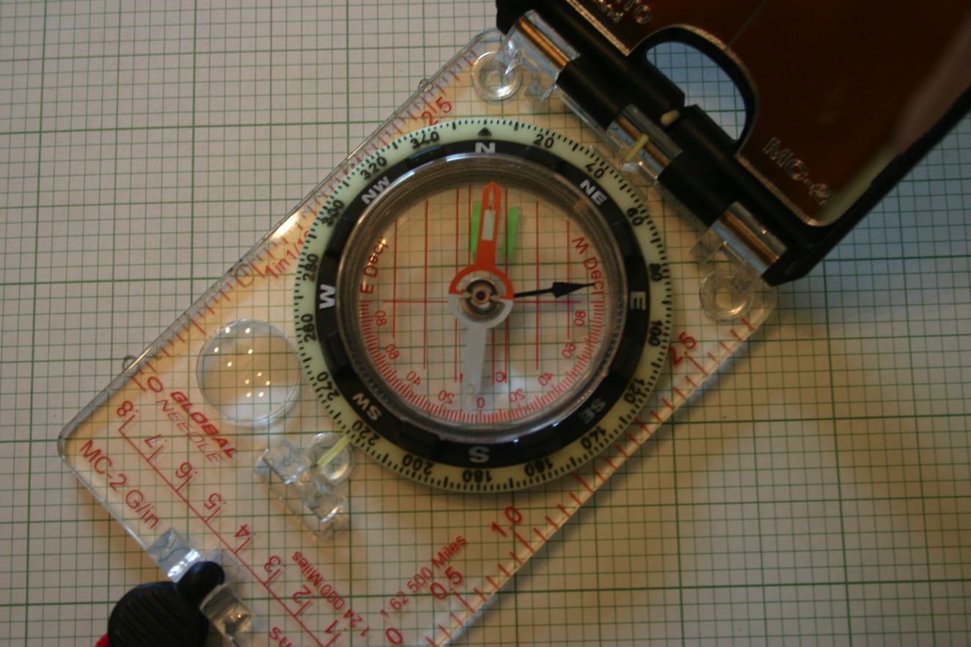
GPS Monument P430
Measuring the azimuth
Read here
Notes:
This compass is designed so that you line the red end of the big swinging needle up with the two green lines in the base by turning the dial (the “bezel”). Read the azimuth from the gauge on the rim of the bezel at the white line on the hinge. (With this compass, the black arrow and inner gauge are to use the compass as a clinometer.)

Slide 35
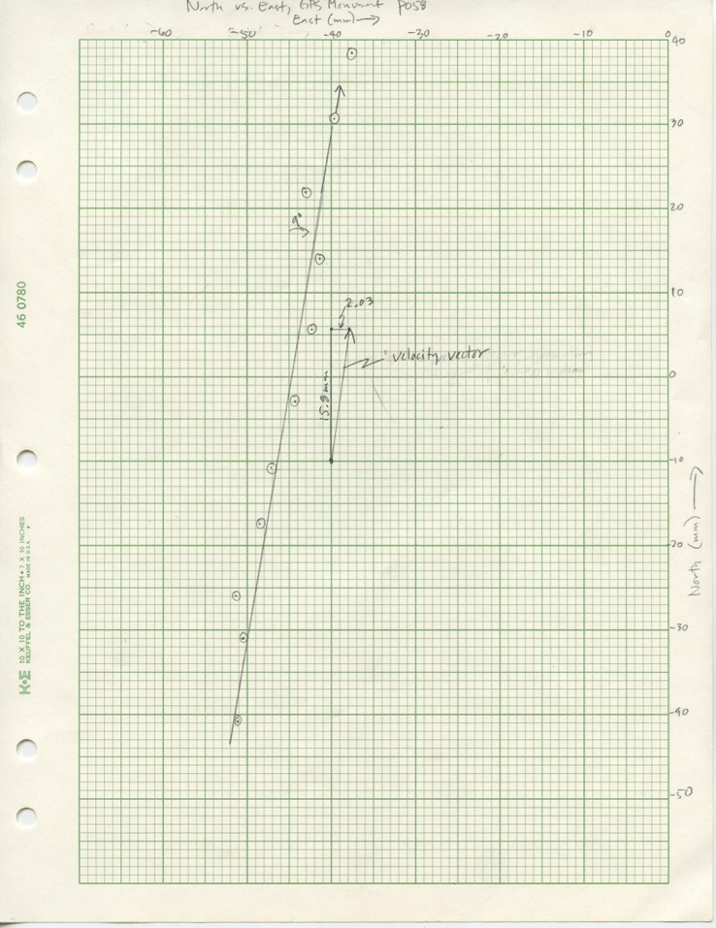
GPS Monument P058
Expanded velocity vector
Notes:
The velocity vector for P058 has an azimuth of 9 degrees. The vector shown to the right of the best-fit line is the “official” vector taken from time series data on P058’s data page. In this case, the eye-balled best-fit line is not quite right—if it were, it would be parallel to the plotted vector. The next slide shows the time series data for this site.
The speed of this monument is 16.0 mm/yr.

Slide 36
GPS Monument P058
Time series data for P058
P058
Notes:
Time series data for GPS monument P058. The best-fit line, calculated from thousands of points, appears as red lines. On the web page for this station (http://pbo.unavco.org/station/overview/P058), clicking on the small image of the plot expands it. Rolling your mouse over the plot makes options appear at the bottom. Selecting the Next arrow, gives cleaned data with values for the vectors displayed at the top. (Search for “Overview PBO station P058.”)

Slide 37
GPS Data: Velocity Viewer
P058
Notes:
Two websites with GPS data:
UNAVCO’s Velocity Viewer can display velocity vectors, earthquakes, volcanoes, and plate tectonic boundaries. Data is available for GPS sites from around the world. (Search for “UNAVCO Viewer.”)
UNAVCO’s Data for Educators site with a selected subset of GPS data from North America. (Search for “UNAVCO educators data.”)

