Slide 1
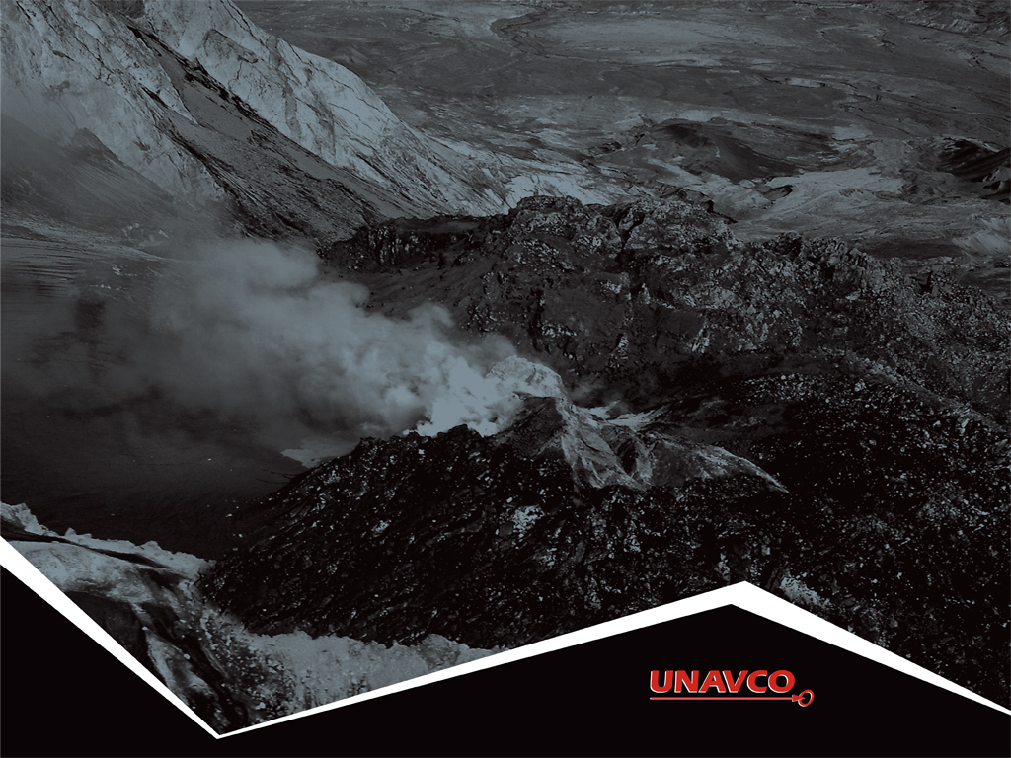
4
Measuring plate motion with GPS:
Introducing GPS to study tectonic plates
as they move, twist, and crumple
Roger Groom and Cate Fox-Lent, UNAVCO Master Teachers-in-Residence, Nancy West and Shelley Olds, UNAVCO

Slide 2
By the end of this activity…
You should be able to:
Describe generally how GPS works;
Interpret graphs in a GPS time series plot;
Determine velocity vectors from GPS time series plots;
Explain relative motions of tectonic plates in Iceland; and
Explore global GPS data.
2

Slide 3
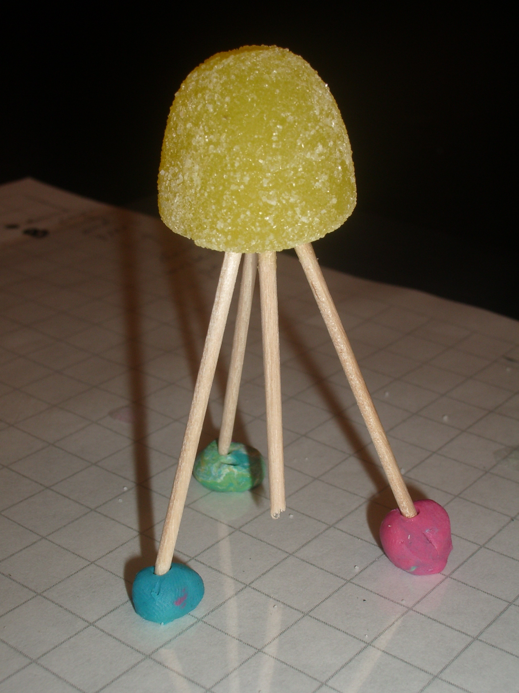
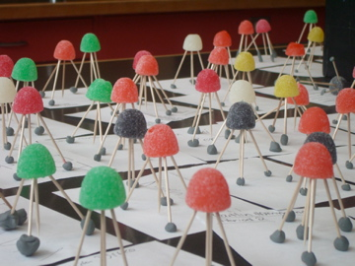
Part 1: Modeling GPS
To build a gumdrop model of a GPS monument:
Use one gumdrop as the receiver (GPS monument).
Use toothpicks as three legs and one center post (monument braces).
Form feet from three small lumps of clay (concrete).
Place on a small piece of transparent paper (“see-through” crust).
Notes:
Have students write, “This is a tectonic plate” on the transparency.

Slide 4
Part 1: Modeling GPS
To build a gumdrop model of a GPS monument:
Use one gumdrop as the receiver (GPS monument).
Use toothpicks as three legs and one center post (monument braces).
Form feet from three small lumps of clay (concrete).
Place on a small piece of transparent paper (“see-through” crust).
4
Notes:
Have students write, “This is a tectonic plate” on the transparency.

Slide 5
NASA’s Brief History of Geodesy
http://bit.ly/nasawhatisgeodesy
5

Slide 6
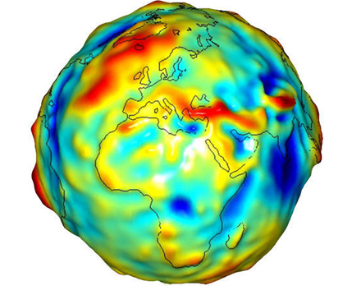
About geodesy
Geodesy is the science of …
measuring Earth’s
size,
shape,
orientation,
gravitational field, and
variations of these with time.
6
Notes:
6
6
Traditional geodetic application is the precise positioning of points on the surface of the Earth.
Image from NASA’s Grace satellite, showing gravitational variation around the globe. Jet Propulsion Laboratory, 2007. http://www.jpl.nasa.gov/news/news.php?release=2007-147 Retrieved 10 October, 2013.

Slide 7
Demonstration How does GPS work to pinpoint location?
7
Notes:
How to demonstrate this:
http://www.youtube.com/watch?feature=player_embedded&v=s_CeiMjO5Pc#!

Slide 8
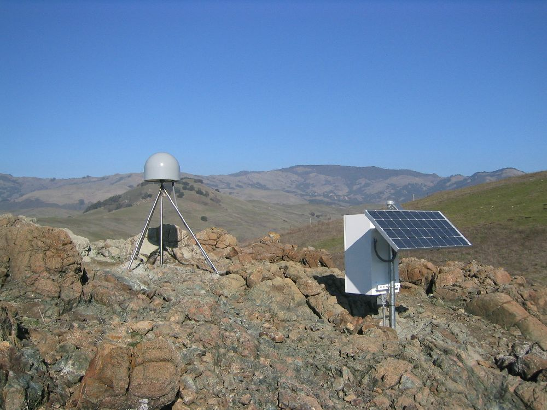
How GPS Works - Basics
Satellites broadcast their name and position in space.
The GPS ‘listens’ only.
GPS antenna collects the satellite signals and sends the signals to the GPS receiver
GPS receiver calculates the GPS antenna to satellite distance.
8
Notes:
Also note that the GPS stations used for scientific work are more precise for many reasons: the unit uses both of the signals coming from the satellites, two the clocks are atomic rather than crystal, (see slide). These stations can measure the change in position of a location with millimeter accuracy.

Slide 9
How GPS Works - Basics
To locate the GPS receiver:
Three satellites for rough location
Fourth satellite corrects time errors, improving location accuracy.
Ground stations, (called the Control Segment), monitor satellite location & health, correct orbits & time synchronization
Position can be calculated within to a millimeter.
9
Notes:
Also note that the GPS stations used for scientific work are more precise for many reasons: the unit uses both of the signals coming from the satellites, two the clocks are atomic rather than crystal, (see slide). These stations can measure the change in position of a location with millimeter accuracy.

Slide 10
Anatomy of a High-precision Permanent GPS Station
GPS antenna inside of dome
Tripod legs are cemented 10 – 30 feet into the ground
Solar panel(s) for power.
Equipment enclosure:
GPS receiver
Power storage: Batteries
Communications: radio modem
Data storage: memory cards

Slide 11
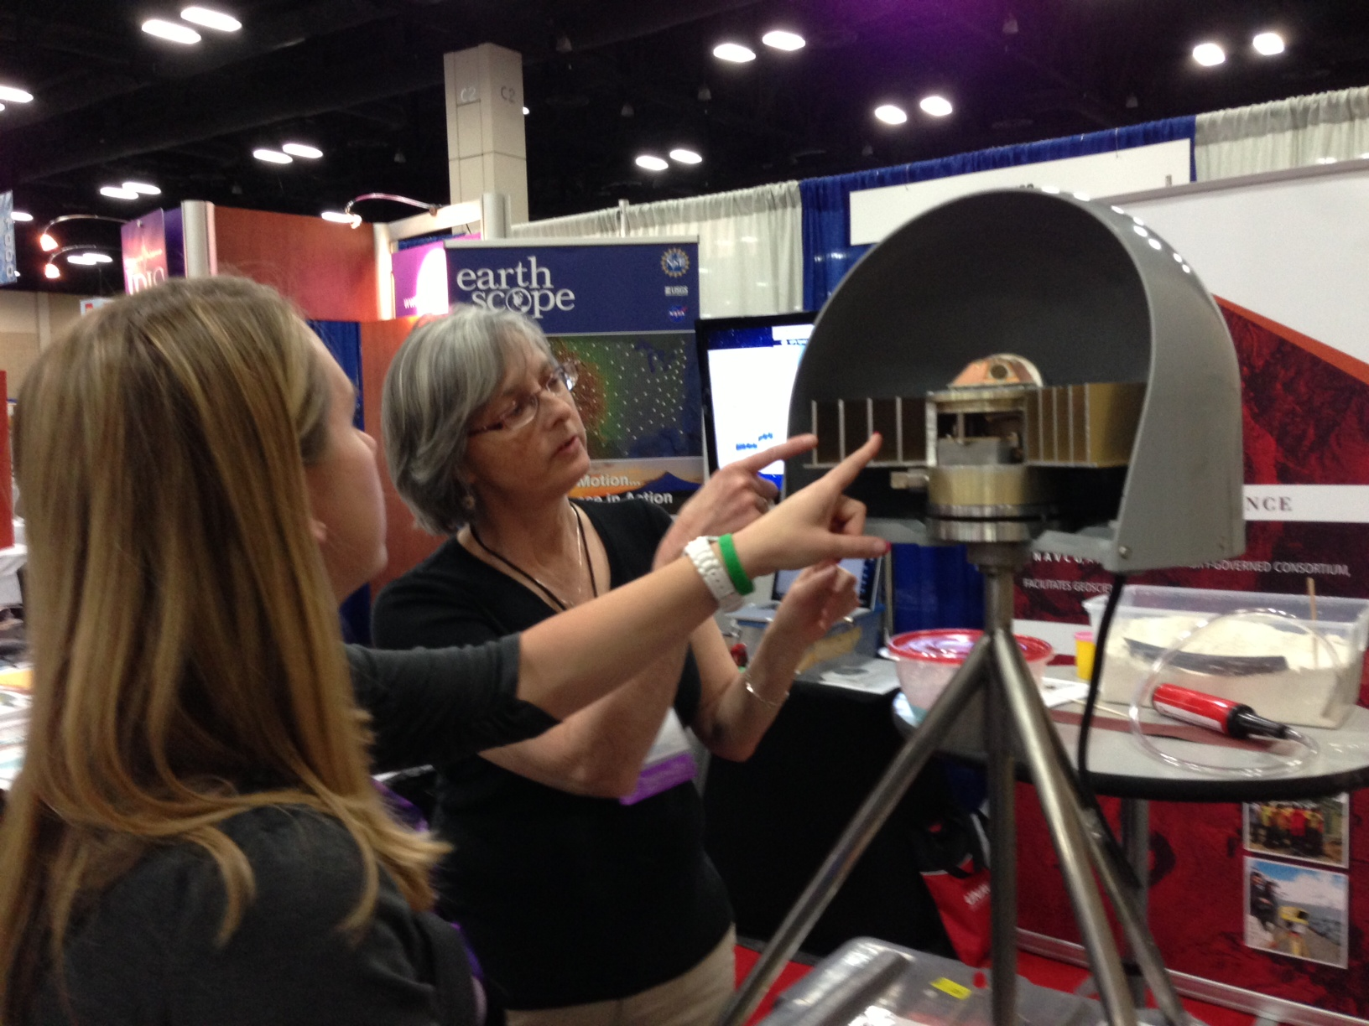
A high precision GPS antenna is much bigger than a cell phone
32 cm (~12.6 in)
42 cm (~16.5 in)
11
Notes:
This photo provides a sense of scale for a high precision GPS antenna

Slide 12
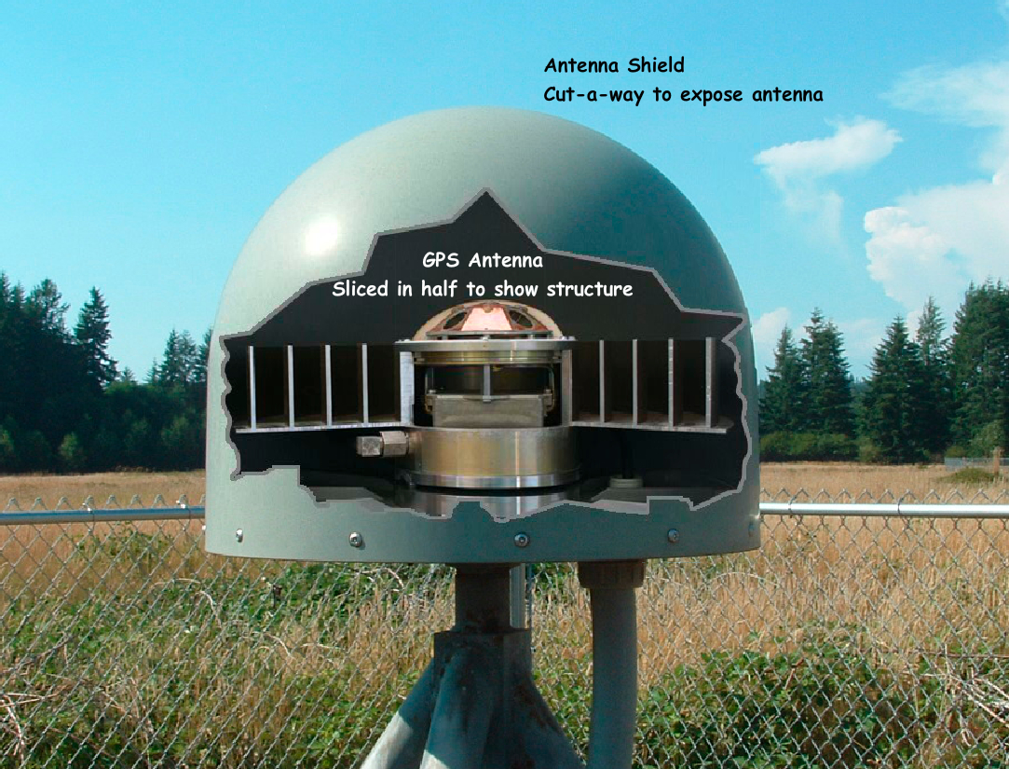
Anatomy of a GPS Antenna
Antenna
Signal Amplifier
Choke ring (to dampen unwanted signals)
Antenna mount
Dome
Power & signal cable
Tripod supports
12

Slide 13
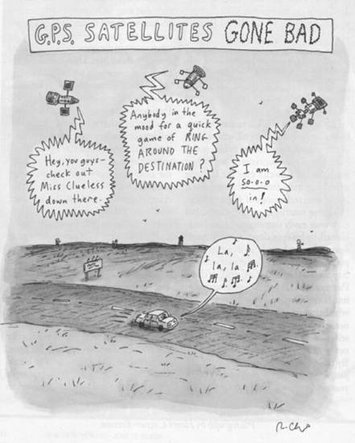
High precision GPS Corrects Some of these Sources of Error –
Some GPS Error Sources
Selective Availability*
Satellite orbits
Satellite and receiver clock errors
Atmospheric delays
Ionosphere
Troposphere
Multi-path (reflections of signals)
Human errors (trained staff)
* historical
The New Yorker, Roz Chast
Notes:
Up until now in this description on how GPS works, a regular cell phone and high precision GPS are very similar.
However – Extensive data processing removes many of these sources of errors which improves the quality of positioning to a few millimeters

Slide 14
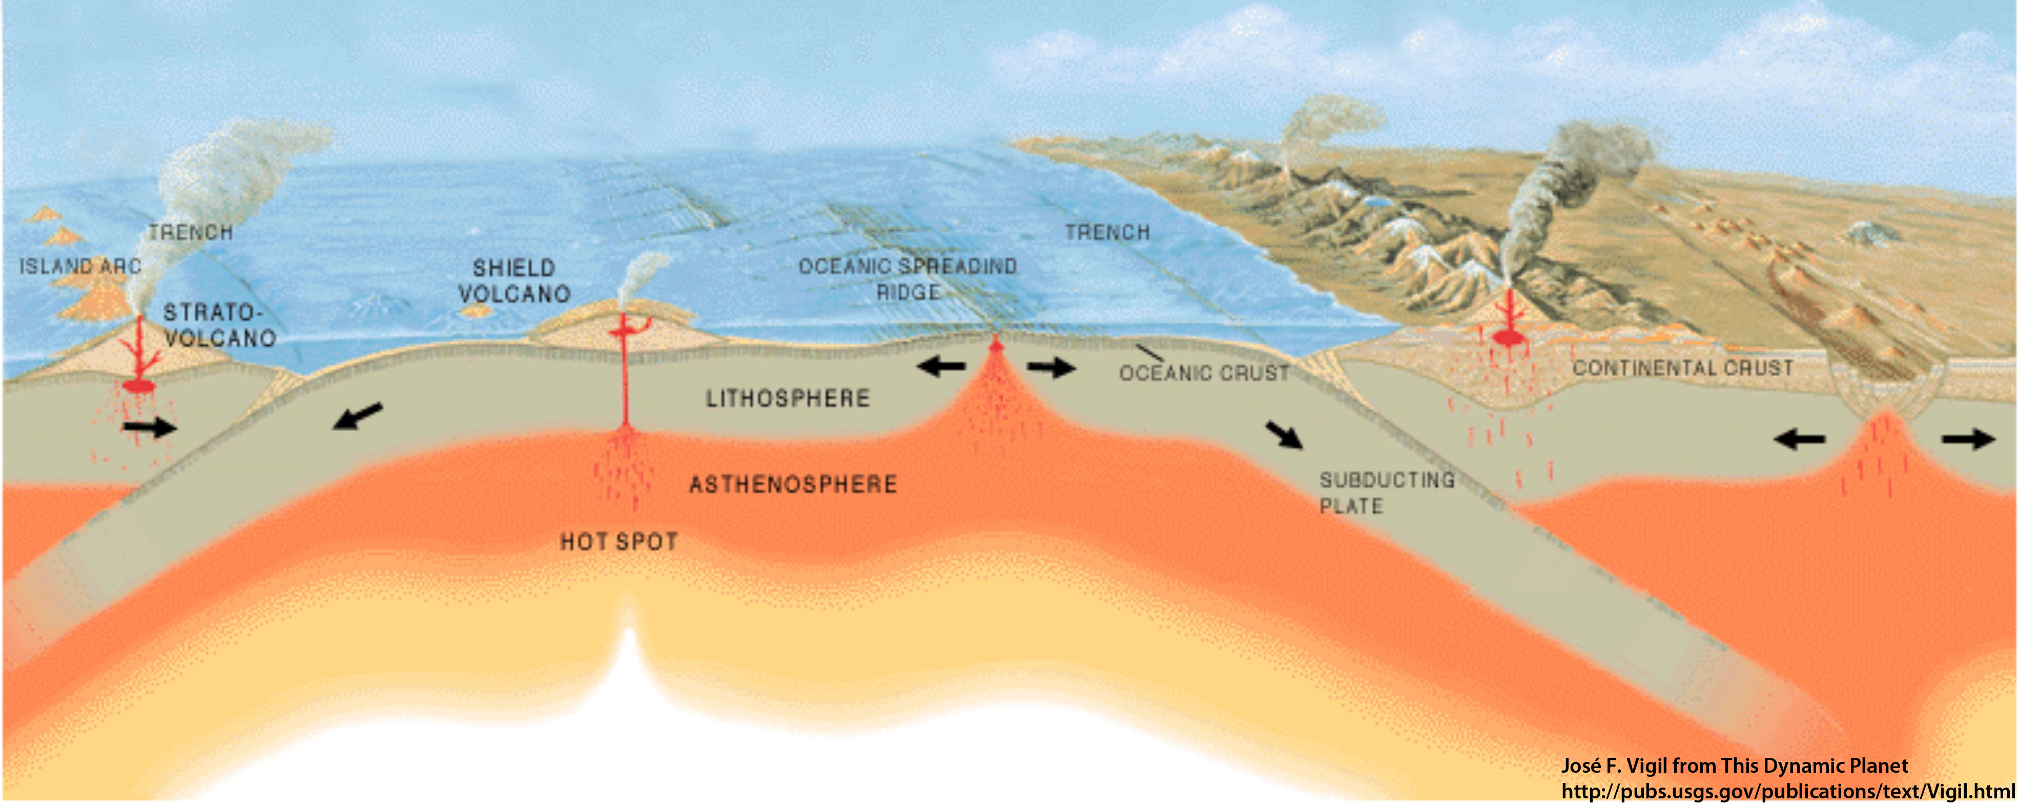
Movement of GPS stations
GPS station positions change as plates move.
A
B
How will Station A move
relative to Station B?
14

Slide 15
Movement of GPS stations
GPS station positions change as plates move.
A
B
GPS Station A is moving toward B.
15
Notes:
Note that the red arrow is really just an arrow… there is no scale to show the rate of motion. And GPS stations are obviously not to scale.

Slide 16
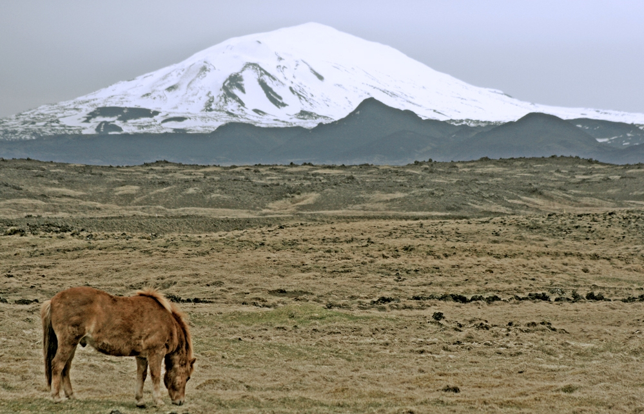
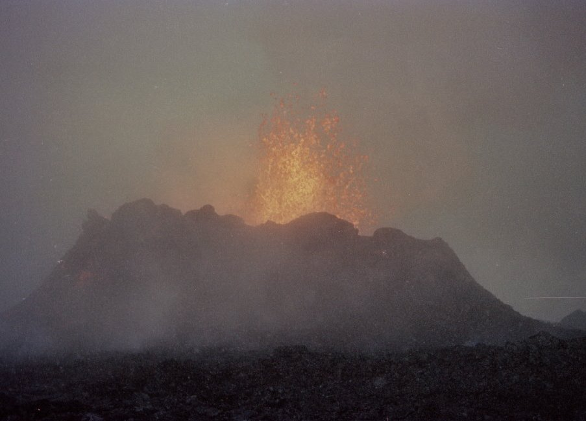
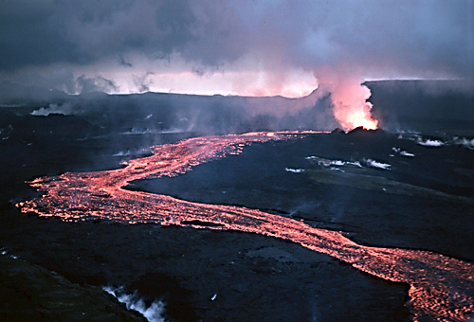
Part 2: What can GPS tell us about Iceland?
Notes:
Large image of the Icelandic pony and Hekla volcano: Skulason, Lydar. 2006. Wikimedia Commons. http://commons.wikimedia.org/wiki/File:Hekla_and_horse.jpg. Retrieved 27 April 2013.
Lava flow at Hekla. Ryan, Michael. U.S. Geological Survey. 1984. Wikimedia Commons. http://commons.wikimedia.org/wiki/File:Lava_flow_at_Krafla,_1984.jpg.
Retrieved 27 April 2013.
Small photo of Krafla eruption. Goodman, Roger. 1984. Wikimedia Commons. http://commons.wikimedia.org/wiki/File:Krafla_eruption,_Sept_1984.jpg.
Retrieved 27 April 2013. Photographer noted: “A small volcano at Krafla, north Iceland, in Sept 1984. There was a snow storm going on at the time, so I was very cold on one side, and very warm on the other. I was entirely too close to this, perhaps a hundred feet away at the most.”

Slide 17
Introduction: Measuring GPS Movement with Time Series Plots:
Date | North (mm) | East (mm) | Vertical (mm)
1/1/2004 | -37.67 | 36.57 | 2.33
1/2/2004 | -38.04 | 35.73 | 5.63
1/3/2004 | -37.16 | 35.83 | 4.69
1/4/2004 | -37.34 | 36.34 | 5.36
1/5/2004 | -37.59 | 36.44 | 9.11
… | … | … | …
1/1/2005 | -9.43 | 9.63 | 2.36
1/1/2006 | 16.48 | -18.09 | 7.35
1/1/2007 | 45.98 | -43.42 | -6.43
Data for SBCC GPS STATION
Located near Mission Viejo, CA
Position data collected every 30 seconds
One position for each day:
North
East
Vertical
17
Notes:
The data from the GPS stations run by UNAVCO's Plate Boundary Observatory (which is one of the EarthScope projects) is freely available to the public. Each GPS station has a data file which contains the daily change in position.
UNAVCO has provided processed data since Jan 1, 2004. Although some GPS stations were installed earlier, only data after January 1, 2004 is currently available.

Slide 18
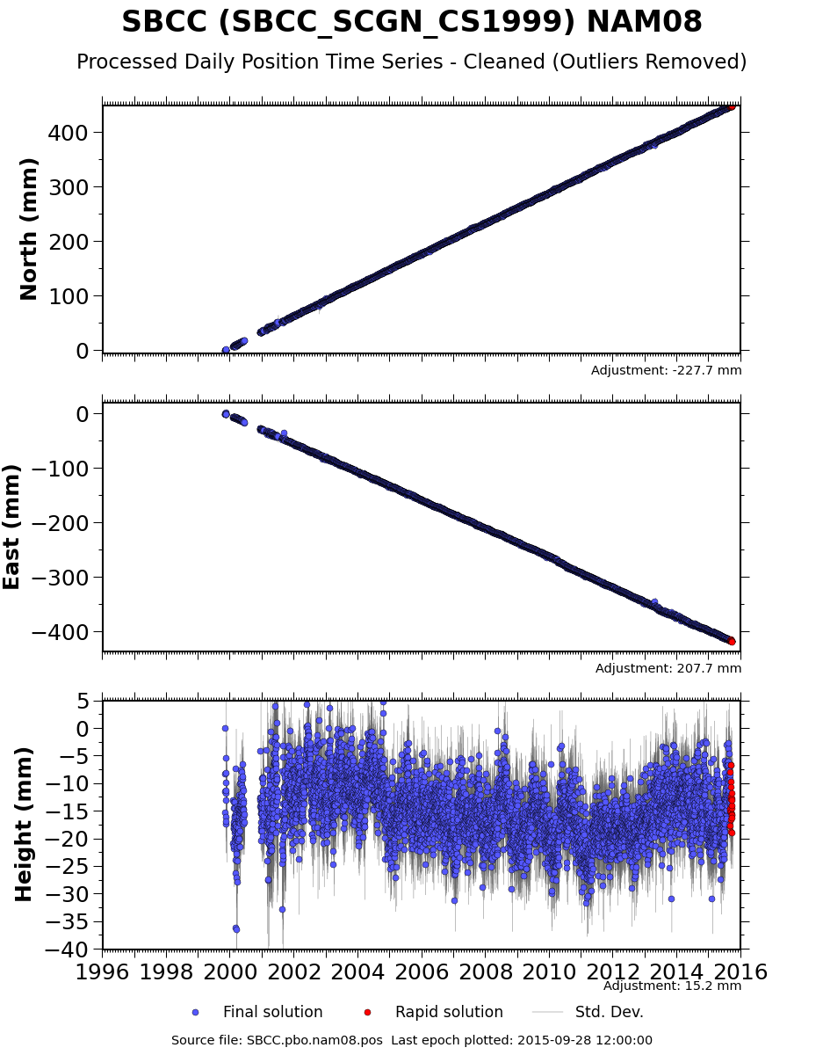
GPS time series plots
3 separate plots :
North
East
Height (Vertical)
X-axis: Time
Y-axis: Distance GPS has moved
*Vertical scales vary per plot.
Red points:
Rapid position estimates
Notes:
GPS time series plots show the change of position of the GPS monument over time.
After processing, the data is provided in a coordinate system (latitude and longitude) then converted to millimeters of offset since the GPS was installed..

Slide 19
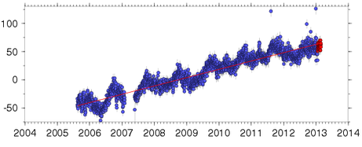
Which way are we going?
Is the GPS station moving
north or south?
east or west?
up or down?
North (mm)
East (mm)
Height (mm)
Time
Notes:
Trend: the average direction of the graph (simplest terms).

Slide 20
Which way are we going?
Positive slope:
The station is moving north.
The station is moving east.
The station is moving up.
North (mm)
East (mm)
Height (mm)
Time
Notes:
Have students sketch these graphs on their worksheet. This station is moving northeast and up over time.

Slide 21
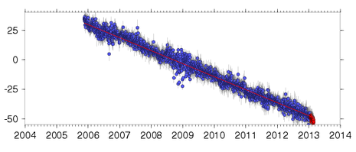
Which way are we going?
Is the GPS station moving
north or south?
east or west?
up or down?
North (mm)
East (mm)
Height (mm)
Time
Notes:
This station is moving southwest and down over time.

Slide 22
Which way are we going?
Negative slope:
The station is moving south.
The station is moving west.
The station is moving down.
North (mm)
East (mm)
Height (mm)
Time
Notes:
Have students sketch these graphs on their worksheet.

Slide 23
Time series plots
Notes:
Have students simulate a number of these possible time series plots using their models.

Slide 24
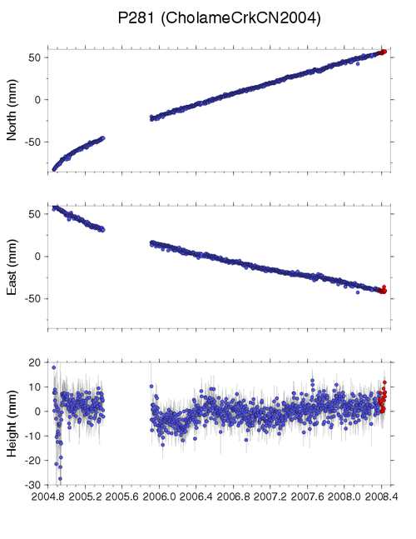
Gaps in data
Causes:
Power outages
Snow coverage
Equipment failure
Vandalism
Wildlife
Etc.

Slide 25
Exploring Iceland’s GPS data and maps
Notes:
Large image of the Icelandic pony and Hekla volcano: Skulason, Lydar. 2006. Wikimedia Commons. http://commons.wikimedia.org/wiki/File:Hekla_and_horse.jpg. Retrieved 27 April 2013.
Lava flow at Hekla. Ryan, Michael. U.S. Geological Survey. 1984. Wikimedia Commons. http://commons.wikimedia.org/wiki/File:Lava_flow_at_Krafla,_1984.jpg.
Retrieved 27 April 2013.
Small photo of Krafla eruption. Goodman, Roger. 1984. Wikimedia Commons. http://commons.wikimedia.org/wiki/File:Krafla_eruption,_Sept_1984.jpg.
Retrieved 27 April 2013. Photographer noted: “A small volcano at Krafla, north Iceland, in Sept 1984. There was a snow storm going on at the time, so I was very cold on one side, and very warm on the other. I was entirely too close to this, perhaps a hundred feet away at the most.”

Slide 26
Where is Iceland?
HOFN
REYK
26

Slide 27
Iceland’s GPS Data: REYK & HOFN
HOFN
REYK
27

Slide 28
Iceland’s GPS data
REYK
HOFN
North (mm)
North (mm)
East (mm)
East (mm)
28
Notes:
Think, simulate the movement of each GPS using the data and the map, then discuss with your neighbor: what general directions are monuments REYK and HOFN moving? How did you determine this?
REYK is moving northwest HOFN is moving northeast.
Are the two monuments moving towards each other, away from each other, or in the same direction? ? away from each other
On these time series plots, the trend lines have already been drawn for you. What are the units of measurement for these time series?

Slide 29
Calculating velocities of the GPS stations
What are the units of measurement for this data?
North (mm)
East (mm)
29

Slide 30
GPS monument HOFN: north
How quickly is HOFN moving in the north - south direction?
North (mm)
Let’s look at 1998 and 2008.
Average position on 1/1/2008 = ______ mm
Average position on 1/1/1998 = ______ mm
30
Notes:
Consider determining the north motion as a class. Have students follow along on their worksheet – drawing the lines across and down seems to help. You can give them the hint of drawing light vertical lines for 1998 and 2008 up to the plot, then a horizontal line from the plot to the y-axis.

Slide 31
GPS monument HOFN: north
North (mm)
Average position on 1/1/2008 = 50 mm
Average position on 1/1/1998 = -98 mm
Change in position = 50 – (-98) = 148 mm
Annual speed of HOFN north = 148 mm/10 years
= 14.8 mm/yr to the north for HOFN

Slide 32
GPS monument HOFN: east
How quickly is HOFN moving in the east - west direction?
East (mm)
Average position on 1/1/2008 = ______ mm
Average position on 1/1/1998 = ______ mm
Speed of HOFN east = ___ mm/10 years
= ____ /yr to the (east or west)

Slide 33
GPS monument HOFN: east
How quickly is HOFN moving in the east - west direction?
East (mm)
Average position on 1/1/2008 = 50 mm
Average position on 1/1/1998 = -80 mm
Speed of HOFN east = 130 mm/10 years
= 13 mm/yr to the east for HOFN

Slide 34
GPS monument HOFN
What direction is Monument HOFN moving?
a) north only b) northwest
c) northeast d) southwest
North (mm)
East (mm)

Slide 35
GPS monument REYK
Think, then discuss with your neighbor: What direction is monument REYK moving? About how fast?
North (mm)
East (mm)
Notes:
Give your students a chance to think about this, then solicit responses.

Slide 36
GPS monument REYK
How quickly is REYK moving in the north - south direction?
North (mm)
Average position on 1/1/2008 = 90 mm
Average position on 1/1/1998 = -115 mm
Speed of REYK north = (90 – -115) mm/10 years
= 205 mm/10 yr
= 20.5 mm/yr to the north for REYK

Slide 37
GPS monument REYK
How quickly are they moving in the east - west direction?
East (mm)
Average position on 1/1/2008 = -50 mm
Average position on 1/1/1998 = 60 mm
Speed of REYK (east) = (-50 - 60) mm/10 years
= -110 mm/10 yrs
= 110 mm/10yr to the west
= -11 mm/yr to the west for REYK
Notes:
Having thought through and shown these worked examples for HOFN and now REYK, now ask your students to use the time series plots for 1997 to 2013 provided on their worksheets to calculate motion for HOFN and REYK again. They could do this in pairs or solo. Their results will be similar to results from this earlier data.

Slide 38
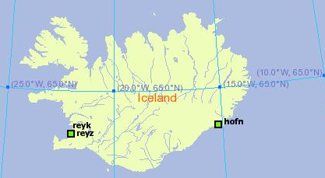
Displaying velocities on a map
There must be an easier way to show this!
North: 20.5 mm/yr
East: -11 mm/yr
North: 15 mm/yr
East: 13 mm/yr
HOFN
REYK
REYK
HOFN
North (mm)
North (mm)
REYK North = 20.5 mm/year
HOFN North = 15.0 mm/year
East (mm)
East (mm)
REYK EAST = ⁻11.0 mm/year
HOFN EAST = 13.0 mm/year
Notes:
Negative east is west

Slide 39
Are REYK and HOFN moving…
…towards each other, away from each other, or in the same direction?
North: 15 mm/yr
East: 13 mm/yr
North: 20.5 mm/yr
East: -11 mm/yr
HOFN
REYK
Mimic these motions with your GPS models.
Notes:
Now think about a map with many GPS stations. And, each one has two numbers for north and east on it … it would get very complicated. There has to be a better way!

Slide 40
Mapping plate movement
Notes:
We can use vectors to show motion. Each arrow on this map represents the velocity of a single GPS station. These GPS stations, affixed to the ground, also show the motion of tectonic plates.

Slide 41
What is a vector?
A vector shows
Velocity and direction of motion.
Notes:
All vectors have magnitude and direction. With GPS monuments, the magnitude is the speed at which moves. The direction is, obviously, the direction it moves, or its azimuth.
Vector’s tail = starting location of the GPS monument.
Direction the vector points = direction the GPS station is moving.
Length of the vector = how fast the GPS station is moving.

Slide 42
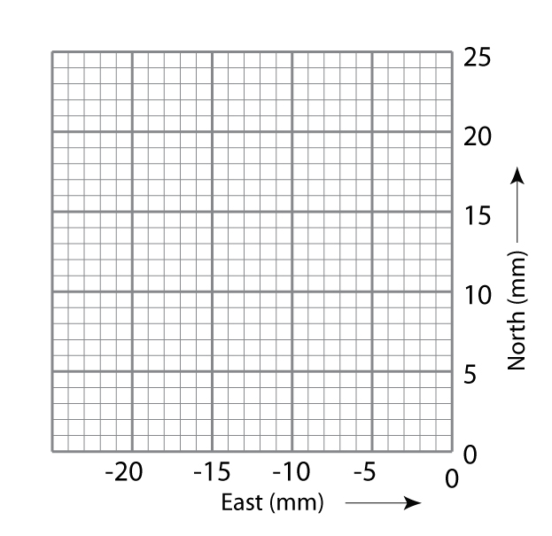
Graph paper as a map
Each axis uses the same scale.
X-axis: east in millimeters (per year)
Y-axis: north in millimeters (per year)
On your graph paper, each block represents 1 mm.
Where is the origin on this graph paper?
Notes:
Students will draw vectors on grids like this to represent motion of GPS stations. This one will be used for REYK. Notice the negative x-axis.
It is very important that both north and east axes use the same scale so that the two vectors can be added together.
Have students work in pairs – check each other’s work.

Slide 43
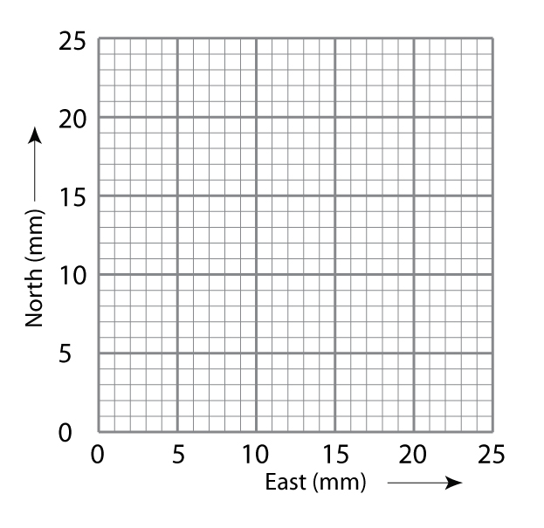
Graph paper as a map
REYK
HOFN
Notes:
On the left will be REYK, and on the right will be HOFN. Your students might recognize these as the first two quadrants of a Cartesian coordinate system that have been pulled apart along the y-axis. REYK’s vector will be mapped in quadrant II; HOFN’s vector in quadrant I.

Slide 44
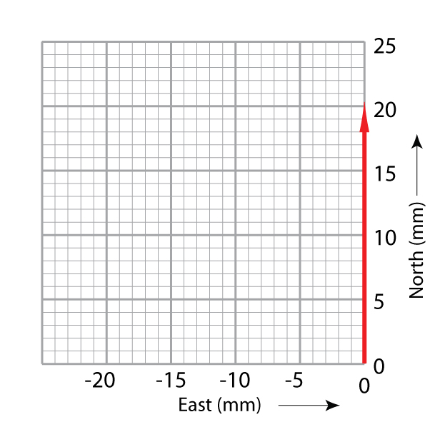
Plotting REYK vectors
Vector: magnitude and direction
Tail is the GPS monument location.
Length of arrow is the magnitude.
Shows direction on a map.
Notes:
Let’s start with the north vector for REYK.

Slide 45
Plotting REYK vectors
Step 1. Draw the first vector along the north axis with the tail at 0.
GPS monument REYK moves 20.5 mm to the north per year
Draw a vector arrow 20.5 blocks along the north axis.

Slide 46
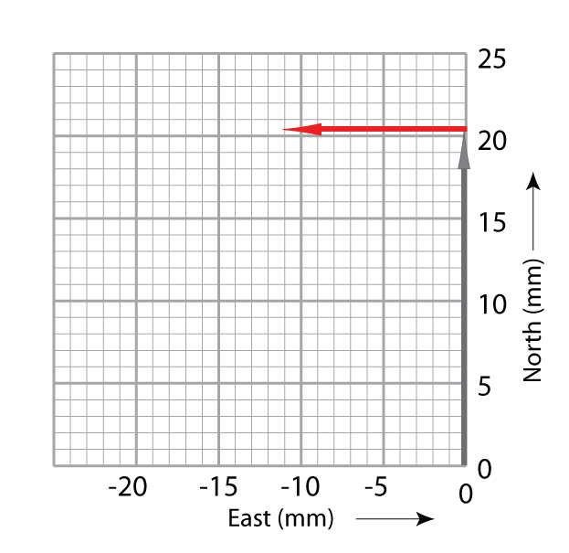
Plotting REYK vectors
Step 2. Place the tail of
the east vector at the
head of the north vector.
Draw the vector -11.0 blocks (mm) beginning
at the head of the north arrow
Notes:
REYK is moving west--or negative east.

Slide 47
Adding REYK vectors
Step 3. Draw a diagonal arrow from (0,0) to the arrowhead of the east vector.
This new vector is the sum of the north and east vectors.
Notes:
Have students work in pairs – check each other’s work.
Students can move their gum-drop GPS stations along the final vector (in blue) to get the feel of the movement of the GPS.
Reiterate that the GPS is moving because the Earth’s tectonic plate is moving.
This analysis is qualitative: Students don’t measure the length of the total vector, although they could. They could mark the length of the total vector on a scrap of paper and measure it against the scale. They could use proportions or ratios to calculate it. Or, as in the next slide, they could use the Pythagorean theorem (typically taught in pre-Algebra). Students could use a protractor, directional compass, or smartphone with a compass app to measure the azimuth of the vector.
Note, however, that this activity does not expect quantitative analysis, only qualitative. Attaching numbers to the vector is optional, an added bonus to build in connections to mathematics.

Slide 48
Another approach to adding vectors
Or, use the Pythagorean theorem to add the vectors to find the sum.
GPS monument moves at: √(x² + y²⁾ =
____ mm/yr to the ____
Notes:
For students in pre-Algebra or Algebra 1, this is an opportunity to apply the Pythagorean theorem.
For students who are in Geometry, you can ask them also to find the azimuth using the sine, cosine, or tangent of the angle between the vector and the y-axis. They might have learned “SOH CAH TOA”. For example, SOH means that the sine is the opposite/hypotenuse, or in this case, east vector/total vector. The cosine is adjacent/hypotenuse or north/total. The tangent is opposite/adjacent or east/north.

Slide 49
Mapping vectors
Now do HOFN on your own – compare with a neighbor
Notes:
Students will map the vectors on their worksheets. Circulate and troubleshoot while they do this. Ask them to write responses to questions in the section, “Thinking through the data and maps.”

Slide 50
Looking at the world view of motion
Perspective of looking from space
Notes:
We can use vectors to show motion. Each arrow on this map represents the velocity of a single GPS station. These GPS stations, affixed to the ground, also show the motion of tectonic plates.

Slide 51
What is happening to Iceland?
Extra credit – – if you were sitting at HOFN for a very long time, how would REYK be moving?
Notes:
A placeholder slide for a class or group discussion about the splaying of Iceland.

Slide 52
Motion of western Iceland when eastern Iceland is not moving
Notes:
A placeholder slide for a class or group discussion about the splaying of Iceland.

Slide 53
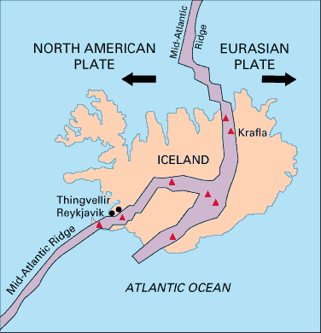
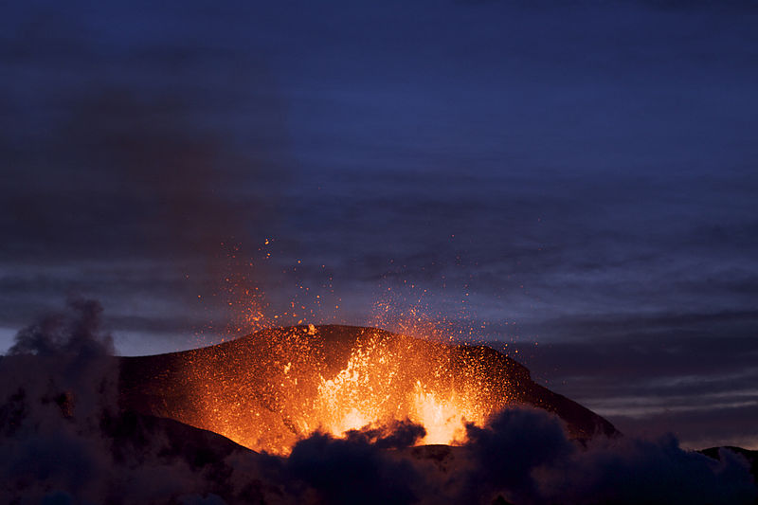
Rifting
Sites of surface eruptions
Notes:
Photo is of the volcano Fimmorduhais, Iceland. Boaworm. 2010. Wikimedia Commons. http://commons.wikimedia.org/wiki/File:Fimmvorduhals_2010_03_27_dawn.jpg Retrieved 26 April 2013.
The map shows the Mid-Atlantic Ridge rifting Iceland. REYK lies to the west of the rift, while HOFN lies to the east. Kious, J. and R. Tilling, U.S. Geological Survey. 1996. “Understanding Plate Motions” in This Dynamic Earth: the story of plate tectonics, online edition. http://pubs.usgs.gov/gip/dynamic/understanding.html. Retrieved 26 April 2013.

Slide 54
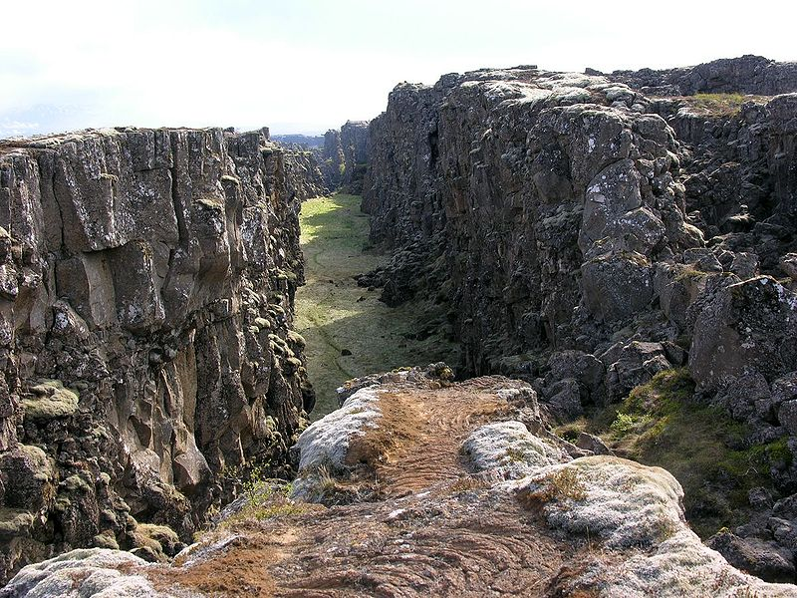
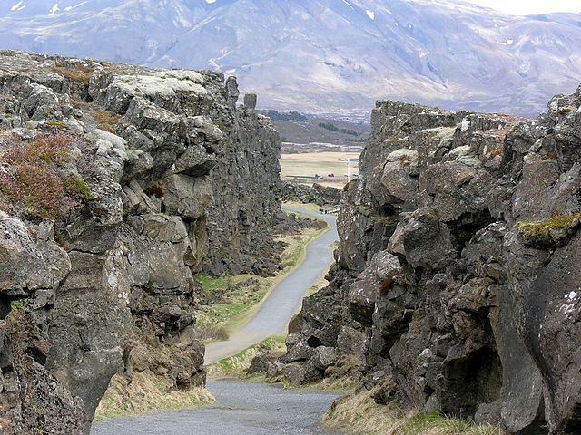
Fissures opening
Notes:
This fissure near Þingvellir, Iceland is where the Mid-Atlantic Ridge is slowly spreading the island apart.
Photo on right: Krapf, Hansueli. 2006. Wikimedia Commons. http://upload.wikimedia.org/wikipedia/commons/9/9a/%C3%9Eingvellir_Iceland_011.JPG. Retrieved 26 April 2013.
Photo on left: Krapf, Hansuili. 2006. Wikimedia Commons. http://upload.wikimedia.org/wikipedia/commons/thumb/7/79/%C3%9Eingvellir_Iceland_037.JPG/640px-%C3%9Eingvellir_Iceland_037.JPG. Retrieved 26 April 2013.

Slide 55
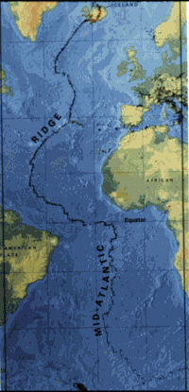
Mid-Atlantic Ridge
Iceland
Mid-Atlantic
Ridge
Notes:
Iceland is a high spot on the Mid-Atlantic Ridge—volcanically and seismically active, rifting, and above sea level.
Map from the U.S. Geological Survey. Kious, J. and R. Tilling, U.S. Geological Survey. 1996. “Understanding Plate Motions” in This Dynamic Earth: the story of plate tectonics, online edition. http://pubs.usgs.gov/gip/dynamic/understanding.html. Retrieved 26 April 2013.

Slide 56
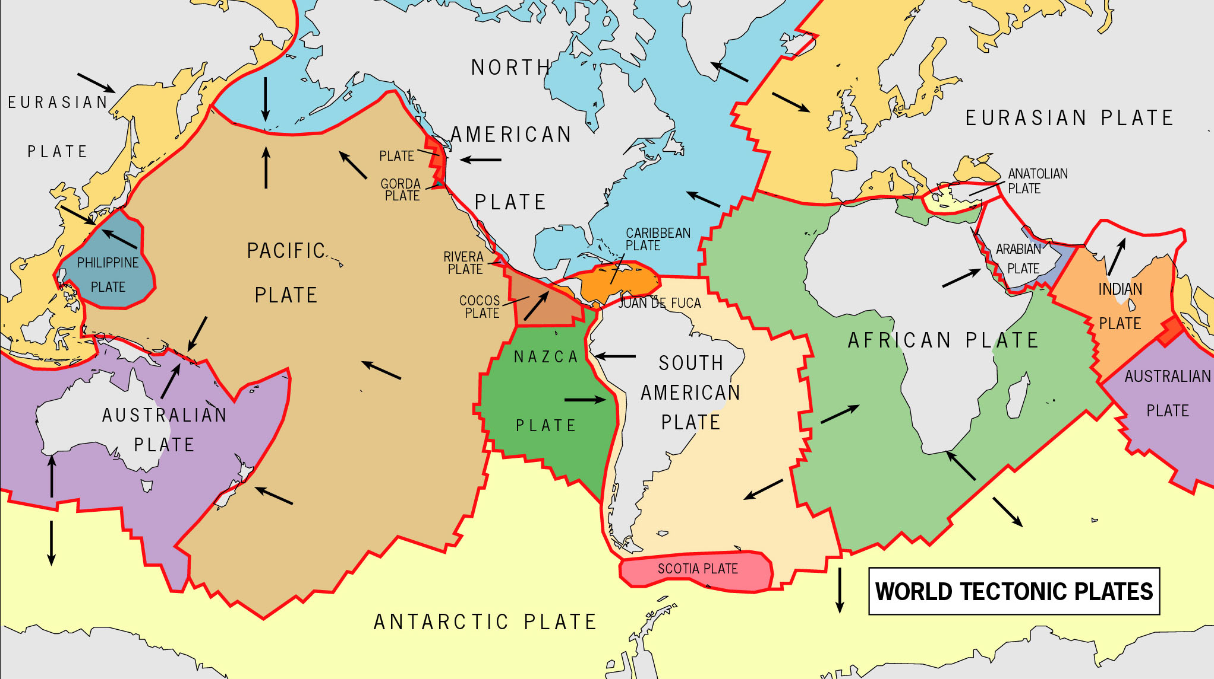
Viewing another region: Africa
Notes:
Image: Map of tectonic plates. USGS. URL?

Slide 57
What’s happening here?
Study the vectors. Reference frame is keeping the mainland Africa fixed. What do you notice about East Africa?
How are the motions similar and different from Iceland?

Slide 58
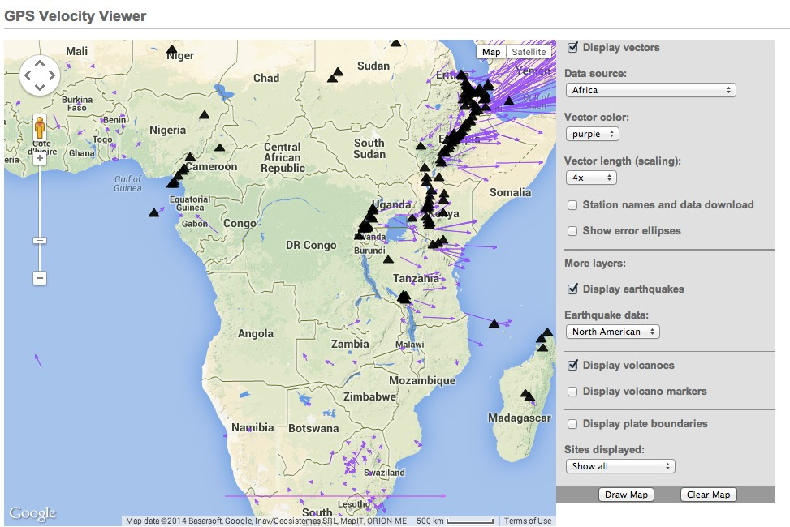
Volcanoes of Africa
Notes:
Image: Map of tectonic plates. USGS. URL?

Slide 59
Explore more:
UNAVCO Velocity Viewer:
http://www.unavco.org/software/visualization/GPS-Velocity-Viewer/GPS-Velocity-Viewer.html
Notes:
Image: Map of tectonic plates. USGS. URL?

Slide 60
Part 3: Apply your knowledge
A
North
B
E
C
D

Slide 61
Match cars and graphs
i)
What
direction?
________
Which car?
________
North
East
North (miles)
East (miles)
Time (Hours)
Time (Hours)
A
North
B
E
C
D

Slide 62
Match cars and graphs
i)
What
direction?
North-Northeast
Which car?
Car A
North
East
North (miles)
East (miles)
Time (Hours)
Time (Hours)
A
North
B
E
C
D

Slide 63
Match cars and graphs
ii)
What
direction?
________
Which car?
________
North
East
North (miles)
East (miles)
Time (Hours)
Time (Hours)
A
North
B
E
C
D

Slide 64
Match cars and graphs
ii)
What
direction?
South
Which car?
Car C
North
East
North (miles)
East (miles)
Time (Hours)
Time (Hours)
A
North
B
E
C
D

Slide 65
What direction is car D moving?
v)
What direction is
Car D moving?
_____________
Draw the north and east graphs
North
East
North (miles)
East (miles)
Time (Hours)
Time (Hours)
A
North
B
E
C
D

Slide 66
What direction is car D moving?
v)
What direction is
Car D moving?
Southeast
Draw the north and east graphs
North
East
North (miles)
East (miles)
Time (Hours)
Time (Hours)
A
North
B
E
C
D

Slide 67
Summary
You should now be able to:
Describe how GPS works;
Interpret graphs in a GPS time series plot;
Determine velocity vectors from GPS time series plots;
Explain relative plate motions in Iceland; and
Explore global GPS data.

Slide 68
Questions?
Contact:
education @ unavco.org
http://www.unavco.org/
Follow UNAVCO on Facebook Twitter

