Slide 1
Using Recreational Drones in STEM
Shelley Olds, UNAVCO
LuAnn Dahlman, NOAA CPO
Earth Science Information Partners (ESIP) Education Committee

Slide 2
Day 1

Slide 3
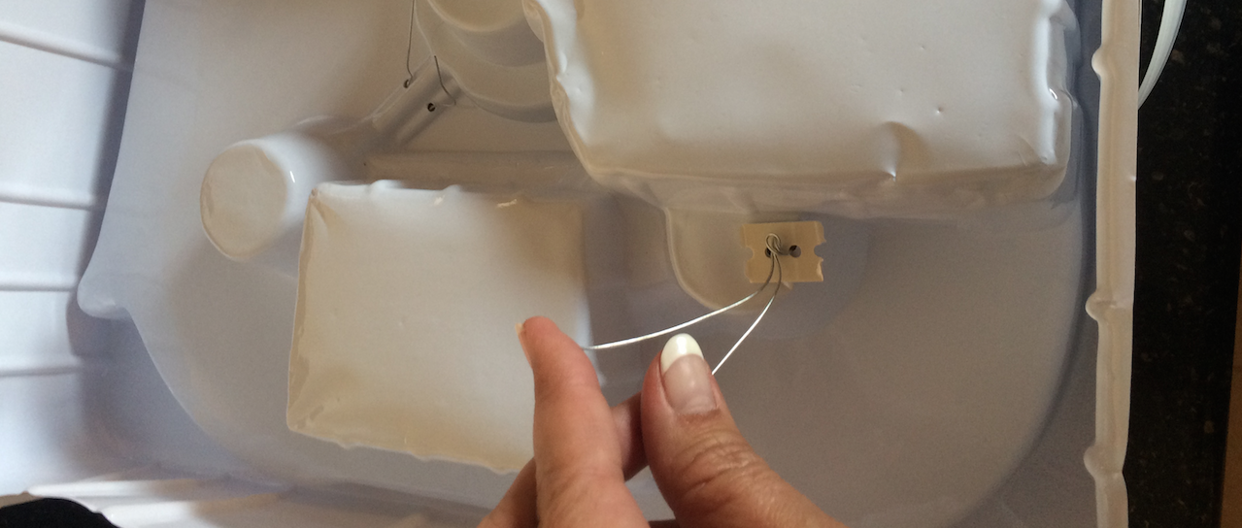
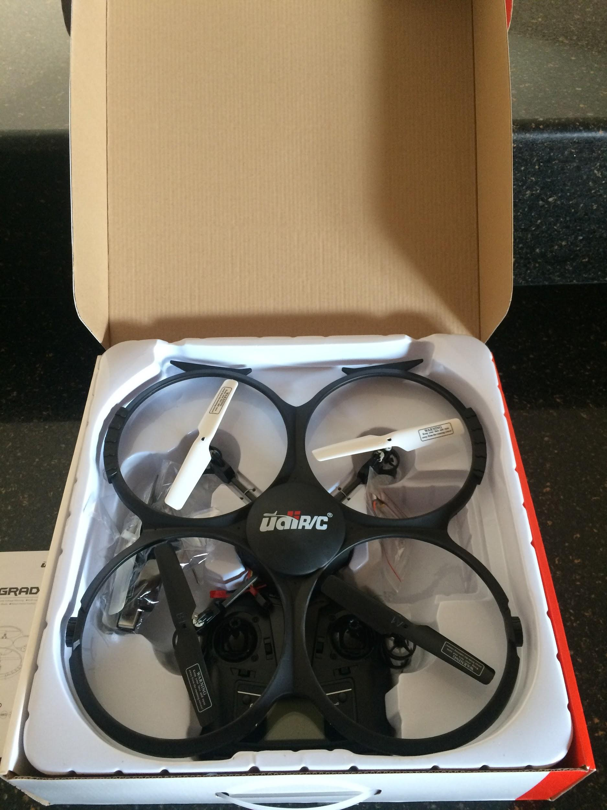
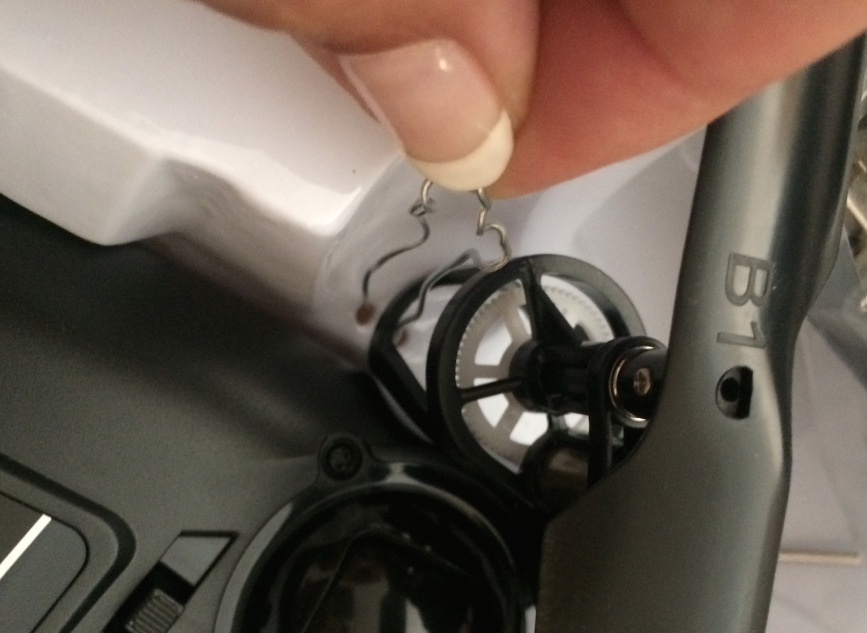
Unboxing your drone
Remove wires from back
Disentangle wires from legs without disturbing gears

Slide 4
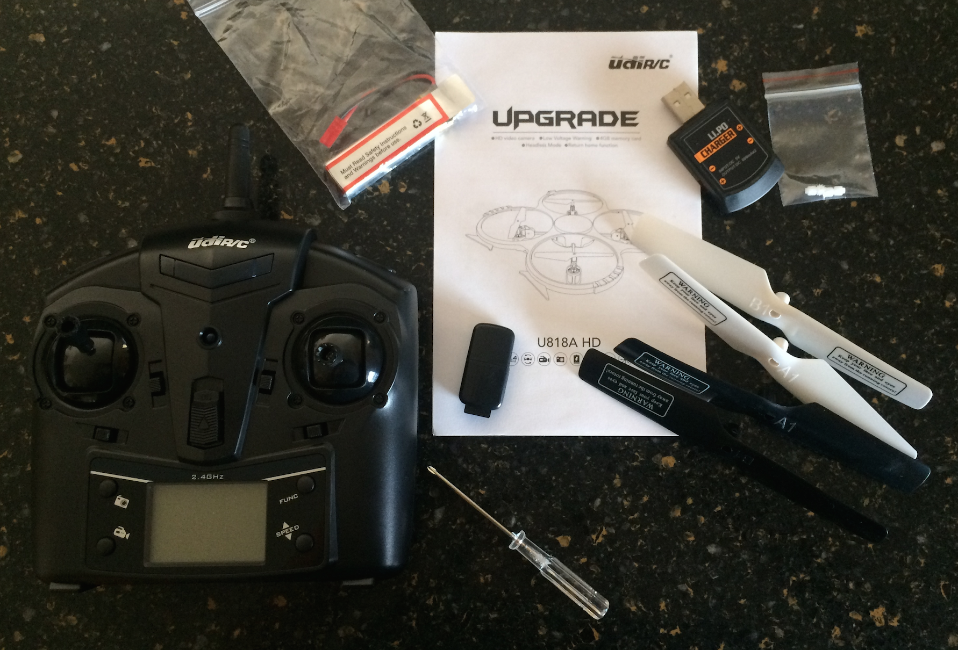
Manual
USB Charger
Battery
Extra gears
Controller
Card & reader
Extra blades
Screwdriver

Slide 5
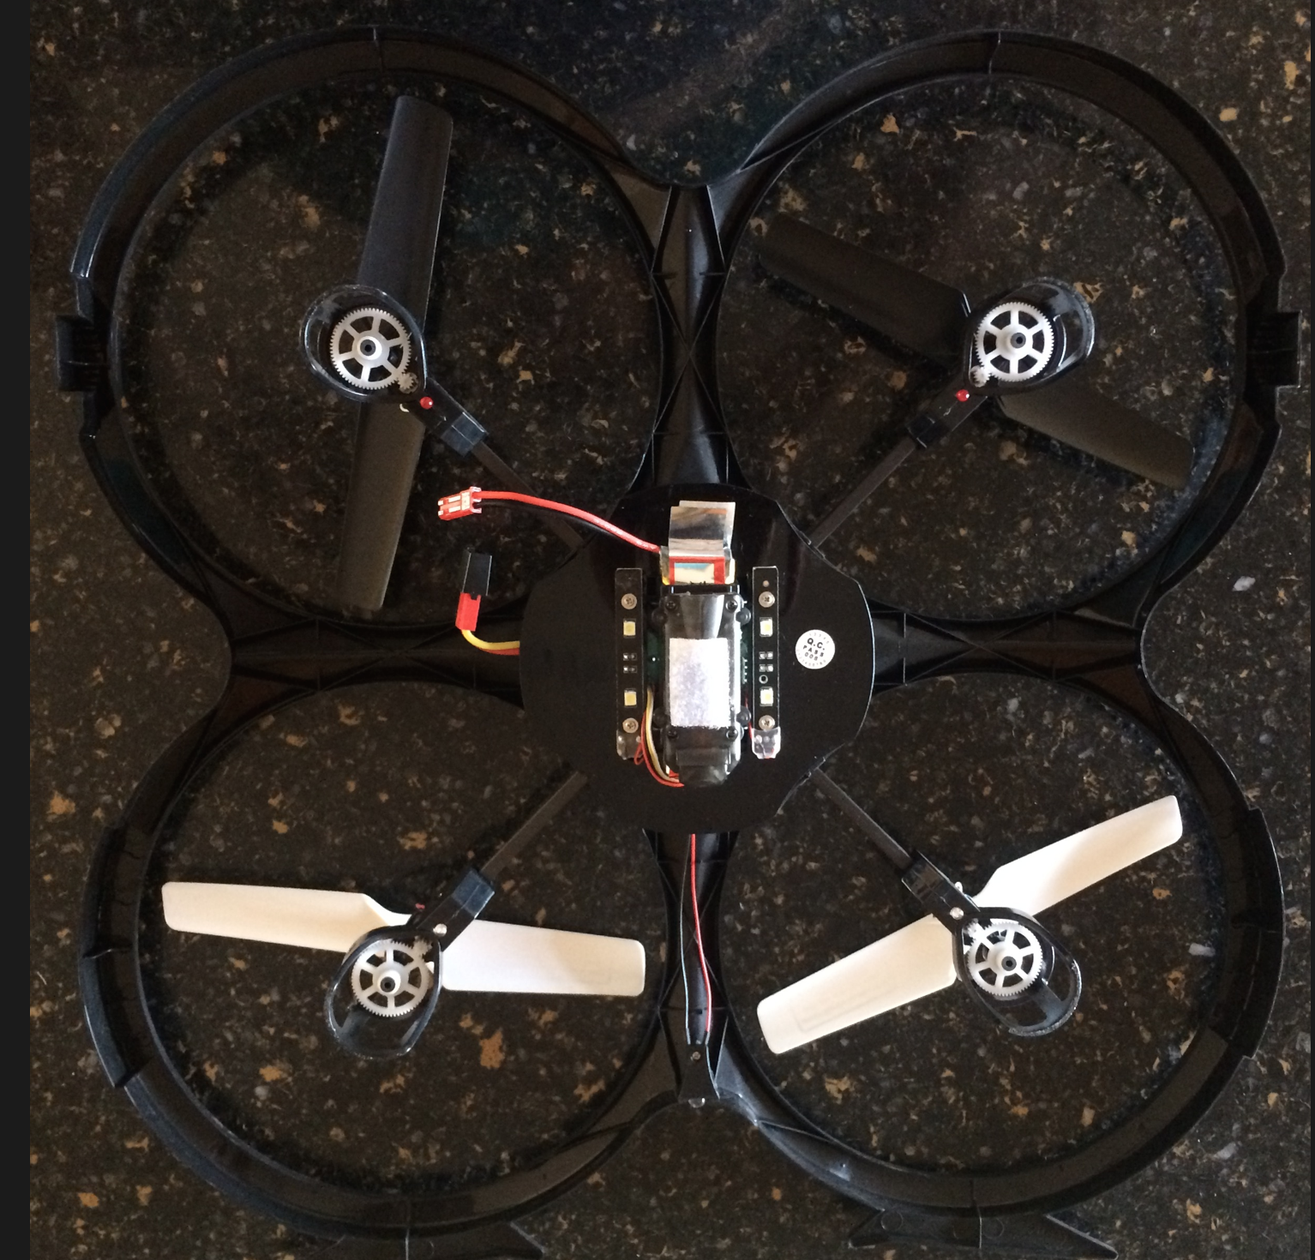
2nd battery is in the drone

Slide 6
Please do all you can to keep your stuff together!!
Notes:
Why we chose this drone
Ease of flight
Works right outta the box
Had a camera
Learning to fly on cheap drone vs expensive mistakes

Slide 7
Tasks before we start Ground School
Trade your signed release form for your boxed drone.
Put your name on your box and manual. Save all packaging.
Put your name or initials on a sticker and place it on top of your drone.
Install 4 AA batteries in your controller.
Put your initials on two different colored dot stickers and place these on your two batteries.
Use dots to label your transmitter and charger.
Connect batteries to your charger and plug into a USB outlet.

Slide 8
Safety & Civility first!
Avoid wind.
Fly only in safe places: set and observe boundaries that keep you and your drone clear of traffic and other hazards.
Be alert! Don’t let enthusiasm overcome common sense.
Whenever you perceive potential dangers, stop and change the situation.
Follow the Golden Rule when choosing a location to fly.
Consider if you would (or could be concerned about seeing a drone in particular situations)
If the site of a drone is likely to disturb people or wildlife, don’t fly there.
Notes:
While your batteries are charging - some basics on safety and civility…
Shelley: Safety and civility

Slide 9
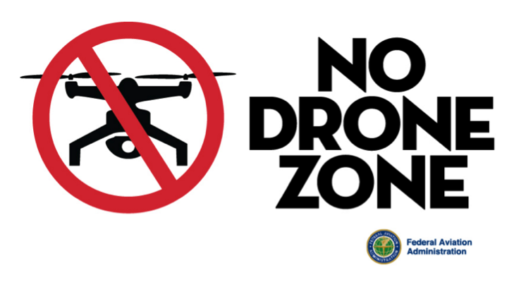
B4U Fly Smartphone App : FAA app
Know Before You Fly
Free for
iOS & Android.
Check for specific restrictions in parks, near sensitive facilities, and places where you might disturb wildlife.
Fly below 400 feet
Keep your drone in eyesight always
Stay clear of planes, helicopters, etc.
Do not fly over people, wildlife, or vehicles
Contact the airport &control tower before flying within five miles of an airport or heliport
Check and follow all local laws and ordinances before flying

Slide 10
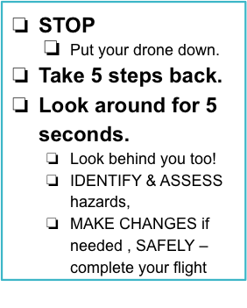
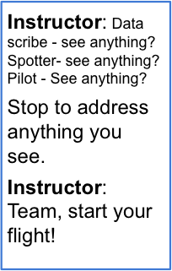
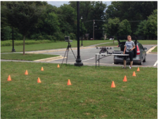
Before you fly Safety - Step Back 5x5 for Safety

Slide 11
The Science / Flight Team & Roles
Data Collector/ Photo Roles:
Pre-flight
Checks instruments
Calls out pre-flight checklist items
Completes the Flight Datasheet
In-flight
Reads out investigation instructions
Records data collected during flight
Post-flight
Calls out post-flight checklist
Spotter/Safety Lead Roles:
Pre-flight
Describes weather data
Checks surroundings for obstacles & hazards
In-flight
Keeps drone in site
Scans surroundings
Reads off data to Data Collector (optional)
Post-flight
Checks area for hazards
Retrieves with photo/ sensor data from drone (optional)
Pilot Roles:
Pre-flight
Checks the drone
Checks instruments/ sensors attachment
In-flight
Flies the drone – follows instructions from Data Collector
Keeps drone in site & lands safely
Post-flight
Turns off drone
Retrieves drone
Notes:
Here’s one example of how the team might divide roles. This will obviously change with different numbers of team members, different skills, and goals.
Important to split into different roles & agree on what these roles are before, during, and after the flight
Scan landing area for hazards ; notice wind conditions
Carefully land
Post-Flight:
Turn the power off to the drone and/or disconnect the batteries.
Turn off the transmitter.
Turn the power off to the photo equipment.
Visually check aircraft for signs of damage and/or excessive wear.
Secure the drone.

Slide 12
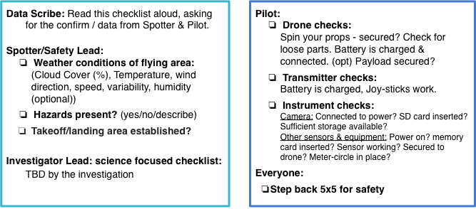
Pre-flight checklist: before every flight

Slide 13
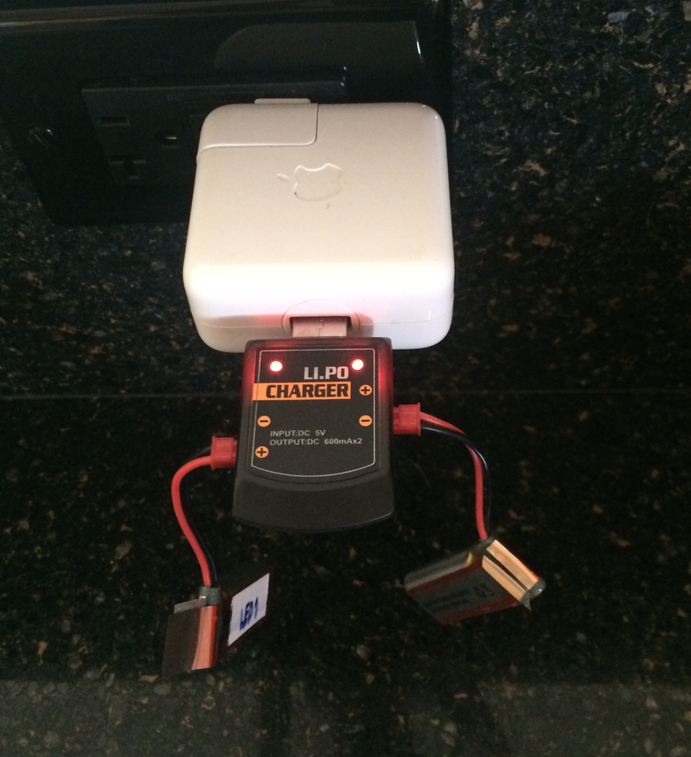
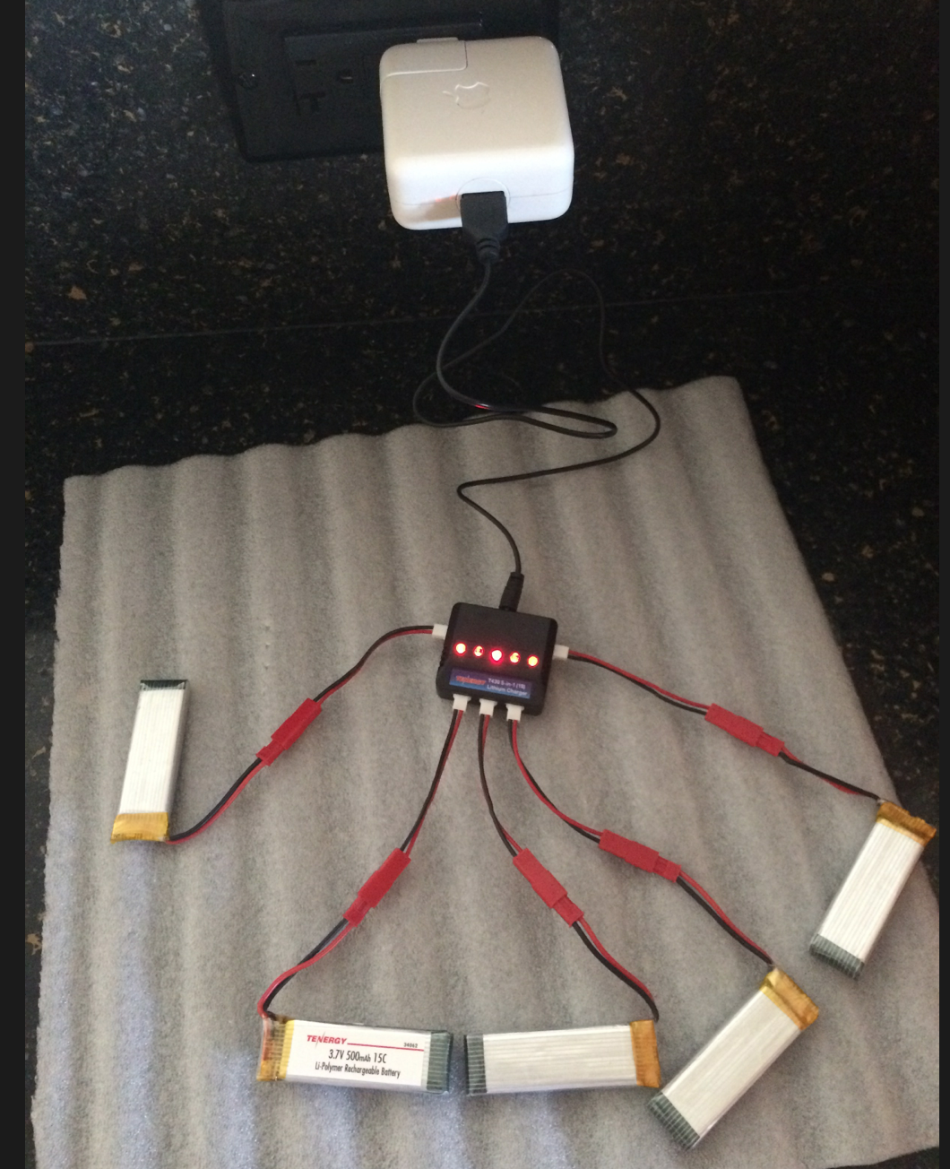

Slide 14
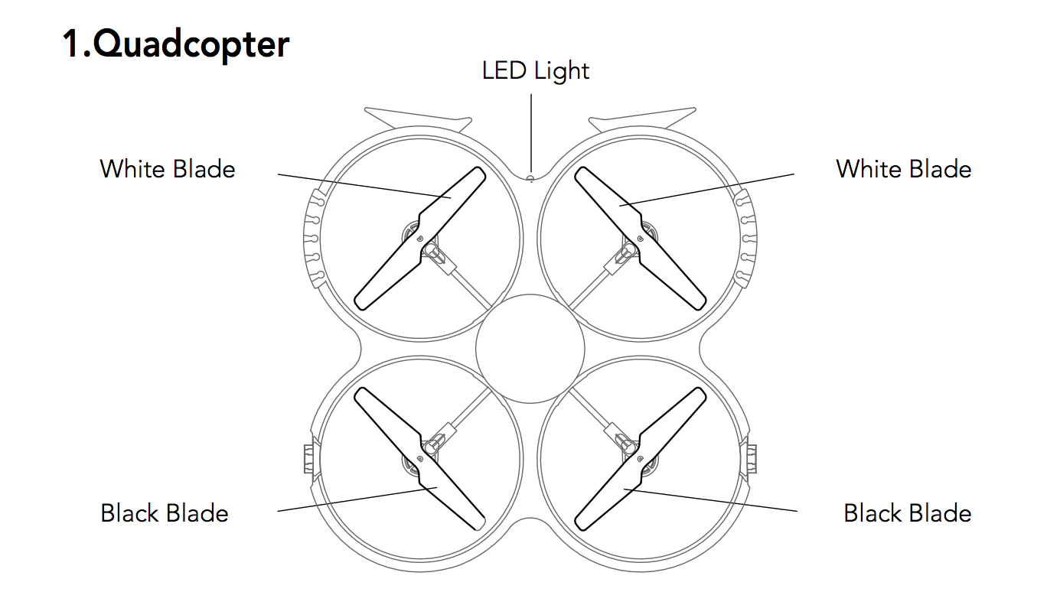
5-minute Ground School

Slide 15
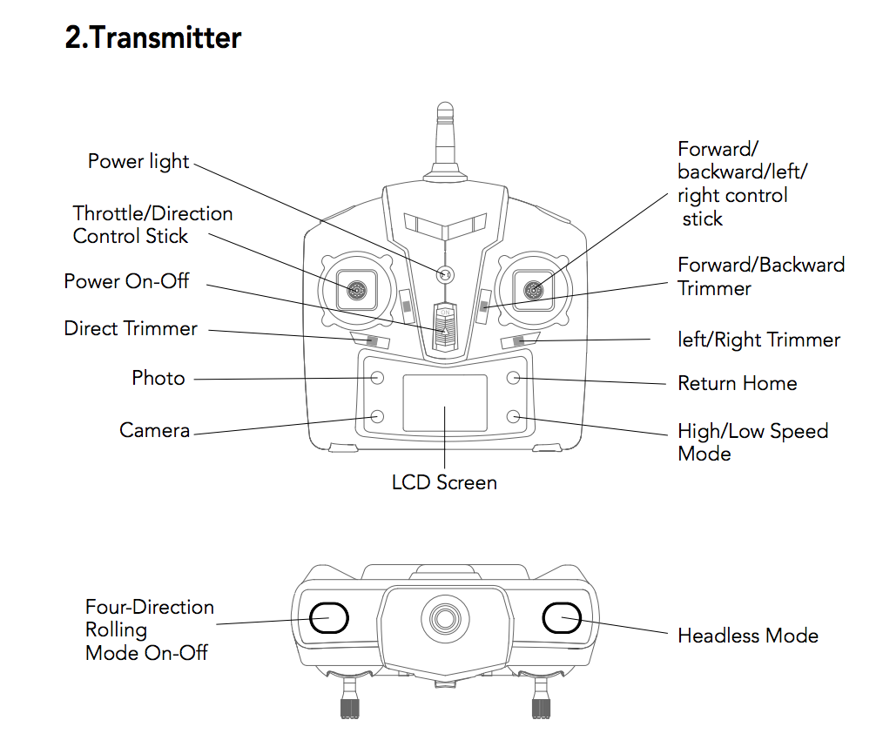

Slide 16
Notes:
We’ll start with only two controls.

Slide 17
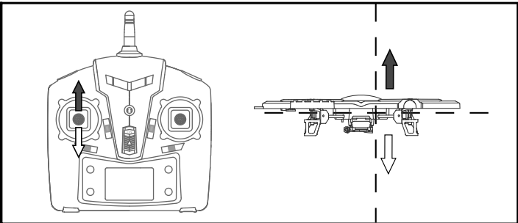
Ascend
Notes:
The left joystick is the throttle

Slide 18
Descend

Slide 19
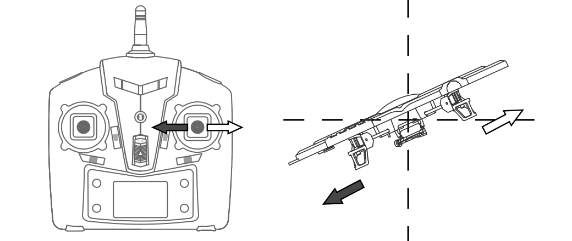
Go left

Slide 20
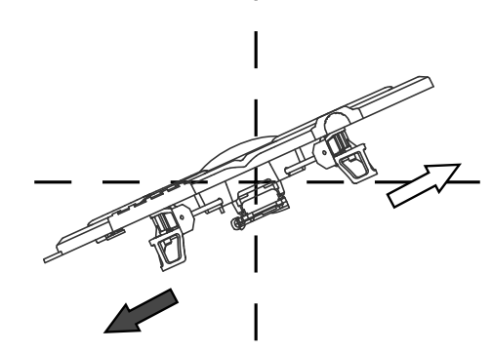
Go right

Slide 21
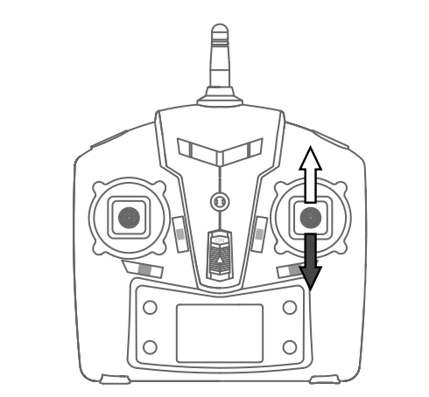
Move Forward

Slide 22
Move Back

Slide 23
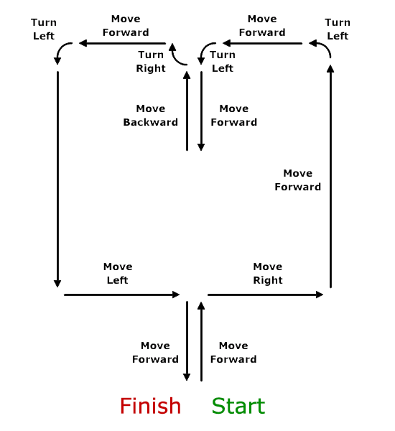
Navigation Practice with your transmitter
To "Move Forward," push the right joystick forward, causing the Drone to pitch down. To "Move Backward," pull the right joystick back, causing the Drone to pitch up.
"Move Right" and "Move Left" are accomplished by moving the right joystick right or left, causing the Drone to roll right or left.
"Turn Right" and "Turn Left" are accomplished by moving the left joystick right or left, causing the Drone to yaw right or left.

Slide 24
Pairing your transmitter and drone
Notes:
Remember how to ascend and descend? Then you already know the process for pairing your transmitter with your drone.

Slide 25
From the UDI818 drone manual:
Message:
Use the transmitter to control your drone.
Notes:
Note this is opposite of what was shown in the “unboxing” video

Slide 26
Turn transmitter on first
Plug battery into drone
Place drone on level surface
Pair the two
Fly!
Unplug battery from drone
Turn transmitter OFF last
Notes:
Transmitter on: flashing blue light
Plug drone battery in: lights in your eyes
Pairing turns the flashing light to constant glow

Slide 27
1
2
Pairing the transmitter with your drone
To pair: Move the left stick all the way to top, then all the way to the bottom.
You should hear a beep, light on the transmitter & drone will go from flashing to solid
Notes:
You’ve also just learned the pattern for pairing your transmitter and your drone. Push all the way to the top and then all the way to the bottom.

Slide 28
Pairing the transmitter with your drone
Once paired, the transmitter’s flashing blue light turns steady

Slide 29
You’re ready to fly!
Notes:
But let me offer just a couple more things...

Slide 30
This model is fairly sensitive. Achieving a steady hover may require continual small adjustments.

Slide 31
And here’s one more move you can make... when you’re ready

Slide 32
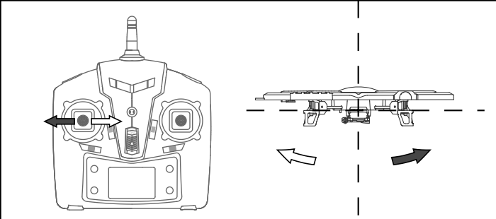
Spin left

Slide 33
Spin right

Slide 34
Flying practice time!
Take off - Hover - Land
Fly left - Fly right
Fly away - Fly back
Repeat until comfortable
Notes:
Initial flights. Poles set up down center of gym.
10 - 15 minutes
Plug in batteries as soon as they run out.

Slide 35
Flying practice time!
Fly left - Fly right
Notes:
Initial flights. Poles set up down center of gym.
10 - 15 minutes
Plug in batteries as soon as they run out.

Slide 36
Fly away - Fly back
Notes:
Initial flights. Poles set up down center of gym.
10 - 15 minutes
Plug in batteries as soon as they run out.

Slide 37
What if my drone won’t fly straight?
Calibrate!

Slide 38
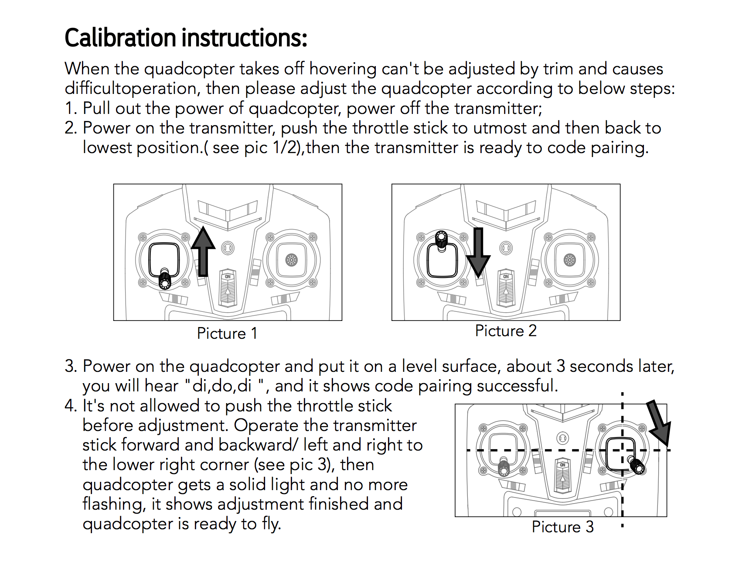
Calibration steps
Turn transmitter off & unplug battery on drone.
Turn transmitter on
Push throttle up then down
Plug battery into drone
Place drone on level surface
Don’t move the throttle.
Push right control forward and back, left and right, and into lower right corner
Notes:
Discussion of how its going

Slide 39
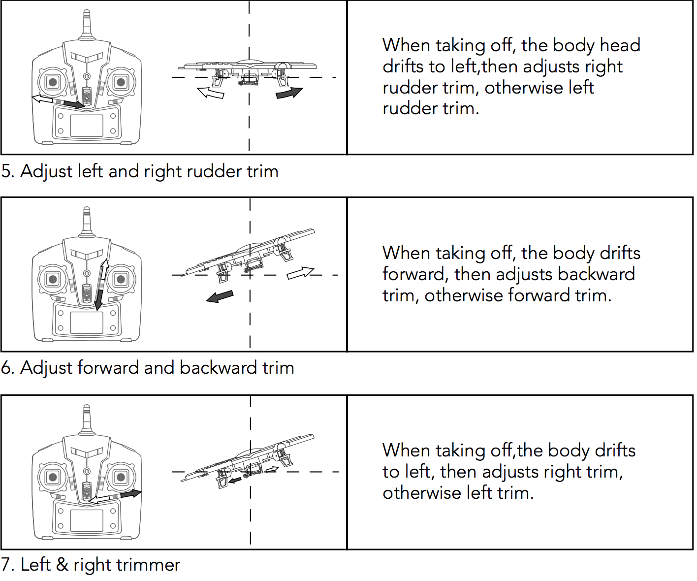
Adjusting Trim
Figure out which direction the drone drifts.
In a low flight adjust the appropriate trim button.

Slide 40
Set up an obstacle course
Help each other master skills
Consider how you will help learners learn
(instructors may want to adopt a hands-off transmitters rule)
Notes:
Set up an obstacle course
Help each other master skills
Consider how you will model help learners learn
(hands off transmitters)

Slide 41
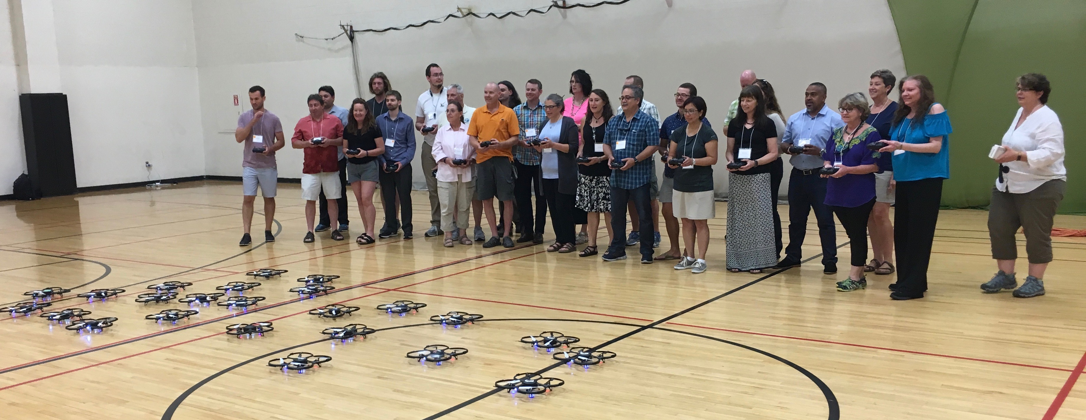
Taking photos and videos with your drone

Slide 42
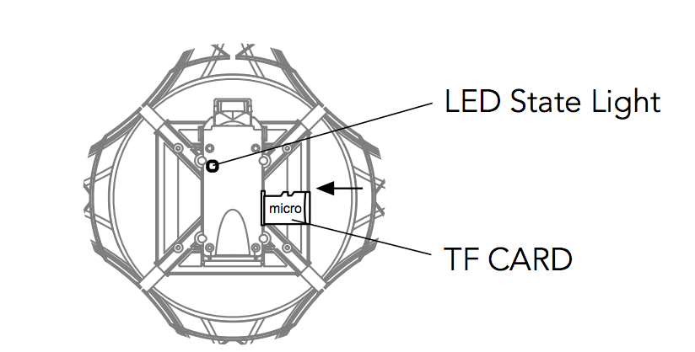
Front of drone
(headlight)
Inserting your TF (Micro SD) card

Slide 43
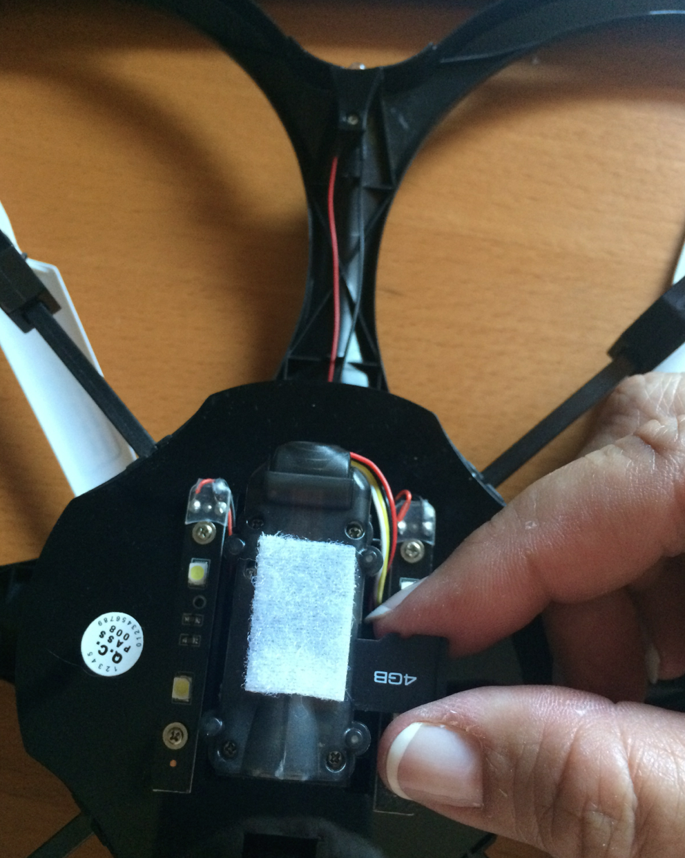
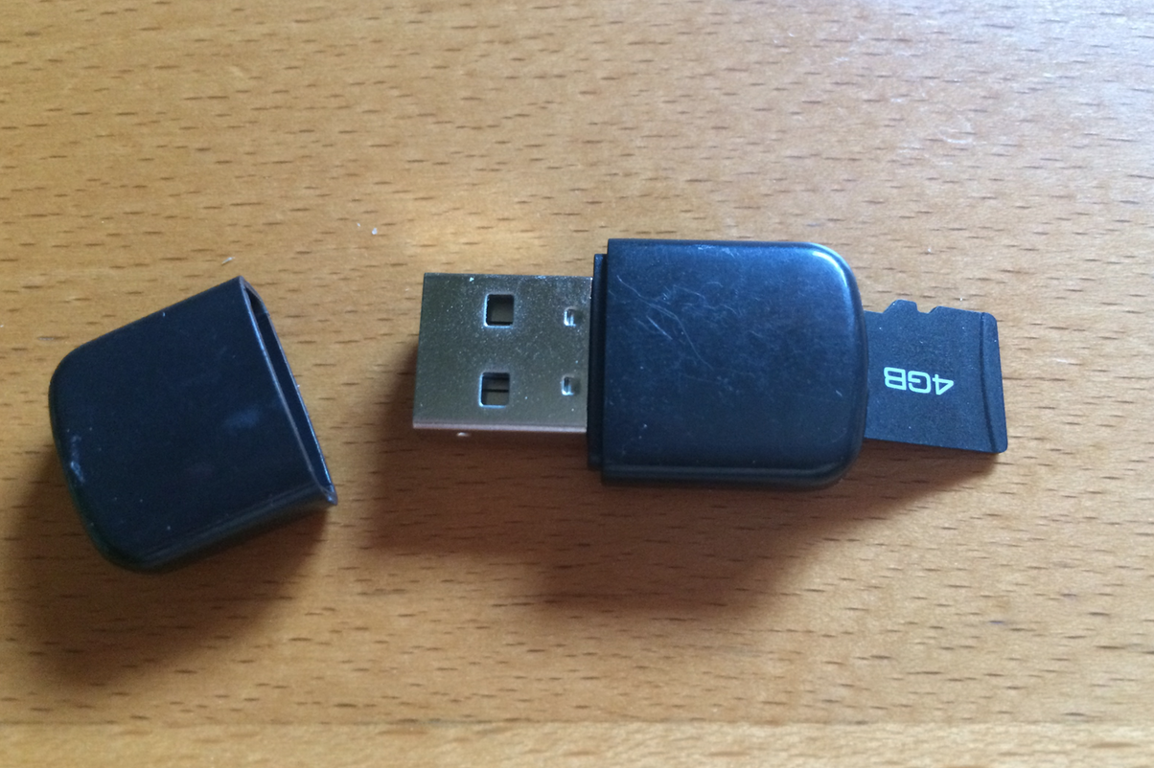
Inserting your TF (Micro SD) card

Slide 44
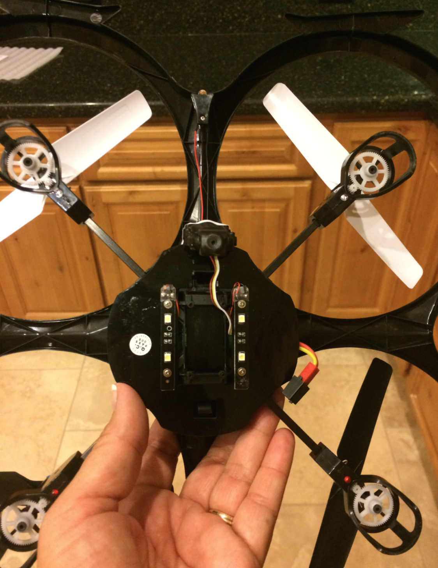
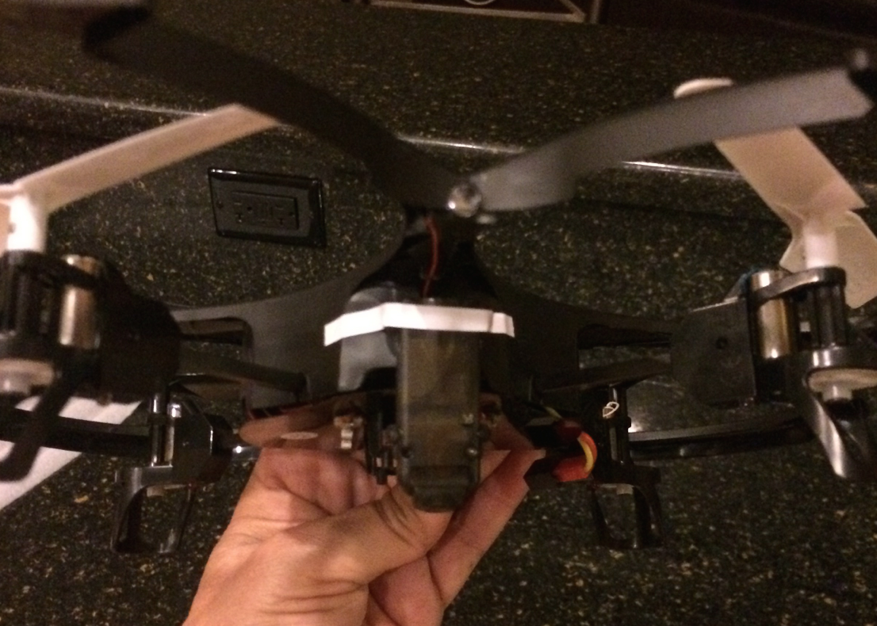
Modifying your camera to point down

Slide 45
Notes:
We’ll start with only two controls.

Slide 46
Day 2
Start charging your batteries
Choose a group and upload photos to the participant pages: http://serc.carleton.edu/earth_rendezvous/2017/program/morning_workshops/w4/workspace/index.html

Slide 47
9:00 Work in small groups through a classroom-ready learning activity
Engineering problem or activity:
How much weight can my drone carry?
https://scied.ucar.edu/activity/uav-test-carry-payload
How high is my drone flying?
https://scied.ucar.edu/activity/uav-test-altitude

Slide 48
The Science / Flight Team & Roles
Data Collector/ Photo Roles:
Pre-flight
Checks instruments
Calls out pre-flight checklist items
Completes the Flight Datasheet
In-flight
Reads out investigation instructions
Records data collected during flight
Post-flight
Calls out post-flight checklist
Spotter/Safety Lead Roles:
Pre-flight
Describes weather data
Checks surroundings for obstacles & hazards
In-flight
Keeps drone in site
Scans surroundings
Reads off data to Data Collector (optional)
Post-flight
Checks area for hazards
Retrieves with photo/ sensor data from drone (optional)
Pilot Roles:
Pre-flight
Checks the drone
Checks instruments/ sensors attachment
In-flight
Flies the drone – follows instructions from Data Collector
Keeps drone in site & lands safely
Post-flight
Turns off drone
Retrieves drone
Notes:
Here’s one example of how the team might divide roles. This will obviously change with different numbers of team members, different skills, and goals.
Important to split into different roles & agree on what these roles are before, during, and after the flight
Scan landing area for hazards ; notice wind conditions
Carefully land
Post-Flight:
Turn the power off to the drone and/or disconnect the batteries.
Turn off the transmitter.
Turn the power off to the photo equipment.
Visually check aircraft for signs of damage and/or excessive wear.
Secure the drone.

Slide 49
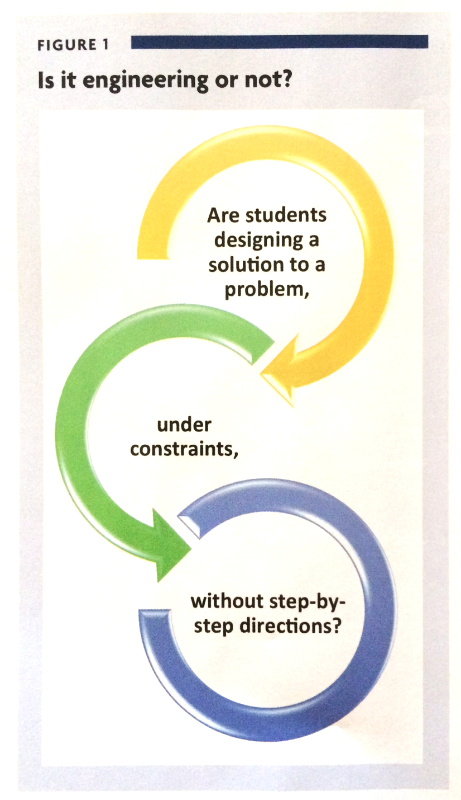
Is it Engineering or Not?
The Science Teacher
Summer 2017
Brooke A. Whitworth and Lindsay B. Wheeler

Slide 50
10:00 Guest Speaker, via GoToWebinar:
Lindsay "Bar" Barbieri,
PhD Student in Natural Resources, University of Vermont
Presentation: Drones, From First Step to Science

Slide 51
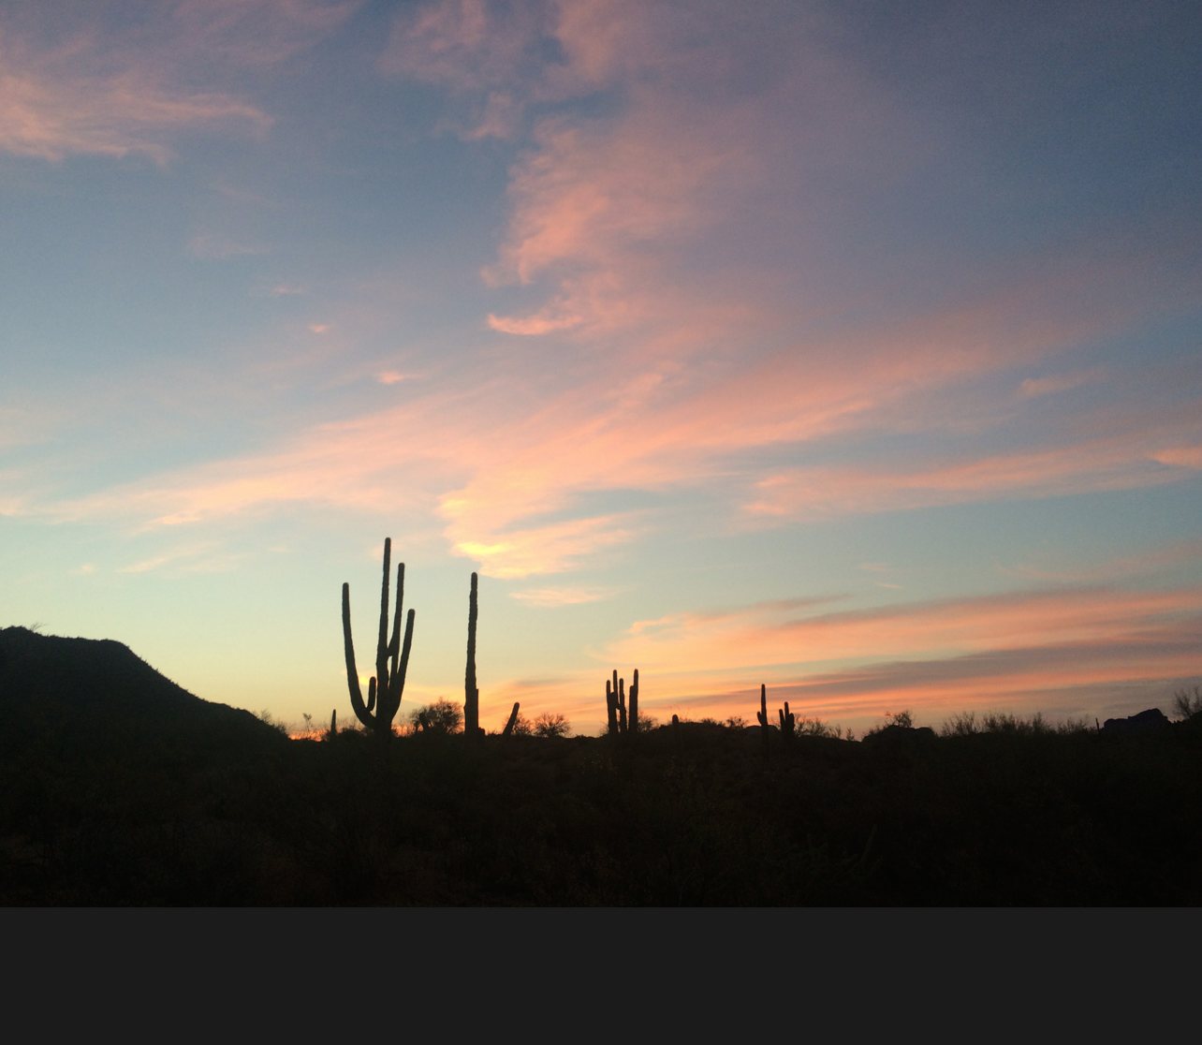

Slide 52
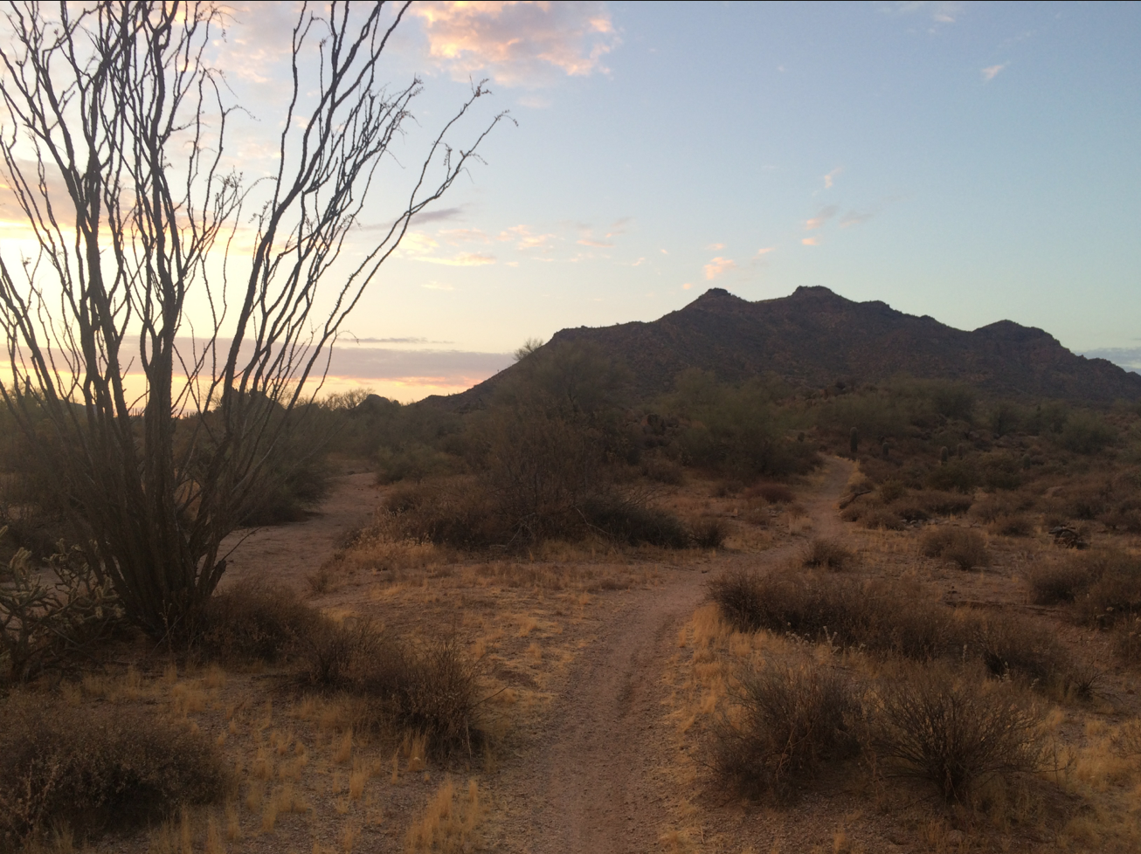
Measuring microclimates

Slide 54
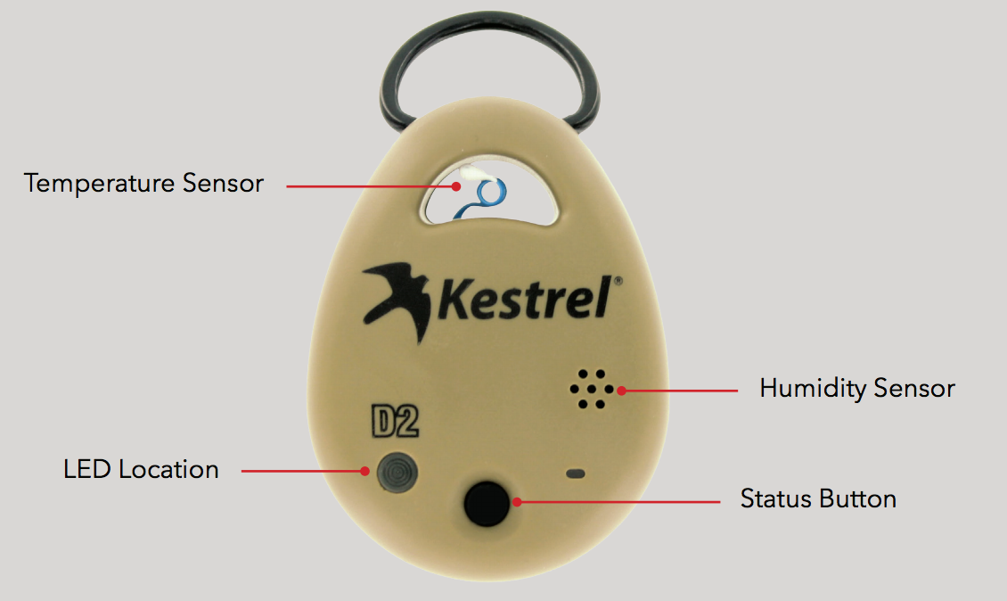
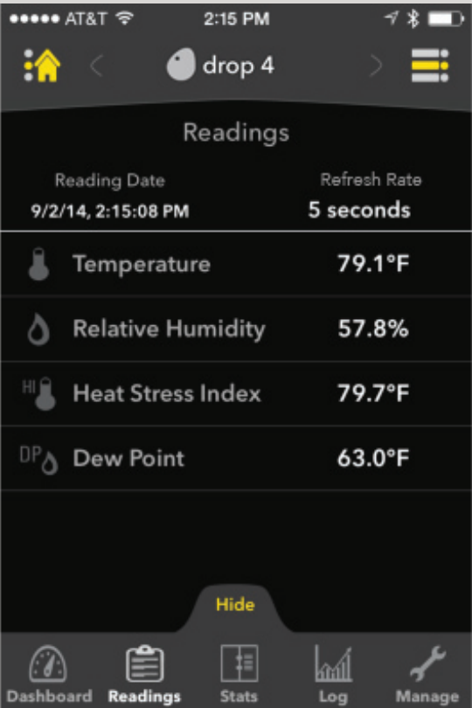

Slide 55
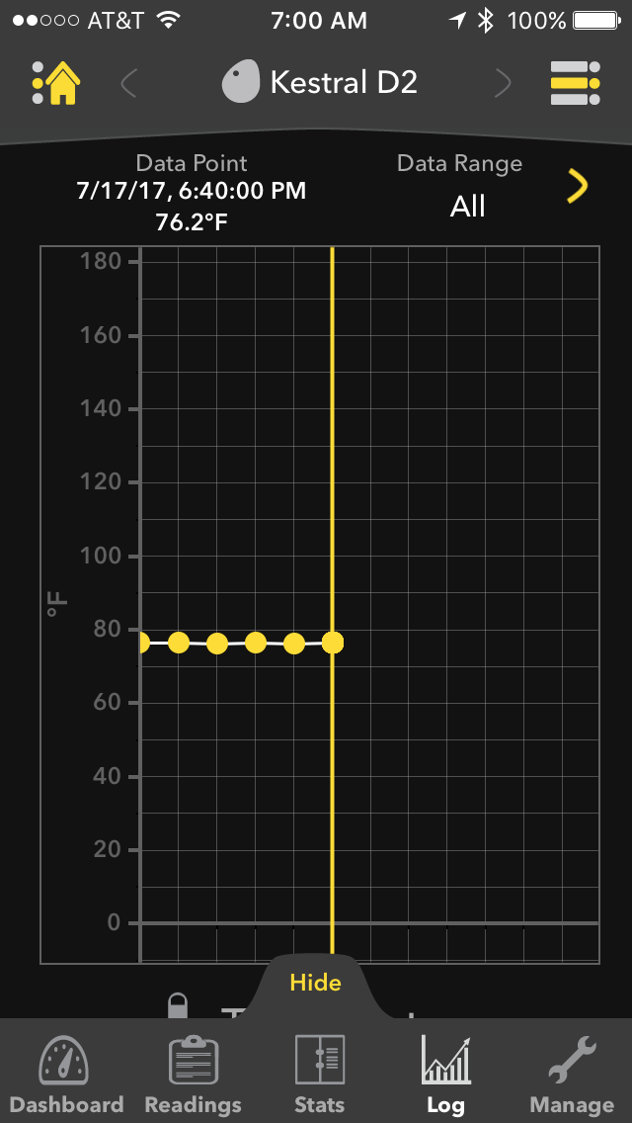
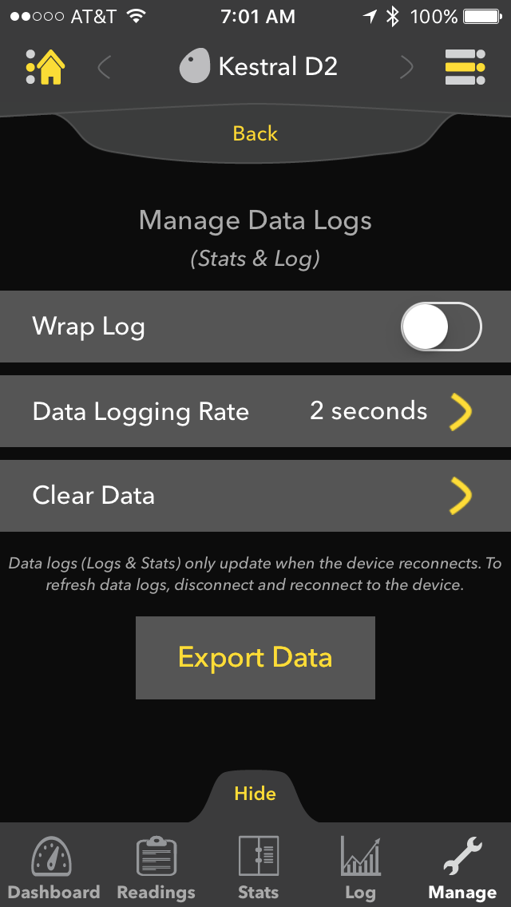

Slide 56
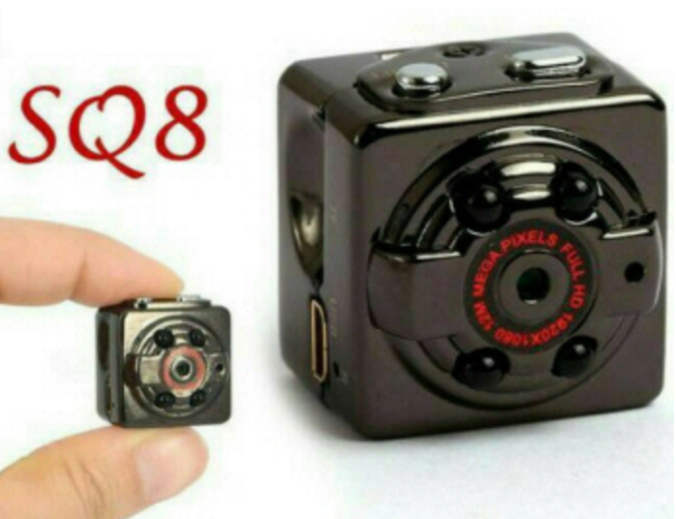
Tiny cameras:
Press On/Off for 3 seconds:
Solid blue light = standby mode
Mode button toggles between
Blue: 720 p video
Blue+Red: 1080 p video
Red: Photo
Press on/off to start and stop video or take a photo
When starting video, light flashes 3 times, then goes out.

Slide 57
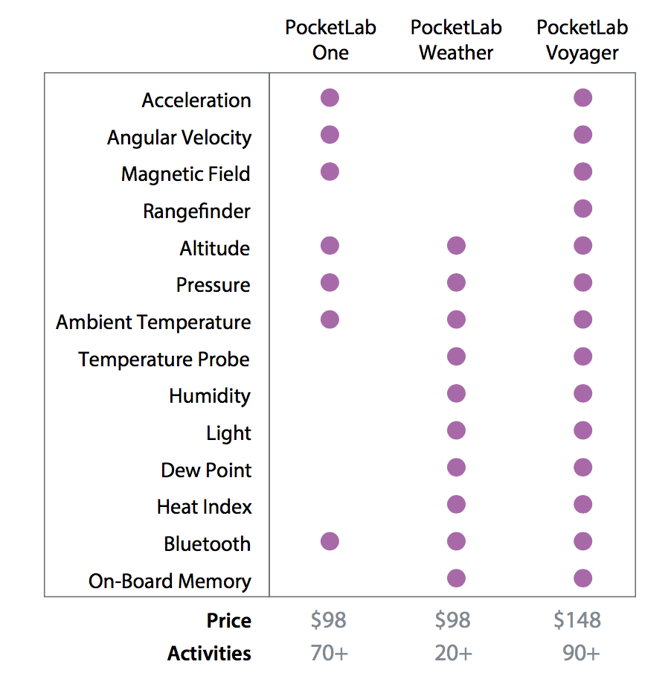
The PocketLab: pic.twitter.com/uDlKjxw695

Slide 58
Brainstorming: Using drones & sensors in classroom

Slide 59
Day 3:
Refine / Design / Customize / Practice a learning activity for use with your learners
Create an Action Plan
(you keep this, we’ll take a picture of it)

Slide 60
Flying with your drone - eg on a plane in the United States
Place the batteries in your CARRY ON luggage.
These are lithium ion batteries
Carry on luggage. Not checked. Not gate checked. Etc :)
Check TSA regulations before taking your drone

Slide 61
Back-up slides

Slide 62
Resources: UAV Flight School https://scied.ucar.edu/activity/uav-flight-school

Slide 63
Resources: Learning the aerodynamics of flying
Learning the aerodynamics of flying

