Slide 1
Examples of Research Results using Borehole Strainmeters
Compiled from the literature by E. Roeloffs, USGS
Last update 2 January 2014

Slide 2
Acknowledgments
These slides summarize published papers (by others) in which borehole strain data have been used to study earthquakes and volcanoes
These are not the only papers of interest! I’ll add more as they become available and time permits.
Most of the figures are from the cited papers, a few background figures from the web have been included.
Notes or comments at the end of each section are by Evelyn R, to point out how the strain data were used
This is not an approved USGS product; please do not cite it. Please go to the original papers and cite those instead.

Slide 3
Contents as of 2 Jan 2014
Yoshida, Y. (2009). The rupture process of the 2004 Sumatra-Andaman earthquake viewed from strainmeter data. Jour. Earthquake and Tsunami 2009.03:35-42.
Ito, Y., and others, (2013). Episodic slow slip events in the Japan subduction zone before the 2011 Tohoku-Oki earthquake. Tectonophysics 600 (2013) 14–26.
Bonaccorso, A., and others, (2013). Etna’s lava fountains investigated by continuous strain, magnetic, ground and satellite thermal data. Bull. Volc. 75:690 DOI 10.1007/s00445-013-0690-9

Slide 4
THE RUPTURE PROCESS OF THE 2004 SUMATRA-ANDAMAN EARTHQUAKE VIEWED FROM STRAINMETER DATA
Yasuhiro Yoshida
J. Earthquake and Tsunami 2009.03:35-42.
Notes:
Summary of Abstract: Eruptive episodes at Etna volcano on 15 November 2011 and 18 March 2012
novel data from two recently installed strainmeters that recorded unique signals during the lava fountain phases of these events.
The strainmeter data, integrated with magnetic data, and with satellite and ground thermal data, defined path of a gas-rich magma batch from the source inside the volcano to the surface and atmosphere.
The amplitude ratio of the volumetric strain changes constrained the storage depth of the magma feeding the lava fountains above 1.5 km below sea level.
Magnetic data revealed an attempted shallow lateral intrusion.
Ground and satellite thermal data quantified the total erupted volumes of ~2.2 × 10⁶ m³ for the 15 November event and ~3.0 × 10⁶ m³ for the 18 March event.
Despite different durations of the explosive and effusive phases of the two lava fountain events, the total erupted volume was quite similar, suggesting the emptying of a shallow storage system displaying a steady behaviour.

Slide 5
Use of normal modes to study 2004 Sumatra earthquake
One of the first papers to show the true size of the Sumatra earthquake was the normal-mode analysis of Stein & Okal (2005), who found that MW 9.3 was required to explain the lowest-frequency normal modes.
Tsai et al. (2005) showed that the large size and duration of the Sumatra earthquake could not be properly modeled with one CMT, but that seismic data are well explained by a series of 5 CMT solutions that mimic a northward-propagating slip pulse and have a total moment of MW 9.3
Stein & Okal (2007; SSA) showed Tsai (2005)’s 5-CMT model also fits the normal modes accurately, and its time dependence explains an apparent increase in moment with normal-mode period that had led Stein & Okal (2005) to speculate about slow slip in the northern part of the rupture.
Lambotte et al. (2006, 2007) used normal-mode phase measurements to estimate the rupture length and duration, obtaining ∼1250 km and ∼550 s.
Braitenberg & Zadro (2007) found that normal modes recorded by a long-base tiltmeter in Italy at 0.3 to 3 mHz were 1.5 to 3 times greater for the 1960 Chile earthquake than for the Sumatra event.
Notes:
From: Lessons Learned from the 2004 Sumatra-Andaman Megathrust Rupture, by Peter Shearer and Roland Burgmann, Annu. Rev. Earth Planet. Sci. 2010.38:103-131.

Slide 6
Yoshida (2009) presents steps for using strain records for quick source determination
Estimate hypocenter by combining back-azimuth derived from multi-component strainmeter data and S-P time
This procedure will be performed a few minutes after the occurrence of an earthquake.
After obtaining focal mechanism, STF (rupture duration) can be estimated.
This information can be utilized to update tsunami warning information.

Slide 7
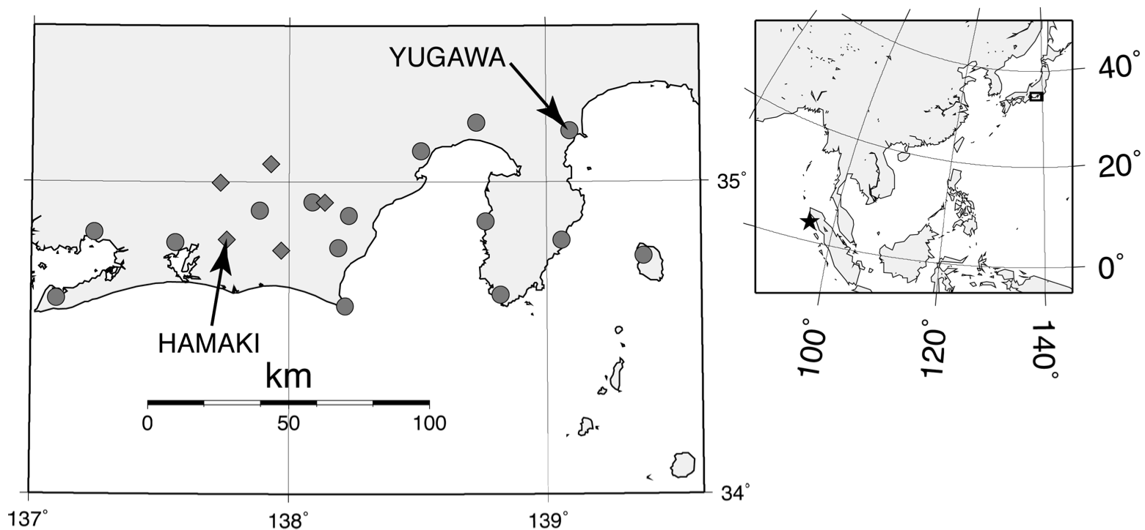
Strainmeter and earthquake locations
Star denotes USGS epicenter of 2004 Sumatra-Andaman earthquake
box denotes area shown in map at left
JMA strainmeter locations (circles are dilatometers and diamonds are multi-component strainmeters). The two stations Hamaki and Yugawa are specifically mentioned in the study but all strainmeters were used.
Notes:
Fig. 1. Station distribution of strainmeters deployed by JMA. Circles and diamonds denote volumetric and multi-component (Ishii-type) strainmeters respectively. Station codes are plotted for stations mentioned in this study. The inserted figure on the right shows the positional relation between epicenter of Sumatra-Andaman earthquake (2004/12/26) and station location. The star denotes the hypocenter determined by USGS.
Strainmeter is a good tool for analyzing very long period waves since the instrument response of the strainmeter is flat over very wide frequency range down to DC component. Few attempts have been made to use strain records for quick determination of source process using high sampling data (e.g. Okubo, 2007; Kasahara et al., 2007).
In this study, a method was developed to determine the hypocenter and source time function of giant earthquakes using strain records.
Distance between epicenter and station region is roughly 50◦. Because of the long distance between epicenter and stations, the radiation pattern for all stations was almost the same, and there was no need to consider the difference in the analysis. The sampling interval of those data is 1Hz, and this is sufficient to analyze temporal variation of source process for large earthquakes.

Slide 8
Estimation of Source Time Function: Method
Source time function (STF) was derived by deconvolution inversion of observed data with theoretical Green’s function, minimizing residual between them in time domain.
A damping parameter was introduced, selected to balance waveform fit and STF smoothness
A non-negativity constraint was used
Green’s function was computed by summing normal modes with >35 s for the Preliminary Reference Earth Model (PREM) (Dziewonski and Anderson, 1981)
Whole waveform data including both body wave and surface wave were used
In general, the amplitude of surface waves is much larger than that of body waves, so the results are more likely controlled by surface waves than body waves.
Group velocity for surface waves is slower than that for body waves, and surface waves are sensitive to the extent of rupture.
Focal mechanism was fixed to the Global Centroid Moment Tensor (GCMT) solution (best double couple parameters: strike = 329◦, dip = 8◦, slip = 110◦).
Both observed and calculated data sets were band-pass filtered from 0.001 to 0.02 Hz (i.e., from 50 to 1000 s) using 2nd-order Butterworth filter.
Strainmeter amplification factor (observed amplitude/theoretical amplitude) was calculated by Kamigaichi (1994), comparing far field surface waves with the period between 300 to 45s.

Slide 9
STF from Yugawa Dilatometer
Comparison between observed strain data (black line) and convolved STF with calculated Green’s function (gray line)
STF from YUGAWA volumetric strainmeter station.
Notes:
Figure 2 shows the result of analyzing the YUGAWA station. Overall fitness between observed and calculated data was in good agreement. Some phase misfit around P phase is due to the difference between actual and assumed seismic velocity structure. Determination of the exact duration of STF is difficult, since the later part of STF was accumulated by the error due to the difference between actual and used seismic velocity structure. The cut-off value of moment rate was selected at 5% of the maximum one. In this case the duration of STF at YUGAWA is about 600 s and total seismic moment is 4.6x10²² Nm (Mw9.0). Three peaks can be seen in STF, however the third one is not so obvious and smaller than the other two. There is a possibility that the third one is a ghost derived from analysis using only one station.

Slide 10
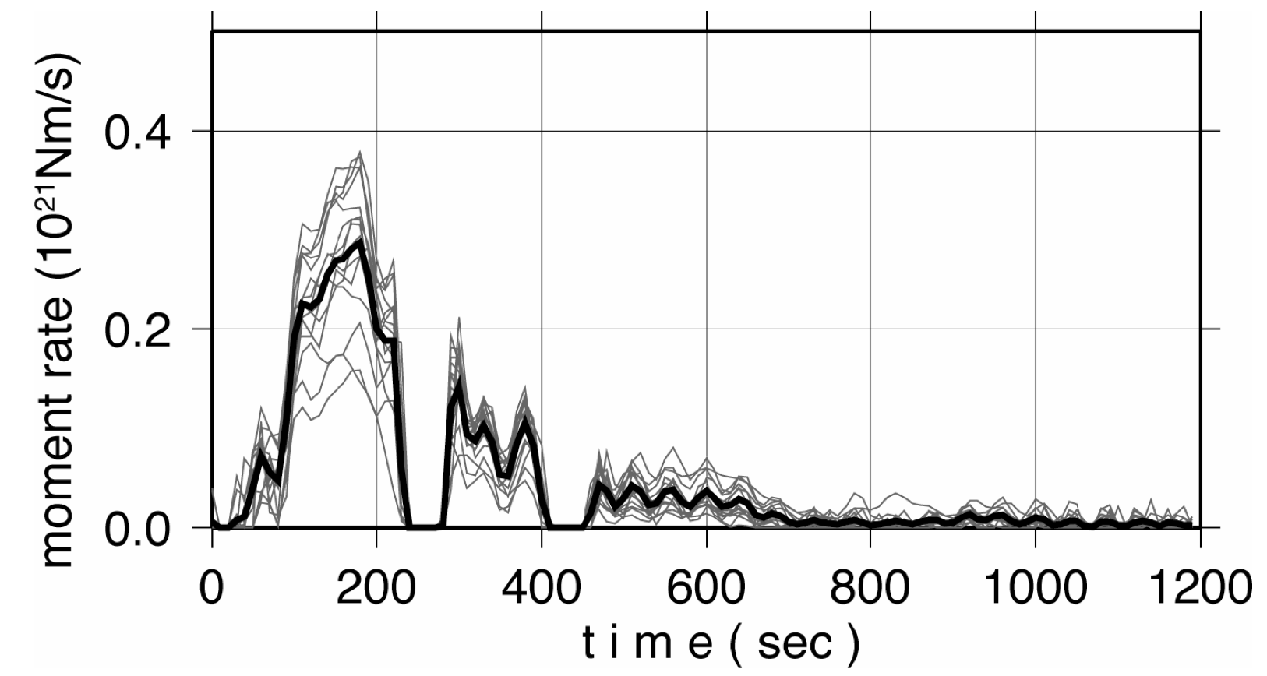
STFs from 18 dilatometers
Source time function for Sumatra-Andaman earthquake (2004/12/26) obtained from 18 dilatometer records. Gray lines represent the source time functions obtained by each of dilatometer. Black line denotes the averaged one.
Notes:
Fig. 3. Source time function for Sumatra-Andaman earthquake (2004/12/26) obtained by strainmeter records deconvolved with synthetic records. Gray dotted lines represent the source time functions obtained by each station. Black solid line denotes the averaged one.
Although the maximum amplitudes of STFs scatter from 0.1 to 0.4 ␣ 1021 Nm/s, the shape of STFs were similar. For about 1 min. after the initiation of rupture, the moment release was not so large.
Then a large moment release occurred during 50 to 200s. The first one was the largest. Next, a large rupture occurred during 250 to 400 s and the last one during 450 to 700 s, but the amplitude of the last one was not so large compared to the pre- vious two peaks and the end time was obscure. Some moment release was observed between 800 and 1200 s, considering the scatter range of STFs this is a ghost. The seismic moments of these peaks (asperities) were 3.5 ␣ 1022 Nm, 1.0 ␣ 1022 Nm and 0.7␣1022 Nm respectively. The total seismic moment was 5.2␣1022 Nm, which cor- responded to Mw9.1. Even if we omitted the third asperity, the total moment was 4.5␣1022 Nm (Mw9.0) and the moment difference was about only 10% of total one.
4.5␣1022 Nm (Mw9.0) and the moment difference was about only 10% of total one. This result (duration: 700sec; 3 major peaks) was almost consistent with Ammon et al. (2005) and Ishii et al. (2005), although the third peak was smaller than the other two.

Slide 11
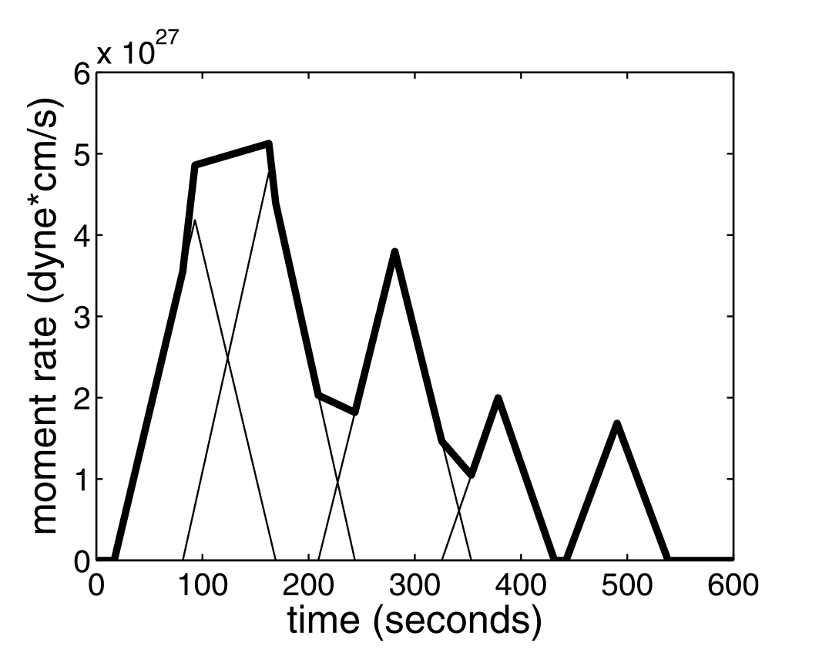
Source-time function from 18 dilatometers
Five-CMT source time function of Tsai et al. (2005). The thin black lines denote the individual sources. The heavy black line denotes the sum. Model based on mantle-wave data filtered in the 200–500-s period range.
Notes:
From Tsai et al. (2005): Figure 2. Source time function. The thin black lines denote the individual sources. The heavy black line denotes the sum. Source durations were chosen to satisfy t = 2.2 􏰄 10􏰃8 􏰄 (M0)1/3 [Ekstro ̈m and Engdahl, 1989; Ekstro ̈m et al., 2005], where t = time (s) and M0 = moment (dyne-cm). The source durations are fixed parameters in the inversion. The zero time corresponds to the hypocentral time of 00:58:53.5.
Note that the amplitudes from the dilatometer are all lower than those from the mantle-wave data

Slide 12
Estimation of source-time function: Results
Although the ruptured area was large and source mechanism was slightly changed during rupture propagation (Tsai et al., 2005), we have assumed that the mechanism change was a secondary effect and could be ignored.
As the distance and azimuthal coverage of station distribution was limited, spatial rupture distribution could not be resolved. We assumed the point source and only temporal distribution was analyzed.
The assumed dip angle has a significant influence on the source-time function results
The amplitude is a bit lower than the Tsai et al. (2005) source-time function
Only dilatometer records were used in the source time function analysis

Slide 13
Determination of back-azimuth
Data from multi-component strainmeters are necessary
The direction of maximum principle shear stress during the P-wave direct arrival was calculated
It is assumed parallel to P-wave particle motion
P-wave particle motion is assumed parallel to back-azimuth
There is a 180 degree ambiguity but it can be resolved if there are arrival times at two stations
All 4 combinations of the gauges were used to assess self-consistency of the strainmeter calibration

Slide 14
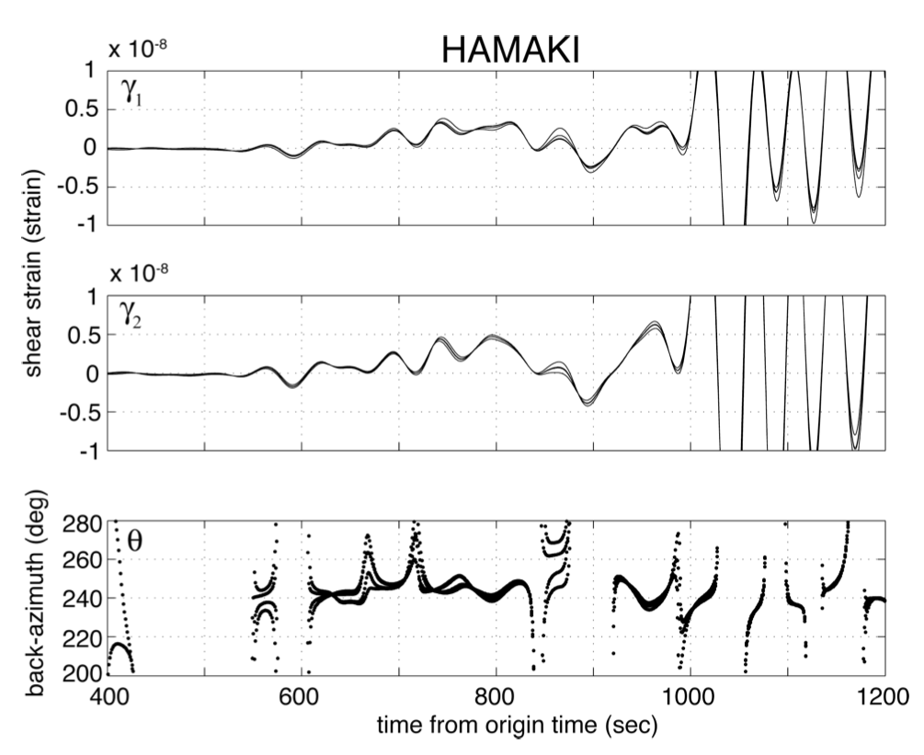
Estimates
Notes:
Fig. 4. Two shear strains (γ1 and γ2) and hypocenter direction from the source (θ) at Hamaki station (distance: 50◦, back-azimuth: 241◦). From above to bottom, γ1, γ2 and θ are plotted. 4 traces correspond to 4 sets of 3-components: (e1, e2, e3), (e1, e2, e4), (e1, e3, e4) and (e2, e3, e4).
Note that the maximum shear strain can only be computed when gamma1 is non-zero
As the epicentral distance was about 50◦, arrival time of P and S waves were 530 and 960 s respectively. The waveform data after 960 s of origin time could not be used to determine the back-azimuth because of contamination of S waves.

Slide 15
Back-azimuth estimation results
Between 530 and 960 s, the results based on the 4 different gauge combinations are very close to each other.
The back-azimuth was almost stable at ~240◦. Fluctuations, for example 570– 600 s, 660 s and 710 s appear because the amplitude of γ1 and γ2 was small and the error of angle was large.
Other source process analyses found the fault length was about 1,300 km, and the arriving angle changed from 240 to 250◦ as the rupture propagated north. However, changes of arrival direction could not be resolved in the strain data.
This is partly because the error of the direction was several degrees, judging from the variation among 4 gauge subsets
Another reason is that phases arriving between P and S waves, such as long-period PP, SS, SP, PS, etc., might be contaminating the P-wave.
These phases correspond to higher-mode free oscillation in normal mode theory
The time window before the PP arrival can be used to estimate the back-azimuth (in this case, about 120 sec) if the temporal variation of back-azimuth is required.
Arrival directions from other multi-component strain records showed almost the same value.
The computing time required for these methods (STF and arrival direction estimation) is relatively short, taking only a few seconds.

Slide 16
Notes on strain data use (ER)
Dilatometers were sufficient for obtaining source-time functions but multi-component strainmeters are required to obtain back-azimuth
Dilatometers were calibrated based on surface waves; multi-component strainmeters were calibrated based on tides (calibrations are unpublished work by Kamigaichi and Kai).
Analysis illustrates the use of the different gauge subsets and also the need to have non-zero shears if maximum shear strain is to be computed

Slide 17
Episodic slow slip events in the Japan subduction zone before the 2011 Tohoku-Oki earthquake
Yoshihiro Ito,Ryota Hino, Motoyuki Kido, Hiromi Fujimoto, Yukihito Osada, Daisuke Inazu, Yusaku Ohta, Takeshi Iinuma, Mako Ohzono, Satoshi Miura, Masaaki Mishina, Kensuke Suzuki, Takeshi Tsuji, Juichiro Ashi
Tectonophysics 600 (2013) 14–26

Slide 18
Abstract
We describe two transient slow slip events that occurred before the 2011 Tohoku-Oki earthquake.
The first transient crustal deformation, which occurred over a period of a week in November 2008, was recorded simultaneously using ocean-bottom pressure gauges and an on-shore volumetric strainmeter; this deformation has been interpreted as being an M6.8 episodic slow slip event.
The second had a duration exceeding 1 month and was observed in February 2011, just before the 2011 Tohoku-Oki earthquake; the moment magnitude of this event reached 7.0.
The two events preceded interplate earthquakes of magnitudes M6.1 (December 2008) and M7.3 (March 9, 2011), respectively; the latter is the largest foreshock of the 2011 Tohoku-Oki earthquake. Our findings indicate that the slow slip events induced increases in shear stress, which in turn triggered the interplate earthquakes.
The slow slip event source area on the fault is also located within the downdip portion of the huge coseismic-slip area of the 2011 earthquake. This demonstrates episodic slow slip and seismic behavior occurring on the same portions of the megathrust fault, suggesting that the faults undergo slip in slow slip events can also rupture seismically.

Slide 19
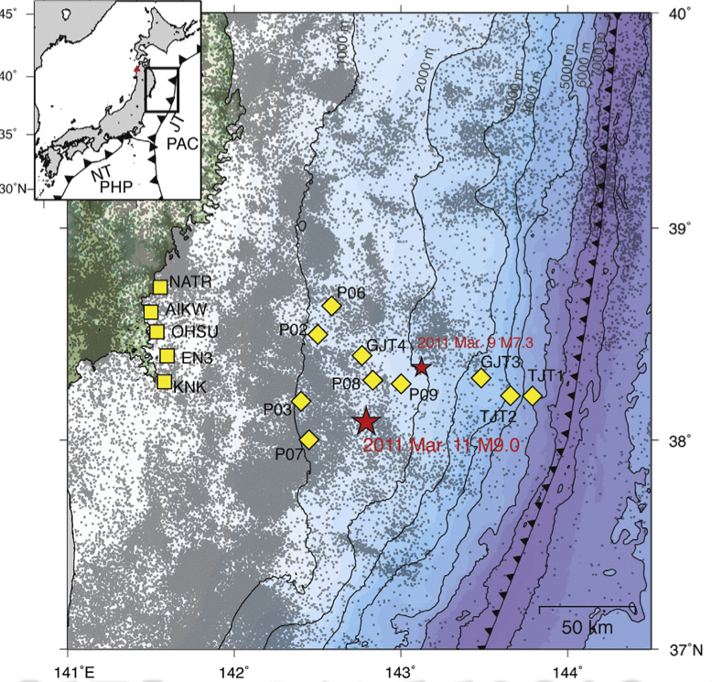
Seismicity prior to 2011 M9 earthquake
Ocean observation site
On-shore observation site
(GPS; also dilatometer at KNK)
2011 M9 mainshock and M7.3 foreshock
GPS reference site 950154 (inset)
Notes:
Fig. 1. Map of the northern part of the Japan subduction zone. The map shows the regional setting of the Japan Trench (inset), local seismicity before the 2011 Tohoku-Oki earthquake (gray dots: Japan Meteorological Agency catalog), ocean observation sites (yellow diamonds), and on-shore observation sites (yellow squares). JT, Japan Trench; PAC, Paci␣c plate; PHS, Philippine Sea plate; NT, Nankai Trough. Red stars indicate the epicenters of the 2011 Tohoku-Oki earthquake and the largest foreshock. The red triangle (inset) indicates the GPS reference site 950154 of the GPS Earth Observation Network, established by the Geographical Survey Institute of Japan.

Slide 20
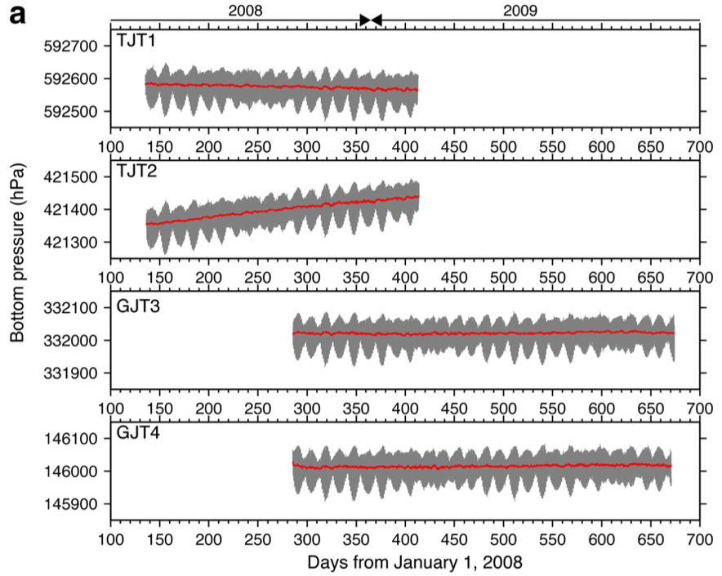
Raw ocean-bottom pressure (OBP) data
The 4 OBP sensors installed in 2008 on landward slope of Japan Trench

Slide 21
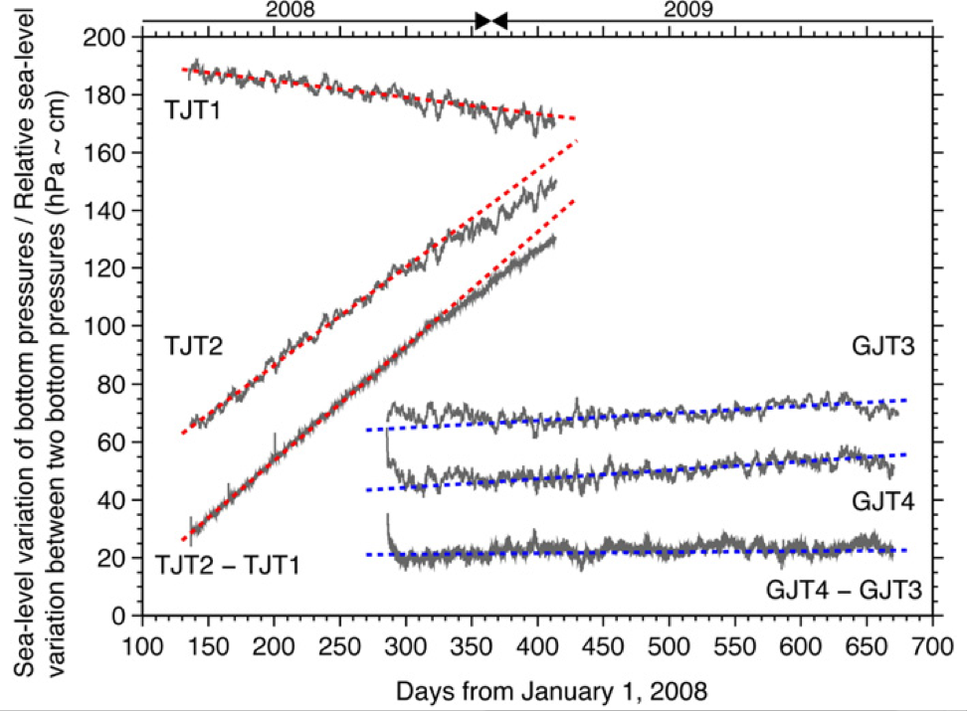
OBP data, tides removed, differenced
Linear trends are attributed to instrument drift
Differencing cancels out non-tidal dynamic ocean components
Notes:
Fig. 3. Sea-level variation of observed ocean-bottom pressure and relative variations between data recorded at two sites in 2008. Data from TJT1, TJT2, GJT3, and GJT4 represent sea-level variations in the observed bottom pressures around the average depths after the removal of ocean tide effects. Data from the difference between TJT2 and TJT1 and between GJT4 and GJT3 indicate relative sea-level variations between two sites as TJT2␣TJT1 and GJT4␣GJT3. Relative sea-level pressures were calculated from the difference between two raw time series shown in Fig. 2. The vertical axis is relative pressure (hPa), which corresponds to relative vertical displacement (cm). Red and blue dashed lines indi- cate the linear trends calculated from the ␣rst and latter half of data of TJT1, TJT2, GJT3, and GJT4, respectively.

Slide 22
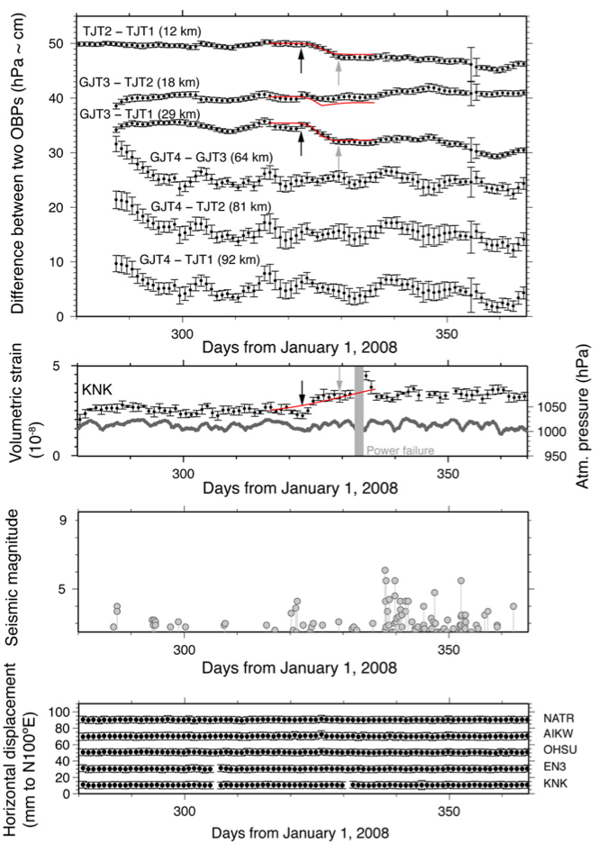
2008 SSE
Differenced, detrended OBP data
Full-scale 55 hPa =~ 55 cm vertical
(modeled displacements in red)
KNK
Volumetric strain (full scale 50x10⁻⁹)
(with error bars)
atmospheric pressure (gray)
(modeled strain in red)
Earthquake magnitude
beneath OBP array
Horizontal displacements
at on-shore GPS sites
Notes:
Fig. 4. Time series of the differences between two ocean-bottom pressure (OBP) gauge recordings, volumetric strain recordings, relative horizontal displacements of GPS sites, and regional seismic activity in the northeastern Japan arc in 2008. a, Difference between the time series of two OBP gauges from October 7, 2008 to the end of that year. Dots and error bars indicate daily averages and standard deviations of the differences between two OBP measurements. Numbers after combinations of two station codes in brackets indicate intersite distances between two stations. The vertical axis indicates the relative pressure in hectopascals corresponding to the relative vertical displacement (cm). Black and gray arrows indicate the beginning and end of the observed crustal deformation, respectively. All data were plotted after removing the trends calculated from data observed before the step. b, Volumetric strain at KNK. Dots and error bars indicate daily averages and standard deviations for the observed volumetric strain. Data were plotted after removing the trends calculated from data observed before the step. The gray line indicates the time series of atmospheric pressure at KNK. The shaded time period coincides with a lack of observations owing to a power failure. c, Seismicity beneath the OBP network during the observation period within an extent of latitude from 37.5°N to 39.0°N and longitude from 142°E to 144°E. The red line from a to b indicates temporal evolution predicted from slip pulse propagation on a suitable slow slip fault model with a unilateral rupture velocity of 5 km/day from north to south. d, Horizontal displacement relative to the GPS site 950154 shown in Fig. 1. Black dots and error bars indicate daily averages and standard deviations of the observed relative displacements.
ER comments: The OBP change is pretty close to the noise level. The error bars on the daily average values of strain are about 15 nanostrain long, which seems reasonable. The signal isn’t very large – perhaps 20-30 nanostrain? It would be nice to see rainfall data.
To me it looks like there is no GPS signal
Note in caption it says: “All data were plotted after removing the trends calculated from data observed before the step”
Summary in text of signals:
TJT2 and GJT3 moved up 2-3 cm relative to TJT1
Strain step of 10 nanostrain
No GPS signal
Above signals occurred in “late November” 2008
On December 4, 2008, after the transient crustal deformation, a moderate-sized interplate earthquake (M6.1) and its associated aftershocks were recorded; these included three M5.5 events

Slide 23
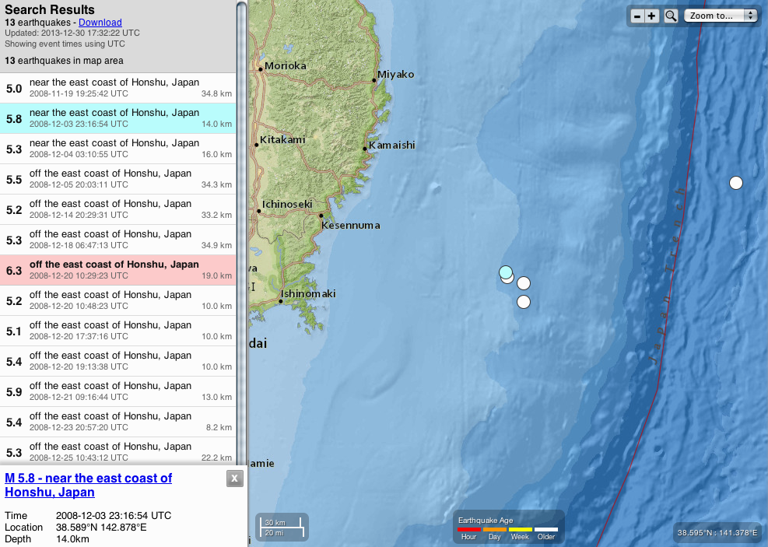
Seismicity following Nov 2008 SSE
This event was south of map area
These are the 5 events on the map
These events are south of map area

Slide 24
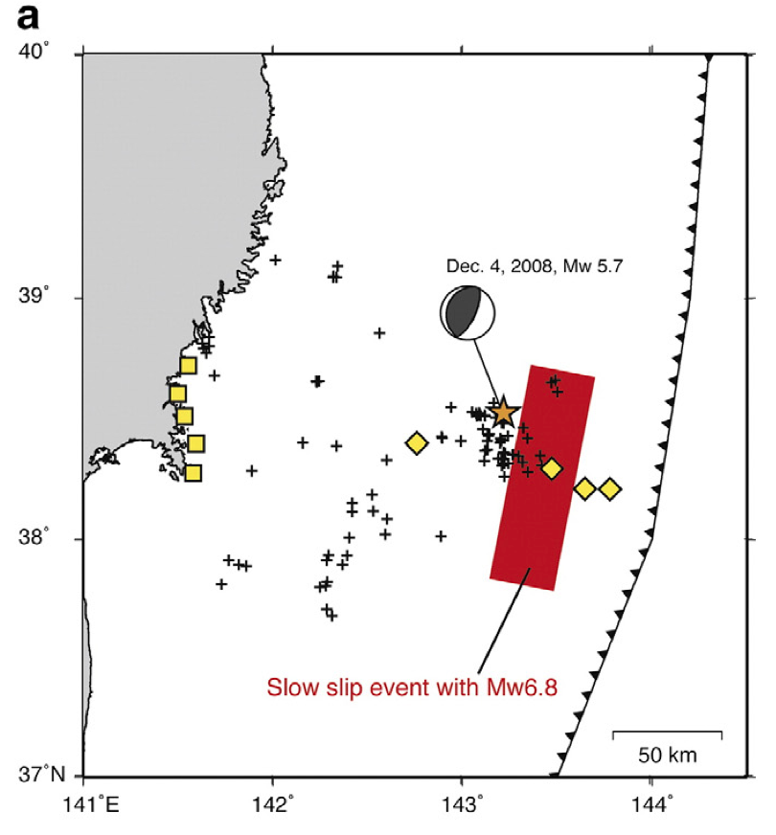
Fault model for 2008 SSE
Area of 2008 SSE
Dec 4, 2008 Mw5.7
Seismicity activated after the 2008 SSE
Uniform slip on rectangular fault plane
Fault plane assumed on plate interface
Constraints:
-Volumetric strain change at KNK is between 5 and 15 nanostrain
-Horizontal displacement trenchward near the coast <3 mm
-Match amplitudes of differential pressure steps
Unknowns: up- and down-dip depths, length along strike, amount of slip
Amount of slip: 0.20 ± 0.05 m,
Length along strike: 60–120 km
Fault width along dip: 40 ± ~10 km
Depth to center: 10–15 km
Moment: 1.8×10¹⁹ Nm
Equivalent magnitude: M_{w} 6.8
Notes:
Fig. 9. Slow slip event and seismicity in 2008. a, The 2008 slow slip event (red rectangle) and seismicity activated after the 2008 slow slip event. The star indicates the epicenter of the M6.1 earthquake, which is the largest earthquake occurring after the 2008 slow slip event. Both OBP and on-shore observation sites used to estimate fault parameters are shown by yellow diamonds and squares, respectively.

Slide 25
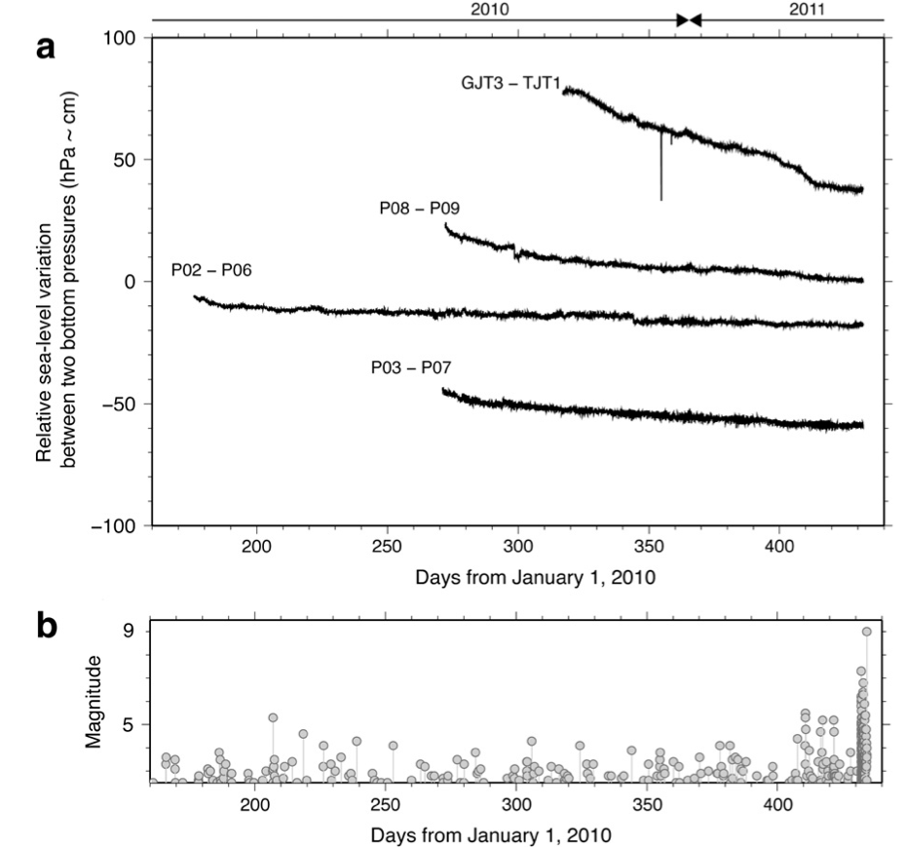
2011 SSE: OBP differences and Seismicity
All OBP differences showed a simple linear trend before approximately day 390 of the year 2010, or the end of January 2011.
P02–P06 showed a sudden drop (no trend change) of a few hPa, probably related to the coseismic signal of an event with longitude, latitude, depth, and magnitude of 142.5170, 38.3177, 32.5 and 3.9 (JMA catalog), just beneath P02 and P06
Coseismic drop?
Notes:
Fig. 5. Time series of the pressure difference between OBPs and seismicity. a, Relative variations between two nearby sites in 2011. Data from the difference between GJT3 and TJT1, P08 and P09, P02 and P06, and P03 and P07 indicate relative sea-level variations between two bottom pressures as GJT3–TJT1, P08–P09, P02–P06, and P03–P07, respectively. Relative sea-level pressures were calculated from the difference between two observed raw time series, as in Fig. 3. The vertical axis is relative pressure (hPa), which corresponds to relative vertical displacement (cm). b, Seismicity beneath OBP network during the observation period.

Slide 26
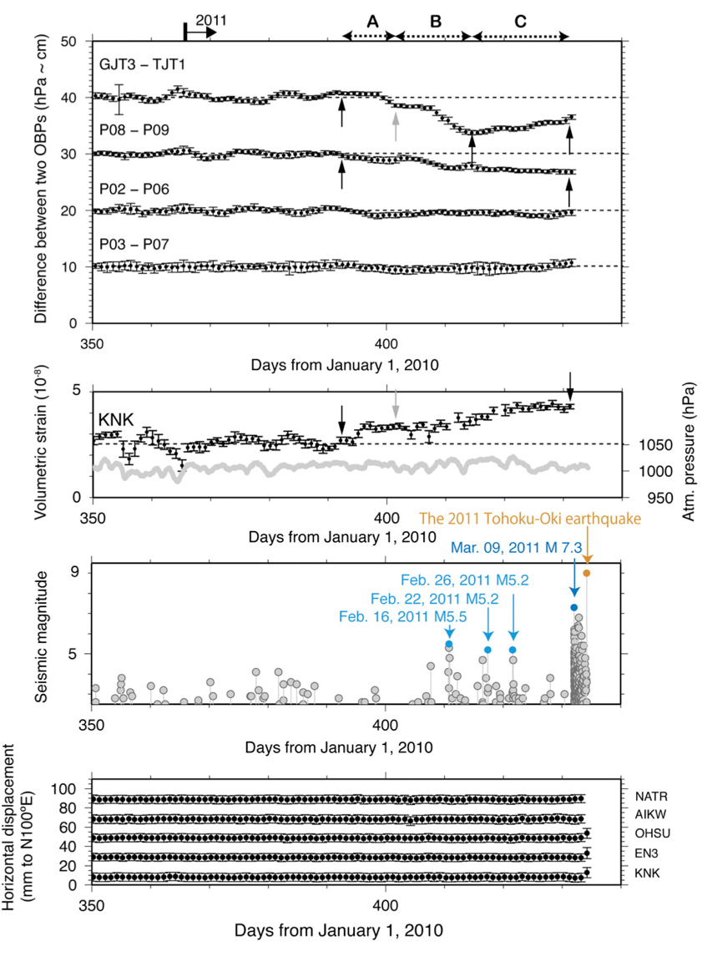
2011 SSE Data
Differenced, detrended OBP data
Phase A: 27 Jan–3 Feb 2011:
-volumetric strain ramp ~10 nanostrain
-P08-P09 relative displacement ~0.5 cm
-GJT3-TJT1 relative displacement ~2 cm
Phase B: -> ~16 Feb 2011
-volumetric strain increases by ~25 nanostrain
-P08–P09 relative displacement ~2 cm
-GJT3-TJT1 relative displacement reaches ~6 cm
-M>5 earthquakes begin
Phase C: -> ~8 Mar 2011
-volumetric strain rate slows
-P08–P09 relative displacement reaches ~3cm
-GJT3-TJT1 partially recovers
Volumetric strain (full scale 50x10⁻⁹)
Earthquake magnitude
beneath OBP array
Trench-parallel GPS displacement
Notes:
Fig. 6. Time series of the differences between two ocean-bottom pressure (OBP) gauge recordings, volumetric strain recordings, and regional seismic activity in the northeastern Japan arc in 2011. a, Difference between the time series of two OBP gauges from December 17, 2010, to March 8, 2011. Dots and error bars indicate daily averages and standard deviations of the differences between two OBP measurements. The vertical axis indicates the relative pressure in hectopascals corresponding to the relative vertical displacement (cm). Black and gray arrows indicate the beginning and end of phases A, B, and C for observed crustal deformation, respectively. All data were plotted after removing the trends calculated from data observed before the step. b, Volumetric strain at KNK. Dots and error bars indicate daily averages and standard deviations for the observed volumetric strain. Data were plotted after removing the trends calculated from data observed before the step. The gray line indicates the time series of atmospheric pressure at KNK. c, Seismicity beneath the OBP network during the observation period within an extent of latitude from 37.5°N to 39.0°N and longitude from 142°E to 144°E from December 17, 2010, to March 11, 2011. d, Horizontal displacement relative to the GPS site 950154 shown in Fig. 1. Black dots and error bars indicate daily averages and standard deviations, respectively, of the observed relative displacements.
The time series of TJT3 ␣ TJT1 showed three signi␣cant phases of transient crustal deformation (Phases A, B, and C in Fig. 6a); the crustal deformation began approximately on day 392 of the year 2010, namely, day 27 of the year 2011. The onset of crustal deformation (phase A) was also distinctly observed in the time series at KNK as a ramp with an amplitude of ~ 1.0 × 10␣ 8 as well as that of P08–P09 with a weak amplitude of ~ 0.5 cm, which is a threshold to detect surface deformations by our OBP network. In the TJT3 ␣ TJT1 time series, the crustal deformation in phase A showed a relative vertical displacement of approximately 2 cm and an apparent duration of approximately 1 week (Fig. 6), which is similar to the features of the 2008 transient crustal deformation.
ER comments: Although OBP difference data are detrended, the “step” is visible in the un-detrended data in the previous figure.
Detrending of the strain data is a little more questionable.

Slide 27
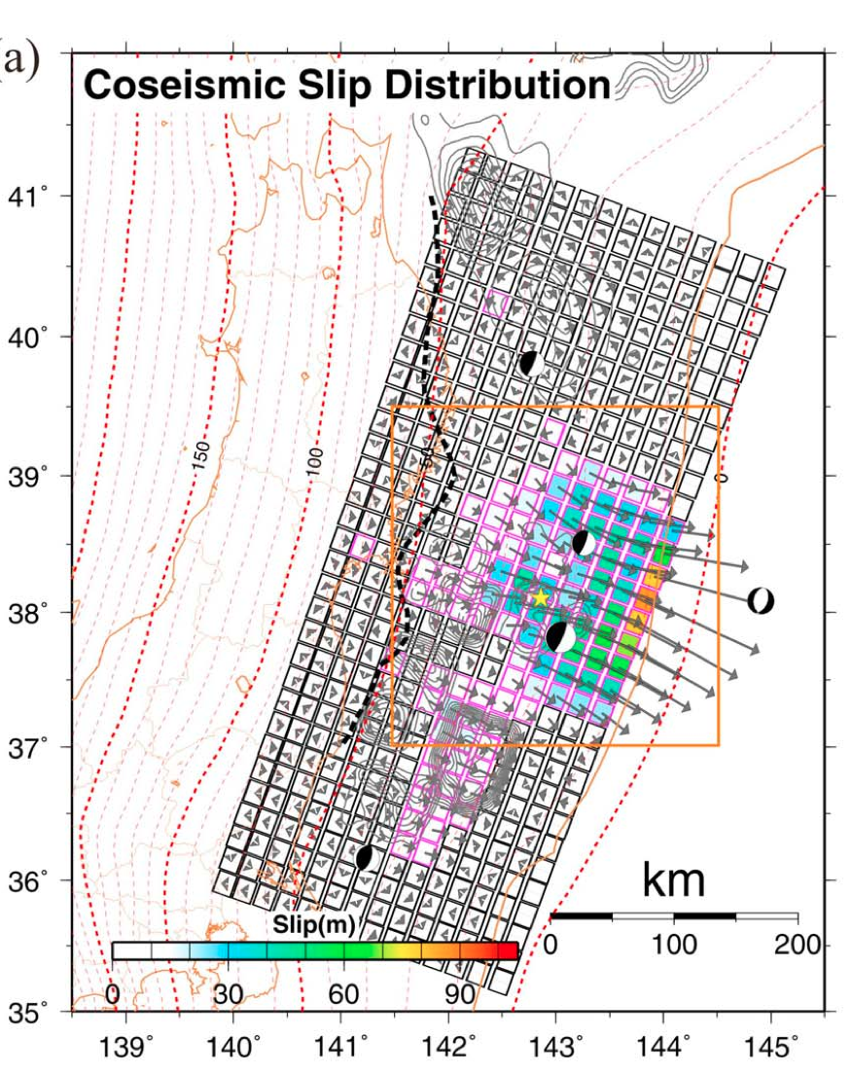
Coseismic slip distribution including seafloor geodetic data (Iinuma et al., JGR, 2012)
Slip vectors on hanging wall of plate interface
Region where estimated slip exceeds estimation error
Down-dip limit of interplate earthquakes
Depth of subducting plate interface (km)
Area of Figure 3b
Notes:
Figure 3. Estimated coseismic slip distribution. (a) Arrows denote slip vectors on the hanging wall of the plate interface. The squares outlined in purple indicate regions where the estimated slip values are greater than the estimation errors (Figure 4a). The black dashed line denotes the down-dip limit of interplate earthquakes determined by Igarashi et al. [2001]. The broken red lines show the depth of the subducting plate interface [Nakajima and Hasegawa, 2006]. An orange rectangle corresponds the range of the Figure 3b.

Slide 28
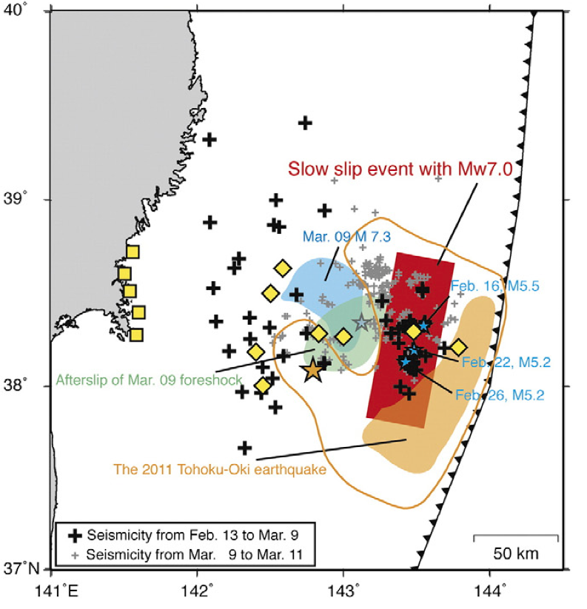
Model for 2011 SSE
Area of 2011 SSE
2011 M9 mainshock
2011 M9 slip area
2011 M9 slip > 30m
09 March M7.3
foreshock and Feb
2011 ~M5-5.5 events
09 March coseismic
slip area
09 March afterslip
area
Notes:
Fig. 9. b. The 2011 slow slip event (red rectangle), epicenter (orange star) and coseismic slip area of the 2011 Tohoku-Oki earthquake (orange shade) (Iinuma et al., 2012), epicenter (right blue shade) and coseismic and afterslip of the largest foreshock on March 9 (right blue and green shades) (Ohta et al., 2012), and seismicity activated after the 2011 slow slip event. Orange contour indicates coseismic slip region of 30 m slip (Iinuma et al., 2012). Solid pluses indicate epicen- ters of the seismicity from February 13, 2011, until the occurrence of the largest fore- shocks on March 9, 2011. Gray pluses indicate epicenters of the seismicity after the largest foreshocks until the 2011 Tohoku-Oki earthquake. Blue stars indicate epicen- ters of the M5-class earthquakes induced by the 2011 slow slip event. Coseismic slip areas of the mainshock and the largest foreshock exceeding 50 m and 1.0 m, respectively, are shown by different colors. Both OBP and on-shore observation sites used to estimate fault parameters are shown by yellow diamonds and squares, respectively.

Slide 29
Time dependence of slow slip
2008 SSE: Slip assumed to propagate from north to south at 5 km/day for 20 days; see red curves on data plots for this event
2011 SSE: Also believe propagation was from north to south

Slide 30
Comments (ER)
The slow slip events took place on the same fault area
The fault area is inferred to be within the rupture zone of the M9 earthquake
The location near the rupture zone is constrained by the OBP data
The fault is updip of the afterslip zone of the M7.3 foreshock
-The fault is downdip of the area of highest slip in the M9, near toe of prism
Slow slip possible in that area because of high fluid pressure due to dehydration reactions
The second slow slip event stimulated seismicity in the M5+ range
Appears that slow slip and seismic slip can both occur in same location

Slide 31
Etna’s lava fountains investigated by continuous strain, magnetic, ground and satellite thermal data
A. Bonaccorso & S. Calvari & G. Currenti & C. Del Negro & G. Ganci & A. Linde & R. Napoli & S. Sacks & A. Sicali,
Bull Volcanol (2013) 75:690 DOI 10.1007/s00445-013-0690-9
Notes:
Summary of Abstract: Eruptive episodes at Etna volcano on 15 November 2011 and 18 March 2012
novel data from two recently installed strainmeters that recorded unique signals during the lava fountain phases of these events.
The strainmeter data, integrated with magnetic data, and with satellite and ground thermal data, defined path of a gas-rich magma batch from the source inside the volcano to the surface and atmosphere.
The amplitude ratio of the volumetric strain changes constrained the storage depth of the magma feeding the lava fountains above 1.5 km below sea level.
Magnetic data revealed an attempted shallow lateral intrusion.
Ground and satellite thermal data quantified the total erupted volumes of ~2.2 × 10⁶ m³ for the 15 November event and ~3.0 × 10⁶ m³ for the 18 March event.
Despite different durations of the explosive and effusive phases of the two lava fountain events, the total erupted volume was quite similar, suggesting the emptying of a shallow storage system displaying a steady behaviour.

Slide 32
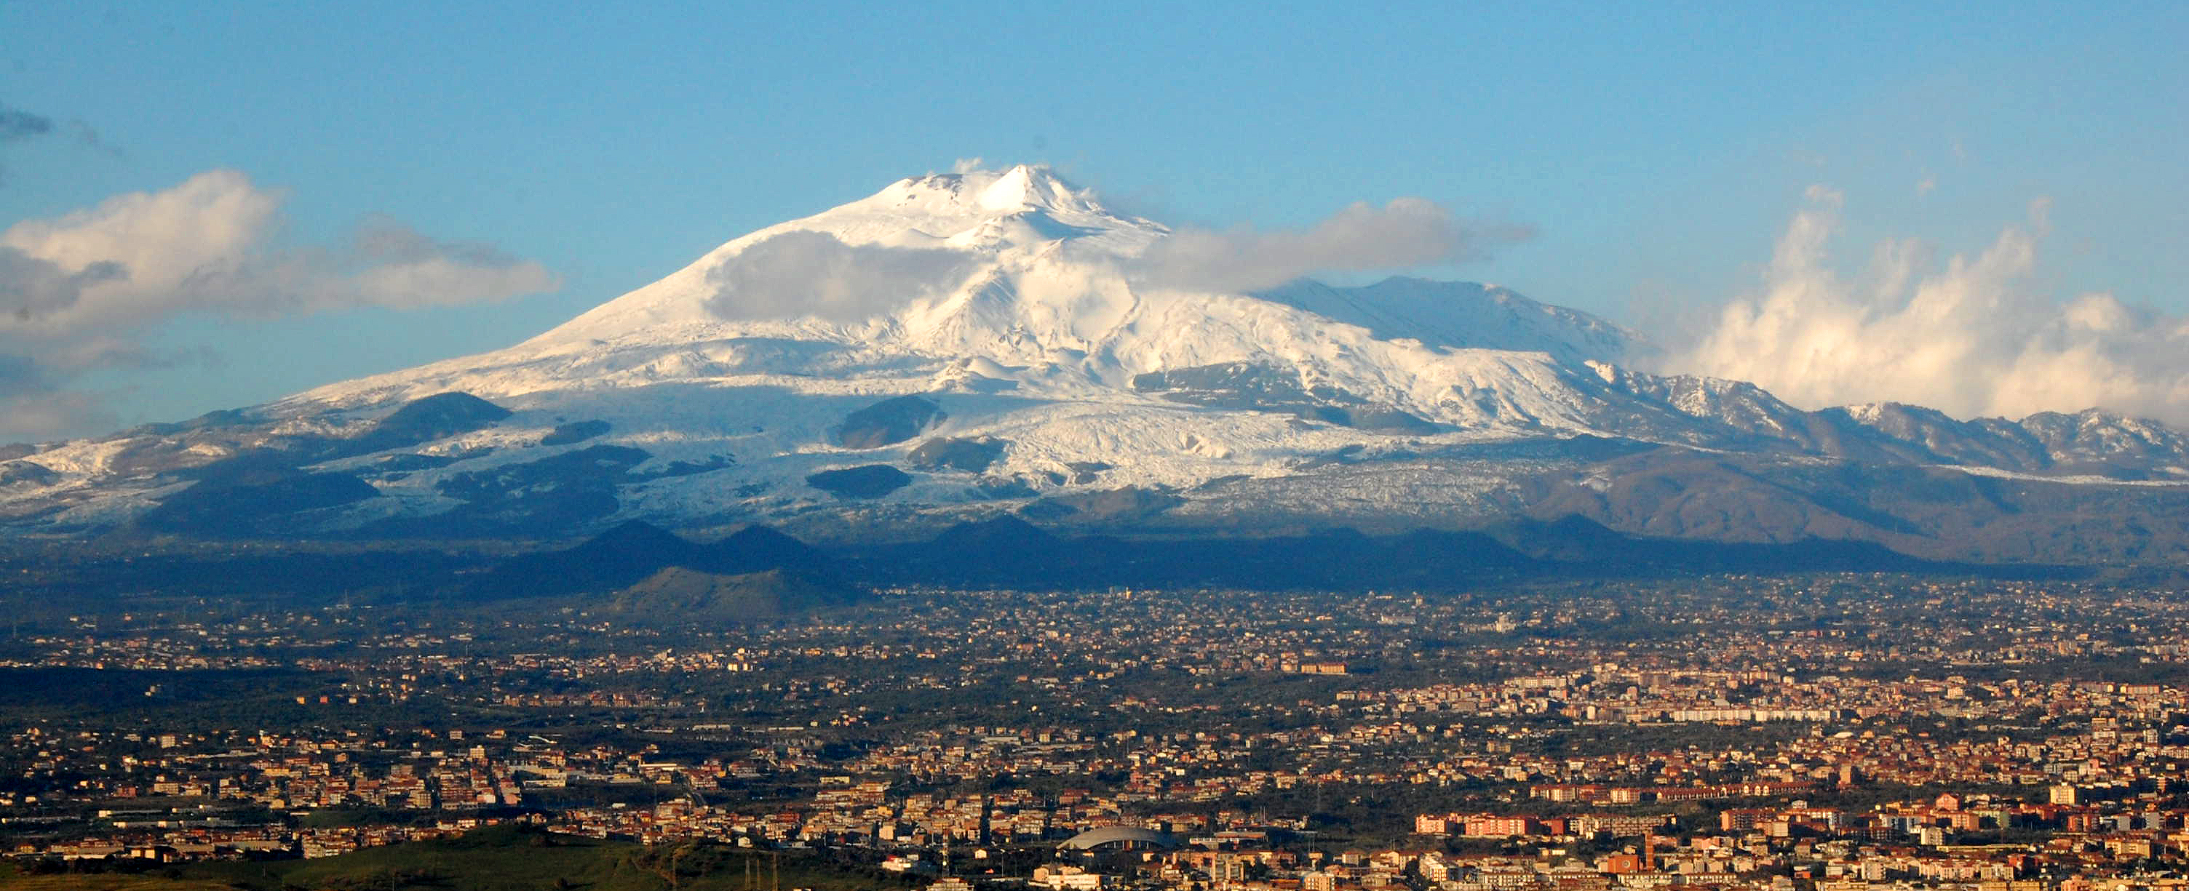
Mount Etna and Catania
Photo: Ben Aveling
Notes:
Photo from http://upload.wikimedia.org/wikipedia/commons/3/39/Mt_Etna_and_Catania1.jpg

Slide 33
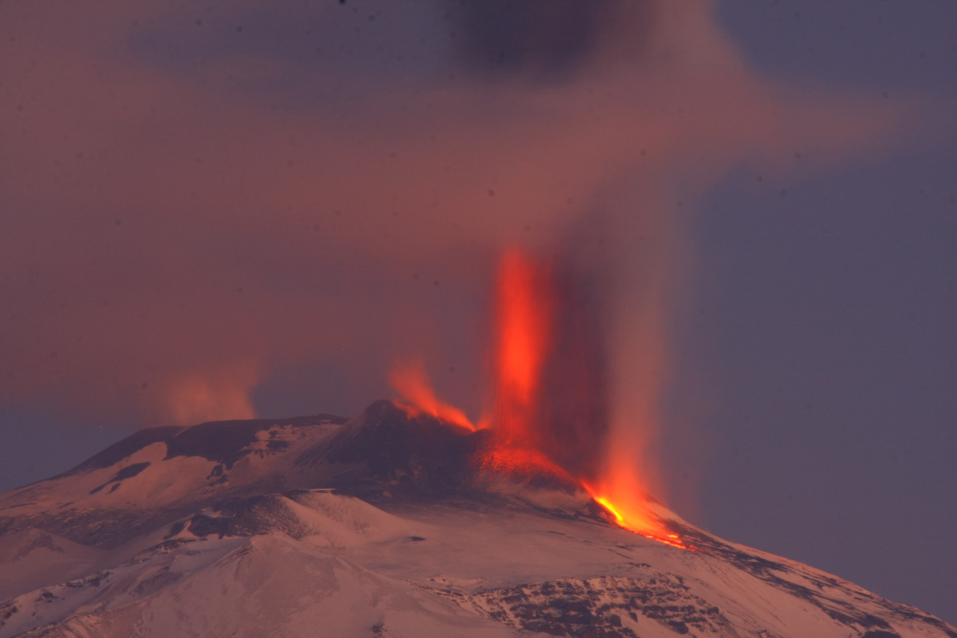
Jan 5, 2012, fountain eruption at Mount Etna
Photo: Gianni Lanzafame
Notes:
A Jan. 5, 2012, fountain eruption at Mount Etna. (Credit: Gianni Lanzafame).
Photo obtained from http://blogs.agu.org/geospace/2012/03/28/mount-etnas-fiery-fountains/
Etna volcano has dis- played intense lava fountains before major flank eruptions, such as the 66 events in 2000 prior to the 2001 and 2002– 2003 eruptions (Andronico et al. 2005; Allard et al. 2006; Behncke et al. 2006; Bonaccorso et al. 2006; Andronico and Corsaro 2011) or the 10 May 2008 paroxysmal event fol- lowed by the 2008-09 lava flow output (Bonaccorso et al. 2011a, b). More recently, Etna’s eruptive activity renewed in January 2011 with the first lava fountain episode after a 1.5- year pause (Calvari et al. 2011; Ganci et al. 2012; Gouhier et al. 2012). Since then, lava fountains occurred with an aver- age frequency of two events per month, with a pause be- tween events spanning 5–50 days, and totalling 18 eruptive episodes in 2011 and 7 in 2012 until 24 April (INGV reports at www.ct.ingv.it). The average duration of each eruptive event was ␣1–2 h (Ganci et al. 2012), with lava fountains up to 800 m high (Calvari et al. 2011) erupting ␣0.8×106m3 pyroclastics and about twice as much lava (Calvari et al. 2011; Ganci et al. 2012).

Slide 34
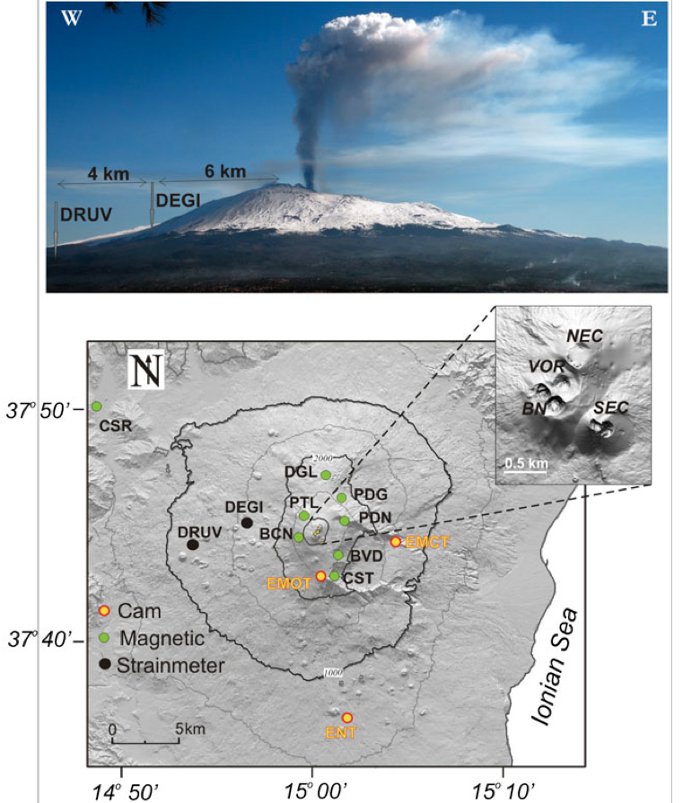
Etna lava fountain and instrument locations
Photo: 18 March 2012 Lava Fountain
First case study was 15 November 2011
A few days after installing borehole strainmeters at DRUV and DEGI
Figures from Bonaccorso et al.,
Bull Volcanol (2013) 75:690
Notes:
Fig. 1 a Etna map and multidisciplinary stations used in this study. The cam ECV is out of the map, 10 km south of ENT station. b 18 March 2012 lava fountain. W–E profile of Etna seen from the village of Centuripe (low SW flank). Photo courtesy of D. Condarelli. The positions of the two borehole strainmeters are also indicated
The 15N11 lava fountain occurred just 2 weeks after the first installation of two borehole strainmeters at Etna. The instruments were installed at ~180 m depth below the ground surface on the western flank of Etna volcano, with horizontal radial distances from the central crater VOR of 6 km for DEGI (altitude 1,500 m a.s.l.) and 10 km for DRUV (altitude 1,200 m a.s.l.), respectively (Fig. 1). The instruments, also known as dilatometers, are Sacks–Everston types and have a resolution of ~10⁻¹¹ (Sacks et al. 1971).
They record a decreasing signal during expansion and an increasing signal during contraction of the medium surrounding the instrument.

Slide 35
Thermal images of the Etna lava fountains
15 November 2011 Lava Fountain
18 March 2012 Lava Fountain
Visual camera
27 km South
Thermal camera ENT
15 km South
Thermal camera EMOT
3 km South
Thermal camera EMCT
8 km East
Figures from Bonaccorso et al.,Bull Volcanol (2013) 75:690
Notes:
Other reading: Ganci G, Harris AJL, Del Negro C, Guéhenneux Y, Cappello A, Labazuy P, Calvari S, Gouhier M (2012) A year of fountaining at Etna: volumes from SEVIRI. Geophys Res Lett 39:L06305. doi:10.1029/2012GL051026

Slide 36
Phases of fountaining based on radiant heat flux from SEVIRI and MODIS data
Phase 1: Slow increase in the radiant heat flux
Phase 2: Peak during the main fountaining phase and the lava flow field expansion;
Phase 3: Slow decrease associated with the cooling of the lava emplaced
Notes:
Multispectral satellite images were obtained from the HOTSAT thermal monitoring system (Ganci et al. 2011). The system ingests SEVIRI and MODIS data provide localisation of thermal anomalous pixels and an estimation of the radiant heat flux. In case of an eruption, we can convert the radiant heat flux into time averaged discharge rate (TADR) following Harris et al. (1997). This is the key parameter when forecasting the maximum extension that a lava flow can reach (Harris et al. 2005, 2007) and is thus extremely important for hazard purposes.

Slide 37
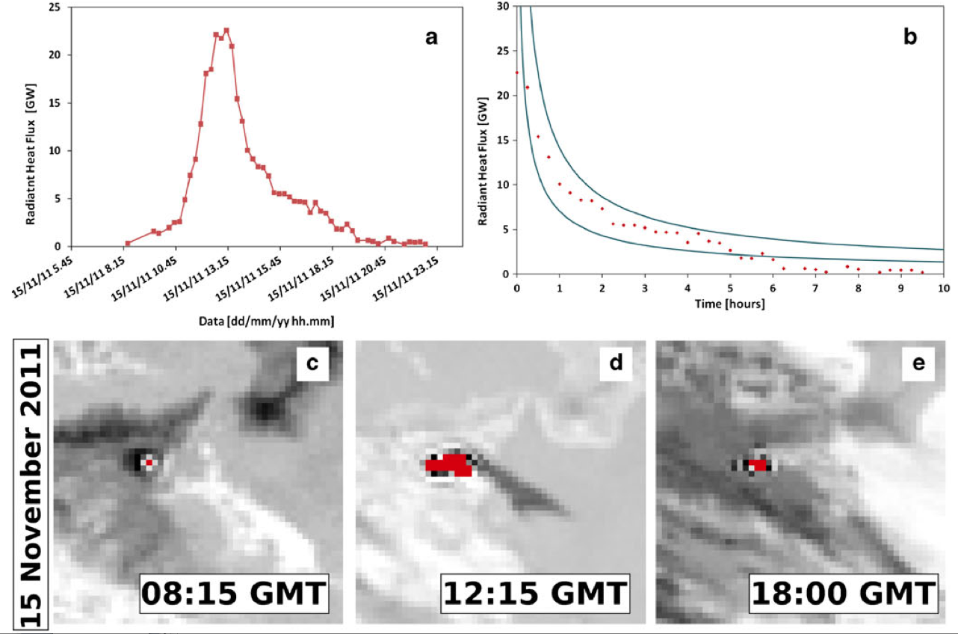
Heat flux and SEVIRI images: 15 Nov 2011
12:15
Cooling curve
with calculated bounds
Radiant Heat Flux (GW)
18:00
08:15
5:45 on 11 Nov – 00:00 on 12 Nov 2011
10 hours
Figures from Bonaccorso et al.,Bull Volcanol (2013) 75:690
Notes:
Fig. 3 Radiant heat flux (a, f) and actual cooling curve (dots) and␣ minimum and maximum bounds for the theoretical cooling curve (lines) (b, g) following 15 November 2011 and 18 March 2012 lava fountains. SEVIRI scenes of Sicily island, South Italy, during 15 November phases (c–e) and 18 March phases (h, i, l). Dark yellow pixels are ash clouds, and red pixels are hot spots associated with the eruptive paroxysms at SE-Crater

Slide 38
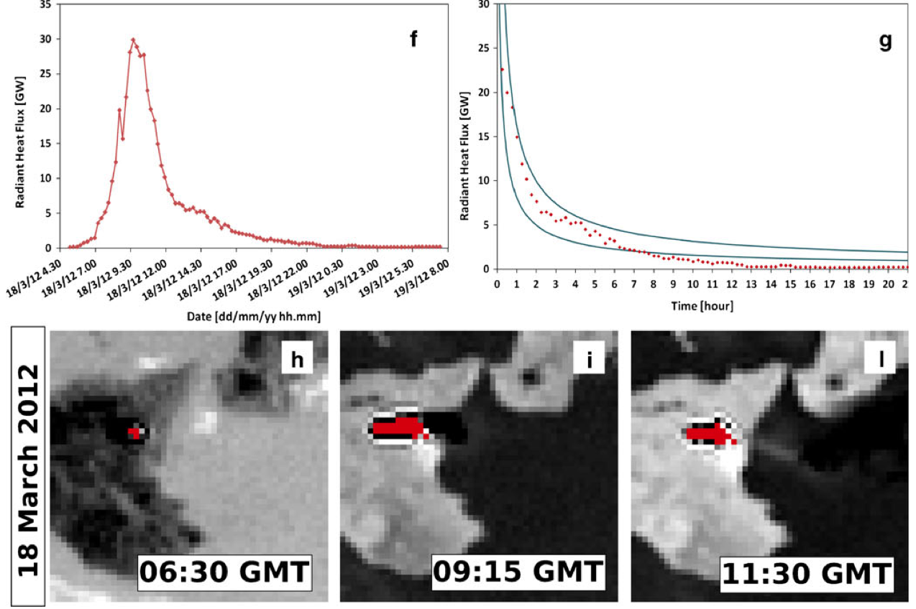
Heat flux and SEVIRI images: 18 March 2012
09:15
11:30
Cooling curve
with calculated bounds
Radiant Heat Flux (GW)
6:30
04:30 on 18 March – 08:00 on 19 March 2011
22 hours
Figures from Bonaccorso et al.,Bull Volcanol (2013) 75:690

Slide 39
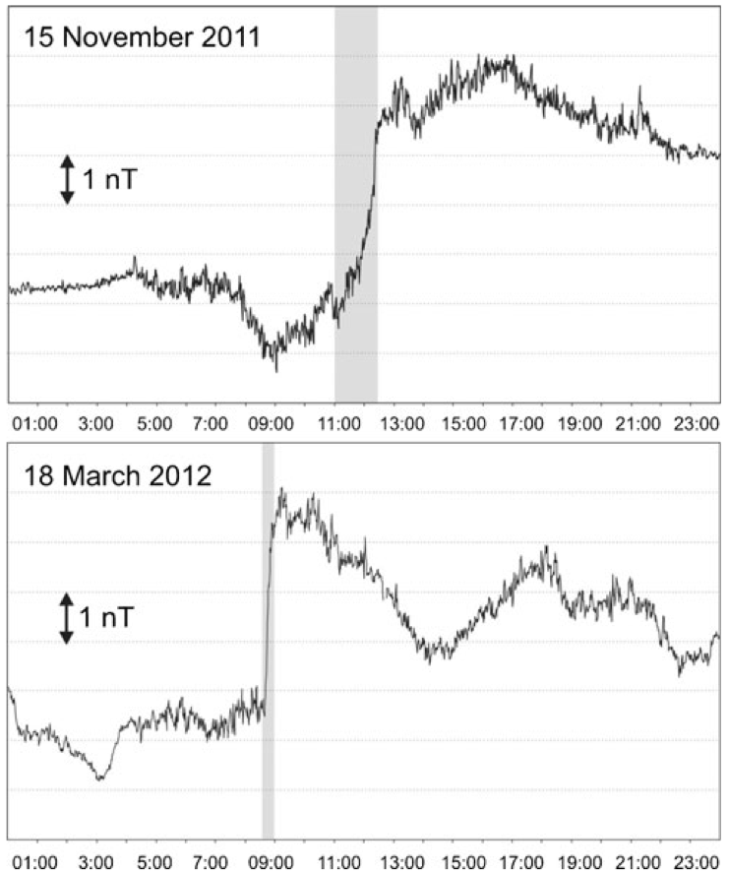
Magnetic intensity differences at BVD from CSR reference station
BVD is < 1 km from Southeast Crater
CSR is 25 km NW of summit
Notes:
Fig. 4 One-minute mean differences of total magnetic intensity with respect to the CSR reference station after removing diurnal compo-nents on 15 November 2011 (a) and on 18 March 2012 (b)
In both cases, the total magnetic field undergoes a permanent change. We can rule out that these observed magnetic changes could arise from the dis- placement of the sensors accompanying the fountaining event, since the monitoring site has low magnetic gradient (2– 3 nT/m at the sensor height of 4 m) and low local noise amplitude. Moreover, the modifications of the local magnetic field lasted less than the duration of the lava fountaining. After the eruptive activity ended, no further magnetic variations were detected.

Slide 40
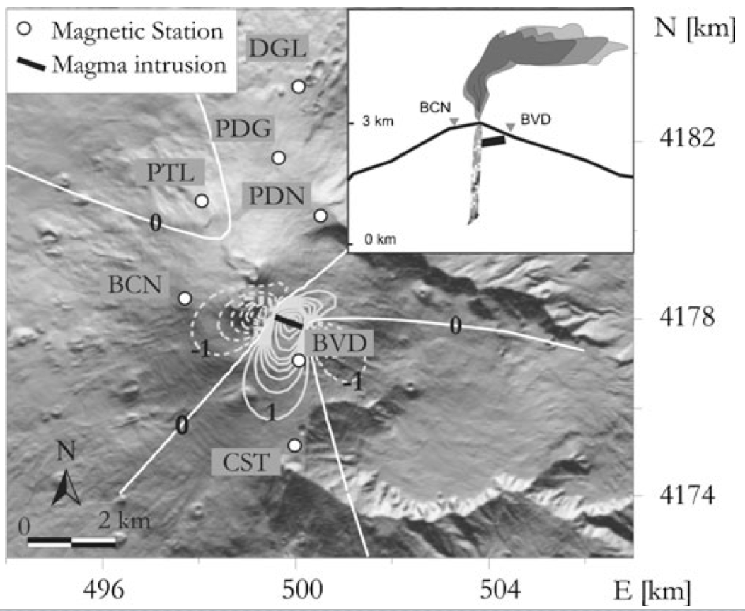
Notes:
Fig.5 Piezomagneticanomaly(contourlinesat1nT)generatedbythe shallow lateral intrusion. The coordinates are in UTM projection, zone 33 N. The inset shows sketch section of the magnetic source model

Slide 41
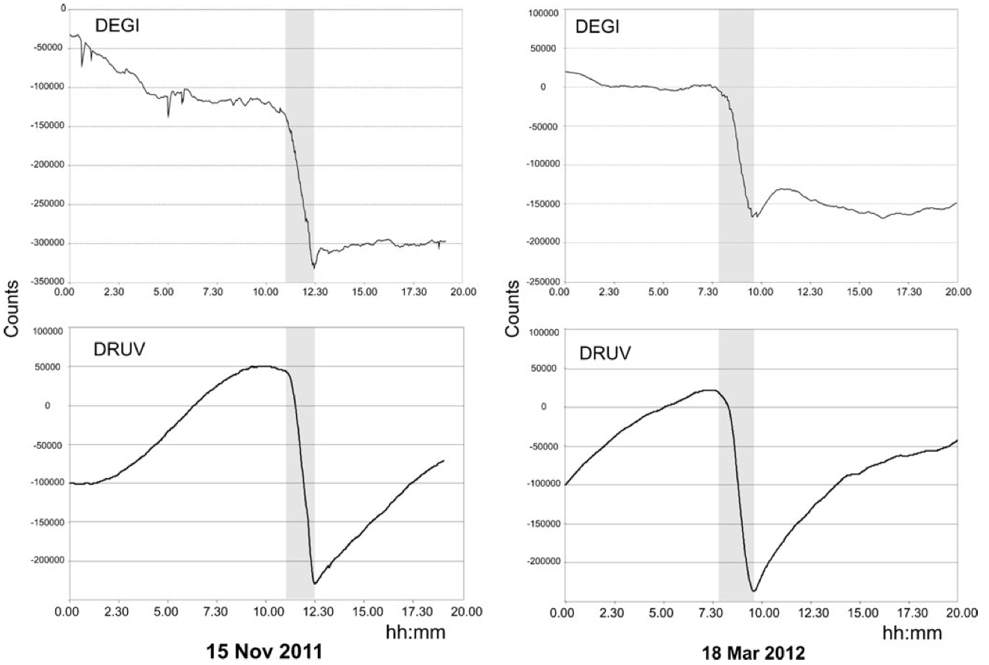
Dilatometer data
Strain, r=6 km
Strain, r=6 km
0.35E6
counts
Contraction
0.35E6
counts
20 hours
20 hours
Strain, r=10 km
Strain, r=10 km
0.35E6
counts
0.35E6
counts
Extension
Notes:
Fig.6 Strain signals recorded during the lava fountains of 15 November 2011 and18 March 2012. For DRUV, the raw data are shown, while for DEGI, due to the marked drift, the data were detrended using a linear filter with a 1-month window
DEGI is characterised by low sensitivity because the instrument is located in a fractured lava layer, resulting in a low coupling coefficient, which delays the decay of the long term drift amplitude (Roelloffs and Linde 2007). Consequently, given that the long-term drift hides the tidal signal, we are unable to carry out an absolute calibration that usually is obtained from the comparison between recorded and theoretical strain tide.
Instead, we estimated the relative sensitivities of the two sites by comparing surface wave amplitudes from distant, very large earthquakes (M > 8). There have been few such earthquakes during the operating life of the strainmeters, and, for now, we have been confined to working with periods shorter than ~30 s. Much longer periods (~80–100 s) are preferable for such a comparison (and presumably will be available in the future). With the limited data so far available, we estimate that the DEGI sensitivity is about a factor of 20 (± ~20%) less than that of DRUV (installed in massive rock). This correction is reflected in the data plots. (???) Relative sensitivities are sufficient for any attempt to determine source location. Note that we have some difficulty in determining the relative sensitivities of the two strainmeter sites. The duration of operation is still very short, and currently, we lack good samples of well-recorded very long period surface waves that are necessary to better estimate the relative sensitivities.
The strain changes were recorded at distances of 6 and 10 km from the summit craters with a similar order of magnitude (I think they mean, similar size for the two events)

Slide 42
24 hours
24 hours
Magnetic Intensity
Strain, DEGI
r=6 km
0.35E6
counts
0.35E6
counts
Strain, DRUV,
r=10 km
0.35E6
counts
0.35E6
counts
Radiant Heat Flux
25
GW
35
GW
Notes:
Note the strain data appear to be uncalibrated.
Magnetic data:Although all magnetic stations were operating throughout the period encompassing these paroxysmal events, step-like variations were recorded only at the magnetic station of Belvedere (BVD, Fig. 4), which is the nearest station (a few hundred metres) to the SEC. the amplitude, extent, and timescale of the magnetic changes recorded at BVD are comparable to those observed during the early stages of the 2001, 2002–2003, and 2008–2009 eruptions (Del Negro and Currenti 2003; Del Negro et al. 2004; Napoli et al. 2008) for which the magnetic changes were ascribed to the piezo- magnetic effect from stress redistribution due to magma intru- sion. Therefore, it is reasonable to suppose that also during the 15N11 and 18M12 paroxysmal events, magma intrusion could have occurred, and the piezomagnetic effect is the most likely mechanism that could generate the detected magnetic changes. Similar magnetic field changes might also be expected as a result of electrokinetic effects generated by fluid flow. However, to explain the observed rapid changes in terms of electrokinetics would require rapid and unreasonable intense fluid flow. Thus, even if the electrokinetic mechanism cannot be ignored, we favour a more straightforward explanation in terms of piezomagnetic effect.

Slide 43
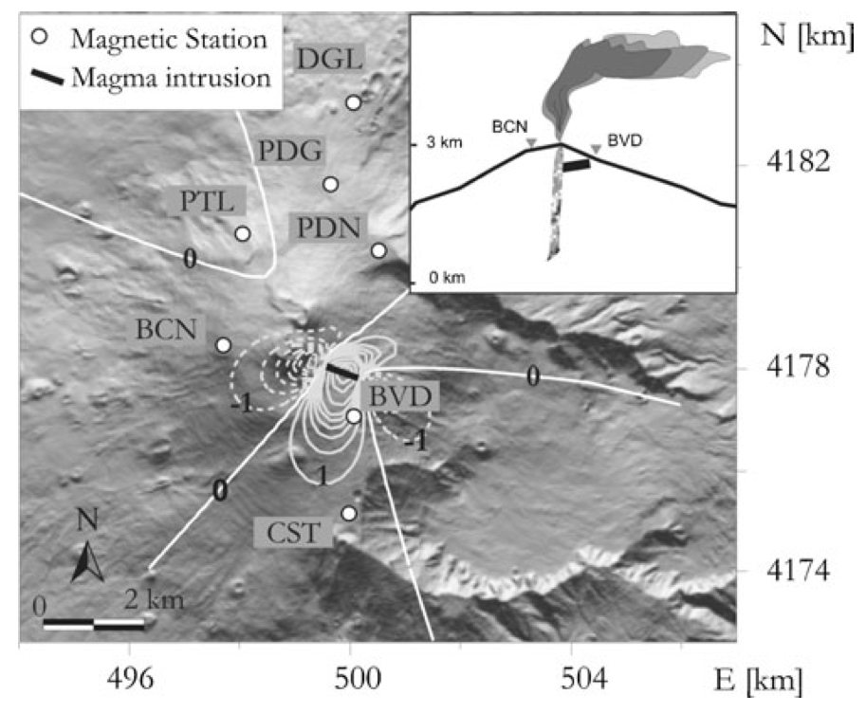
Model for magnetic data
Notes:
Fig.5 Piezomagnetic anomaly(contour lines at 1nT) generated by the shallow lateral intrusion. The coordinates are in UTM projection, zone 33 N. The inset shows sketch section of the magnetic source model

Slide 44
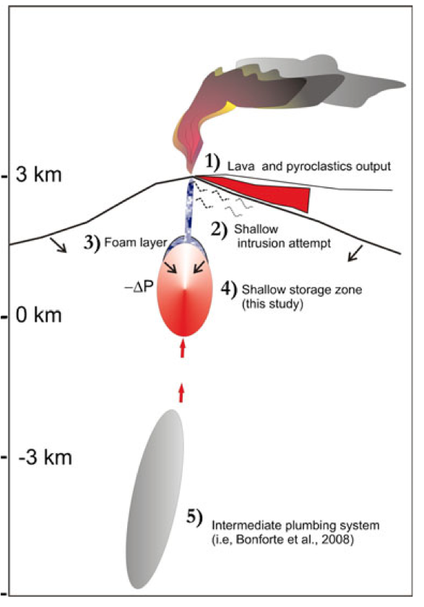
Models to explain all data
Thermal satellite data gives erupted volume
Shallow intrusion explains magnetic data
Foam layer produces fountain
Shallow storage zone depletion accounts for strain signals
Notes:
Fig. 8 Sketch section of Etna’s plumbing system revealed from this multidisciplinary study on lava fountains. The emitted volume of magma is estimated from thermal satellite measurements (1). The attempt of intrusion in the summit area toward SSE direction causes the observed piezomagnetic change (2). The marked violent fragmentation of the bubbly magma (foam), previously accumulated in the shallower foam layer (3), moves through the conduit and originates the lava fountain associated with a depressurisation of the shallow foam source depleting the shallow source (4) now inferred from borehole strainmeter data. Deeper intermediate plumbing zone (5) inferred previously or during main flank eruptions (i.e., Bonforte et al. 2008). The red arrows indicate magma supply

Slide 45
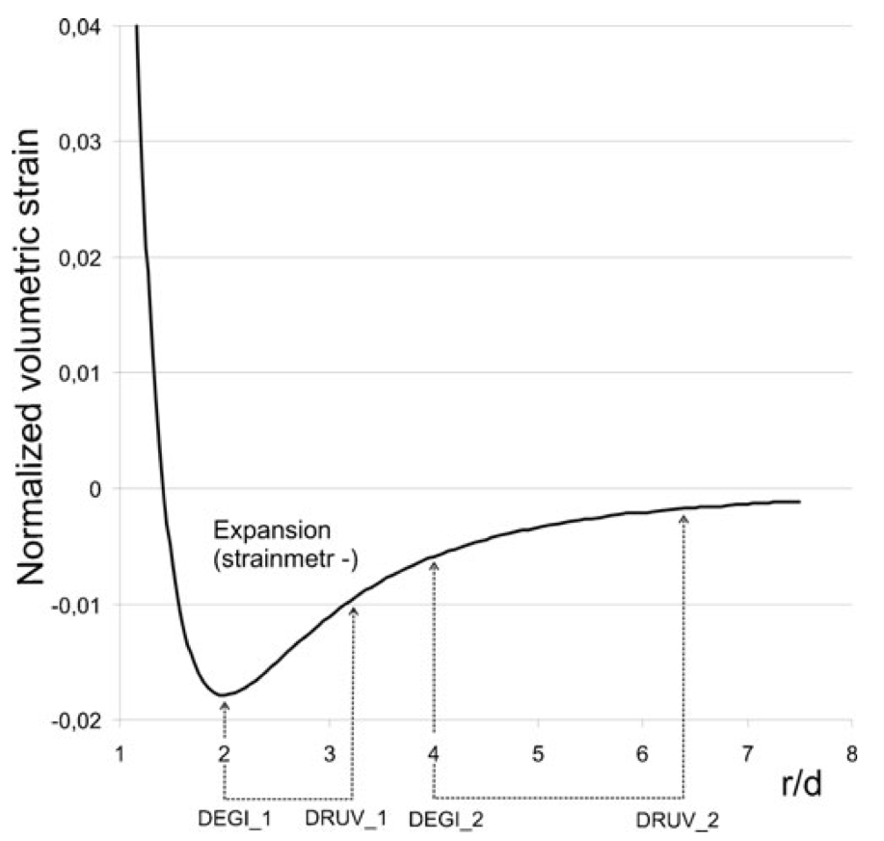
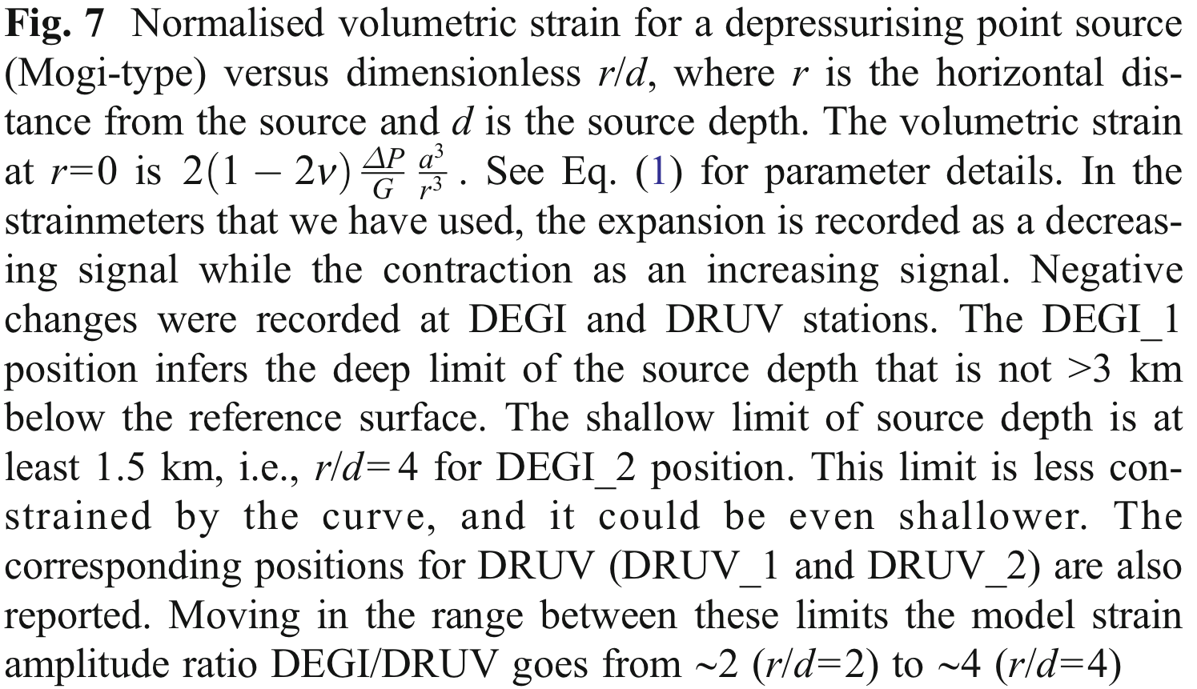
Notes:
In Fig. 7, the value of normalised strain is plotted versus the dimensionless ratio r/d. The graph shows that for a depressurising source a negative strain (i.e. expansion) is recorded when r/d > sqrt(2). The recorded strains are both negative so that DEGI and DRUV are both located at distances greater than sqrt(2)d (Fig. 7). The ratio of the signal amplitudes DEGI/DRUV is about 5.7, and the ratio of the distances is (DRUV/DEGI) 10 km/6 km =~1.6, so we look for positions on the plot of strain vs. r/d that best fit these constraints. Clearly, from Fig. 7, the DEGI distance must be at least twice the source depth. This infers that the deep limit of the source depth is not greater than 3 km. A deeper source would result in a DEGI value to the left of the minimum in the curve, and thus, the amplitude ratio of the strain changes would rapidly change violating the observed value. The shallow limit of source depth is at least 1.5 km, i.e. r/d = 4 for DEGI. A shallower source would result in both values at DEGI and DRUV falling on the right part of the strain curve nearly satisfying the observed amplitude ratio. The deeper and shallower limits are denoted in Fig. 7 as DEGI_1 and DEGI_2, with the corresponding positions for DRUV also being indicated. Moving in this range the model amplitude ratio goes from ~2 (r/d = 2) to ~4 (r/d = 4), therefore indicating that a better fit is obtained for the source positioned towards the shallow depth limit. The average elevation of the two sites is 1.4 km a.s.l. so our depth corresponds to the sea level altitude. We cannot obtain a very good fit and this source depth should be considered a preliminary result. Since the two strainmeters are far from the summit, we cannot place any further constraint to the shallower limit of the source depth. As strainmeter data will not be affected by the long-term drift and will be sufficient to perform the absolute calibrations, the amplitude changes at DEGI and DRUV can give a more accurate estimate of the source depth.
The strain data presented here allowed the identification of a shallow storage source centred approximately at sea level. The amplitude ratio of the volumetric strain changes constrained the storage depth of the magma feeding the lava fountains above 1.5 km below sea level.
However, The strainmeter network should be improved by adding at least a third station at 2–3 km distance from the summit crater area to infer more robustly the theoretical curve, which now is not constrained by recorded data at the close range where bigger strains are expected.

Slide 46
Conclusions from paper
The strain data presented here allowed the identification of a shallow storage source centred approximately at sea level. The amplitude ratio of the volumetric strain changes constrained the storage depth of the magma feeding the lava fountains above 1.5 km below sea level.
The magnetic data revealed a piezomagnetic effect caused by the injection of magma into the shallow crust. In addition, they also detected an attempt of the feeder dike to propagate laterally from the SEC conduit towards the western wall of the Valle del Bove, which is well recognised as a place of structural weakness. We speculate that this attempt of lateral propagation did not succeed because of the eruption of pyroclastics during the lava fountains, which decreased the overpressure within the dike.
Using thermal ground and satellite data, we have estimated the erupted volume of pyroclastics and lavas for the two eruptive episodes, and the results are remark- ably similar, despite the different durations of the explosive and effusive phases. This points out to a constant size of the intermediate storage system, which appears to be independent from the number of lava fountains occurred.

Slide 47
Notes on strain data use (ER)
The instruments are dilatometers
They are uncalibrated owing to rapid contraction (they had only been installed a few weeks before the November 2011 event)
Rate of contraction overwhelms tidal variations
Relative calibrations for the two strainmeters had been obtained
Each BSM recorded similar signals for the two events
Only the relative sizes and the directions of the signals at the two BSMs were needed to constrain depth of the source

Slide 48
To be continued…

