Slide 1
GMTSAR Example Results
Bin Zhao
UC Berkeley

Slide 2
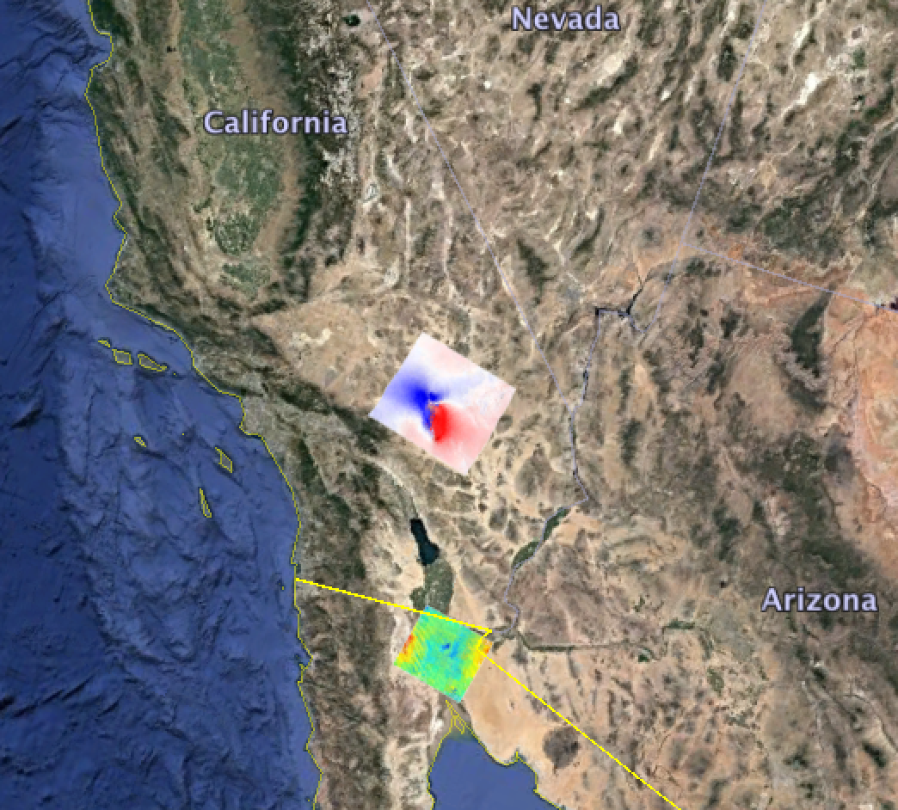
Outline
ERS_Hector_EQ
S1A_Stack_CPGF_T173

Slide 3
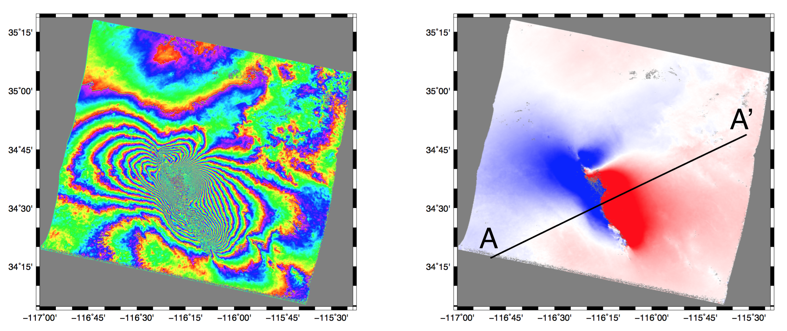
1999 Hector EQ

Slide 4
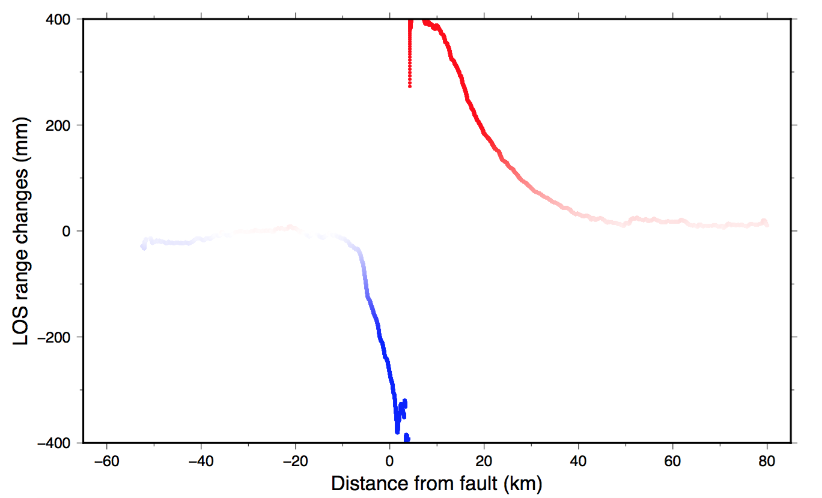
LOS along a profile A–A’ perpendicular to the Hector Mine earthquake rupture

Slide 5
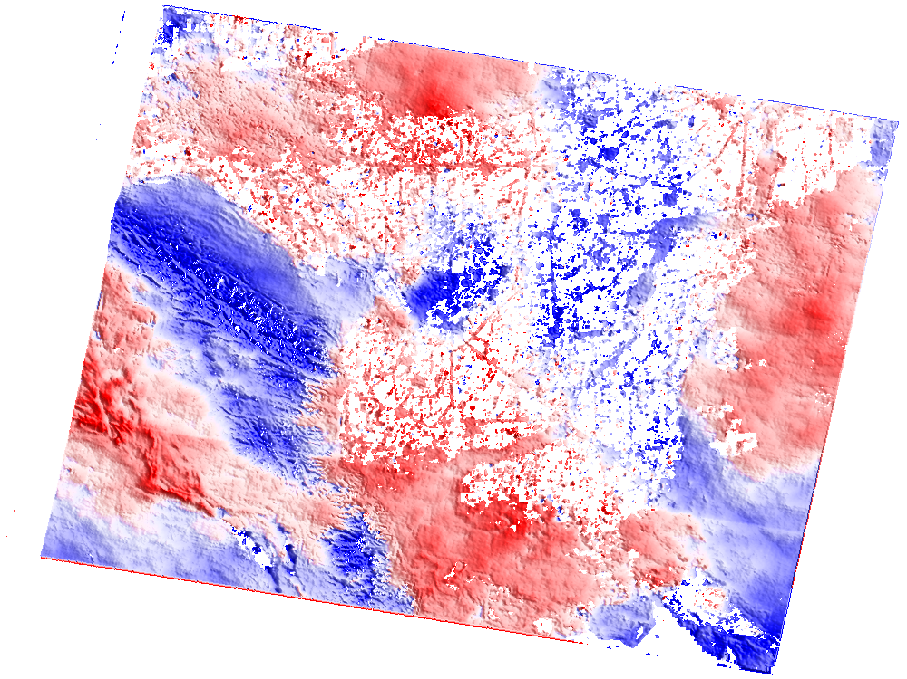
S1A_Stack_CPGF_T173 Example
2015020-2015068
2015020-2015092
2015020-2015116
2015068-2015092
2015068-2015116
2015068-2015140
2015092-2015116
2015092-2015140
2015116-2015140
LOS range changes

Slide 6
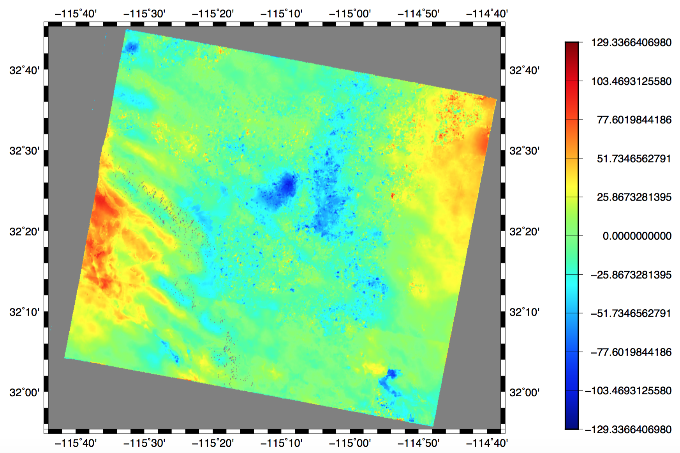
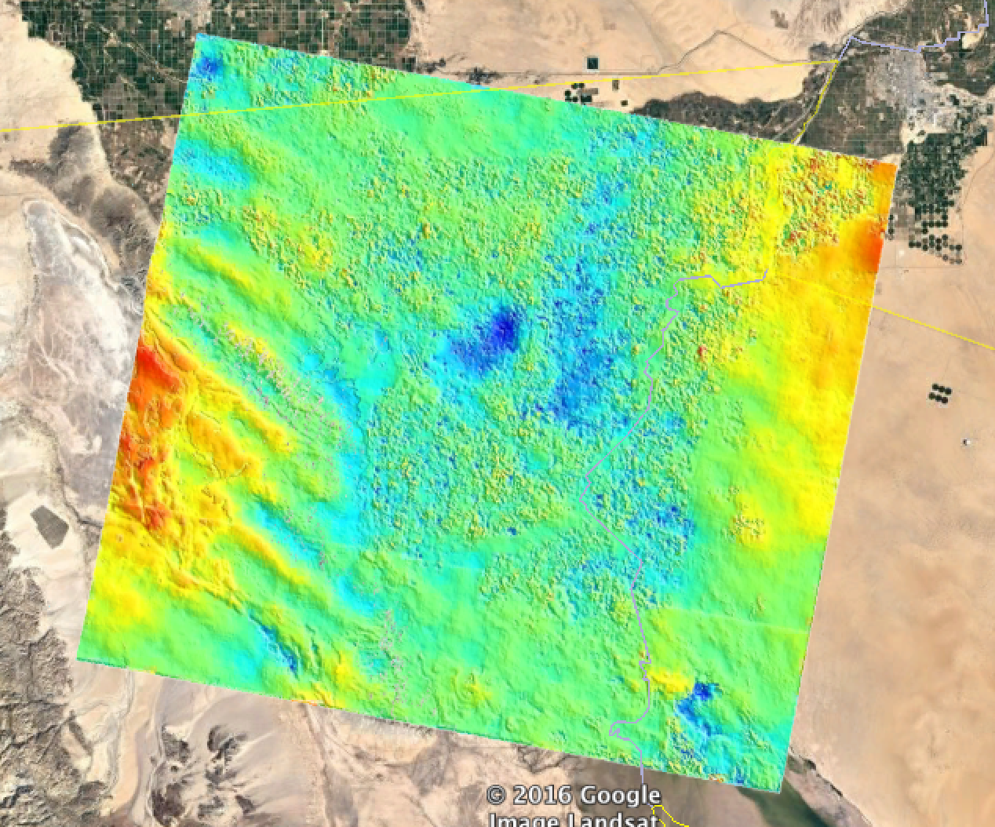
LOS velocity mm/yr

