Slide 1
“It’s in ISCE but not in insarApp.py”
a.k.a
Learn Python Programming to use this

Slide 2
Other functionalities in ISCE
Part of the ISCE package distribution
Very useful for working with radar data
Not top priority for interferogram processing
InsarApp is only one workflow
You can build your own

Slide 3
1. Dense pixel offsets
Two different modules
isceobj.Util.denseoffsets
mroipac.ampcor.DenseAmpcor
Parallelized code
See docs directory for example on how to use

Slide 4
Example: Rutford Ice Stream, Antarctica
2m
3-day COSMO SkyMed pair
Motion of more than 1m/day in ground range direction
Conventional interferometry decorrelates
Azimuth
0m
Range
Slant range offsets in meters

Slide 5
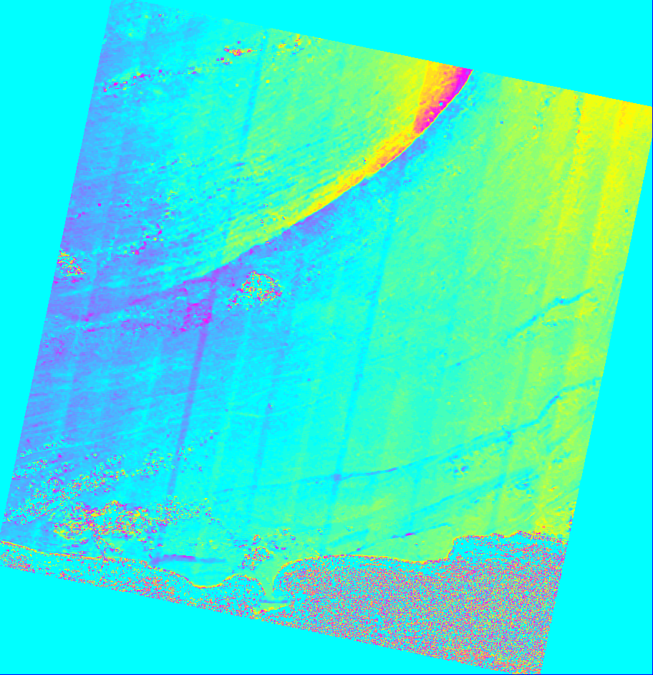
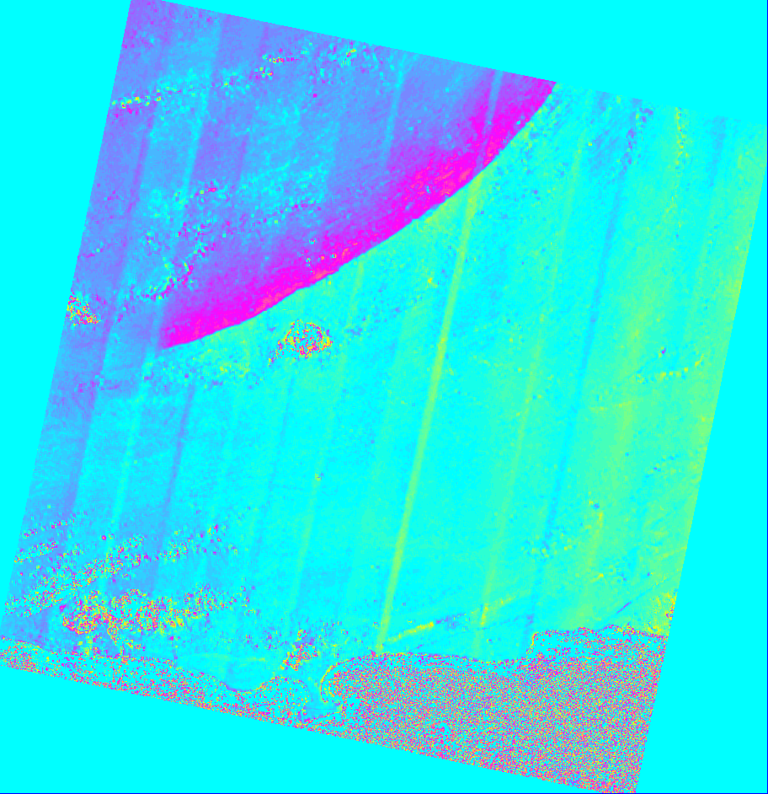
Balochistan EQ, 2013
North displacement
East displacement
Landsat-8 data using denseAmpcor

Slide 6
2. Geo2rdr
Two different modules
stdproc/model/enu2los
stdproc/model/zenith2los
DEM like inputs
See docs directory for example on how to use

Slide 7
3. imageMath.py
Do math directly with images
Examples
imageMath.py -e='a*exp(-1.0*J*arg(b))' -o test.int -t cfloat --a=resampOnlyImage.int --b=topophase.mph
imageMath.py -e='a_0;a_1' --a=resampOnlyImage.amp -o test.amp -s BIL
imageMath.py -e="abs(a);sqrt(b_0**2 + b_1**2)" --a=topophase.flat --b="topophase.mph;3419;float;2;BIP" -o test.mag -s BIL

Slide 8
4. UpsampleDEM
Upsample DEM to smaller posting
Spotlight data, high resolution data
Experimental – under development
Regular grid Akima interpolation
upsampleDem.py -i 32n125w-38n115w-2asec-ELL.le.dem.wgs84 -o upsampled.dem –f 4

Slide 9
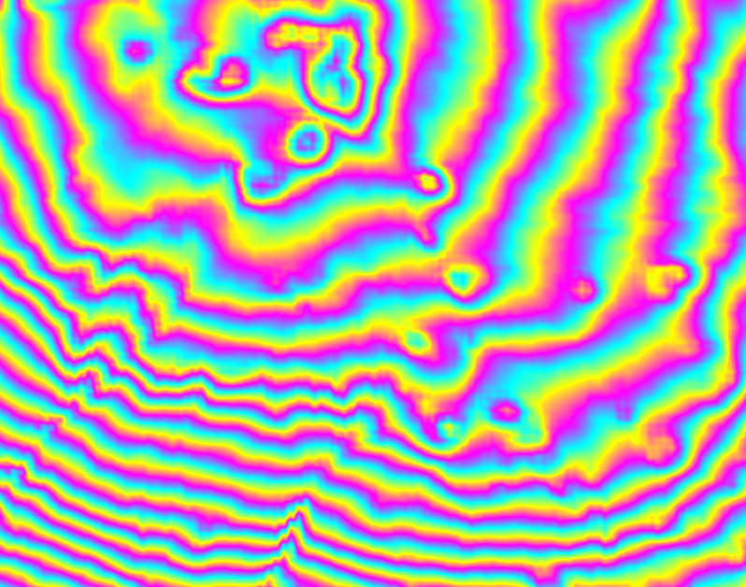
Example: Hawaii
Before interpolation at 10 m Scale
After interpolation at 10 m Scale
Topography contours wrapped at 100m to highlight details

Slide 10
5. ENVI header files
ISCE uses XML files to describe binary raster files
Can output ENVI hdr files
Use gdal to convert to your favorite GIS format.
Img = isceobj.CreateDemImage()
Img.load(‘filt_topophase.unw.geo.xml’)
Img.renderEnviHDR()

Slide 11
6. Direct KML generation
Use mdx.py to generate KML files for geocoded products directly
Example:
mdx.py filt_topophase.flat.geo –kml test.kml

Slide 12
7. Land water mask
Contrib.demUtils.watermask
Operations
Downloads SRTM SWBD shapefile
uses gdal rasterize to create land-water mask.
Use existing DEM and create associated mask easily.
mask.py -i input.dem (Creates input.msk)
mask.py –i filt_topophase.flat.geo –o water.msk

Slide 13
8. ROI_PAC sensor
We support old format ROI_PAC raw files
Three input tags:
RAWFILE (.raw and .raw.rsc)
HDRFILE (hdr_*.rsc)
Ensure you have good temporal sampling for state vectors in hdr file
Not recommended unless absolutely have to

Slide 14
9. estamb
Experimental
Stdproc.stdproc.estamb
Entropy based ambiguity estimator
E.g. - ERS data post-2001
To be run, right after make_raw

Slide 15
10. Orbit Library
Isceobj.Orbit
Orbit interpolation routines
Python, C and Fortran
Orbit extension
Used for Radarsat2
Inertial orbit conversions
Uses JPL’s NAIF SPICE library
Experimental for Radarsat1

