Slide 1
Batch processing, stacking and time series analysis
Introduction
Batch processing
Stacking
Time series analysis
Xiaopeng Tong, InSAR workshop 2014, Boulder, CO

Slide 2
Image alignment
Azimuth
Range

Slide 3
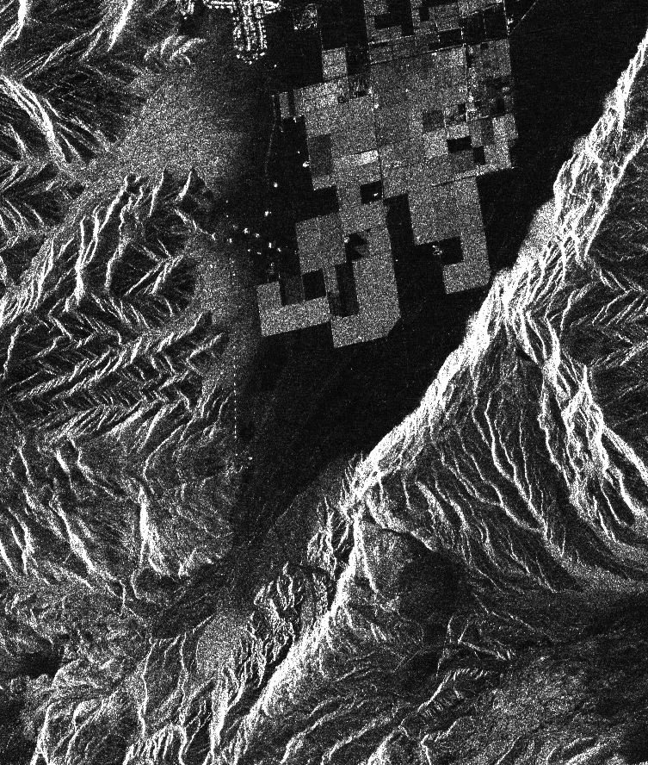
Image alignment
Range
reference
repeat
Azimuth
Notes:
The first step is to align the reference and repeat images to sub-pixel accuracy. This is done by two dimensional cross correlation of hundreds of small sub-patches (e.g., 64 x 64) taken from the master and slave images. Then a 6-parameter affine transformation is determined using a robust 2-D fit to the offset data.

Slide 4
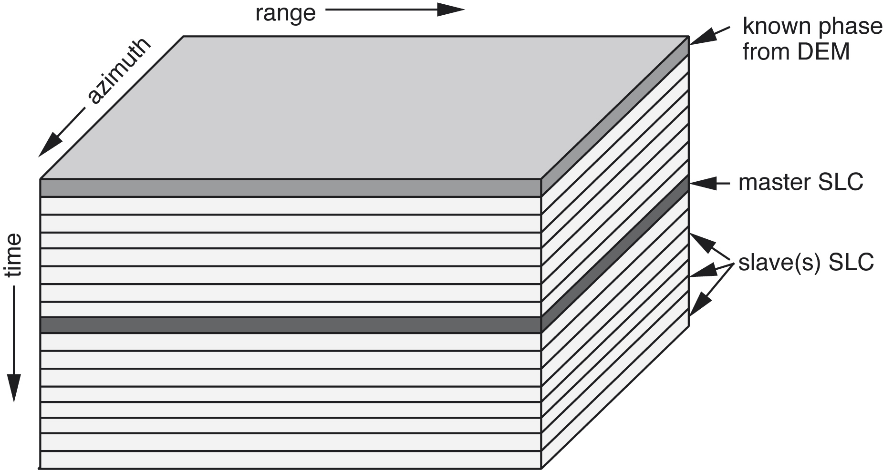
Aligned SAR data stacks

Slide 5
Introduction
Batching processing: Automatic processing of a stack of SAR data to generate interferograms
Stacking: Average multiple interferograms to estimate velocity and standard deviations
Time-series analysis methods: SBAS, PSInSAR
Written in shell and is easy to modify so advanced users are welcome to develop new scripts

Slide 6
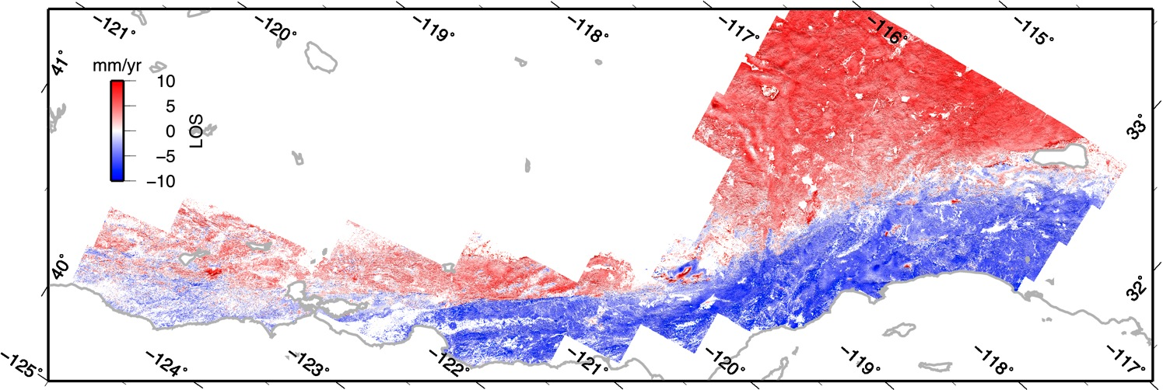

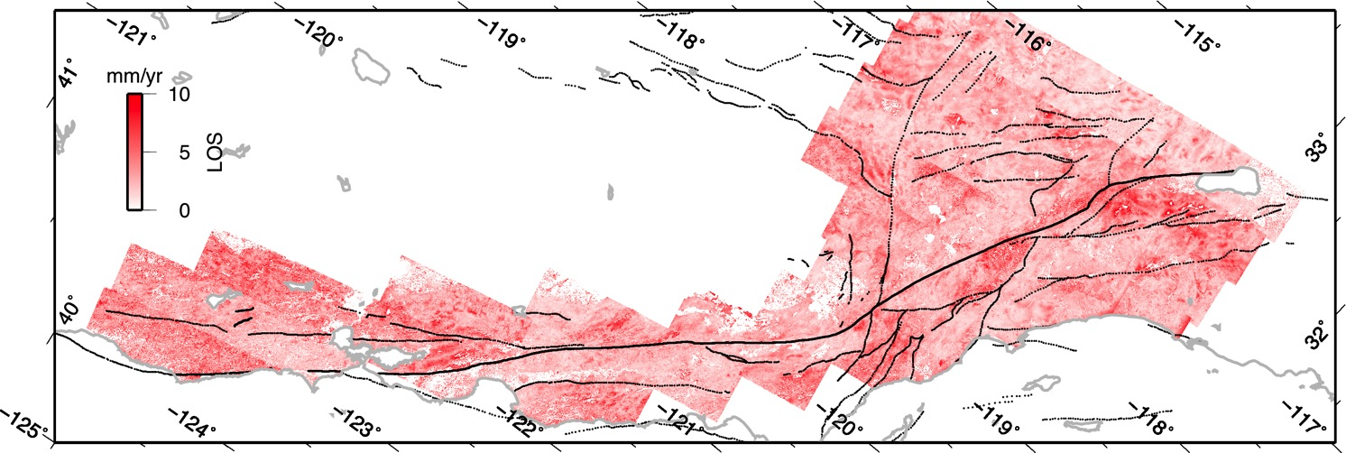
combined high-resolution
velocity
ftp://topex.ucsd.edu/pub/SAF_models/insar/ALOS_ASC_masked.kmz
standard deviation
[Tong et al., 2013]
Notes:
Say I will come back to it. Say you can say it’s really sharp along creeping section,

Slide 7
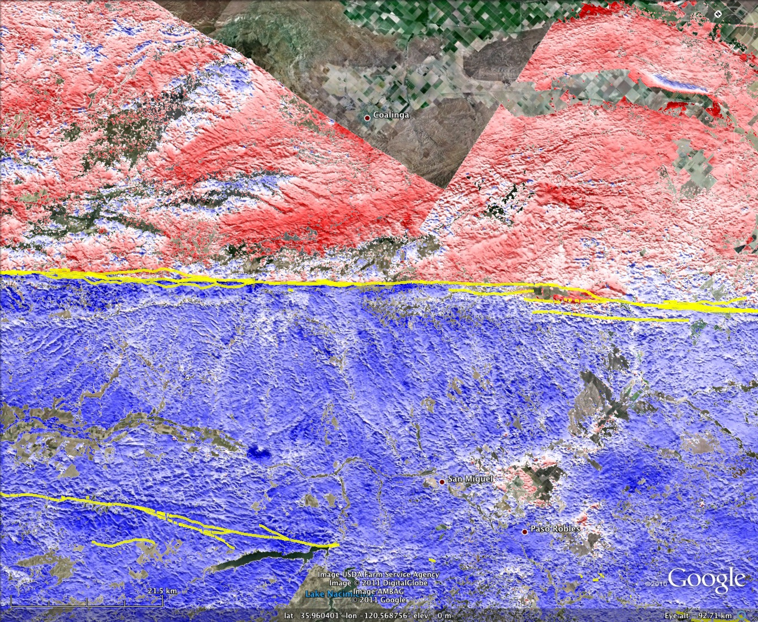
Parkfield SAF
red 10 mm/yr
blue -10mm/yr

Slide 8
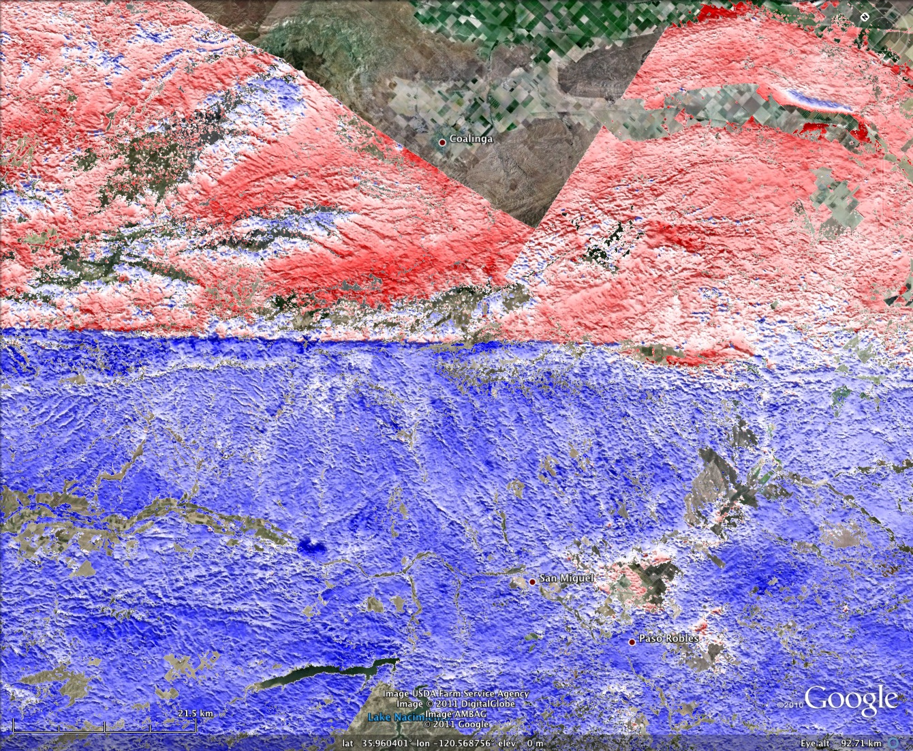
Parkfield SAF
red 10 mm/yr
blue -10mm/yr

Slide 9
Batch processing, stacking and time series analysis
Introduction
Batch processing
Stacking
Time series analysis
InSAR workshop 2014, Boulder, CO

Slide 10
Overview
Batch processing:
  Preprocessing without a master image pre_proc_init.csh
  Preprocessing with a master image pre_proc_batch.csh
  Align a stack of SAR data align_batch.csh
  Form a stack of interferograms intf_batch.csh

Slide 11
  Batch processing: pre_proc_init.csh
Function:
  preprocess a stack of SAR data using default parameters (earth radius, Doppler centroid, near range)
  Generate baseline-time plot to choose master images, alignment strategy, interferometric pairs

Slide 12

  Batch processing: pre_proc_init.csh

Slide 13
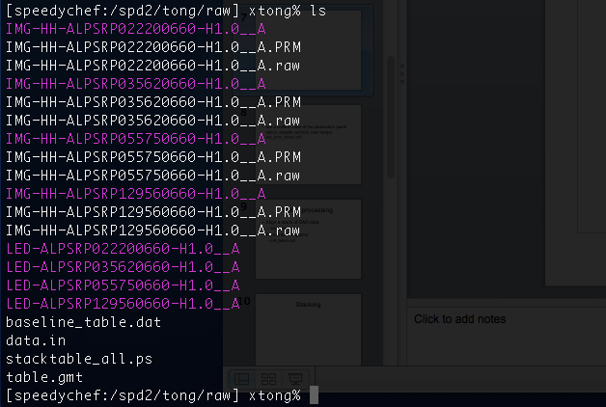
  Batch processing: pre_proc_init.csh

Slide 14
Baseline-time plot: stacktable_all.ps

Slide 15
Baseline-time plot: stacktable_all.ps
Super master

Slide 16
  Batch processing: pre_proc_batch.csh
Function:
  preprocess a stack of SAR data using uniform parameters (earth radius, Doppler centroid, near range) to make them geometrically consistent with one single image (super master)

Slide 17
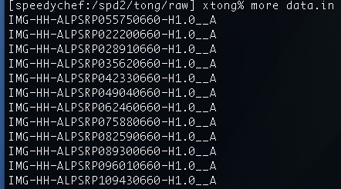
  Batch processing: pre_proc_batch.csh
1. Modify data.in file
Super master
2. Delete old PRM and raw files

Slide 18
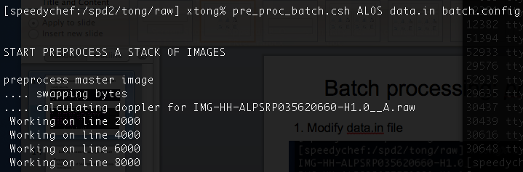
  Batch processing: pre_proc_batch.csh
3. Modify batch.config file and run pre_proc_batch.csh
Stop here to look at the batch.config file

Slide 19
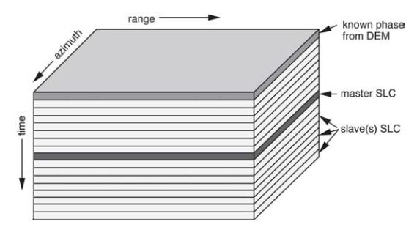
  Batch processing: align_batch.csh
Function:
  Focus SAR images to form Single Look Complex (SLC) data
  Align (image registration) a stack of SLC data using 2D cross-correlation within sub-pixel (<10m) accuracy

Slide 20
Baseline time plot
Super master

Slide 21
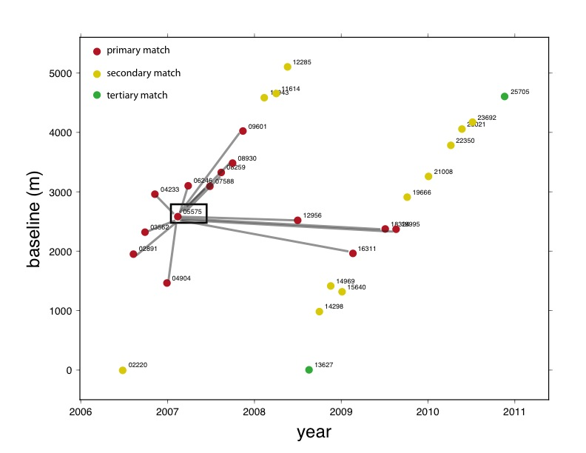
“Leap frog” method to align SAR images
slave
master

Slide 22
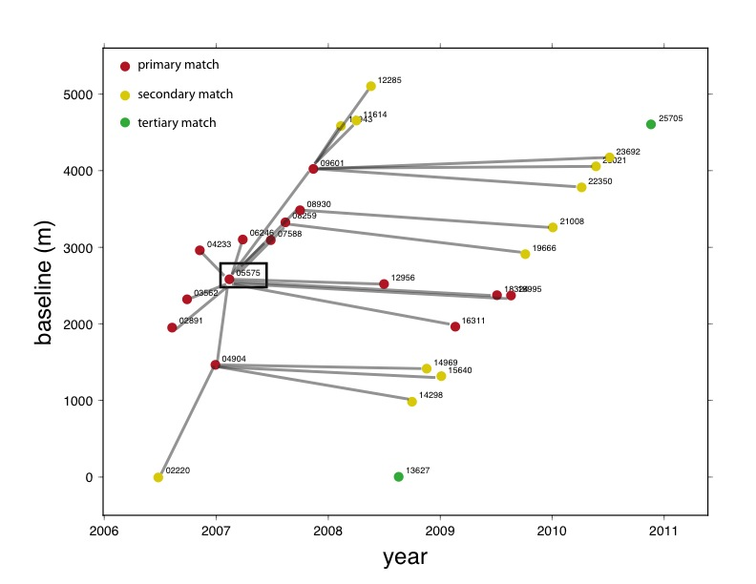
“Leap frog” method to align SAR images
Surrogate master
Slave

Slide 23
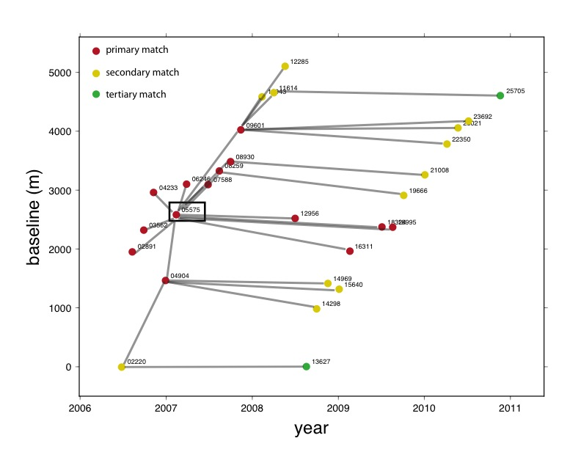
“Leap frog” method to align SAR images

Slide 24

  Batch processing: align_batch.csh
1. Edit align.in file
Master or Surrogate master
Slave
Super master
2. Then run align_batch.csh
Time-consuming part of the processing .. take a break here ..

Slide 25
  Batch processing: intf_batch.csh
Function:
  Convert Digital Elevation Model into radar coordinates
  Form interferograms using two SLC data
  Remove phase due to earth curvature and topography
  Plot amplitude, correlation, phase using GMT
  Unwrap using SNAPHU
  Geocode and make Google Earth KML files

Slide 26
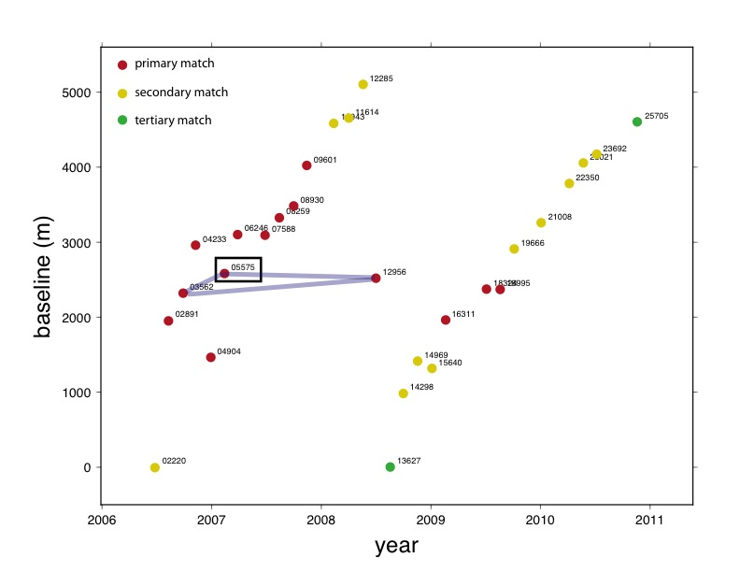
Choose 3 interferograms pairs

Slide 27
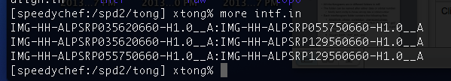
  Batch processing: intf_batch.csh
1. Edit intf.in file to choose inteferogram pairs

Slide 28
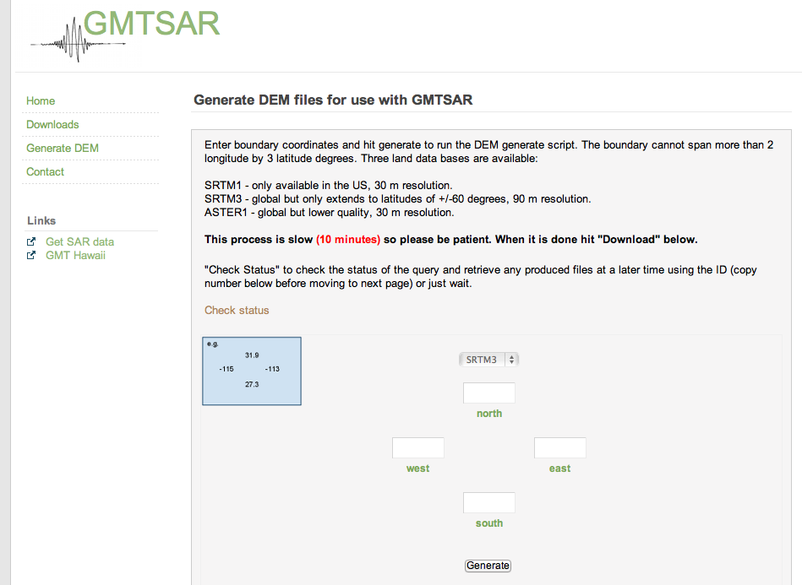
  Batch processing: intf_batch.csh
2. Make dem.grd file and put it inside topo/ directory

Slide 29
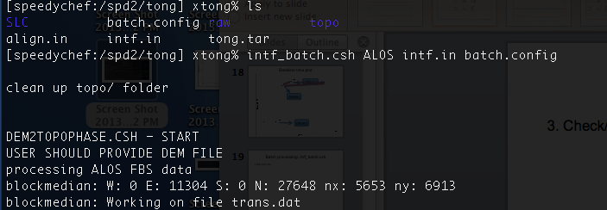
  Batch processing: intf_batch.csh
3. Check/modify batch.config file
Time-consuming part of the processing .. take a break here ..

Slide 30
  Batch processing: results
All interferograms are in different folders in intf/
The folder can be named after either date or orbital number
  Modify batch.config to choose among date or orbital number
Each interferogram folder contains the following files:
  Amplitude, phase, correlation, unwrapped phase, filtered phase image files in GMT/NetCDF format “.grd”
  Corresponding files after geocoding with subfix “_ll.grd”
  Postscripts plots: “.ps”
  Google Earth “.kml” and “.png”

Slide 31
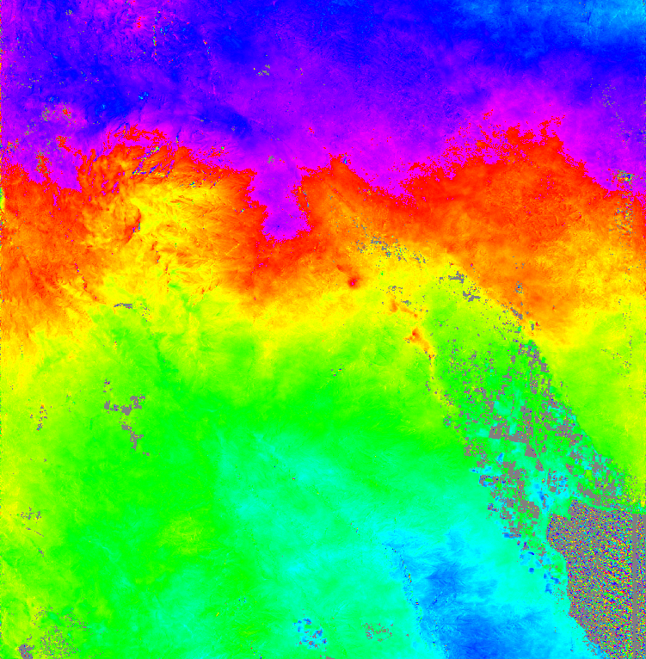
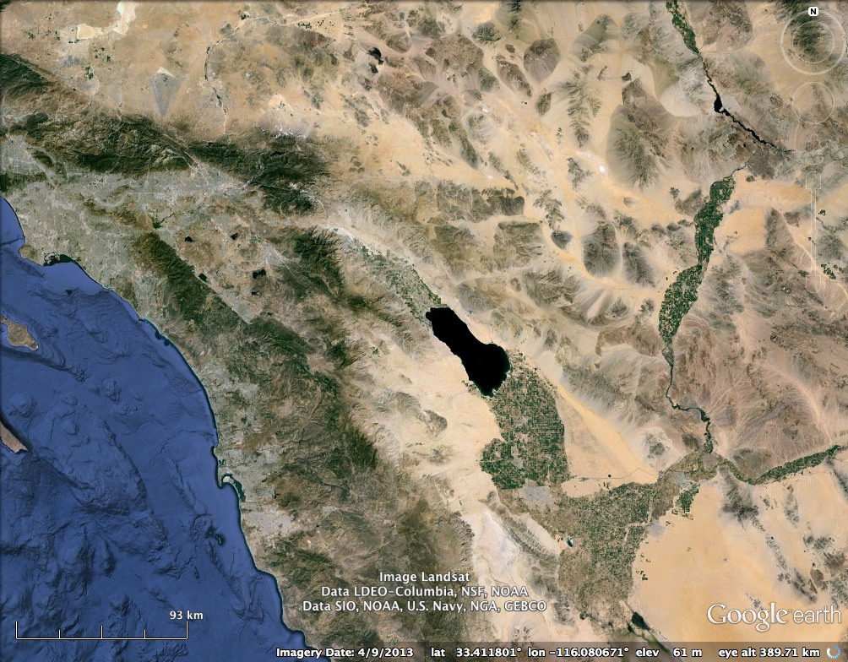
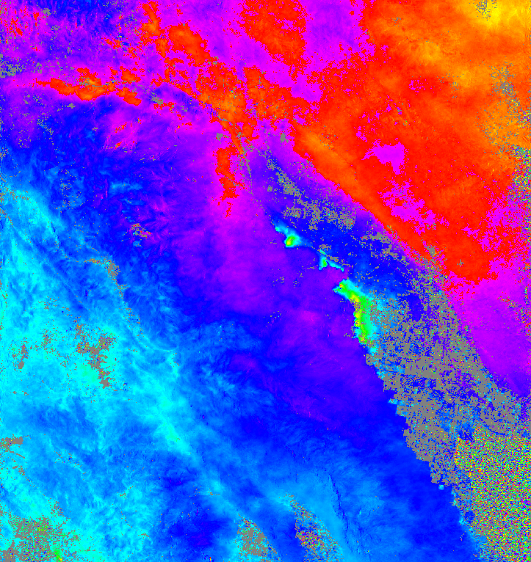
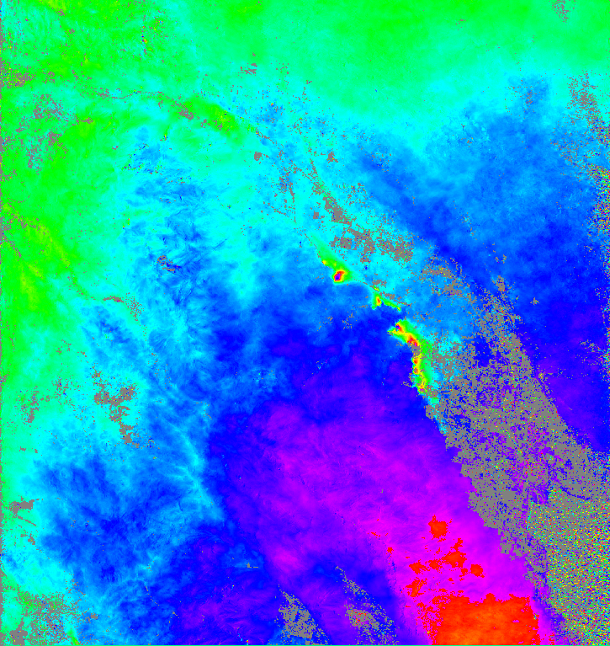
  Batch processing: results
Phase of the 3 interferograms

Slide 32
Batch processing, stacking and time series analysis
Introduction
Batch processing
Stacking
Time series analysis (SBAS)
InSAR workshop 2014, Boulder, CO

Slide 33
Stacking: stack_phase.bash
Function:
  Average unwrapped phase
  Convert the phase (radius) to velocity (mm/yr)
Note: it’s necessary to check the unwrapped phase before stacking or time-series analysis because unwrapping from SNAPHU may give errors, which will corrupt results
More complex processing techniques (e.g. filtering, detrending, GPS/InSAR integration) is incorporated along with stacking

Slide 34
Math of stacking (Appendix C)
Unwrapped phase
Time span
Recovered deformation
True deformation
atmosphere
topography

Slide 35
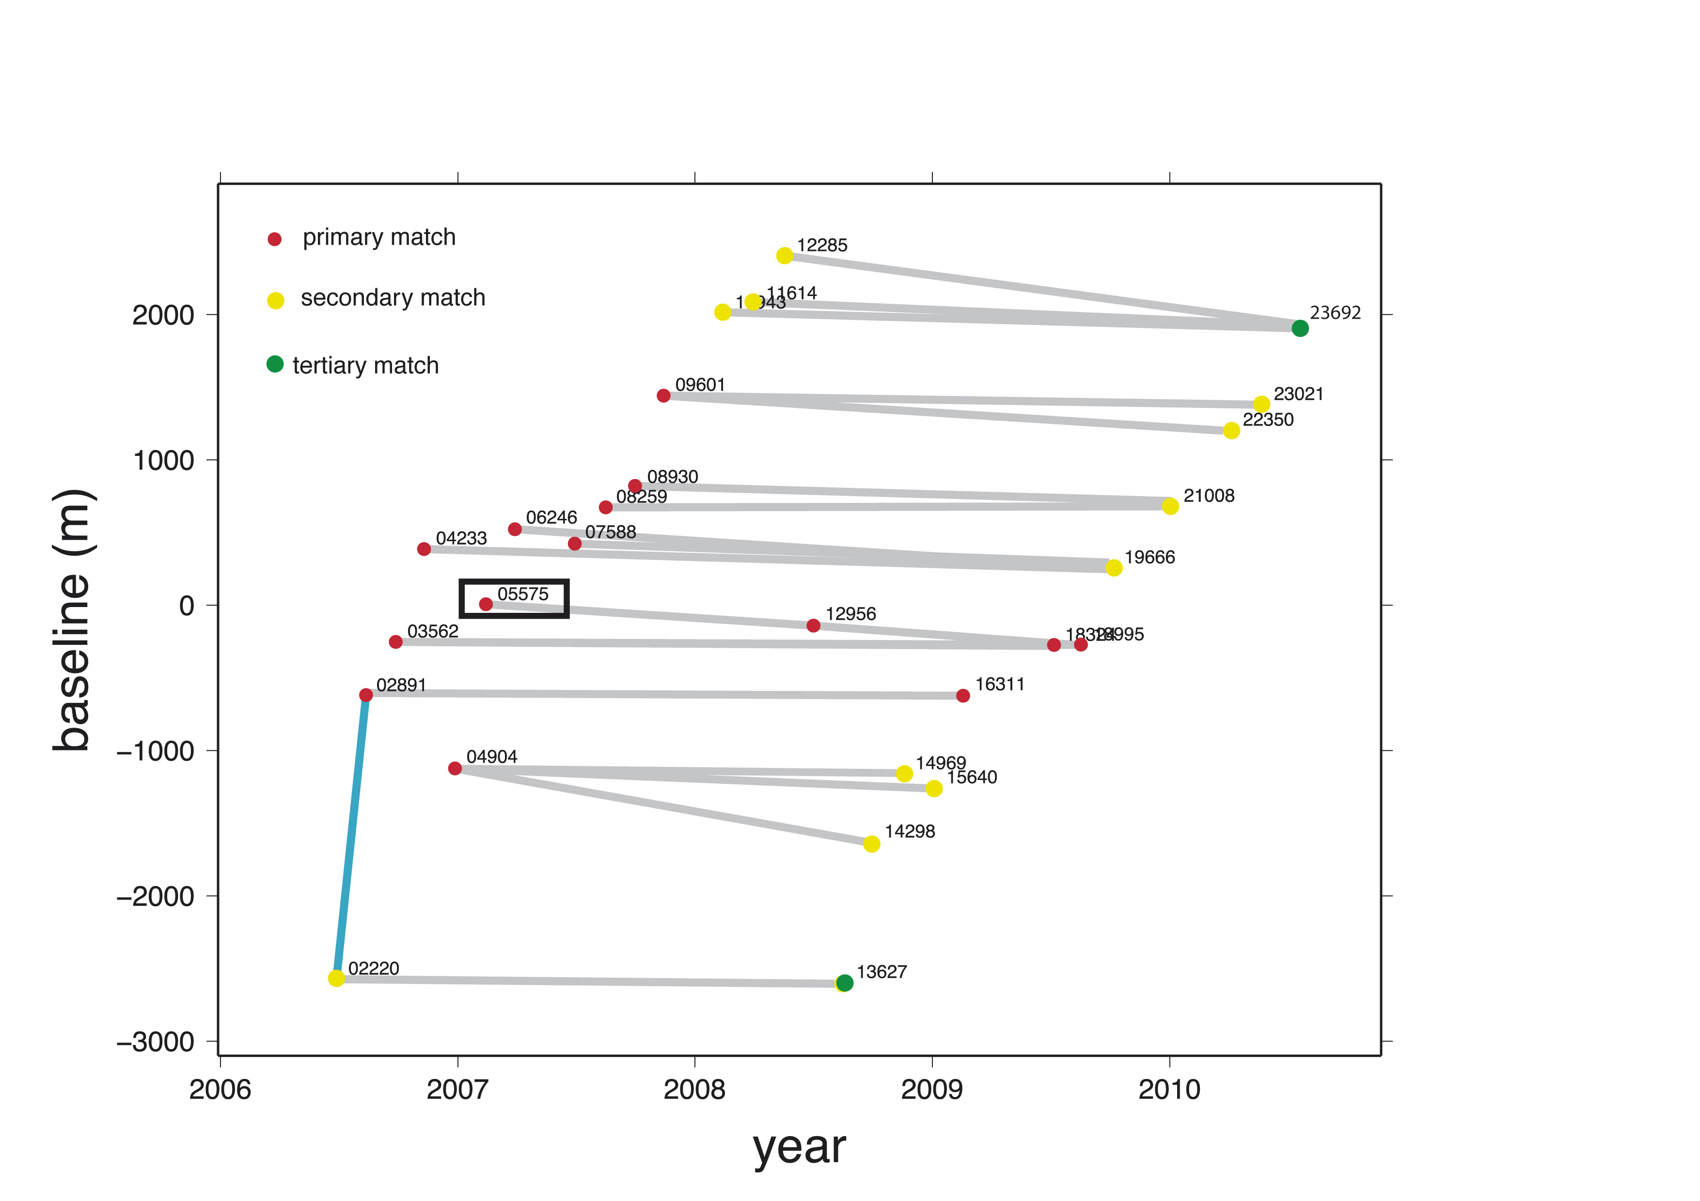
Stacking example with the complete data set

Slide 36
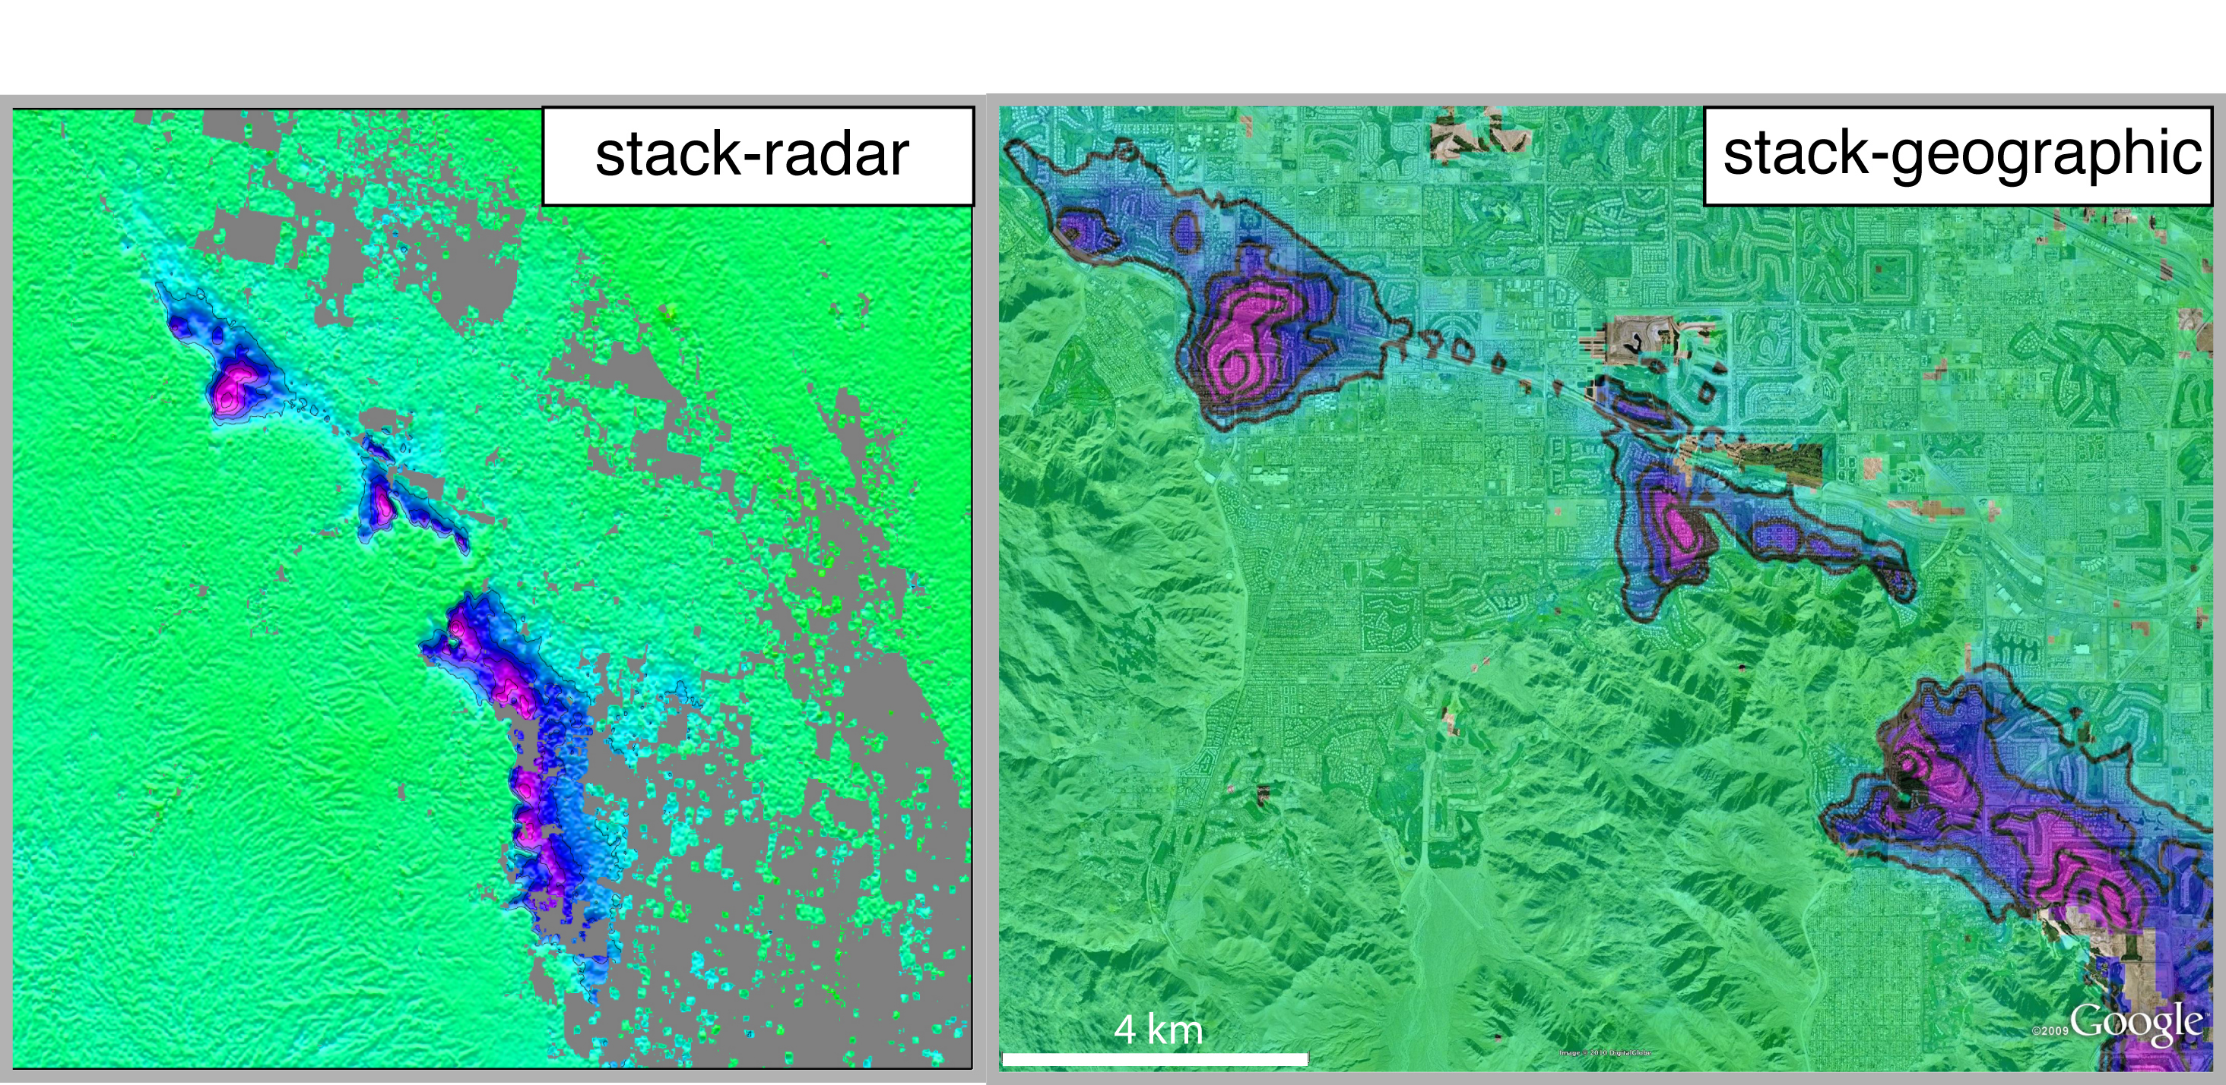
Stacking example with the complete data set
Track 213 Frame 660
Land subsidence near Coachella Valley, California

Slide 37
Batch processing, stacking and time series analysis
Introduction
Batch processing
Stacking
Time series analysis (SBAS)
InSAR workshop 2014, Boulder, CO

Slide 38
T213 F660 ALOS
SBAS
88 interferograms
28 scenes
20 km filter
Since 2006/01/01

Slide 39
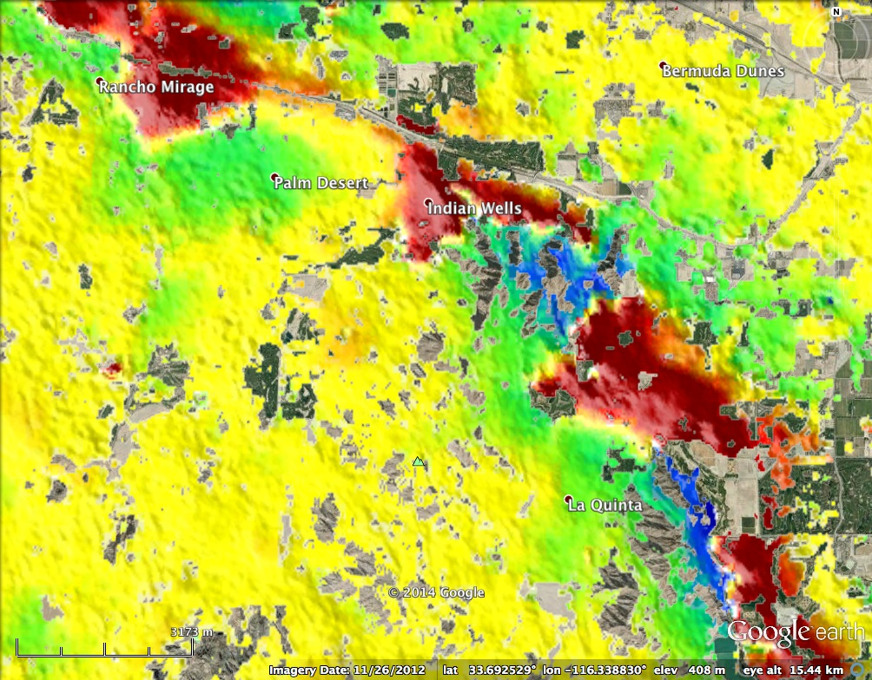

Slide 40
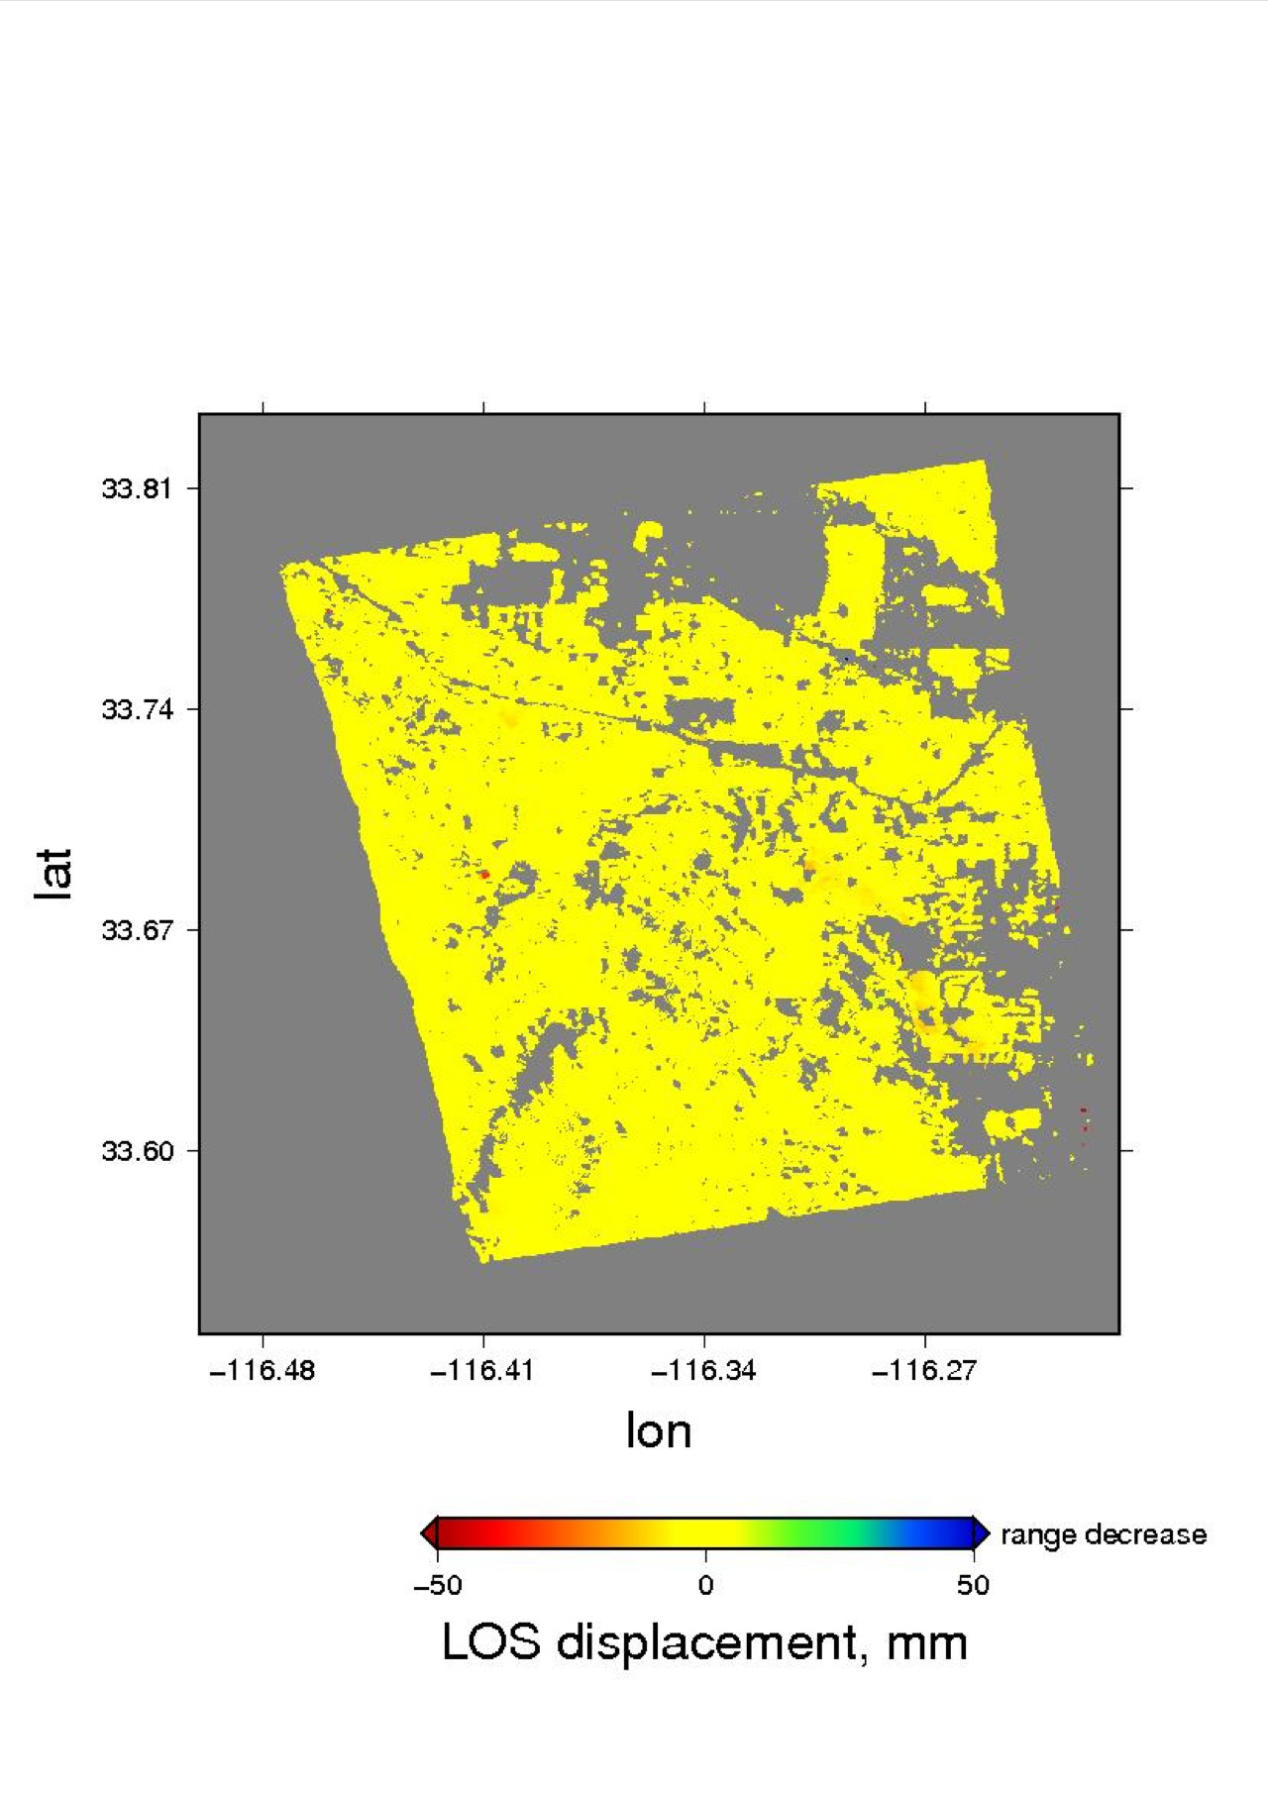
Time-dependent deformation signals

Slide 41
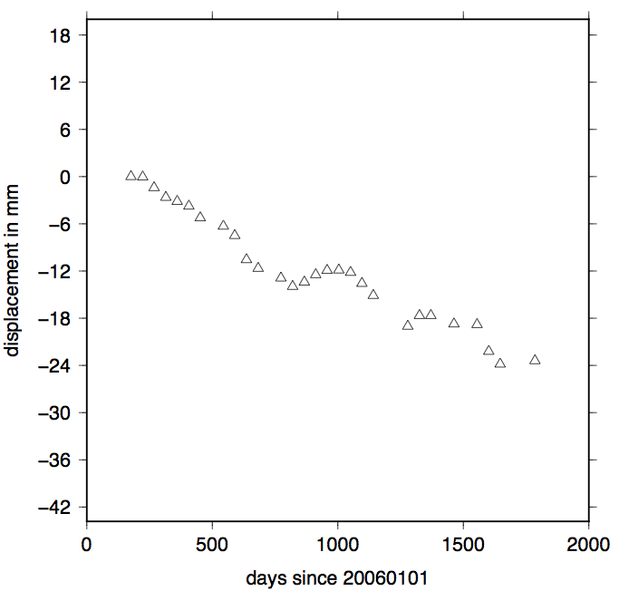
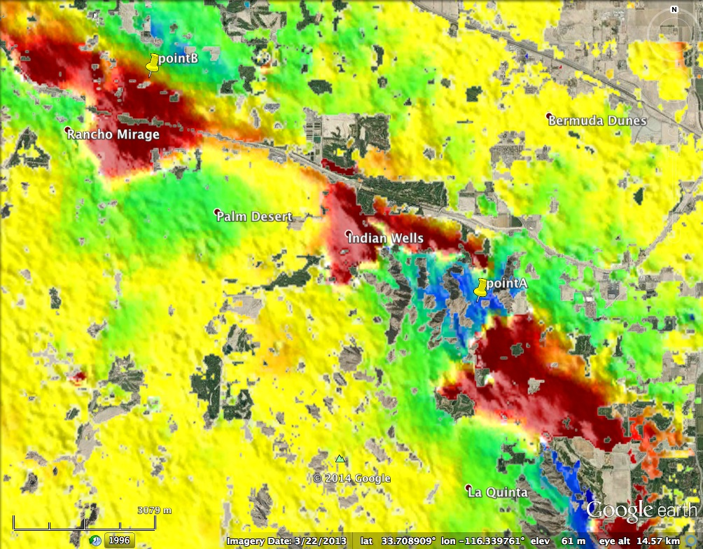
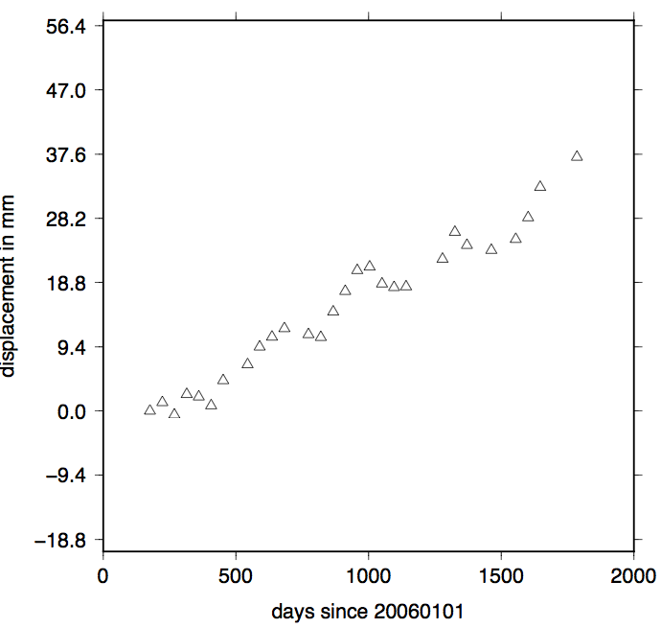
Time-series show seasonal variation and linear trend
Point B
Point A

Slide 42
Summary
Batch processing shell scripts provide automatic InSAR data processing
Stacking scripts provide methods to estimate mean velocity and its standard deviations.
Advanced user can develop custom scripts using tools inside GMT and GMTSAR.
InSAR time-series analysis tool has been developed and will be in the next version of GMTSAR.
Any questions?

