Slide 1
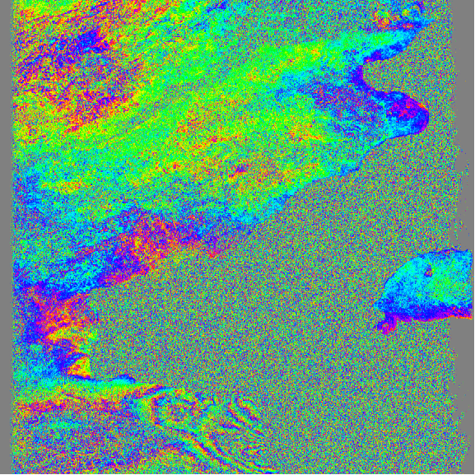
Filtering, unwrapping , and geocoding
R. Mellors
or what to do when your interferogram looks like this

Slide 2
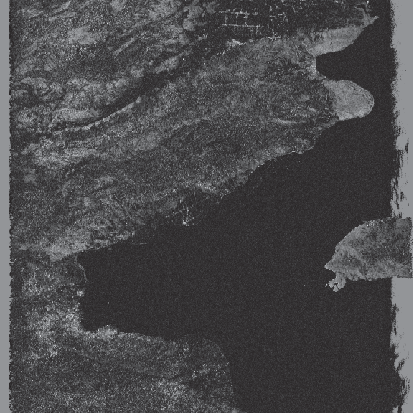
correlation
Haiti
ALOS L-band
(23 cm)
ascend
T447, F249
3/9/09-1/25/10
Bperp = 780
(gmtsar)
phase
azimuth
range

Slide 3
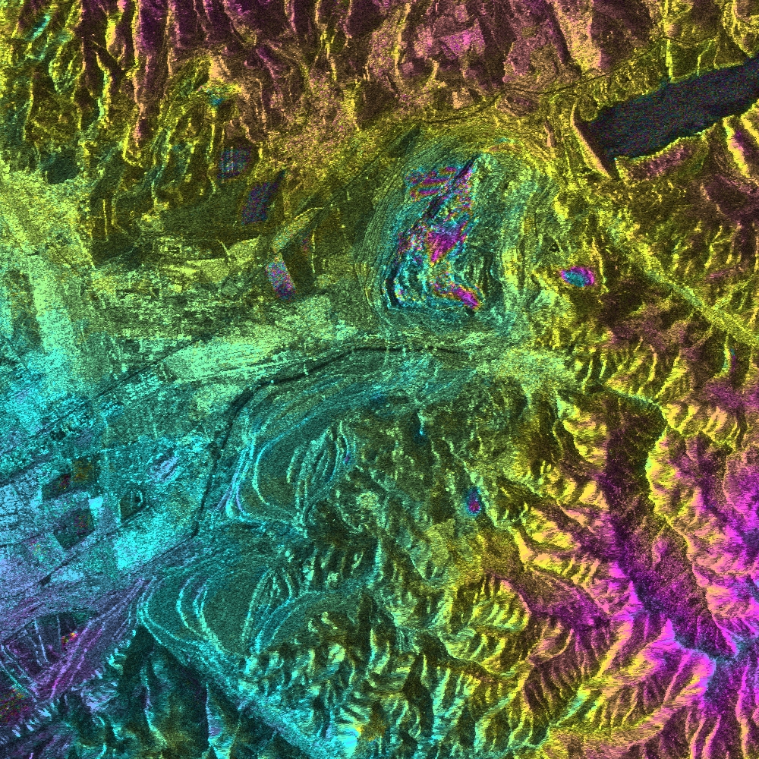
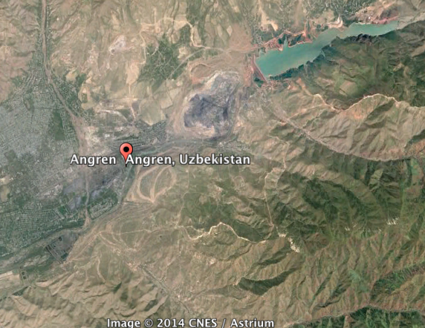
Coal mine in
Uzbekistan

Slide 4
Mud volcano in Azerbaijan

Slide 5
Tunnels of LA

Slide 6
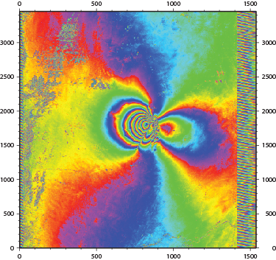
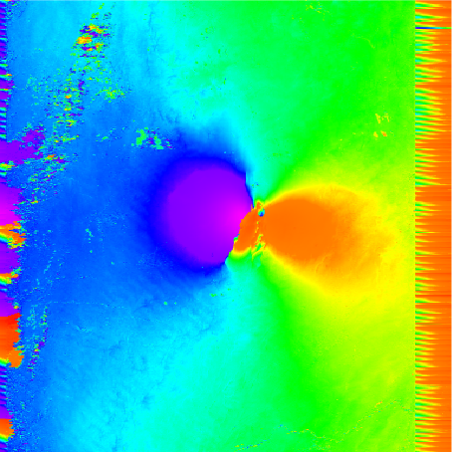
Overview
Given an interferogram(s)
- usually need to convert to useful units
- convert phase to m, cm, mm, furlongs, etc
- we know radar wavelength
- we know geometry
Requires unwrapping
- often filter beforehand
- unwrapping not trivial
Saudi 7/1/08-8/19/08 ALOS Bperp 20 m

Slide 7
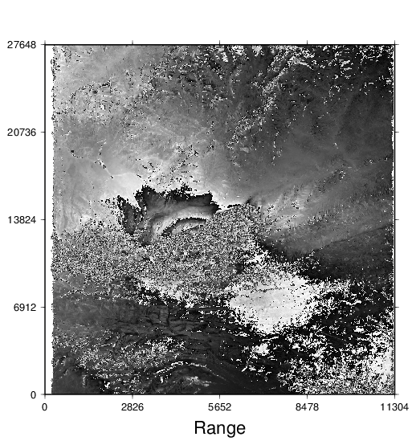
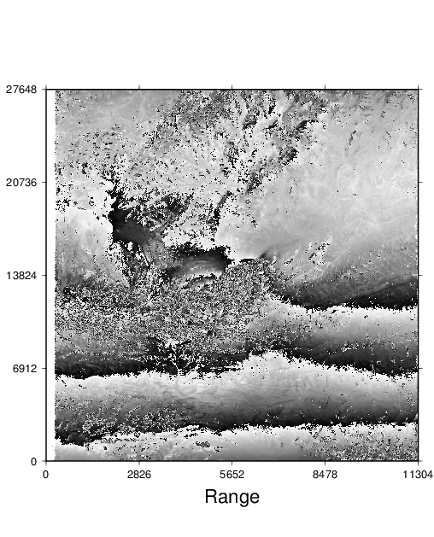

Slide 8
Filtering
objective: improve signal-to-noise
static
- usually lowpass
convolve with set of filter coefficients (boxcar, Gaussian, etc)
adaptive
Goldstein and Werner [1998] spectral filter.
effective but “can significantly change the structure of the interferogram”[Baran et al, 2003]

Slide 9
adaptive filter
- filter parameter vary depending of properties of each patch
H(u,v) = (S{|Z(u,v)|}ª )(Z(u,v))
Z(u,v) Fourier spectrum of small 2D patch of complex interferogram
(perhaps 32 by 32 pixels)
S smoothing (e.g. 3 by 3 pixels)
H output
α exponent (a = 0, no filter, a > 0 filters)
take Fourier of small patch
raise spectrum to power
inverse FFT
results depends on noise and phase!
Baran et al [2003] use α = 1 – γ where γ is the coherence

Slide 10
Phase unwrapping* overview
A) The problem and some answers**
  Global solutions
    Transforms
    Matrix
  Local solutions
    Residues
    Quality
  Network methods
B) Reduce or avoid the problem***
  Filter
  Model phase beforehand
*phase unwrapping problems occurs in other areas as well
**many algorithms exist; I present only selected ones.
*** this is the best strategy in many cases.

Slide 11
Phase unwrapping
Assume that we have two signals taken at different times:
g₁ = a₁ exp(i4πR₁/λ)
g₂ = a₂ exp(i4πR₂ /λ)
a1,a2 = complex reflectivity
R1, R2 is range from antenna to surface
= wavelength
At a given point, assume a₁ = a₂ = a
(g1)(g2*) = (a²)exp[i4π(R₁-R₂)] = s(t)
The phase of this function is proportional
to the effective difference in range, which
in turn depends on satellite geometry,
topography, soil moisture, or maybe
even deformation.

Slide 12
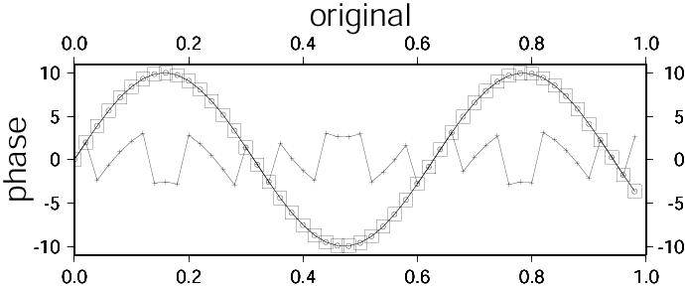
Extracting the phase
We can get only the wrapped phase*
ψ(t) = arctan(I(s(t)),R(s(t)))
where –π < ψ(t) < π
We would like the continuous phase.
This appears simple. Look for 2π jumps and then add the appropriate multiple of 2π.
If the data are good, phase unwrapping is straightforward
We could take derivative in complex version
(e.g. Sandwell & Price)

Slide 13
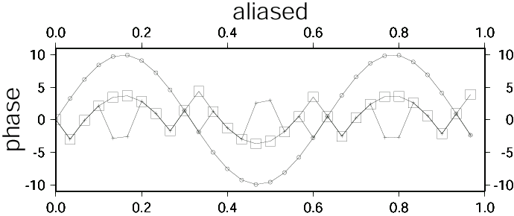
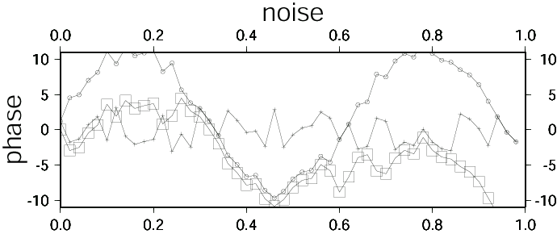
Two major problems
Aliasing.
True phase changes by more than 1 cycle (π radian) between samples.
Caused by long baselines, steep topography, or high deformation.
Noise and/or gaps in the data.
Changes in the surface may decorrelate the signal and introduce noise.

Slide 14
For 2D data the same problems exist.
How to unwrap?
Want to find a function that when wrapped, is “close” to the observed data (whatever “close” is).
Two basic approaches:
Global methods that attempt to unwrap all pixels simultaneously.
Local methods that solve along a path.
Note that the correlation data allows some estimation of how good the phase data is (maybe also amplitude/phase stability over time?)

Slide 15
Global
We want to find the function whose local derivatives “match” the observed derivatives given some measure :
e^{p} = [(φ_{i+1},_{k}-φ_{i,k}) – Δ^{x}_{i,k}]^{p} + [(φ_{ik+1}- φ_{ik})-Δ^{y}_{ik})]^{p}
P = exponent
φ = unknown function
Δ = derivatives of the observed phase (can calculate from the complex phase).
For p = 2, this is equivalent to the discrete version of Poisson’s Equation
Two basic ways to solve:
Transform : FFT, DCT (discrete cosine transform-be careful with b.c.’s)
Matrix (will allow weighting but now nonlinear and requires iteration)
Can vary the exponent (i.e. don’t have to use 2)

Slide 16
An elegant and easy solution, but….
doesn’t work very well with noise.
Tend to underestimate true phase when noise exists (it’s a least-square fit).
No easy way to add weighting short of iterating.
Matrix methods solve:
Ax = b
With weighting:
WAx = Wb
W = matrix of weights
A = operator
B = set of observed phase values
x = unknown function
These work better than the transform methods but like all global solutions, do not provide a good fit anywhere.

Slide 17
Transform-based methods
Fast, but do not allow weighting
FFT requires periodic conditions and extension of data.
Apply 2D Fourier transform:
= Fourier transform of φ
P = Fourier transform of ρ
Calculate the ρ_{i,k} from the data
Calculate the 2D FFT of ρ_{i,k}
Calculate Φ_{m,n} from the transformed ρ_{i,k}
Do inverse FFT

Slide 18
Local (path following)
Similar to the 1D approach
1.) Calculate the differences of the wrapped phase.
2.) Wrap the differences.
3.) Set the value of the first value.
3.) Integrate along all values.
Do this along a line throughout 2D area (in a zigzag back and forth along the rows, for example)
Works great if there is no noise.
With noise:
1) An error near the start of the path propagates along the whole path.
2) Answer may vary with path.
3) Need to identify bad pixels. How?

Slide 19
For 2D data integration around a closed loop should sum to zero.
(in cycles – multiply by 2π to get radians)
0.1 0.2 0.3
-0.1 -0.2 -0.4
-0.2 -0.2 -0.3
Δ₄
Δ₁
Δ₃
Δ₂
Δ₁ = -0.2
Δ₂ = -0.1
Δ₃ = 0.4
Δ₄ = -0.1
Sum: 0.0

Slide 20
However, we know that topographic surfaces are conservative
Any points that violate this should be avoided.
These points are known as residues.
Any integration path that circles a residue will contain errors – need to make “branch cuts”
A residue is a property of phase differences, not a single pixel.
can be positive or negative

Slide 21
1.) Identify all residues in data (marked as the upper left pixel)
2) Draw lines (branch cuts) between them to eliminate possibility of drawing a circle around a residue.
3) Unwrap the rest of the data
*Note: residues can be positive or negative. A positive linked to a negative cancel each other out.
This is the basis of the Goldstein approach, (used in Roi_pac).
Often, poor data (with low correlation is masked out beforehand)

Slide 22
Goldstein* algorithm
[different from filtering]
1.) Calculate correlation for phase data.
2.) Mask out all areas with correlation less than a certain threshold value.
3.) Go through all pixels and identify residue locations (upper left of 4 pixels).
4) Start with first residue, look for nearest residue. Draw a “line” of marked pixels between the two.
if residues cancel, go to next residue and start new “tree”
otherwise, look for next nearest and draw line
can also “cancel” by connecting to edge.
connected lines are called a tree.
5) path-integrate along remaining pixels.

Slide 23
Negative residue
-
+
Branch cut
Positive residue
1) start
+
2) search
in box
-
+
3) find second residue
4) connect with branch cut

Slide 24
Fast
Need to start integration (seed point) in area of good data.
Residues often lie in areas of layover.
Regions can get isolated from each other with dramatically different phase (by multiples of 2π).
Some implementations allows manual connecting of regions.
Some implementations allow “pre-processing” to connect closely-spaced opposite residues (dipoles) first.
Minimizes distance between residues; does not minimize number of cycles needed to “unwrap”.
A similar algorithm uses quality rather than residues to define.

Slide 25
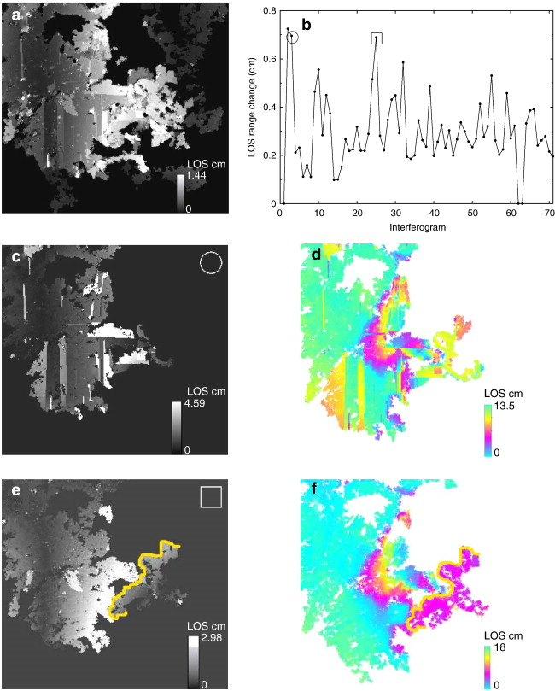
if it doesn’t work
Lopez-Quiroz et al, [2009,]

Slide 26
Flynn’s minimum discontinuity
Identify lines of discontinuity (fringe lines)
  Difference between adjacent pixels > π
  Magnitude of discontinuity defined by number of multiples of 2π needed to fix.
Add multiples of 2π to eliminate lines of discontinuities that form loops.
Checks to see if operation creates more discontinuities than removes.
Continues in an iterative fashion.
At end, no more discontinuities can be removed without adding more.
Complicated algorithm (i.e. I looked at it and got a headache)
Comments:
Slow. Masking helps.
Can be appended after other unwrapping algorithms.
Good to run Goldstein or quality first, then Flynn.

Slide 27
Chen and Zebker’s (2000)
[SNAPHU]
A branch-cut algorithm minimizes the total discontinuity length (L⁰).
Flynn yields a L¹ solution.
Least-squares yield an L² solution.
C&Z claim low norms are best.
For interferograms corrupted by noise, L⁰ and L¹ algorithms yield similar solutions.
For layover, where discontinuities separate severe phase gradients, L¹ algorithms do not do well.

Slide 28
Residues caused by topographic layover with illumination from one side
Good – L0
Bad – L1
Negative residue
Positive residue

Slide 29
The ultimate L0 algorithm would minimize the total cut length.
C&Z show that the L0 problem is equivalent to an NP-complete problem and therefore hard for efficient algorithms to solve completely.
Therefore, the L0 branch-cut algorithm is a good place to start.
Major problem is that cuts close on themselves.
Total tree length is upper bound on total discontinuity length.

Slide 30
Modifications
Minimum span (MST)
  Define cuts so that a tree cannot connect to itself.
  Connect all trees.
  Use knowledge of residues to guide integration.
  Complete unwrapping
Minimum cost (MCF)
  Uses flow to reduce cycles

Slide 31
Removing topography (and deformation)
If an accurate topographic model is available, then many of these problems can be alleviated during calculation of the interferogram.
Reduce need for unwrapping.
Deformation model can also be included.
Can be done iteratively.
Also true for large deformations (maybe done in an iterative fashion)

Slide 32
The future: persistent scatterers
3D unwrapping
The PS technique leads to widely spaced pixels. Phase relationships between these pixels may be challenging to define.
If we have a time series of interferograms, phase unwrapping becomes a 3d problem.

Slide 33
Geocoding: One method
“Fly” satellite along path with known orbit
Find point (azimuth) of nearest approach to each DEM pixel with known latitude and longitude.
Distance to point yields range
This provides a mapping of range, azimith to latitude, longitude.

Slide 34
sometimes filtering is not necessary
Saudi
7/1/08-8/19/08
ALOS
Bperp 20 m
(low coherence masked out)

Slide 35
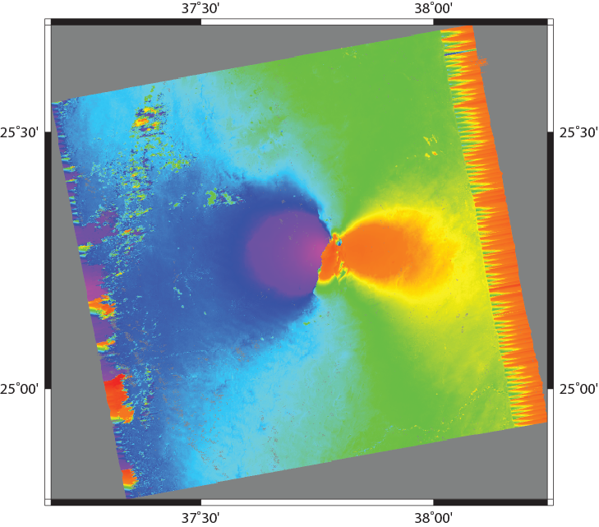
Geocoding

Slide 36
want to eliminate “fringes”

