Slide 1
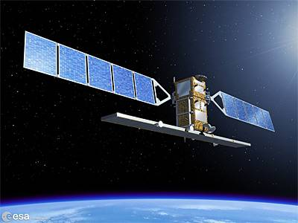
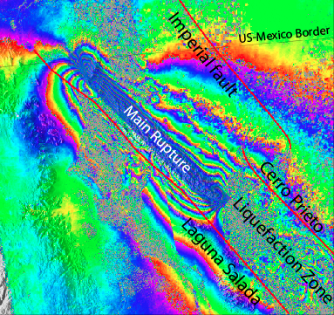
GMTSAR Short Course
UNAVCO, July 2014
David Sandwell, Rob Mellors,
Xiaopeng Tong, Scott Baker
Objectives:
run GMT and GMTSAR on your own computer
perform 2-pass InSAR processing on your own computer
data (ERS, Envisat, ALOS-1) from UNAVCO and ASF (processing TSX, CSK, RS2, S1A, ALOS-2 possible)
prepare large stacks of interferograms
time series (see next UNAVCO InSAR short course, Aug 4-6 )
Notes:
1

Slide 2
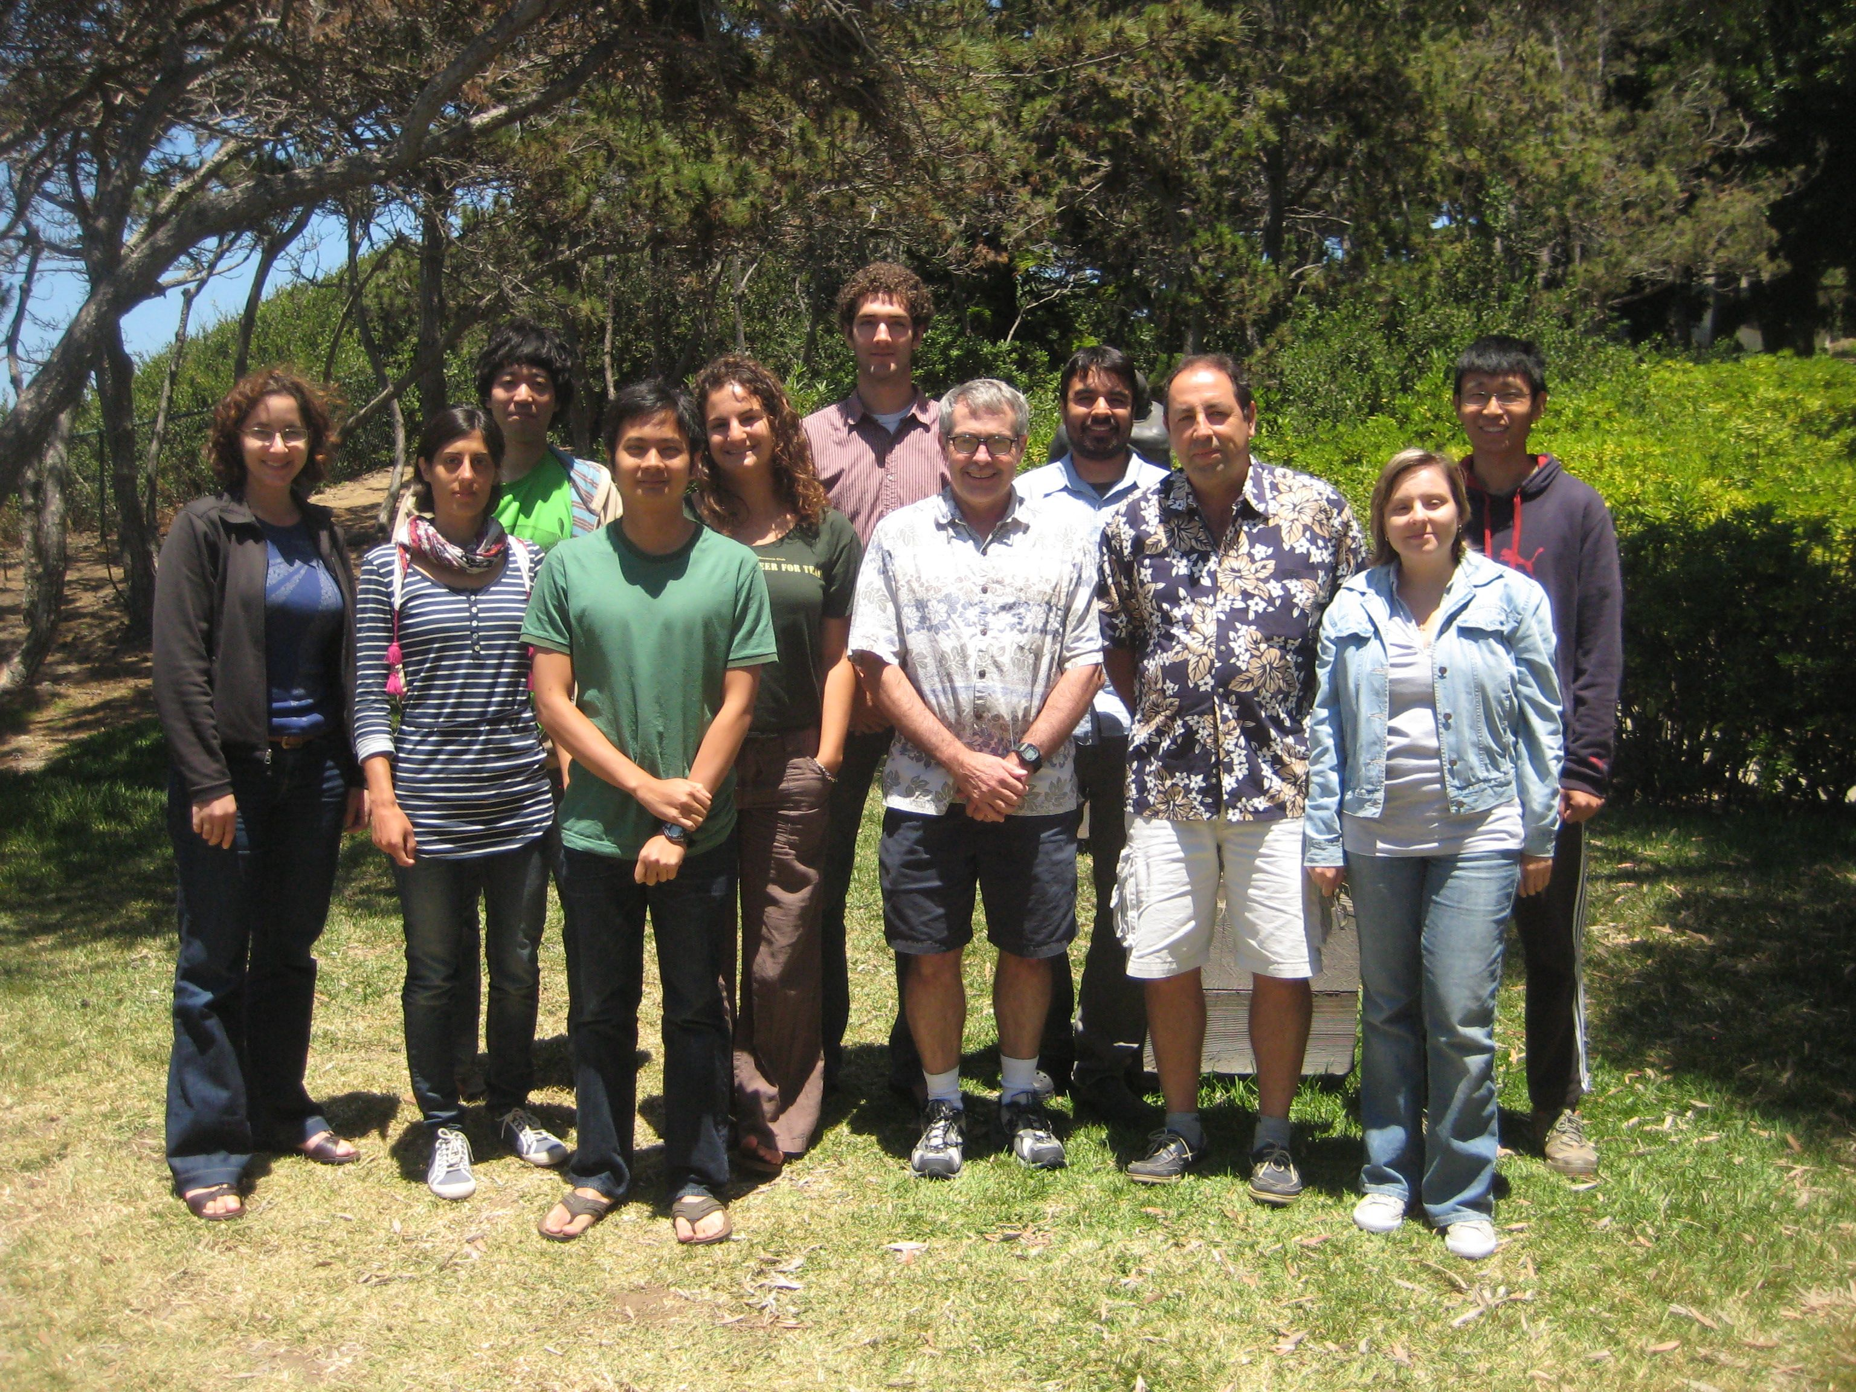
First GMTSAR Course
La Jolla, June 2011

Slide 3
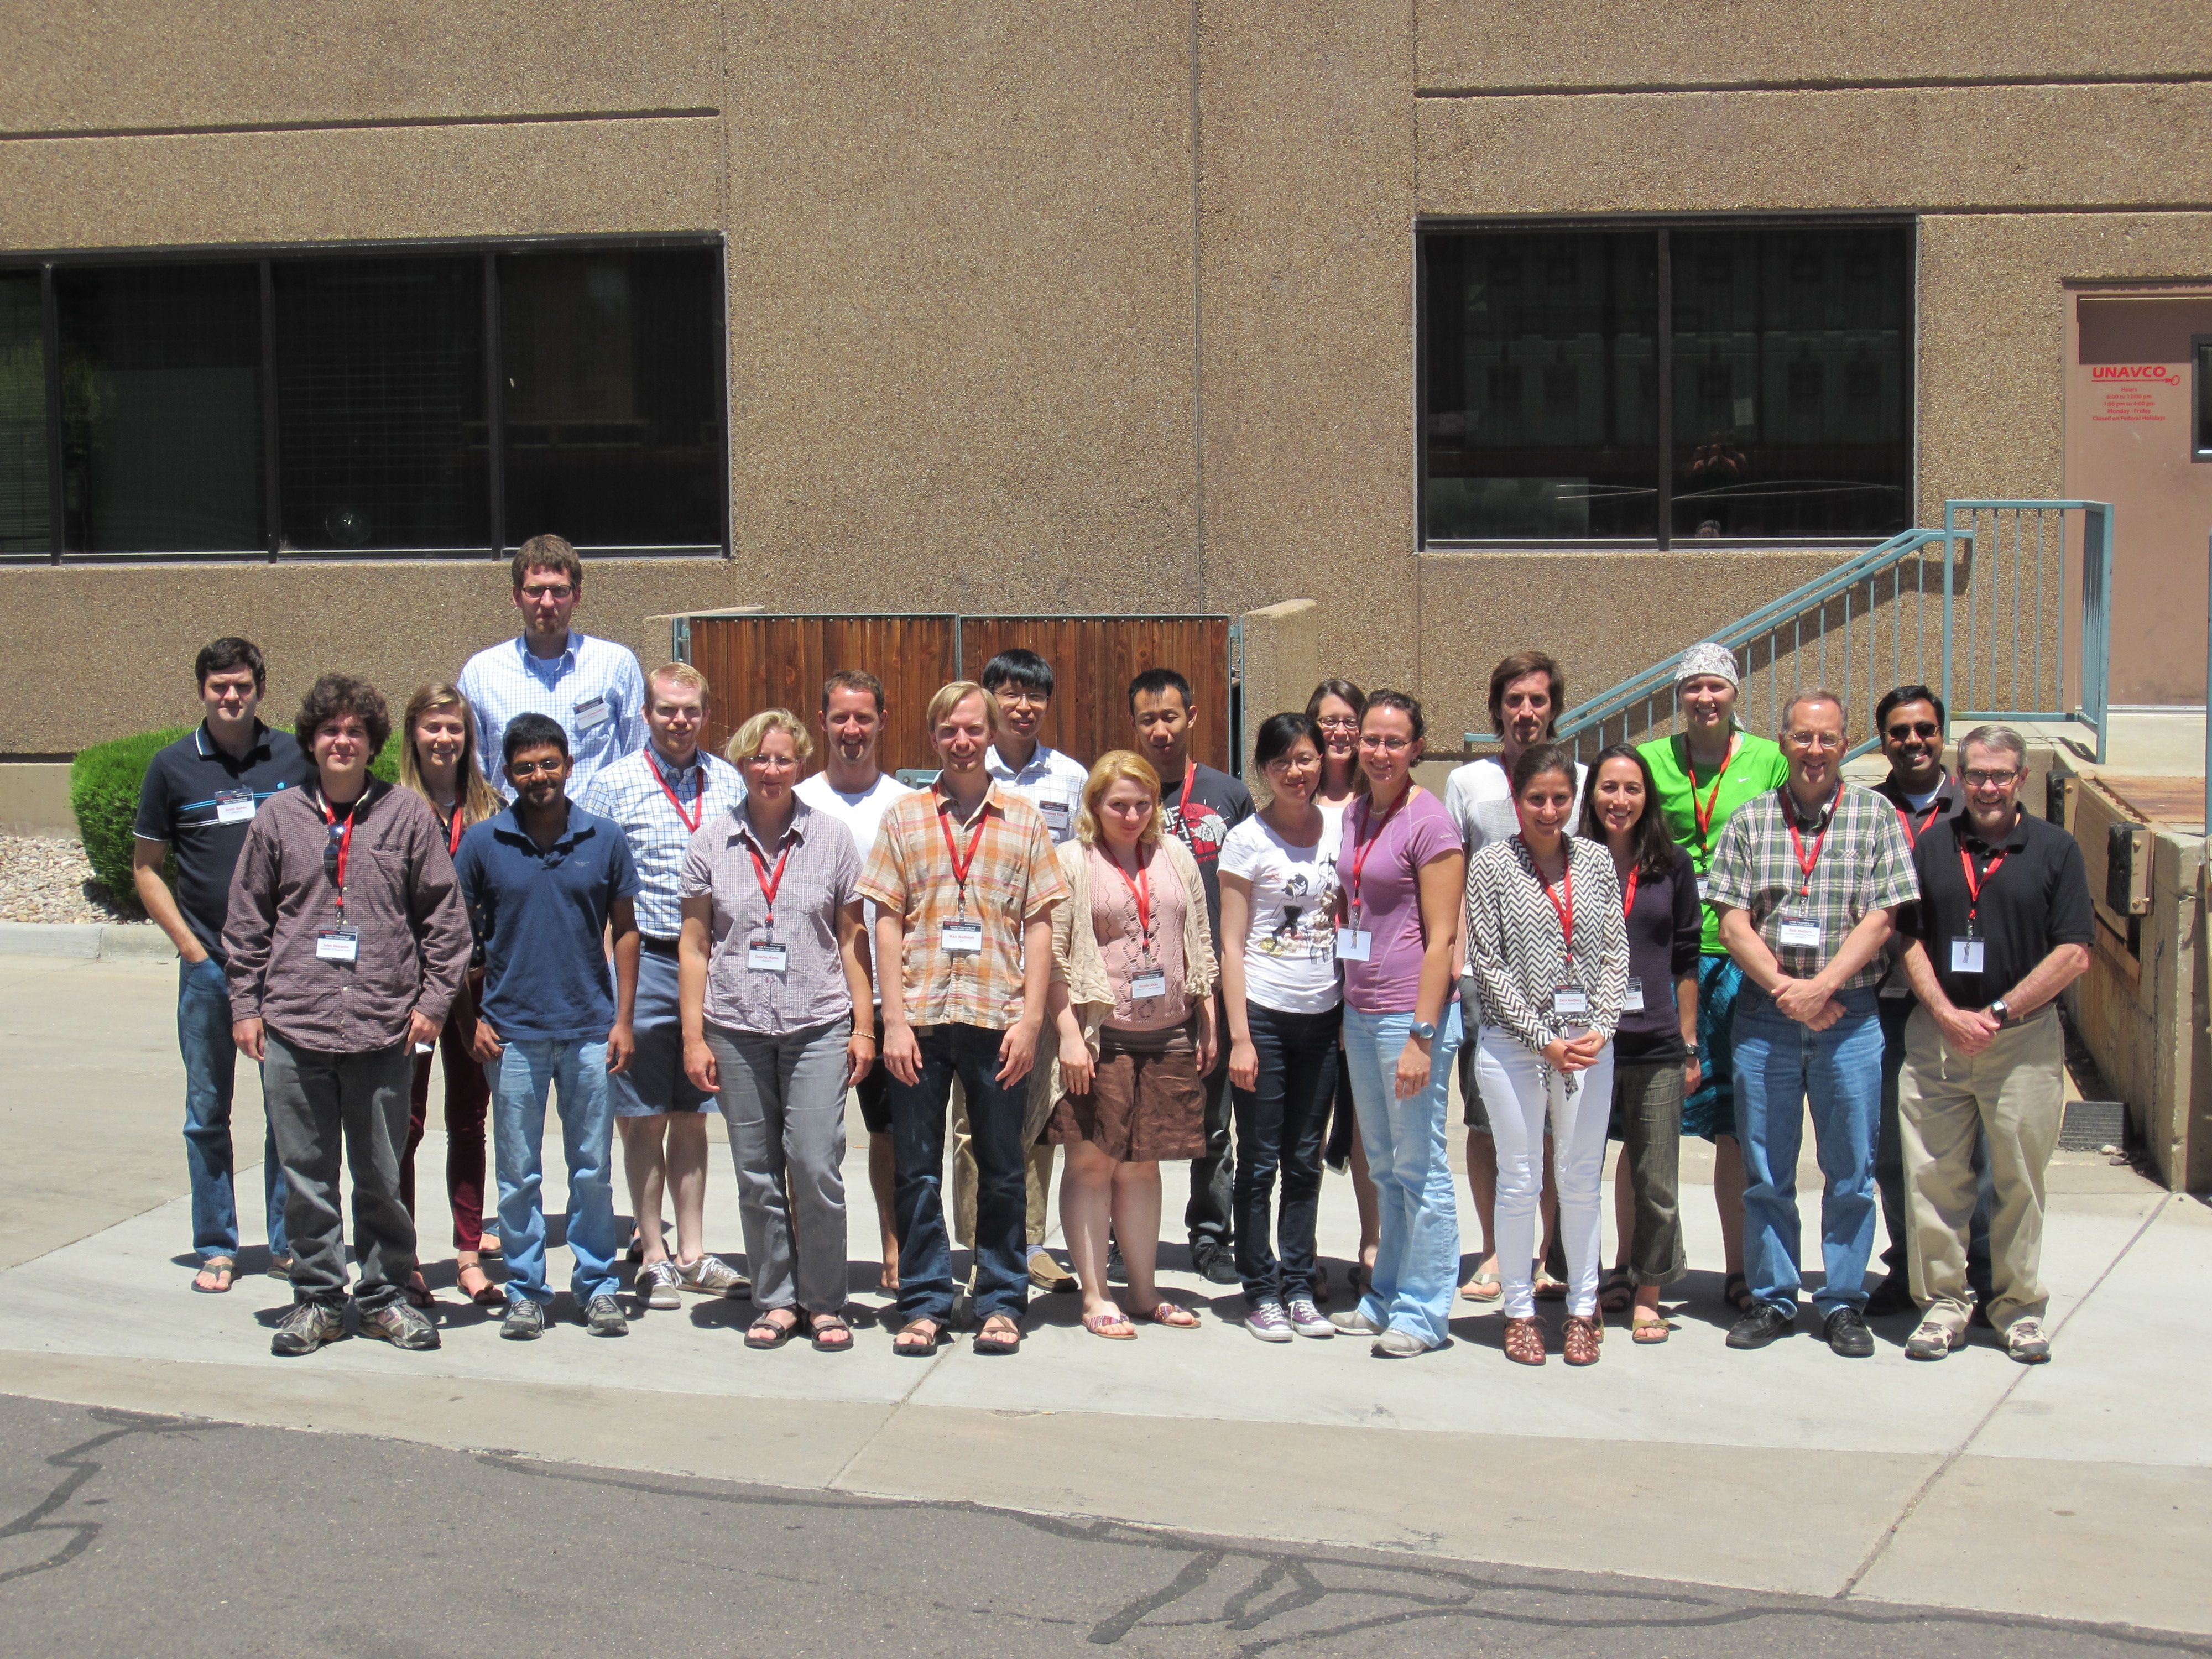
Second GMTSAR Course
UNAVCO, June 2013

Slide 4
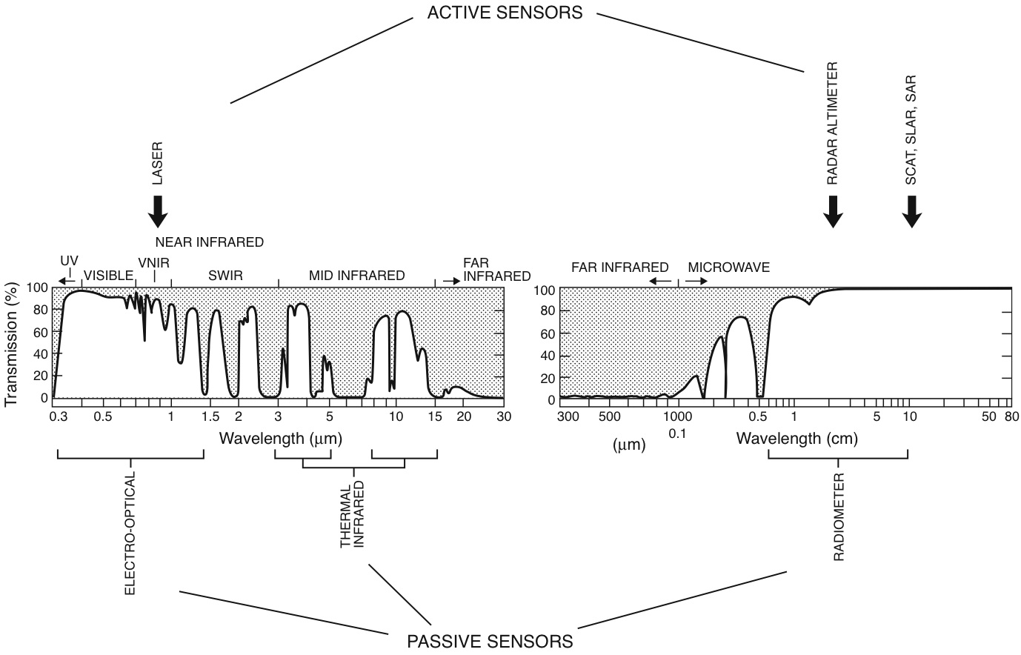
passive and active remote sensing – optical and microwave

Slide 5
GMTSAR Short Course
OUTLINE
setup UNIX, GMT, and GMTSAR – test cases
overview of SAR and InSAR
learn to select SAR scenes at UNAVCO and ASF
SAR and InSAR theory
GMTSAR overview, modules, standard InSAR processing
2-D phase unwrapping
batch processing
imaging earthquakes
student presentations of interferograms
Notes:
5

Slide 6
GMTSAR Short Course
UNAVCO
David Sandwell, Rob Mellors,
Xiaopeng Tong, Scott Baker
setup:
install UNIX and csh
make .tcshrc file
install GMT
make topography map
install GMTSAR
run test cases:
1 - OSX – Envisat
2 - FEDORA – ERS
3 - BATCH - ALOS
Notes:
6

Slide 7
.cshrc
.tcshrc
what is the . for??

Slide 8
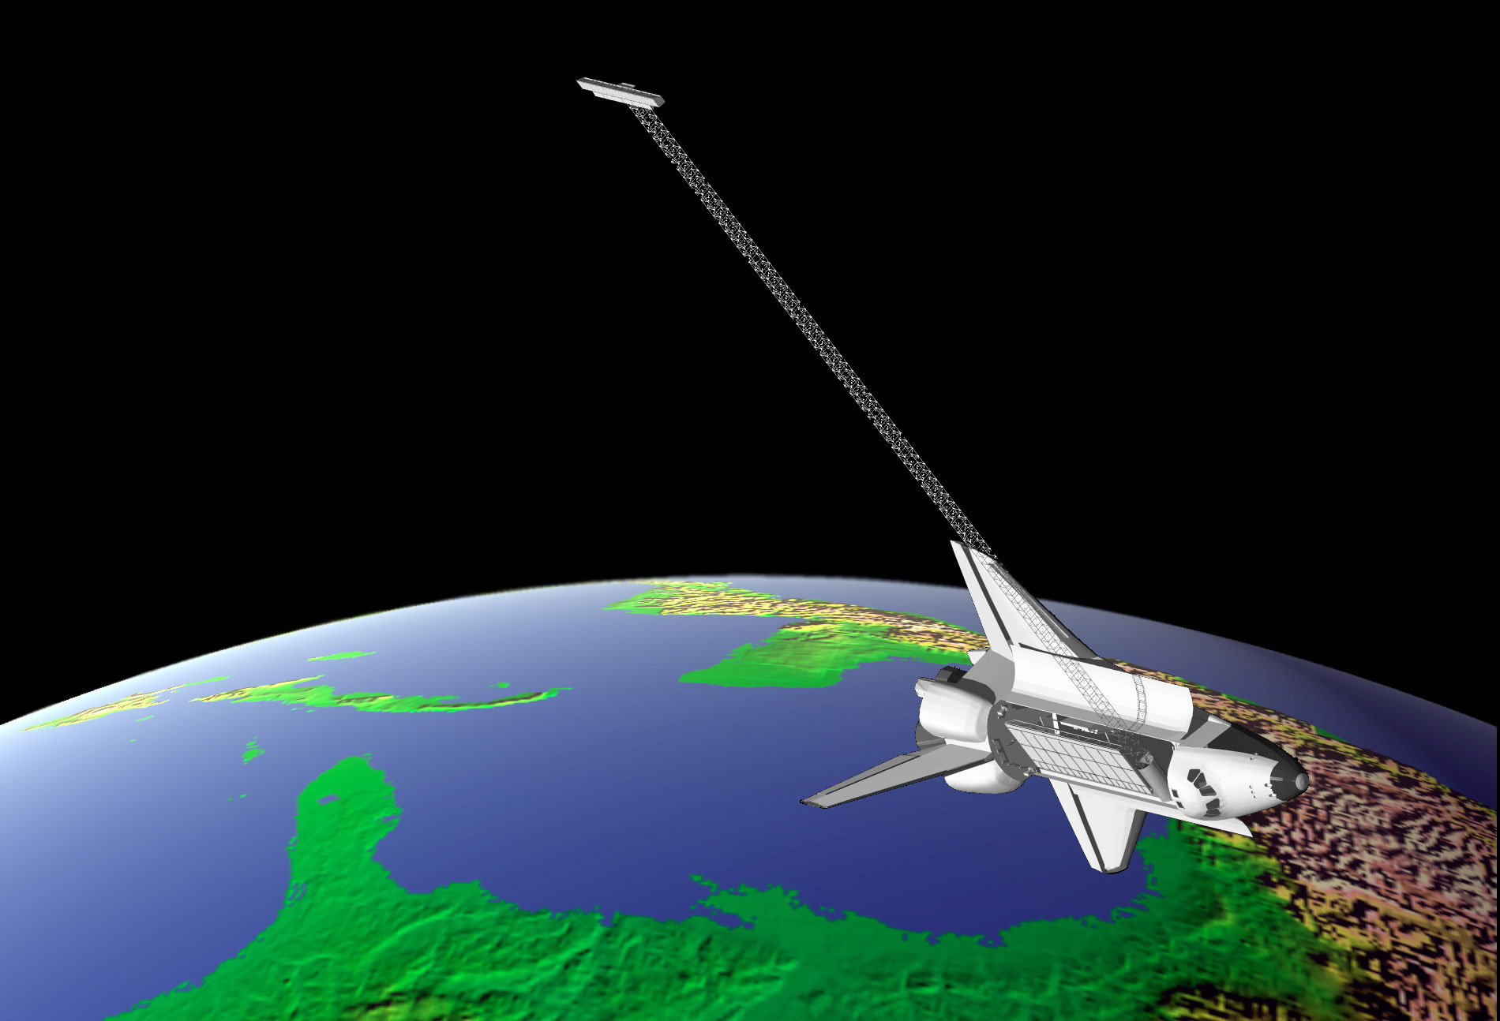
Global Topography from SRTM InSAR [Farr et al., 2005]

Slide 9
generate DEM
from SRTM

Slide 10
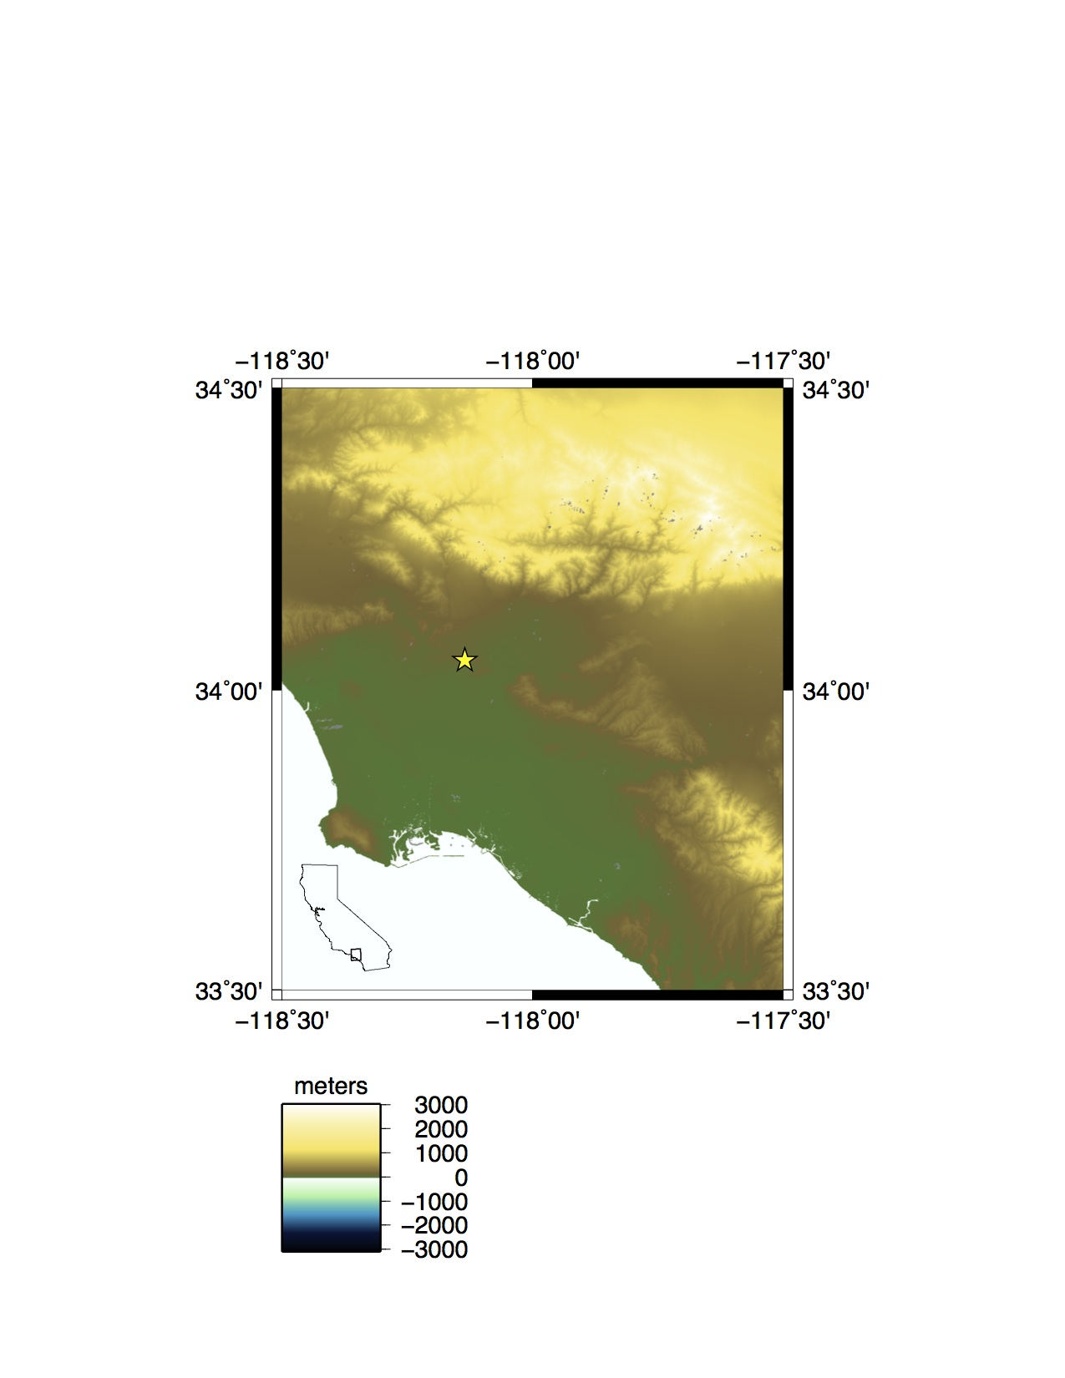
Magali Barba

Slide 11
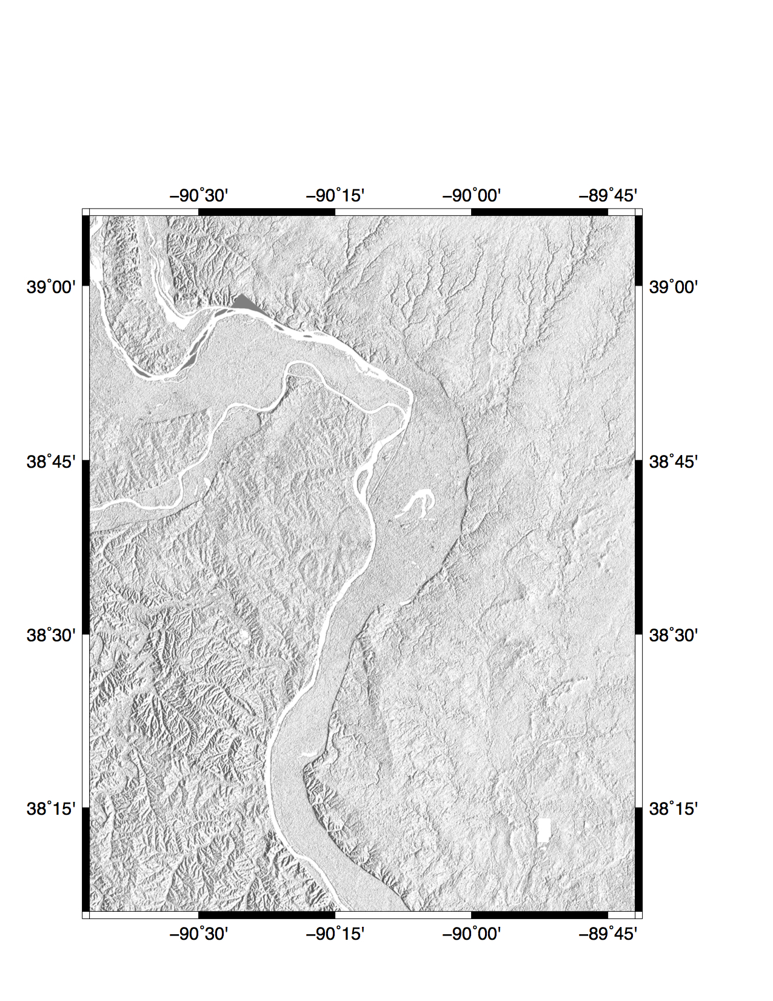
Mark Grzovic

Slide 12
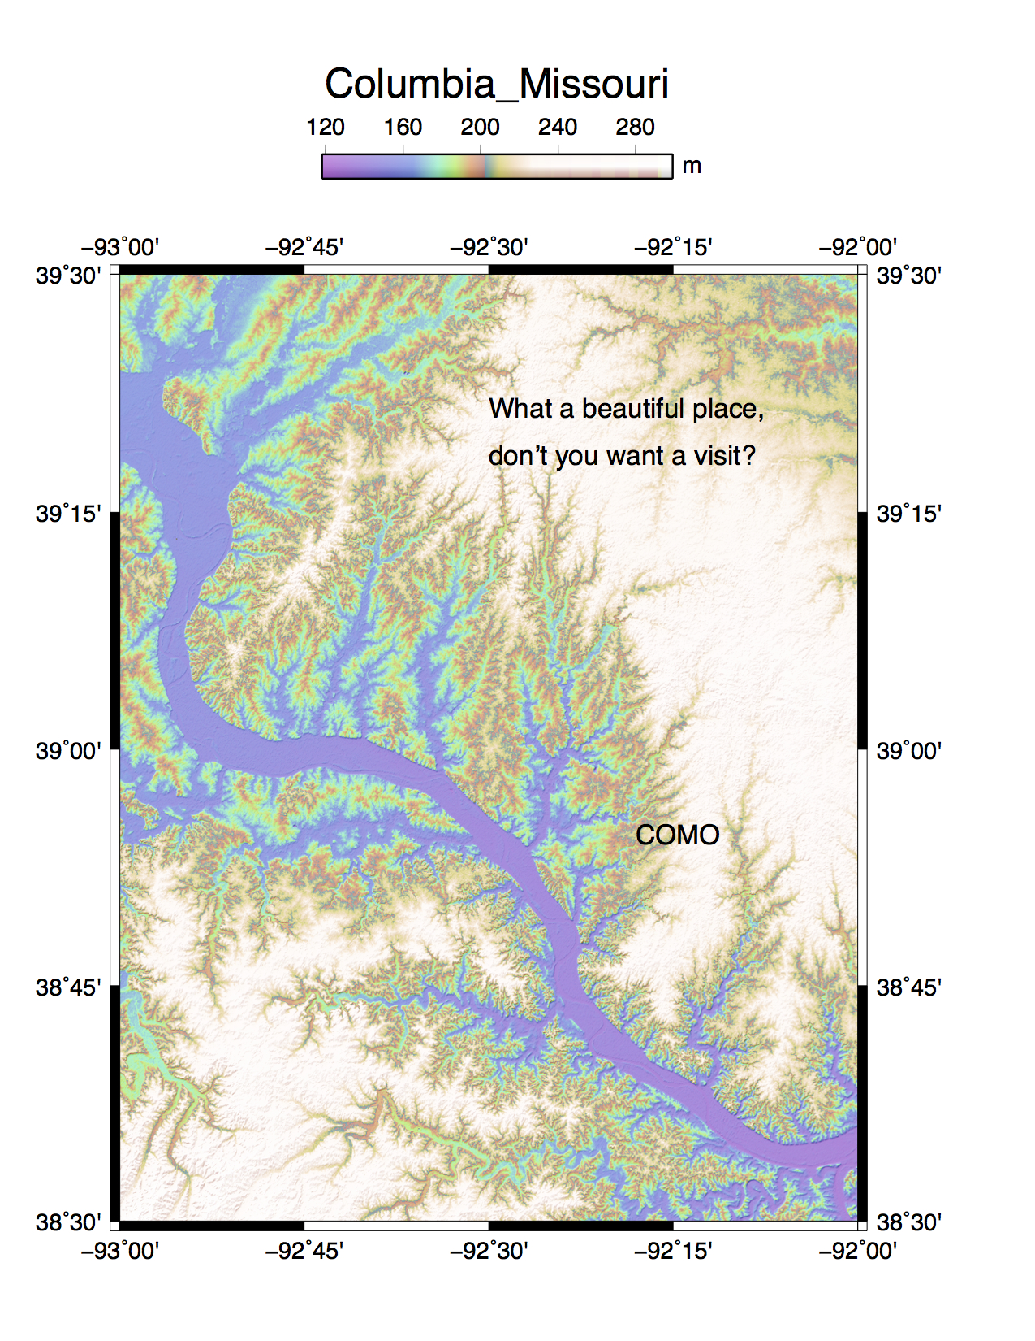
Jiyang Ye

Slide 13
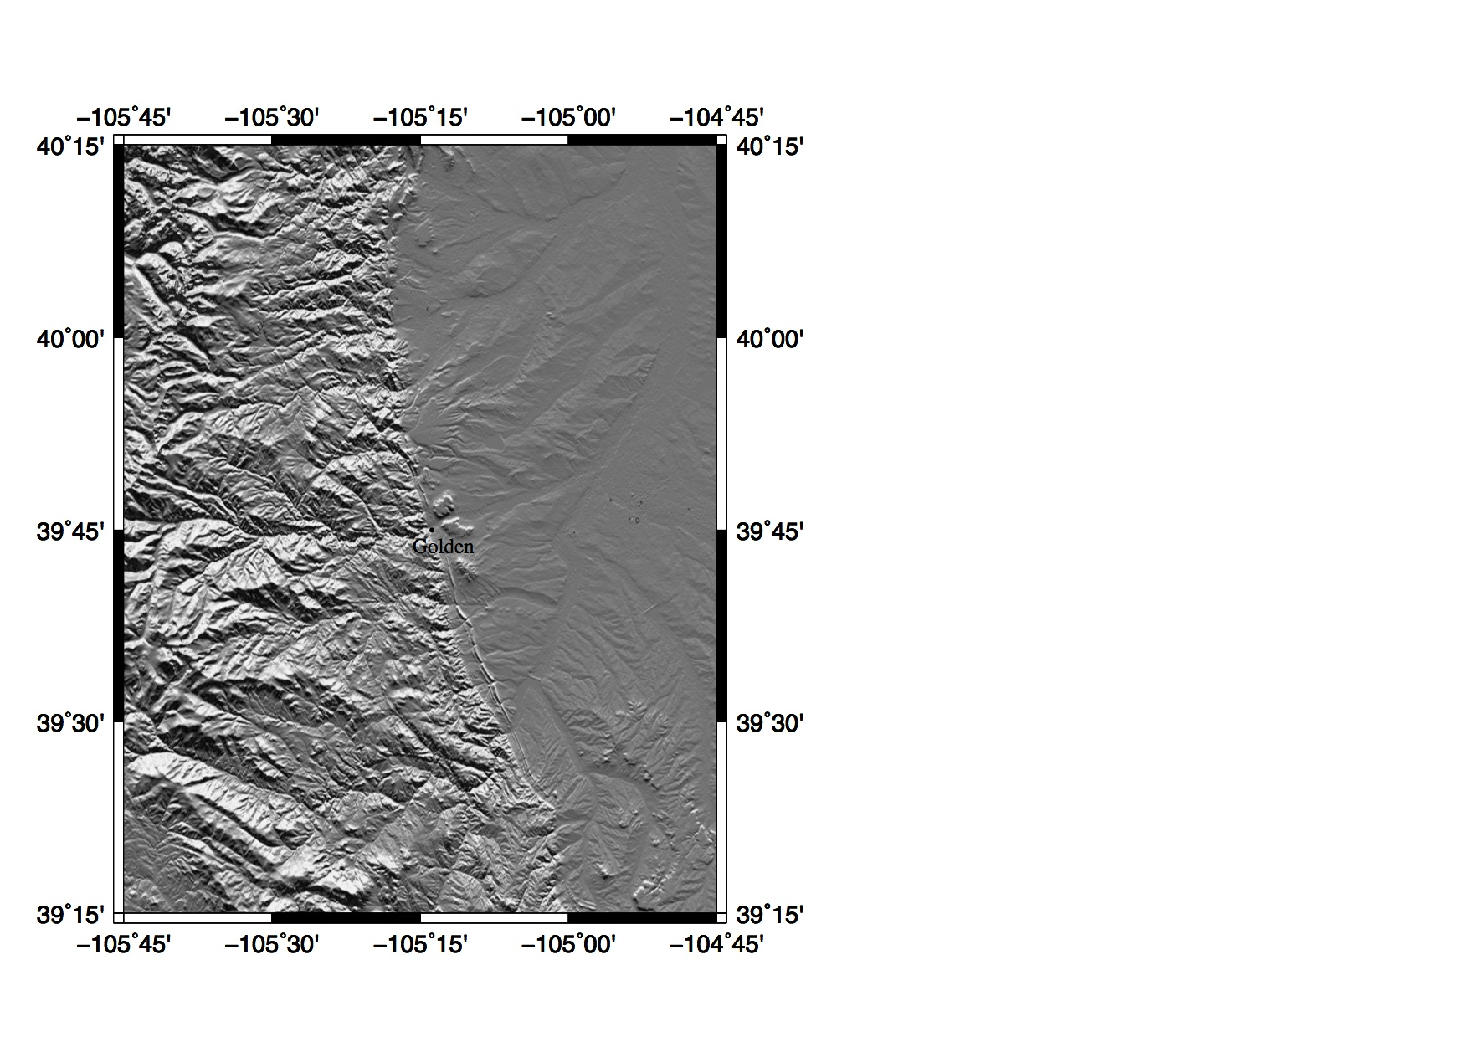
Kendra Johnson

Slide 14
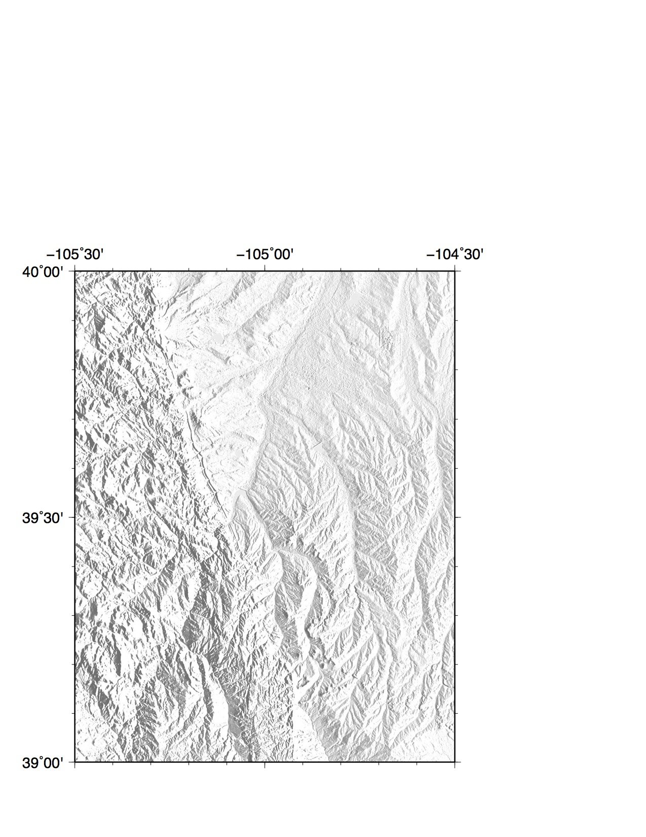
Ezgi
Karasozen

Slide 15
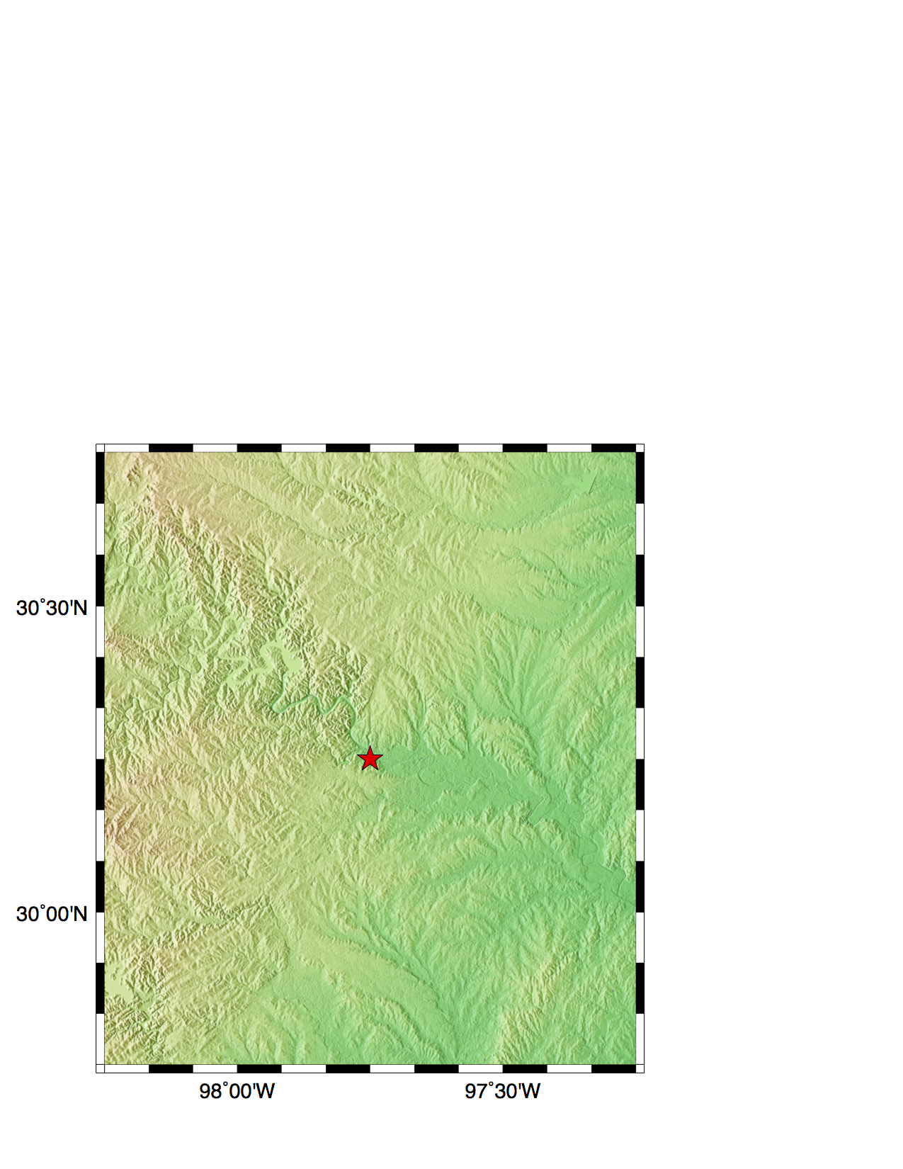
Kimberly
McCormack

Slide 16
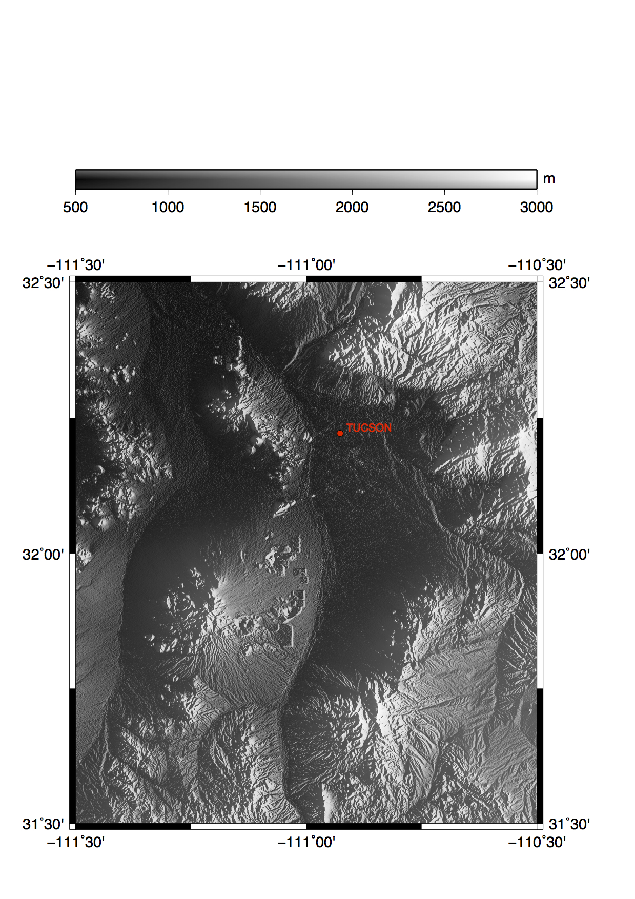
Phillip Mcfarland

Slide 17
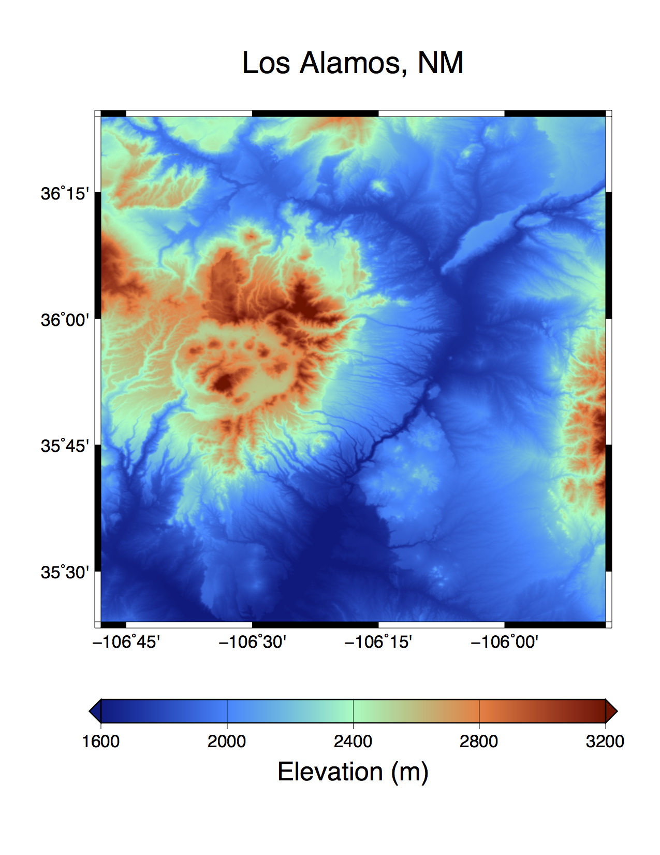
Daniel Trugman

Slide 18
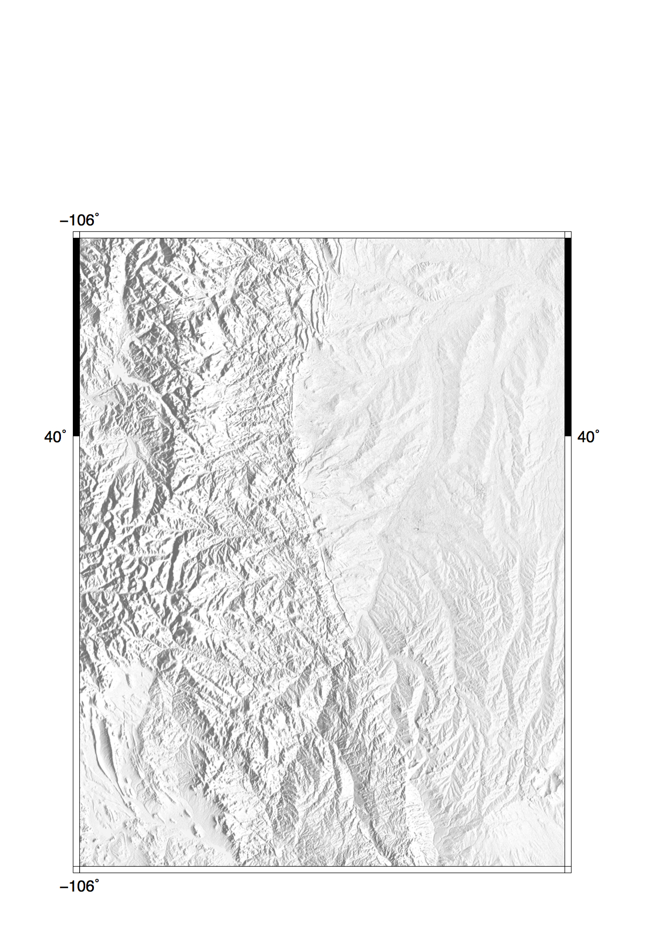
Wendy Zhou

Slide 19
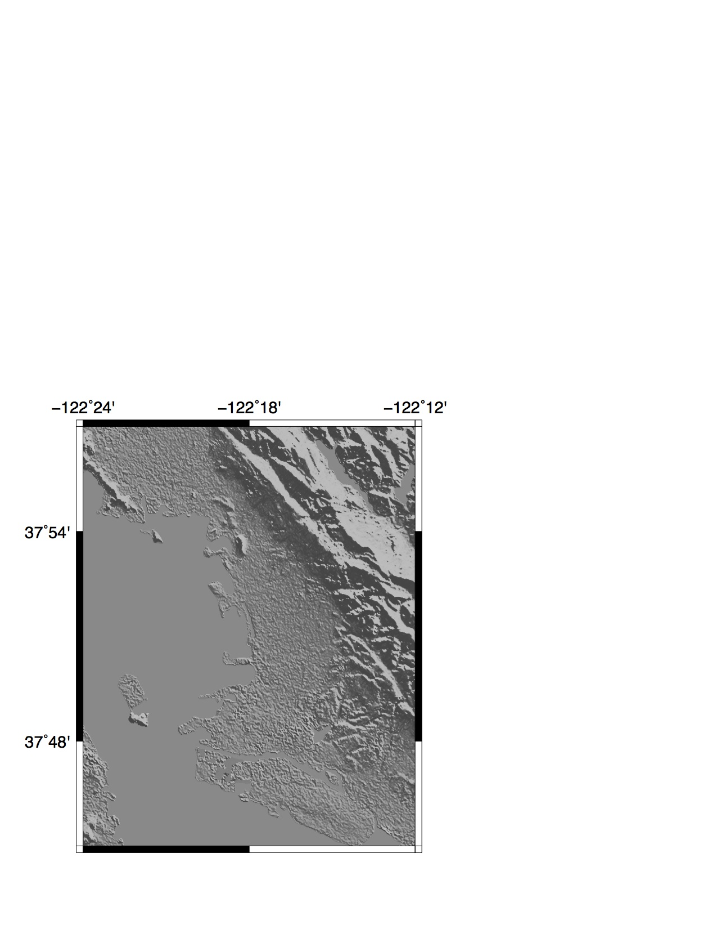
Mong-Han Huang

Slide 20
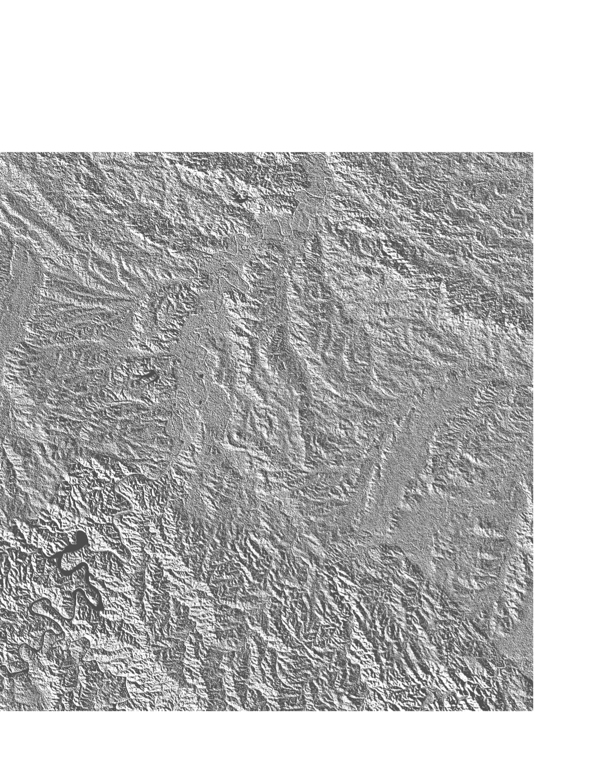
Chris Linick

Slide 21
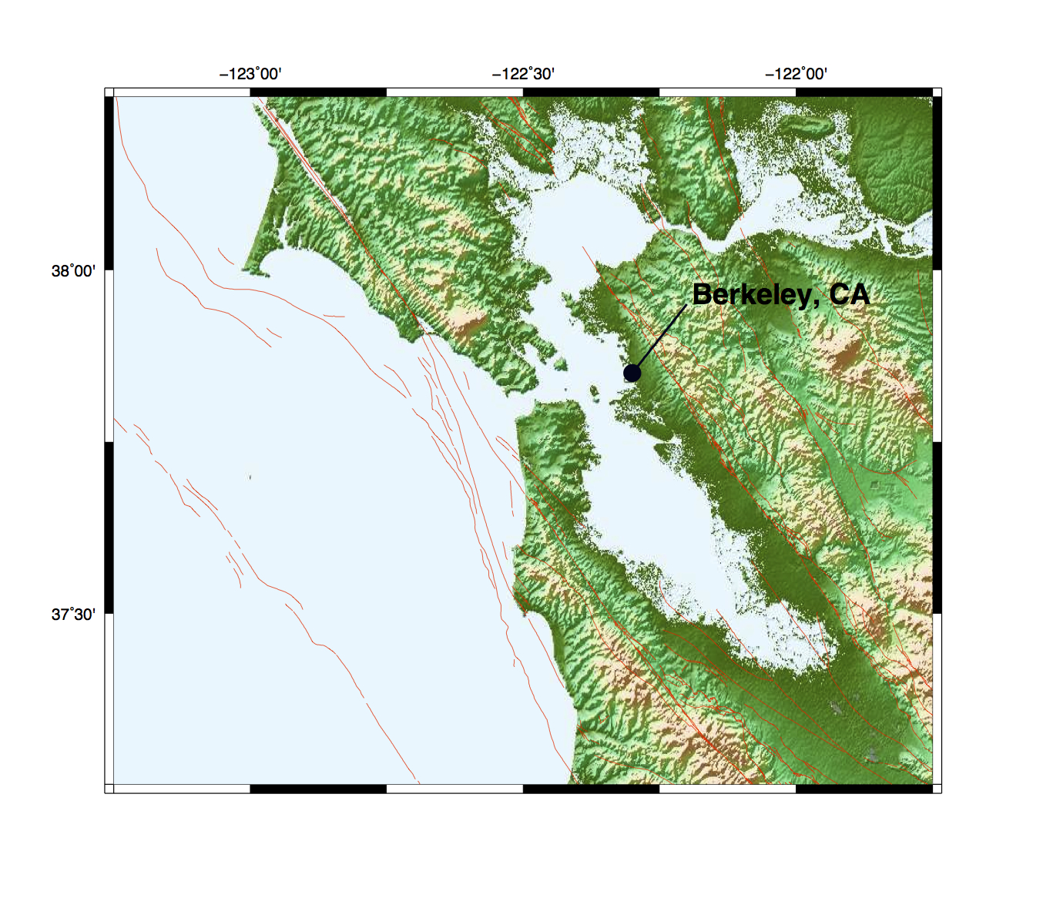
Chris Johnson

Slide 22
GMTSAR
2-pass processing
no ground control
seamless abutment of frames along track
stacking for time series
one master and many slaves
primary, secondary, tertiary, image alignment
ScanSAR Interferometry
possible but not easy
code needs refinement

Slide 23
GMTSAR Short Course
UNAVCO, July 2014
David Sandwell, Rob Mellors,
Xiaopeng Tong, Scott Baker
setup:
install UNIX and csh
make .tcshrc file
install GMT
make topography map
install GMTSAR
run test cases:
1 - OSX – Envisat
2 - FEDORA – ERS
3 – Batch - ALOS
Split into groups. Need volunteers to show working setup for each group.
Add names to group lists.
Notes:
23

