Slide 1
Track Short Course: Track Introduction and Commands
Lecture 01
Thomas Herring, MIT
Room 54-820A
tah@mit.edu

Slide 2
Schedule
Lectures 9:00-10:30 and 11:00-12:30;
Tutorial sessions 13:30-17:00
Tuesday: Cover track, the post-processing program
Wednesday: Cover trackRT, real-time processing and trackRTr the post-processing version of trackRT (used for analysis and tuning of trackRT).

Slide 3
Kinematic GPS
The style of GPS data collection and processing suggests that one or more GPS stations is moving (e.g., car, aircraft)
To obtain good results for positioning as a function of time it helps if the ambiguities can be fixed to integer values. Although with the “back smooth” option in track this is nit so critical.
Program track is the MIT implementation of this style of processing. The real time version is trackRT
Unlike many programs of this type, track pre-reads all data before processing. (This approach has its pros and cons)

Slide 4
General aspects
The success of kinematic processing depends on separation of sites
If there are one or more static base stations and the moving receivers are positioned relative to these.
For separations < 10 km, usually easy
10>100 km more difficult but often successful
>100 km very mixed results depending on quality of data collected.

Slide 5
Issues with length
As site separation increases, the differential ionospheric delays increases, atmospheric delay differences also increase
For short baselines (<2-3 km), ionospheric delay can be treated as ~zero and L1 and L2 ambiguities resolved separately. Positioning can use L1 and L2 separately (less random noise).
For longer baselines this is no longer true and track uses the MW-WL to resolve L1-L2 cycles

Slide 6
Track features
Track uses the Melbourne-Wubena Wide Lane to resolve L1-L2 and then a combination of techniques to determine L1 and L2 cycles separately.
“Bias flags” are added at times of cycle slips and the ambiguity resolution tries to resolve these to integer values.
Track uses floating point estimate with LC, MW-WL and ionospheric delay constraints to determine the integer biases and the reliability with which they are determined.
Kalman filter smoothing can be used. (Non-resolved ambiguity parameters are constant, and atmospheric delays are consistent with process noise). When atmospheric delays are estimated, the smoothing option should always be used.

Slide 7
Ambiguity resolution
Algorithm is “relative-rank” approach. Chi-squared increment of making L1 and L2 ambiguities integer values for the best choice and next best are compared. If best has much smaller chi-squared impact, then ambiguity is fixed to integer values.
Test is on inverse-ratio of chi-squared increments (i.e., Large relative rank (RR) is good).
Chi-squared computed from:
  Match of LC combination to estimated value (LC)
  Match to MW-WL average value (WL)
  Closeness of ionospheric delay to zero (less weight on longer baselines) (LG)
Relative weights of LC, WL and LG can be set.
Estimates are iterated until no more ambiguities can be resolved.

Slide 8
Basic GPS phase and range equations
Basic equations show the relationship between pseudorange and phase measurements

Slide 9
L1-L2 and Melbourne-Wubena Wide Lane
The difference between L1 and L2 phase with the L2 phase scaled to the L1 wavelength is often called simply the widelane and used to detect cycle slips. However it is effected fluctuations in the ionospheric delay which in delay is inversely proportional to frequency squared.
The lower frequency L2 has a larger contribution than the higher frequency L1
The MW-WL removes both the effects on the ionospheric delay and changes in range by using the range measurements to estimate the difference in phase between L1 and L2

Slide 10
MW-WL Characteristics
In one-way form as shown the MW-WL does not need to be an integer or constant
Slope in one-way is common, but notice that both satellites show the same slope.
If same satellite-pair difference from another station (especially when same brand receiver and antenna) are subtracted from these results then would be an integer (even at this one station, difference is close to integer)
The MW-WL tells you the difference between the L1 and L2 cycles. To get the individual cycles at L1 and L2 we need another technique.
There is a formula that gives L1+L2 cycles but it has 10 times the noise of the range data (f/f) and generally is not used.

Slide 11
Melbourne-Wubena Wide Lane (MW-WL)
Equation for the MW-WL. The term Rf/c are the range in cycles (notice the sum due to change of sign ionospheric delay)
The Δf/Σf term for GPS is ~0.124 which means range noise is reduced by a about a factor of ten.
The ML-WL should be integer (within noise) when data from different sites and satellites (double differences) are used.
However, receiver/satellite dependent biases need to be accounted for (and kept up to date).

Slide 12
Example MW-WL PRN 07 and PRN 28)

Slide 13
EX-WL Extra-Wide-lane
The other measure of the difference in cycles between L1 and L2 used by track is the EX-WL (Extra Widelane).
This measure is independent of geometry but is affected by the ionospheric delays. On short separations this measure is often more robust than the MW-WL.

Slide 14
Basic Inputs for track.
Track runs using a command file
The base inputs needed are:
  Obs_file specifies names of rinex data files. Sites can be K kinematic or F fixed
  Nav_file orbit file either broadcast ephemeris file or sp3 file
  Mode air/short/long -- Mode command is not strictly needed but it sets defaults for variety of situations
  Normally back_type smooth would also be specified.
Normally start with just these commands and see how the run looks and based on this output start tuning track.

Slide 15
Basic use
Recommended to start with above commands and see how the solution looks
Usage: track -f track.cmd >&! track.out
Basic quality checks:
grep RMS of output file
      Kinematic site rovr appears dynamic Coordinate RMS XYZ 283.44 662.53 859.17 m.
      For 2067 Double differences: Average RMS 17.85 mm
Check track.sum file for ambiguity status and RMS scatter of residuals.

Slide 16
Track command line
% track -f <command file> -a <ambiguity file> -d <day> -w <week> -s <S01> <S02> .. <S10>
where <command file> is a required file containing a list of commands to control the program (see below)
<ambiguity file> is an optional file containing a modified set of integer bias parameters and settings (see full description below).
<day> the string in this argument replaces <day> in the command file lines (e.g., bas1<day>0.03o will become bas12220.03o if the -d 222 option is given.
<week> the string here will replace any <week> strings in the command file (useful for the nav_file name which could be a week of concatenated sp3 files.
<S01>, <S02> .. <S10> are up to 10 strings that can be replaced in the command file i.e. the string <S01> in the command file will be replaced by the first string, <S02> by the second and so on. If one the strings is called space (all lower case), the corresponding <SXX> entry will be replaced by a blank character (This provides a means to un-comment lines)

Slide 17
Basic use: Things to check
Check on number of ambiguities (biases) fixed
  grep FINAL <summary file>
A 3 in column “Fixd” means fixed, 1 means still floating point estimate
If still non-fixed biases or atmospheric delays are estimated then smoothing solution should be made (back_type smooth)
output in NEU, geodetic, DHU, XYZ coordinates. NEU are simple North East distances and height differences from fixed site. (Convenient for plotting and small position changes). DHU is similar but difference are from the apriori coordinates of the site.

Slide 18
More advanced features
Track has a large help file which explains strategies for using the program, commands available and an explanation of the output and how to interpret it.
It is possible to read a set of ambiguities in.
  Works by running track and extracting FINAL lines into an ambiguity file. Setting 7 for the Fixd column will force fix the ambiguity. ambiguity file is then read into track (-a option or ambin_file)

Slide 19
Advanced features
Commands allow control of how the biases are fixed and editing criteria for data
Editing is tricky because on moving platform, jumps in phase could simply be movement
Ionospheric delay and MW WL used for editing.
Explicit edit_svs command
Explicit add and remove bias flags

Slide 20
Main Tunable commands
BF_SET <Max gap> <Min good>
  Sets sizes of gaps in data that will automatically add bias flag for possible cycle slip. Default is 1, but high rate data often misses measurements.
ION_STATS <Jump>
  Size of jump in ionospheric delay that will be flagged as cycle slip. Can be increased for noisy data
FLOAT_TYPE <Start> <Decimation> <Type> <Float sigma Limits(2)> <WL_Fact> <Ion_fact> <MAX_Fit> <RR>
  Main control on resolving ambiguities. Float sigma limits (for LC and WL) often need resetting based on data quality.
  <WL_Fact> <Ion_fact> control relative weights of WL and LG chi-squared contributions.
  RR is relative rank tolerance
Fcode in output is diagnostic of why biases are not resolved.

Slide 21
Other common commands
USR_ADDBF <site> <prn #> <time (ymdhms)>
Allows user to add a bias file at site <site> for PRN <prn #> at time <time>. First valid measurement at or after time will be flags.
USR_DELBF <site> <prn #> <time (ymdhms)>
Allows user to delete a bias file at site <site> for PRN <prn #> at time <time>. The time must match within 50% of sampling interval.

Slide 22
Some results
Examine the short baseline MIT results: Look at this example in more detail later
April 4, 2010 El-Mayor Cucapah earthquake in Baja California: 5-Hz results. Look later at long baseline processing for these sites.

Slide 23
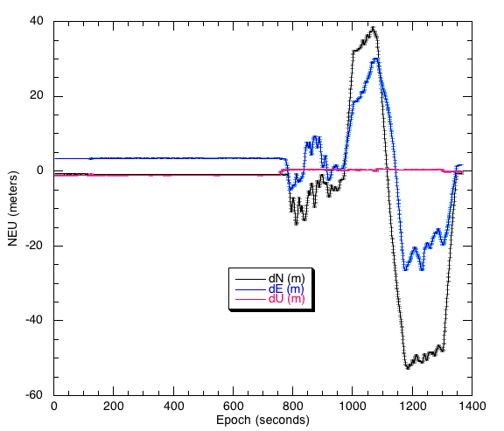
MIT Short Example
Analysis with LC data type

Slide 24
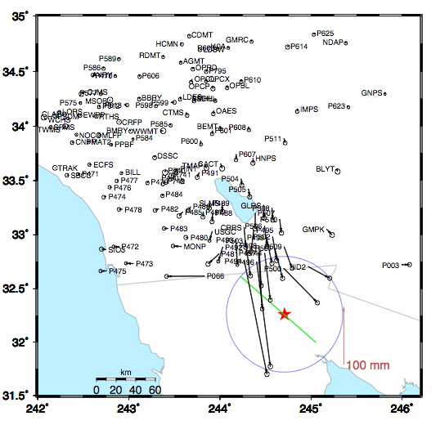
Coseismic offsets
Offsets based on 2-days before and after earthquake.
Two days used is reduce leakage of postseismic motions.
Red Star is epicenter; blue circle is 60 km (15-20 seconds surface wave speed)

Slide 25
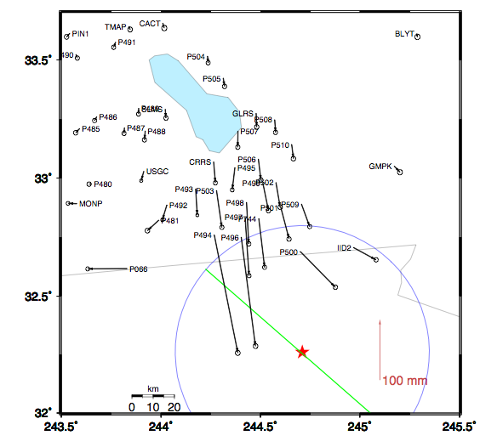
Zoom around border
Sites near the epicenter.
Blue circle is 60 km radius
Displacements
P494 200 mm
P496 182 mm
P497 97 mm
…
P491 9 mm

Slide 26
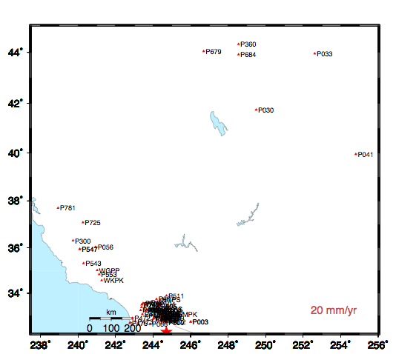
High-rate GPS site download
1Hz reference site
High rate data from these sites downloaded after event.
Most sites are 5-Hz; more distant sites are 1-Hz.
Reference site for high rate positioning

Slide 27
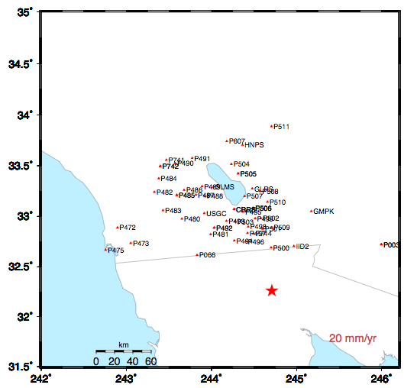
Sites in coseismic region
Sites shown have 5-Hz data for 3-days before and after the earthquake
Examine sequence of sites along US/Mexico border and North
Notes:
P494, P496 P500 P066 P473 P472 sequence in next slides.

Slide 28
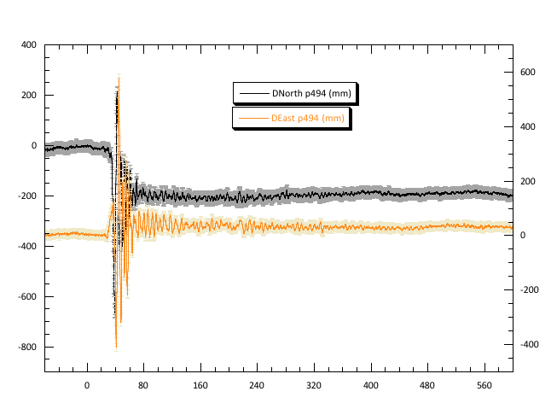
P494

Slide 29
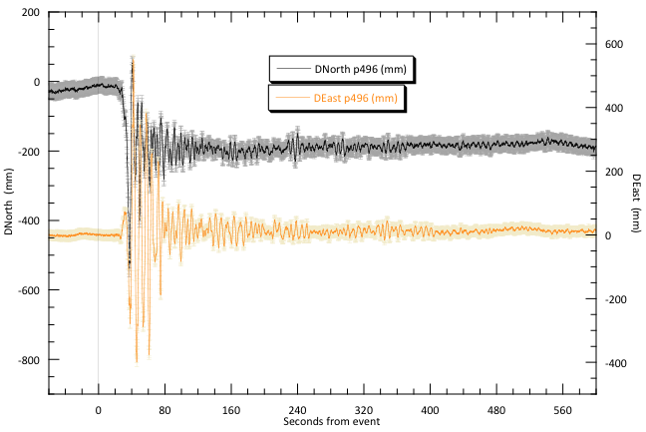
P496

Slide 30
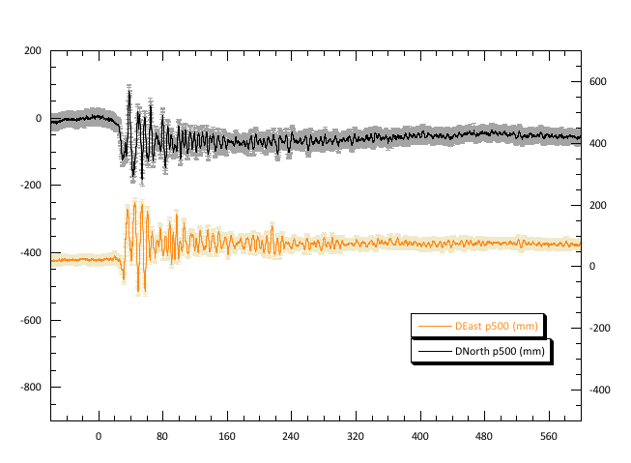
P500

Slide 31
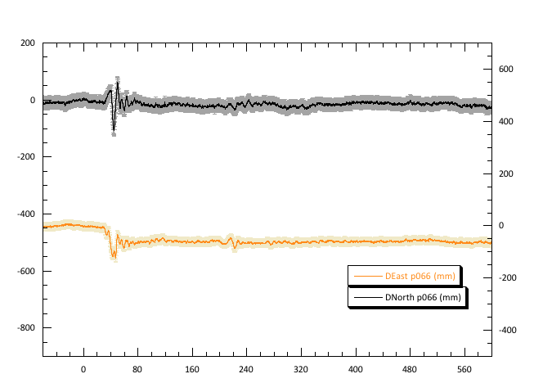
P066

Slide 32
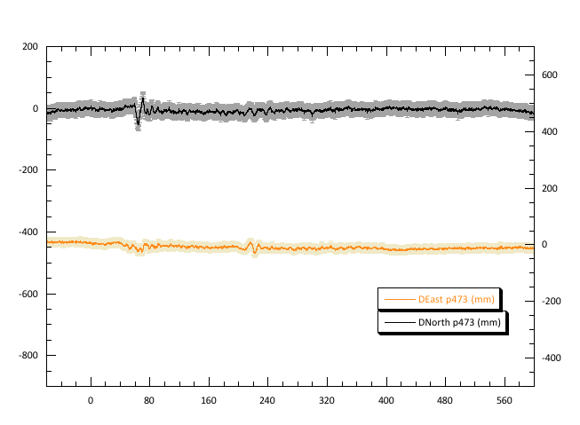
P473
Notes:
Note that this and the next site are similar distances from the epicenter but P742 is along the San Andreas. Also point out the 220-sec arrival

Slide 33
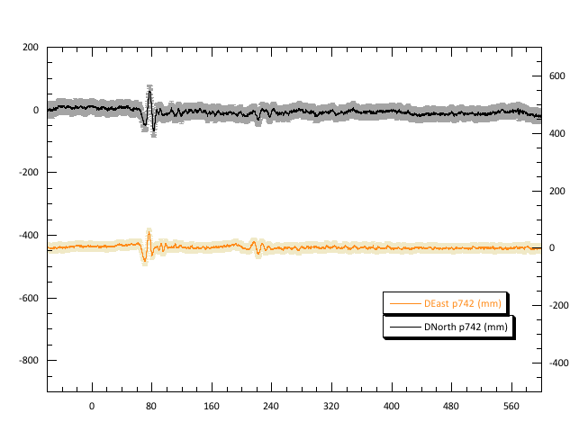
P742

Slide 34
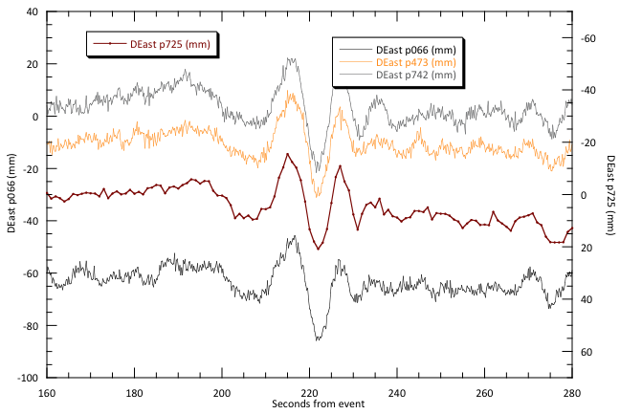
Surface wave arrival at P725
P725 is ~600 km from epicenter. This signal common to sites is the arrival at the “reference site”
Notes:
Low rate data from distance reference site (with sign flipped)

Slide 35
Next
Next lecture will look at commands in more detail
Tutorial session will also look at some of these results.

