Slide 1
UNAVCO & InSAR Training and Education
Dr. Donna J. Charlevoix, Director Education & Community Engagement
Dr. Beth Pratt-Sitaula, Education Specialist
22 October 2018
Synthetic Aperture Radar Literacy and Training Workshop
Notes:
UNAVCO mission statement including education support
What UNAVCO is, funded by, includes support for InSAR (WInSAR)
“UNAVCO, a non-profit university-governed consortium, facilitates geoscience research and education using geodesy.”

Slide 2
a non-profit university-governed consortium, facilitating geoscience research and education using geodesy
NSF-funded: Earth Sciences (EAR), Polar (PLR)
NASA funded
Organizational and
operational support for WInSAR activities.
Education & Community Engagement Program
Short courses (organization, student support, online course materials)
Educational materials
Notes:
UNAVCO is governed by the community
Funded by NSF and NASA
Provides support for WInSAR consortium
ECE hosts technical short courses, provides funding for graduate students and post-docs; creates educational materials and disseminates information about SAR, broadly

Slide 3
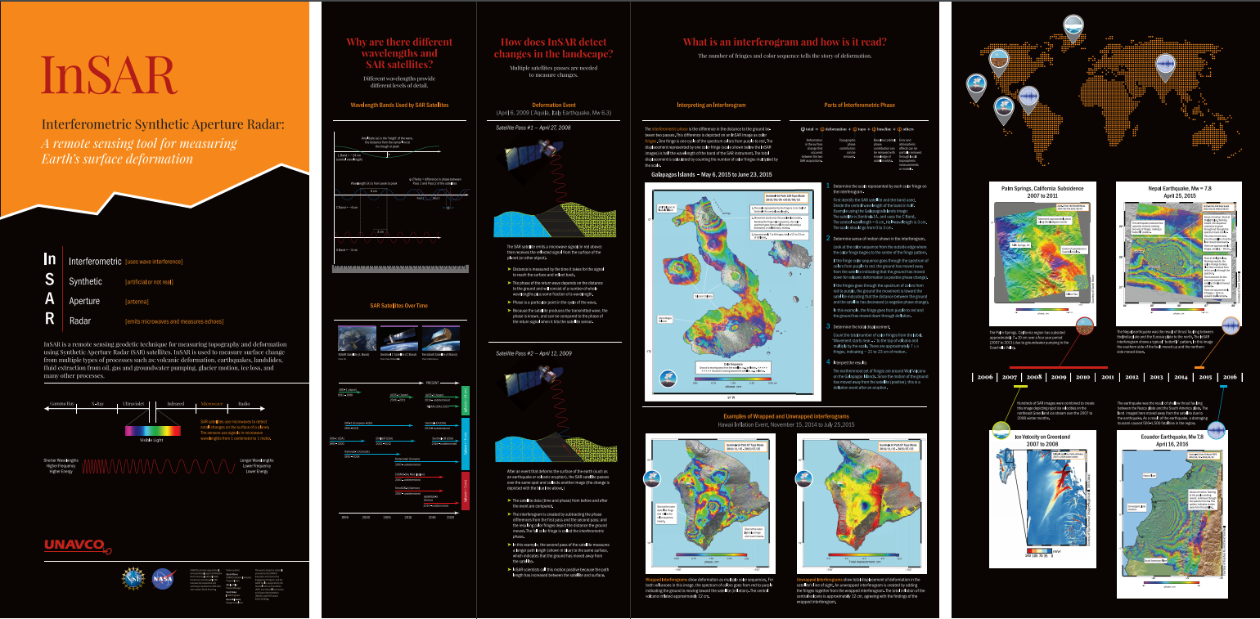
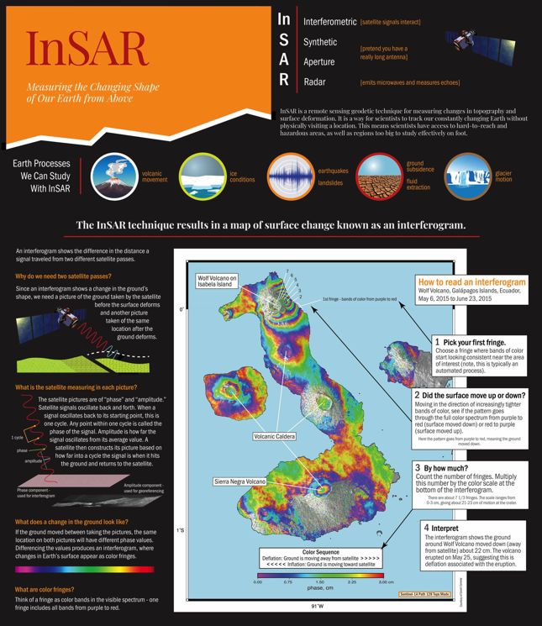
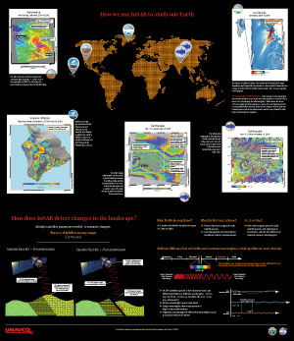
InSAR Education & Outreach
Wall display at UNAVCO Headquarters in Boulder
Created by graduate student intern
Wall display converted to poster for distribution
UNAVCO has the ability to consider other SAR-focused support activities in education & outreach
Notes:
Intern spent summer making the SAR display
Getting transferred to poster

Slide 4
InSAR Short Courses
Offered based on community requests
Focus on data managed by UNAVCO
Audience: current researchers including post-docs & graduate students
Financial support available for students (“participant support”)
Taught by community experts
Course materials archived online
Recordings of courses available online

Slide 5
InSAR Short Courses
2008 – 2018 (2014 started remote option)
12 Short courses, 429 Participants
42 countries represented; 56% U.S.
(Mexico, 7%; China & Canada 4%; India 3%)
Most common: Male, Caucasian,
non-Hispanic, graduate student
Notes:
UNAVCO SAR training workshops have evolved, numbers of attendees (where from, student/faculty, PS recipients), GMTSAR, ISCE, who funds, survey results of overall satisfaction; online vs in person; Jupyter vs not; how frequently the online materials are accessed?
Explain about UNAVCO sponsored short courses (funding from GAGE and maybe a few GDS other awards)
Donna should have these numbers
Note: all materials from courses are posted online
Note: instructors donate their time (thus it is volunteer and not scalable with same people)
Evolution
first one listed on UNAVCO website is 2008
Started online ~2014 (at least that’s what show on the UNAVCO short course websites
David Sandwell allowed online participants in 2018 for first time
SAR ICSE started application process for 2018 for first time

Slide 6
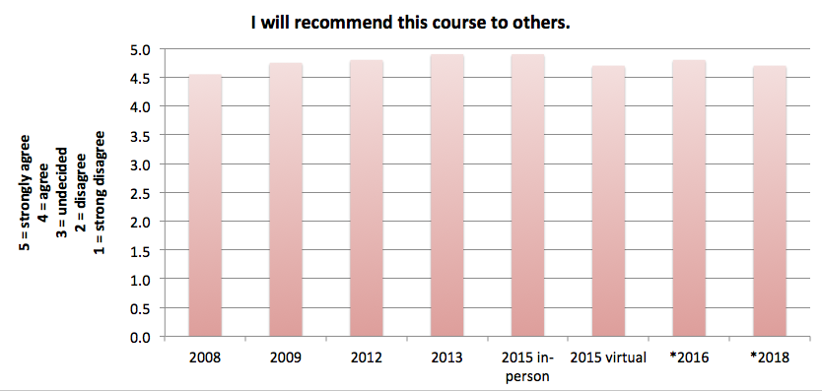
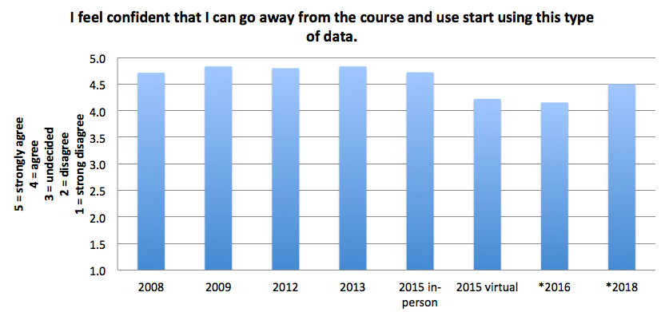
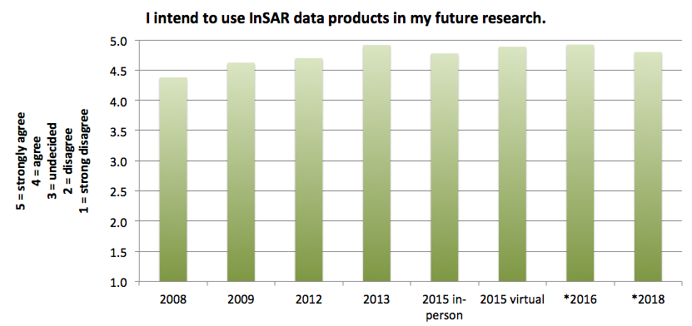
InSAR Short Course Survey Results
Included Jupyter notebook
* low% responses
Would recommend = 4.8/5
Confident to use = 4.6/5
Intend to use = 4.8/5
Notes:
Results are from the Paul Rosen/Eric Fielding group – Roipac followed by ISCE-GIaNT-StaMPS (most but not all years – missing 2010, 2011, 2014)

Slide 7
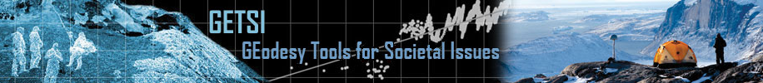
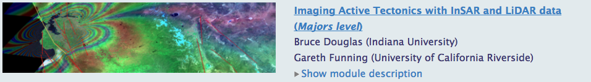
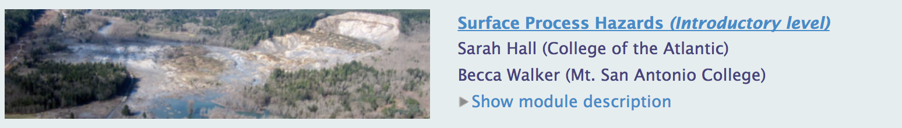

GETSI and InSAR
Mission: Develop and disseminate teaching and learning materials that feature geodesy data & quantitative skills applied to critical societal issues such as climate change, water resources, and natural hazards
US National Science Foundation funded (3 grants)
Partnership with Science Education Resource Center (SERC) and National Association of Geoscience Teachers (NAGT)
Developing dozen modules (~2 weeks each)
  Introductory & Majors-level
  Classroom & field
Modules with InSAR
Monitoring Volcanic Hazards (Intro) – coming in 2019
Notes:
InSAR in GEodesy teaching resources

Slide 8
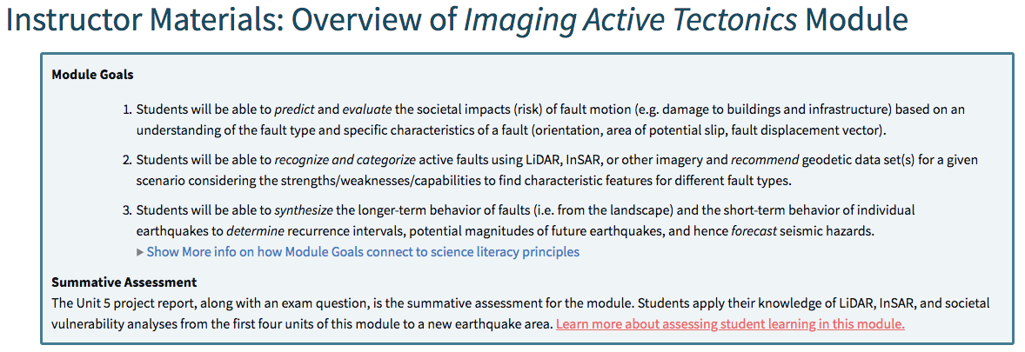
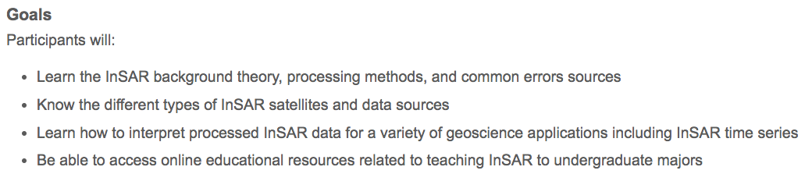
Thoughts on designing educational programs
Clearly define the learning goals
Decide how you will assess goal achievement
Include process for feedback and improvement
Notes:
Backwards design

