Slide 1
Using kinematic and static GPS in undergraduate field courses
Introductions & Overview
August 14-17, 2018

Slide 2
Where is your field teaching site located? (the one you might integrate field geodesy into)
West coast (CA, OR, WA)
Rockies/Southwest
Eastern USA
Somewhere else

Slide 3
What is your primary geoscience discipline?
Geodesy/geophysics
Structural geology/tectonics
Geomorphology/surface processes
Something else

Slide 4
What type of course with a field component are you potentially using field geodesy in?
Day trips during academic year
2-7 day excursions during academic year
Summer field “camp”
Something else

Slide 5
How much experience do you have with GPS in geoscience research?
I have used high precision GPS as a primary data source
I have used low precision GPS for research (ex. waypoints, sample locations, geotagged photos)
I have used GPS data collected by someone else
I have not used GPS

Slide 6
How much experience do you have with GPS in geoscience teaching?
I teach a course that is entirely devoted to GPS
I teach a course that incorporates high precision GPS
Someone else in my department uses GPS in their courses
Little or no experience with teaching GPS

Slide 7
What is your preferred decompression method?
Exercise
Chocolate
Beer (or other libation)
Something else

Slide 8
Instructors
Benjamin Crosby (ISU)
Beth Pratt-Sitaula (UNAVCO)
Ian Lauer (ISU)
Dylan Schmeelk (UNAVCO)

Slide 9
Binder Overview
Front Pocket – paperwork for getting stipend
If you are not US resident/citizen, Beth has another form
Fill out and give to Beth tonight
Tab 1 – Overarching info
Tabs 2-8 – Module resources (also available online)
Back pocket – nifty swag

Slide 10
Tuesday

Slide 11
Wednesday

Slide 12
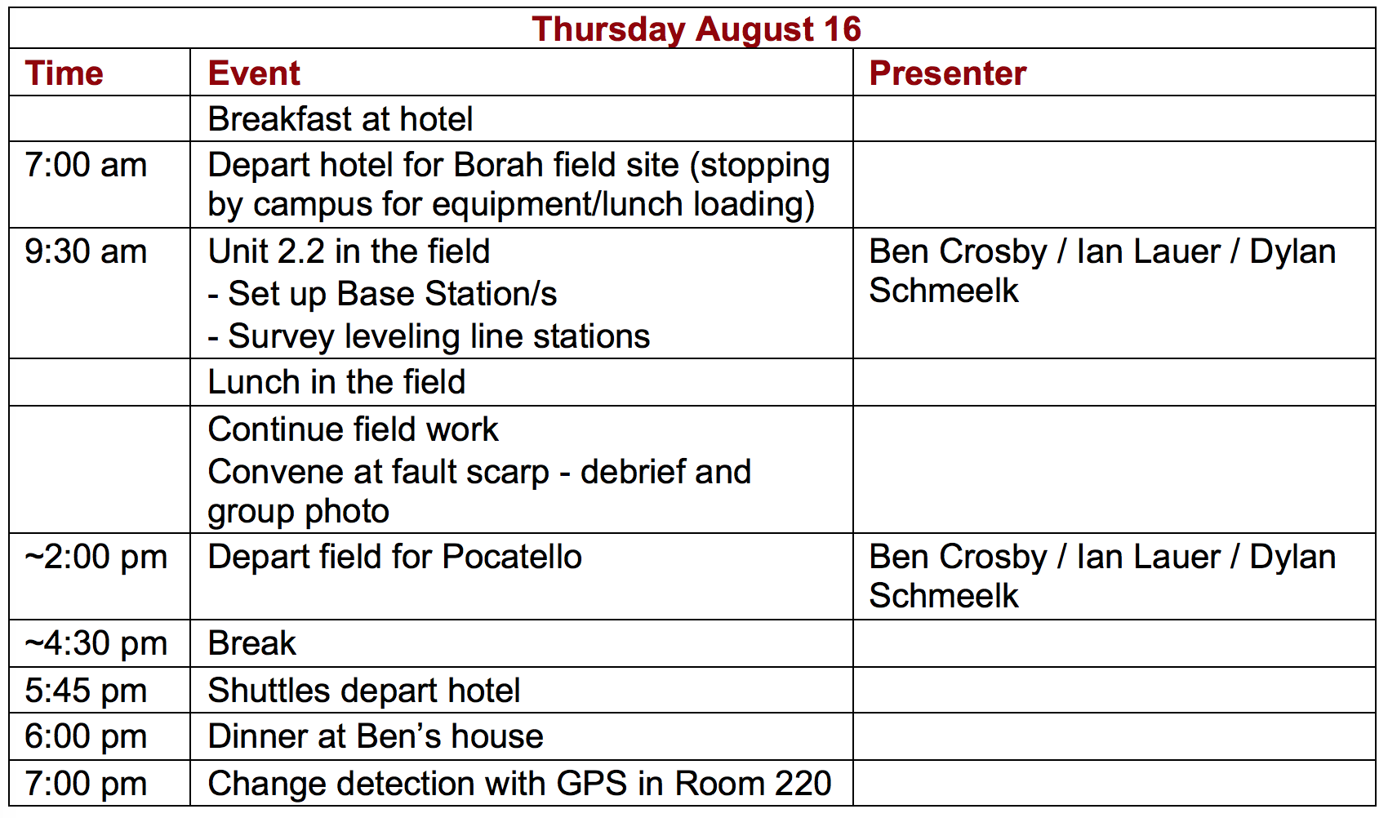
Thursday

Slide 13
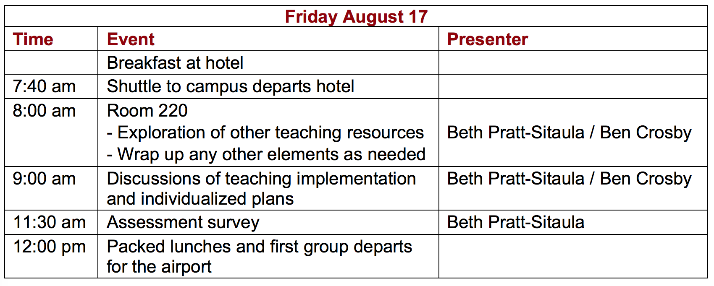
Friday

Slide 14
Other stuff
Post-it notes for questions, comments, ideas
Wednesday Community Presentations Session
Email Beth your pptx Today (ideally) or at least by Wednesday morning
5 min MAX; 5-7 slides recommended

Slide 15
UNAVCO Explained in 3 Minutes video

Slide 16
A Brief History of Geodesy in Field Education (supported by UNAVCO)
Bruce Douglas (IU), Nathan Niemi & Marin Clark (U. Michigan),
David Phillips (UNAVCO) + numerous faculty & students

Slide 17
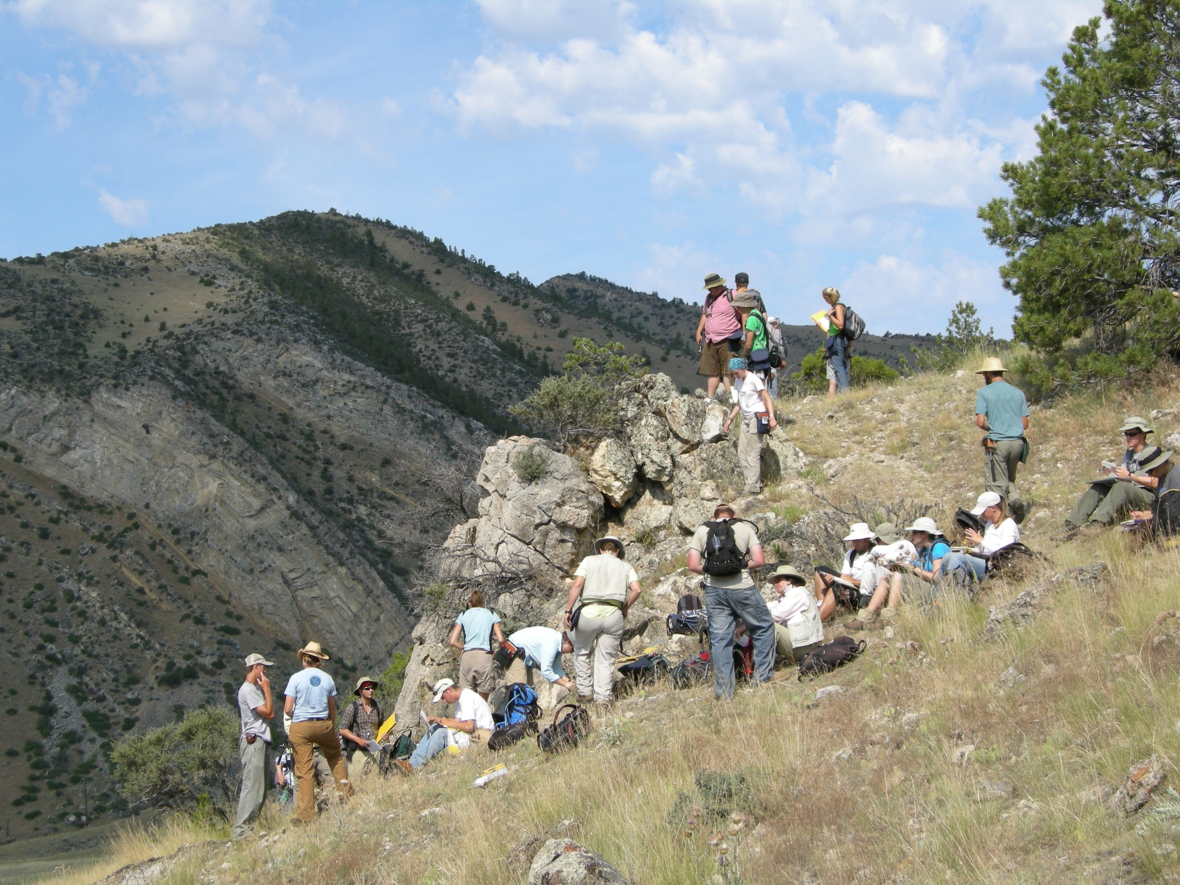
IUGFS G429 – A Traditional Field Course
Cardwell, MT

Slide 18
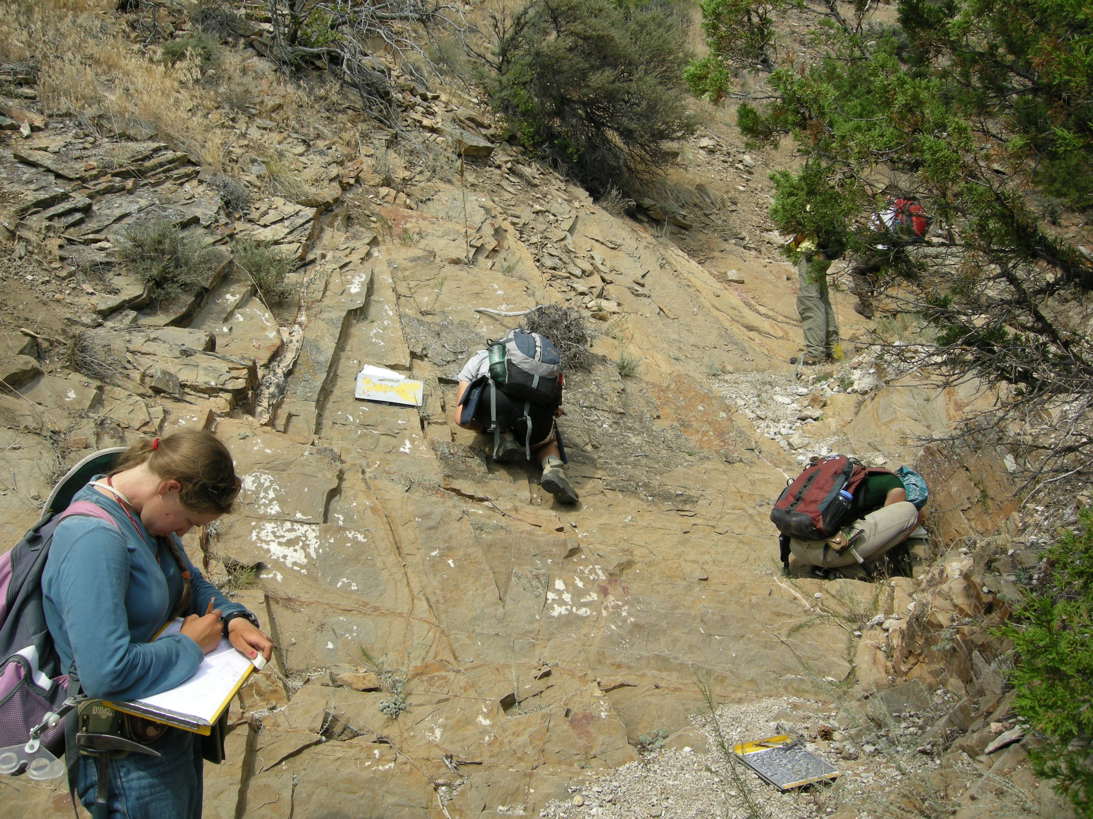
Traditional Methods
Individual Work

Slide 19
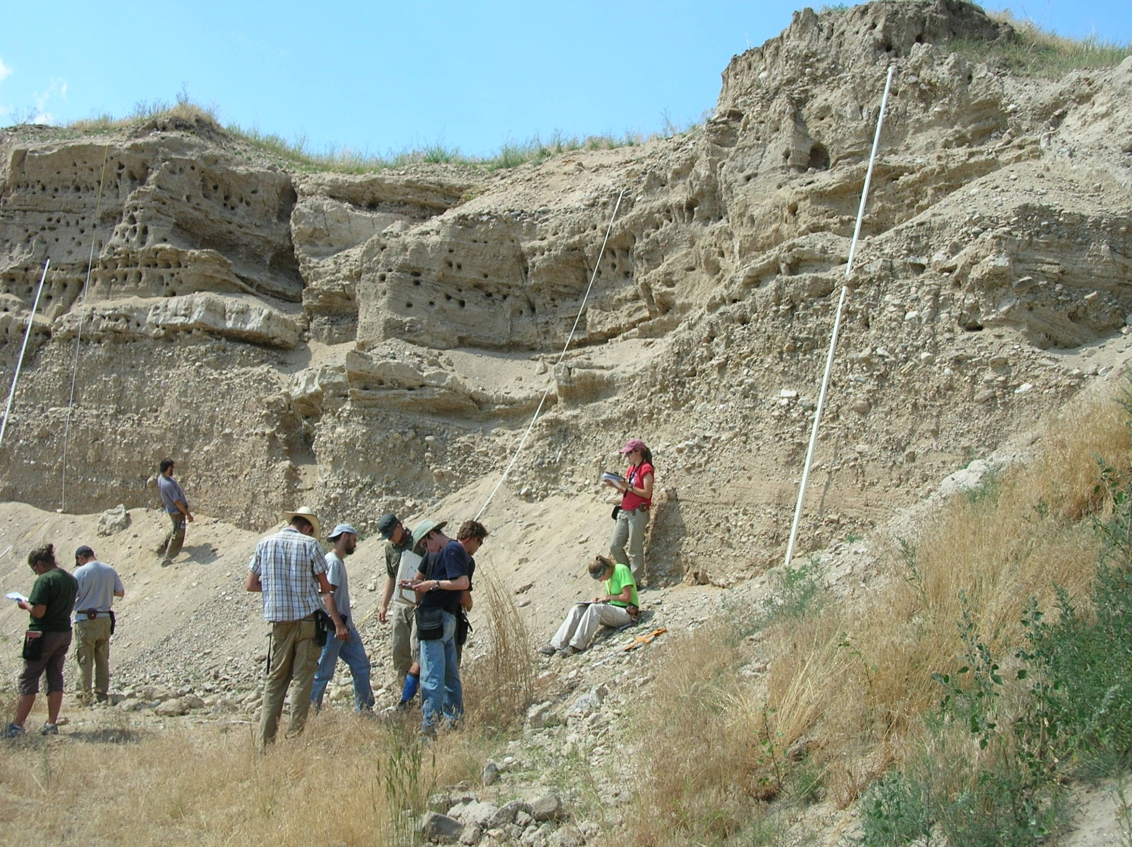
Limitations Associated with Traditional Field Techniques

Slide 20
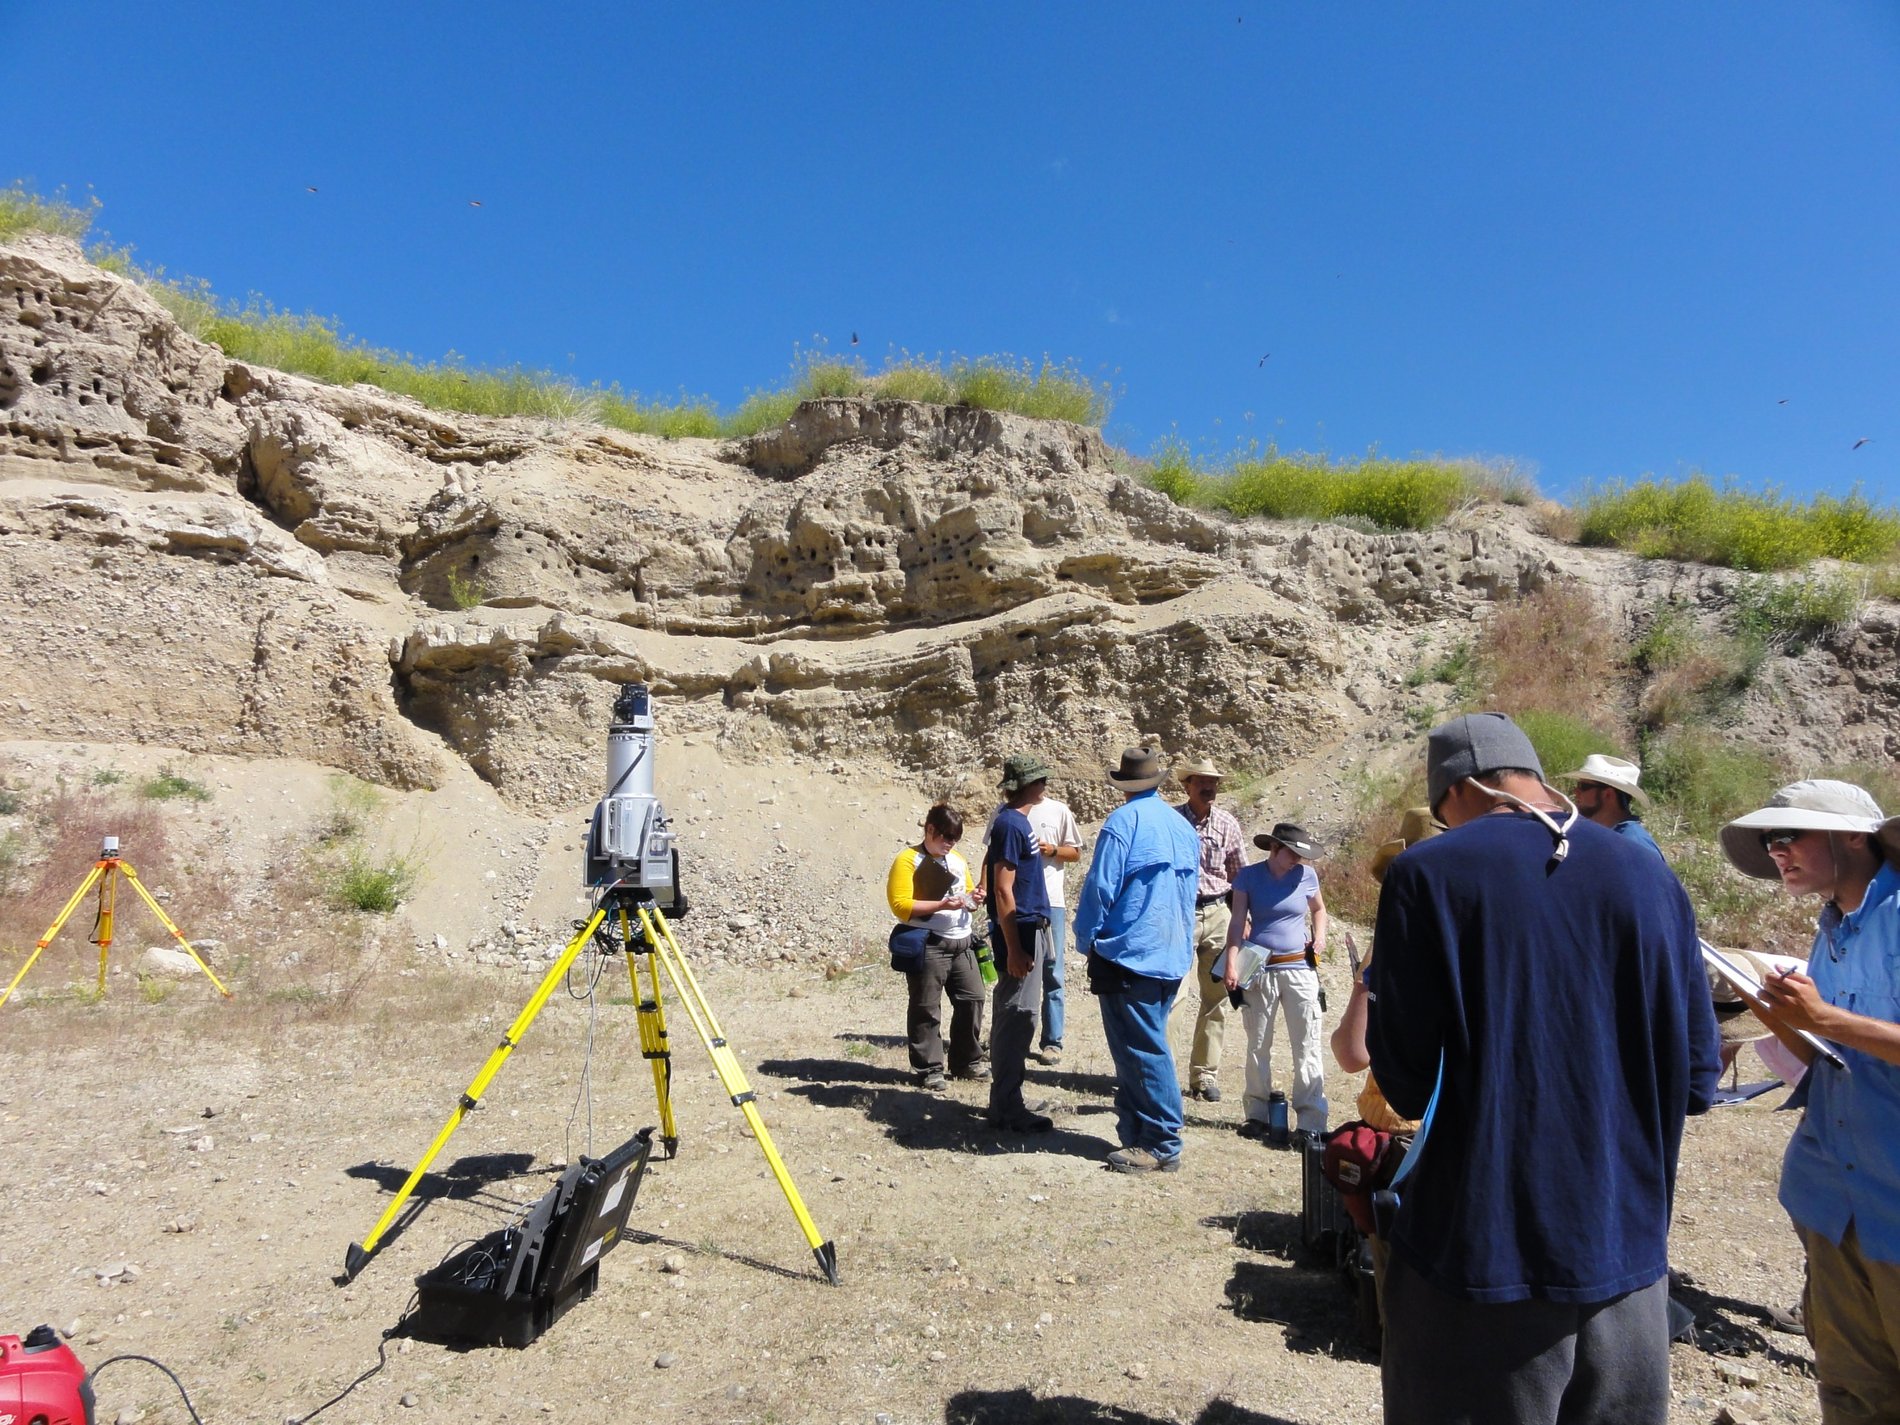
2009: 1st efforts to introduce TLS into IUGFS G429 as one week elective

Slide 21
Collaborative Learning
Incorporation of Instrumentation
into traditional field work

Slide 22
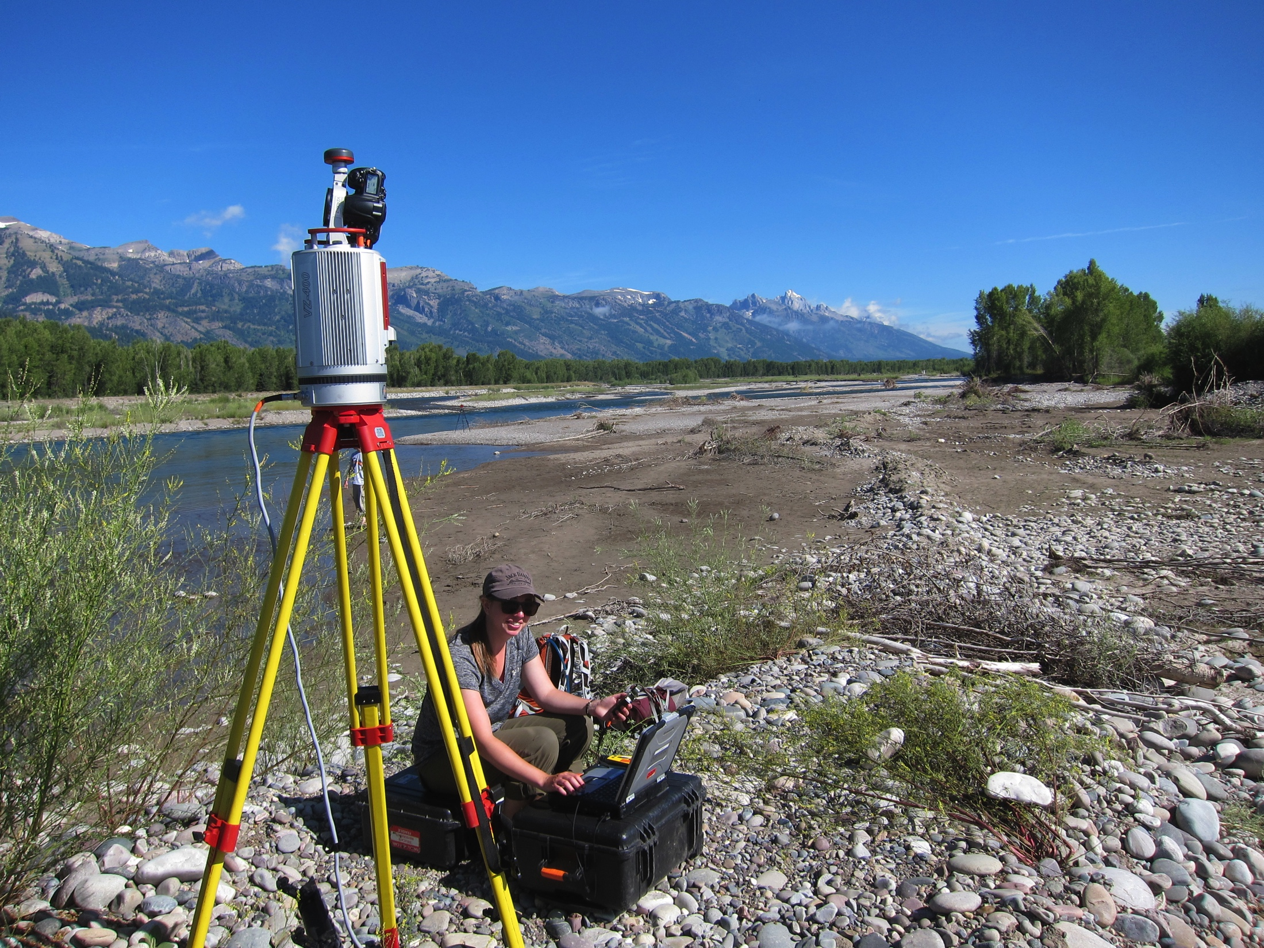
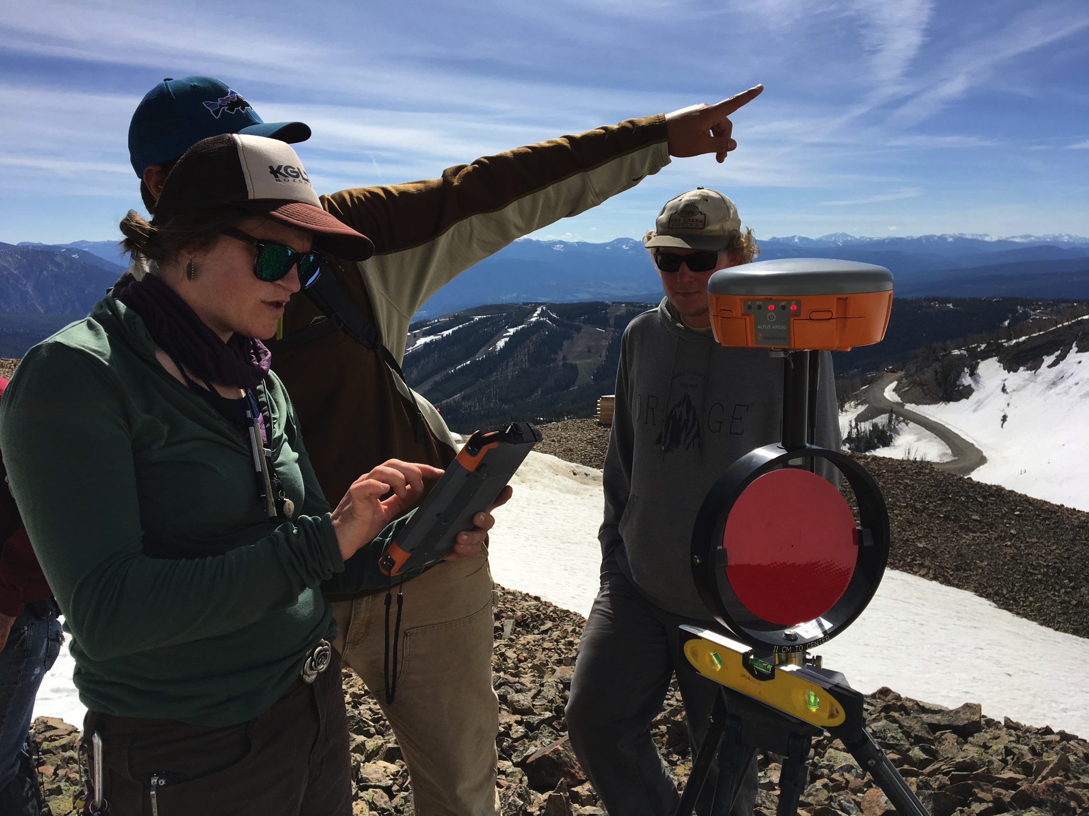
Two dozen field education projects since ‘09
Indiana University (9x)
University of Michigan (8x),
University of Houston (3x)
UC Santa Cruz, Cal Poly Pomona, U. Saint Thomas, Stanford, NM State University, Montana State University

Slide 23
2014 Geodesy Field Education Community Input Workshop
Increase the visibility of field education services available from UNAVCO.
Provide professional development for technical and pedagogical aspects of field education.
Make existing and new resources available to the community via online pathways – TLS, SfM, GPS

Slide 24
NSF Funding
A Field-Based Curriculum for Quantifying Deformation of the Earth’s Surface with Lasers, GPS and Cameras
NSF IUSE (Improving Undergraduate STEM Education)
UNAVCO, Indiana University, Idaho State University
$300,000 over two years (2016-2018)
Two field education modules
Analyzing High Resolution Topography w/ TLS and SfM
High Precision Positioning w/ Kinematic & Static GPS/GNSS
Several short courses and workshops for instructors

Slide 25
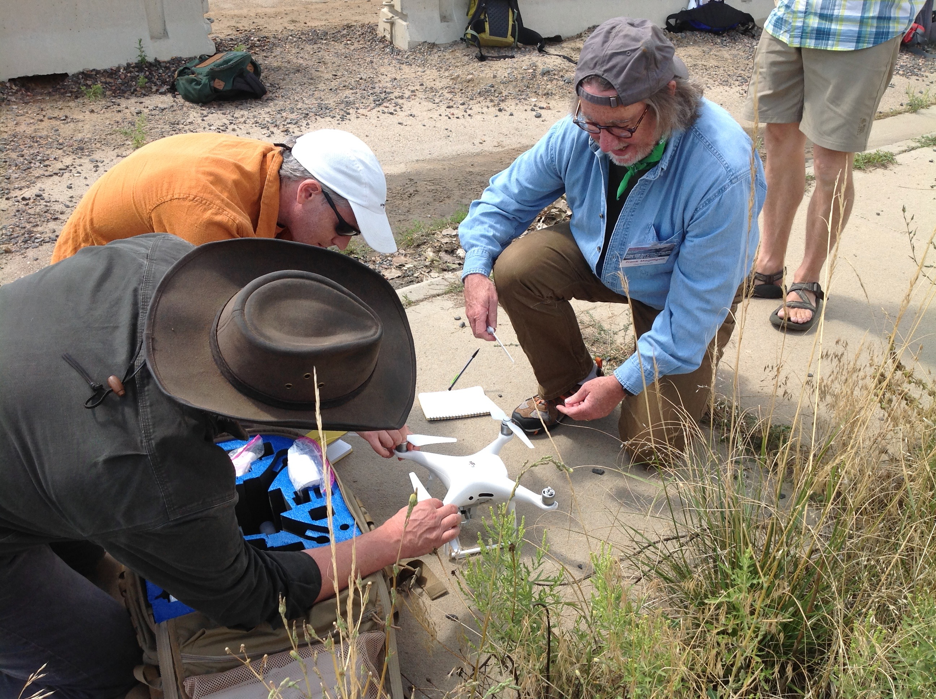
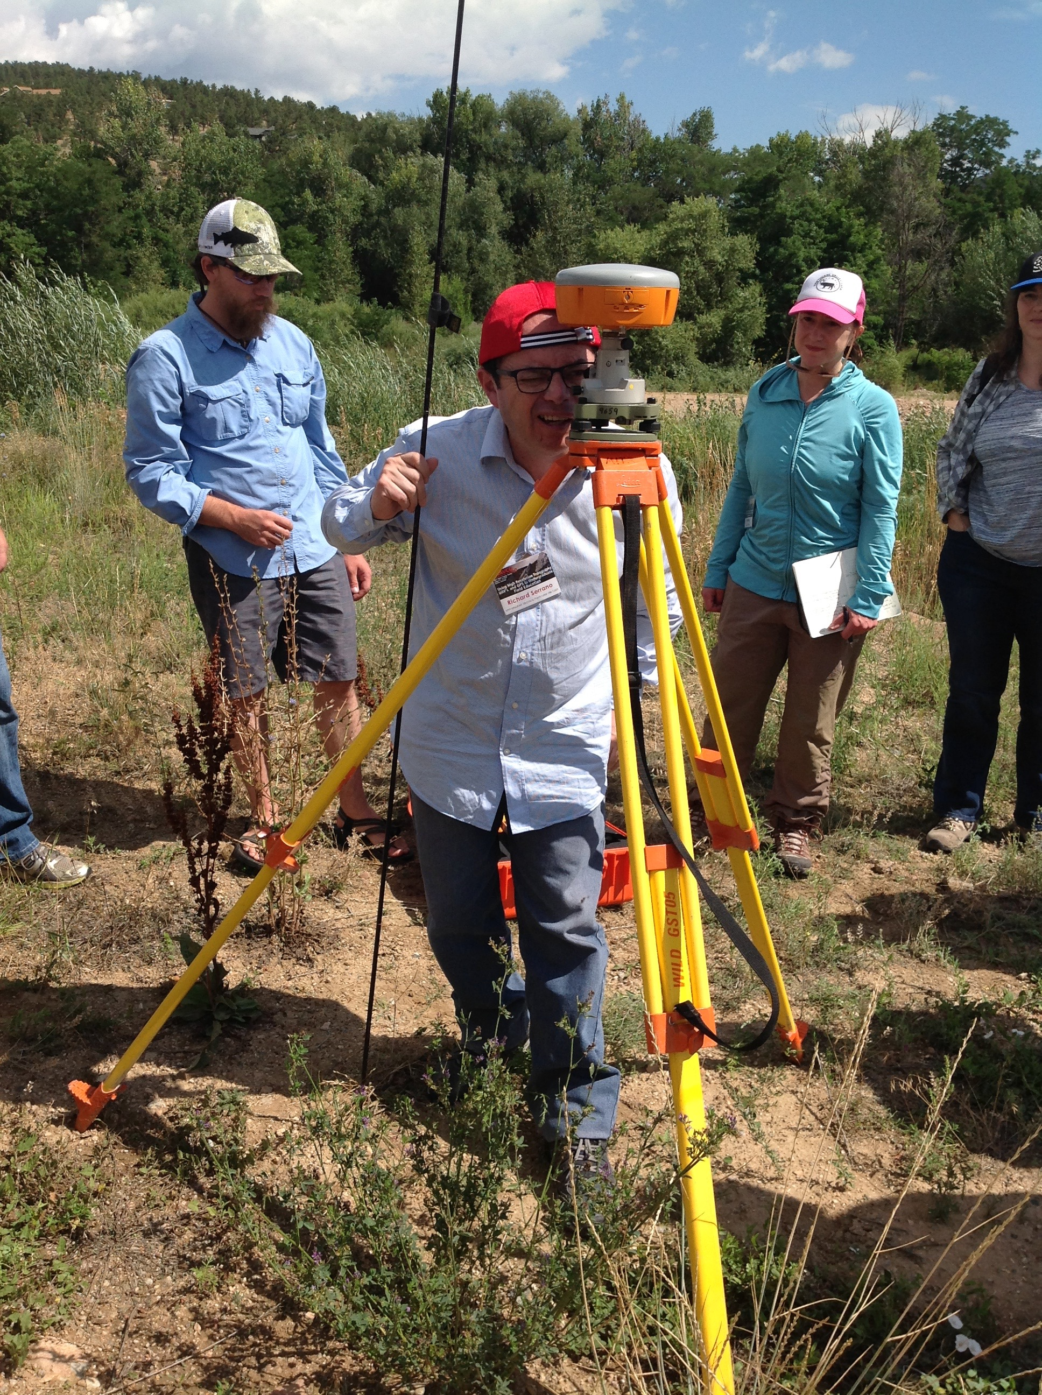
2016 & 2017 short courses

Slide 26
Intro to GETSI-Field Development Model & Guiding Principles

Slide 27
GEodesy Tools for Societal Issues GETSI
Develop and disseminate teaching and learning materials that feature geodesy data & quantitative skills applied to critical societal issues such as climate change, water resources, and natural hazards
FIELD COLLECTION – integrate geodetic methods into geoscience field learning

Slide 28
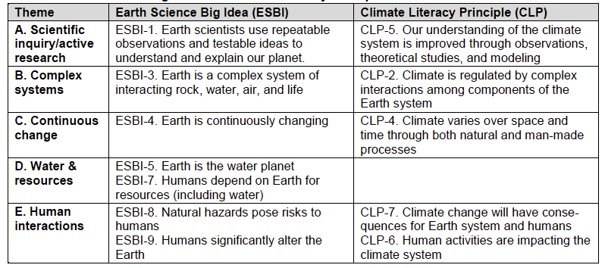
Guided by Earth Science & Climate Literacy Docs

Slide 29
GETSI Field Education Guiding Principles
Address one or more geodesy-related grand challenges facing society
Improve student understanding of the nature and methods of geoscience and developing geoscientific habits of mind
Make use of authentic and credible geodesy field methods and data to learn central concepts in the context of geoscience methods of inquiry
Increase student capacity to apply quantitative skills (GETSI) to geoscience learning
* Referred to as Guiding Principles for Curriculum Design

Slide 30
Pedagogic Goals
Engaged, student centered, research based pedagogy supports higher order learning
Alignment of goals, materials and assessments supports and documents learning
Develops scientific thinking and an understanding of the process of science
Materials can be used successfully in multiple settings

Slide 31
Implementation Goals
Materials are used widely by faculty across the country
Learning by students can be documented to show increased higher level understanding of sustainability and geoscience
Notes:
InTeGrate is specifically aiming to get some of their modules taught outside geoscience departments. Although it would be great if GETSI modules are used in some physics engineering courses and some disseminations efforts will be aimed towards this end, significant implementation outside of geoscience courses is not a stated GETSI goal.

Slide 32
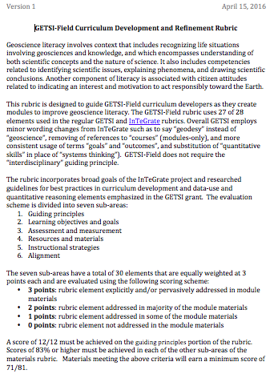
Linking Goals and Process: The Materials Design Rubric
Guiding Principles
Learning Goals and Outcomes
Assessment and Measurement
Resources and Materials
Instructional Strategies
Alignment

Slide 33
Linking Goals and Process: Part 2: Testing and Publishing
Collection of assessment data
Revision of materials
Publication of teaching materials and supporting information for faculty
“Instructor Stories” document implementation at different institutions
Notes:
Move on to showing the online teaching resources

Slide 34
Online teaching resources
http://serc.carleton.edu/getsi

Slide 35
Other logistics
How many people have PCs w/ ArcGIS?
Tonight – other activities?
Back to hotel directly
Back to hotel via grocery/beer stop
Head downtown for awhile

Slide 36
Tomorrow
Meet hotel foyer 7:40 am
Tomorrow is on campus but we will be outside up to several hours total so bring:
Binder
Laptop
Water bottle
Coffee cup
Sunscreen/gear

