Slide 1
High Precision Positioning with Static and Kinematic GPS/GNSS
Teaching Resources for Field Courses
Ian Lauer, Ben Crosby, Beth Pratt-Sitaula
Idaho State University and UNAVCO
photo: crosby
Version: August 14, 2018

Slide 2
Motivation to Develop this Curriculum
GNSS in increasingly accessible to geoscientists
Ubiquitous, affordable and dependable hardware
Simpler to operate. Easy to download and visualize
High-precision GNSS remains valuable to science applications

Slide 3
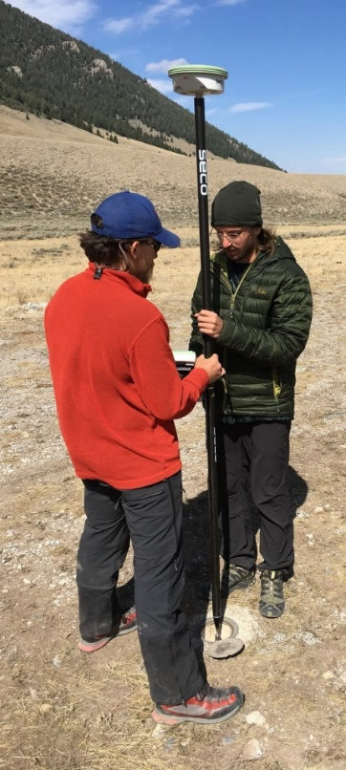
High Precision GNSS in the Geosciences
Why teach students high precision GNSS tools?
If you want to measure small changes (a few cm or less), you have to use high precision instruments. Applications include:
Tectonics (intra-plate and plate boundary)
Volcanic Activity
Geomorphic Change Detection
Hydrologic Change
Tracking or mapping other fine-scale objects

Slide 4
Benefits to Integrating GNSS in Field Courses
What are your experiences?
Students developing desirable/saleable skills
Provide differing approaches to similar questions
Integrate quantitative skills into traditionally qualitative learning environments
Broaden the types of data incorporated into field observations

Slide 5
Barriers to Integrating GNSS in Field Courses
What are your experiences?
Traditional vs. Modern Tools
How to keep all students engaged?
Technology is expensive
We may not be experts in the technology yet

Slide 6
Students Need GNSS Skills Moving Forward
Curriculum is constructed around three goals:
Students can design and conduct a GNSS survey to address a geologic research question.
Students can justify when and why different techniques are appropriate in different situations.
Students can apply the findings of GNSS surveys to societal issues
We accomplish these in three, field-based units
(to be discussed tomorrow morning)

Slide 7
Other logistics
Internet connection (see board)
How many people have PCs w/ ArcGIS?
Tonight – other activities?
Back to hotel directly
Back to hotel via grocery/beer stop
Head downtown for awhile

Slide 8
Tomorrow
Meet hotel foyer 7:40 am
Tomorrow is on campus but we will be outside up to several hours total so bring:
Binder
Laptop
Water bottle
Coffee cup
Sunscreen/gear

